Slide 1
Parallelization of QR Factorization of matrices
ME766 Course Project
Team:
Abhijeet Bodas (190100004)
Hardik Shrivastava (190100053)
Shiven Barbare (190100110)

Slide 2
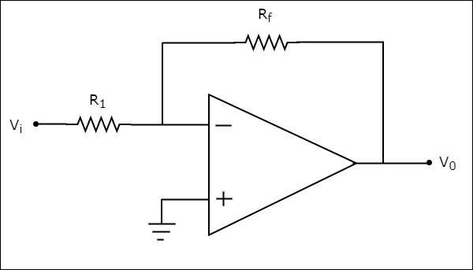
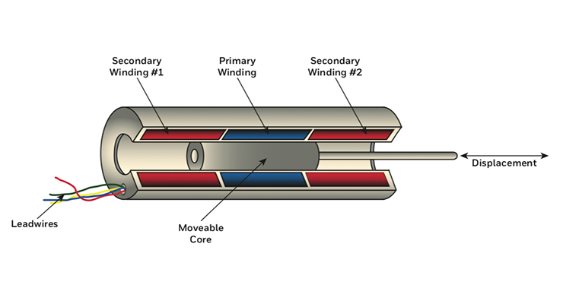
Overview
Motivation for choice of project:
Hands-on implementation of theoretical concepts
Efficient method of solving Linear systems
Applications of Linear Systems:
Mechanical Systems
Weather forecasting
Data analysis
Signal processing
Notes:
Why we chose this Project?
Hands on implementation of learnings from numerical analysis course
Linear Variable Differential Transformer

Slide 3
The Factorization Approach
Some widely used matrix decomposition techniques include the LU, Cholesky and QR factorization methods.
The QR method is used to factorize any matrix into a product of orthogonal (Q) and upper triangular (R) matrices. In this project, we have made an attempt at parallelizing two popular algorithms for the same:
Gram-Schmidt algorithm
Householder algorithm
System: Ax = b
Approach: A = BC
Notes:
LU Factorization: A=LU
Cholesky Factorization: A=BBT
QR Factorization: A=QR
If A is invertible, R is also invertible
If R has positive diagonal entries, then the pair (Q,R) is unique

Slide 4
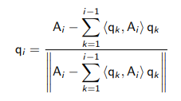
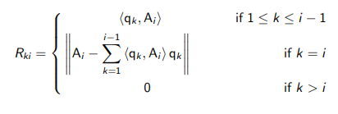
Gram-Schmidt Algorithm (GS)
Gram-Schmidt process: Orthonormalization of a set of vectors in an Inner product space
If A_{i} and q_{i} represent the column vectors of A and Q respectively and R_{ki} represents the elements of the matrix R, then we have the following relations:
Source: Lecture Slides, MA214, Spring 2021, IIT Bombay

Slide 5
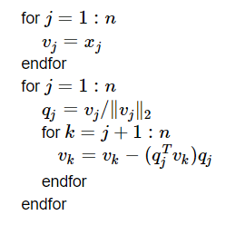
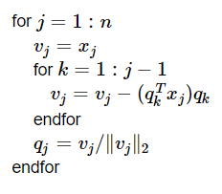
Modified Gram-Schmidt Algorithm (MGS)
The Gram-Schmidt algorithm is not numerically stable for implementation of QR factorization Hence, a modified Gram Schmidt algorithm is used which reduces errors.
A comparison of pseudocodes for GS and MGS:
Gram-Schmidt
Modified Gram-Schmidt
Source: https://www.math.uci.edu/~ttrogdon/105A/html/Lecture23.html
Notes:
The Gram-Schmidt algorithm is not numerically stable for implementation of QR factorization as it leads to rounding errors when dealing with floating point numbers i.e. orthogonality is lost. Hence, a modified Gram Schmidt algorithm is used which reduces errors.
In modified Gram-Schmidt (MGS), we take each vector, and modify all forthcoming vectors to be orthogonal to it.
always orthogonalizing against the computed version of w.

Slide 6
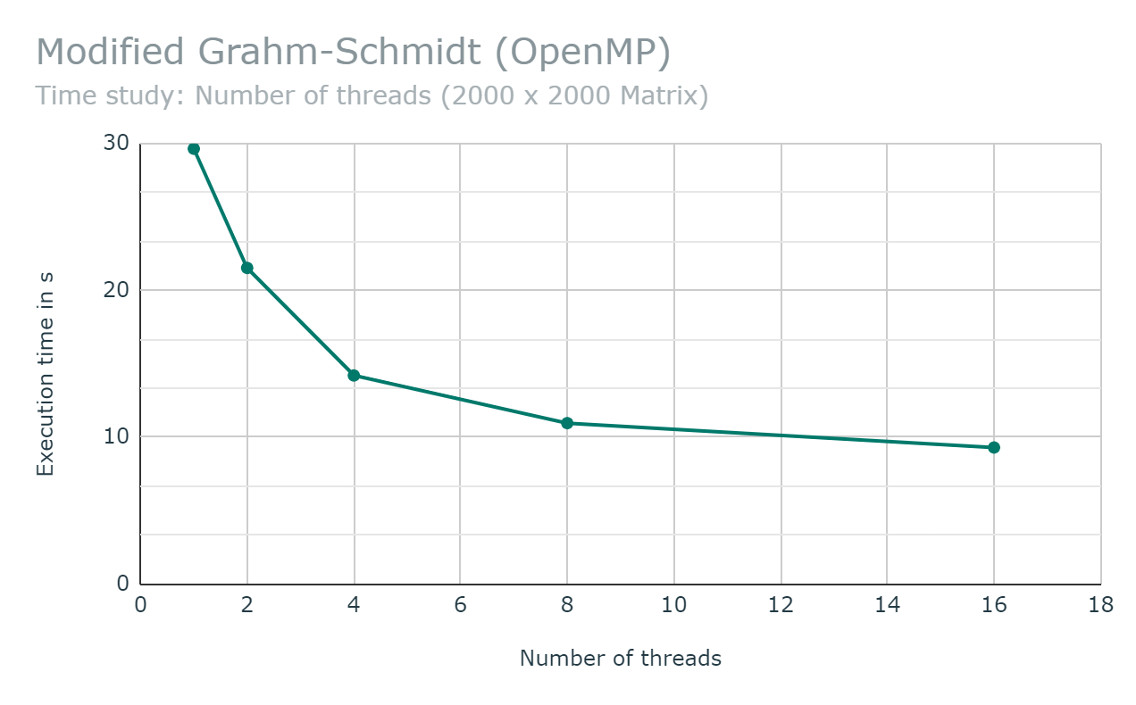
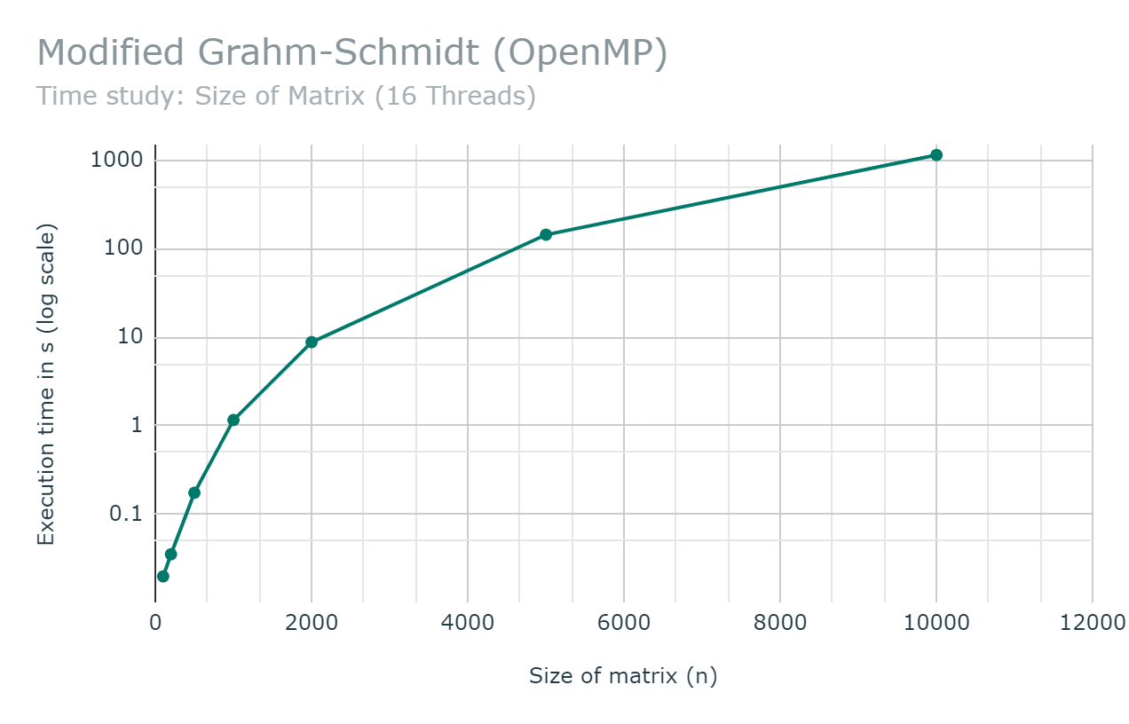
Time Study: Modified Gram-Schmidt (OpenMP)
Operational Cost : O(n³)

Slide 7
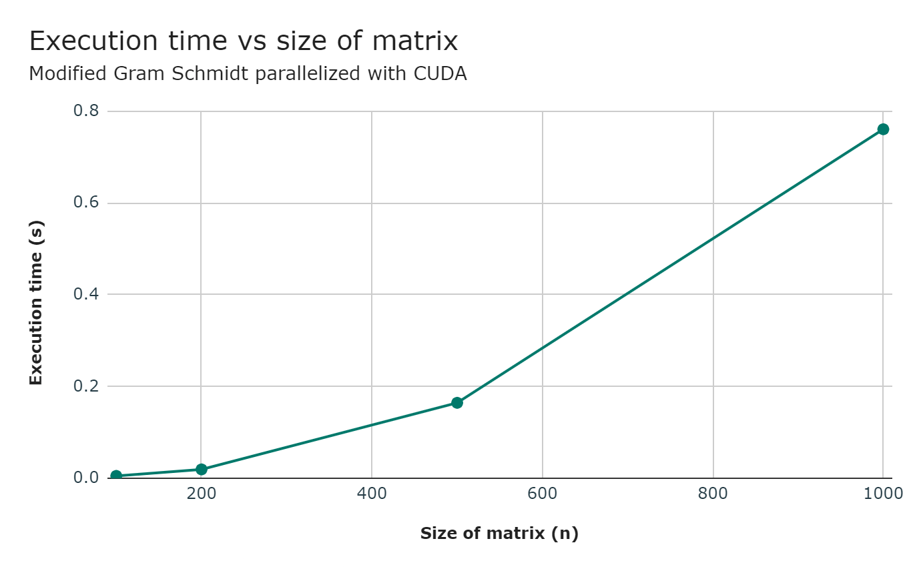
Time Study: Modified Gram-Schmidt (CUDA)
Notes:
The parts we parallelized are
Calculating norms of column vectors.
Normalizing vectors (dividing each element by 2-norm)
Calculating inner products / coefficients of q with column vectors at each step.

Slide 8
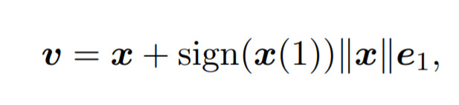
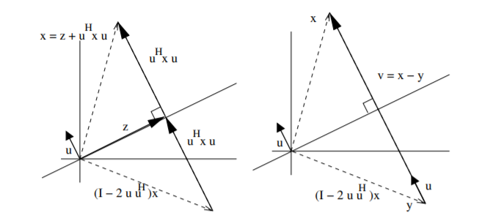



Householder Transformation
This algorithm is based on Householder transformations which is a transformation that reflects a vector about a plane. The goal is to find an appropriate reflection matrix, Q and multiplying them on the left to the original matrix A, to construct upper triangular matrix R.
Source:
https://www.cs.utexas.edu/users/rvdg/books/HQR.pdf
https://rpubs.com/aaronsc32/qr-decomposition-householder
Notes:
The orthogonal factor computed by the Householder factorization is generally more accurate than that of the (modified) Gram-Schmidt unless the GS is implemented with reorthogonalization. On the other hand, GS gives the orthogonal factor directly, while Householder provides it in a factored form (essentially as a product of elementary reflections).
The loss of orthogonality does not need to be a problem for the modified GS, e.g., when solving least squares problem, a careful implementation (without reorthogonalization) can give the solution with the same accuracy as the Householder variant.

Slide 9
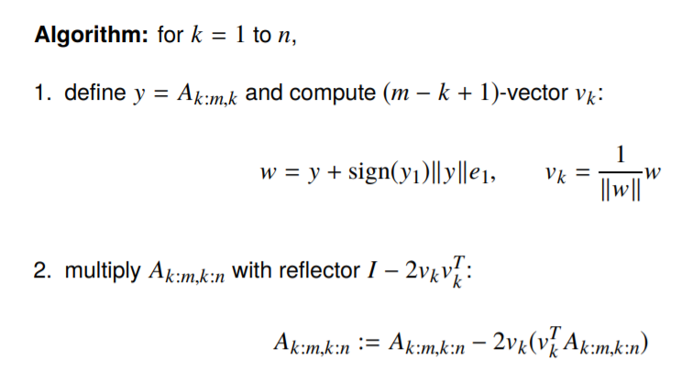
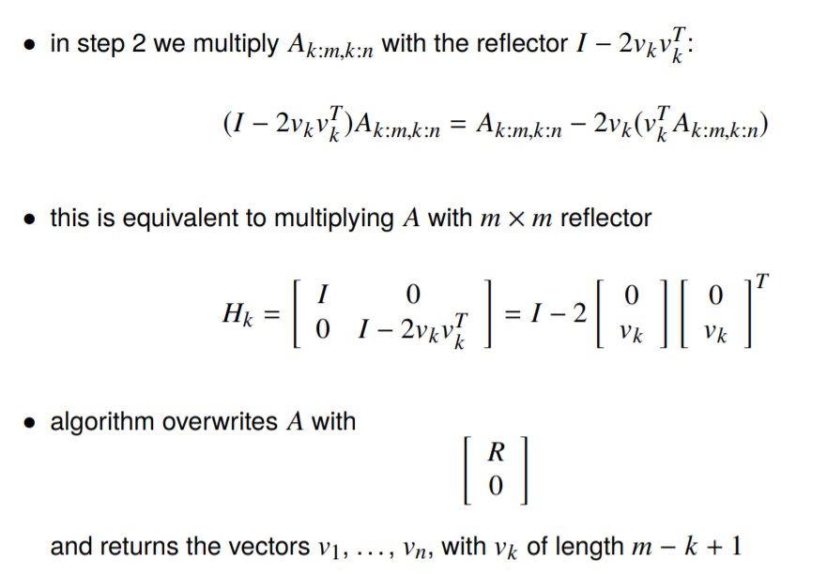
Algorithm for Householder Triangularization
Source: http://www.seas.ucla.edu/~vandenbe/133A/lectures/qr.pdf

Slide 10
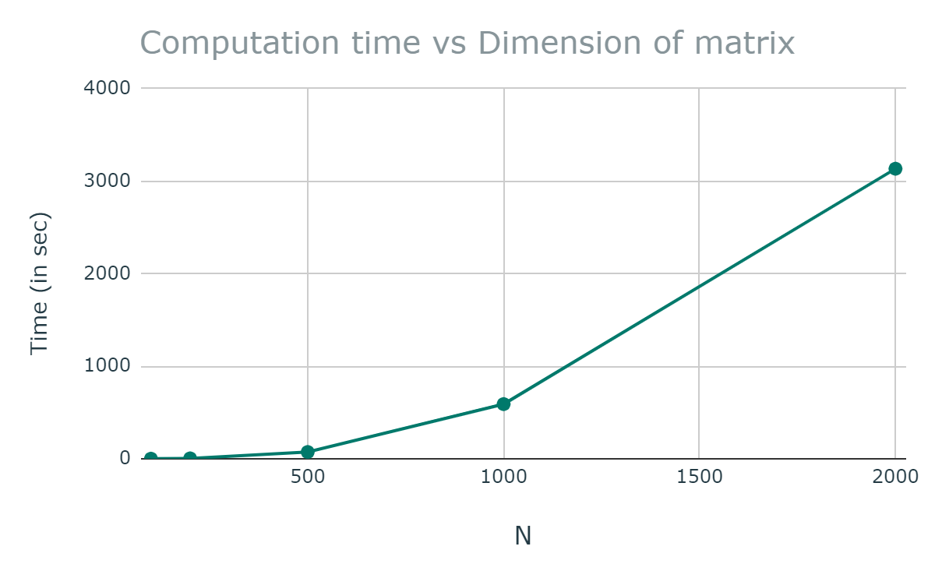
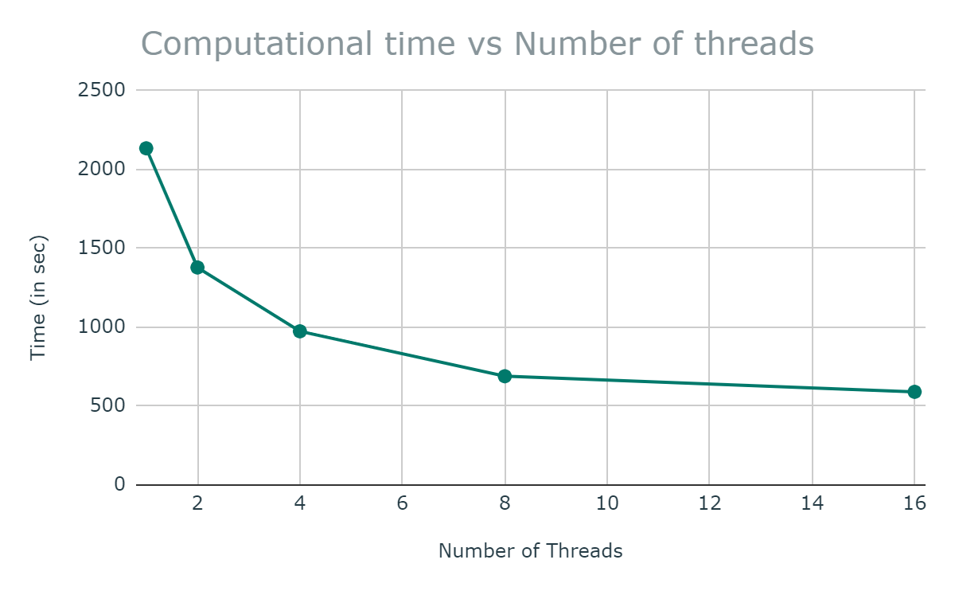
Time Study: Householder OpenMP code
For number of threads = 16
For matrix size n = 1000
Time Complexity is O(n³)

Slide 11
Contributions
All three members worked in tandem, supporting each other throughout the duration of this project, however a breakdown of the individuals tasks undertaken by each member is as shown below:
MGS OpenMP | MGS CUDA | Householder OpenMP
Shiven | Abhijeet | Hardik

Slide 12
Thank you !

Slide 13
The Factorization approach
Rationale: To solve a linear system (square) Ax=b, we factorize A as a product A=BC, where B and C are triangular/orthogonal making it easy to solve for x using simple methods such as back-substitution.
Depending on B and C the factorization techniques are classified as follows:
LU Factorization: A=LU
Cholesky Factorization: A=BB^{T}
QR Factorization: A=QR
Notes:
LU: L has
A : all of its diagonal submatrices of order k with k = 1, . . . , n are invertible
Cholesky: A is Real, Symm, PD

Slide 14
QR Factorization
A=QR
Q: Orthogonal R: Upper Triangular
If A is invertible, R is also invertible
If R has positive diagonal entries, then the pair (Q,R) is unique
Q. How to determine a suitable (Q,R)?
Two widely used practical algorithms:
Gram-Schmidt process
Householder algorithm
Notes:
Givens Rotations

Slide 15
Modified Gram-Schmidt Algorithm (MGS)
The Gram-Schmidt algorithm is not numerically stable for implementation of QR factorization as it leads to rounding errors when dealing with floating point numbers i.e. orthogonality is lost. Hence, a modified Gram Schmidt algorithm is used to which reduces errors.
In GS, we take each vector, one by one, and make it orthogonal to all previous vectors
In MGS, we take each vector, and modify all forthcoming vectors to be orthogonal to it. That is, we orthogonalize each of the vectors in each step based on the previous orthogonalisation.
Mathematically, both these approaches are equivalent.

Slide 16
Householder Transformation
The Householder reflection method of QR decomposition works by finding appropriate reflection matrix, Q and multiplying them on the left to the original matrix A, to construct upper triangular matrix R.
Here x is the column vector of A starting from the diagonal entries. F is the Householder reflector.
Source: https://rpubs.com/aaronsc32/qr-decomposition-householder
Notes:
The orthogonal factor computed by the Householder factorization is generally more accurate than that of the (modified) Gram-Schmidt unless the GS is implemented with reorthogonalization. On the other hand, GS gives the orthogonal factor directly, while Householder provides it in a factored form (essentially as a product of elementary reflections).
The loss of orthogonality does not need to be a problem for the modified GS, e.g., when solving least squares problem, a careful implementation (without reorthogonalization) can give the solution with the same accuracy as the Householder variant.

