Slide 1
Computer Science - Algorithm
20174627 HYEJIN KIM

Slide 2
Contents
01/ What is the algorithm?
02/ Algorithm Characteristic

Slide 3
01.
What is the Algorithm?

Slide 4
01
Algorithm?
Start
Condition
false
true
Do you know algorithm?
Command 2
Command 1
END

Slide 5
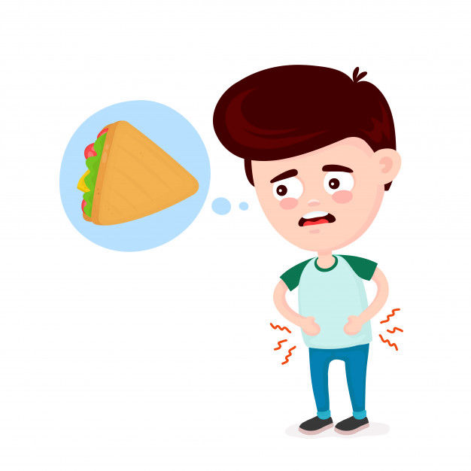
01
Algorithm?
What do you do when you don't eat anything?

Slide 6
01
Algorithm?
Didn’t eat any food.
Are you hungry?
no
Yes, hungry ! eat
No, not hungry ! doen't eat
yes
Don't eat rice.
Eat rice.
END

Slide 7
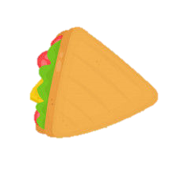

01
Algorithm?
In other words, the methods and procedures for solving the problem.
hungry
eat
Are you hungry?
not hungry
doen't eat

Slide 8
02.
Algorithm Characteristic

Slide 9

02
Characteristic
Input
Print
Clarity
Finiteness
Effectiveness

Slide 10
02
Characteristic
Input
Data may be provided externally.
Print
Once the problem is dealt with,
at least one result must be obtained.
Clarity
Each phase of the algorithm should be
clearly defined as what it is intended to do.

Slide 11
02
Characteristic
Finiteness
When performed according to the algorithm's command, the given value should be processed and then terminated.
Effectiveness
The more efficient the algorithm is, the higher the value is. Must have time and spatial efficiency.

Slide 12
Thank You !

