Slide 1


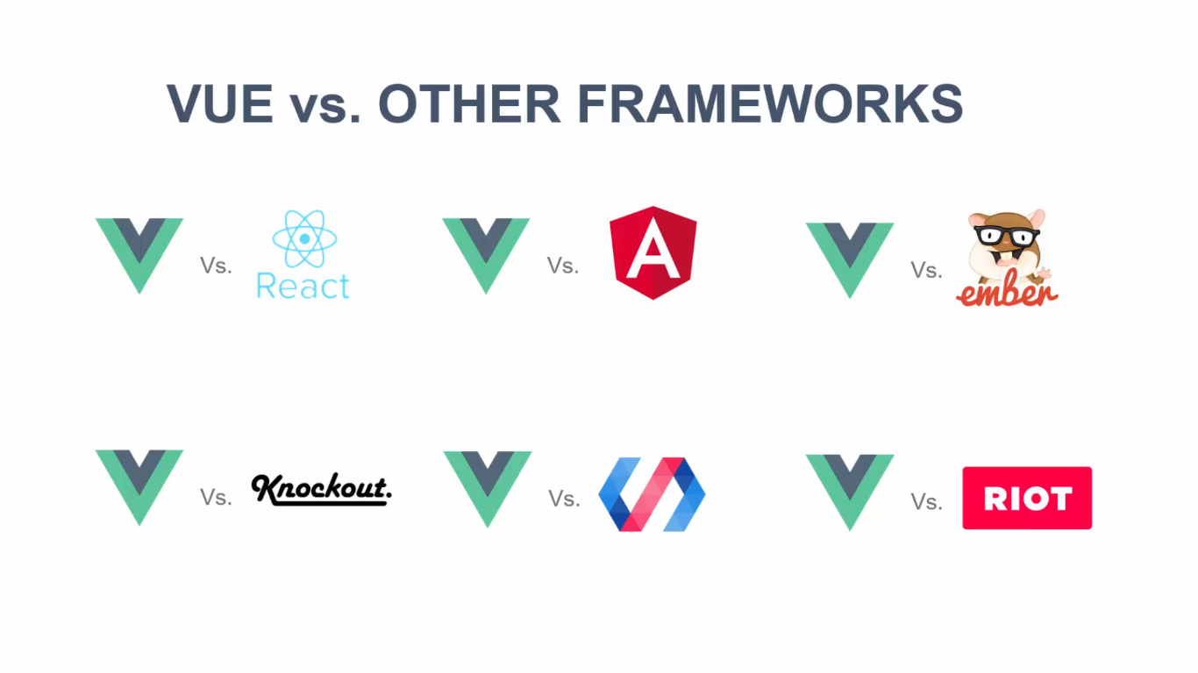
Frontend and Vue JS
By Mohamed BOUHAMED
Hosting Company TECOS
www.bouhamed.coffeescript.fr
Mohamed.bouhamed@it-tecos.fr

Slide 2
Plan
1
Introduction
6
Why VUE JS ?
2
Presentation Goals
7
Conclusion
3
Frontend Challenge
4
Solution
5
Link between Angular, React and VUE js

Slide 3


Introduction
Notes:
- Thanks to Tecos TEAM
- The Company: about Tecos
About me
The Front end and the backend

Slide 4

Introduction
Plan
Introduction
Presentation
Goals
FrontEnd
Solution
Link
ARV
Why
Vue JS ?
Conclusion
TECOS
Our TEAM
About Me
FrontEnd vs BackEnd
Notes:
Thanks to Tecos TEAM
About me
The Front end and the backend
The Company: about Tecos :
Our company brings an expert eye on your projects and more particularly in the following technical expertise and languages

Slide 5
Presentation Goals

Slide 6

Presentation Goals
Front-End challenge
Show the power of VUE JS
Know the difference between VUE, react and angular.
What is the life cycle of component in VUE JS
Component rendering
The DOM
Component Status
How to create a fast application.
Data refresh.
Decrease the number of client request base on the data status.

Slide 7
FrontEnd Challenge

Slide 8


The challenge of today :
Can we have a fast application like google ?
30 seconds is a lot of time.
Time is mony.
Client can not wait a lot.
Notes:
Rendering the component only if the data changed
Dom refresh
Listners

Slide 9
Solution

Slide 10

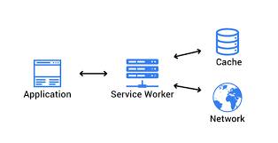


Solutiuon
Angular JS
React JS
Vue JS
Jquery
TYPESCRIPT
HTML5
LocalStorage
SERVICE WORKER
Angular Universal …
Notes:
Rendering the component only if the data changed
Dom refresh
Listners
Manage components status
promes
Mvvm Architecture

Slide 11

Link between Angular, React and Vue JS

Slide 12
React JS
Extremely popular
A librery for buildin and rediring compon
Evrything is javascript JSX
Just about creating component
You have to add some packages
Developed By FaceBook
You can build mobile app
Notes:
Extremely popular, used by many large and smal. Businesses
A librery for buildin and rediring components (no other featsure included)
Evrything is javascript May utilize JSX for working with HTML we can not use JSX but dosont recommonde
You have to add some packages in order to create a one single page application (React router or redux)
The update are pretty easy with the help of React Team
Adding to your knowladge about react some consopt and develop your own mobile app

Slide 13
Angular
Extremely popular
Create one single page framework
Use a web native API
USE TS
Routing, state management, http etc…
Developed and maintained by Google
Mobile App
Notes:
Extremely popular, used by many large and smal. Businesses
Create one single page framework that ollow us to build a reactive component-driven apps
Use a web native API html, ts, js, css
Routing, state management, http etc all in included or provided by core Angulare teams / tem member
Developed and maintained by google
Primarily used for web apps but can be used to build mobile apps with Ionic or NativeScript.

Slide 14
VUE JS
Extremely popular, not used by too many large businesses though
A complete framework for building reactive, component-driven apps
Uses native web APIs, Uses HTML templates, uses CSS
Routing and vus X state management by core team other capabilities are provided by community « only »
Developed and maintained by Evan YOU + other maintainers/ core team
Primarily used for web apps but can be used to build mobile apps with Ionic or NativeScript
Notes:
Extremely popular, not used by too many large businesses though
It like if angular having sex and then we got vue
Uses native web APIs, Uses HTML templates, uses CSS
Routing and vus X state management by core team other capabilities are provided by community « only »
Developed and maintained by Evan YOU + other maintainers/ core team
Primarily used for web apps but can be used to build mobile apps with Ionic or NativeScript

Slide 15

Notes:
Son OF ANGULAR AND REACT:
Generate the rend of components and create a one single page application.
Multiti libreries in one package
Type script with angular
The mixt between html css so I dont like the mixt that they did
Writin evruthing in javascriipt. ES6
Angular : Type script
VUE JS:
YOU CAN USE
ES5, ES6, Typescript
We have separation of templates and js code
You dont have a dependency injection
Vue x for state mangement
Alot of official package

Slide 16
Why VUE JS ?

Slide 17
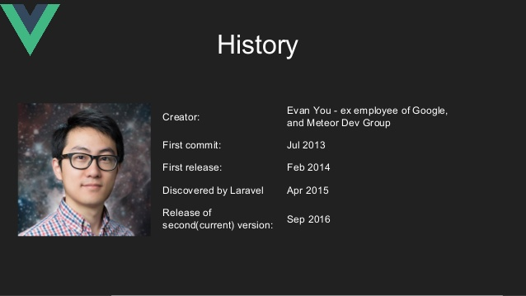



+
=

Slide 18

VUE JS
Uses HTML & CSS and JS in a well-known way
Can be dropped into existing web apps /view (new business logic)
Intuitive syntax and core features provided by the core team
A progressive FRAMEWORK
So fast to create your first app (CLI)
Some key feature for more complex apps have to be added manually
VUE is reactive
VUE created by a geek
Notes:
A progressive FRAMEWORK : IT MEAN U CAN USED ONLY FOR A PART OF YOUR APPLICATION.
Helps you to create a new business logic : vue has the core + vue + VUE- Router
Change the app logic to a reusable component : each component has his own js,html and css file need it to rend that peace of page.
So fast to create your first app all you have to do is to call the library in you code and create an instance of a new app with TAG #app
Vue is Reactive : the magic start when you change the data even from your console react will update your html automatically with any kind of data type
Vue created by a geek at least we are sure that will be free for a wile.
Son OF ANGULAR AND REACT:
Write a maintanbe and testable code
Generate the rend of components and create a one single page application.
Multiti libreries in one package
Type script with angular
The mixt between html css so I dont like the mixt that they did
Writin evruthing in javascriipt. ES6
Angular : Type script
VUE JS:
YOU CAN USE
ES5, ES6, Typescript
We have separation of templates and js code
You dont have a dependency injection
Vue x for state mangement
Alot of official package

Slide 19
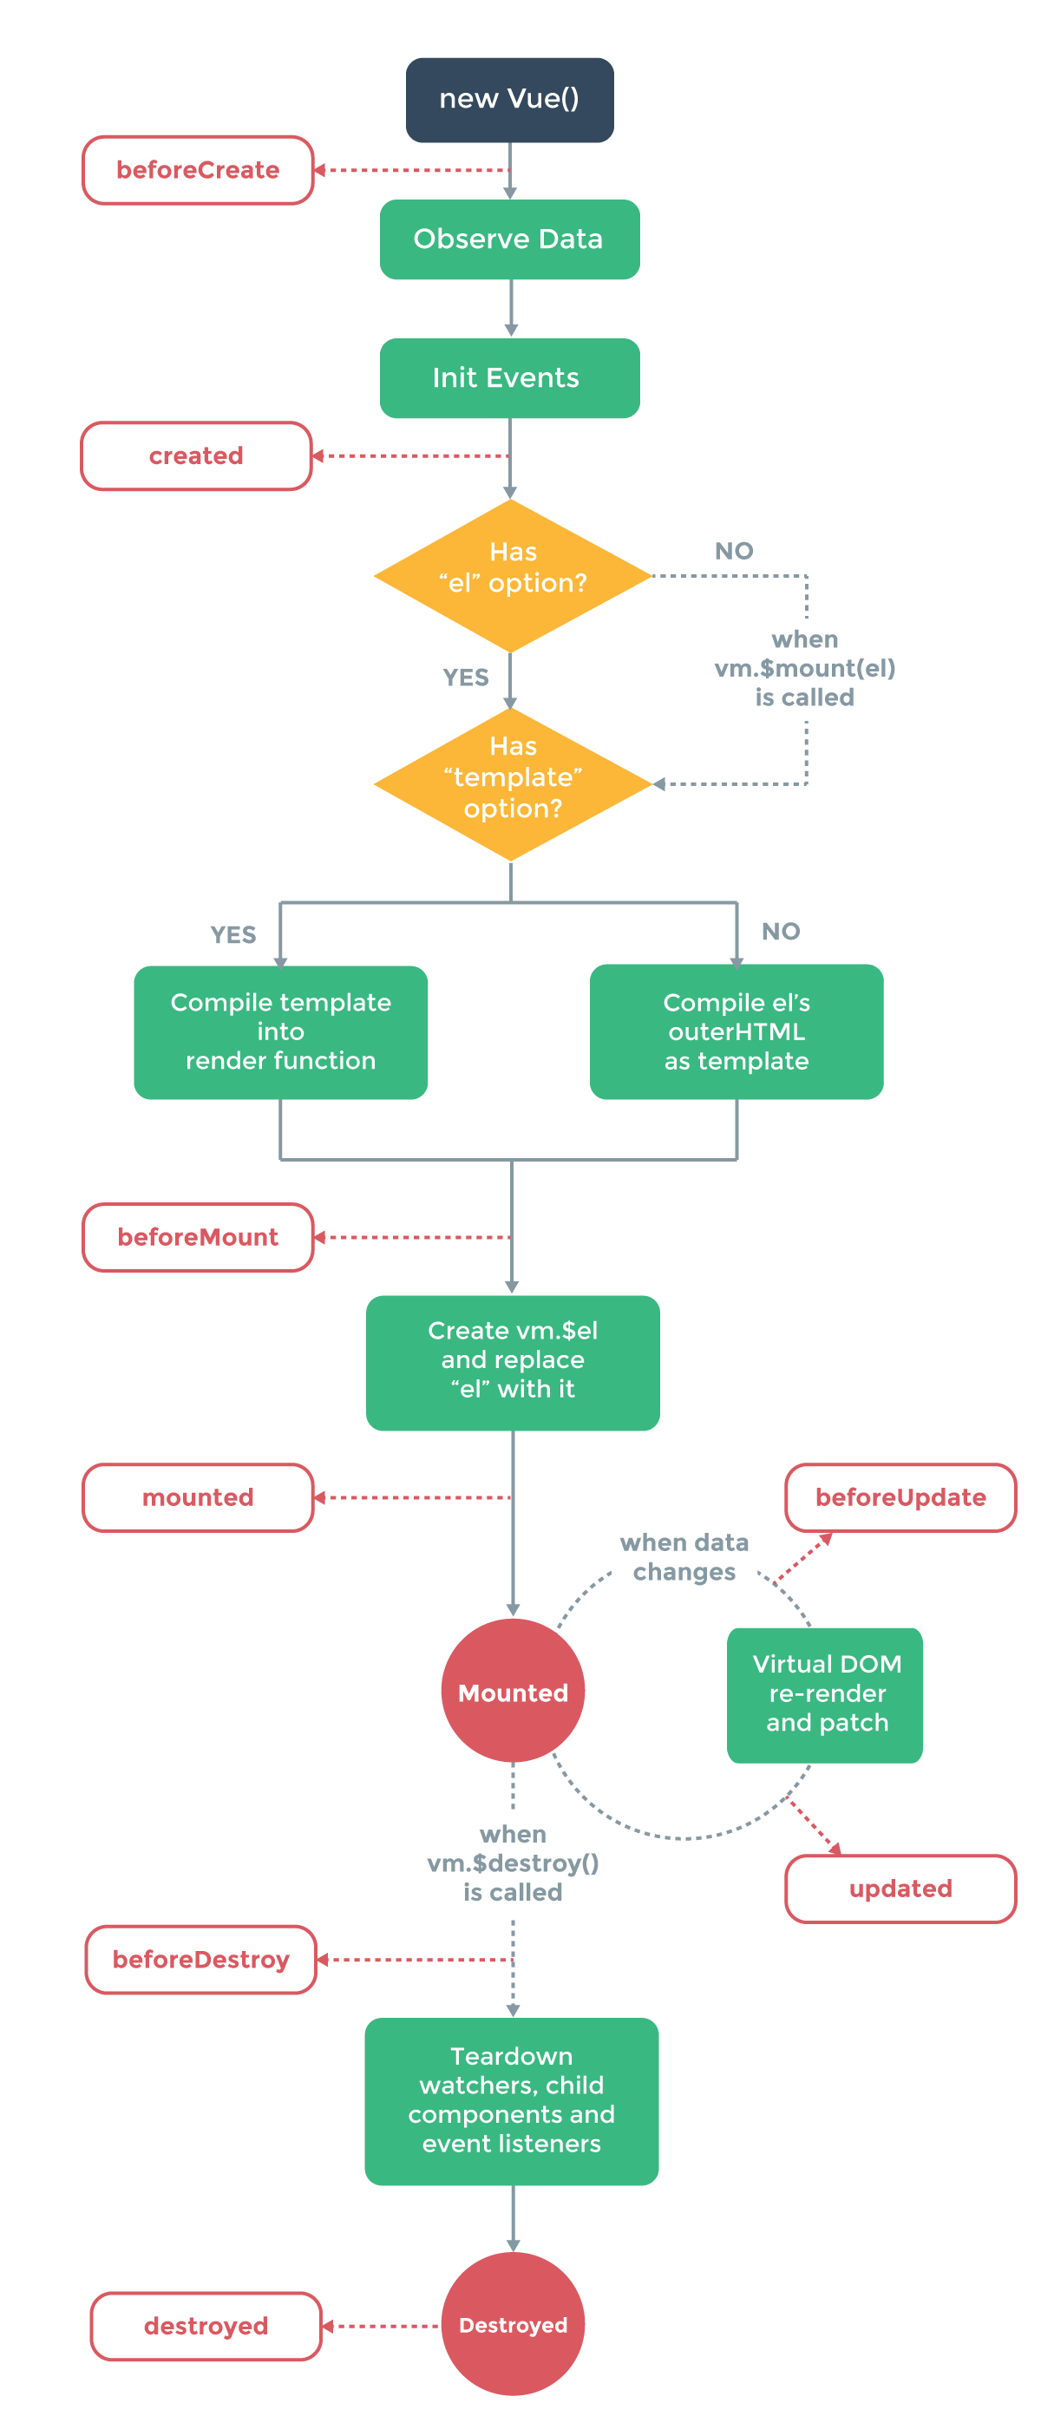
VUE JS Logic.
How to create Component?
How to detect data change?
What is a life cycle component?

Slide 20
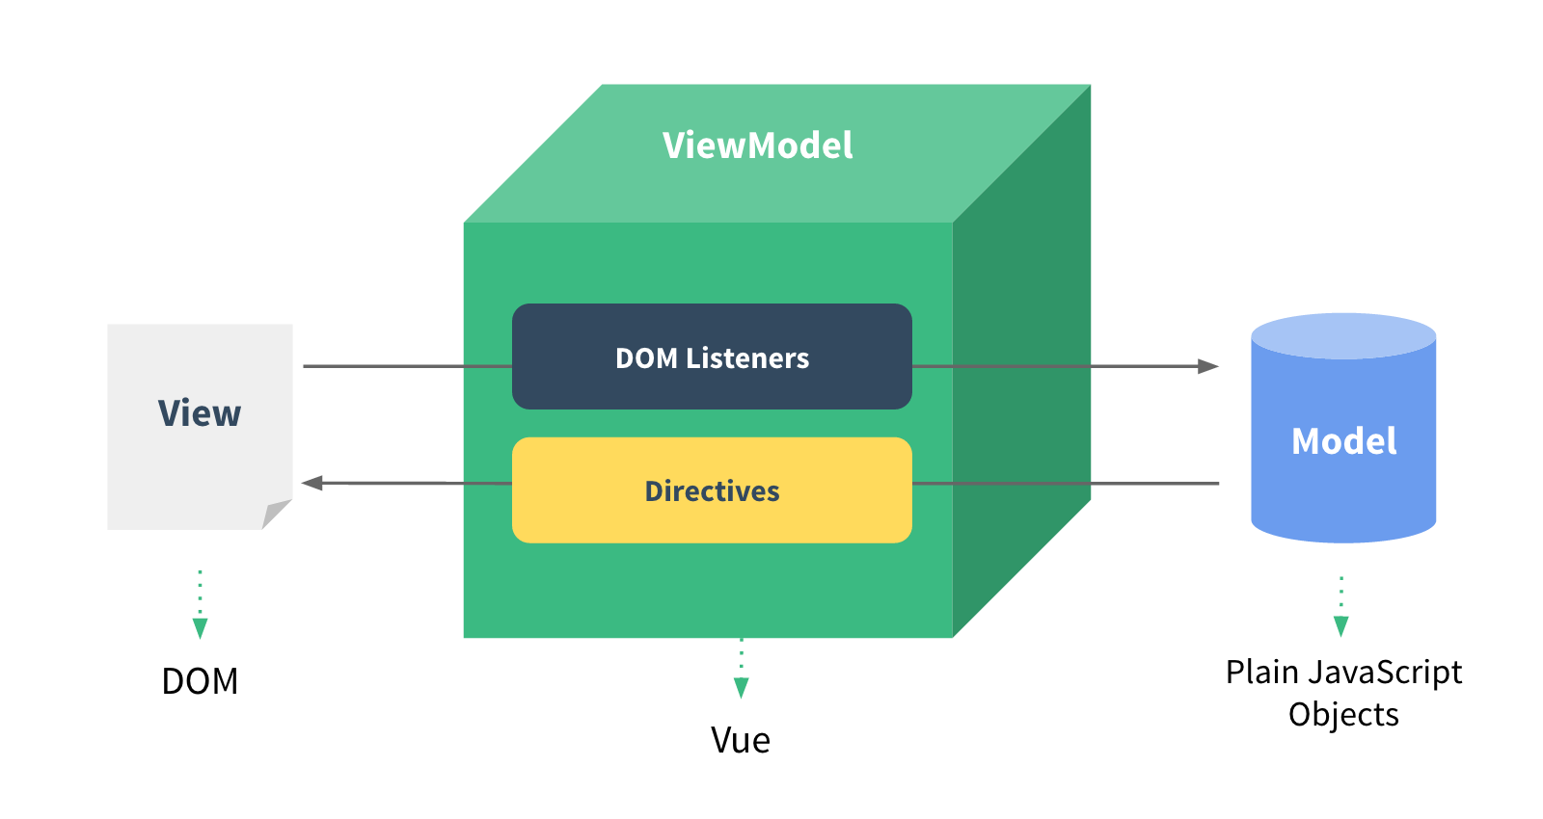

Slide 21
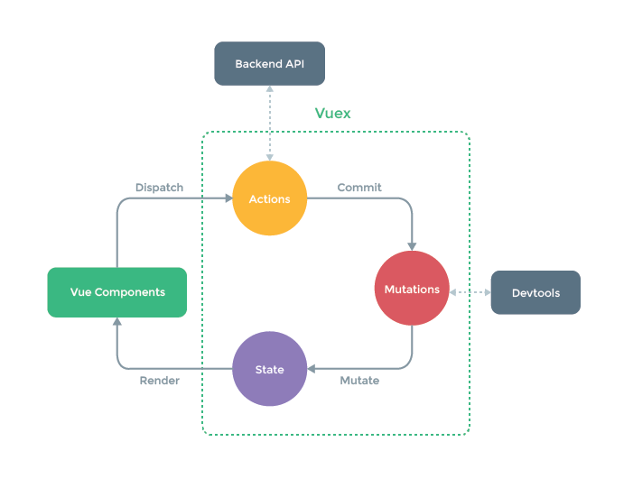
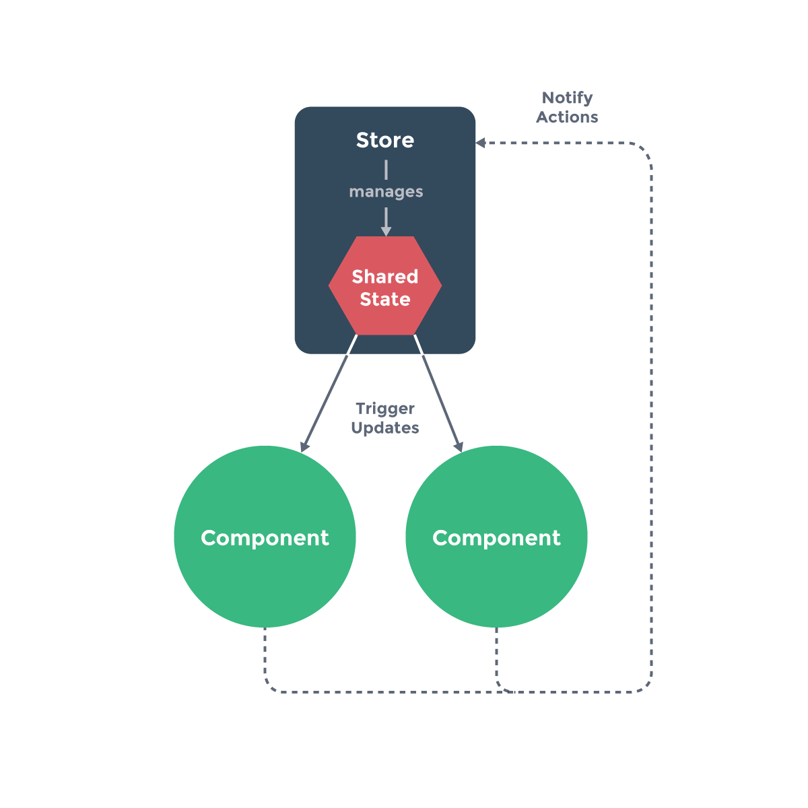
How to mange state components
Vue Component
Actions
State
Mutations
Listeners
Interaction with the devTools
Interacting with APIS

Slide 22

Building your very first app in VUE JS
www.github.com/MEDBED/VUEJS-MEETUP-TECOS

Slide 23
Conclusion

Slide 24
Conclusion
VUE JS
The future of the frontend Development
Our Future Workshop With TECOS

Slide 25
THANK YOU
<:p> PLEASE DON'T ASK ME ANY QUESTIONS
I AM NOT GOOGLE</:P>
Notes:
017532373401753237340175323734

