Slide 1
Mutual Fund Analysis
Data Analyst Internship Project
Presented by: Vuba Medhaswini
Internship Capstone | Indian Mutual Fund Market
📊 40 Schemes
🏦 10 Fund Houses
💰 ₹1M Cr AUM

Slide 2
SLIDE 02
Problem Statement & Objectives
🔍 Problem Statement
🎯 Objectives
Retail investors in India lack access to structured, data-driven analysis of mutual fund performance.
Existing tools are fragmented and fail to quantify risk-adjusted returns, drawdowns, and alpha generation across fund categories comprehensively.
Build an end-to-end ETL + analytics pipeline for MF data
Compute risk metrics: Alpha, Beta, Sharpe, VaR, CAGR
Identify top-performing funds by category & risk profile
Create interactive Power BI dashboards for stakeholders
Provide actionable investment recommendations

Slide 3
SLIDE 03
Dataset Overview
📁
Source
📐
Dimensions
📅
Time Period
AMFI India (amfiindia.com)
Historical NAV data
Scheme master data
40 Mutual Fund Schemes
10 Fund Houses
Multiple categories
3+ Year Historical Data
Daily NAV records
1Y & 3Y return windows
🧮
Key Fields
🗂️
Categories
🏗️
Storage
Scheme NAV, AUM (Cr)
Alpha, Beta, Std Dev
CAGR, Sharpe Ratio
Large Cap, Mid Cap
Small Cap, ELSS, Flexi Cap
Gilt, Liquid, Index/ETF
SQL Database (cleaned)
Power BI Data Model
Python DataFrames

Slide 4
SLIDE 04
Project Architecture
🌐
⚙️
🗄️
📊
📈
Data Source
ETL Pipeline
SQL Database
Analytics
Dashboard
AMFI India
NAV & Scheme Data
Python + Pandas
Extract & Transform
Clean Storage
Relational Model
Metrics Engine
Alpha/Beta/Sharpe
Power BI Reports
Interactive Views
1
2
3
4
5
Tech Stack:
Python 3.x
Pandas/NumPy
SQL Server
Power BI
DAX/M Query

Slide 5
SLIDE 05
ETL & Data Cleaning
E
Extract
🧹 Data Cleaning Steps
Fetched NAV data via AMFI API & CSV files. Collected scheme metadata, AUM, and fund house mappings.
✓
Removed duplicate NAV entries
✓
Handled missing values via forward-fill
T
Transform
✓
Standardized scheme names & codes
Normalized NAV data, computed daily returns, annualized volatility (252-day). Calculated Alpha, Beta, CAGR.
✓
Outlier detection on return series
✓
Date alignment across fund records
L
Load
✓
AUM normalization (Cr units)
Loaded into relational SQL database with staging tables. Created analytical views for Power BI connection.
✓
Category tagging & validation
✓
Beta benchmark: Nifty 50 index

Slide 6
SLIDE 06
Exploratory Data Analysis
40
Total Schemes Analyzed
10
Fund Houses Covered
1.25
Average Alpha Generated
₹1M Cr
Total Industry AUM
Key Insight: Large Cap dominates with 31% of total AUM. Small Cap & Mid Cap show higher alpha generation.

Slide 7
SLIDE 07
Performance Analytics
📈 CAGR
⚖️ Sharpe Ratio
Compound Annual Growth Rate measures the fund's mean annual growth over the specified period, smoothing out volatility.
Risk-adjusted return metric. Higher ratio indicates better return per unit of risk.
CAGR = (End NAV / Start NAV)^(1/n) - 1
Sharpe = (Rp − Rf) / σp
💡 Top performer: ABSL Small Cap — 24.93% (1Y)
💡 Liquid funds show lower Sharpe; Small Cap funds highest
🎯 Alpha & Beta
📉 Drawdown
Alpha: excess return over benchmark. Beta: sensitivity to market movements.
Maximum peak-to-trough decline. Measures downside risk and recovery potential.
Rp = α + β·Rm + ε
MDD = (Trough − Peak) / Peak
💡 Avg Alpha: 1.25 | Avg Beta: 0.87 (market corr.)
💡 Small Cap funds exhibit highest drawdown risk

Slide 8
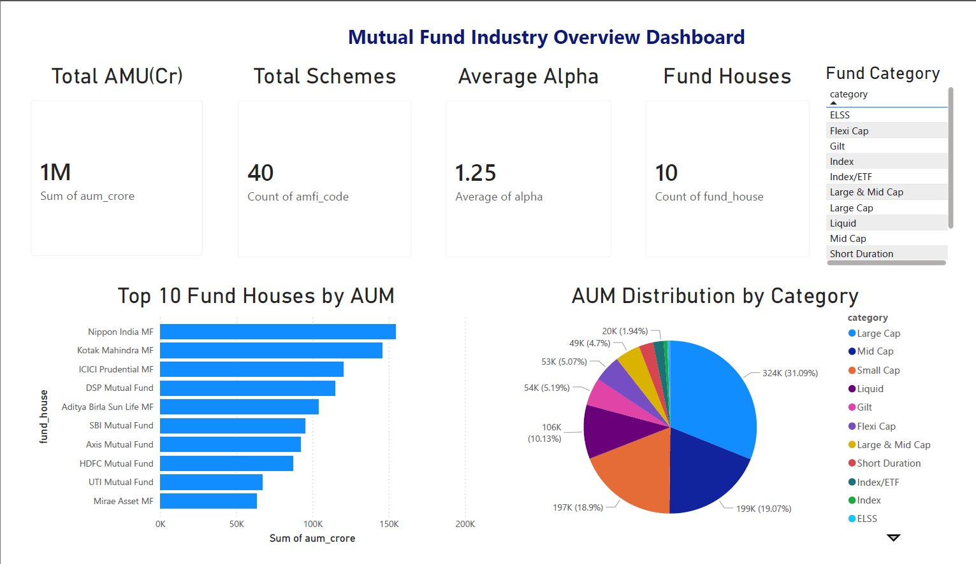
SLIDE 08
Industry Overview Dashboard
Dashboard built in Power BI | Covers AUM distribution, top fund houses, and category-wise breakdown

Slide 9
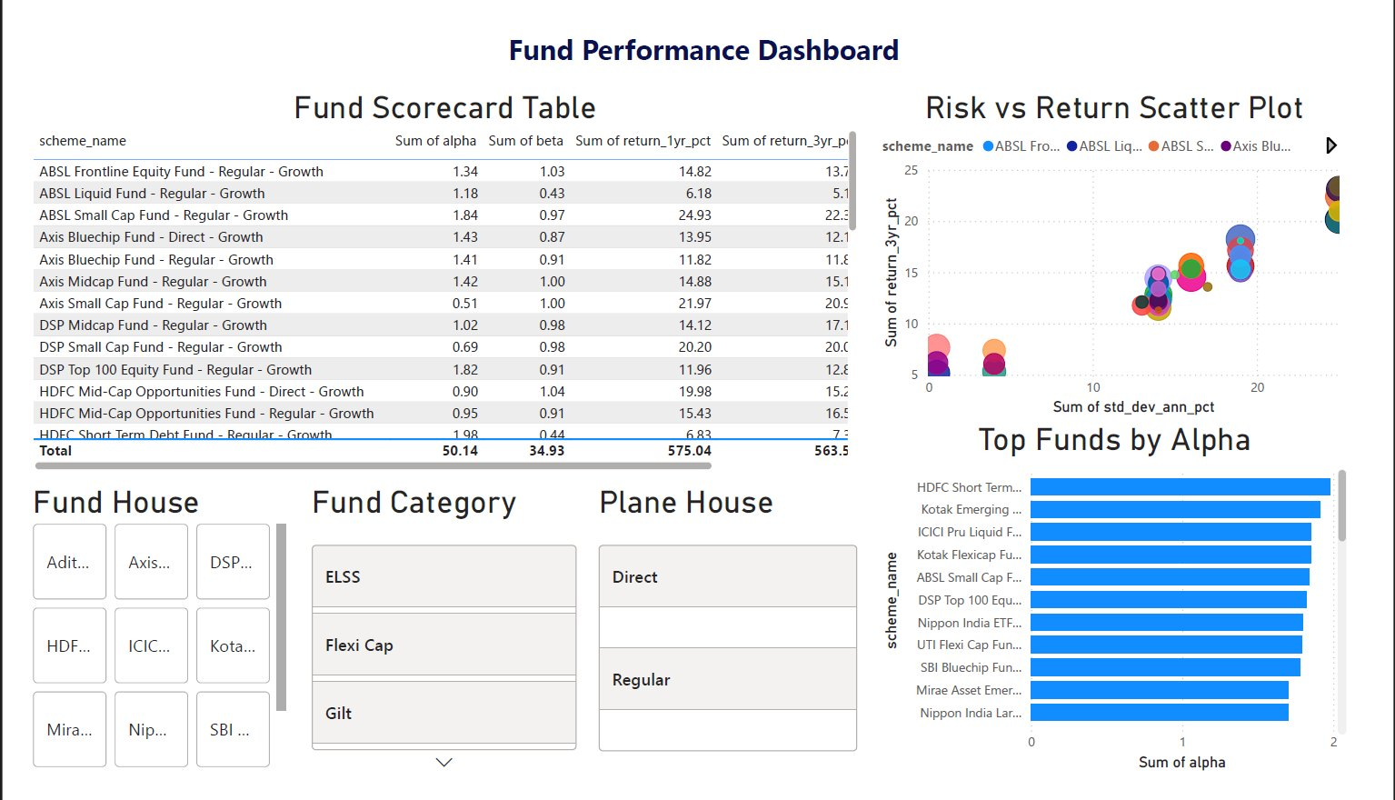
SLIDE 09
Fund Performance Dashboard
Interactive scorecard with Risk vs Return scatter plot and Top Funds by Alpha ranking

Slide 10
SLIDE 10
Advanced Analytics
⚠️ VaR & CVaR
📊 Rolling Sharpe
Value at Risk (95% conf.): Max expected loss
90-day rolling Sharpe ratio computed
CVaR = Average loss beyond VaR threshold
Identifies consistency of risk-adjusted returns
Applied Monte Carlo simulation approach
Peaks aligned with bull market phases
🔬 Cohort Analysis
💼 SIP Continuity
Funds grouped by category & vintage
Analyzed SIP investor return patterns
Tracks performance evolution over time
Rupee-cost averaging impact measured
Small Cap cohort outperforms over 3Y
CAGR uplift of ~1.5–2% over lump sum

Slide 11
SLIDE 11
Key Findings & Recommendations
📌 Key Findings
🚀 Recommendations
Nippon India MF leads in AUM with ₹1.5L Cr
Conservative Investors: Liquid & Short-Duration funds
ABSL Small Cap Fund: highest 1Y return at 24.93%
Moderate Risk Appetite: Large Cap or Flexi Cap funds
Average Alpha of 1.25 signals skilled fund management
Aggressive Growth: Small/Mid Cap with SIP approach
Liquid funds offer near-zero beta — ideal for parking
Tax Planning: ELSS with 3-year lock-in for 80C
HDFC Short Term Debt shows highest alpha (2.0) in debt
Portfolio Diversification: Blend categories for Sharpe > 1
Small Cap funds exhibit highest VaR & max drawdown
Review Frequency: Quarterly rebalancing recommended

Slide 12
SLIDE 12
40
Conclusion
Schemes
This project demonstrates a complete data analytics lifecycle — from raw NAV data ingestion to actionable investment insights.
10
We built robust ETL pipelines, computed industry-standard risk metrics, and delivered interactive Power BI dashboards.
Fund Houses
1.25
Findings reveal clear performance differentiation across fund categories, empowering investors with evidence-based decision tools.
Avg Alpha
5+
Thank You
Analytics Models

