Slide 1
An inconsistency is not fraud
01 PROBLEM, STAKEHOLDERS, HYPOTHESIS
Evidence arrives in pieces
Who needs what
PHOTO
damage, EXIF
STATEMENT
claimant's account
Claims adjuster
A defensible file, not a black box.
Reviewer / manager
Signs off, and must know the approval still matches the evidence.
POLICY
terms, clauses
ESTIMATE
line items, totals
DISCREPANCY Rear-impact story, front-damage photo. A question to resolve, not a verdict.
Claimant
A fair, faster outcome; an explanation before any accusation.
Compliance
An audit trail: who saw what, which version, when.
The honest path: inconsistency, possible explanations, the evidence that separates them, a recommendation for a human.
PRODUCT HYPOTHESIS
Verity doesn't hand you a verdict. When new evidence lands, it re-opens only the findings that depended on it, shows the cited before-and-after, and voids any human approval that is now out of date. It does this live, on the jury's own unseen case.
Verity | TCS AI Engineering Hackathon, Challenge 08 | synthetic evidence only
1 / 5
Notes:
THE PROBLEM (about 75 seconds). A motor claim arrives as scattered evidence: photos, the claimant's account, the policy, a repair estimate. When they disagree, for example a rear-impact story next to a front-damage photo, the lazy answer is 'fraud'. The honest answer is a chain: inconsistency, then possible explanations including a benign one, then which evidence would tell them apart, then a recommendation for a human. Evidence also keeps arriving, and today analysts either redo work or, worse, act on analysis that is already stale.
Four people care. The adjuster needs a defensible file. The reviewer or manager signs and must know the signature is still valid. The claimant needs a fair, faster outcome and an explanation before an accusation. Compliance needs an audit trail.
Our product hypothesis is the sentence at the bottom. Say it slowly. Say 'we found no public product that does this', never 'first' or 'nobody has'. The methods are established; the combination, running live on unseen input, is the new part.

Slide 2
Architecture: the model proposes, code decides
02 ARCHITECTURE
INPUT
AI / AGENTS
TOOLS
DATA / KNOWLEDGE
DECISIONS
HUMAN CONTROL
OUTPUT
One drop bar
Photo, PDF, statement, CSV, typed text
SHA-256 on arrival
Reader: no tools, schema JSON only
Planner: sees extracted JSON, never raw text
Hypotheses, findings, requests
Closed registry
Arguments validated
Every call on a visible tape
Policy, totals, history, weather
PostgreSQL 16
Hash-chained audit log
Private evidence store
One document per revision
Deterministic code
Receipts, ranking, staleness
Decimal money
Missing term: no number
AI never denies, flags fraud or pays
Approval voids on new evidence
Delegation table by rupees
Version-bound PDF
DRAFT unless approved
Revision and approval hash printed
Files in
Model proposes
Code decides: deterministic, inspectable
Human signs
Sealed copy
Degraded mode: if every model fails, hashing, EXIF, PDF text and OCR, arithmetic, receipts and review still work; AI sections say unavailable and the system asks for what it needs.
Verity | TCS AI Engineering Hackathon, Challenge 08 | synthetic evidence only
2 / 5
Notes:
ARCHITECTURE (about 80 seconds). Read it left to right in the TCS order.
Input: one drop bar takes any file or typed statement, and every file is hashed on arrival.
AI and agents: a 'reader' model that has no tools turns documents into schema-bound JSON; instruction-like text inside a document is listed as content and ignored. A separate 'planner' sees only that JSON, never the raw document, and proposes hypotheses, findings and evidence requests.
Tools: a closed registry. Policy clause lookup, estimate-total check, synthetic claim history, weather, create-request. Arguments are validated, an unknown tool is rejected, and every call lands on a visible tape.
Data and knowledge: PostgreSQL, originals in a private store with SHA-256, every revision stored as one document, and a hash-chained audit log.
Decisions: this is deterministic code you can inspect. Receipts, ranking by fewest contradictions, staleness, and money in Decimal. If a policy term is missing it refuses to give a number.
Human control: the AI never denies, never labels fraud, never releases payment. A reviewer approves; the approval is sealed to one revision and is voided when new evidence arrives. The role comes from a delegation table by rupees at stake. The reviewer name is a typed label, not authentication, and we say so.
Output: a version-bound PDF with a DRAFT watermark unless approved. The strip at the bottom is the trust boundary: the model proposes, code decides, a human signs.

Slide 3
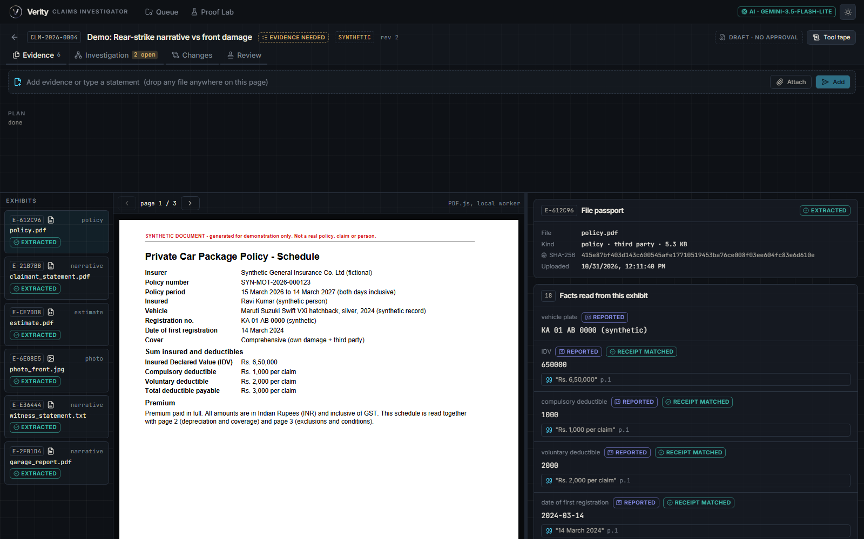
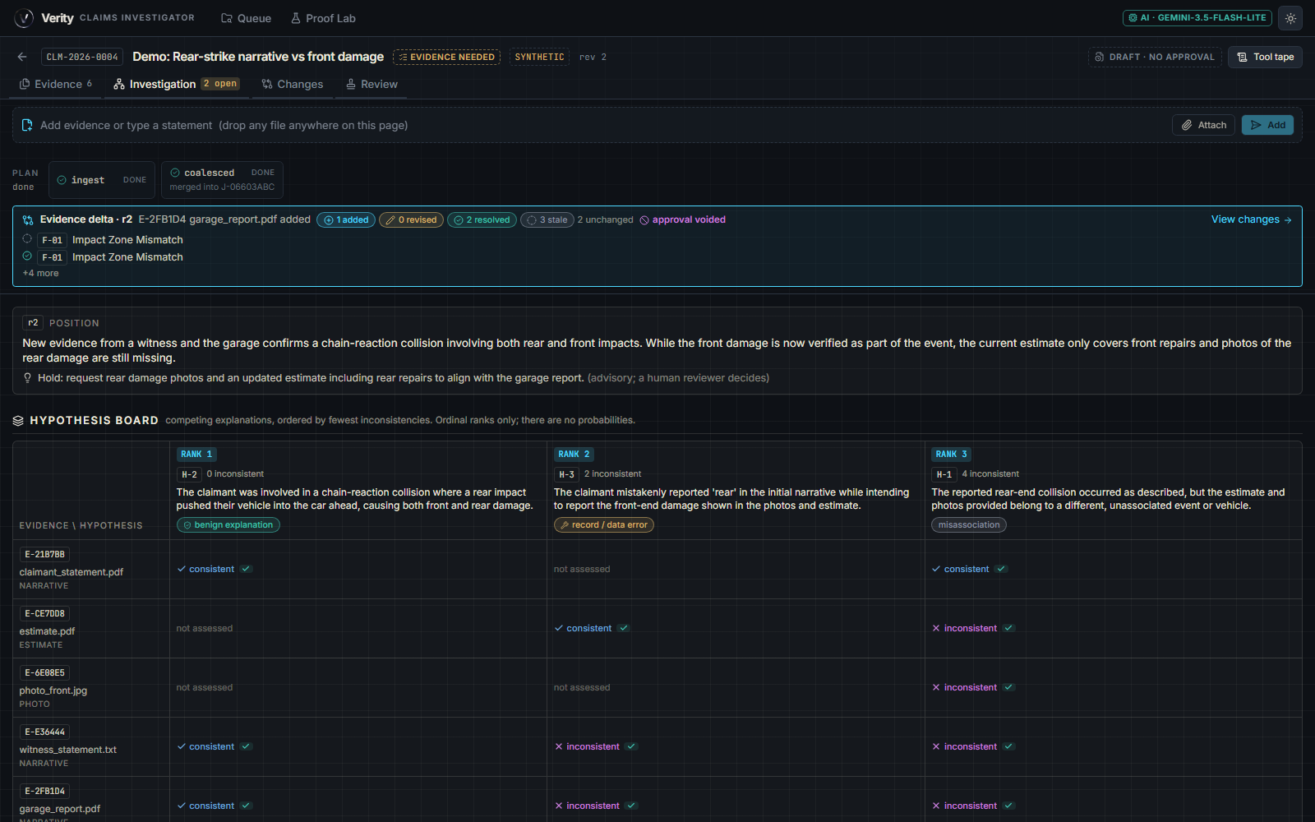
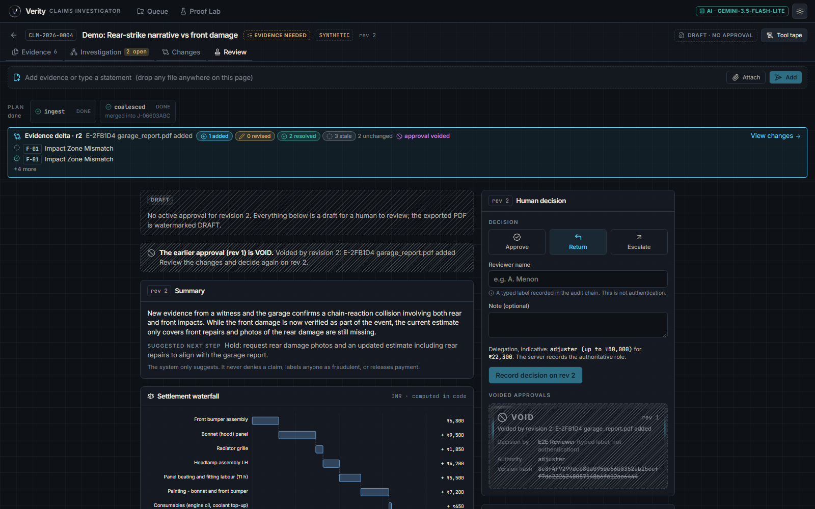
Working prototype: one case, five steps, live
03 WORKING PROTOTYPE
1 Create case, drop evidence
files become tagged facts
2 Hypothesis Board
ranked by fewest contradictions
3 Next-evidence request
prediction locked
4 Settlement and approval
Decimal math, sealed to a revision
5 New evidence arrives
the live moment
LIVE DEMO Leave the slides, open the running app, load the case, and ask the jury for their own document.
Verity | TCS AI Engineering Hackathon, Challenge 08 | synthetic evidence only
3 / 5
Notes:
WORKING PROTOTYPE (about 60 seconds, then switch to the app). The strip is the story we are about to run live.
One: create a case and drop the policy, the claimant statement, a damage photo and the repair estimate. Each file is read and every fact is tagged observed, reported, computed, inferred or human.
Two: the Hypothesis Board lays out competing explanations, always including a benign one, ranked by fewest contradictions. No probabilities, no fraud score.
Three: the system asks for the single most useful next document, says which explanations it would separate and what is at stake in rupees, and locks a prediction before the answer arrives.
Four: settlement is exact decimal arithmetic on the supplied policy terms, or it lists what is missing. A reviewer approves and the approval is sealed to that revision.
Five is the moment: a juror hands over a new document.
[Presenter: replace the three dashed boxes with screenshots before the event, or skip them and go straight to the live app. Transition line: 'Let me show you rather than tell you.' Open the running app, load the case, ask the juror for their document. Check on the running app anything marked VERIFY in EXPLAIN_IT.md before saying it.]

Slide 4
Evidence, evaluation and responsible AI
04 EVIDENCE, EVALUATION, RESPONSIBLE AI
Why you can trust a finding
Proof Lab gates (run on every upload)
OBSERVED
REPORTED
COMPUTED
INFERRED
HUMAN
Check | Result
Schema valid | [MEASURED: fill from Proof Lab]
Citations resolve to source | [MEASURED: fill from Proof Lab]
No-accusation language guard | [MEASURED: fill from Proof Lab]
Math recomputes exactly | [MEASURED: fill from Proof Lab]
No unverified value in the math | [MEASURED: fill from Proof Lab]
Name-swap fairness test | [MEASURED: fill from Proof Lab]
Labelled scenarios | [MEASURED: fill from Proof Lab]
Receipts
Every quote and amount is found in its source page; failures show UNVERIFIED and stay out of the money.
Airlock
Reader has no tools; embedded instructions are listed as content, never obeyed.
No fraud score
Explanations ranked by contradictions, a benign one always present, no invented probabilities.
Language guard
Accusatory words rejected unless inside a quoted source span.
Fairness
Name-swap test at temperature 0 compares structured fields only.
Failure handling
Model failover, then degraded mode that never fabricates.
Cells stay empty until read from the running Proof Lab. No figure is estimated here.
Honest limits
Synthetic data
All evidence and policy terms are synthetic and labelled.
Team-written scenarios
Show regression and consistency, not field accuracy.
No real auth
The reviewer name is a typed label, recorded in the audit chain.
Free-tier models
Some timed out in testing; hence failover and degraded mode.
Built on established ideas: Heuer's Analysis of Competing Hypotheses; truth maintenance (Doyle, 1979); dual-LLM pattern and CaMeL; OWASP LLM01 prompt injection.
Verity | TCS AI Engineering Hackathon, Challenge 08 | synthetic evidence only
4 / 5
Notes:
EVIDENCE, EVALUATION AND RESPONSIBLE AI (about 90 seconds).
Left side, why you can trust a finding. Receipts: every quote and amount must be found in the source page after normalisation; failures show as UNVERIFIED and are excluded from the money. Epistemic chips tag every fact; no red and green verdict colours. Airlock: the reader has no tools, its output is schema-bound, and instructions hidden in a document are listed as embedded instructions and ignored. No fraud score: the evidence shows inconsistency, not intent, so we rank explanations by contradictions and always include a benign one; we never invent probabilities. A language guard rejects accusatory words unless they sit inside a quoted source span. A name-swap fairness test compares structured fields only. If a model is overloaded the app fails over, and if all fail it shows degraded mode and never fabricates.
Right side, Proof Lab runs five gates on every analysis, including the jury's upload. The result cells are deliberately empty: [MEASURED: fill from Proof Lab]. [Presenter: type in only numbers read off the Proof Lab screen.]
Limits, said before you ask: all evidence is synthetic; our scenarios are team-written, so they show regression and consistency, not field accuracy; there is no real authentication; and on the free model tier some models timed out when we tested, which is why failover exists.
Small print credits Heuer, Doyle, dual-LLM and CaMeL, OWASP LLM01.

Slide 5
Dynamic adaptation: only dependants re-open
05 DYNAMIC ADAPTATION AND BUSINESS VALUE
New document
A juror hands over unseen evidence.
Dependants go STALE
Only findings that rested on it; hatched, the rest untouched.
Cited diff
Before and after, each line with its source.
Prediction scored
The locked prediction is checked against the answer.
Approval VOID
Sealed to an old revision; a human must sign again.
How: every finding stores the evidence ids and entity keys it rests on. A new revision re-opens only findings whose justification overlaps the new evidence; the ranking of evidence requests updates and the diff is committed as a new, hash-chained revision.
BUSINESS-VALUE HYPOTHESIS
A case file that stays current and defensible should cost reviewers less re-checking, cause less rework when evidence arrives late, and close evidence requests sooner.
A hypothesis to test, not a result. We report no savings.
What a pilot would measure (not results)
Review time per case
Case opened to approval, against the current process on the same case mix.
Rework avoided
Analyses redone after late evidence, counted with and without Verity.
Time to resolve an evidence request
Request raised to matching evidence attached.
Verity | TCS AI Engineering Hackathon, Challenge 08 | synthetic evidence only
5 / 5
Notes:
DYNAMIC ADAPTATION (about 75 seconds). This is the jury moment, and in the live demo it happens on the jury's own document.
A new document arrives. One: only the findings that depended on it go stale, shown hatched; everything else stays exactly as it was. Two: those findings re-resolve and Verity shows a cited before-and-after diff. Three: the prediction we locked before the evidence arrived is scored, so you can see whether the system's reasoning was right. Four: the earlier human approval flips to VOID, because it was sealed to a revision that is no longer current.
How it works, briefly: every finding stores the evidence ids and entity keys it rests on. That is the truth-maintenance idea. A new revision invalidates only findings whose justification overlaps the new evidence, with a fallback to same-category findings if keys cannot be extracted.
Business value, honestly: this is a hypothesis. If the file stays current and defensible, reviewers should spend less time re-checking, fewer cases should be reworked after late evidence, and evidence requests should close faster. We have not measured any of this and we are not claiming savings. A pilot would measure three things: review time per case, rework avoided, and time to resolve an evidence request, each against the current process on the same case mix.
Close on the first slide's sentence: no verdict, only what changed, why, and who must sign again.

