Slide 1
Verity — Claims Investigator
• Multimodal insurance claims investigator · TCS Challenge 08 · AI for Business
• Reads photos, estimates, policy documents and statements together and shows what does not add up
• When new evidence lands, only the findings that depended on it are re-opened
• Evidence is synthetic and labelled; a human always decides

Slide 2
The problem
• Claims arrive as a pile: photos, estimates, statements, policy pages — and keep changing
• Adjusters re-read everything whenever one new document arrives
• Reviewers approve a case that may be stale by the time it is paid
• Verity keeps the case state, re-checks only what changed, and shows exactly why

Slide 3
What Verity can do right now
• Ingest PDFs, photos and text; extract text, OCR, EXIF and hashes locally
• Build competing hypotheses (benign, record error, misassociation) ranked by fewest inconsistencies — ordinal, no probabilities
• Recompute estimate arithmetic and a settlement waterfall in code (decimal strings)
• Re-open only the dependent findings on new evidence, with a cited before/after diff
• Void an earlier human approval automatically; export a PDF report (DRAFT until approved)
• Run 5 gates on every analysis: schema, citations, language, math, unverified

Slide 4
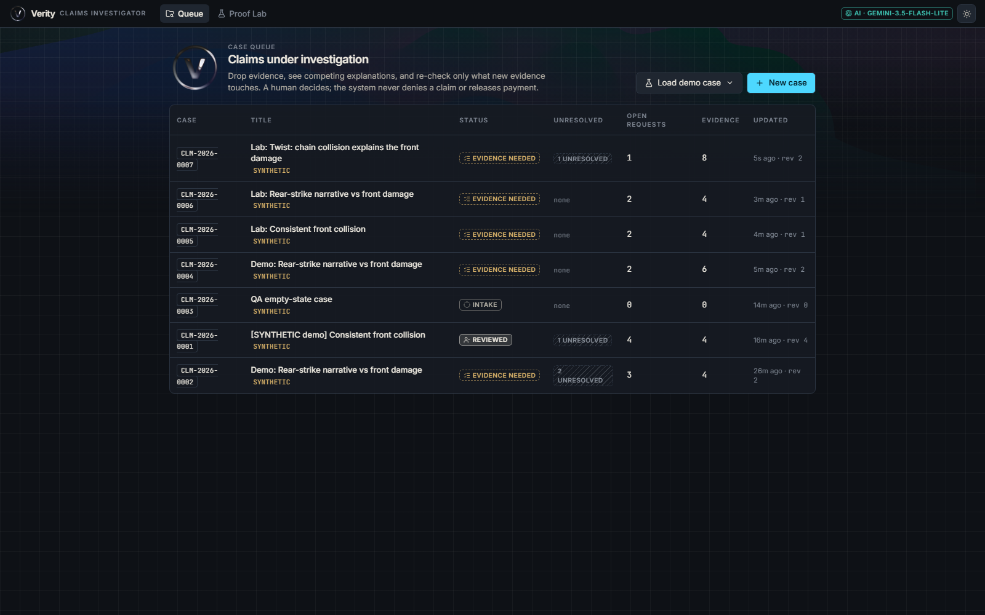
Case queue
• One list of cases, each marked synthetic
• Open a case to see its evidence, investigation, changes and review tabs
• Drag-drop any file onto a case to add evidence
Notes:
Screenshot of the running app.

Slide 5
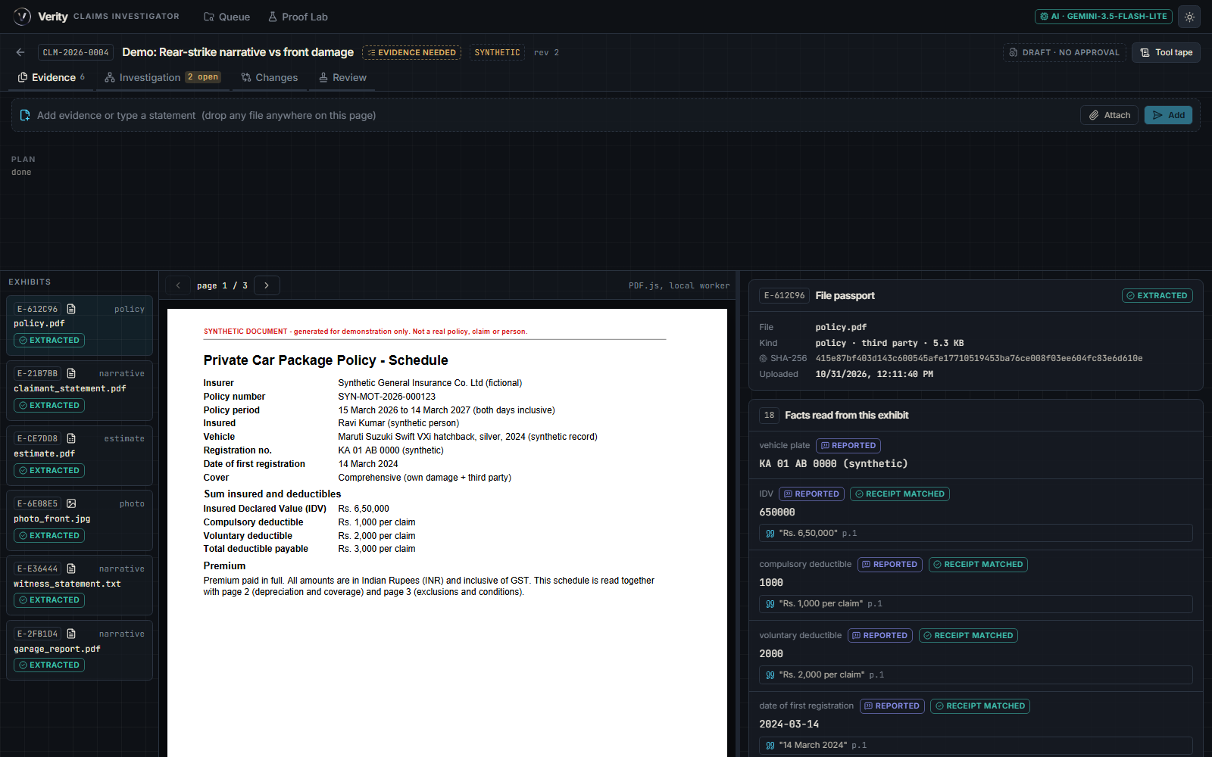
Evidence: what was submitted
• Every file is hashed and extracted before any AI reasoning
• Photos: EXIF read locally; missing EXIF is shown as unavailable, never as suspicious
• Quotes can be traced back to the source text (receipts)
Notes:
Does not detect AI-generated images; checks consistency across evidence.

Slide 6
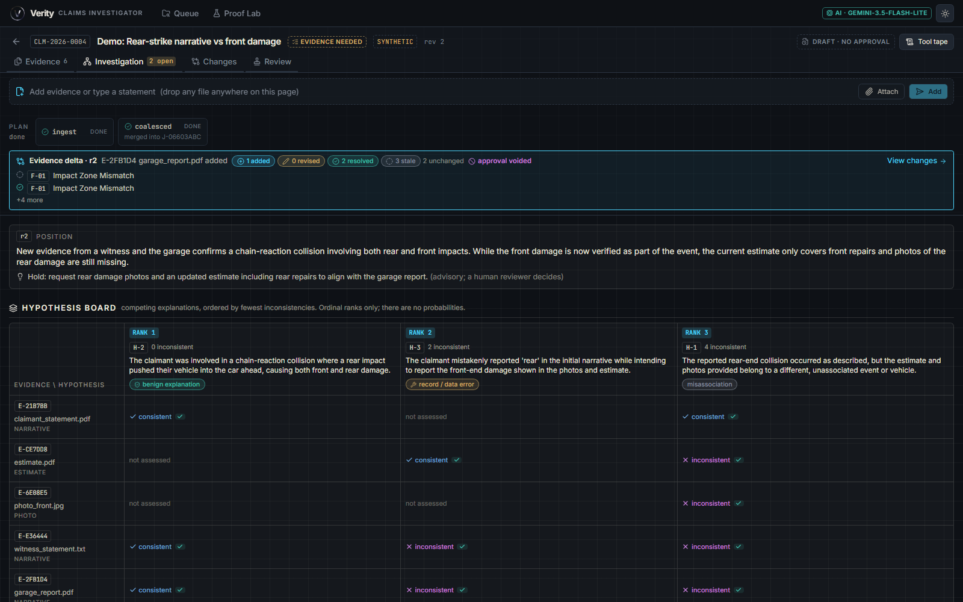
Investigation: competing explanations
• Hypothesis board: benign explanation vs record/data error vs misassociation
• Ranked by fewest inconsistencies; ordinal ranks only, no probabilities
• Evidence × hypothesis matrix with a verified-quote check on each cell
• Advisory position: "Hold: request rear damage photos" — a human reviewer decides
Notes:
Demo case: rear-strike narrative vs front-damage photo.

Slide 7
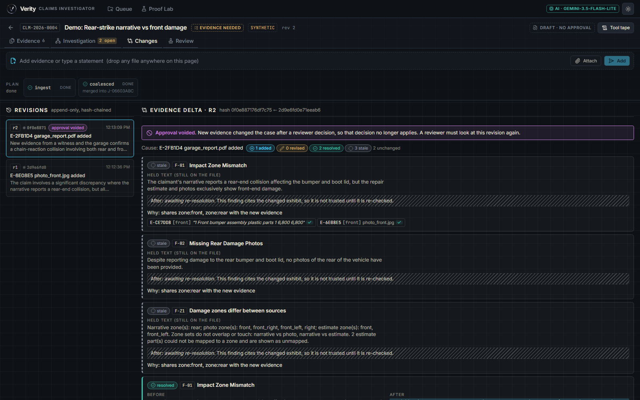
Changes: new evidence, cited diff
• Garage report added → 1 added, 2 resolved, 3 stale, 2 unchanged
• Stale findings are held, not trusted until re-checked, and name why (shared zones)
• Revisions are append-only and hash-chained
• Approval voided banner appears on the same screen
Notes:
Core USP.

Slide 8
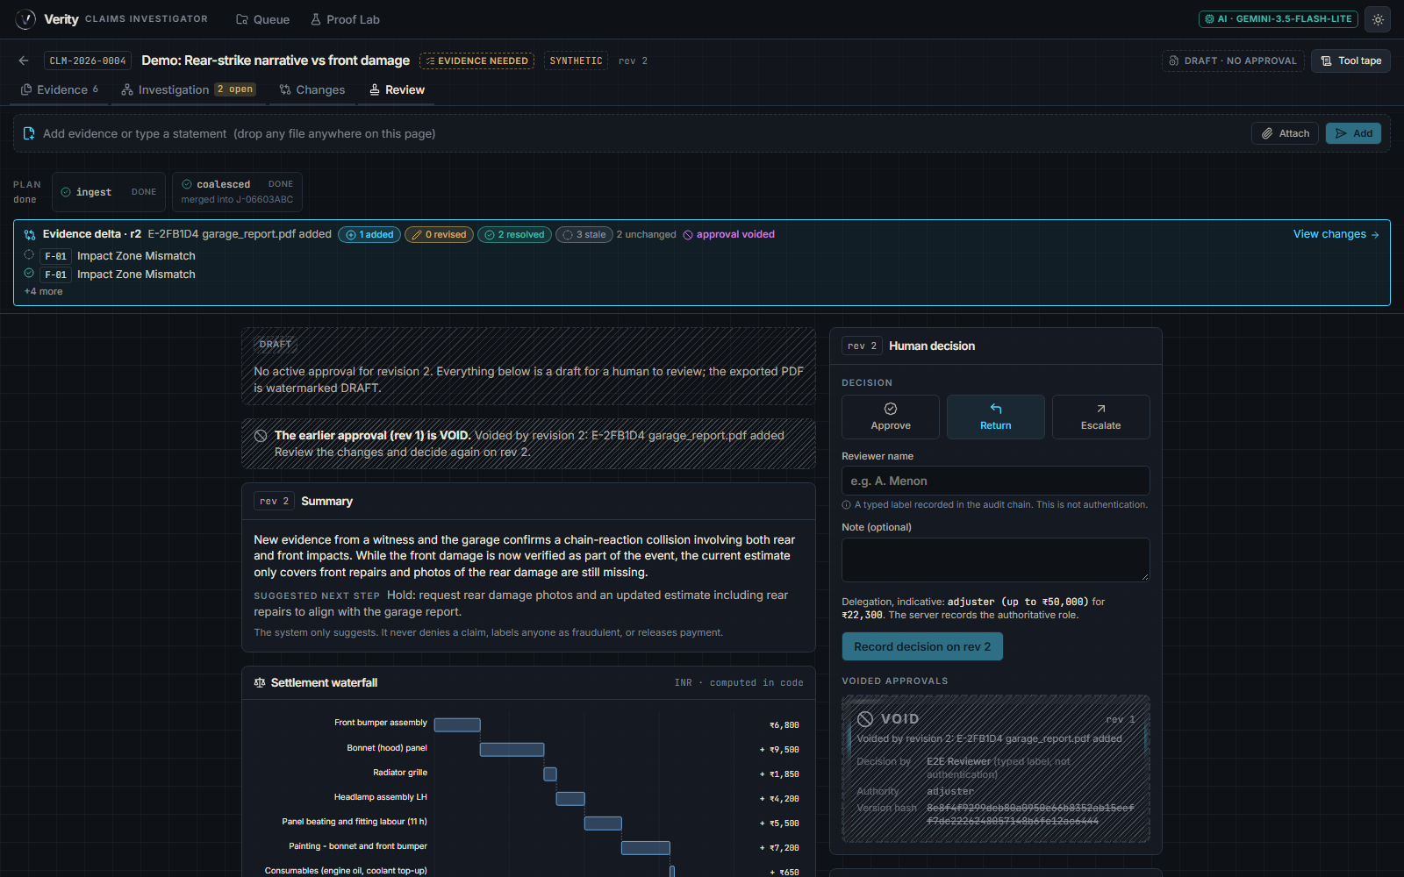
Review: human decision
• Draft watermark until a human approves; earlier approval shown as VOID
• Settlement waterfall computed in code: ₹22,300 proposed
• Approve / Return / Escalate; the system never denies, scores fraud or pays
• Reviewer name is a typed label recorded in the audit chain, not authentication
Notes:
Amounts come from deterministic calc.

Slide 9
Proof Lab: measured results
• 10 scripted scenarios run one at a time against the live pipeline
• 5 of 10 passed: consistent, rear_vs_front, unreadable, scanned_estimate, swapped_image
• 1 real finding: twist_secondary_impact — stale re-open worked, but no new finding was added (expectation may be too strict)
• 4 failures were Gemini 503 outages — app degraded honestly with no hypotheses; to be re-run
• Also: pytest 78 passed; end-to-end check 19/20 (the 1 failure was a real bug, since fixed)
Notes:
One run per scenario; small sample; synthetic evidence.

Slide 10
Guardrails and limits
• The AI never denies a claim, scores fraud or releases payment
• Every quote and amount must be found in the source text
• Does not detect AI-generated images — it checks consistency across evidence and provenance signals
• Free-tier Gemini rate limits: the app degrades visibly and says so
• We found no public product that does this

