Slide 1
Verity — Claims Investigator
• Multimodal insurance claims investigator · TCS Challenge 08 · AI for Business
• Reads photos, estimates, policy documents and statements together and shows what does not add up
• When new evidence lands, only the findings that depended on it are re-opened
• Evidence is synthetic and labelled; a human always decides

Slide 2
The problem
• Claims arrive as a pile: photos, estimates, statements, policy pages — and keep changing
• Adjusters re-read everything whenever one new document arrives
• Reviewers approve a case that may be stale by the time it is paid
• Verity keeps the case state, re-checks only what changed, and shows exactly why

Slide 3
What Verity can do right now
• Ingest PDFs, photos and text; extract text, OCR, EXIF and hashes locally
• Build competing hypotheses (benign, record error, misassociation) ranked by fewest inconsistencies — ordinal, no probabilities
• Recompute estimate arithmetic and a settlement waterfall in code (decimal strings)
• Re-open only the dependent findings on new evidence, with a cited before/after diff
• Void an earlier human approval automatically; export a PDF report (DRAFT until approved)
• Run 5 gates on every analysis: schema, citations, language, math, unverified

Slide 4
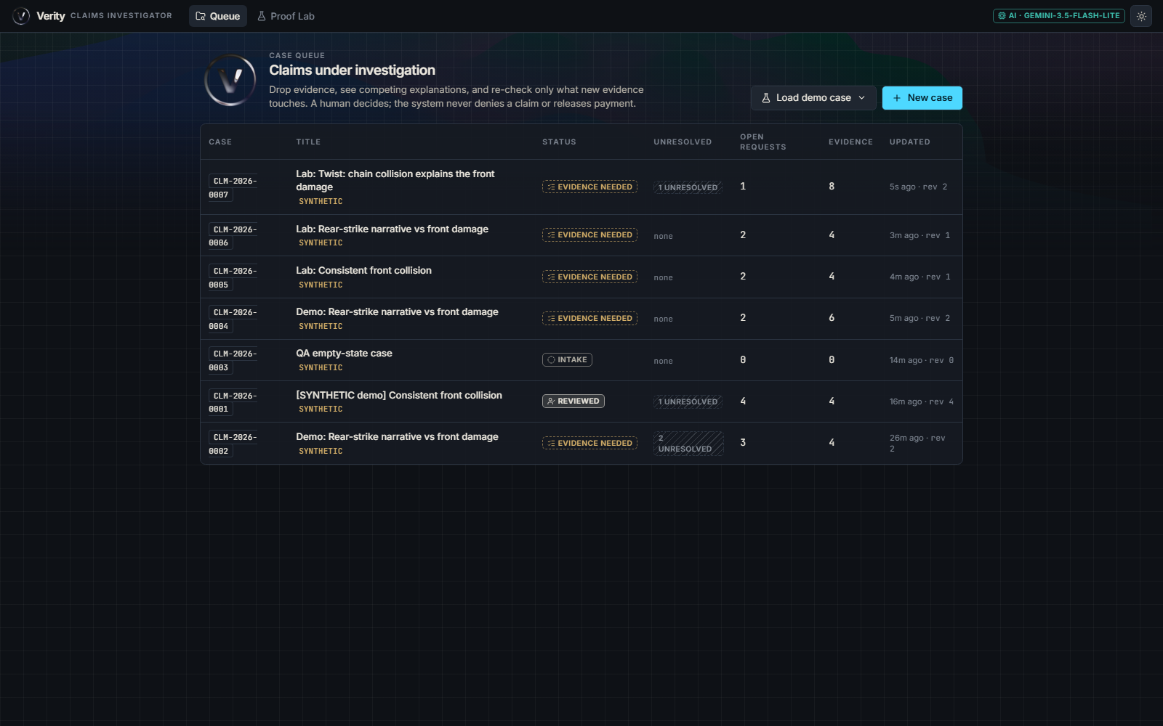
Case queue
• One list of cases, each marked synthetic
• Open a case to see its evidence, investigation, changes and review tabs
• Drag-drop any file onto a case to add evidence
Notes:
Screenshot of the running app.

Slide 5
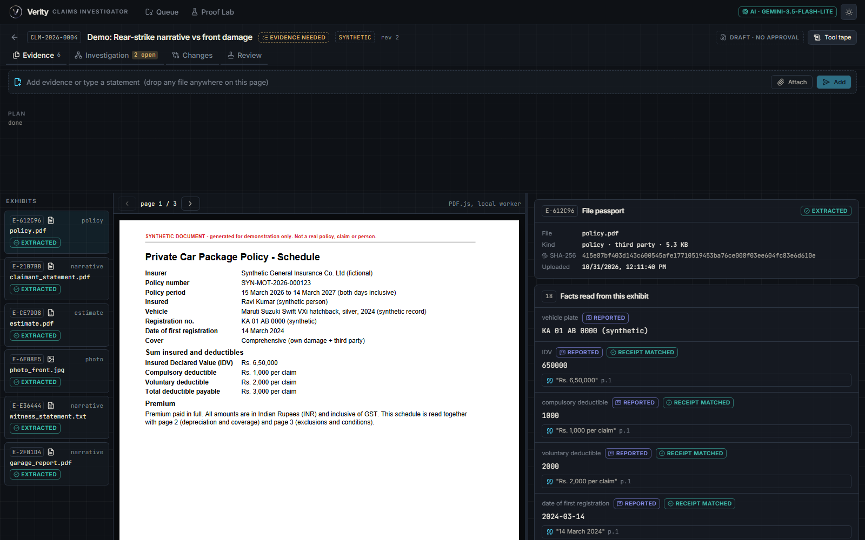
Evidence: what was submitted
• Every file is hashed and extracted before any AI reasoning
• Photos: EXIF read locally; missing EXIF is shown as unavailable, never as suspicious
• Quotes can be traced back to the source text (receipts)
Notes:
Does not detect AI-generated images; checks consistency across evidence.

Slide 6
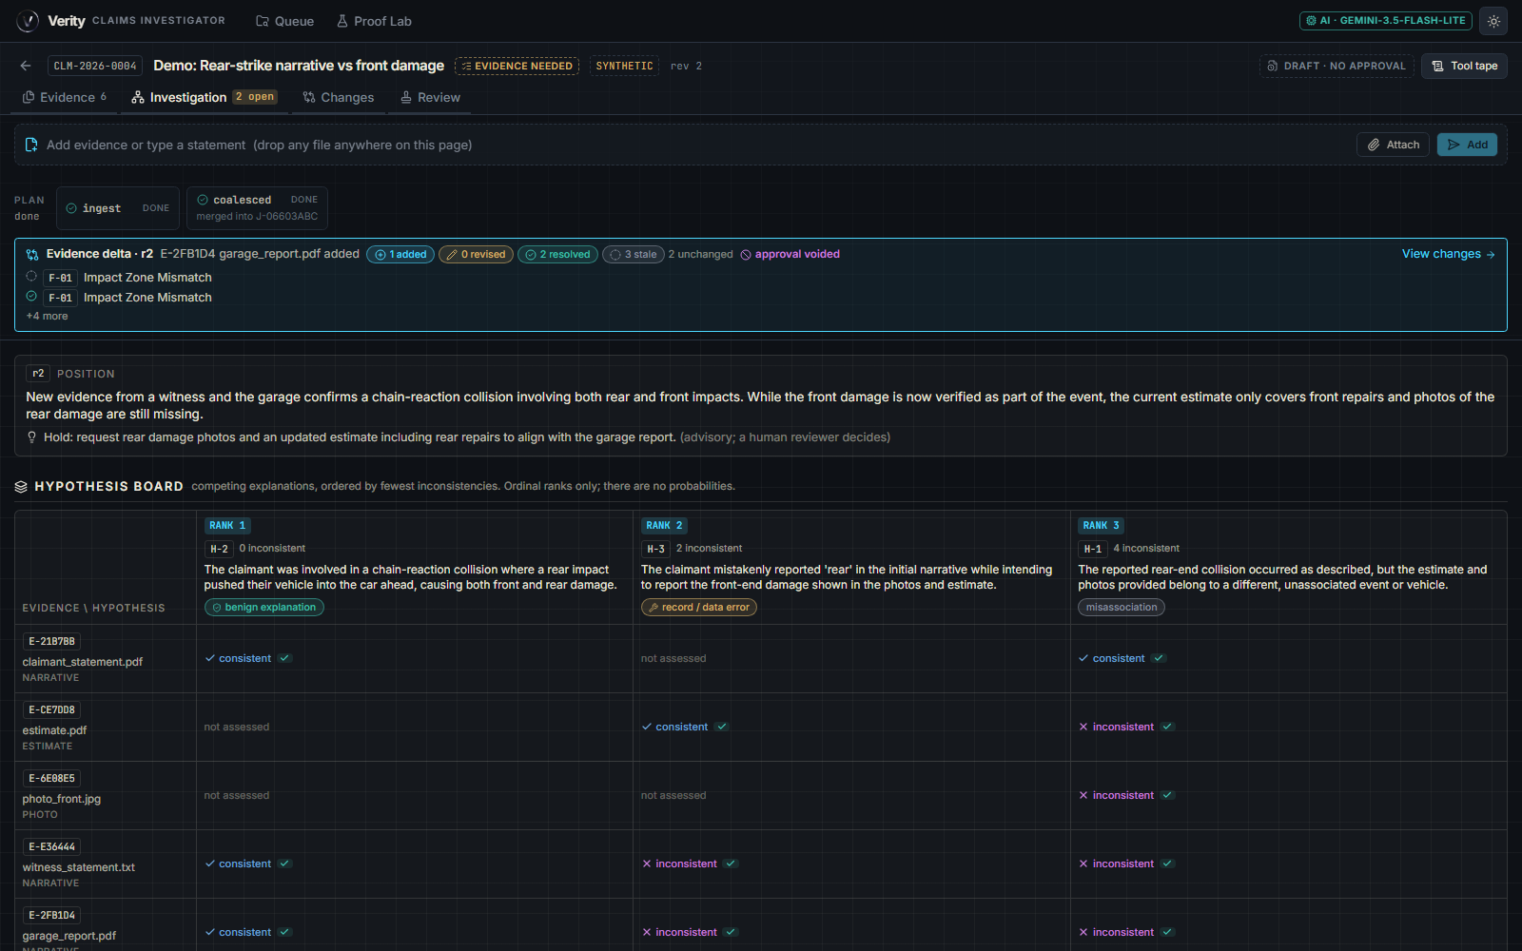
Investigation: competing explanations
• Hypothesis board: benign explanation vs record/data error vs misassociation
• Ranked by fewest inconsistencies; ordinal ranks only, no probabilities
• Evidence × hypothesis matrix with a verified-quote check on each cell
• Advisory position: "Hold: request rear damage photos" — a human reviewer decides
Notes:
Demo case: rear-strike narrative vs front-damage photo.

Slide 7
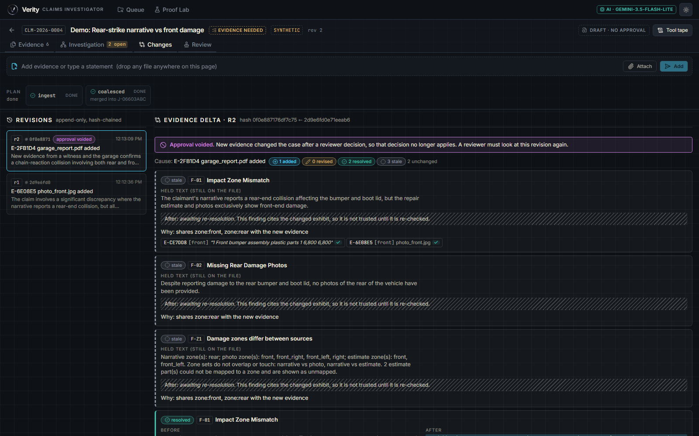
Changes: new evidence, cited diff
• Garage report added → 1 added, 2 resolved, 3 stale, 2 unchanged
• Stale findings are held, not trusted until re-checked, and name why (shared zones)
• Revisions are append-only and hash-chained
• Approval voided banner appears on the same screen
Notes:
Core USP.

Slide 8
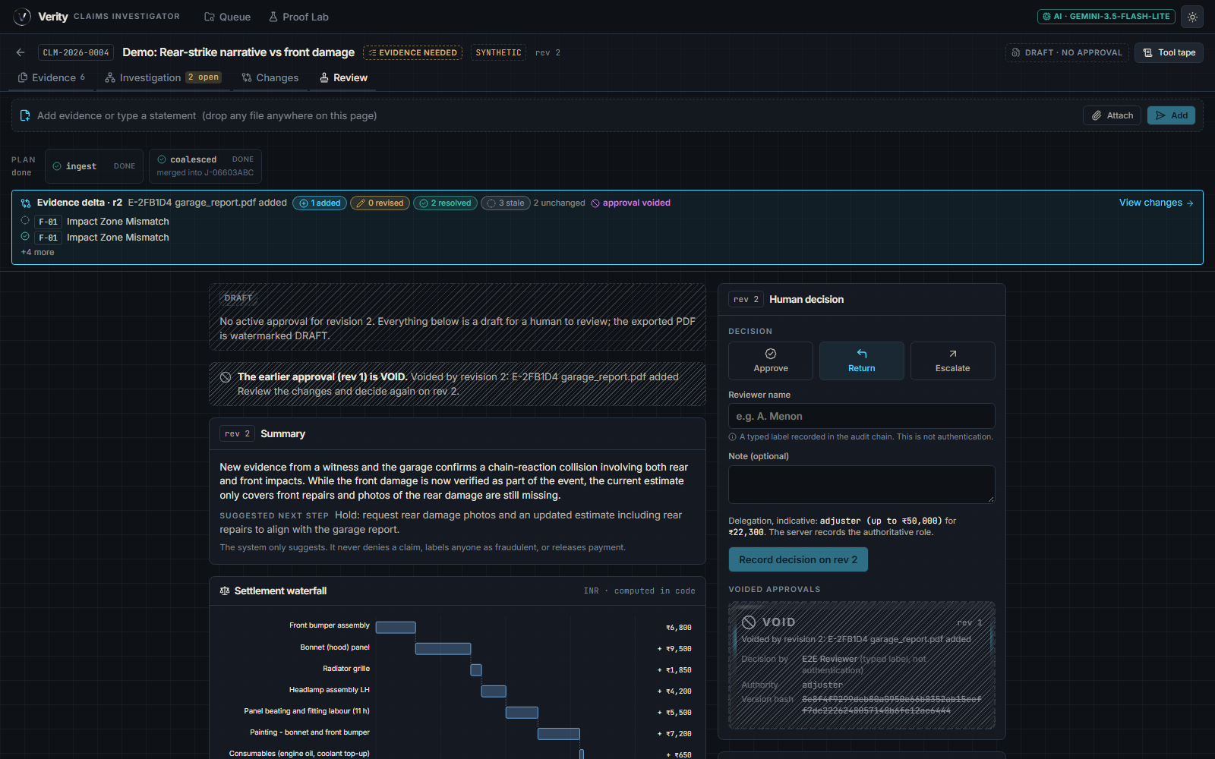
Review: human decision
• Draft watermark until a human approves; earlier approval shown as VOID
• Settlement waterfall computed in code: ₹22,300 proposed
• Approve / Return / Escalate; the system never denies, scores fraud or pays
• Reviewer name is a typed label recorded in the audit chain, not authentication
Notes:
Amounts come from deterministic calc.

Slide 9
How it works: architecture
• Backend: FastAPI + SQLAlchemy + PostgreSQL 16; Alembic migrations; advisory locks serialise writes per case
• Revision state is one JSONB document; money is NUMERIC; every row is scoped by case_id
• Job worker queue: uploads for the same case coalesce into one revision; a commit checks base_rev so a stale run is rejected
• Frontend: React + Vite + Tailwind; types.ts mirrors the backend data contract (contracts.py)
• AI layer: Gemini over a failover chain; AI proposes, deterministic code checks, computes and records

Slide 10
The pipeline, step by step
• 1 Extract: EXIF via Pillow, SHA-256, OCR fallback (pypdfium2 + RapidOCR), narrative events with exact source spans; cached by hash
• 2 Analyze: one planner call over extracted JSON passed as quoted data with closed ids -> hypotheses, matrix, findings, requests, timeline
• 3 Validate: every quote/amount matched to source (exact, fuzzy>=90 = partial, else unverified); language guard; baseline hypotheses added if omitted
• 4 Rank: count inconsistent cells per hypothesis, ordinal ranks; rupees-at-stake per request
• 5 Calc: Decimal waterfall to proposed settlement; any missing term -> no settlement, listed as unresolved
• 6 Invalidate -> 7 Commit: hash-chained revision, prior approval voided, audit event

Slide 11
USP mechanism: re-open only what depended on it
• Each finding carries a justification set: evidence ids + entity keys (zone:rear, amount:48250, clause:...)
• New evidence yields its own keys; a finding goes stale only if the sets intersect
• Missing-rule: any model-authored 'X is missing' finding goes stale on new evidence (the new document may satisfy it)
• Fallback: if no keys can be extracted, all finding types that evidence kind could touch go stale
• Planner re-resolves only stale findings; delta records added / revised / resolved / stale with before/after and cause
• Staleness is plain set intersection in code, not an LLM decision: explainable and testable

Slide 12
AI provider layer
• Gemini REST failover chain: lite models read evidence, stronger models plan
• Up to 10 API keys rotate on 429; per-key spacing; Retry-After honoured once; circuit breaker 20 s (429) / 90 s (timeout, 503)
• Content-hash disk cache, labelled cached
• Output validated with one repair retry; if everything fails the pipeline degrades visibly (deterministic checks only) and says so
• Keys travel only in a header and are scrubbed from error text

Slide 13
Safety and integrity
• Five gates on every analysis: schema, citations resolve, no accusation language, math recompute, no unverified value in numbers
• Document text is treated as data: instruction-like strings are flagged and ignored (poison_pill scenario)
• Hash-chained revisions; approvals bind to a revision hash and can be re-verified
• The AI never denies a claim, scores fraud or releases payment; ranks are ordinal, no probabilities

Slide 14
Proof Lab: measured results
• 10 scripted scenarios run one at a time against the live pipeline
• 5 of 10 passed: consistent, rear_vs_front, unreadable, scanned_estimate, swapped_image
• 1 real finding: twist_secondary_impact — stale re-open worked, but no new finding was added (expectation may be too strict)
• 4 failures were Gemini 503 outages — app degraded honestly with no hypotheses; to be re-run
• Also: pytest 78 passed; end-to-end check 19/20 (the 1 failure was a real bug, since fixed)
Notes:
One run per scenario; small sample; synthetic evidence.

Slide 15
Guardrails and limits
• The AI never denies a claim, scores fraud or releases payment
• Every quote and amount must be found in the source text
• Does not detect AI-generated images — it checks consistency across evidence and provenance signals
• Free-tier Gemini rate limits: the app degrades visibly and says so
• We found no public product that does this

Slide 16
Likely judge questions
• What if the AI is wrong? Quotes are verified against source, maths recomputed in code, unverified values excluded, a human decides
• Why not let the LLM decide staleness? Set intersection in code is deterministic, explainable and testable
• Does it detect AI-generated images? No: it checks consistency across evidence and metadata, not single-image authenticity
• Why no fraud score? Design rule: the AI never scores fraud; it surfaces cited inconsistencies for a human
• What happens when Gemini is down? The app degrades honestly: deterministic checks only, labelled unavailable

