Slide 1






StarMist

Slide 2

Table of contents
01
02
03
04
05
06
Task
Team
Project Goal
Project Issues
Тechnologies
Conclusion

Slide 3



Task
01
A website that shows all information about the space project StarMist
http://projectpgkpi.eu3.biz

Slide 4
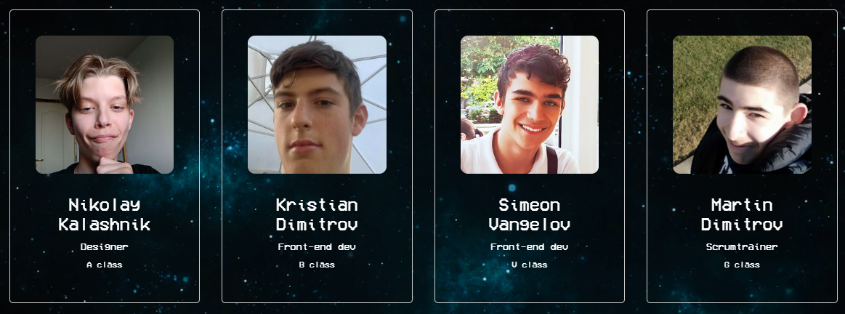
Team
02

Slide 5


Project Goal
03
Starlight, an advanced spacecraft, is on a groundbreaking mission to the interstellar star Proxima Centauri. Equipped with cutting-edge technology, it aims to deploy the three rovers on Proxima Centauri B to collect samples and conduct extensive research, pushing the boundaries of human exploration

Slide 6

Project Issues
04

Slide 7



Technologies
05

Slide 8
Conclusion
06

Slide 9

Thanks!
Do you have any questions?
Please keep this slide for attribution

