Slide 1

GEA1401 – ENVIRONMENTAL SCIENCE
IV year / VII Sem
CORAL BLEACHING EARLY – WARNING BUOY
(Batch - 4)
TEAM MEMBERS
AARTHI S (8115U23EC001)
BAVADHARANI P (8115U23EC008)
MADHUMITHA T (8115U23EC059)
MEERA B (8115U23EC062)
GUIDED BY,
Mr.R.BALAMURUGAN, M.E., (Ph.D).,
ASSISTANT PROFESSOR,
DEPARTMENT OF ECE, KRCE

Slide 2
CONTENTS
SDG MAPPING
ABSTRACT
PROBLEM STATEMENT
INTRODUCTION
PROPOSED SYSTEM
HARDWARE REQUIREMENTS
COST BREAKUP
BLOCK DIAGRAM
BLOCK SPECIFICATION
CIRCUIT DIAGRAM
WORKING PRINCIPLE
HARDWARE & SOFTWARE OUTPUT
RESULT AND DISCUSSIONS
FUTURE SCOPES
CONCLUSION
REFERENCES

Slide 3


SDG MAPPING
SDG 13 – CLIMATE ACTION
Monitors temperature variations associated with climate-induced coral stress.
Provides early-warning alerts for abnormal environmental conditions.
Supports timely climate-related conservation actions.
SDG 14 – LIFE BELOW WATER
Supports coral reef and marine biodiversity protection.
Enables continuous monitoring of underwater environmental conditions.
Helps identify potential coral bleaching risks at an early stage.

Slide 4
ABSTRACT
The Coral Bleaching Early-Warning Buoy is an IoT-based system designed to monitor water temperature and light intensity to identify potential coral bleaching risks.
Using ESP32, DS18B20, and LDR sensors, the system detects abnormal environmental conditions and provides alerts through a buzzer and LED.
Wi-Fi connectivity enables real-time remote monitoring, while solar power supports sustainable operation.
This project aims to protect coral reefs and marine biodiversity.

Slide 5
PROBLEM STATEMENT
Coral bleaching is a major threat to marine ecosystems, often caused by sudden changes in water temperature and light intensity.
Existing monitoring methods may lack continuous monitoring and real-time alerts, making early detection of coral stress difficult.
This creates a need for a Coral Bleaching Early-Warning Buoy to monitor environmental conditions continuously and provide timely alerts to support coral reef protection.

Slide 6
INTRODUCTION
Coral bleaching is a major threat to marine biodiversity, often caused by changes in water temperature and light intensity.
To address this issue, the proposed Coral Bleaching Early-Warning Buoy uses IoT technology to continuously monitor environmental conditions with sensors and a NodeMCU.
The system provides real-time alerts through a buzzer and LED indicators, with solar-powered backup and Wi-Fi monitoring for early detection and coral reef protection.

Slide 7
PROPOSED SYSTEM
Environmental Monitoring: Continuously monitor water temperature and light intensity using DS18B20 and LDR sensors.
Smart Control: Process sensor data through the NodeMCU microcontroller to identify abnormal environmental conditions.
Real-Time Alerts: Provide warnings through a buzzer and LED indicators, with remote monitoring using Wi-Fi connectivity.
Uninterrupted Power: Support continuous operation using a rechargeable battery and solar power system.

Slide 8
HARDWARE REQUIREMENTS
ESP8266 NodeMCU (Wi-Fi Microcontroller)
Temperature Sensor (Waterproof DS18B20)
Light Sensor (LDR)
Buzzer (Alert System)
LED Indicators (Red & Green)
Solar Panel (Power Generation)
Rechargeable Battery (Power Backup)
Voltage Regulator / Buck Converter (Power Supply Regulation)
Resistors (Current Limiting)
PCB / Breadboard
Connecting Wires

Slide 9
COST BREAKUP
Component (with Specification) | Qty | Estimated Cost (₹)
ESP8266 NodeMCU Wi-Fi Module | 1 | 300
DS18B20 Waterproof Temperature Sensor | 1 | 120
LDR Sensor Module | 1 | 35
Solar Panel (6V, 3W) | 1 | 230
Rechargeable Battery (3.7V, 2200mAh) | 1 | 250
Solar Charging Module | 1 | 100
Buck/Boost Converter | 1 | 100
Buzzer & LED Indicator | 1 | 50
PCB | 1 | 150
Waterproof Enclosure | 1 | 300
Connecting Wires & Accessories | As Required | 150
Total Estimated Cost | — | ₹1,785

Slide 10
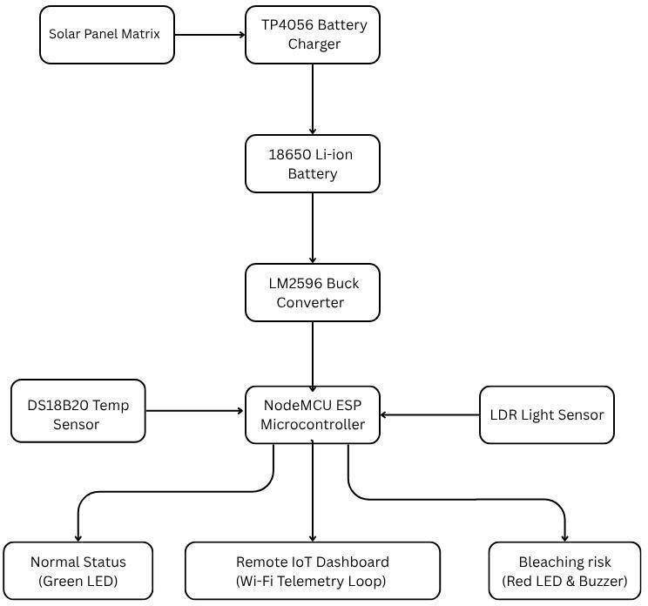
BLOCK DIAGRAM

Slide 11
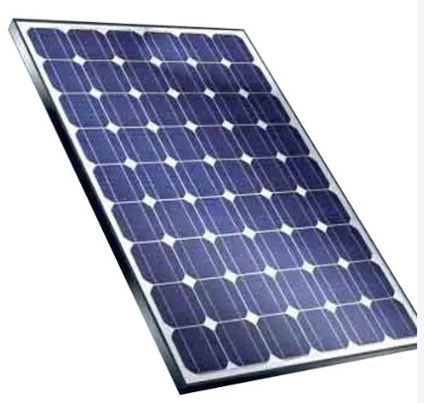
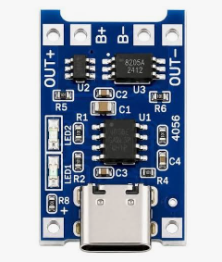
BLOCK SPECIFICATION
  SOLAR PANEL MATRIX:
  The Solar Panel Matrix converts sunlight into electrical energy to power the buoy system and support continuous operation through battery charging.
  TP4056 BATTERY CHARGER:
  Safely charges the rechargeable lithium-ion battery using a controlled charging circuit with overcharge protection.

Slide 12

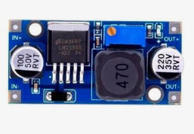
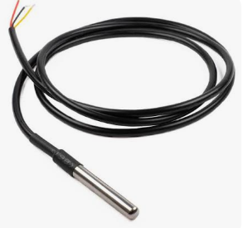
18650 Li-ion BATTERY:
  Stores electrical energy to provide backup power for continuous system operation.
LM2596 BUCK CONVERTER:
  Steps down the input DC voltage to a stable voltage required by the components.
DS18B20 TEMPERATURE SENSOR:
Measures water temperature to identify conditions that may cause coral bleaching.

Slide 13
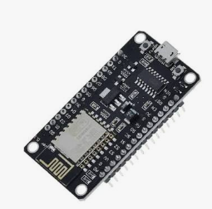
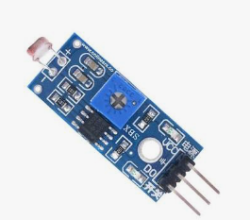
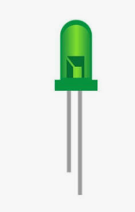
NodeMCU ESP8266 MICROCONTROLLER:
  Processes sensor data and sends monitoring information to the IoT dashboard through Wi-Fi.
LDR LIGHT SENSOR:
  Measures light intensity to monitor changes in the surrounding environment.
  GREEN LED:
  Indicates normal environmental conditions

Slide 14

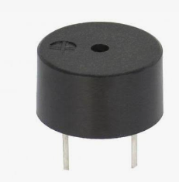
REMOTE IOT DASHBOARD:
  Displays real-time temperature and light intensity data for remote monitoring.
RED LED & BUZZER:
  Provide alerts when environmental parameters exceed the predefined safety limits.

Slide 15
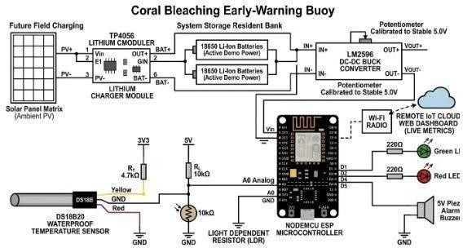
CIRCUIT DIAGRAM

Slide 16
WORKING PRINCIPLE
POWER SUPPLY: The 18650 Li-ion battery supplies power to the system, while the LM2596 buck converter provides the required regulated voltage.
TEMPERATURE MONITORING: The DS18B20 sensor continuously measures water temperature and sends the readings to the NodeMCU ESP8266.
LIGHT MONITORING: The LDR sensor measures the surrounding light intensity and sends the data to the microcontroller.

Slide 17
DATA PROCESSING: The NodeMCU processes both sensor readings and compares them with predefined threshold values to identify abnormal environmental conditions.
ALERT INDICATION: The green LED indicates normal conditions, while the red LED and buzzer are activated when the readings cross the set limits.
REMOTE MONITORING: The NodeMCU uses Wi-Fi to send real-time sensor data to the IoT dashboard, allowing users to monitor environmental changes remotely.

Slide 18
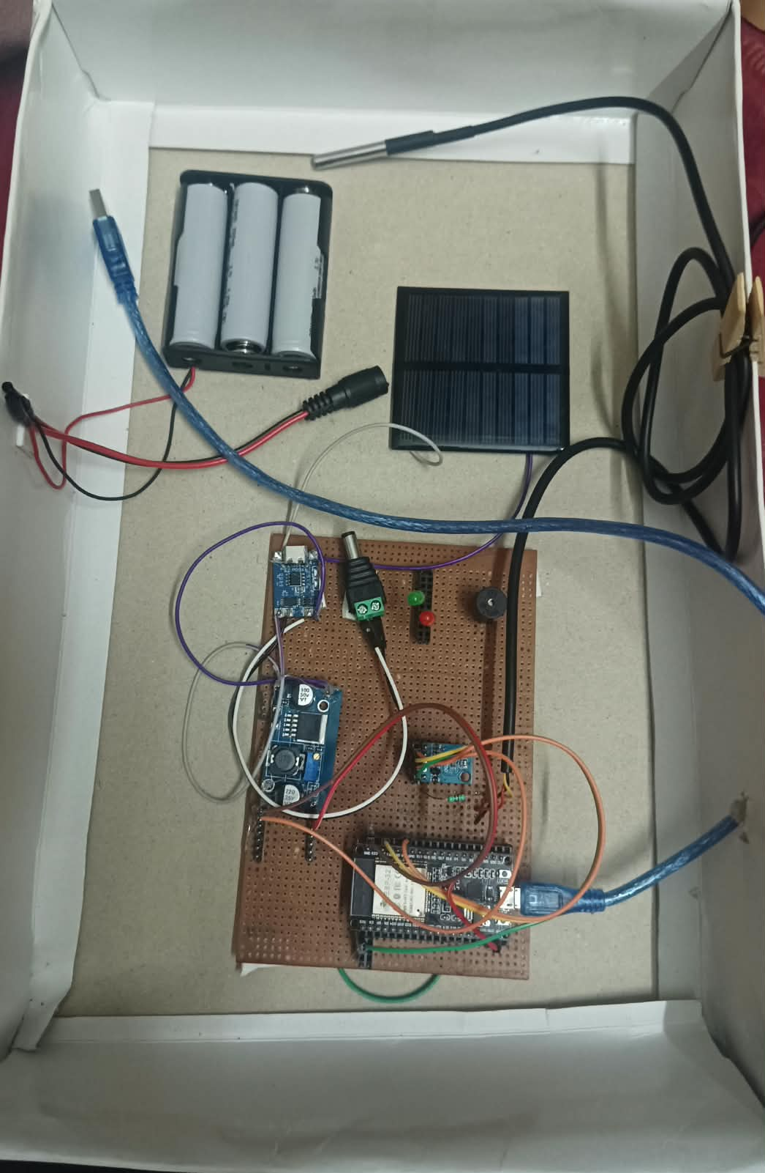
HARDWARE OUTPUT

Slide 19
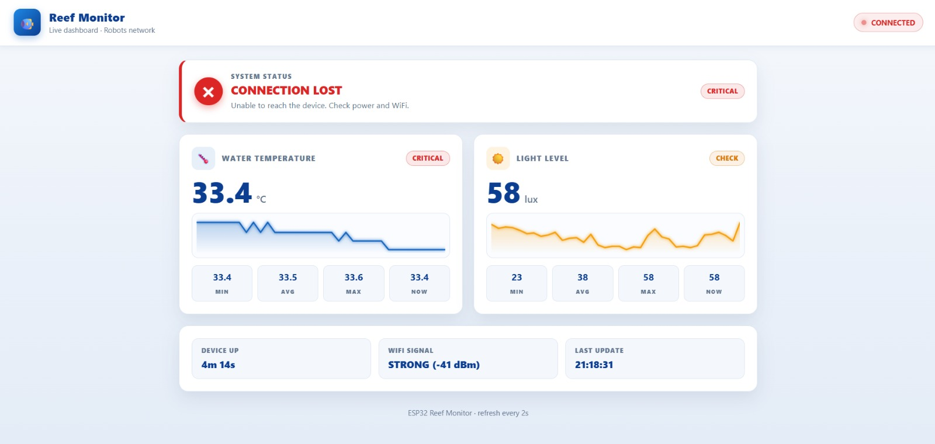
SOFTWARE OUTPUT

Slide 20
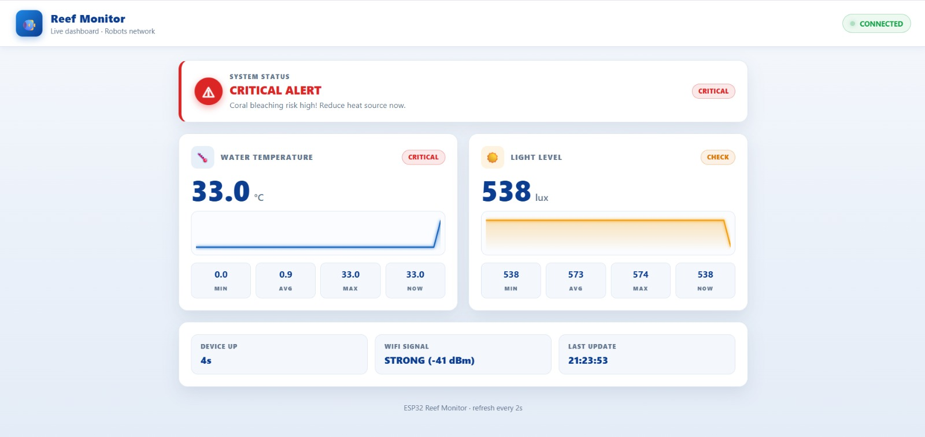
SOFTWARE OUTPUT

Slide 21
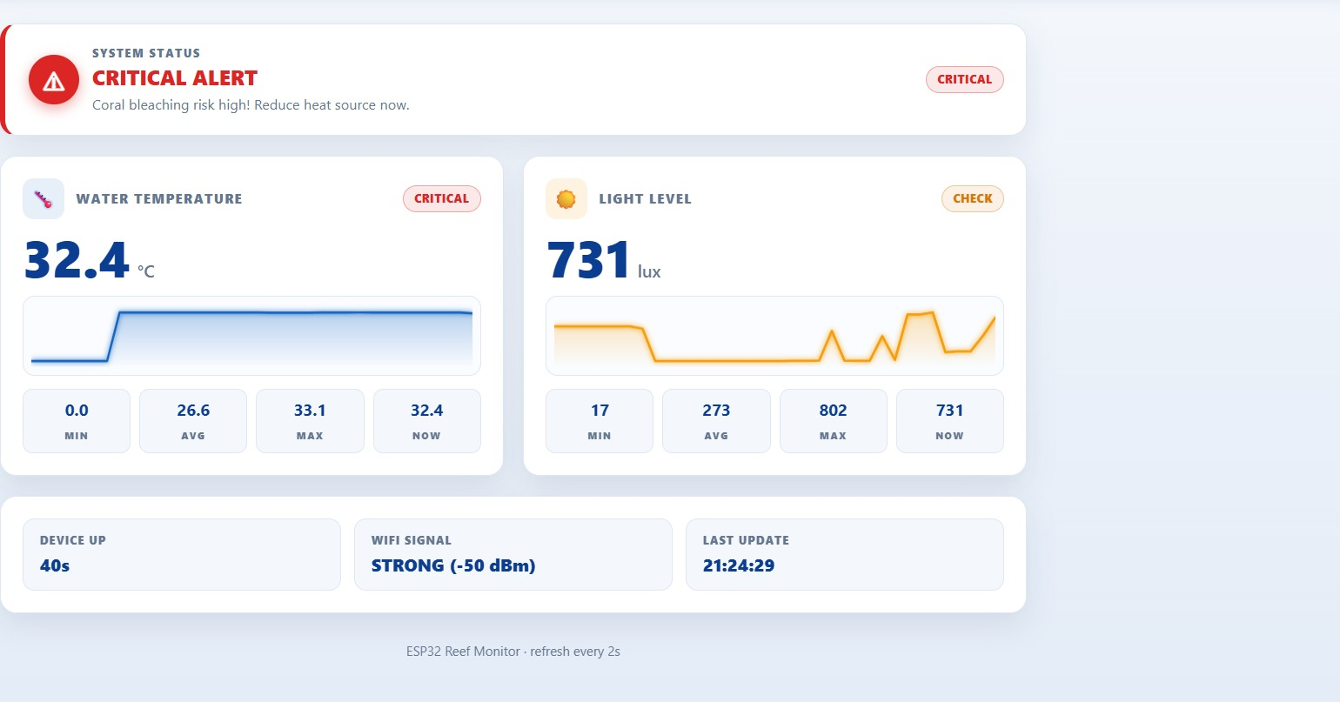
SOFTWARE OUTPUT

Slide 22
RESULT AND DISCUSSIONS
The DS18B20 sensor successfully monitors water temperature in real time.
The LDR sensor measures surrounding light intensity continuously.
The NodeMCU ESP8266 processes sensor data and identifies abnormal conditions.
The red LED and buzzer provide alerts, while the green LED indicates normal conditions.
The IoT dashboard displays real-time sensor readings, enabling remote monitoring and early detection of coral bleaching risks.

Slide 23
FUTURE SCOPES
AI-Based Prediction: Integrate machine learning to predict coral bleaching risks using environmental data.
Multiple Buoy Deployment: Install multiple buoys at different reef locations for wider monitoring.
Mobile Application: Develop a mobile app for instant alerts and remote access.
Advanced Sensors: Include pH, salinity and dissolved oxygen sensors for detailed water-quality monitoring.
Cloud Data Analysis: Store historical data in the cloud to analyse long-term environmental changes.

Slide 24
CONCLUSION
The Coral Bleaching Early-Warning Buoy continuously monitors water temperature and light intensity.
IoT technology enables real-time data collection and remote monitoring.
LED indicators and a buzzer provide immediate alerts during abnormal conditions.
Battery-powered operation supports continuous monitoring.
The system helps identify potential coral bleaching risks and supports marine ecosystem protection.

Slide 25
REFERENCES
Remote Sensing of Coral Bleaching Using Temperature and Light
https://www.mdpi.com/2072-4292/10/1/18
Design and Development of Low-Cost Coral Monitoring System
https://jtec.utem.edu.my/jtec/article/view/2406
A Novel Low-Cost, High-Precision Sea Temperature Sensor for Coral Reef Monitoring
https://repository.library.noaa.gov/view/noaa/27189
Wireless Sensor Networks for Coral Reef Monitoring
https://www.mdpi.com/1424-8220/11/7/6842

Slide 26


