Slide 1

ECB1411 – PROJECT WORK
PHASE 1 VIVA VOCE
DOMAIN –IMAGE PROCESSING
ELECTRONICS AND COMMUNICATION ENGINEERING
TITLE: D-FINE-BASED INTELLIGENT SURVEILLANCE VIDEO COMPRESSION USING ADAPTIVE MOTION ESTIMATION
GUIDED BY:
Dr. K. PRIYADARSHINI ,
PROFESSOR,
DEPARTMENT OF ECE, KRCE
TEAM MEMBERS
AFSHANA R (8115U23EC002)
DHARINI N (8115U23EC021)
KIRUBHA SHRIVAISHNAVI G (8115U23EC051)
MEERA B (8115U23EC062)
DATE : 02/11/2026

Slide 2
CONTENTS
ABSTRACT
INTRODUCTION
LITERATURE SURVEY
EXISTING SYSTEM
CHALLENGES IN EXISTING SYSTEM
SOFTWARE REQUIRED
PROPOSED SYSTEM
MODULE DESCRIPTION
CONCLUSION
FUTURE SCOPES
REFERENCES

Slide 3
ABSTRACT
Surveillance cameras records continuously, so storage and network bandwidth needs are very high. Codecs such as H.264 and H.265 treat every part of a frame the same way and spend many bits on static background.
This project pairs the D-FINE object detector with adaptive motion estimation. D-FINE finds persons and vehicles, and the boxes are turned into a Region of Interest (ROI) mask for every frame.
Object regions get small blocks and a wide search range to keep detail. Background regions get large blocks and a narrow search range for stronger compression.

Slide 4
INTRODUCTION
Video surveillance is widely used in traffic monitoring, public safety, and smart cities, and cameras record continuously.
Continuous recording creates huge volumes of video data, which increases storage and bandwidth cost.
Most surveillance footage contains static background, while only a small part (persons, vehicles) carries useful information.
Conventional codecs such as H.264 and H.265 compress every region of a frame in the same way, so bits are wasted on unimportant areas.
This project uses D-FINE object detection to find important objects and applies adaptive motion estimation, so object regions keep high quality and the background is compressed more.

Slide 5
LITERATURE SURVEY
S. No | Paper Title (With Citation) | Methodology | Advantages | Applications
1 | Overview of the H.264/AVC Video Coding Standard — T. Wiegand et al., IEEE Trans. Circuits Syst. Video Technol., 2003. | Block-based motion estimation and compensation with transform and entropy coding was used. | High compression efficiency with good quality. | Streaming, broadcasting, surveillance.
2 | Overview of the High Efficiency Video Coding (HEVC) Standard — G. J. Sullivan et al., IEEE Trans. Circuits Syst. Video Technol., 2012. | Larger coding tree units and flexible block partitioning were introduced. | About 50% lower bitrate than H.264 at similar quality. | High-resolution video storage and transmission.
3 | Overview of the Versatile Video Coding (VVC) Standard and its Applications — B. Bross et al., IEEE Trans. Circuits Syst. Video Technol., 2021. | Advanced partitioning and prediction tools were added over HEVC. | Further bitrate reduction over HEVC. | 4K/8K video, streaming.

Slide 6
S.No | Paper Title (With Citation) | Methodology | Advantages | Applications
4 | Motion-Vector-Driven Lightweight ROI Tracking for Real-Time Saliency-Guided Video Encoding — T. Partanen, M. Kotajärvi, A. Mercat, J. Vanne, EUSIPCO, 2024. | Encoder motion vectors are fed to a neural network that estimates ROI movement and size changes, so detection does not run on every frame. | Up to 50-fold speedup with 87% accuracy when tracking a single ROI with a 64-frame detection interval. | ROI-guided encoding, video conferencing, surveillance.
5 | FRVC: Frame Relevance Based Video Compression for Surveillance Videos Using Deep Learning Methods — Agrawal et al., PeerJ Computer Science, 2025. | Mask R-CNN and YOLOv9 detect relevant frames of surveillance video, and similarity analysis then builds the compressed video. | Compression of up to 96.3%, 99.9% and 63.3% in three scenarios, keeping the original resolution and frame rate. | CCTV and ATM surveillance storage.
6 | DVC: An End-to-End Deep Video Compression Framework — G. Lu et al., IEEE CVPR, 2019. | Learned optical flow gives motion information, and auto-encoders compress motion and residual, all trained jointly. | Outperforms H.264 in PSNR and is on par with H.265 in MS-SSIM. | Learning-based video compression.
2-Nov-26

Slide 7
S.No | Paper Title (With Citation) | Methodology | Advantages | Applications
7 | End-to-End Object Detection with Transformers (DETR) — N. Carion et al., ECCV, 2020. | A transformer encoder-decoder with object queries predicted objects directly. | Removes NMS and handcrafted components. | Object detection, scene understanding.
8 | DETRs Beat YOLOs on Real-time Object Detection (RT-DETR) — Y. Zhao et al., IEEE CVPR, 2024. | An efficient hybrid encoder was designed to make DETR run in real time. | Real-time speed with higher accuracy than YOLO models. | Real-time detection, video analytics.
9 | D-FINE: Redefine Regression Task in DETRs as Fine-grained Distribution Refinement — Y. Peng et al., arXiv:2410.13842, 2024. | FDR and GO-LSD were used for box regression. | Accurate localization at real-time speed. | Real-time detection, surveillance.

Slide 8
EXISTING SYSTEM
Standard codecs: H.264/AVC and H.265/HEVC are the most common in surveillance cameras. Each block is matched against a reference frame within a fixed search range.
Fast search: Diamond search cuts the number of search points and the encoding time, but it uses the same pattern for every block.
Detector-based work: Mask R-CNN and YOLO are used to drop irrelevant frames from long recordings.
ROI and learned coding: ROI-based coding and learned codecs such as DVC have been explored, but not combined with a real-time DETR-based detector to control block-level motion estimation.
Reference method: An existing YOLOv8-based compression method is compared with the proposed D-FINE method on the same test videos.

Slide 9
CHALLENGES IN EXISTING SYSTEM
Uniform treatment: Standard codecs handle object and background regions the same way, so many bits go to static background.
Fixed parameters: Block size and search range are the same across the whole frame, so computation is wasted on blocks with no motion.
Frame-level selection only: Detector-based methods decide which frames to keep, but inside kept frames objects and background are still compressed alike.
Loss of detail: At low bitrates, faces, number plates and other fine details of moving objects can lose clarity.
High storage and bandwidth cost: Continuous high-resolution recording is expensive to store and send.
Inconsistent saving: In our tests the YOLOv8-based method reduced only one of the four videos and made the other three larger.

Slide 10
SOFTWARE REQUIRED
 | SOFTWARE TOOLS
Programming language | Python | Implementation of the complete pipeline
Deep learning framework | PyTorch | Running the D-FINE model
Detection model | D-FINE (pretrained model) | Object detection and ROI generation
Image and video library | OpenCV | Frame reading, mask generation, visualization
Video encoding tool | FFmpeg (libx264) | Encoding of the compressed video
The whole pipeline runs in software with Python, PyTorch, OpenCV and FFmpeg, so no special hardware is needed.

Slide 11
PROPOSED SYSTEM
D-FINE detection: Finds persons, vehicles and other objects in every frame and returns boxes, class labels and confidence scores.
ROI mask: The boxes are turned into a mask, and every block of the frame is labelled as an object block or a background block.
Adaptive motion estimation: Object blocks use a small block size and a wide search range. Background blocks use a large block size and a narrow search range.
Encoding: Motion vectors and residuals are entropy coded, and the video is written as H.264 with FFmpeg.
Why D-FINE: It runs in real time, localizes boxes precisely through FDR and GO-LSD, and needs no non-maximum suppression.

Slide 12
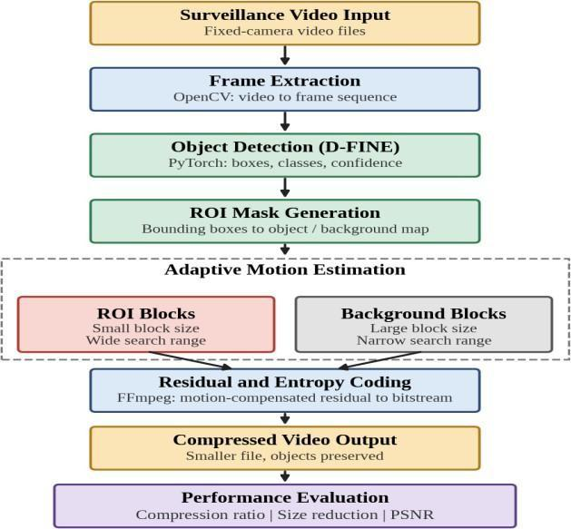
FLOW DIAGRAM
The surveillance video is read and split into frames with OpenCV.
Each frame goes to the D-FINE detector, which returns bounding boxes, class labels and confidence scores.
The boxes become an ROI mask. Adaptive motion estimation uses it to pick the block size and search range for every block.
Motion vectors and residuals are entropy coded with FFmpeg to produce the compressed video.
The output is evaluated with compression ratio, size reduction and PSNR.
Flow diagram of the proposed system

Slide 13
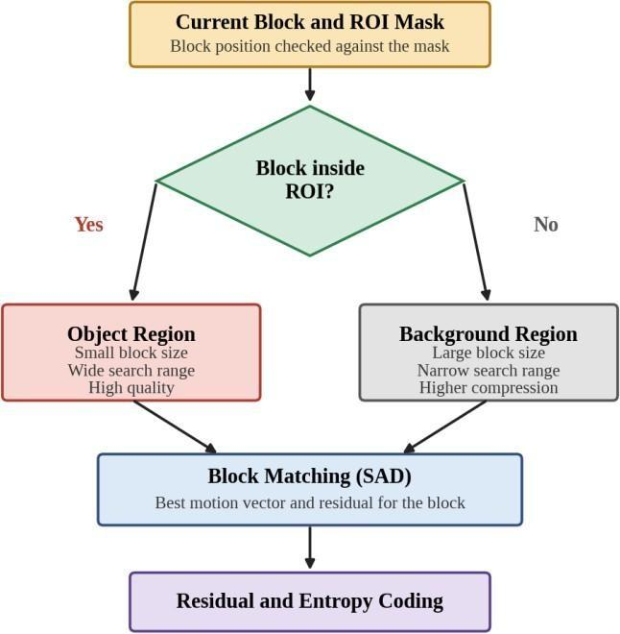
ADAPTIVE MOTION ESTIMATION
Every block is checked against the ROI mask. A block inside the ROI gets a small block size and a wide search range. A block outside gets a large block size and a narrow search range. Either way, the best match is found by block matching, and the motion vector and residual go to the encoder.
Region | Block Size | Search Range | Objective
Object (ROI) blocks | Small (fine) | Wide | High accuracy and quality
Background blocks | Large (coarse) | Narrow | Higher compression, lower computation

Slide 14
MODULE DESCRIPTION
1. Video Input and Frame Extraction Module
Reads the fixed-camera surveillance video frame by frame with OpenCV and notes its frame rate, resolution and duration.
S. No. | Input video filename | Video format | Duration (seconds) | Resolution (pixels) | Frame rate (FPS)
1 | not_shoplifting1.mp4 | MP4 | 6 | 544 × 544 | 24
2 | not_shoplifting2.mp4 | MP4 | 6 | 544 × 544 | 24
3 | not_shoplifting3.mp4 | MP4 | 6 | 544 × 544 | 24
4 | not_shoplifting4.mp4 | MP4 | 6 | 544 × 544 | 24

Slide 15
MODULE DESCRIPTION
2. D-FINE Object Detection Module
The Pretrained D-FINE object detection model to identify and locate important objects in the input video frames.
It detects objects such as people and generates
bounding boxes
class labels
confidence scores.
Stages | Processing stage | Description
1 | Model loading | Load the pretrained D-FINE model.
2 | Frame input | Receive preprocessed video frames.
3 | Object detection | Detect people and other relevant objects.
4 | Bounding box generation | Mark detected object locations.
5 | Result visualization | Display object labels and confidence scores.
6 | Output generation | Save object detection results and videos.

Slide 16
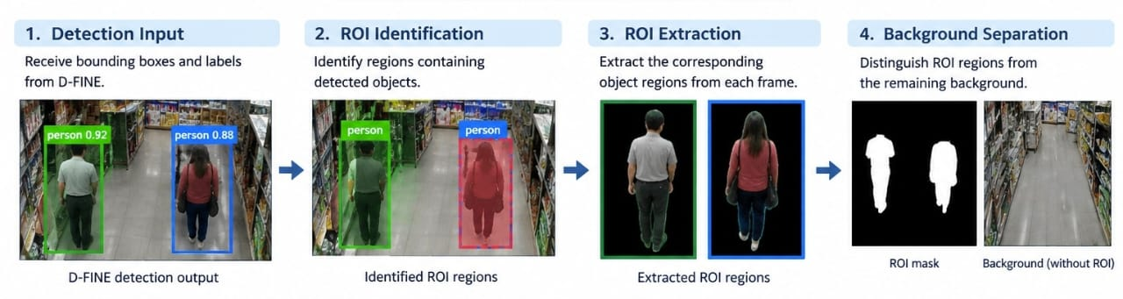
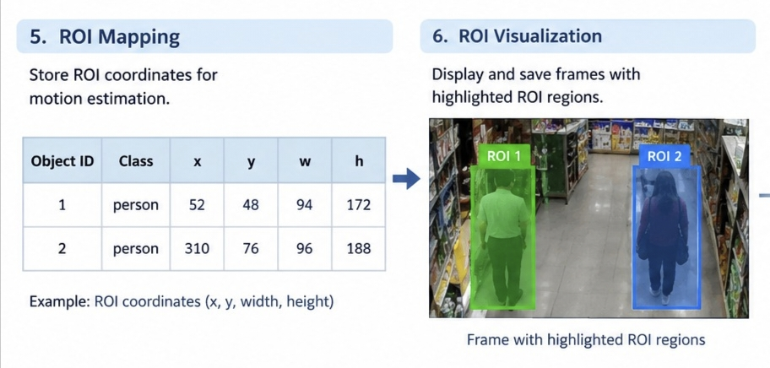
MODULE DESCRIPTION
3. ROI Mask Generation Module
Receives D-FINE detection results.
Identifies important object regions.
Extracts detected object areas.
Separates objects from the background.
Stores ROI coordinates.
Highlights ROIs in video frames.

Slide 17
MODULE DESCRIPTION
4. Adaptive Motion Estimation Module
Frame Input: Receives consecutive video frames and ROI data.
Motion Detection: Identifies object movement between frames.
Motion Vector Calculation: Calculates the direction and distance of movement.
Adaptive Estimation: Applies suitable motion estimation based on ROI and background regions.
Motion Compensation: Reduces differences between consecutive frames.
Output Generation: Produces motion-compensated frames for compression.

Slide 18
MODULE DESCRIPTION
5. Residual Generation and Adaptive Video Generation Module
Compares original and motion-compensated frames.
Calculates differences between the frames.
Preserves important object details.
Applies higher compression to less important regions.
Adjusts compression based on ROI and background regions.
Reconstructs the compressed video frames.
Frame Comparison
Residual Generation
ROI Processing
Background Compression
Adaptive Compression
Video Reconstruction

Slide 19
MODULE DESCRIPTION
6. Performance Evaluation Module
Video Comparison: Compares original and compressed videos.
PSNR Calculation: Measures video quality after compression.
SSIM Calculation: Evaluates structural similarity between frames.
Compression Ratio: Measures reduction in video file size.
Processing Time: Records the time taken for compression.
Performance Analysis: Compares conventional and D-FINE-based adaptive methods.
PSNR – Peak Signal to Noise Ratio
SSIM– Structural Similarity Index Measure

Slide 20
PERFORMANCE PARAMETERS
Table 4.1 Details of the test videos
Video | File Name | Original Size (MB)
Video 1 | not_shoplifting1.mp4 | 0.9434
Video 2 | not_shoplifting2.mp4 | 1.6120
Video 3 | not_shoplifting3.mp4 | 1.3040
Video 4 | not_shoplifting4.mp4 | 1.0636
Total |  | 4.9230
Each video was compressed by both methods, and the compressed video was compared with the original in file size and PSNR.

Slide 21
PERFORMANCE METRICS
Compression Ratio = Original Size / Compressed Size
Size Reduction (%) = (1 − Compressed Size / Original Size) × 100
A negative size reduction means the output file is larger than the input file.
PSNR = 10 log10 ( MAX² / MSE )
Pixel-level difference between the original and compressed frames, in dB. A higher value means a closer reconstruction. MAX is the maximum pixel value and MSE is the mean squared error.
SSIM(x, y) = [(2μxμy + C1)(2σxy + C2)] / [(μx² + μy² + C1)(σx² + σy² + C2)]
Compares luminance, contrast and structure. The value lies between 0 and 1, and a value near 1 means the frames are almost identical. μ is the mean, σ² the variance, σxy the covariance, and C1, C2 are small constants that avoid division by zero.
SAD(dx, dy) = Σ Σ | C(i, j) − R(i + dx, j + dy) |
C is the current block, R is the reference frame and (dx, dy) is a candidate displacement. A larger search range and a smaller block improve prediction but raise computation and the number of motion vectors.

Slide 22
SIZE REDUCTION RESULTS
Video | Method | Original Size (MB) | Compressed Size (MB) | Size Reduction (%) | Compression Ratio
not_shoplifting1.mp4 | Existing (YOLOv8) | 0.9434 | 0.8960 | 5.05 | 1.05
 | Proposed (D-FINE) | 0.9434 | 0.1174 | 87.556 | 8.04
not_shoplifting2.mp4 | Existing (YOLOv8) | 1.6120 | 2.1180 | -31.38 | 0.76
 | Proposed (D-FINE) | 1.6120 | 0.3188 | 80.226 | 5.06
not_shoplifting3.mp4 | Existing (YOLOv8) | 1.3040 | 2.2040 | -68.99 | 0.59
 | Proposed (D-FINE) | 1.3040 | 0.2293 | 82.416 | 5.69
not_shoplifting4.mp4 | Existing (YOLOv8) | 1.0636 | 1.4920 | -40.26 | 0.71
 | Proposed (D-FINE) | 1.0636 | 0.1987 | 81.316 | 5.35
Proposed method: size reduction of 80.226% to 87.556% on all four videos, with a compression ratio of 5.06 to 8.04.
Existing method: Video 1 shrinks by only 5.05%, and Videos 2, 3 and 4 come out larger than the original (−31.38%, −68.99%, −40.26%).

Slide 23
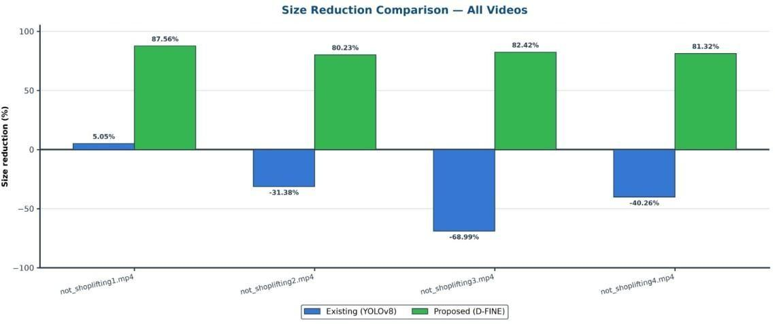
SIZE REDUCTION COMPARISON
The proposed D-FINE method (green bars) gives a size reduction of 87.56%, 80.23%, 82.42% and 81.32% for the four videos.
The existing YOLOv8 method (blue bars) gives only 5.05% for Video 1, and the bars for Videos 2, 3 and 4 lie below zero, which means the output file is larger than the original.
The proposed method saves storage for every video, whereas the existing method does not.

Slide 24
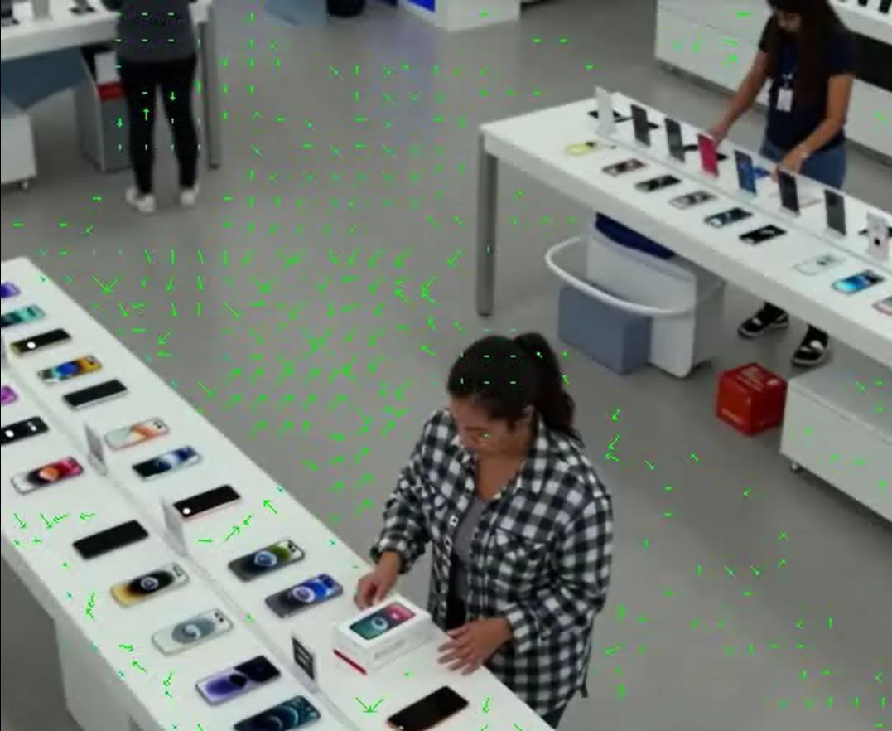
MOTION VECTOR OUTPUT
Green arrows show block movement between frames.
Arrow length and direction indicate displacement.
More vectors appear around the moving person.
Vectors help predict frames, reducing residual data.

Slide 25
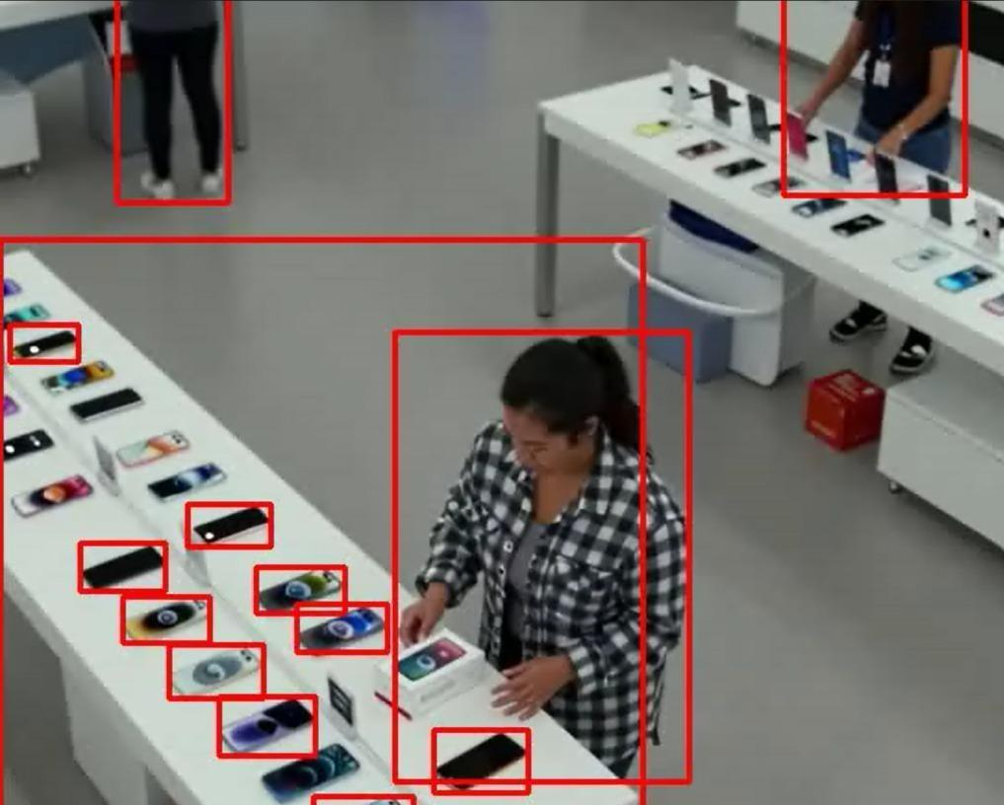
D-FINE DETECTION OUTPUT
Red boxes show D-FINE detected objects.
Detected regions form the ROI mask.
ROIs use smaller blocks and wider search ranges.
Background uses larger blocks and narrower search ranges.

Slide 26
QUALITY METRICS: PSNR AND SSIM
Video | Method | PSNR (dB) | SSIM
not_shoplifting1.mp4 | Existing (YOLOv8) | 35.1620 | N/A
 | Proposed (D-FINE) | 36.7985 | 0.963371
not_shoplifting2.mp4 | Existing (YOLOv8) | 31.9720 | N/A
 | Proposed (D-FINE) | 32.7761 | 0.966796
not_shoplifting3.mp4 | Existing (YOLOv8) | 32.3320 | N/A
 | Proposed (D-FINE) | 33.8115 | 0.967573
not_shoplifting4.mp4 | Existing (YOLOv8) | 33.7350 | N/A
 | Proposed (D-FINE) | 34.5551 | 0.962830
Average | Existing (YOLOv8) | 33.30 | N/A
 | Proposed (D-FINE) | 34.49 | 0.9651
The proposed PSNR is higher for every video, with a gain of 0.80 dB to 1.64 dB and an average gain of 1.19 dB.
The proposed SSIM is above 0.96 for all videos.

Slide 27
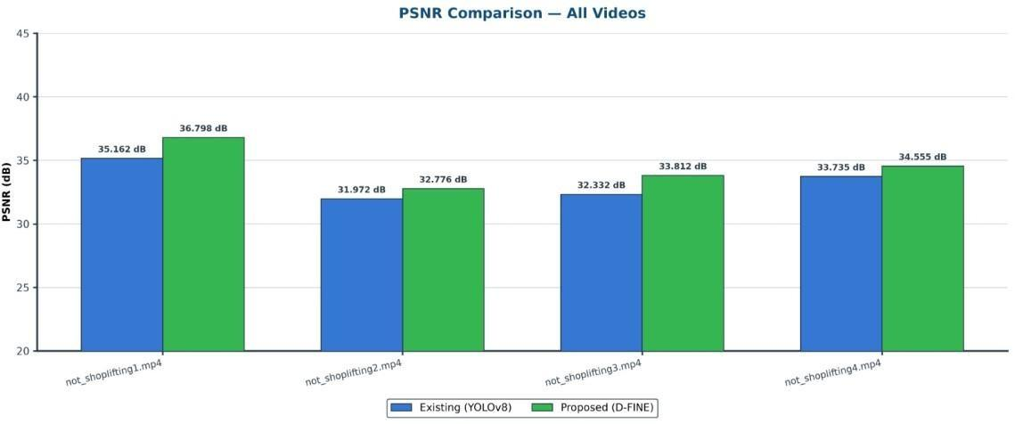
PSNR COMPARISON
The proposed method gives a higher PSNR than the existing method for all four videos:
36.80 dB against 35.16 dB for Video 1
32.78 dB against 31.97 dB for Video 2
33.81 dB against 32.33 dB for Video 3
34.56 dB against 33.74 dB for Video 4
The average is 34.49 dB for the proposed method and 33.30 dB for the existing one.

Slide 28
OVERALL COMPARISON SUMMARY
Parameter | Existing (YOLOv8) | Proposed (D-FINE)
Number of videos | 4 | 4
Total original size (MB) | 4.9230 | 4.9230
Total compressed size (MB) | 6.7100 | 0.8642
Overall size reduction (%) | -36.30 | 82.45
Average size reduction (%) | -33.90 | 82.879
Overall compression ratio | 0.73 | 5.70
Average PSNR (dB) | 33.30 | 34.49
Average SSIM | N/A | 0.9651
The four original videos total 4.9230 MB.
The existing method raises this to 6.7100 MB, an increase of 36.30%.
The proposed method brings it down to 0.8642 MB, an overall reduction of 82.45%.

Slide 29
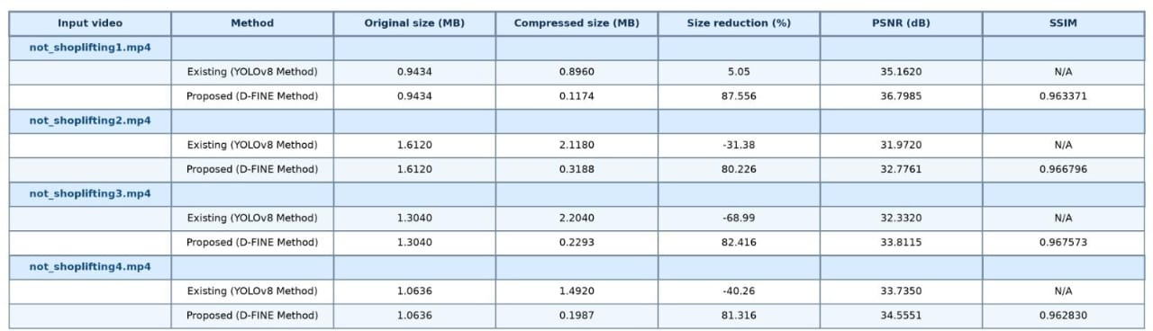
OVERALL PERFORMANCE

Slide 30
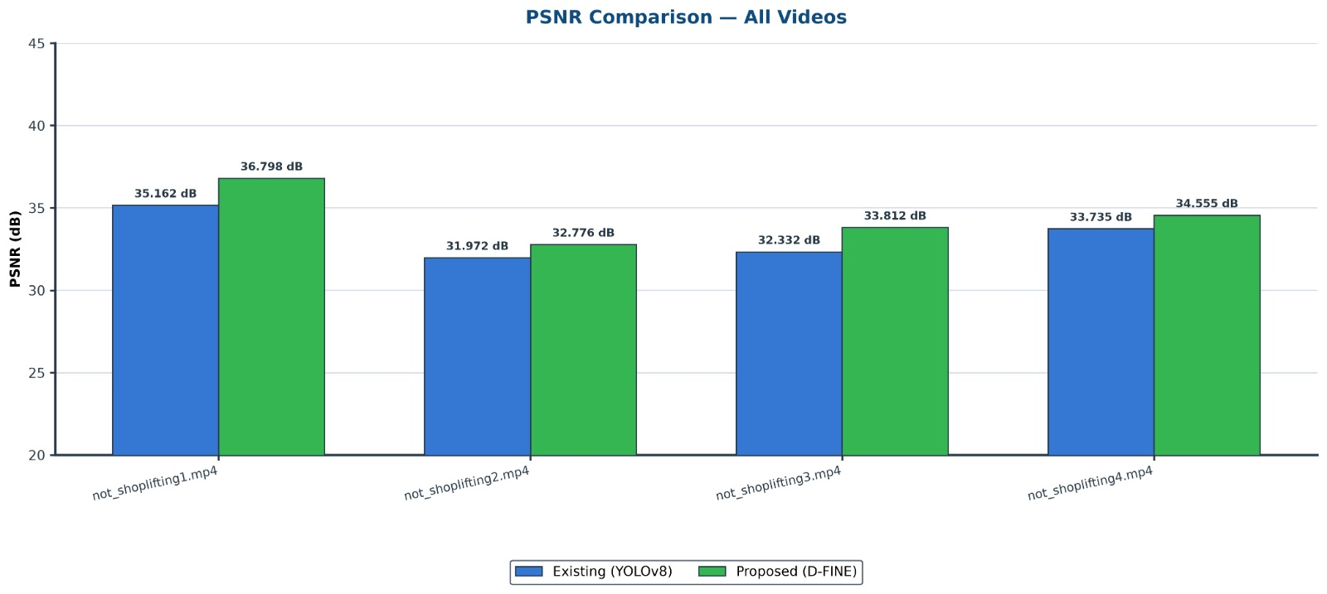
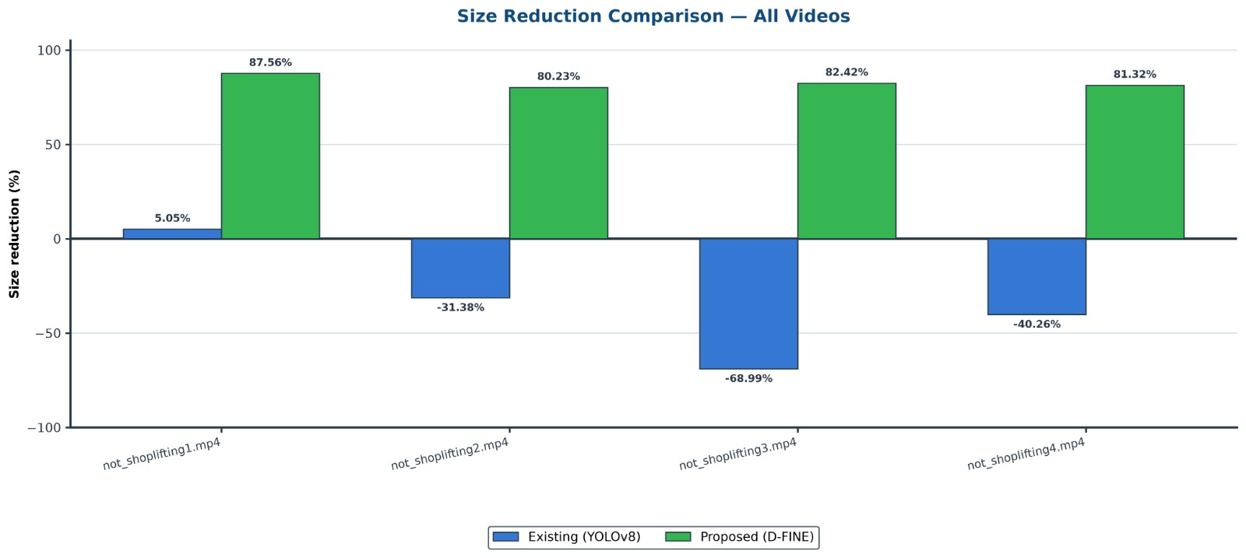
OVERALL PERFORMANCE
Average size reduction of the proposed method: 82.879%.
The Average PSNR of the proposed method : 34.485 dB.

Slide 31
LIMITATIONS
Depends on the detector: An object that is missed is treated as background and may lose some quality.
Fixed cameras: The approach is designed for fixed-camera surveillance, where the background is largely static. It may give smaller gains for moving cameras.
SSIM comparison: SSIM was computed only for the proposed method, so the structural similarity of the two methods could not be compared directly.
Possible fix: A lower confidence threshold and simple motion cues can reduce the effect of missed detections.

Slide 32
CONCLUSION
The D-FINE based system gives a content-aware answer to the storage and bandwidth problem of continuous surveillance. D-FINE finds the important objects and builds an ROI mask for every frame.
Guided by the mask, object regions use small blocks and a wide search range, while background regions use large blocks and a narrow search range.
On four surveillance videos, file size fell by 80.23% to 87.56% (average 82.879%). The YOLOv8-based method reduced only one video, by 5.05%, and made the other three larger.
Average PSNR was 34.49 dB against 33.30 dB, and average SSIM was 0.9651, so quality held up even at a size reduction above 80%.
The framework runs fully in software (Python, PyTorch, OpenCV, FFmpeg), which makes it practical without special hardware.

Slide 33
FUTURE SCOPE
The system can be extended with RF-DETR to improve performance and prepare it for real deployment.
Edge deployment: Run on edge devices and embedded cameras so compression happens close to the source and upload bandwidth drops.
Multi-camera and live streaming: Support several cameras and live streams, with detection and encoding running in parallel.
Class-based priority: Give persons a higher quality level than vehicles or other objects.
ROI tracking: Use object tracking or motion-vector based ROI tracking so the detector does not have to run on every frame.
Modern codecs: Combine the method with HEVC, VVC or learning-based codecs for higher compression efficiency.
Wider testing: Test on larger and more varied datasets, including night-time and low-light video, and extend the evaluation with bitrate, encoding time and SSIM of the existing method.

Slide 34
REFERENCES
[1] T. Wiegand, G. J. Sullivan, G. Bjøntegaard and A. Luthra, “Overview of the H.264/AVC Video Coding Standard,” IEEE Transactions on Circuits and Systems for Video Technology, vol. 13, no. 7, pp. 560–576, Jul. 2003.
[2] G. J. Sullivan, J.-R. Ohm, W.-J. Han and T. Wiegand, “Overview of the High Efficiency Video Coding (HEVC) Standard,” IEEE Transactions on Circuits and Systems for Video Technology, vol. 22, no. 12, pp. 1649–1668, Dec. 2012.
[3] B. Bross et al., “Overview of the Versatile Video Coding (VVC) Standard and its Applications,” IEEE Transactions on Circuits and Systems for Video Technology, vol. 31, no. 10, pp. 3736–3764, Oct. 2021.
[4] S. Zhu and K.-K. Ma, “A New Diamond Search Algorithm for Fast Block-Matching Motion Estimation,” IEEE Transactions on Image Processing, vol. 9, no. 2, pp. 287–290, Feb. 2000.
[5] T. Partanen, M. Kotajärvi, A. Mercat and J. Vanne, “Motion-Vector-Driven Lightweight ROI Tracking for Real-Time Saliency-Guided Video Encoding,” in Proc. European Signal Processing Conference (EUSIPCO), 2024, pp. 521–525.

Slide 35
REFERENCES
[5] T. Partanen, M. Kotajärvi, A. Mercat and J. Vanne, “Motion-Vector-Driven Lightweight ROI Tracking for Real-Time Saliency-Guided Video Encoding,” in Proc. European Signal Processing Conference (EUSIPCO), 2024, pp. 521–525.
[6] Agrawal et al., “FRVC: Frame Relevance Based Video Compression for Surveillance Videos Using Deep Learning Methods,” PeerJ Computer Science, vol. 11, e3155, 2025.
[7] G. Lu, W. Ouyang, D. Xu, X. Zhang, C. Cai and Z. Gao, “DVC: An End-to-End Deep Video Compression Framework,” in Proc. IEEE/CVF Conference on Computer Vision and Pattern Recognition (CVPR), 2019.
[8] N. Carion, F. Massa, G. Synnaeve, N. Usunier, A. Kirillov and S. Zagoruyko, “End-to-End Object Detection with Transformers,” in Proc. European Conference on Computer Vision (ECCV), 2020.
[9] Y. Zhao et al., “DETRs Beat YOLOs on Real-time Object Detection,” in Proc. IEEE/CVF Conference on Computer Vision and Pattern Recognition (CVPR), 2024.
[10] Y. Peng et al., “D-FINE: Redefine Regression Task in DETRs as Fine-grained Distribution Refinement,” arXiv:2410.13842, 2024.

Slide 36


