Slide 1


K.RAMAKRISHNAN COLLEGE OF ENGINEERING
(AUTONOMOUS)
ECB1323 - ANTENNA AND MILLIMETER WAVE COMMUNICATION
Design and Analysis of Dual-Band Podium-Shaped Microstrip Patch Antenna for n78 and n46 band applications
TEAM MEMBERS :
AARTHI S – 8115U23EC001
MADHUMITHA T – 8115U23EC059
MARIYAYEE L – 8115U23EC061
MEERA B – 8115U23EC062
GUIDED BY :
Dr.G.Kalpanadevi M.E.,Ph.D.,
Associate Professor

Slide 2
OVERVIEW
Abstract
Introduction
Applications
Literature review
Objective
Proposed method
Design diagram with dimensions
Design Specifications
Design diagram with dimensions
Design and analysis
Simulation results
Conclusion
Future scope
References

Slide 3
ABSTRACT
This work presents the design and analysis of a dual-band podium-shaped microstrip patch antenna operating at 3.5 GHz and 5.3 GHz.
The 3.5 GHz frequency corresponds to Sub-6 GHz 5G (n78 band) supporting enhanced mobile broadband (eMBB), while the 5.3 GHz band is used for n46 band for WLAN applications.
The podium-shaped geometry generates dual resonant frequencies within a compact structure. The antenna achieves return loss (S11 < -10 dB) and VSWR ≤ 2 at both operating frequencies, along with a stable radiation pattern and moderate gain.

Slide 4
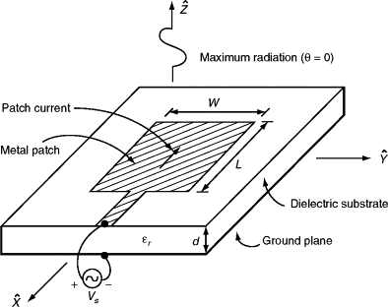
INTRODUCTION
MICROSTRIP PATCH ANTENNA
A microstrip patch antenna consists of a conducting patch, dielectric substrate, and ground plane
The antenna radiates due to fringing fields at the patch edges
Operates effectively in the 3–6 GHz frequency range, suitable for modern wireless systems
Supports planar structure, making it ideal for compact RF designs

Slide 5
PODIUM SHAPED
A rectangular microstrip patch gives only single resonance
Required operation at 3.5 GHz and 5.3 GHz needs dual-band behavior
The podium-shaped geometry modifies the current distribution on the patch
Creates different effective current path lengths
These paths produce two resonant frequencies within the same structure
Achieves dual-band operation without increasing antenna size

Slide 6
APPLICATIONS
Sub-6 GHz 5G (3.5 GHz – n78 band)
→ Used for enhanced mobile broadband (eMBB)
→ Supports high data rate, video streaming, and smart devices
n46 band (5.3 GHz band)
→ Enables high-speed indoor wireless communication
Dual-band wireless devices
→ Supports both 5G and Wireless apploiactions in a single antenna

Slide 7
LITERATURE REVIEW
S.No | Author (Year) | Technique Used | Key Inference | Limitation (Existing Work) | Proposed Work Advantage
1 | Kumar (2020) | Slot-loaded patch | Achieves dual-band operation | Increased design complexity | Simple podium geometry
2 | Singh (2021) | DGS | Improves bandwidth | Difficult fabrication | Easy PCB implementation
3 | Lee (2019) | Compact patch | Reduces antenna size | Low gain | Better radiation performance
4 | Sharma (2022) | Fractal geometry | Enables multiband operation | Complex structure | Simple geometry design
5 | Patel (2023) | Modified patch | Covers 5G & WLAN bands | Larger size | More compact design

Slide 8
LITERATURE REVIEW
S.No | Author (Year) | Technique Used | Key Inference | Limitation (Existing Work) | Proposed Work Advantage
6 | Zhang (2021) | Slot technique | Dual-band achieved | Matching issues | Improved S11 (< -10 dB)
7 | Ahmed (2020) | Compact design | Size reduction achieved | Limited bandwidth | Effective dual-band
8 | Rao (2022) | Stub-loaded patch | Multiband operation | Moderate matching | Better impedance matching
9 | Kim (2023) | High gain design | Improved gain | Increased size | Compact structure
10 | Verma (2021) | Fractal antenna | Wide frequency coverage | Complex fabrication | Simple podium structure

Slide 9
OBJECTIVE
To design a podium-shaped microstrip patch antenna for dual-band operation at 3.5 GHz (n78 band) and 5.3 GHz (n46 band)
To achieve good impedance matching (S11 < -10 dB) and stable radiation characteristics in a compact structure

Slide 10
PROPOSED METHOD
To propose a podium-shaped microstrip patch antenna for dual-band operation at 3.5 GHz and 5.3 GHz. The design uses a stepped geometry to create multiple current paths, resulting in dual resonance within a compact structure.
The antenna achieves good impedance matching (S11 < -10 dB) and maintains VSWR ≤ 2, with stable radiation characteristics, ensuring effective dual-band performance.

Slide 11
DESIGN SPECIFICATIONS
Antenna Type: Podium-shaped Microstrip Patch Antenna
Substrate: FR4 (εr = 4.4, thickness = 1.6 mm)
Conducting Material: Copper used for both patch and ground plane
Feeding Method: Microstrip line feed for proper impedance matching
Operating Frequencies: 3.5 GHz and 5.3 GHz
Application Bands: Sub-6 GHz 5G n78 band and n46 bands.

Slide 12
DESIGN DIAGRAM WITH DIMENSIONS
S.No | Parameter Description | Value (mm)
1 | Top patch width | 13 mm
2 | Left step horizontal length | 20 mm
3 | Right step horizontal length | 16 mm
4 | Left vertical height | 35 mm
5 | Right vertical height | 25 mm
6 | Bottom left horizontal length | 20 mm
7 | Bottom right horizontal length | 15 mm
8 | Feed line width | 10 mm
9 | Feed line length | 10 mm
10 | Feed connection width (top) | 13 mm

Slide 13
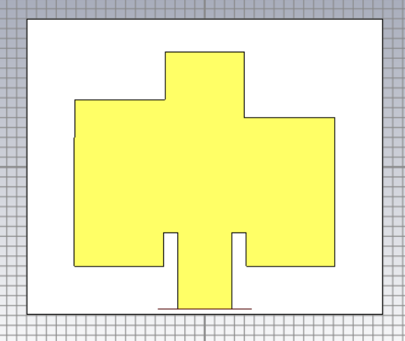
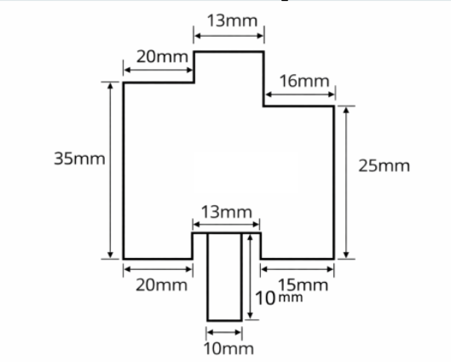
DESIGN DIAGRAM

Slide 14
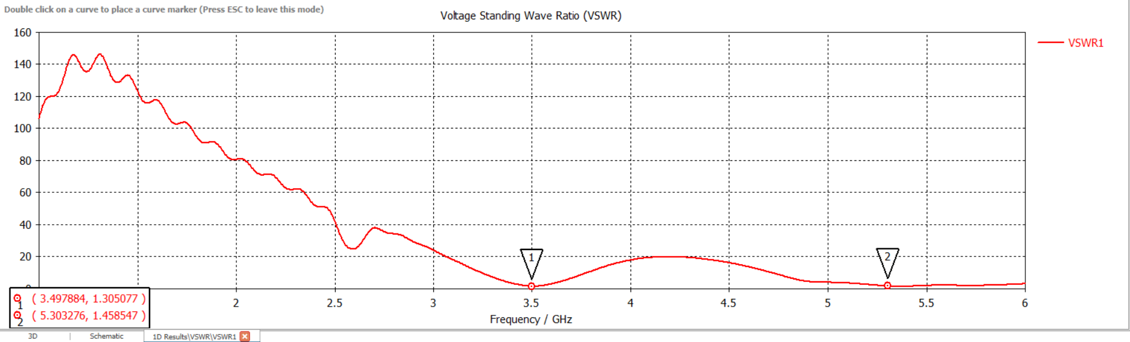
SIMULATION RESULTS
VSWR
S.No | Frequency (GHz) | VSWR Value
1 | 3.50 | 1.30
2 | 5.30 | 1.46

Slide 15
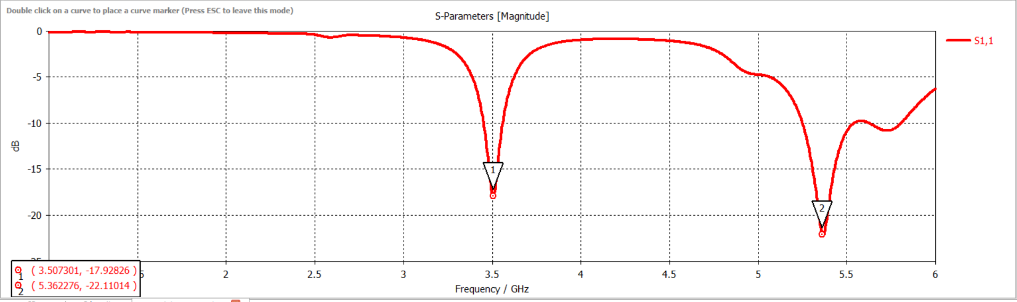
SIMULATION RESULTS
S-PARAMETERS
S.No | Frequency (GHz) | S11 (dB)
1 | 3.50 | -17.93 dB
2 | 5.36 | -22.11 dB

Slide 16
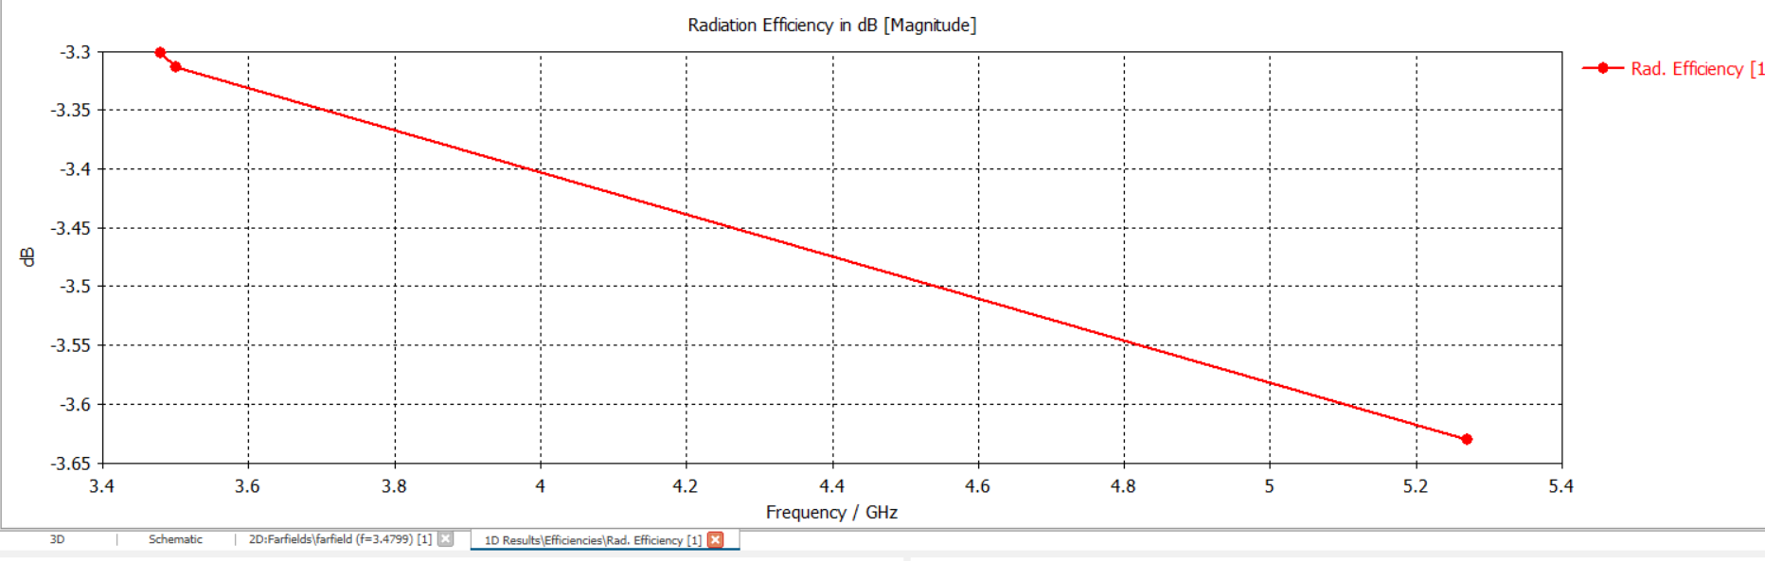
SIMULATION RESULTS
RADIATION EFFICIENCY
S.No | Frequency (GHz) | Radiation Efficiency (dB)
1 | 3.50 | -3.30 dB
2 | 5.30 | -3.63 dB

Slide 17
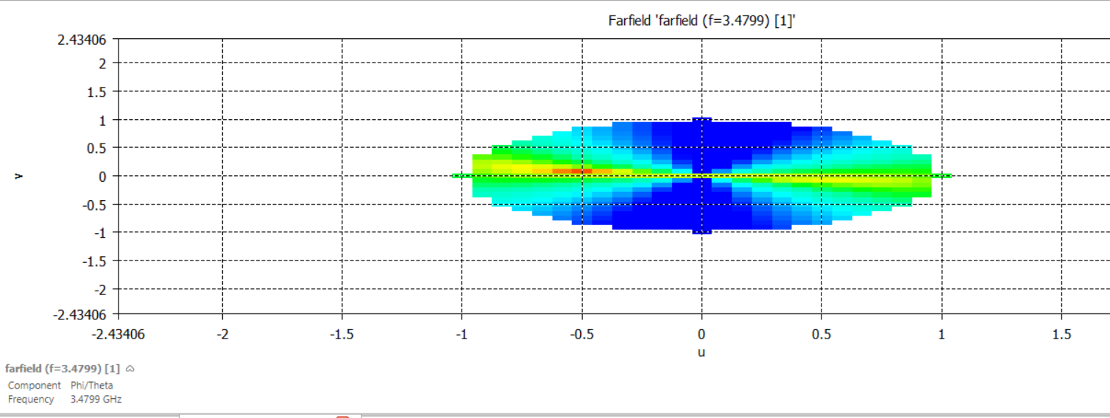
SIMULATION RESULTS
RADIATION PATTERN - FARFIELD (2D)
Parameter | Value
Frequency | 3.48 GHz & 5.30 GHz
Radiation Type | Broadside
Pattern Shape | Nearly Omnidirectional
Main Lobe Direction | Normal to patch (0°)

Slide 18
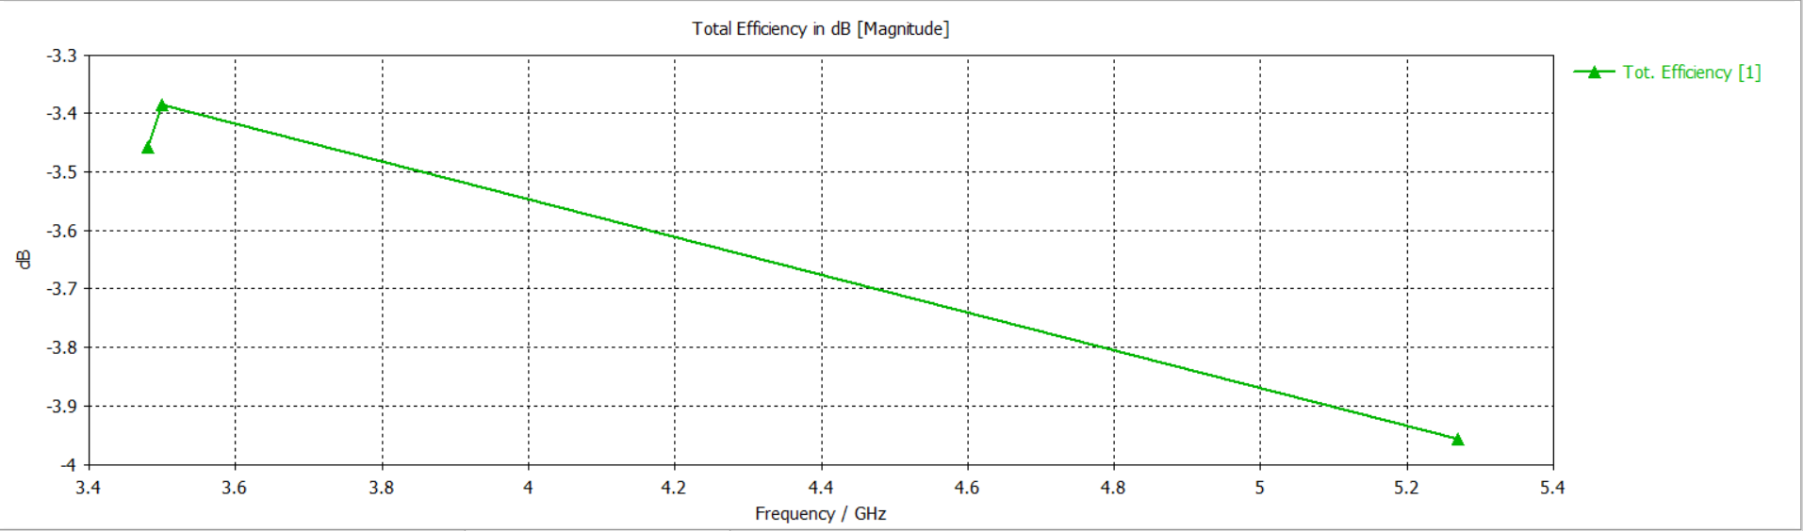
SIMULATION RESULTS
TOTAL EFFICIENCY
S.No | Frequency (GHz) | Total Efficiency (dB)
1 | 3.50 | -3.40 dB
2 | 5.30 | -3.95 dB

Slide 19
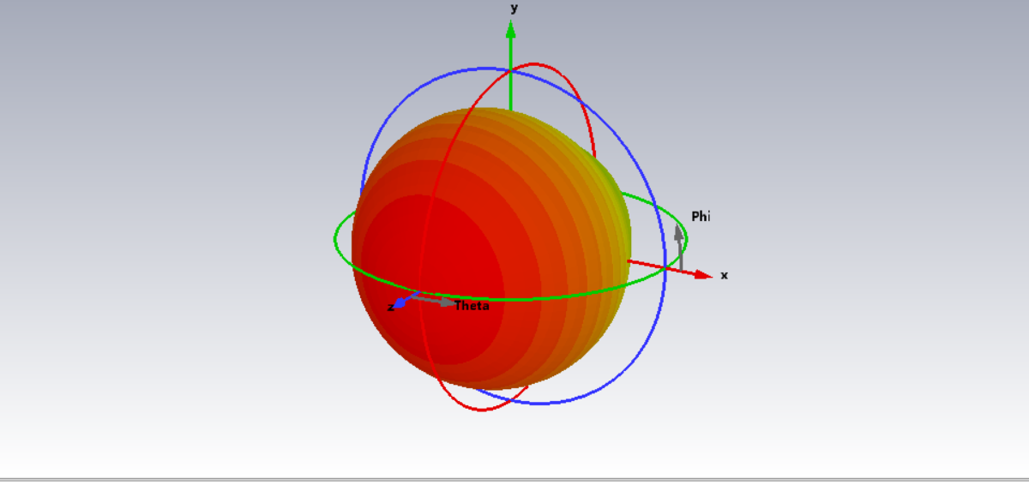
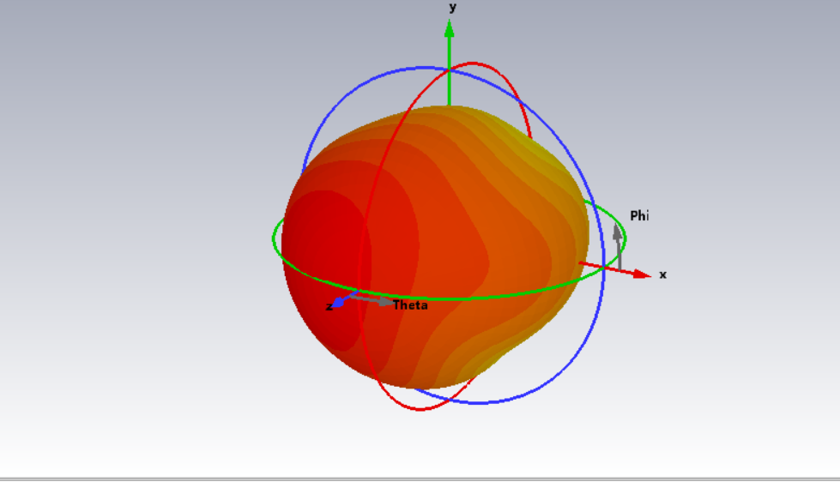
SIMULATION RESULTS
GAIN & DIRECTIVITY
At 3.5 GHz :
At 5.3 GHz :
S.No | Frequency (GHz) | Gain (dBi)
1 | 3.50 | ~ 2.3 dBi
2 | 5.30 | ~ 2.0 dBi
S.No | Frequency (GHz) | Directivity (dBi)
1 | 3.50 | ~ 4.8 dBi
2 | 5.30 | ~ 4.5 dBi

Slide 20
DESIGN AND ANALYSIS
Antenna Size ≈ 35 mm × 40 mm
Parameter | 3.5 GHz Value | 5.3 GHz Value | Inference
Return Loss (S11) | -17.93 dB | -22.11 dB | Good matching
VSWR | 1.30 | 1.46 | Efficient transmission
Gain | ~ 2.3 dBi | ~ 2.0 dBi | Moderate gain
Directivity | ~ 4.8 dBi | ~ 4.5 dBi | Moderate directivity
Total Efficiency | ~ -3.40 dB (~45%) | ~ -3.95 dB (~40%) | Moderate efficiency
Radiation Efficiency | ~ -3.30 dB | ~ -3.63 dB | Acceptable radiation
Radiation Pattern | Omnidirectional | Omnidirectional | Stable radiation

Slide 21
CONCLUSION
The proposed work presents a podium-shaped microstrip patch antenna achieving dual-band operation at 3.5 GHz and 5.3 GHz
Dual resonance is obtained by modifying surface current distribution and creating multiple current paths
Achieves good impedance matching with S11 = -17.9 dB and -22.1 dB
Maintains VSWR ≤ 2, ensuring efficient power transmission
Exhibits stable and nearly omnidirectional radiation pattern
Shows moderate total and radiation efficiency
The proposed work demonstrates a more efficient and practical solution for integrating 5G (n78) and WLAN (n46) bands

Slide 22
FUTURE SCOPE
Enhance gain using antenna array or parasitic elements
Improve bandwidth using slot techniques or advanced substrates
Increase efficiency by replacing FR4 with low-loss materials
Further miniaturize the antenna using compact design techniques
Extend the design for multiband or wideband operation
Integrate with real-time 5G and WLAN devices
Optimize design using AI/optimization algorithms
Develop for practical fabrication and measurement validation

Slide 23
REFERENCES
[1] C. A. Balanis, Antenna Theory: Analysis and Design, 4th ed., Hoboken, NJ, USA: Wiley, 2016.
[2] K. L. Wong, Compact and Broadband Microstrip Antennas, New York, NY, USA: Wiley, 2002.
[3] D. M. Pozar, “Microstrip antennas,” Proceedings of the IEEE, vol. 80, no. 1, pp. 79–91, Jan. 1992.
[4] R. Garg, P. Bhartia, I. Bahl, and A. Ittipiboon, Microstrip Antenna Design Handbook, Norwood, MA, USA: Artech House, 2001.
[5] J. R. James and P. S. Hall, Handbook of Microstrip Antennas, London, U.K.: IET, 1989.
[6] S. Maci and G. B. Gentili, “Dual-frequency patch antennas,” IEEE Antennas and Propagation Magazine, vol. 39, no. 6, pp. 13–20, Dec. 1997.
[7] H. Wong, K. M. Luk, and C. H. Chan, “Microstrip patch antennas for wireless applications,” IEEE Access, vol. 5, pp. 254–267, 2017.
[8] A. Kumar, R. Singh, and P. Sharma, “Design of dual-band microstrip patch antenna for 5G and WLAN applications,” International Journal of RF and Microwave Engineering, vol. 30, no. 5, pp. 1–8, 2020.

Slide 24


