Slide 1


K. RAMAKRISHNAN COLLEGE OF ENGINEERING
(AUTONOMOUS), SAMAYAPURAM - TRICHY DEPARTMENT OF ECE
EGB1221 – DATABASE MANAGEMENT SYSTEM
RETAIL POINT OF SALE SYSTEM
PRESENTED BY SUPERVISOR
MEERA B Mrs. R.Nalini M.E., (Ph.D.,),
8115U23EC062 Assistant Professor / CSE.
Date of Review : 04/06/2025

Slide 2

PRESENTATION OVERVIEW
Project Introduction
Objective
Problem Statement
Technologies Used
ER Diagram
Modules Used
Output Screenshots
Conclusion
Future Scope
References

Slide 3
PROJECT INTRODUCTION
The Retail Point of Sale (POS) System is a software application used in shops to handle billing, manage inventory, track sales, and generate receipts. It simplifies daily business tasks by automating product entry, customer checkout, and stock updates, making store operations faster and more accurate.

Slide 4
OBJECTIVE
To automate retail store operations by managing products, billing, inventory, and receipts efficiently, ensuring fast and accurate sales processing.

Slide 5
PROBLEM STATEMENT
Manual billing and inventory tracking in retail stores often lead to errors, delays, and poor stock management. There is a need for an automated Point of Sale system to streamline sales, update inventory in real-time, and generate accurate bills and receipts efficiently.

Slide 6
TECHNOLOGIES USED
FRONTEND: HTML, CSS – For designing the user interface.
BACKEND: PHP – For server-side logic and database interaction.
DATABASE: MySQL – To securely store users and notes.
DEVELOPMENT TOOLS: Visual Studio Code – Code editor XAMPP – Local server environment.

Slide 7
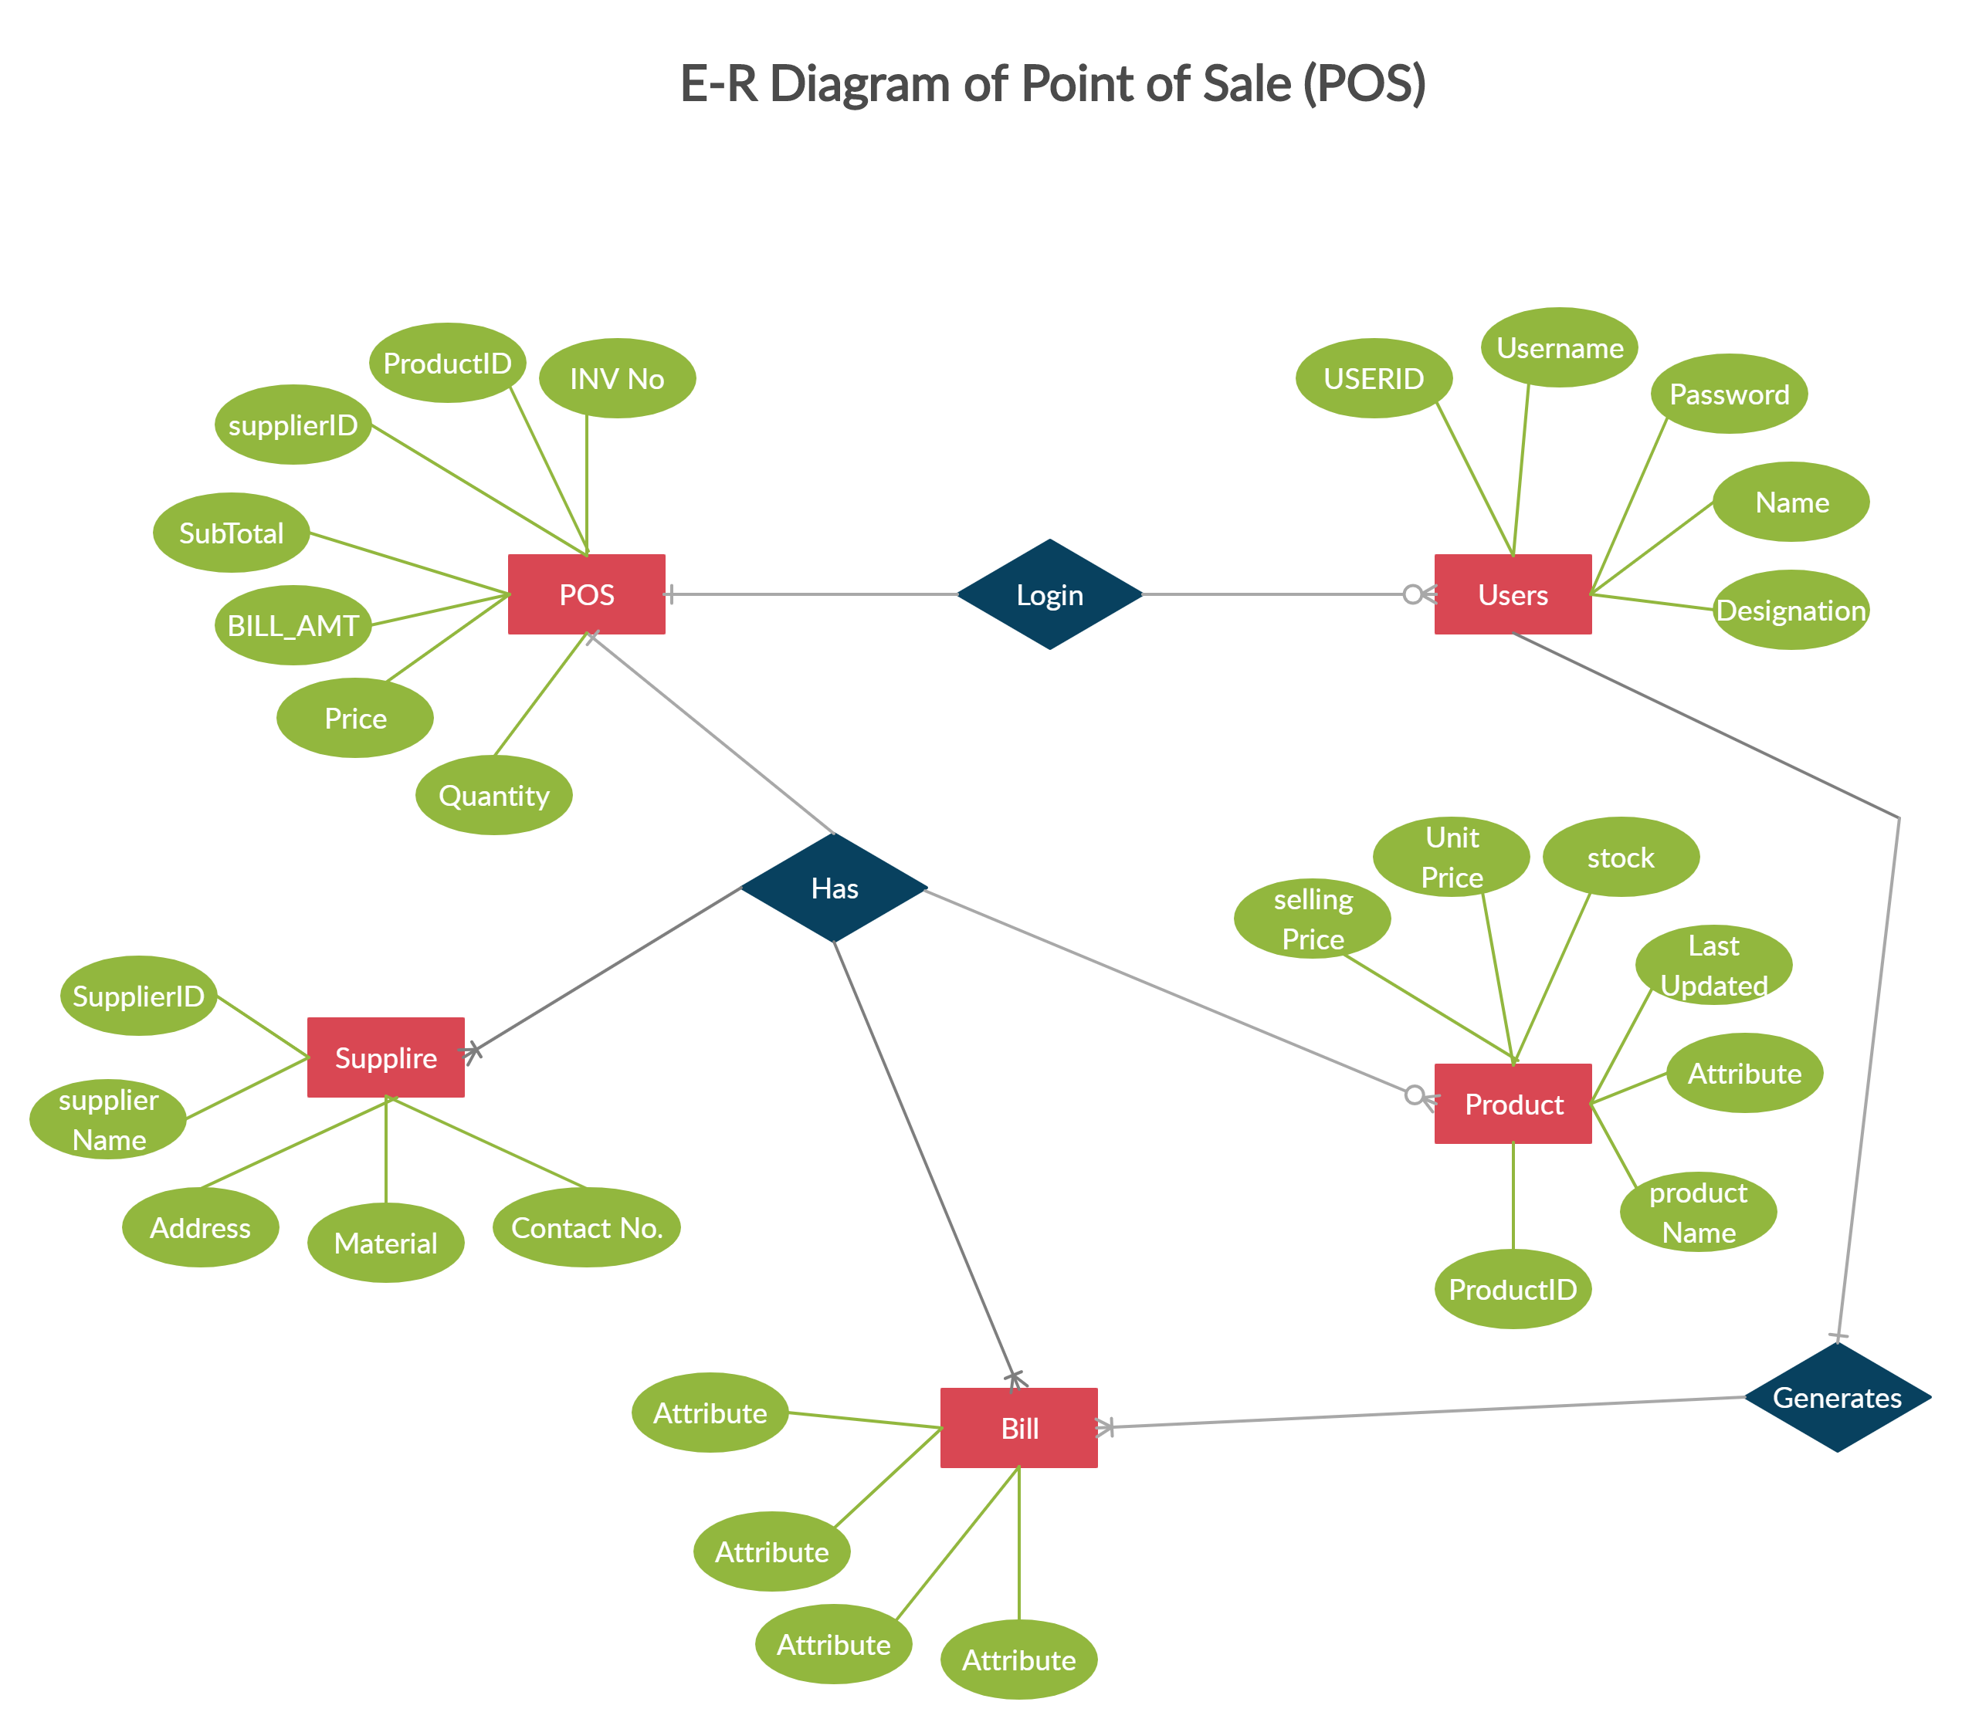
ER DIAGRAM
ER DIAGRAM

Slide 8
MODULES USED
Product Management
This module allows the admin to add, update, or delete products. Each product includes attributes like name, price, quantity, category, description, and warranty details.
2. Inventory Management Module
Keeps track of stock levels. When a product is sold, the quantity is automatically reduced. It helps monitor low stock and manage inventory efficiently.

Slide 9
MODULES USED
3. Customer Management Module
Stores customer information such as name, contact details, and purchase history. Useful for faster billing and targeted promotions or loyalty programs.
4. Cart and Billing Module
Enables adding products to the cart, calculating the total price with applicable taxes or discounts, and processing the order for checkout.
5. Payment Module
Handles different modes of payment like cash, credit/debit card, or digital payments. It confirms successful transactions and updates records.

Slide 10
MODULES USED
6. Receipt Generation Module
After payment, this module generates a printable or downloadable receipt with order details, total cost, and payment confirmation.
7. Sales Reporting Module
Generates reports on sales over a period (daily, monthly, etc.) for analysis. Helps the owner understand performance and plan inventory or pricing strategies.
8. User/Login Module
Provides login access for different users like admin or cashier. Secures the system and limits access to sensitive operations.

Slide 11
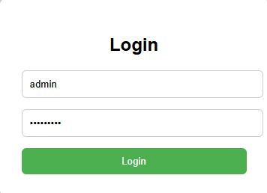
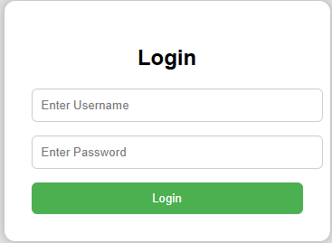


OUTPUT SCREENSHOTS

Slide 12
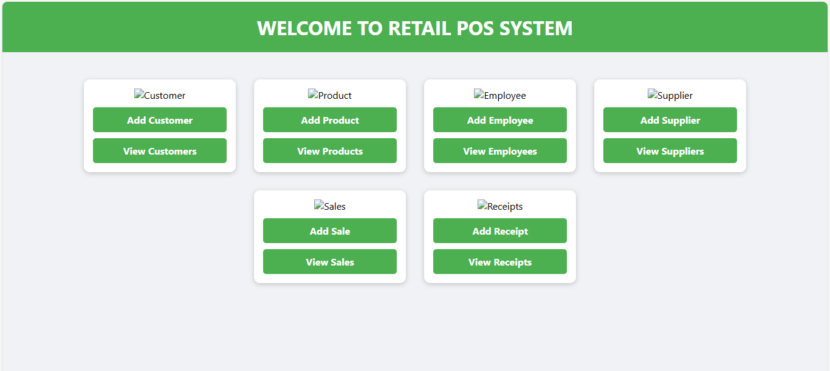
OUTPUT SCREENSHOTS

Slide 13
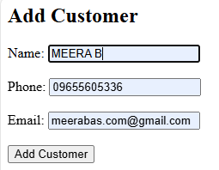
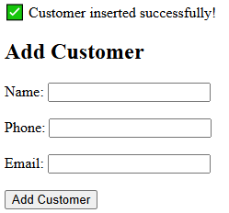
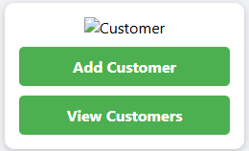
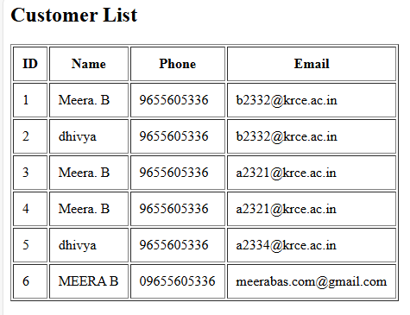
OUTPUT SCREENSHOTS

Slide 14
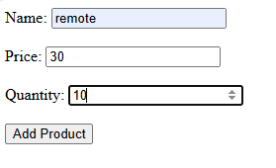
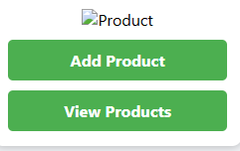
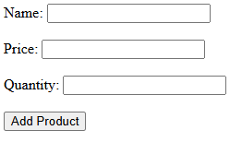
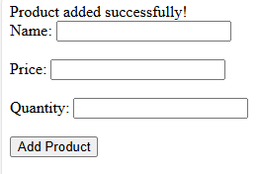
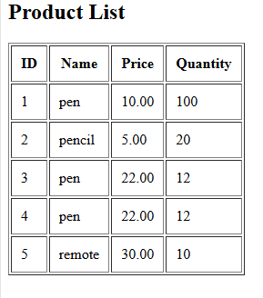
OUTPUT SCREENSHOTS

Slide 15
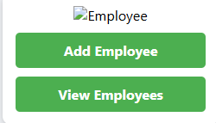
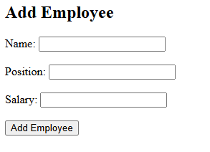
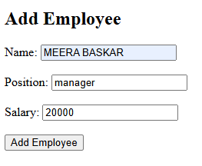
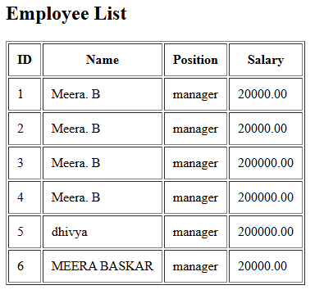
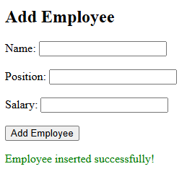
OUTPUT SCREENSHOTS

Slide 16
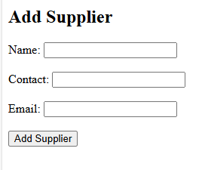
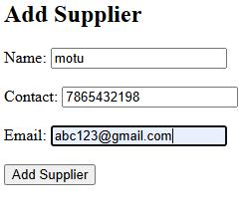
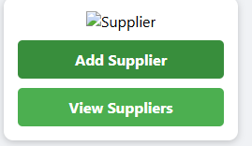
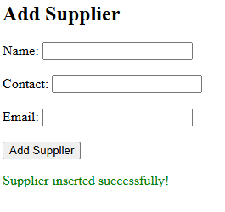
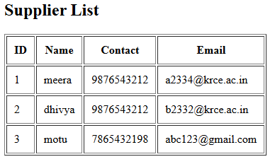
OUTPUT SCREENSHOTS

Slide 17
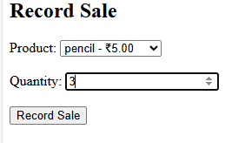
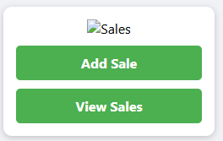
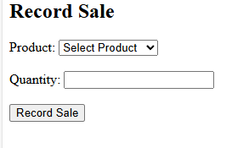
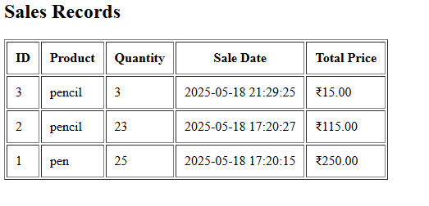
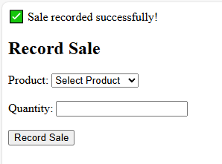
OUTPUT SCREENSHOTS

Slide 18
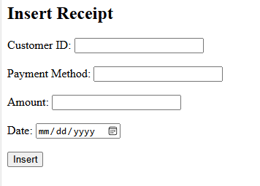
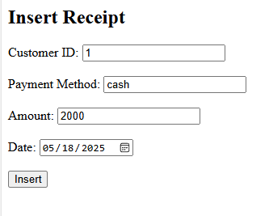
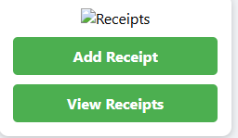
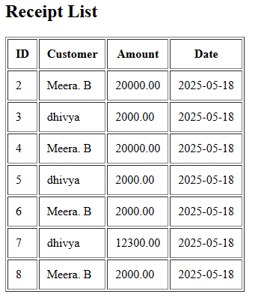
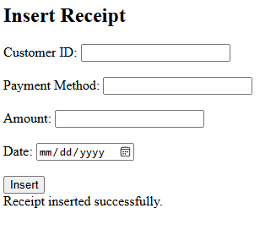
OUTPUT SCREENSHOTS

Slide 19
CONCLUSION
The Retail Point of Sale System automates sales, billing, and inventory processes.
It improves accuracy, reduces manual work, and speeds up transactions.
Customer and product data are managed efficiently.
It enhances the productivity of retail operations.

Slide 20
FUTURE SCOPE
Sync inventory and sales with e-commerce platforms.
Manage POS operations from smartphones or tablets.
Generate sales trends and customer behavior reports.
Add points and discounts for frequent buyers.
Allow secure access from anywhere for multiple branches.

Slide 21
REFERENCES
W3Schools https://www.w3schools.com/
2. MDN Web Docs https://developer.mozilla.org/
3. PHP Manual https://www.php.net/manual/en/
4. MySQL Documentation https://dev.mysql.com/doc/
5. XAMPP Official Site https://www.apachefriends.org/

Slide 22


