Slide 1
BIG DATA ESSENTIALS GROUP PROJECT
IMPORT – EXPORT ANALYSIS
R - Coders
Mercan Karacabey
Leyla Yiğit
Merve Özen Şahin
Mehmet Ak
Büşra Aydemir

Slide 2

ABOUT PROJECT
We will analyze the recent changes in inflation vs. data on exports and imports.We will analyze the factors which affecting export and import in 3 categories:
Inflation
Exchange Rates
Interest Rates

Slide 3
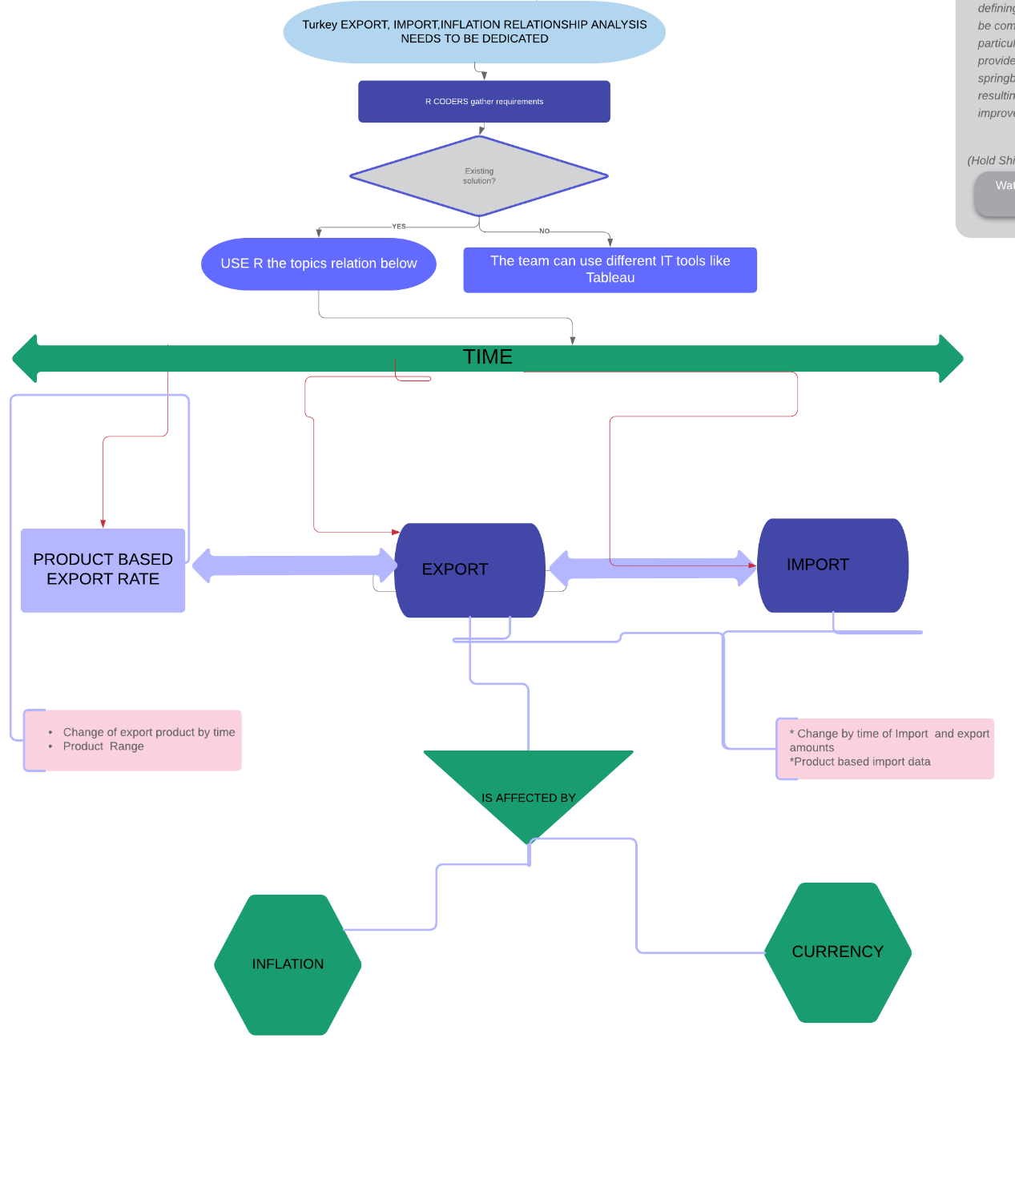
PROJECT SCHEMA
-Timely Import/Export Change
* Affected By :
Inflation
Currency
- Product Based Export/Import Rate

Slide 4
Where do we get data? && Data Preparation
WHERE DO WE GET DATA ?
For Import Data → http://www.oaib.gov.tr/
For Export Data → http://www.tim.org.tr/tr/ihracat-rakamlari.html
For Inflation → https://www.tcmb.gov.tr/wps/wcm/connect/TR/TCMB+TR/Main+Menu/Istatistikler/Enflasyon+Verileri/Tuketici+Fiyatlari
For Exchange Rate Data → https://github.com/algopoly/EVDS
For Interest Data → https://evds2.tcmb.gov.tr/
DATA PREPARATION
Data Identification :
Our main data used between 2010 - 2018 import and export results. In addition, inflation and currency figures are our main variables.
Data Acquisition & Filtering :
Above data links was used this stage.
Data Validation & Cleansing :
Invalid data can skew and falsify analysis results. The Data Validation and Cleansing stage is dedicated to establishing often complex validation rules and removing any known invalid data.
We removed the NA rows and change the column names of data. Also we don’t use total amount, because of this removed the total amount columns. And convert char data types to numeric data types for all columns except sector type code and sector name columns.
Data Aggregation & Representation :
Data may be spread across multiple datasets, requiring that datasets be joined together via common fields, for example date or ID. In our cases, the same data fields appear in multiple datasets, such as sector type code and sector name. Either way, a method of data reconciliation is required or the dataset representing the correct value needs to be determined.

Slide 5
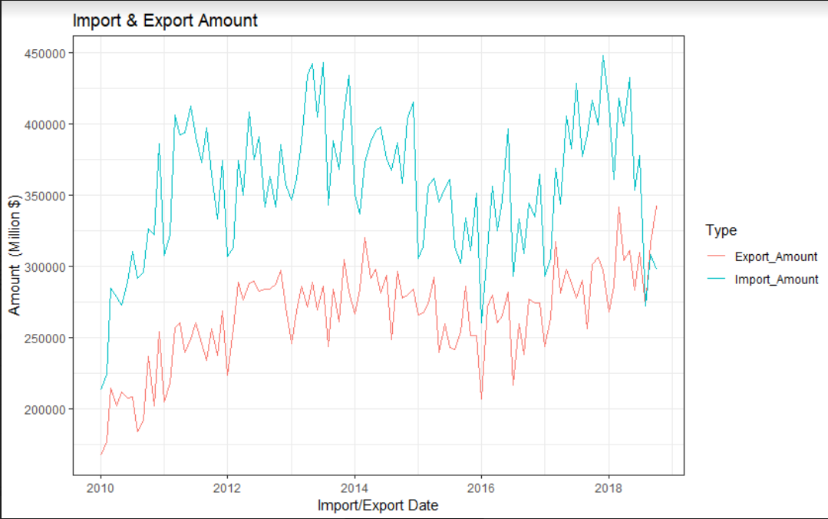
Analysis With Graphics
The graph shows the year-based comparison of export and import amount data. A very long period of increases and decreases are moving synchronously. In April 2018, the import amount Line has a major decline, while export amount Line has a major increase.

Slide 6
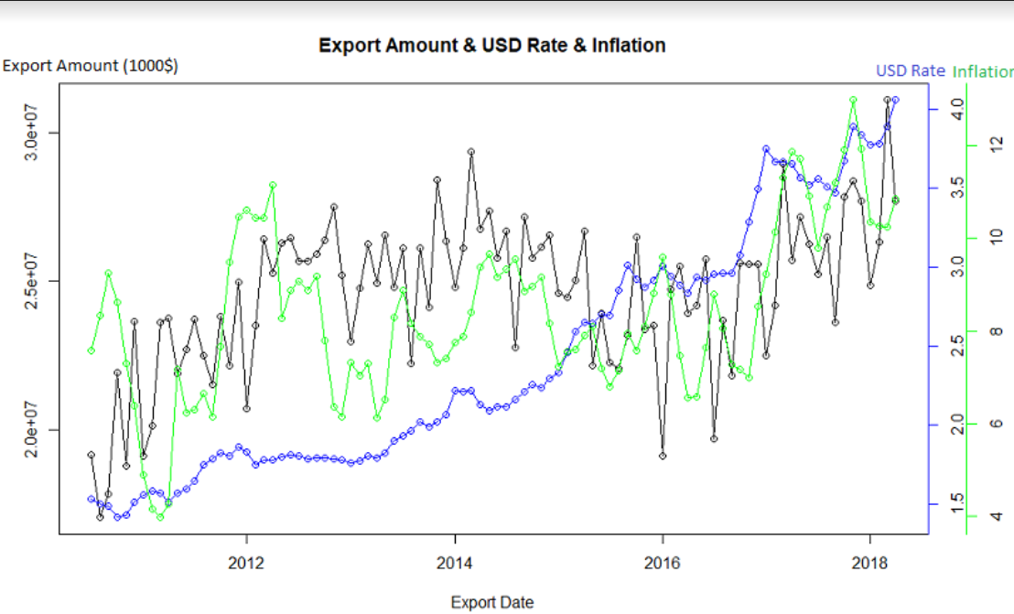
Analysis With Graphics
The graph shows export amounts, USD rate and inflation. First thing that take attention is USD rate is increasing slowly or fast but it is always increasing however export amount and inflation is fluctuated by years. Export amount and inflation is nearly synchronized. If we look at 2014-2016 USD rate is increasing and export amount is decreased significantly however in 2016-2018 USD rate is increasing again and export amount is increased significantly which means that only USD rate is not enough to explain direction and fluctuations in export amounts.

Slide 7
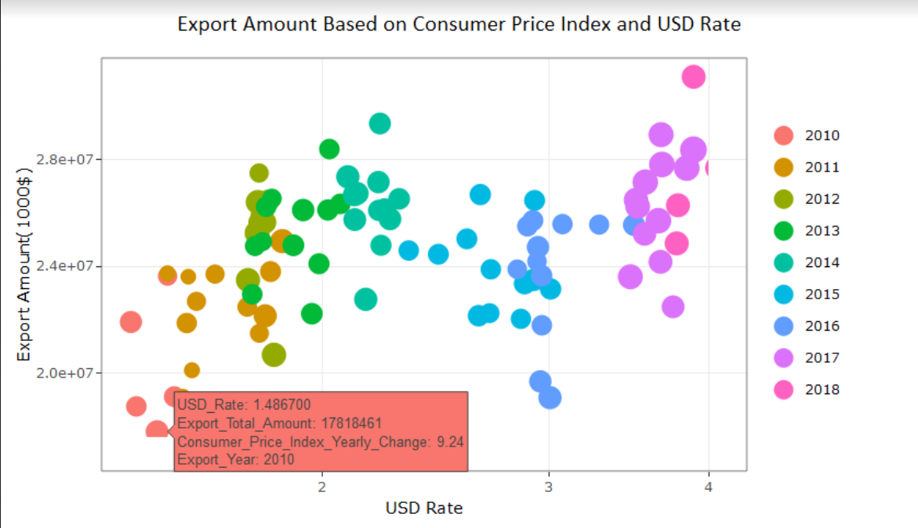
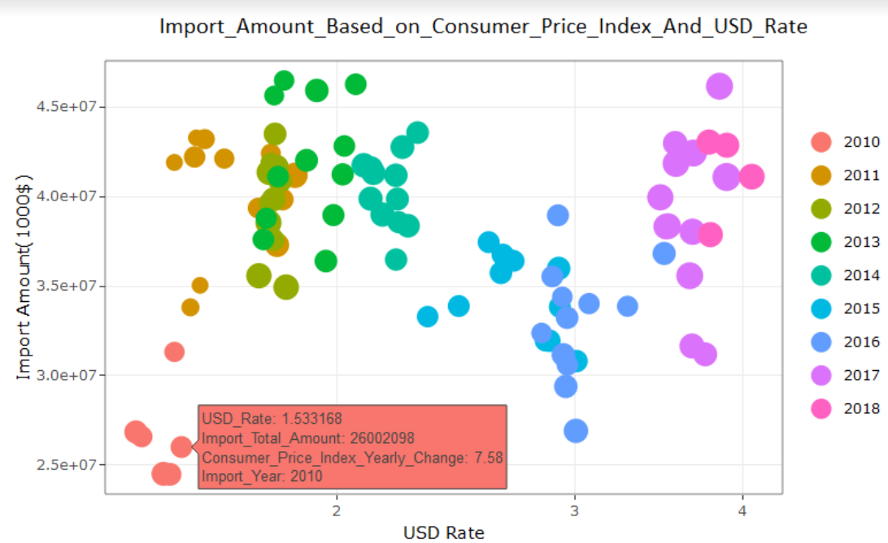
Analysis With Graphics
→ The graph shows export amount based on consumer price index and USD rate on monthly basis. Each year is indicated in different colors and every point shows monthly variables values.
→ The graph shows import amount based on consumer price index and USD rate on monthly basis. Each year is indicated in different colors and every point shows monthly variables values.

Slide 8
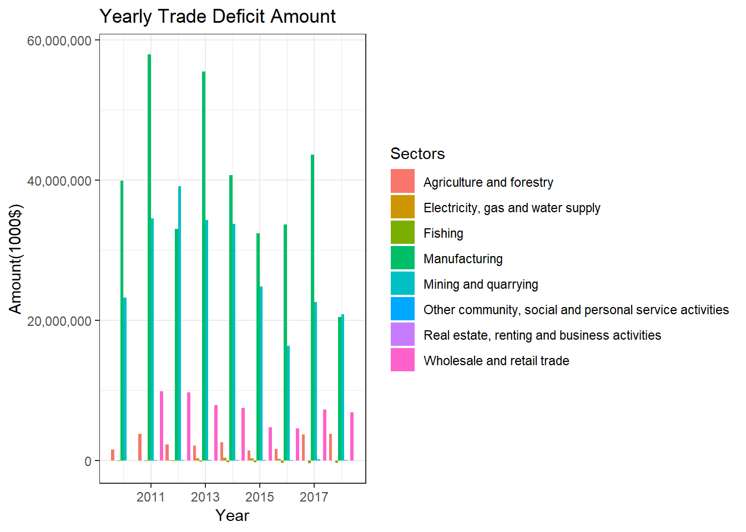
Analysis With Graphics
Sector Based Analysis
Yearly trade deficit amount graph was prepared based on the sector. In general, there is a constant decline. Although a clear result can not be seen due to the incomplete year for 2018, we can see that the year will be closed down again for two months due to the close of the year.

Slide 9
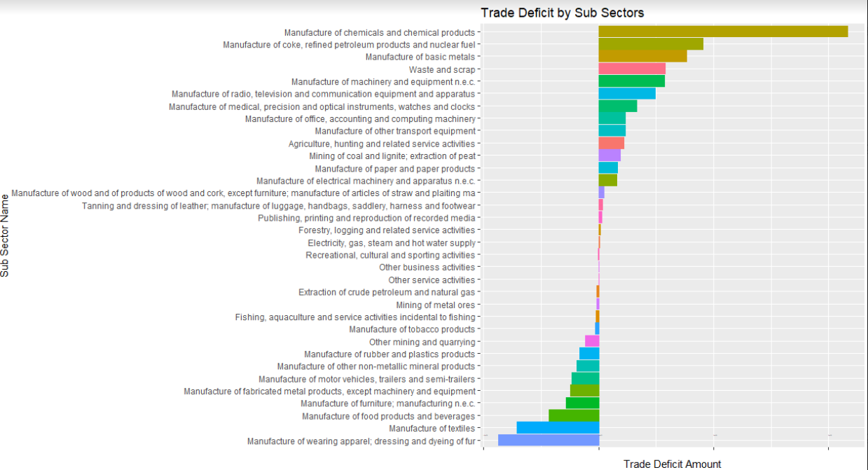
Analysis With Graphics
Sector Based Analysis
When export sub-sectors are investigated for last 3 years, we saw that top 3 export subsectors are manufacture of motor vehicles and trailers, manufacture of basic metals and manufacture of textiles.
When import subsectors are investigated for last 3 years, we saw that top 3 import subsectors are manufacture of basic metals, manufacture of chemicals and chemical products, mining and quarrying.

Slide 10
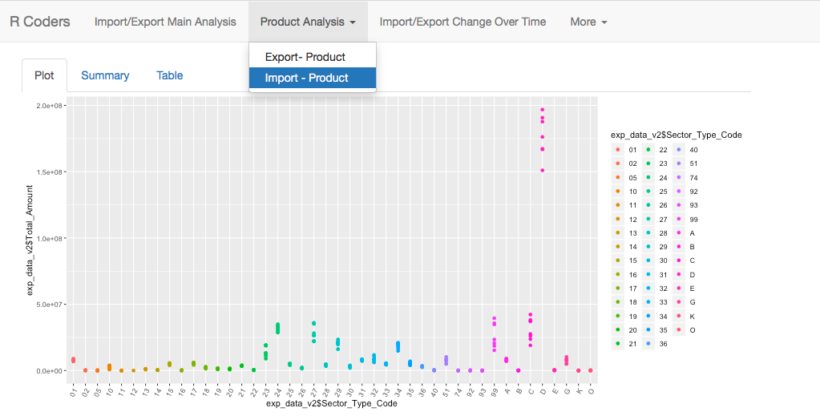
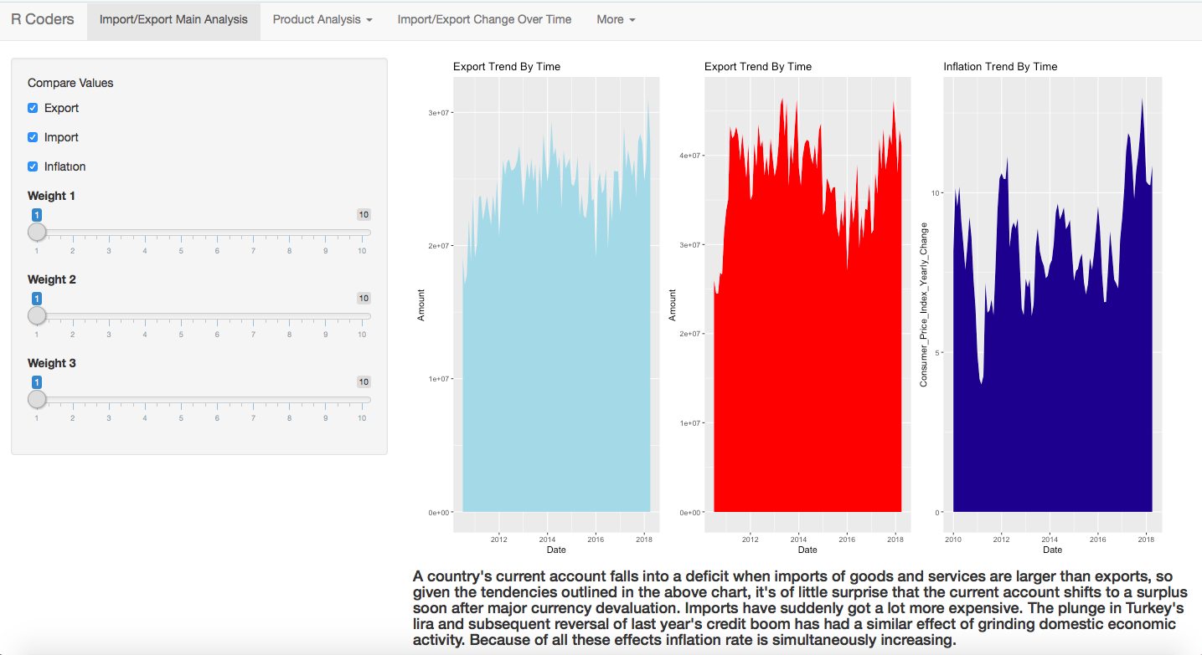
Shiny Page
EXAMPLE PAGES
Shiny Link →

Slide 11

Thank You!

