Slide 1
TOGETHER AGAIN! · “HERE WE GO AGAIN… KICK’N IT WITH THE KINS!”
Harris-Nelson Family Reunion 2026
Our roots run deep — from Mississippi to Cleveland and beyond…
Cleveland, Ohio · July 17–19, 2026 · hnfamilyreunion.com

Slide 2
TODAY'S PROGRAM
What We'll Cover
1. Welcome & The Weekend at a Glance
2. Our Family History & Trivia
3. Family Yearbook
4. Reunion 2024 Memories — Cleveland
5. Acknowledgments & Accomplishments
6. Family Superlatives — Cast Your Vote!
7. Tribute to Loved Ones We've Lost
8. Family Business: Financial Report
9. Officers, Robert's Rules & Our Constitution
10. Board Recognition, Committees & Sign-Ups
11. Where We Meet Next — Location Vote
12. Our New Website: hnfamilyreunion.com
13. Getting Our Land Back — Where Is My Land
14. Scholarship Fund for Our Descendants
15. Helping Hands — Family Hardship Fund
16. The Family Foundation — Our 501(c)(3)
17. The Family Tree Project — Add Yourself!
18. Closing & Next Steps

Slide 3
JULY 17–19, 2026 · CLEVELAND, OHIO
The Weekend at a Glance
FRIDAY 7/17 · 5–9 PM · Meet & Greet / Fish Fry
• Andrews Osborne Park — at the front pavilion, 38575 Lakeshore Blvd, Willoughby OH 44094
• Wear any PREVIOUS reunion shirt
• Pick up your 2026 shirt & Clay's Park tickets
• Courts, pool, playground, disc golf & swings by the lake
SATURDAY 7/18 · 11 AM–8 PM · Family Fun
• Clay's Park, 12951 Patterson St NW, North Lawrence OH 44666
• Wear the BEIGE/BURGUNDY 2026 reunion tee
• Water & dry activities all day
• FAMILY PICTURE 11:30 AM at the pavilion — ALL attendees
SUNDAY 7/19 · 11 AM–3 PM · Brunch & Farewell
• SiteCenters, 3333 Richmond Rd, Beachwood OH
• Wear WHITE top & blue-jean bottom
• Brunch 11:30 AM · family pictures 1:45 PM
• Acknowledgments, next reunion, committee changes & close-out
Shirts: $10 (2XL–4XL $15) — adult SM–4XL, youth SM–XL, toddler 6M–24M. Pick up Friday; wear Saturday.

Slide 4
WELCOME
Welcome to the Harris-Nelson Family Reunion
This reunion started when Mr. John Harris and Ms. Judy Bender united a long time ago. Both were born in the late 1800s — he was a farmer, and she was a homemaker.
Their union brought forth six children, four boys and two girls: Gussy, Pasty, Josh, A.C., D.B., and Will Harris.
“As I call your name, please stand with your family!”
Why we gather
• To honor the people who got us here
• To make sure every branch knows every other branch
• To pass the story — and the land, and the legacy — to the next generation

Slide 5
OUR FAMILY HISTORY
From One Union, Many Branches
1 · John Harris & Judy Bender (born late 1800s) — six children: Gussy, Pasty, Josh, A.C., D.B., and Will Harris.
2 · Emma (Bently) Moncrief (1867–1954) & Ed Moncrief had 16 children. Out of these 16, Mandy Moncrief (c. 1900–1986) was born. Mandy married Nelson Price (b. 1894) and blessed us with Lela Mae Price (July 16, 1922 – February 15, 1996).
3 · Lela Mae Price married Dennis Bernard “D.B.” Harris — three girls: Mary Nelson, Mildred Lucile Harris (1942–2012), Jessie Mae Harris-Moore. She later married Floyd Nelson and had six more children: James Edward, James Earl (mom liked the name James!), Floyd Nelson Jr, Mary Jane Harris (Gray), Mandy Louise Ellis, and the baby of the bunch, Shirley Harris.
4 · Charlie Nelson & Mandy Harris brought forth two boys: Floyd Nelson (the oldest) and Joe Nelson. Joe married Oreatha Ward — four children: Doris Joe Smith, Mandy Mary Thomas, Charles Nelson, and the baby, Naiomi Matthews.
This family history was brought to you by Yours Truly — That Aunt 💛

Slide 6
OUR FAMILY HISTORY
The Nine Branches — Stand With Your Family!
Mary Nelson
8 children
Mildred Ellis
6 children
Jessie Moore
4 children
James Edward
5 children
James Earl
3 children
Curtis
4 children
Mary Jane Gray
2 children
Mandy Ellis
3 children
Shirley Harris
1 children
Every branch keeps growing — that's what the Family Tree Project is for!

Slide 7
LET'S PLAY
Family History Trivia 🏆
Q1. Who founded this family, and what did he do for a living?
A: John Harris (m. Judy Bender) — a farmer; she was a homemaker
Q2. How many children did Emma & Ed Moncrief have?
A: Sixteen!
Q3. What is Lela Mae Price's birthday?
A: July 16, 1922
Q4. Which two brothers share a first name — and why?
A: James Edward & James Earl — mom just liked the name James!
Q5. Who is “the baby of the bunch”?
A: Shirley Harris
Q6. Joe Nelson married whom?
A: Oreatha Ward — 4 children
Q7. Which branch has the most children?
A: Mary Nelson's, with 8
Q8. In what year did Mary marry Willie Nelson?
A: 1957

Slide 8
KEEPSAKE
The Family Yearbook 📖
• Portraits, superlatives, branch pages, recipes & the year's biggest moments
• Submit photos & captions to harrisnelsonfamilyreunion@gmail.com
• Photographer & videographer shoot portraits at reunion events
• Recipe/cookbook section — bring your best dish AND the recipe
Yearbook links
• Yearbook preview post (X): x.com/tendin2
• Yearbook & history working doc: Google Docs (link on the website)
• Photos & stories album: the family Canva album

Slide 9

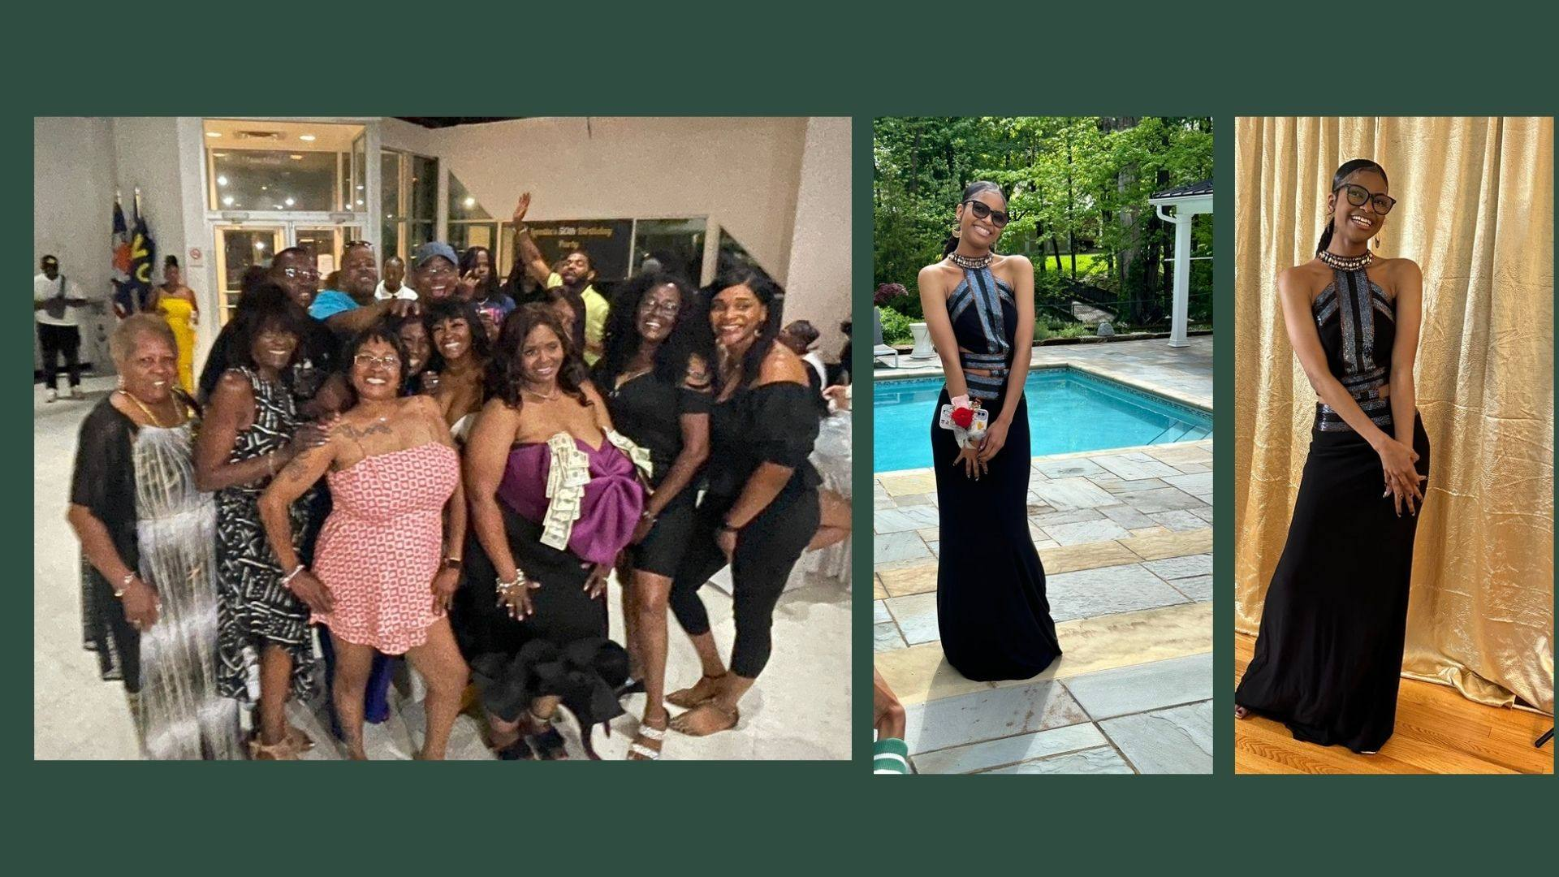
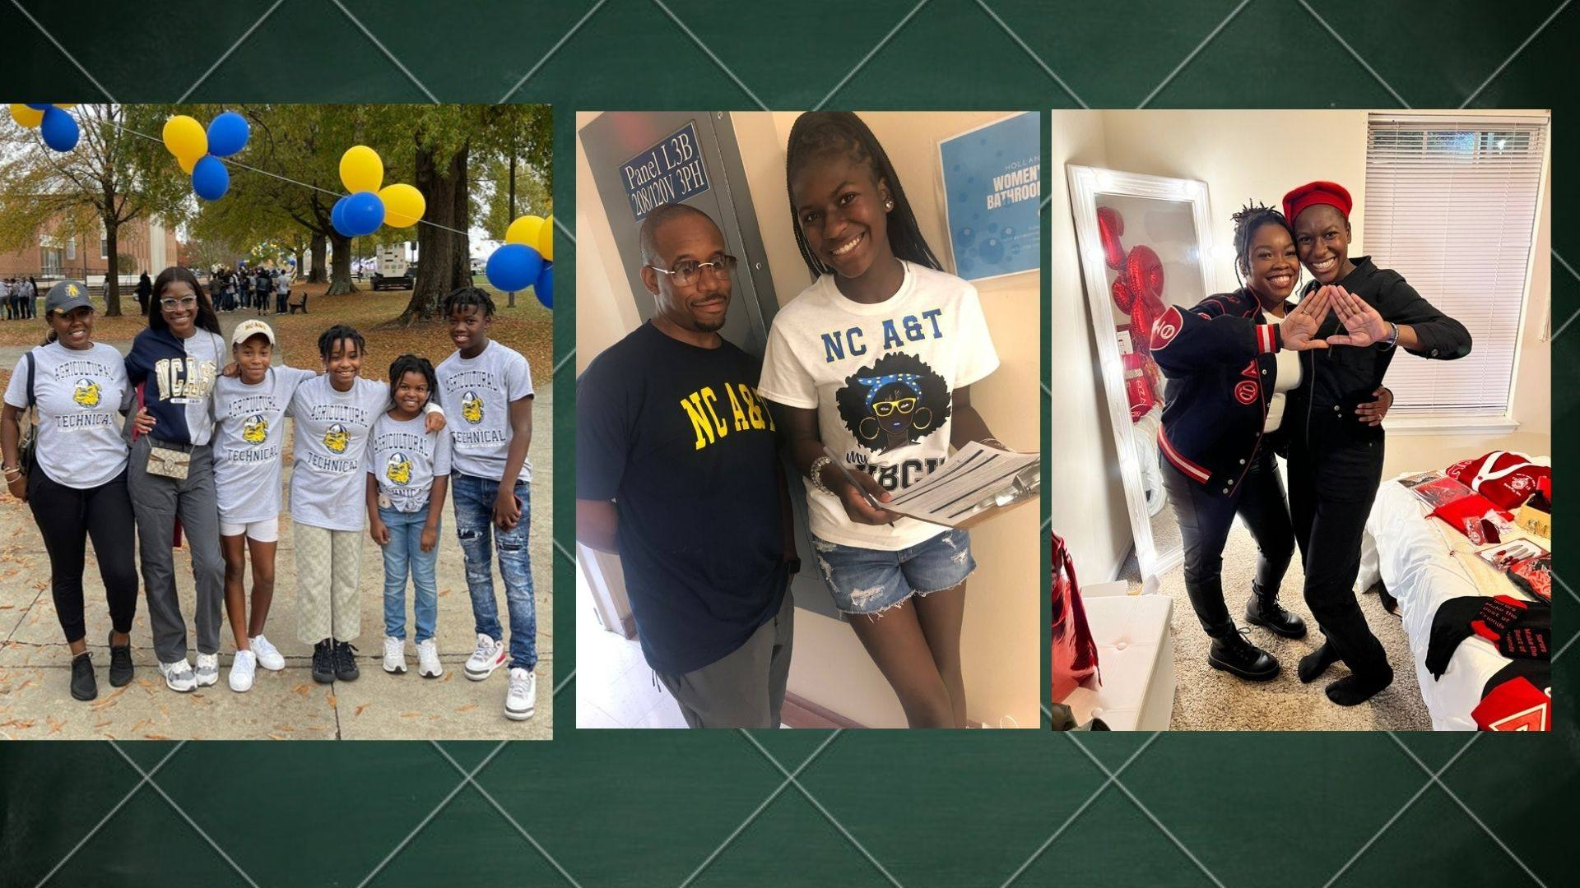
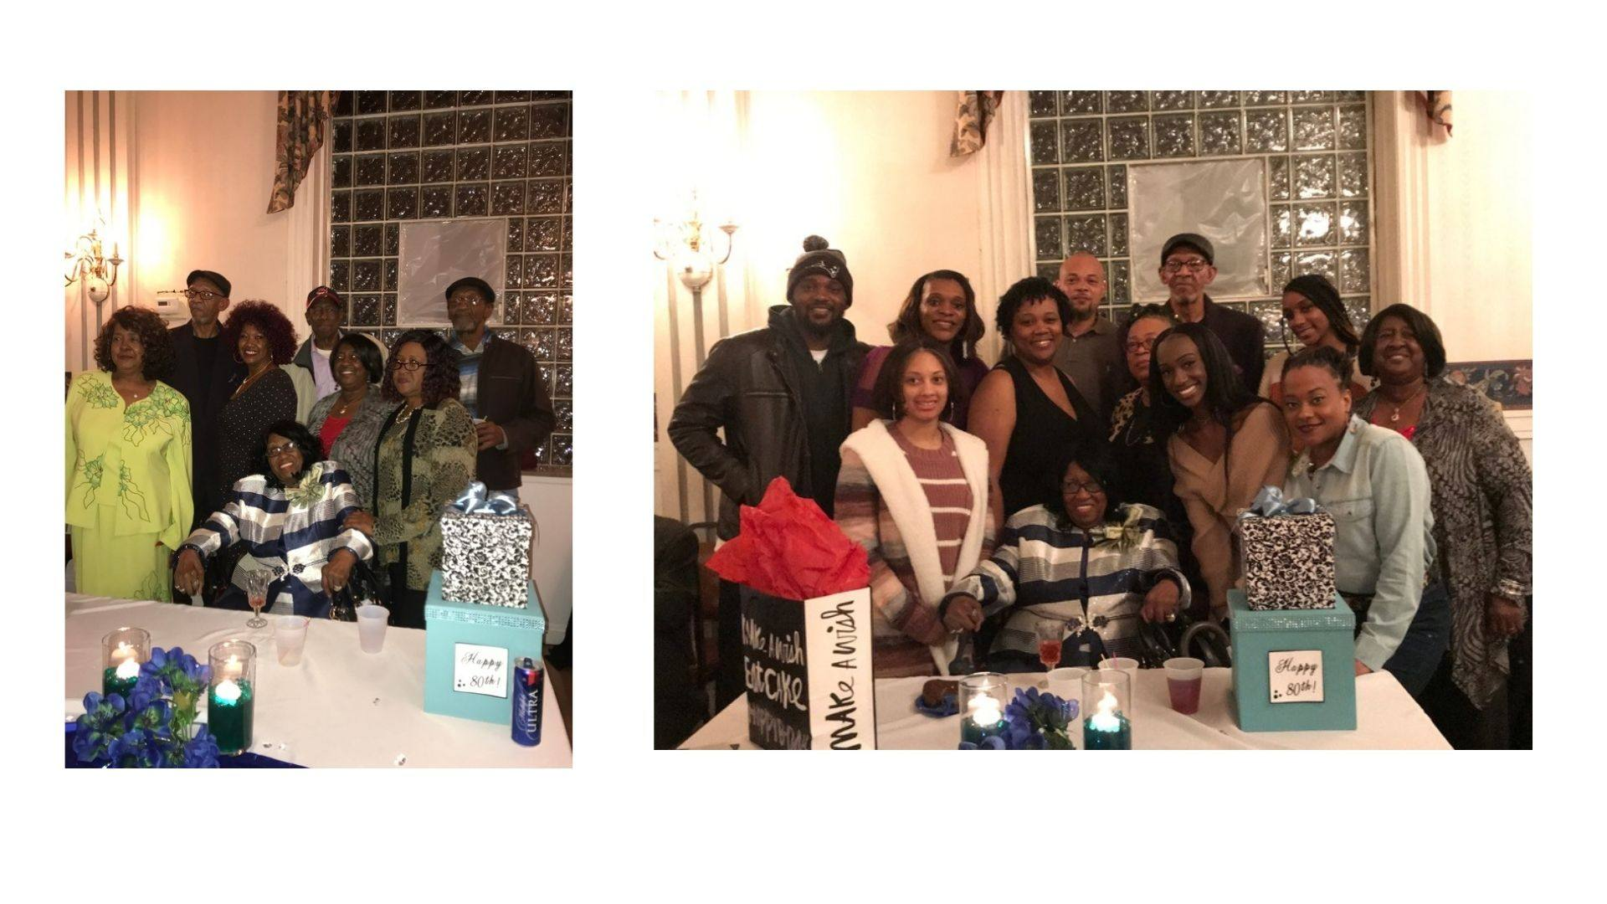
REUNION 2024 · CLEVELAND, OHIO
“We All We Got… We All We Need!” 📸
[Add caption]
[Add caption]
[Add caption]
[Add caption]
▶ Watch the full slideshow
• All 123 slides play fullscreen on the Photos page of hnfamilyreunion.com
• Put it on the big screen during dinner!
Add to next year's show
• Send this weekend's photos to harrisnelsonfamilyreunion@gmail.com
• The Photography Committee builds the next slideshow & yearbook from what you send

Slide 10
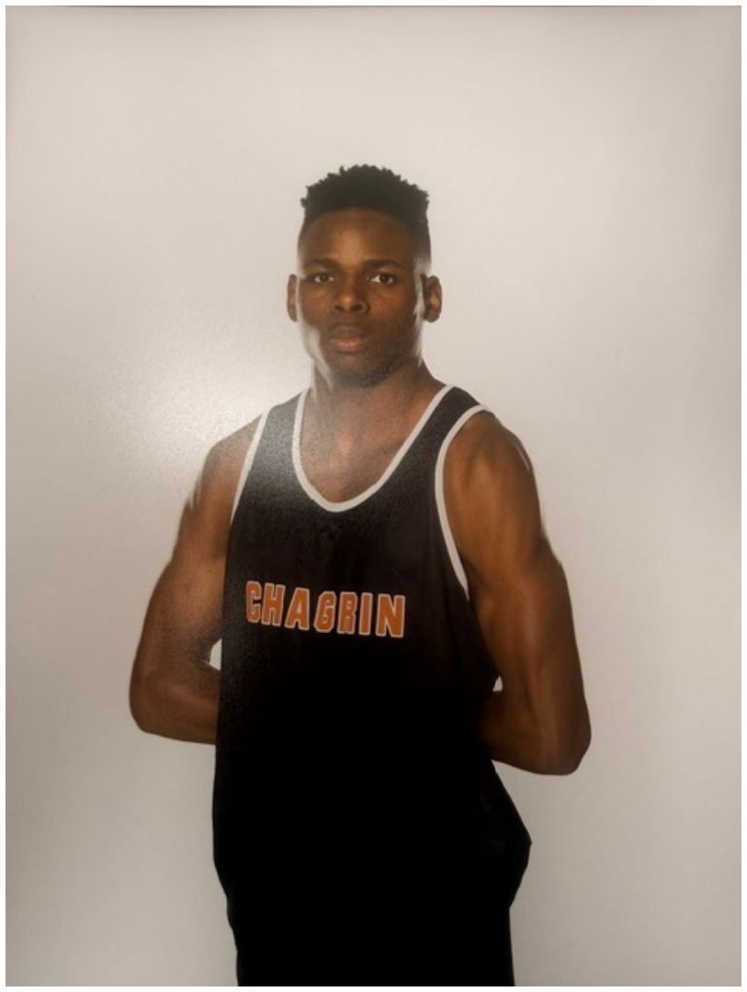
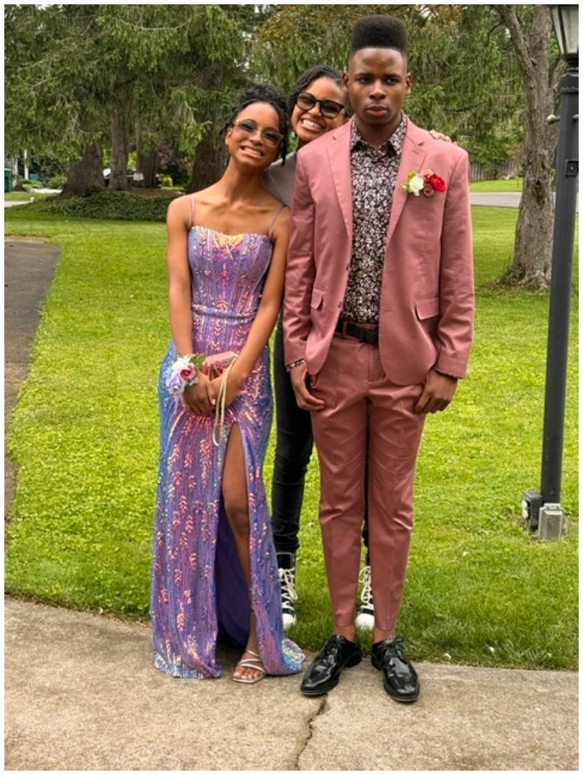
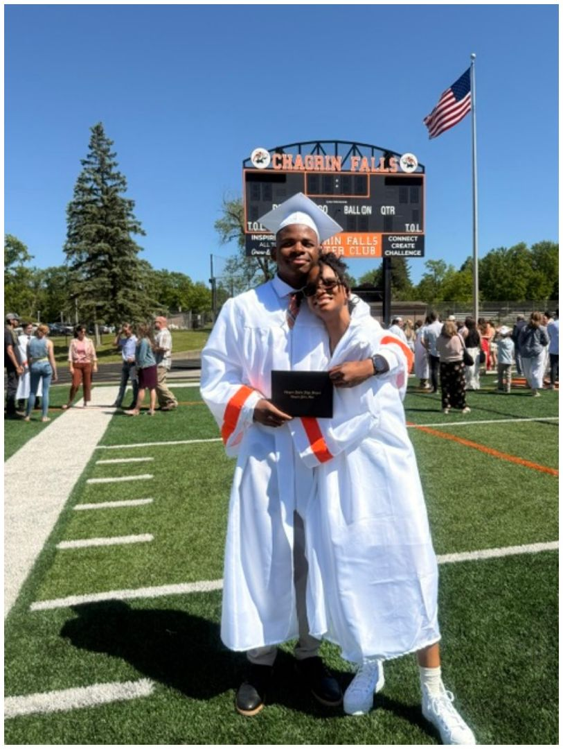
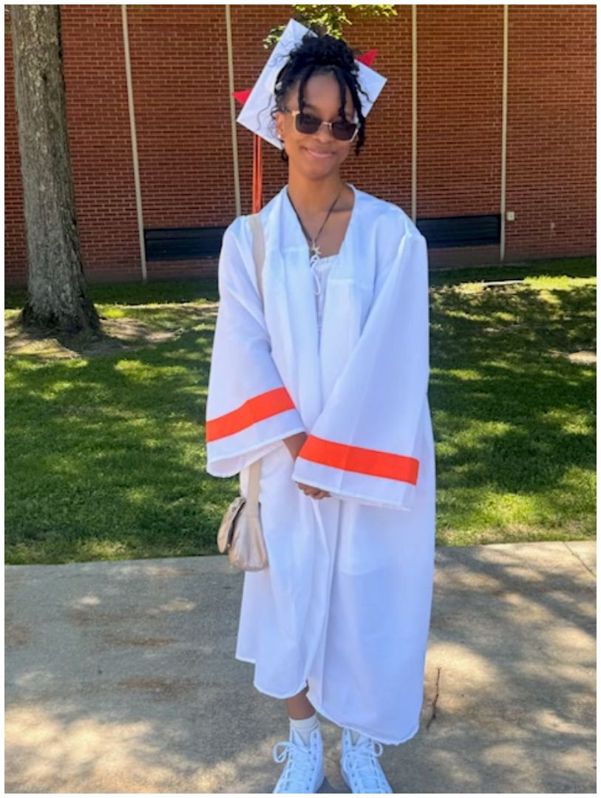
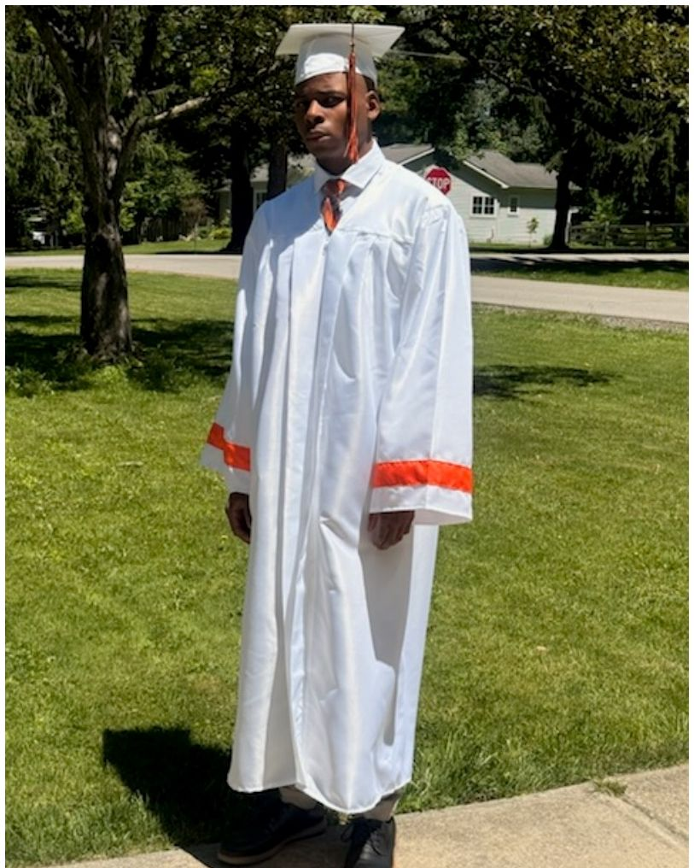
CELEBRATE
Acknowledgments — Congratulations, Class of 2026! 🎓
[Add name]
[Add name]
[Add name]
[Add name]
[Add name]
Also celebrating: [new babies] · [weddings & anniversaries] · [promotions, retirements & new businesses] · [military service, awards & honors] · [our elders present today]
Edit the [Add name] boxes above with each graduate's name and school. Send accomplishments to harrisnelsonfamilyreunion@gmail.com for the yearbook.

Slide 11
STRAIGHT FROM THE FAMILY QUESTIONNAIRE
You Talked, We Listened 📝
🌟 Shine on
• Miesha — first college degree in her grandmother's family; NuLife Fitness Camp turns 20 (Mar 2026); Juicy Vegan; property owner since 2021
• Lovie — homeowner at 24 (May 2026)
• Denisha — RN for 10 years, NP in progress
• Dennis Jr. — serves special-needs students
• Marcelette — Virginia State '12, Master's from WashU St. Louis '17 (Alpha Kappa Alpha)
😄 Did you know…
• Nyeri is our resident makeup artist
• Lovie reps us in Cincinnati — and Delta Sigma Theta Sorority, Inc.
• Mary Jane loves to fish
• Miesha researched the census from when Grandma Lela Mae was a baby
• Everyone in Marcelette's house has an M name — including the dogs, Mitchell & Maximus
🗳 What y'all want next
• More participants — every branch in the building
• More creative ways to showcase our history
• Skits from the youth
• A destination reunion — 'a 1-hour trip'
• Keep the competitions coming!
From the 2026 Family Questionnaire (8 responses so far). Genealogy answers went straight to the Historian for the family tree.

Slide 12
REAL TALK · THE NUMBERS
115 of Us Showed Up. 8 Filled Out the Questionnaire. 😬
≈115
Family members at Reunion 2026
8
Questionnaire responses
7%
Our participation rate, family…
Who showed up vs. who spoke up
Seats filled vs. seats we need
Attended Reunion 2026
≈115
Board seats
8/12
Serving on the board today
8
Committee chairs
1/11
Filled out the questionnaire
8
Committee members
0/~33
Why it matters
• The yearbook, tree poster, acknowledgments & trivia were ALL built from those 8 responses
• Imagine what we could show with 115 — your history dies untold if you don't tell it
The plea 🙏
• Before you leave Sunday: fill out the questionnaire — phone, paper, or grab a grandchild to type
• Join a committee — 9 chairs and every membership seat still open
• Add yourself to the family tree; send photos to the family email
Goal for the next reunion: 100+ questionnaire responses. The Membership Chair (voting today!) will be on all of us about it — lovingly.

Slide 13
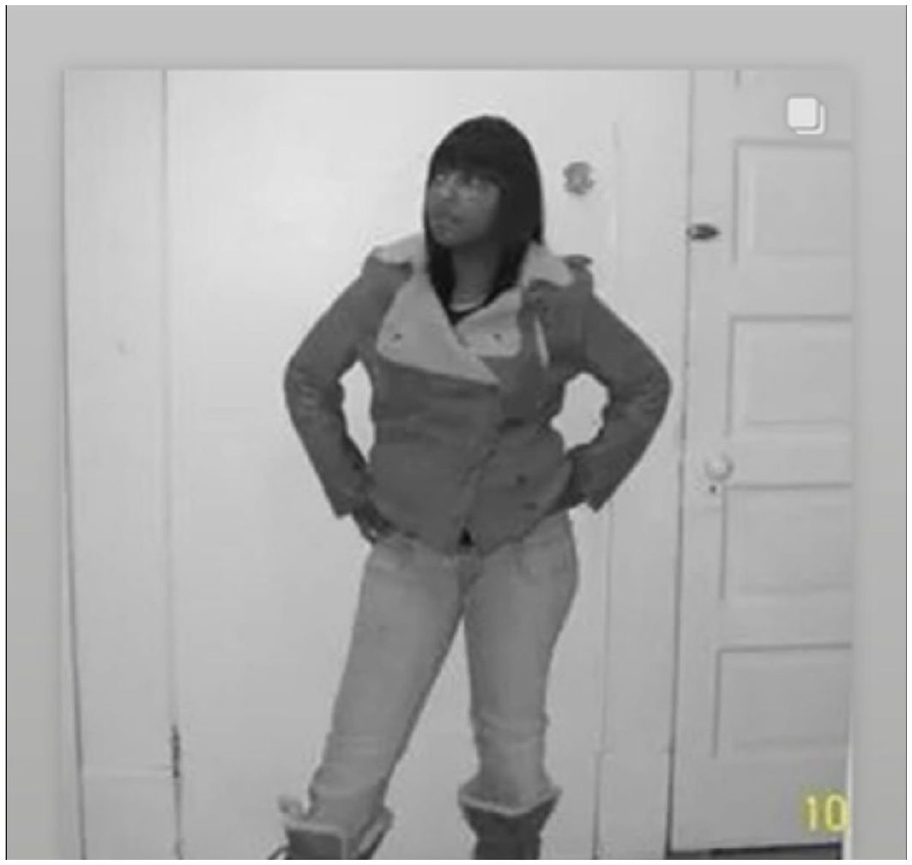
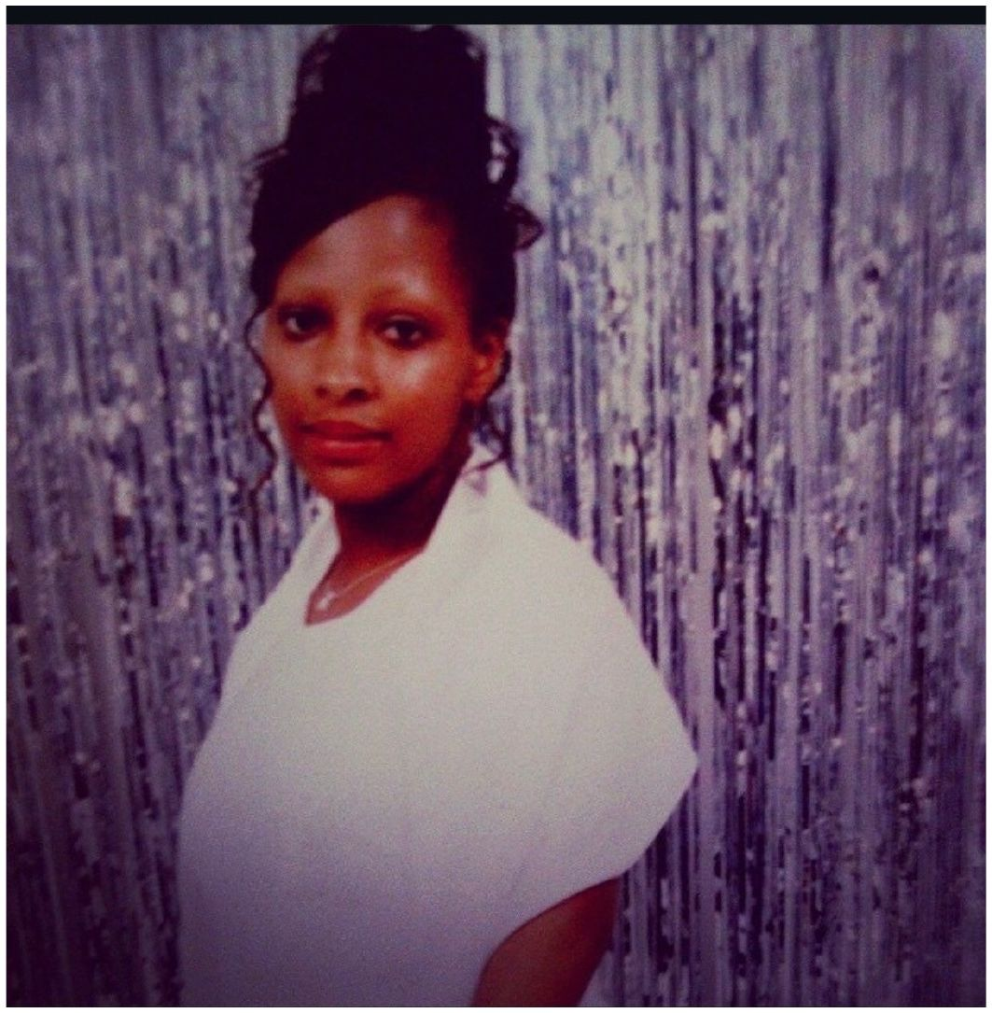
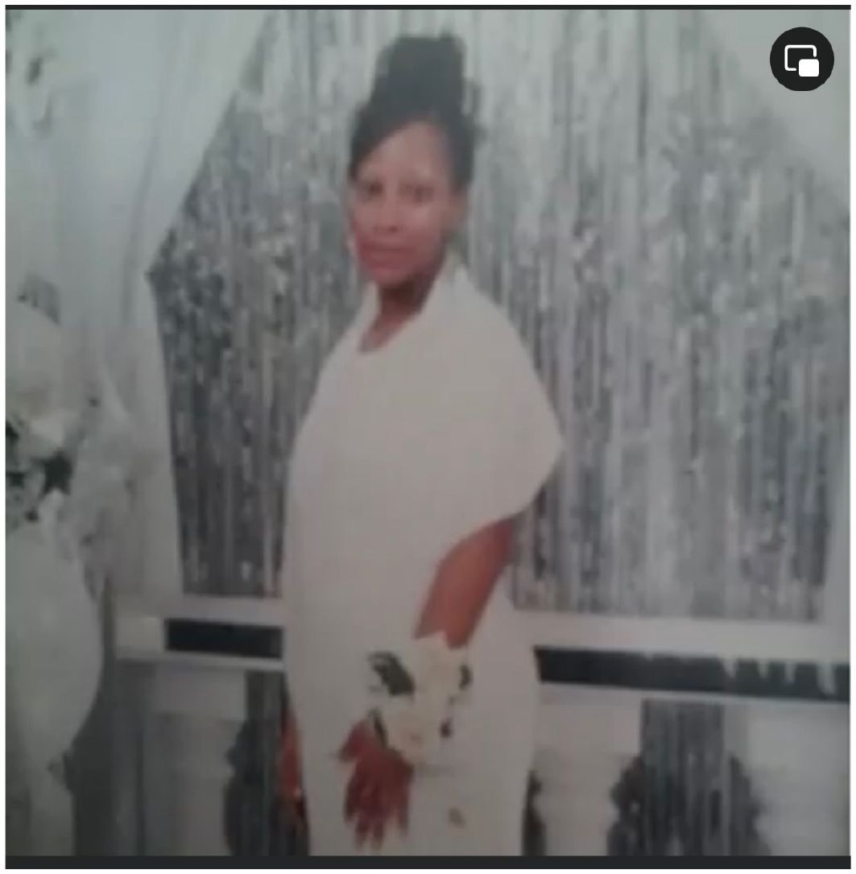
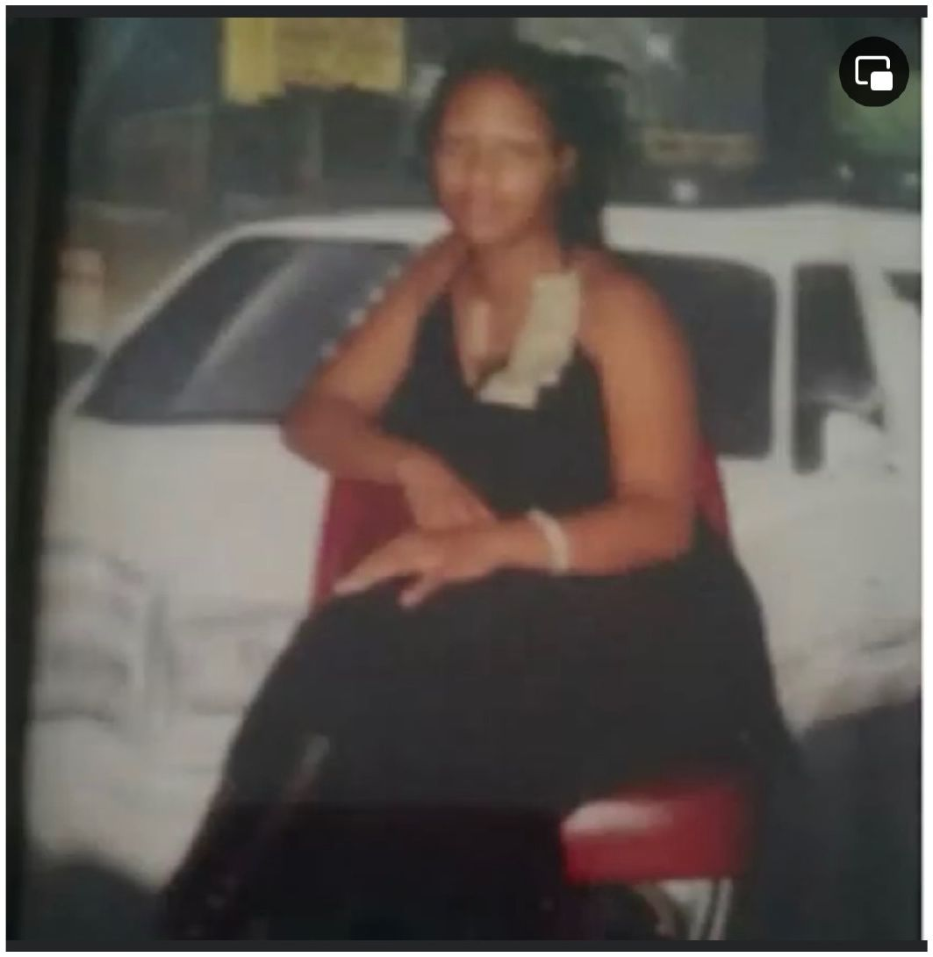
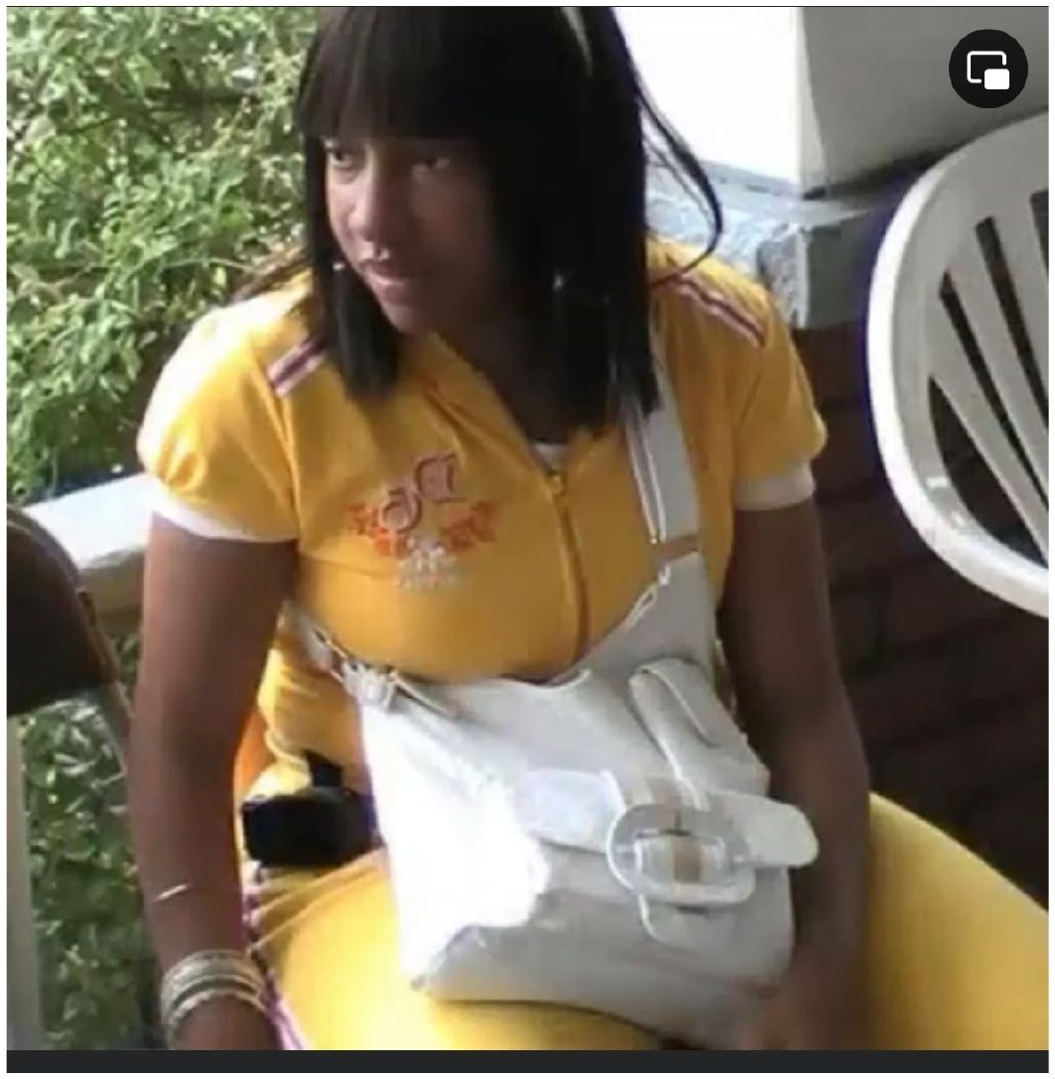
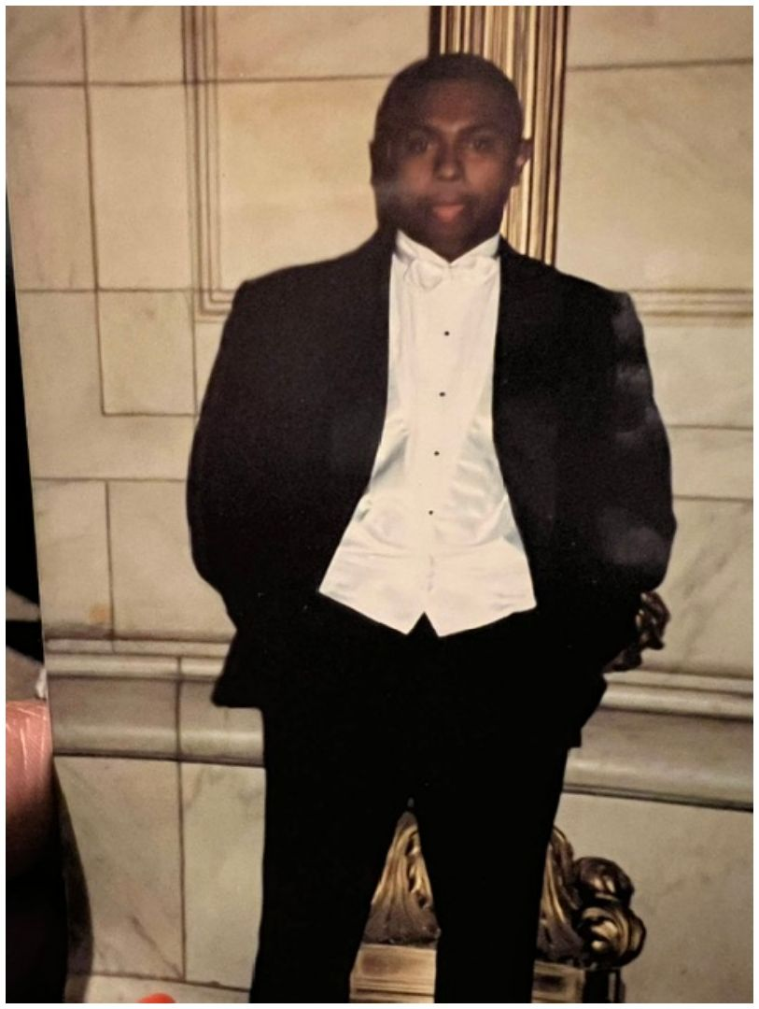
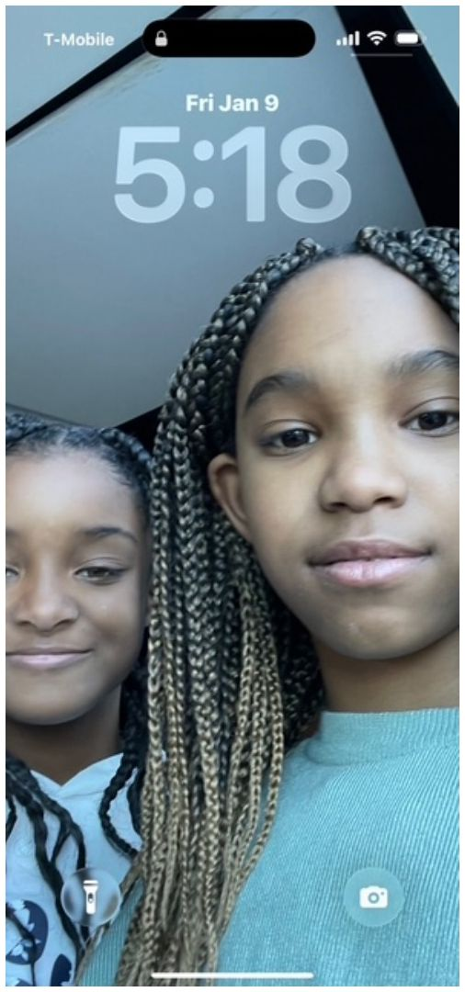
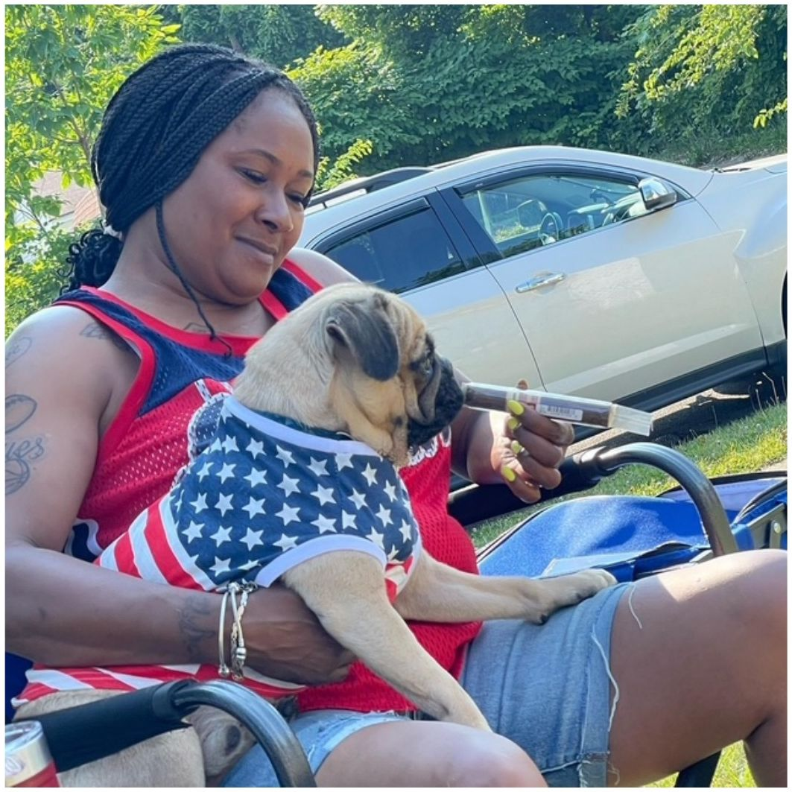
FAMILY ALBUM
Throwbacks & Treasures 💾
[Add name]
[Add name]
[Add name]
[Add name]
[Add name]
[Add name]
[Add name]
[Add name]
Edit the [Add name] boxes with who's who — these photos also live on the website's Photos page.

Slide 14
VOTE ALL WEEKEND
Family Superlatives 🏅 — Cast Your Vote!
😂 The Fun Ones
• Best Dressed
• Life of the Party
• Best Dancer
• Loudest Laugh
• Most Likely to Be Late
🍗 The Skills
• Best Cook / Best Dish
• Grill Master
• Best Card/Domino Player
• Spades Champion's Table
• MVP of the Family Games
💛 The Heart
• Family Glue Award
• Traveled the Farthest
• Eldest & Youngest Present
• Biggest Branch in Attendance
• Legacy Keeper (history & stories)
Nominations open Friday at check-in · voting closes Saturday 6 PM · one ballot per person · Hospitality counts · winners crowned at Sunday brunch.

Slide 15
IN LOVING MEMORY
A Tribute to Those We've Lost 🕊️
They are not gone — they are the roots beneath everything we do today. Please stand with us for a moment of silence.
We remember
[Add the names of loved ones lost, with branch and years]
Candle-lighting
One representative from each of the nine branches lights a candle as their branch's names are read aloud.
A memorial page in the yearbook and on the website keeps their stories alive.

Slide 16
Family Business
Finances · Governance · Committees · Website · Land · Scholarships · Foundation

Slide 17
FAMILY BUSINESS · FINANCIAL REPORT
Where the Money Stands 💵 (as of July 13, 2026)
$5,540
Dues collected · 115 attending
$1,675
Dues still outstanding
$410
Projected shortfall — let's close it!
Expense | Amount | Status
Clay's Park pavilion | $700 | PAID 3/13/26
Friday pavilion (Andrews Osborne) | $65 | PAID 3/1/26
Clay's Park tickets — 93 @ $20 | $1,860 | Due
Sunday banquet space | $200 | Due
Sunday brunch catering | $2,600 | $1,734 paid · $866.75 due
Estimated food — Fri / Sat | $2,200 | Due
TOTAL | $7,625 | $2,499 paid · $5,127 remaining
Dues total expected: $7,215. Dues: $125 single (or w/ 1 minor) · $175 single + guest/college student · $225 family of 3+. See the Treasurer for your balance.

Slide 18
FAMILY BUSINESS · GOVERNANCE
How We'll Govern Going Forward 🏛
Office | Officer | Core duty
President | Miesha | Presides, sets agenda, speaks for the family
Vice President | Aunt Shirley | Presides in absence; oversees committee chairs
Secretary | Marcelette | Minutes; TAKES ATTENDANCE; records, correspondence & notices
Treasurer | Jasmine | Holds funds, pays approved expenses, reports
Financial Secretary | Aunt Vanessa | Records all money in, issues receipts, tracks dues
Historian | Shone | History, archives, yearbook, family tree
Hospitality Chair | Loretta | Leads the COURTESY COMMITTEE: welcome, elders' care, tables & ushers, birthdays & accomplishments
Sergeant-at-Arms | Joseph | Keeps order; GUARDS THE DOOR (assisted by the Doorkeeper); safety
Membership Chair | [Open — vote today] | Membership roll & recruitment; matches volunteers to committees
Parliamentarian | [Open — vote today] | Advises on Robert's Rules; rules on points of order; CHAIRS THE PROTOCOL COMMITTEE
Doorkeeper | [Open — vote today] | Assists the Sergeant-at-Arms: door check-in, controls entry during votes, carries messages
Meditation Chair | [Open — vote today] | Leads prayers & prayer requests; delivers the condolences report; memorials with Services
Our written Constitution & Bylaws (Robert's Rules as parliamentary authority) is ready for adoption at this meeting.

Slide 19
FAMILY BUSINESS · RECOGNITION
Give Our Board & Committee Members Their Flowers 👏
Our current board — thank you!
• Miesha — President
• Aunt Shirley — Vice President
• Marcelette — Secretary
• Jasmine — Treasurer
• Aunt Vanessa — Financial Secretary
• Shone — Historian
• Loretta — Hospitality
• Joseph — Sergeant-at-Arms
Our committee members
• [Add the names of everyone currently serving on a committee — they get recognized here]
We need YOU
• Four new board seats, open for votes today:
• MEMBERSHIP CHAIR — roll & recruitment
• PARLIAMENTARIAN — Robert's Rules + Protocol Committee
• DOORKEEPER — assists the Sergeant-at-Arms
• MEDITATION CHAIR — prayers & condolences report
• COMMITTEE MEMBERS — every committee needs 2–5 members to assist its chair; no chair should carry a committee alone
The Membership Chair keeps the family roll, welcomes new members, and matches volunteers to committees. The Secretary is taking nominations right now.

Slide 20
FAMILY BUSINESS · GOVERNANCE
Robert's Rules of Order + Our Constitution 📜
Meetings stay fair, short & drama-free
• Quorum — minimum members present to conduct business
• Motion — “I move that we…” puts an idea on the floor
• Second — one member seconds to open discussion
• Discussion — the chair recognizes speakers in turn
• Vote — majority carries; the Secretary records it
Cheat sheet — what do I say?
• Propose → “I move that…”
• Support → “Second!”
• Change wording → “I move to amend…”
• End debate → “I move the previous question”
• Wrap up → “I move to adjourn”
Motion on today's agenda: adopt the Harris-Nelson Constitution & Bylaws — membership, officers & terms, quorum, dues, committees, amendments.

Slide 21
FAMILY BUSINESS · OPEN SEATS
Nine Committee Chairs Still Need a Name Next to Them 📋
🏈 Sports / Games Chair — OPEN
tournaments, kids' games, family Olympics, spades & dominoes brackets
🎶 Music Chair — OPEN
DJ & playlists, line-dance sets, old-school hour, banquet music
🍽 Food Chair — OPEN
caterers, menus, the cookout & potluck, family cookbook
🦺 Safety Chair — OPEN
first aid, headcounts, weather plans — with the Sergeant-at-Arms
🙏 Services Chair — OPEN
Sunday worship, memorial tribute, elder care — with the Meditation Chair
📸 Photography Chair — OPEN
photographer & videographer, branch portraits, yearbook photos
💝 Philanthropy & Fundraising Chair — OPEN
fundraisers for all three funds; scholarship & hardship review
🗓 Planning Chair — OPEN
dates, venues, decade planning, budgets, registration
💻 Technology Chair — OPEN
hnfamilyreunion.com, online payments & shirts, tree tools
Courtesy (Loretta) and Protocol (Parliamentarian) are covered. Chairs appointed by the President, confirmed by member vote — raise your hand or check 'I want to chair' on the sign-up form.

Slide 22
FAMILY BUSINESS · COMMITTEES
Committees Need Chairs — That Means YOU 🙋
🏈 Sports / Games
Chair: [sign up] · Members: [sign up]
🎶 Music
Chair: [sign up] · Members: [sign up]
🍽 Food
Chair: [sign up] · Members: [sign up]
🦺 Safety
Chair: [sign up] · Members: [sign up]
🙏 Services
Chair: [sign up] · Members: [sign up]
📸 Photography
Chair: [sign up] · Members: [sign up]
💝 Philanthropy & Fundraising
Chair: [sign up] · Members: [sign up]
🗓 Planning
Chair: [sign up] · Members: [sign up]
💻 Technology
Chair: [sign up] · Members: [sign up]
💐 Courtesy (led by the Hospitality Chair)
Chair: [sign up] · Members: [sign up]
📜 Protocol (chaired by the Parliamentarian)
Chair: [sign up] · Members: [sign up]
How committees operate
• Chairs appointed by the President, confirmed by member vote
• Meet monthly · report to the Vice President · 3-minute report each meeting
• Budget requests in writing to the Treasurer BEFORE spending
Three ways to sign up
• Paper sheets at the welcome table (write your name under Chair or Member)
• Online: Committee Sign-Up form on hnfamilyreunion.com
• Right now: raise your hand when your committee is called

Slide 23
FAMILY BUSINESS · DECADE PLANNING
Where We Meet Next 🗺 — Halfway Between Jackson, MS & Cleveland, OH
The drive is ~930 miles, so the halfway point lands around Nashville, TN / Bowling Green, KY.
🎯 At the halfway mark
• Montgomery Bell State Park — Burns, TN: 117 lakefront lodge rooms, 7,000+ sq ft event space
• Barren River Lake State Resort Park — Bowling Green, KY: banquet room seats 224–400
🚗 Along the route
• Kentucky Dam Village State Resort Park — Gilbertsville, KY
• General Butler State Resort Park — off I-71, Louisville↔Cincinnati
• Brown County / Abe Martin Lodge — IN (indoor water park!)
• Hueston Woods Lodge — College Corner, OH
🏙 Closer to Cleveland
• Salt Fork State Park Lodge — Lore City, OH
• Punderson Manor Lodge — Newbury, OH
• The Lodge at Geneva-on-the-Lake — Lake Erie shore
The Planning Committee gets group-rate quotes from the top three picks; we choose by member vote. Decade planning = we rotate.

Slide 24
FAMILY BUSINESS · TECHNOLOGY
Our New Home Online: hnfamilyreunion.com 💻
Everything reunion
• Announcements & event schedule
• Family history & photo gallery
• 2024 slideshow & yearbook archive
• Memorial page
Payments & shop
• Registration & dues online
• T-shirt orders
• Donations to the Land & Scholarship funds
Get involved
• Committee & chair sign-up
• Superlatives voting
• Family tree submission form
• Contact the officers
The Technology Committee launches from starter code already written (in the family GitHub repo). Payments run through Zelle/Cash App and a secure processor — we never store card numbers.

Slide 25
FAMILY BUSINESS · OUR LAND
Getting Our Family Land Back 🏡
We are partnering with Where Is My Land (whereismyland.com) — an organization that helps Black families research, document, and reclaim land that was taken from them.
Step 1: gather deeds, tax records & oral history Step 2: fund the RETAINER through reunion fundraising Step 3: family volunteers support the research
How fundraising is split
• 🏡 A share of every fundraiser → the land-back fund (retainer + renovation & revitalization of our land)
• 🛠 A share → the OPERATING FUND (strictly operating costs: website hosting, printing, permits + seed money for future reunions)
• 🎓 A share → the scholarship fund
• Exact percentages set by member vote today — chair, entertain a motion!
If our claim succeeds, recovered land/proceeds are stewarded by the family foundation.

Slide 26
FAMILY BUSINESS · EDUCATION
The Harris-Nelson Scholarship Fund 🎓
A scholarship for descendants of our ancestors
• Who: any descendant enrolled (or enrolling) in an accredited program — college, trade school, certifications
• How: short application + one-page essay on what family legacy means to you
• Selection: Philanthropy & Fundraising Committee reviews; officers ratify; awarded at the banquet
How we'll fund it
• A set share of all reunion fundraising (vote today)
• Dedicated fundraisers: raffle, fish fry, walk-a-thon, souvenirs
• Online giving — in honor or in memory of a loved one
• Tax-deductible once the 501(c)(3) is approved
Goal: award our first scholarship(s) at the next reunion.

Slide 27
FAMILY BUSINESS · NEW PROGRAM
Helping Hands — the Family Hardship Fund 🤝
Who can apply
• Any descendant, spouse/partner, or child (minors via a guardian) — or apply on behalf of a relative
• Hardship within the past 12 months: medical, job loss, housing/disaster, funeral, caregiving, education emergency
• One award per household per cycle; dues status does NOT affect eligibility
How the recipient is chosen
• Confidential application → Philanthropy & Fundraising Committee scores it
• Rubric: severity & urgency 40% · impact 30% · clarity & completeness 20% · discretion 10%
• 3+ independent scorers; household conflicts recuse; officers ratify
• Recipient may stay ANONYMOUS — always their choice
Deadlines each cycle
• Applications open January 1 of the reunion year
• Deadline: 30 days before the reunion
• Committee scores by 14 days out; officers ratify by 7
• Award presented at Sunday brunch
Apply at hnfamilyreunion.com (Hardship Fund page) or on paper from any officer. Award amount set by the Treasurer's budget each cycle — funded from the fundraising split.

Slide 28
FAMILY BUSINESS · THE FOUNDATION
Starting Our Family Foundation — a 501(c)(3) 🏛
The process (next few months)
• Month 1: choose the name, elect the founding board, draft bylaws & conflict-of-interest policy
• Month 1–2: file Articles of Incorporation; get an EIN (free, IRS.gov)
• Month 2–3: file IRS Form 1023-EZ (if eligible) or Form 1023
• Month 3+: state charity registration, bank account, annual budget
Foundation board (to be elected)
• Board Chair · Vice Chair · Board Secretary · Board Treasurer
• 3–5 at-large directors — one from each generation if we can
• Its own body with its own votes, separate from reunion officers
• Board meets quarterly; minutes published to the family
Nominations open today — see the Secretary. Already raised their hands on the questionnaire: Toni Nelson, Dennis Derrick Jr. & Marcelette We ratify the founding board by motion and vote.

Slide 29
ALL WEEKEND LONG
The Family Tree Project — Add Yourself! 🌳
Four easy steps
• Stop by the Family Tree table (or scan the QR code)
• Fill out the short form — name, birthday, parents, branch, children
• The Historian (Shone) adds you to the Ancestry tree
• A large family tree poster gets printed with EVERYONE listed
Ways to submit
• Online: the Family Tree Google Form, or the matching form on hnfamilyreunion.com
• Paper: forms at the Family Tree table all weekend
• Bring old photos, obituaries, bibles, deeds — we scan them on the spot (you keep the originals)

Slide 30
KEEP THESE HANDY
All the Links 🔗
What | Where
Family website | hnfamilyreunion.com (launching soon)
Family email | harrisnelsonfamilyreunion@gmail.com
Zelle (dues & shirts) | Joseph Nelson — harrisnelsonfamilyreunion@gmail.com
Cash App | Miesha Wilson — $mieshanulife06
Yearbook post | x.com/tendin2
History & yearbook doc | Google Docs (link on the website)
Photos & stories album | canva.link/fqxj2trjluu9fl5
Family tree form | Google Form (QR at the Family Tree table)
Land-back partner | whereismyland.com

Slide 31
We Are the Harvest of Their Planting
Sign a form. Chair a committee. Add your branch to the tree. See you at the next reunion — bigger, better, and on our own land.
Harris-Nelson Family Reunion · hnfamilyreunion.com · harrisnelsonfamilyreunion@gmail.com

