Slide 1

Pipeline FFT processor
https://docs.google.com/presentation/d/e/2PACX-1vSqj7ePaEtihTBUsl9Ayv-p-JQas8AV9MLNRlEO0CQ-OL9cp8e6d7nYdWdlicNTMgOeAKzbUcBivgEE/pub?start=false&loop=false&delayms=60000
대한상공회의소 서울기술교육센터 AI 시스템 반도체 설계 (2기)
6조 오정일, 김민규, 임승빈, 조성현
renew

Slide 2




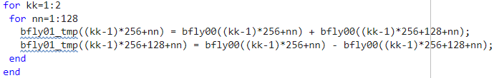

Formula
indexing
butterfly

Slide 3
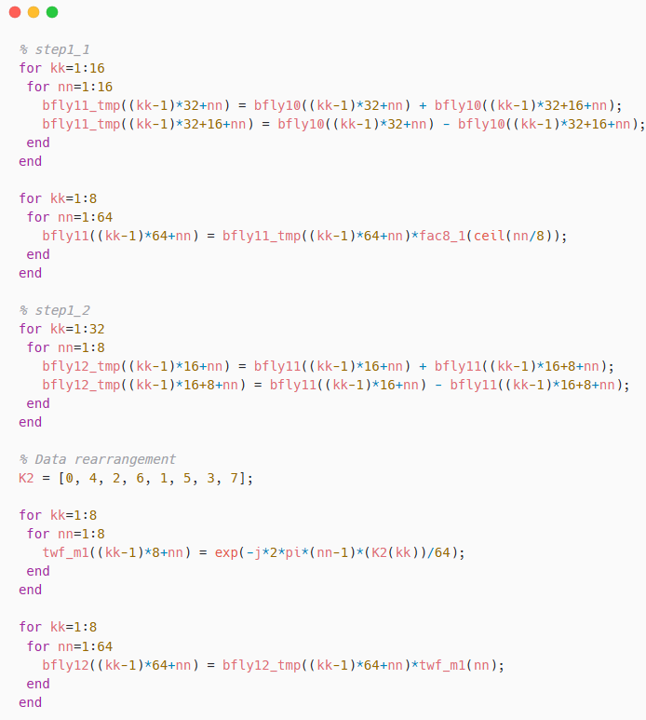
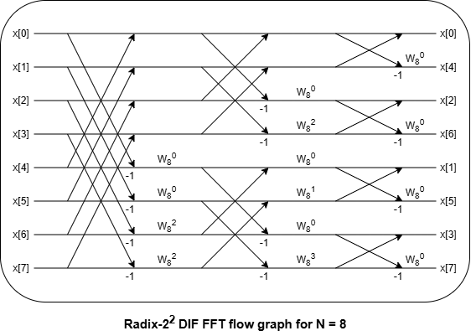
DIF FFT Process (8-point)

Slide 4
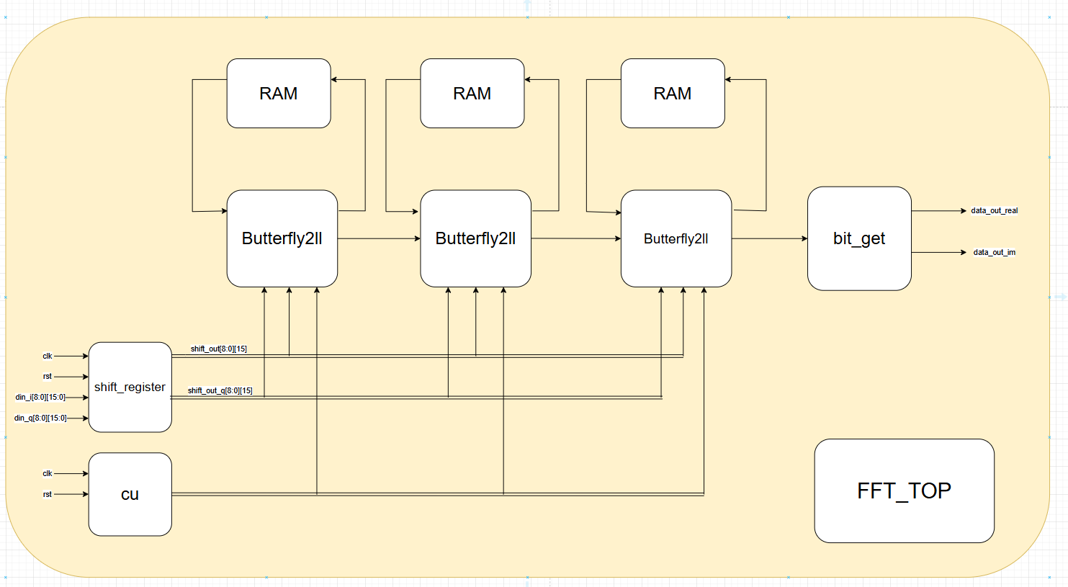
Block diagram

Slide 5
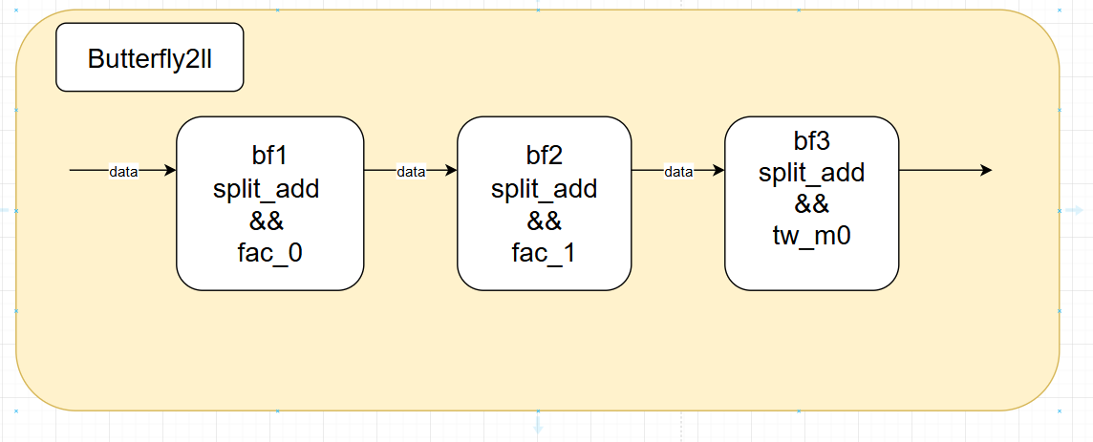
Block diagram

Slide 6
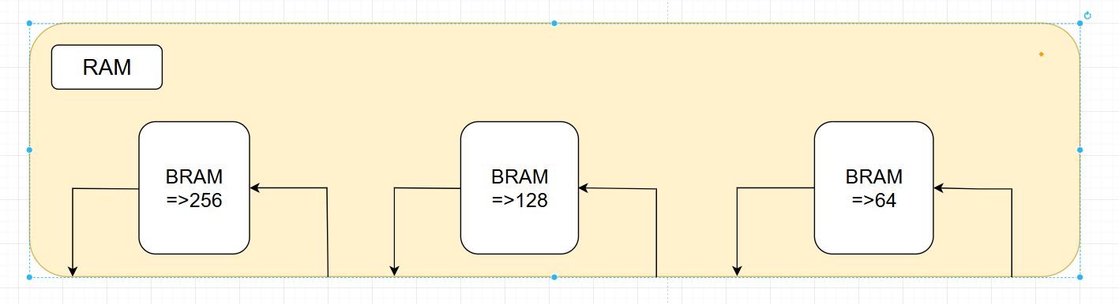
Block diagram

Slide 7
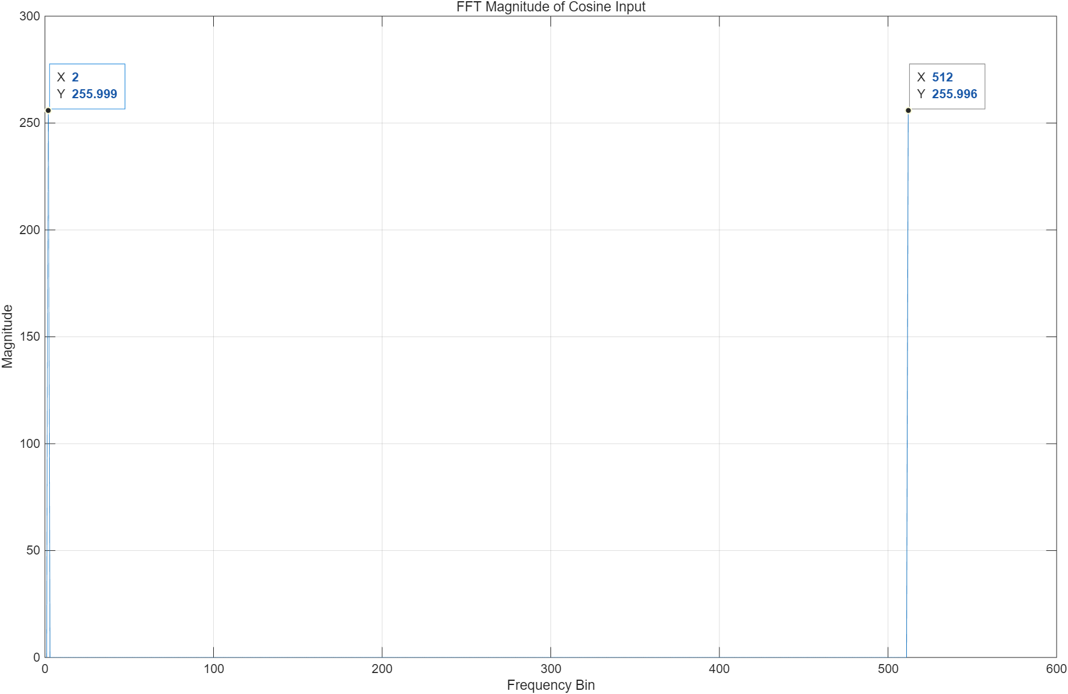

Float FFT result

Slide 8
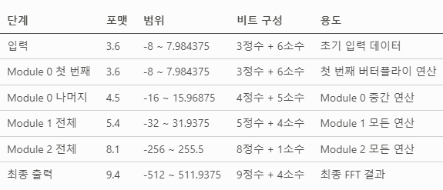
Fixed-pointing
process

Slide 9
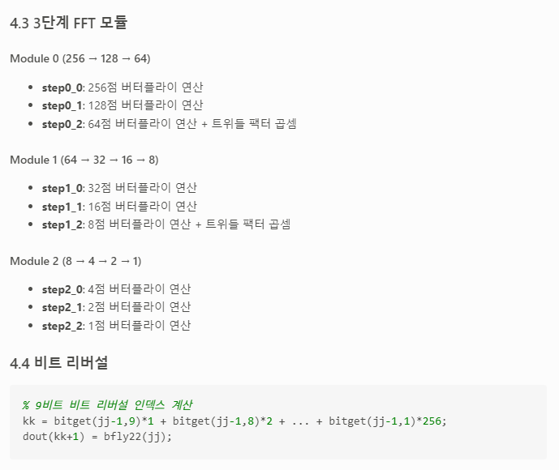
Fixed-pointing

Slide 10
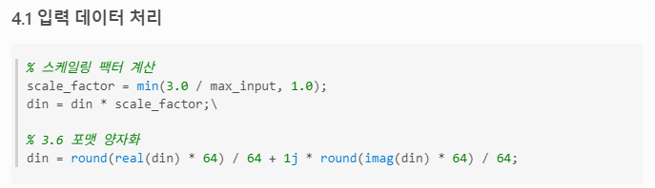
Fixed-pointing

Slide 11
Fixed-pointing

Slide 12
Fixed-pointing

Slide 13
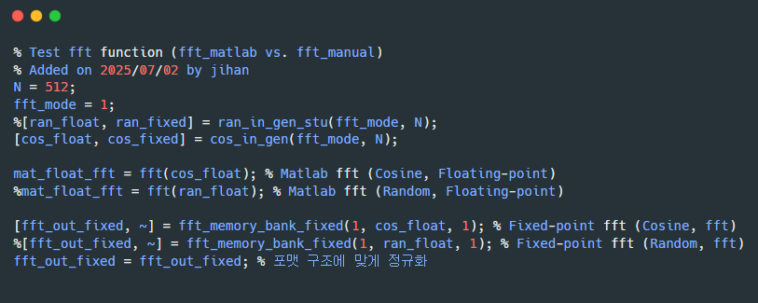
Test_bench

Slide 14
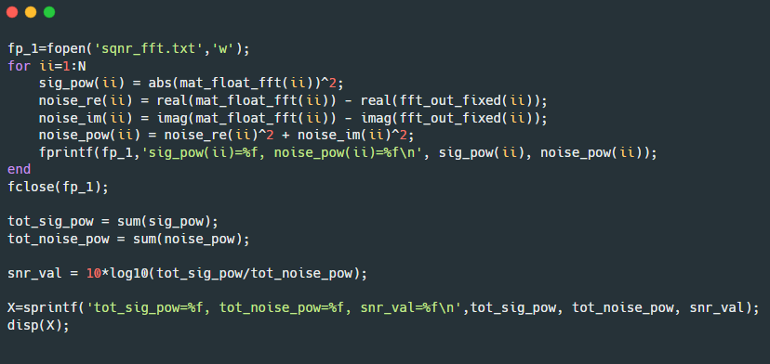
Test_bench

Slide 15
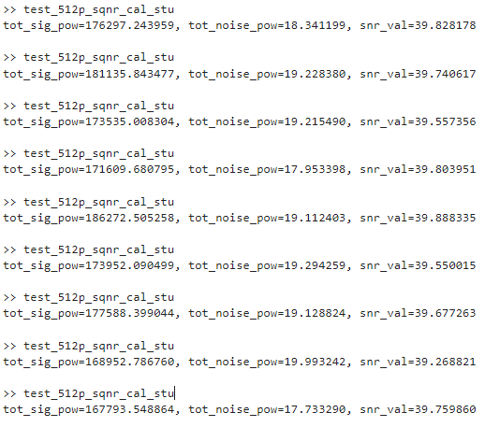
Test_bench
result_random

Slide 16
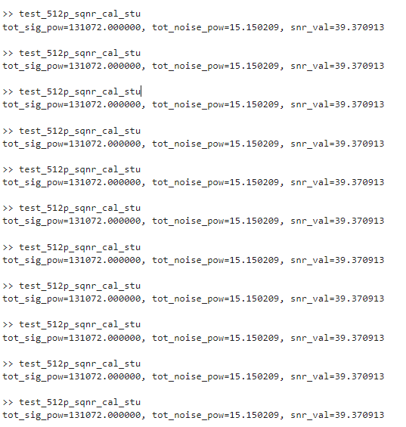
Test_bench
result_cosine

Slide 17
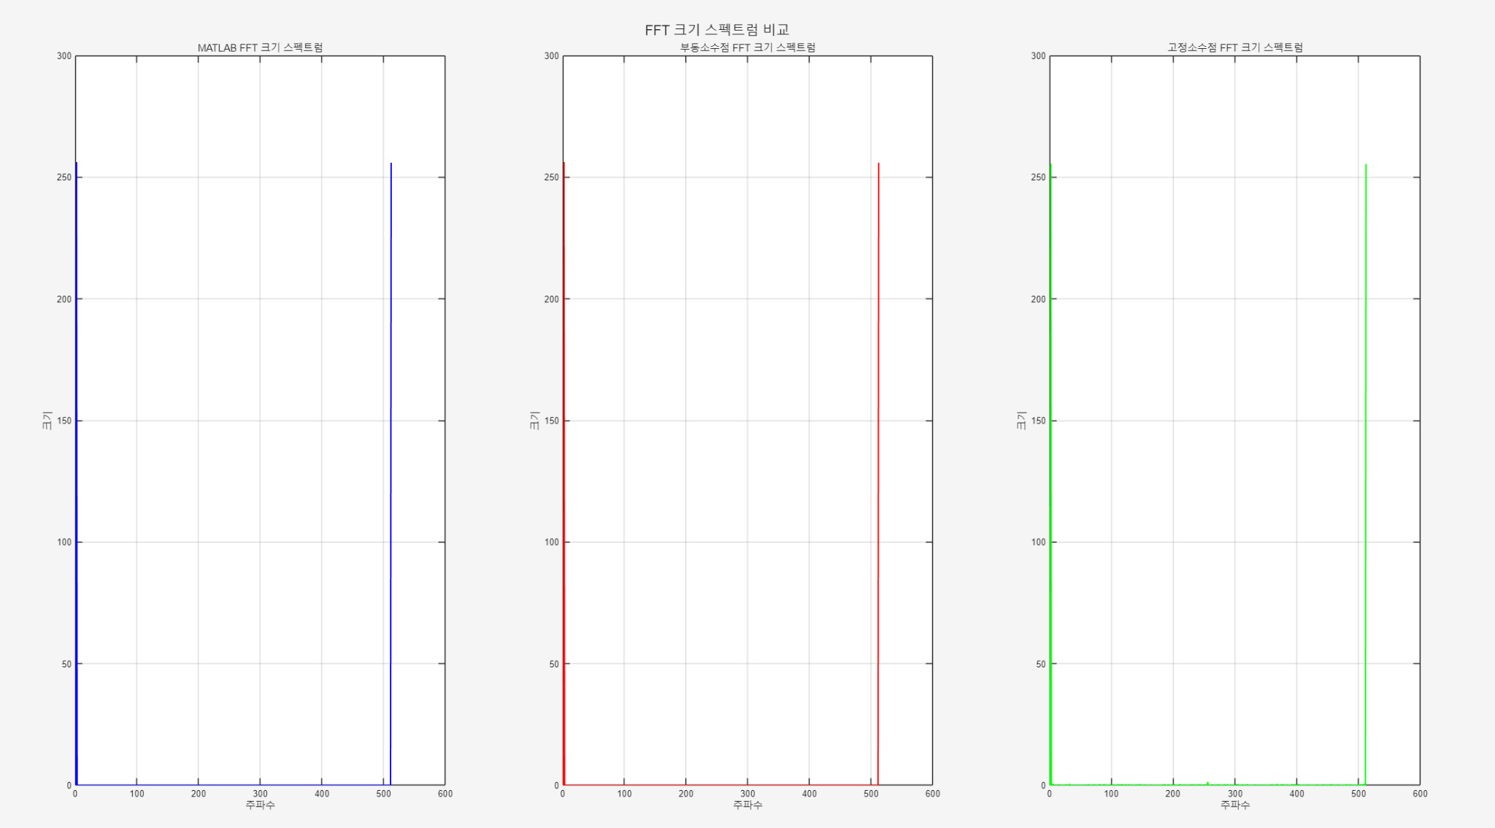
Test_bench

