Slide 1

Introduction to
Data Mining
By Kelly

Slide 2
Types of Data Mining Models
Supervised | Unsupervised
Regression: Linear, Multiple, Regularised, LASSO, Ridge, Weighted, Logistic | K means Clustering
Neural Network: Forward propagation, Backward propagation | Market basket analysis
Classification: Regression Tree, Random Forest | Principal Component analysis
Xgboost
Support vector machines

Slide 3
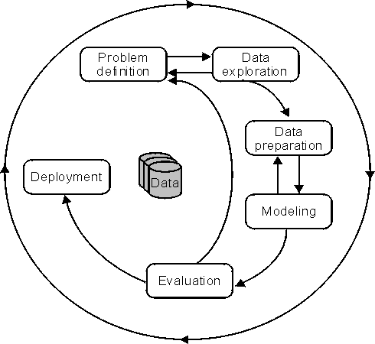
Data Mining Process
CRISP DM process model

Slide 4
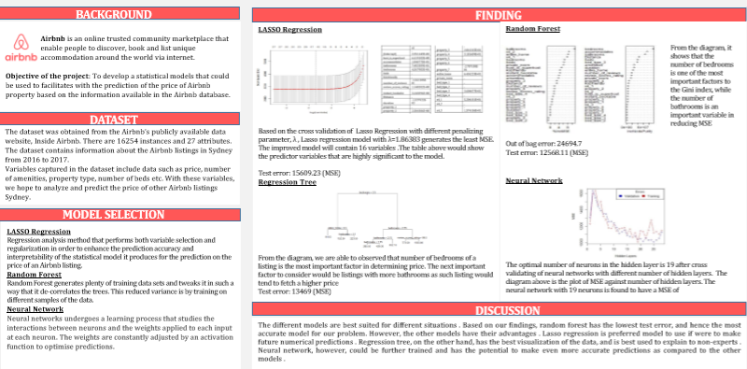
Data Mining Project - Airbnb

Slide 5

LASSO Regression
Lasso regression is a type of linear regression that uses shrinkage. The lasso procedure encourages simple, sparse models. This particular type of regression is well-suited for models showing high levels of muticollinearity or when you want to automate certain parts of model selection, like variable selection/parameter elimination.
Cost Function -

Slide 6
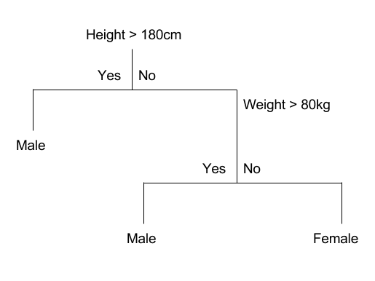
Regression Tree
Trees divide the predictor space into distinct and non-overlapping regions
The decision of making strategic splits heavily affects a tree’s accuracy.
    Gini Index
    Chi Square
Stopping Criteria – e.g. stop once the number of observations per node becomes < 50.
Pruning - remove irrelevant nodes

Slide 7
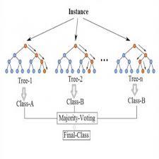
Random Forest
Create a “forest” of decision trees
Determine the prediction made by each decision tree
Majority vote will be used to obtain the final decision

Slide 8
Cross Validation
K-fold cross validation:
Cross-validation is a technique to evaluate predictive models by partitioning the original sample into a training set to train the model, and a test set to evaluate it.
    This is a common practice
Leave-out-one cross validation: when K=N (total number or data points)

Slide 9

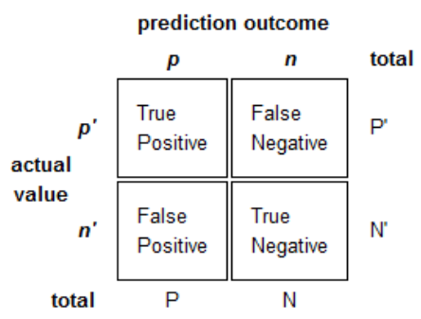
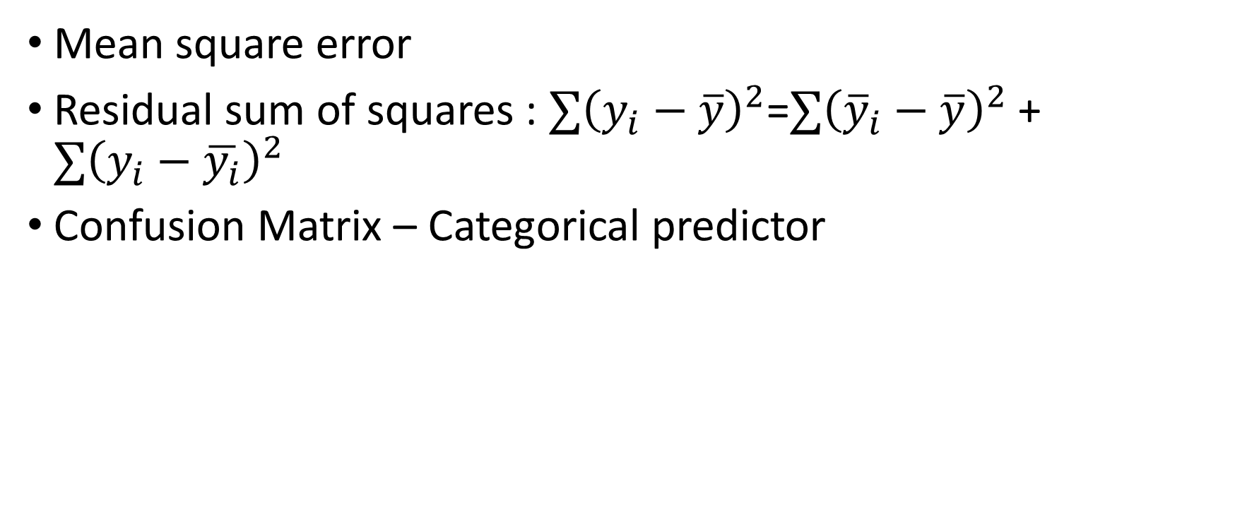
Data Model Evaluation
Mean square error
Residual sum of squares : $∑{\left(y_{i}−\overline{y}\right)}^{2}$=$∑{\left({\overline{y}}_{i}−\overline{y}\right)}^{2}$ + $∑{\left(y_{i}−\overline{y_{i}}\right)}^{2}$
Confusion Matrix – Categorical predictor

Slide 10
Data Mining Models for Customer Service
Classification models: Decision trees and Random Forest – for exploratory data analysis and customer satisfaction prediction
Regression models : Identify relevant variables, create prediction models
Clustering : Identify unique customer groups
Feature Engineering
Possible areas to explore:
  The relationship between customer experience and customer satisfaction
  Identify factors that affects customer’s satisfaction

Slide 11
Managing Unstructured data
Obtain tokens from text
Remove high frequency/common English words
Stemming
Calculate the frequency of remaining words/phrases
Unstructured data: Images, Text, Sounds, HTML, pdf etc.
General steps for handling unstructured data:
Tokenization is the process of breaking a stream of test up into words, phrases, symbols
Example: Stop words: I,we,you,are,is ...
So that we can unveil more interesting trends -
Stemming: identifying words with the same root word.

Slide 12
Methods in Text mining
Natural language Processing
Sentiment analysis
Bag-of-words

Slide 13
Statistical Models for unstructured data
Clustering
Classifications

