Slide 1
Automated Vulnerability Scanning and Reporting Tool
Built with OWASP ZAP, Python, and Flask
Presented by
MEGAVARSHINI A
SNS College of Technology

Slide 2
Introduction:
Brief Overview:
The need for secure web applications is critical.
Manual vulnerability testing is time-consuming.
Aim: Automate the scanning process using OWASP ZAP and generate reports.

Slide 3
Problem Statement:
Manual vulnerability testing is often time-consuming, complex, and requires expert knowledge. Many developers lack access to easy-to-use tools for identifying common web security flaws. This project addresses the need for a simple, automated solution by using OWASP ZAP and Python to scan web applications and generate detailed vulnerability reports through a user-friendly web interface.
Challenges:
Many developers neglect security testing during development.
Manual testing requires expertise and time.
Lack of easy-to-use tools for non-experts.

Slide 4
Importance of the Project :
Why it Matters:
Enhances cybersecurity posture of web apps.
Saves time with automation.
Useful for developers, testers, and security analysts.
Helps identify OWASP Top 10 vulnerabilities.

Slide 5
Objectives:
To develop a user-friendly interface for scanning.
Automate scanning using OWASP ZAP’s API.
Generate vulnerability reports in PDF format.
Support single and multiple URLs via file upload.

Slide 6
Tools and Technologies Used:
Languages: Python
Framework: Flask (for Web Interface)
Security Tool: OWASP ZAP
Libraries: ReportLab (for PDF generation), Requests, OS, subprocess
Others: Windows Task Scheduler (for automation)

Slide 7
System Architecture:
Flow Diagram:
Web Interface
URL Input
OWASP ZAP Scan
Generate Report
Output PDF

Slide 8
Module-wise Explanation:
1. zap_scanner.py – Handles communication with ZAP API and performs scans.
2. generate_report.py – Formats and exports results as a PDF.
3. app.py – Flask app that provides the web interface.
4. run_tool.py – Executes the tool and integrates other modules.

Slide 9
Key Features:
Simple and clean Flask UI.
Scans for vulnerabilities like XSS, SQLi, CSRF.
Report includes URL, alerts, risk levels, and recommendations.
Supports multiple input methods – single URL or text file.

Slide 10
Future Scope:
Add user authentication to the web app.
Integrate SSL/TLS scanning.
Enable scan scheduling and logs.
Implement email alerts and report export in other formats (CSV/HTML).
Dockerise the app for deployment on any system.

Slide 11
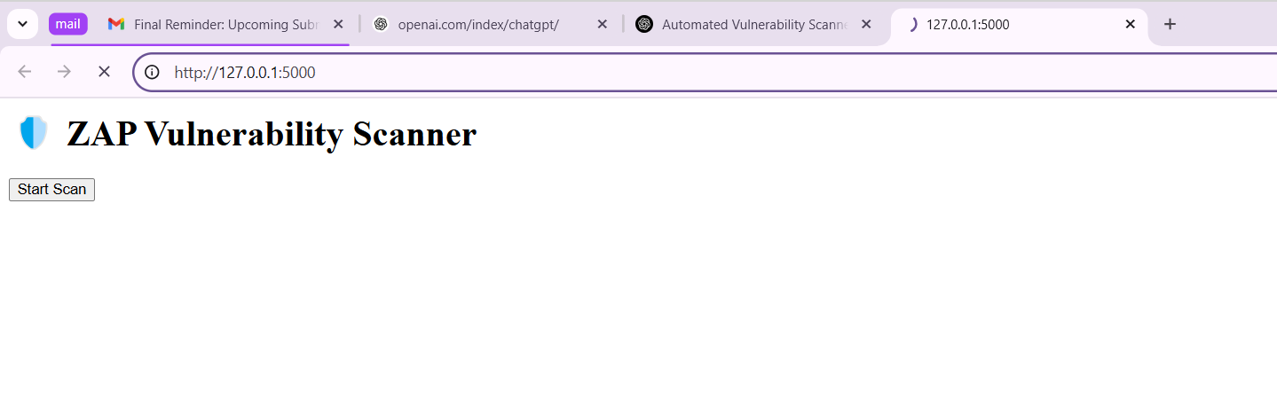
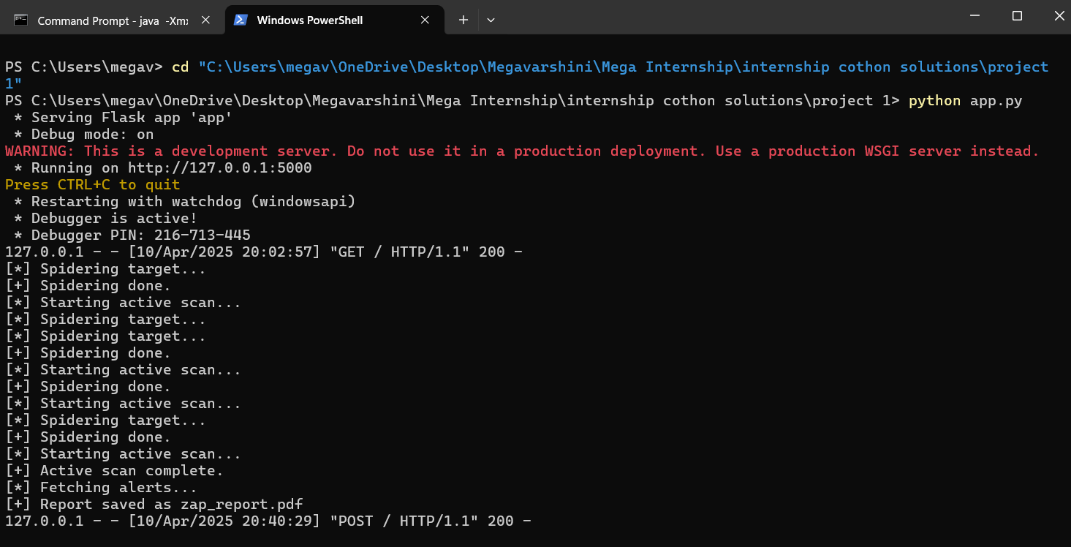
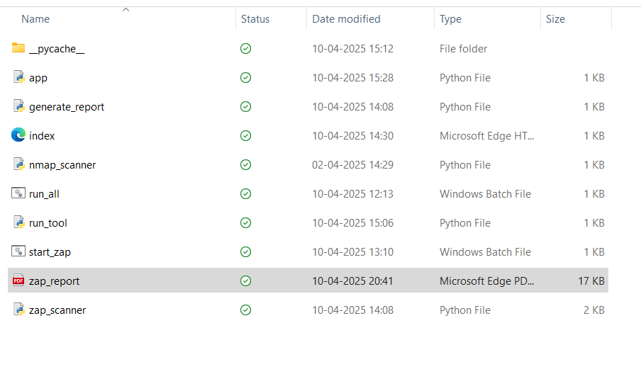
Results and Demonstration:

Slide 12
Conclusion:
The project successfully automates web vulnerability scanning using OWASP ZAP and Python, making security testing faster, easier, and more accessible. With a simple Flask interface and detailed PDF reports, it helps developers and testers identify and fix critical security issues. This tool contributes to building safer web applications and has strong potential for future enhancements.
C:\Program Files\ZAP\Zed Attack Proxy>java -Xmx512m -jar zap-2.16.1.jar - daemon -host 127.0.0.1 -port 8081 -config api.key=testkey

