Slide 1

BIRLA INSTITUTE OF TECHNOLOGY MESRA JAIPUR CAMPUS
ANALYSIS OF COVID -19 BASED UPON THE SYMPTOMS
SUBMITTED TO: SUBMMITED BY:
Dr. Madhavi Sinha Meghaj Kumar Mallick
(H.O.D Computer Science Department) (MCA/25017/18)
3rd Year, 6th Semester
Dr. Piyush Gupta 2018-2021
(Project Coordinator)

Slide 2
CONTENTS
1.WHAT IS COVID-19
2. INTRODUCTION
3.MACHINE LEARNING APPROACH
4.PROBLEM STATEMENT
5.AIM & OBJECTIVE
6.SOFTWARE REQUIREMENT
7.STEPS TO CREATE COVID-19 APPLICATION
8.DATASET
9.DATA PRE-PROCESSING
10.MODEL SELECTION
11.ENSEMBLE TECHNIQUE
12.FRONT END DESIGN
13.LIMITATIONS
14.CONCLUSION
15.REFERENCES

Slide 3
1.WHAT IS COVID-19
Corona viruses are a large family of viruses that are known to cause illness ranging from the common cold to more severe diseases such as Middle East Respiratory Syndrome(MERS) and Severe Acute Respiratory Syndrome(SARS).
These two diseases are spread by the corona viruses named as MERS-CoV and SARS-CoV. SARS was first seen in 2002 in China and MERS was first seen in 2012 in Saudi Arabia.
The latest virus seen in Wuhan, China is called SARS-COV-2 and it causes corona virus

Slide 4
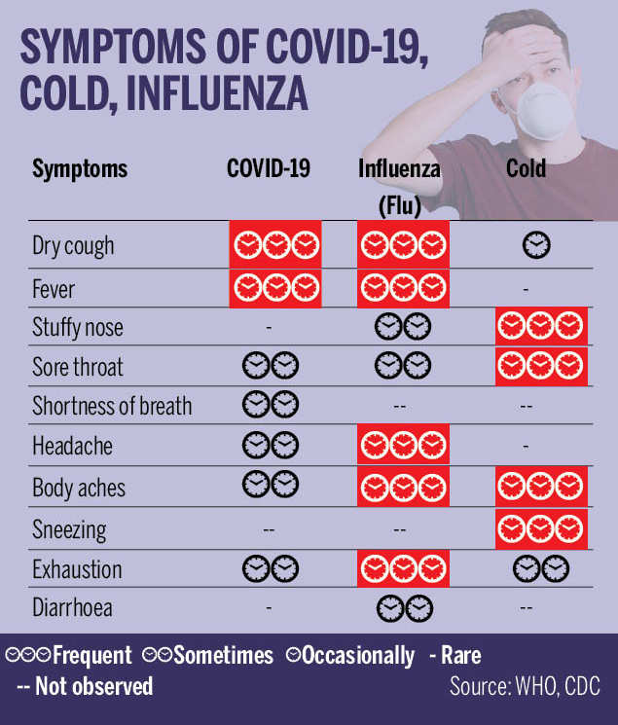
2.INTRODUCTION
The aim of this project is to predict whether a person has COVID-19 or not, using machine learning techniques.
The prediction is performed using the clinical information of the patients.
The goal is to identify whether a patient can potentially be diagnosed with COVID-19.

Slide 5
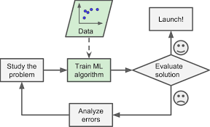
3.MACHINE LEARNING APPROACH
A Systematic Literature Review is performed to identify the most suitable algorithms for the prediction model.
Then through the findings of the literature study, an experimental model is developed for prediction of COVID-19 and to identify the features that impact the model.
The main objective of Machine Learning is that it learns from the feed data without any interference of humans that is, it automatically learns from given data(experience) and gives us the desired output where it searches the trends/patterns in the data

Slide 6
4.PROBLEM STATEMENT
A pneumonia of unknown cause detected in Wuhan, China was first reported to the World Health Organisation (WHO) Country Office in China on 31 December, 2019. Since, then the number of cases of corona virus are increasing along with high death toll.
Corona virus spread from one city to whole country in just 30 days .On Feb 11, it was named as COVID-19 by World Health Organisation (WHO)
COVID-19 has spread across the globe with around 213 countries .
In our thesis, we would like to use machine learning techniques to predict the symptoms of COVID-19.

Slide 7
5. AIM & OBJECTIVE
The aim is to provide a machine learning model that can easily analysis the symptoms of COVID-19.
It will help to reduce the risk of getting affected. By using the machine leaning model we will try to indentify the symptoms of this disease.
The main goal of this thesis is to develop a machine learning model that could predict whether a patient is suffering from COVID-19.

Slide 8
6.SOFTWARE REQUIREMENT
Package Requirement: Tinker, NumPy, Scikit Learn, Matplot Library
Tinker: This is python module to create graphical application. Firstly we have to import it from python and then we can create graphical form of our program and see the information with user-interface.
NumPy: NumPy is a library for the Python programming language, adding support for large, multi-dimensional arrays and matrices, along with a large collection of high-level mathematical functions to operate on these arrays.
Scikit Learn : Scikit-learn is a free software machine learning library for the Python programming language. It features various classification, regression and clustering algorithms including support vector machines.
Matplot Library: Matplotlib is a plotting library for the Python programming language and its numerical mathematics extension NumPy. It provides an object-oriented API for embedding plots into applications using general-purpose GUI toolkits like Tkinter, wxPython, Qt, or GTK

Slide 9
7. STEPS TO CREATE COVID-19 APPLICATION
We have to collect the raw data from various dataset repositories such as github, kaggle etc.
After collecting the data we have to pre-process & clean the data.
Then we have to implement the machine learning algorithm to predict the result.
Ensemble technique of bagging approach is used for the overall performance improvement.
Finally the result is obtained in GUI.

Slide 10
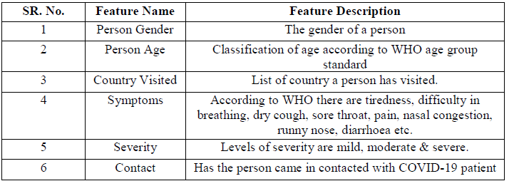
8. DATASET
The data-set is a combined multi-dimensional data. It contains fields with textual data and some with precise values. The data set for COVID-19 symptoms have been downloaded from world health organization
The attributes that were considered in the data-set for the machine learning model are presented in Table 1.

Slide 11
9. DATA PRE-PROCESSING
Data pre-processing occurs to be a curial step while implementing in every data science project .
In our case due to binary data sight in every feature, we don’t require much pre-processing of our data.
We have first tried to use feature engineering to handle our categorical data input.
There are some null values after that we have gone for a basic dimensionally deduction by admitting the non reliable feature of the data.
At last we have also gone through capturing feature i.e. very important for some analysis about the most relevant feature acting in our results.

Slide 12
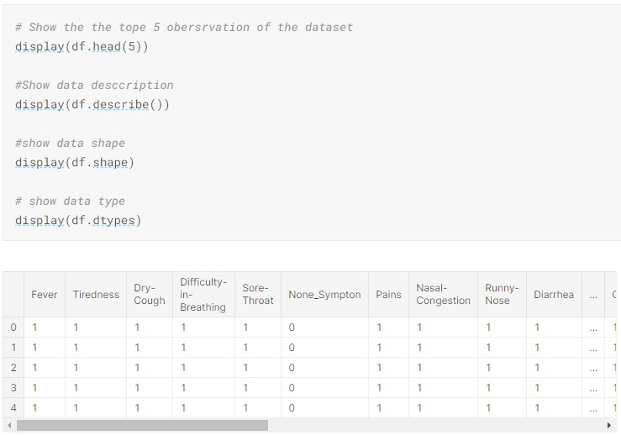

Slide 13
10. MODEL SELECTION
Model selection is the process of selecting one final machine learning model from among a collection of candidate machine learning models for a training dataset.
Model selection is a process that can be applied both across different types of models and across models of the same type configured with different model hyper parameters (e.g. different kernels in an SVM) .
For this project we cannot rely on one model to predict the actual result, we have to use three algorithms such as Random Forest, Logistic Regression & Naive Bayes to predict the result.

Slide 14
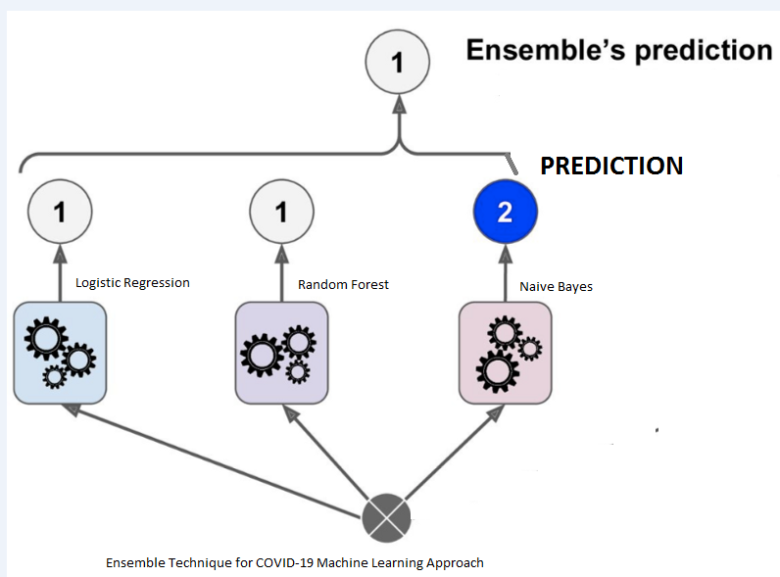
11.ENSEMBLE TECHNIQUE
Ensemble methods are techniques that create multiple models and then combine them to produce improved results.
The ensemble method usually produces more accurate solutions than a single model would produce.

Slide 15
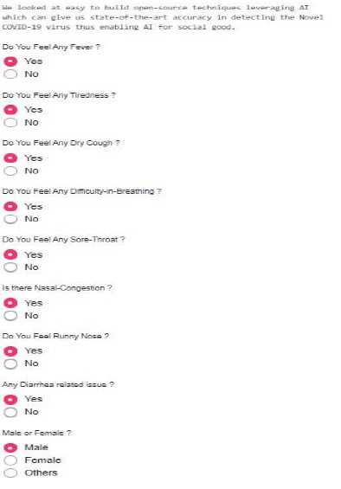
12.FRONT END DESIGN

Slide 16
13. LIMITATIONS
This entire project of COVID-19 is based upon the first wave of corona virus i.e. which can be determined by their symptoms.
This project can only determine the result when the input values are correct.
The machine learning model can be used to analysis the symptoms of this disease only when the correct option is being selected by the user.
To predict the actual result we have to use the clinical dataset which contains the patient medical reports such as CT scanning & RT-PCR test data

Slide 17
14. CONCLUSION
In this research, a systematic literature review has been conducted to identify the suitable algorithm for prediction of COVID-19 in patients.
The selected algorithms were trained with the patient clinical information about the basic symptoms that indicated the infection in a person.
A prediction system that could find the possibility of outbreak of novel diseases that could harm mankind through socio-economic and cultural factor consideration can be developed.
It is recommended to work on calibrated and ensemble methods that could resolve problems faster with better outcomes than the existing algorithms

Slide 18
15. REFERNENCES
[1] Punn, N. S, Sonbhadra, S. K. & Agarwal, S. COVID-19 Epidemic Analysis using Machine Learning and Deep Learning Algorithms. medRxiv, https://doi.org/10.1101/2020.04.08.20057679 (2020).
[2] Dong, E., Du, H. & Gardner, L. An interactive web-based dashboard to track COVID-19 in real time. Lancet Infect. Dis. https://doi.org/10.1016/S1473-3099 (20)30120-1
[3] Mei, X. et al. Artificial intelligence–enabled rapid diagnosis of patients with COVID-19. Nat. Med. 26, 1224–1228 (2020)
[4] Feng, C. et al. A novel triage tool of artificial intelligence assisted diagnosis aid system for suspected COVID-19 pneumonia in fever clinics. medRxiv,
https://doi.org/10.1101/2020.03.19.20039099 (2020).
[5] Hastie, T., Tibshirani, R. & Friedman, J. In The Elements of Statistical Learning: Data
Mining, Inference, and Prediction (eds. Hastie, T.,Tibshirani, R. & Friedman, J.)337–387 (Springer,2009).
[6] Google covid-19 search trends symptoms dataset. https://goo.gle/covid19symptomdataset

Slide 19
THANK YOU

