Slide 1
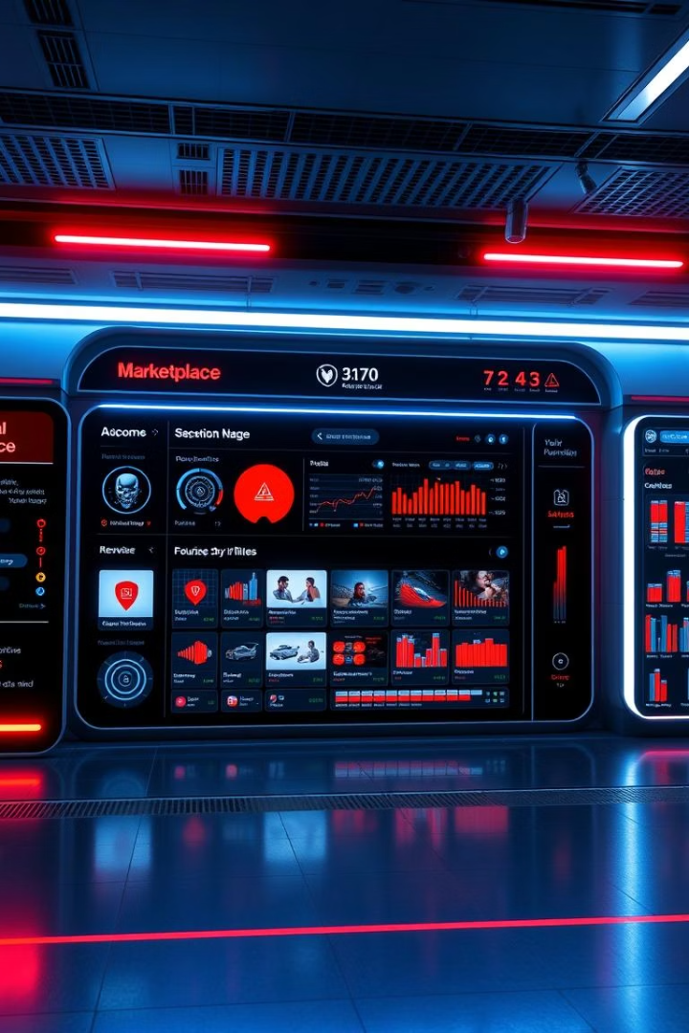
AI-Driven Barter Exchange Platform with AI-Based Price Prediction
Minor Project Presentation :-
Megha Bachiyani(22CBS10043)
Kumar Utkarsh(22CBS10003)
Lakshay(22CBS10016)

Slide 2
Problem Statement and Proposed Solution
Problem Statement
Proposed Solution
Barter lacks transparency, no standardized pricing
AI predicts real-time fair prices
Users find fair value estimation difficult
Smart, transparent, trustworthy exchanges

Slide 3
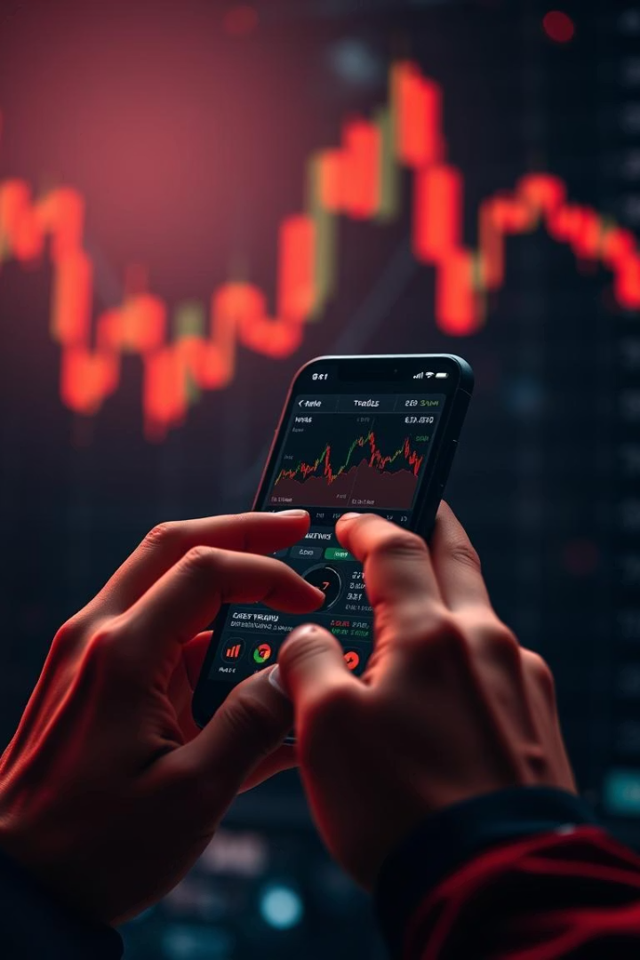
Project Objectives
AI price prediction model
Focus on used smartphones initially
Intuitive listing and trading app
User friendly, seamless design
Real-time chat integration
Facilitate buyer-seller negotiation
Sustainable trading promotion
Encourage fair, eco-friendly reuse

Slide 4
Methodology Overview
Data Collection
Brand, specs, condition, usage, purchase price
Preprocessing
Missing data handling, encoding, feature scaling
Model Building
Random Forest, SVM, Decision Tree, Linear Regression
App Development
Flutter frontend, Dart/Node.js backend, Flask AI API
Integration
Connect AI model with live user interaction

Slide 5
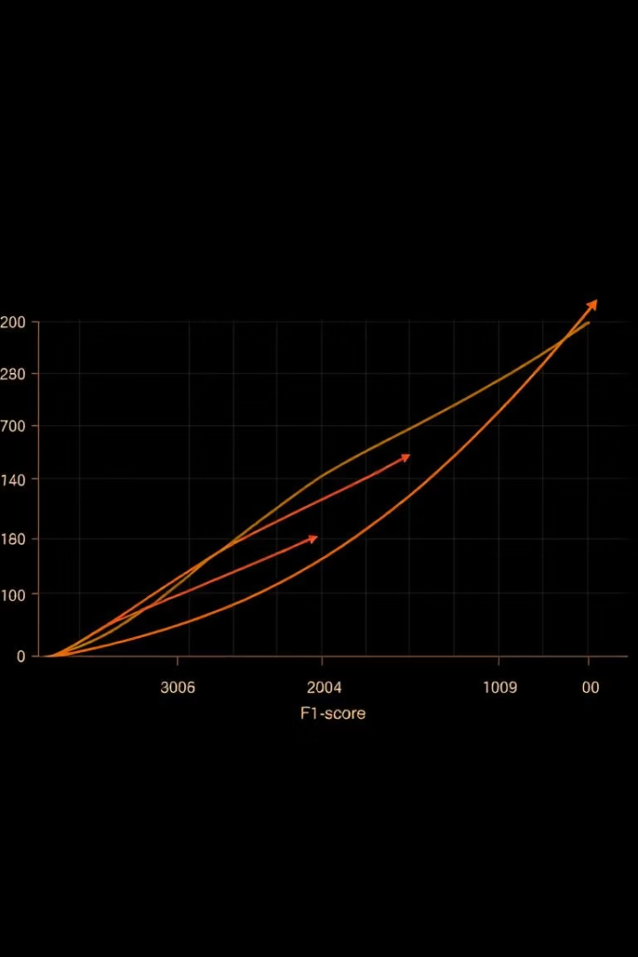
Results and Achievements
Random Forest Regressor
Best model: R² = 0.9711, MSE = 0.0071
Accurate Price Prediction
Predicts real-world resale values well
Functional Integration
Price estimation, listings, chat combined
Validated System
Real-world device testing confirms performance

Slide 6
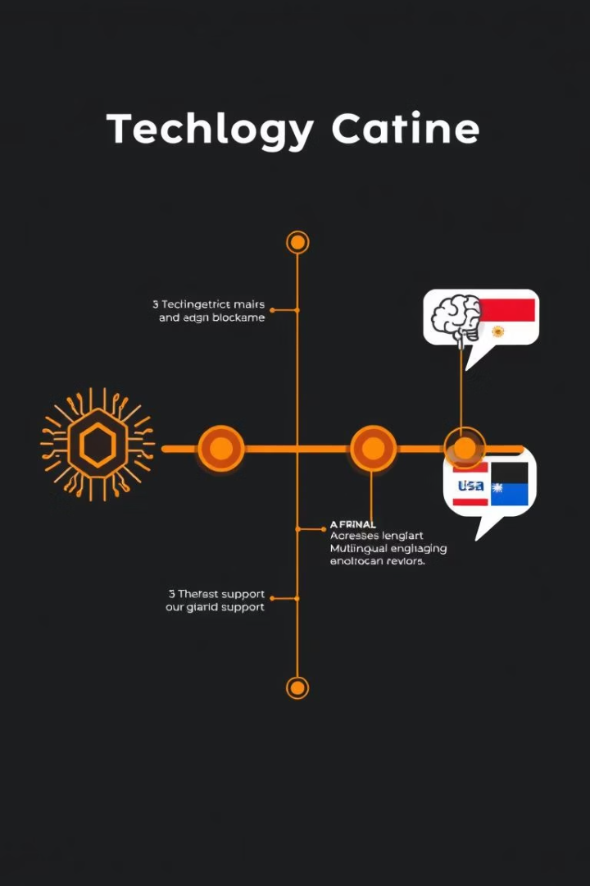




Future Work and Enhancements
Expand Product Categories
Laptops, tablets, furniture
Blockchain Integration
Trade authenticity and secure ownership
AI Smart Matching
Recommend products and partners
Multilingual & CV Support
Image-based condition assessment

Slide 7
Conclusion and Impact
Fairness, transparency, trust in barter trading
Our platform redefines barter exchanges with cutting-edge AI, fostering trust and sustainability in trading used products.
Empowers data-driven user decisions
Promotes sustainability and electronic waste reduction
Foundation for AI-powered trading ecosystems

