Slide 1
100 days of coding challenge
DAY 3
NAME-MEGHNA MITRA
REG.NO.-22MCA10043

Slide 2
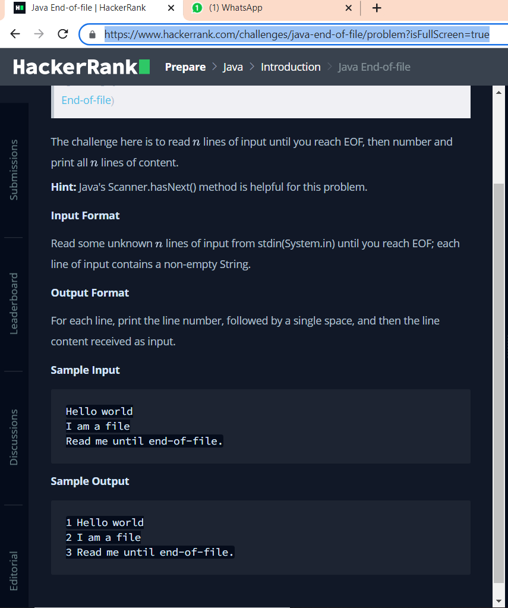
LINK:https://www.hackerrank.com/challenges/java-end-of-file/problem?isFullScreen=true

Slide 3
PROGRAM
import java.io.*;
import java.util.*;
import java.text.*;
import java.math.*;
import java.util.regex.*;
public class Solution {
public static void main(String[] args) {
int x=0;
Scanner sc = new Scanner(System.in);
while(sc.hasNext()){
x++;
System.out.println(x+" "+sc.nextLine());
}
sc.close();
}
}

Slide 4
LEARNING
The problem is here is to read n lines of input until you reach the statement ” end of function”.
In first, I take a input name x. Then took while loop for condition check. hasNext() class which return true if this
Scanner has another token in its input . Then I increased the input for next line and the loop is going on
and at the end when it returns end of function it stopped looping.

Slide 5
Interview question
1. What is the difference between equals() method and == operator?
The equals() method matches content of the strings whereas == operator matches object or reference of the strings.
.
2. Is String class final?
Yes..
3. What is String in Java?
The string is a final class in Java defined in java.lang package. You can assign a sequence of characters to a string variable.

Slide 6
4. What is the String pool in Java?
The String pool is a special type of memory maintained by the JVM.
5. Is String a keyword in java ?
No, String is not a keyword in java.

