Slide 1
100 days of coding challenge
DAY 2
NAME-MEGHNA MITRA
REG.NO.-22MCA10043

Slide 2
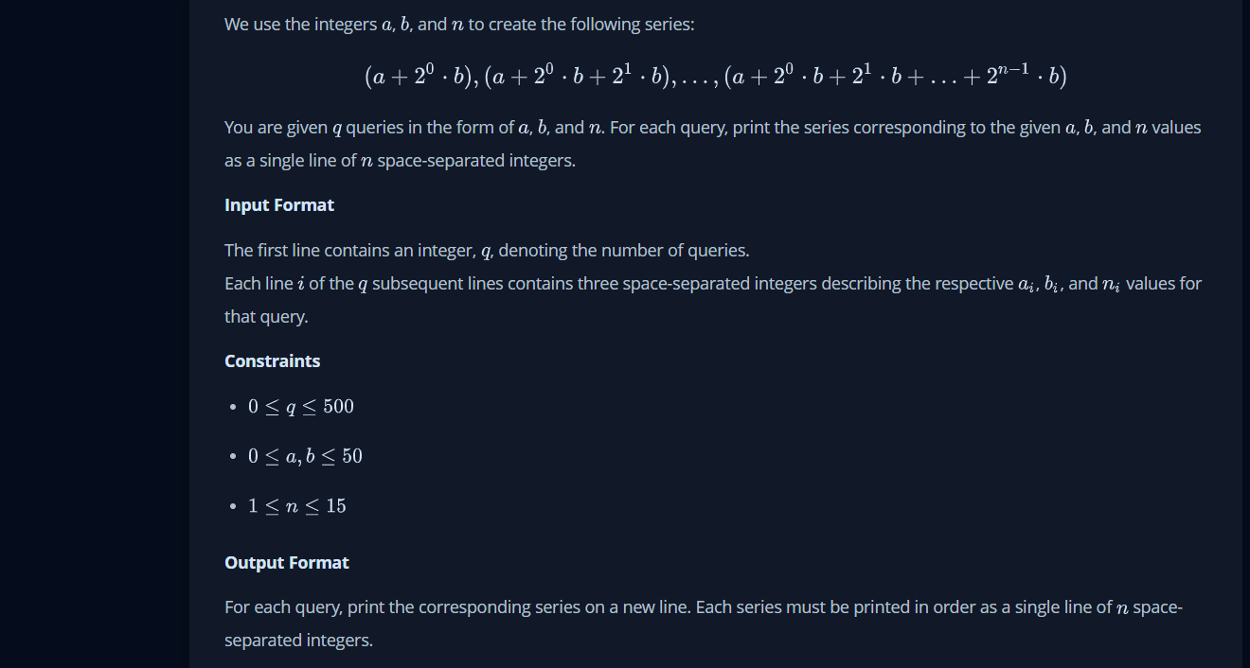
LINK : https://www.hackerrank.com/challenges/java-loops/problem?h_r=next-challenge&h_v=zen&isFullScreen=false

Slide 3
PROGRAM
import java.util.*;
import java.io.*;
class Solution{
public static void main(String []argh){
Scanner in = new Scanner(System.in);
int t=in.nextInt();
for(int i=0;i<t;i++){
int a = in.nextInt();
int b = in.nextInt();
int n = in.nextInt();
for(int j=0;j<n;j++) {
a=a+b;
if(j>0){
System.out.print(" ");
}
System.out.print(a);
b=b*2;
}
System.out.println();
}
in.close();
}
}

Slide 4
LEARNING
First of all we have to run a loop from 0 to n. So,we take an integer value name ‘j’. Then,from the sequence we get a pattern of ‘a=a+b’.after that for printing space we took a if statementin which if the j is greater than zero then it will give a space. Then,it will print a and then b will be increasing by 2 everytime. After that it will back to the ‘a= a+b’ statement for printing the given sequence.

Slide 5
Interview question
1. What are Loops in Java
Looping is used in programming to execute a statement or a block of statement repeatedly.
2. What is an infinite Loop
An infinite loop runs without any condition and runs infinitely. An infinite loop can be broken by defining any breaking logic in the body of the statement blocks.
3. What is the difference between continue and break statement?
break and continue are two important keywords used in Loops. When a break keyword is used in a loop, loop is broken instantly while when continue keyword is used, current iteration is broken and loop continues with next iteration.

Slide 6
4. What is ternary operator
Ternary operator , also called conditional operator is used to decide which value to assign to a variable based on a Boolean value evaluation. It’s denoted as ?.
5. What is default switch case?
In a switch statement, default case is executed when no other switch condition matches. Default case is an optional case .It can be declared only once all other switch cases have been coded.

