Slide 1

VisionZero Traffic Data Analysis
Mary Glantz
Data 205
May 10, 2021

Slide 2
Datasets
Montgomery County/dataMontgomery:
Incidents Data Set
Drivers Data Set
Non-Motorists Data Set
Maryland/OpenData Maryland:
Maryland Crashes
Maryland Drivers
Maryland Annual Average Daily Traffic - Annual Average Daily Traffic (SHA Statewide AADT Points)
Washington, DC/OpenData DC:
DC Crash Data
DC Crash Details Data
US Census ACS 2015-2019
Notes:
Variables of interest: dataMontgomery: variables indicating the type of crash (serious injury, fatal, or property damage), and the time, date, and location of the crashes. There were over 69,000 rows and 44 columns to explore ; opendata Maryland: included information on the type of crash and injury severity. The Maryland Statewide Vehicle Crashes dataset consisted of over 666,000 rows and 56 columns, which required very little cleaning because of the consistency of the entries and the lack of missing data. AADT gave info on traffic volumes at certain points; DC openData: a high-quality set, requiring very little cleaning, and featuring almost 600,000 entries and 75 columns. I focused on the time, location, and type of crash variables, narrowing my focus to serious injury and fatal collisions. Census Data: population.

Slide 3
Assessing Montgomery County’s Performance

Slide 4
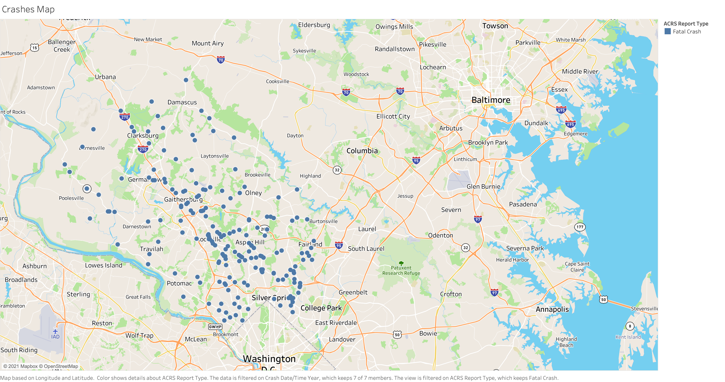
Notes:
Fatal Crashes in Montgomery County from 2015-2021

Slide 5
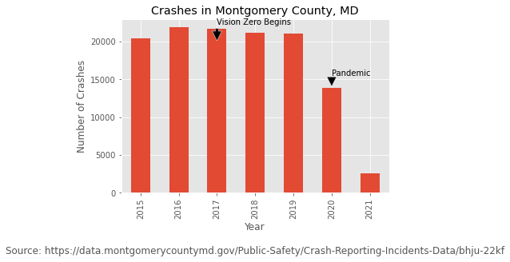
Crashes in Montgomery County
Notes:
These are the total number of crashes by years and by type of crash. I realized the second plot was not very useful as the numbers varied a lot and it doesn’t really tell you much.

Slide 6
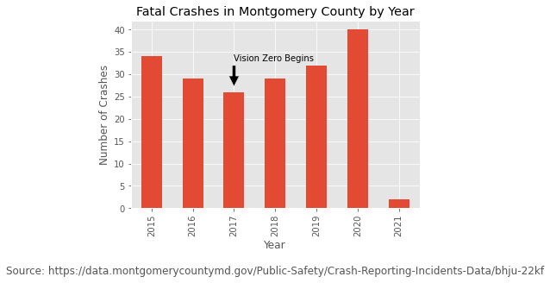
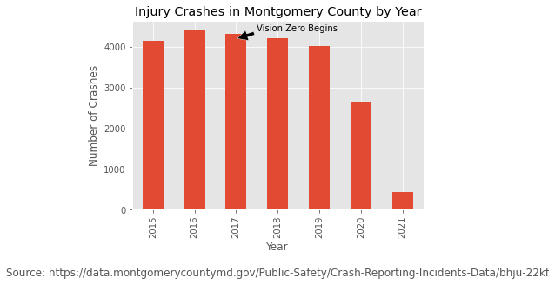
Montgomery County: Fatal and Injury Crashes
Notes:
I decided to go with simpler plots. This shows injury crashes by year and fatal crashes by year.
Montgomery County’s first two-year Vision Zero plan set a goal of 240 serious or fatal injury crashes by 2019. The graph on the left shows fatal injury crashes, the other two show serious injuries to motorists and non-motorists. The actual total for 2019 was 270.
The goal for 2020 was 221 serious or fatal injuries. The actual number was 210. The fatalities increase though.

Slide 7
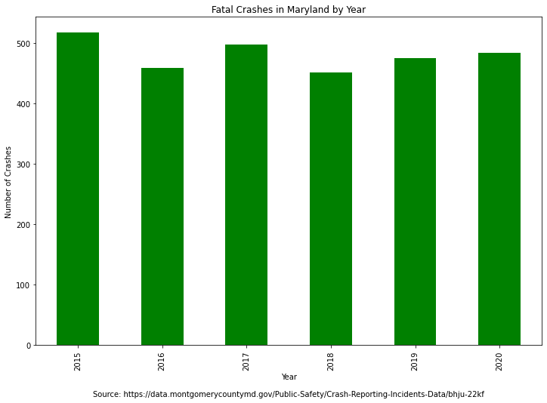
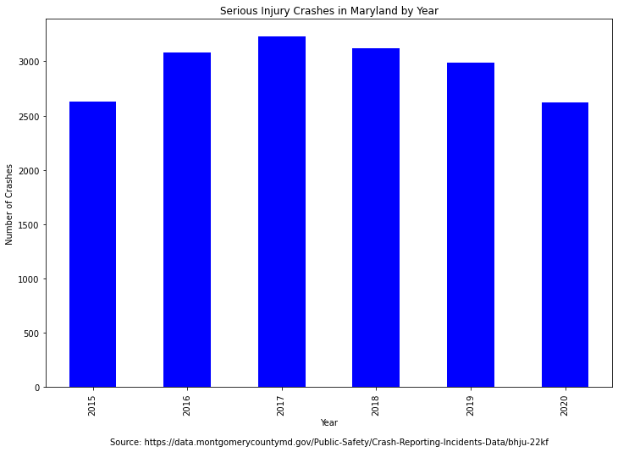
Maryland: Fatal and Injury Crashes
Notes:
The overall picture in Maryland showed a decrease in serious injuries, but an increase in fatalities in 2019.

Slide 8
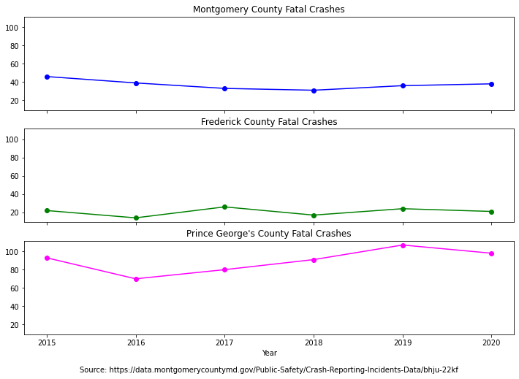
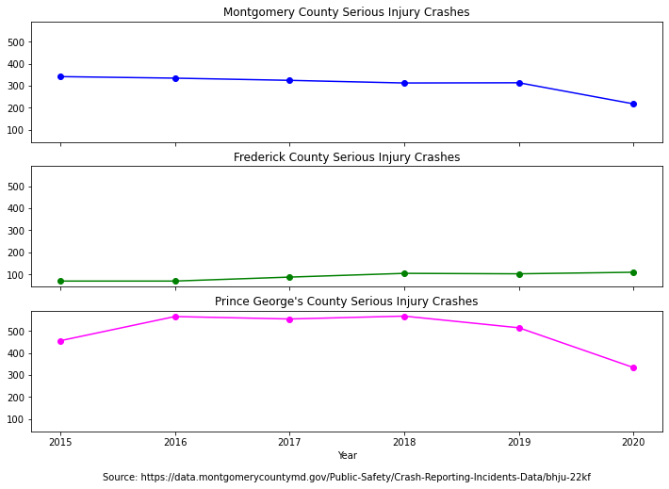
Fatal and Serious Injury Crashes: Key MD Counties
Notes:
This is a comparison of Montgomery county with its two “sister counties.”

Slide 9
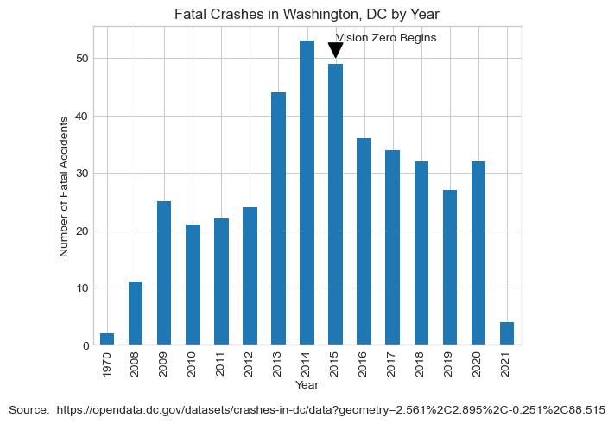
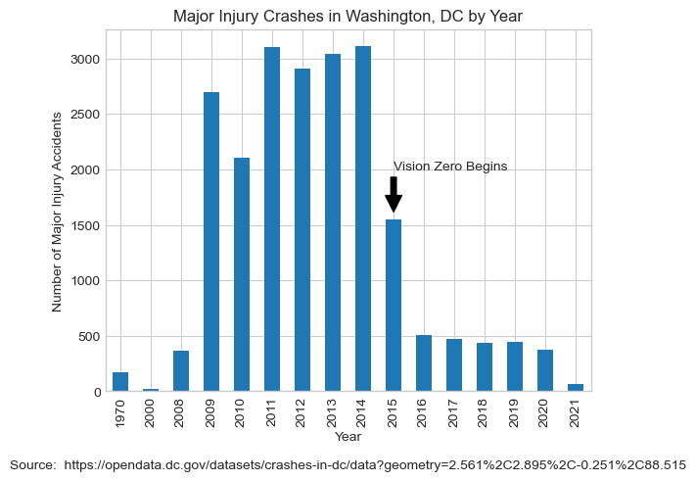
Fatal and Injury Crashes in Washington, DC
Notes:
Finally, the picture in Washington, DC, which implemented Vision Zero beginning in 2015.

Slide 10
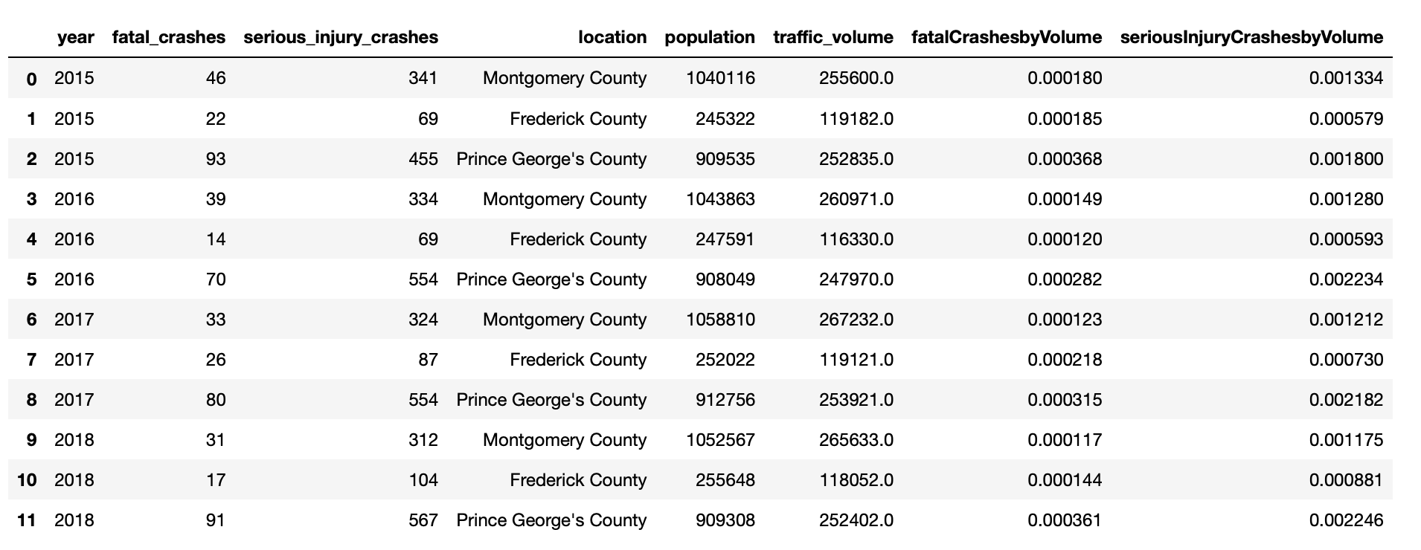
Fatal and Serious Injury Crash Rates, Maryland Counties
Source: OpenData Maryland

Slide 11
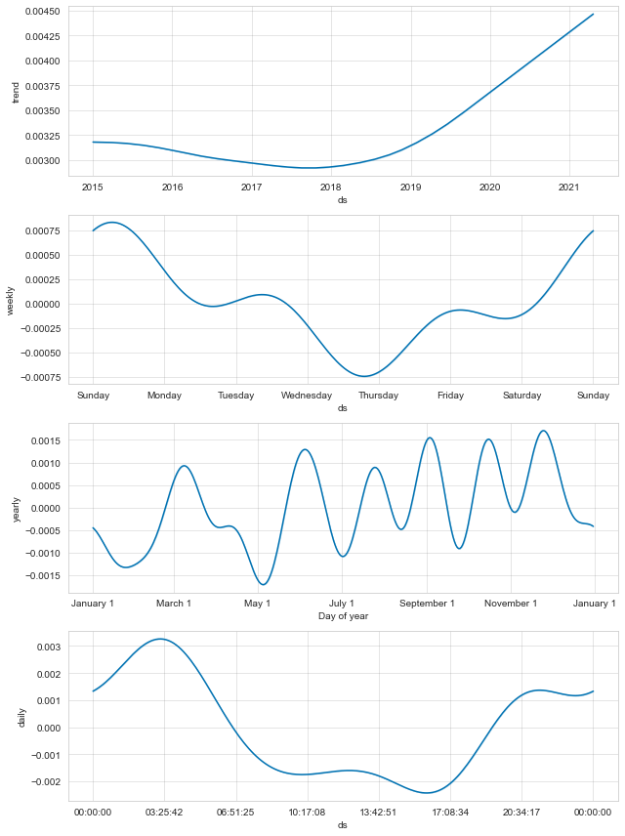
Future Forecast: Montgomery County Fatal Accidents
Annual Trend
Trend by Day of Week
Seasonal Trend
Time of Day Trend
Method: FBProphet

Slide 12
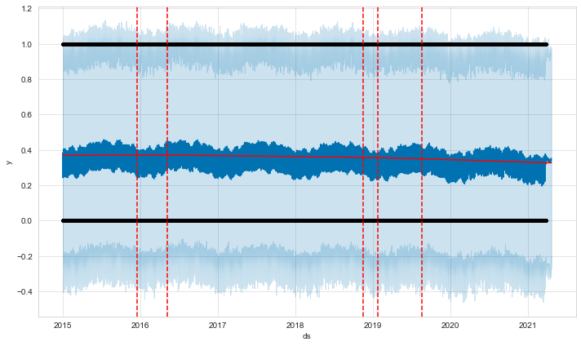
Future Forecast: Montgomery County Serious Injury Accidents
Method: FBProphet

Slide 13
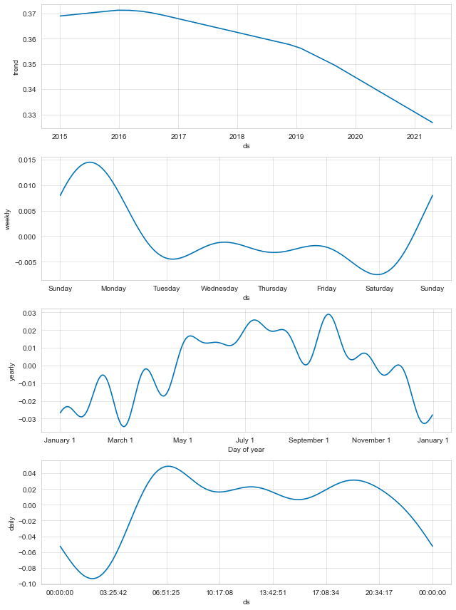
Time Series Serious Injury Components
Annual Trend
Trend by Day of Week
Seasonal Trend
Time of Day Trend
Method: FBProphet

Slide 14
Recommendations
Continue outstanding data collection and analysis
Establish what conditions most often occur in correlation with serious accidents
More comparative analysis with neighboring communities
Explore which crashes can be prevented by changes in engineering, and which are the result of human nature

Slide 15
Acknowledgements
Victoria Lewis at dataMontgomery
Organizers of data at OpenData Maryland, OpenDataDC, and the US Census Bureau
My Professors: Rachel Saidi, Abdirisak Mohamed, and Michael Iapalucci

