Slide 1
BRITISH AIRWAYS
Web Scraping to Gain Company Insights
16-10-2024

Slide 2
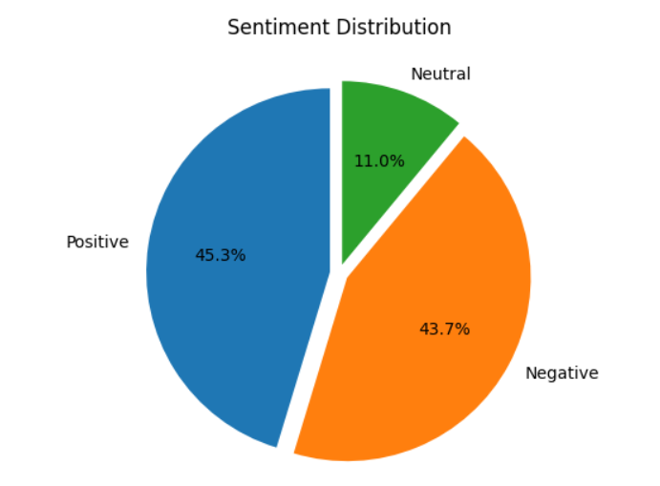
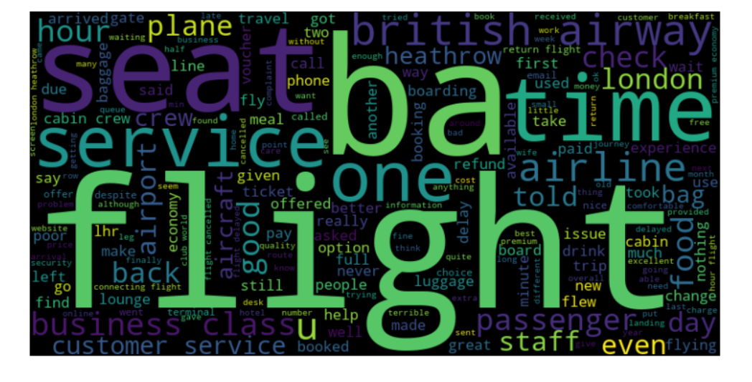
INSIGHTS FROM CUSTOMER REVIEWS
From our analysis of 1000 customer reviews on the website we find that
Positive reviews:453
Negative reviews:437
Neutral reviews:110
Also the most frequently used keywords are given in the
below wordcloud.

