Slide 1
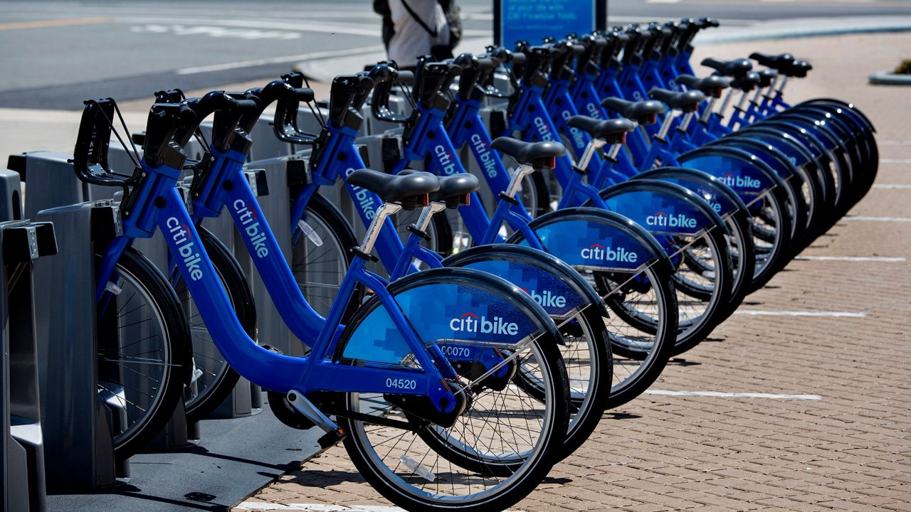
Turning Data into Action - Boosting Urban Cycling with Predictive Analytics
Group – 4
YUVA RAJ BALLA
K.HARSHITH REDDY
P. DIMITRA
Y. PRANEETH RAM

Slide 2
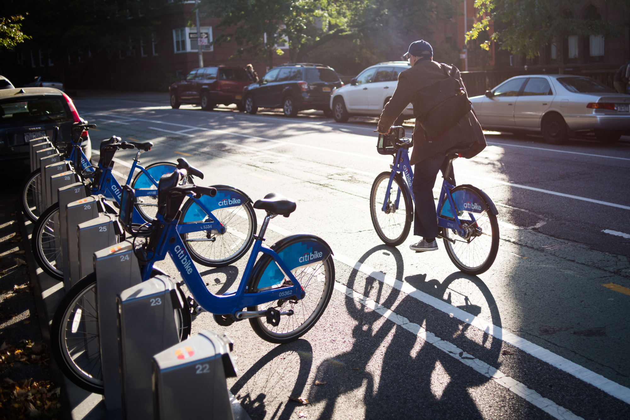
Introduction: A Quick Overview
Demand Trends: Discover when and where people want bikes the most by tracking rental or sales data over time and in different locations.
Understanding User Behavior and Segmentation: Explore variations in actions between subscribers and customers, revealing how demographics impact behavior patterns.
Exploring Location Data: Use Station IDs to find trends and put bike stations where they're easy for everyone to reach.
Weather and Commuting Patterns: Look into how weather affects when people ride bikes and how they travel to work, to understand everything better.

Slide 3
Objective Determine the optimal number of bikes to allocate to each station at the start of the day to ensure the highest possible number of daily bike trips QUESTIONS
What is the daily demand for bike trips between stations during the morning and evening periods?
How many bikes should be distributed to each station?

Slide 4
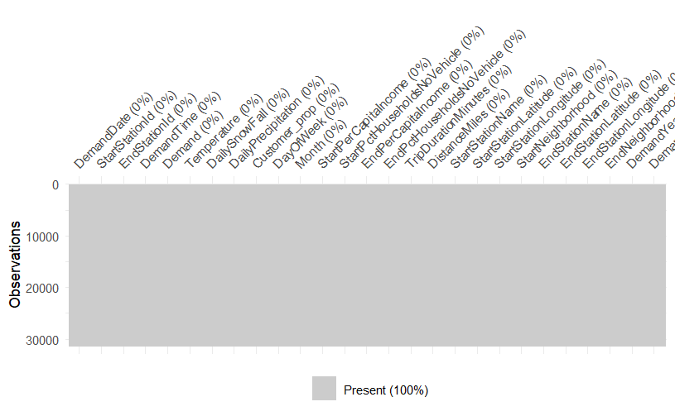
Cleaning Data – Data Visualizing" as a concise alternative
Spotting Differences
Make Formats Consistent
Take Out Unusual Data
Fix Data Accuracy

Slide 5
Descriptive Analysis
Comprehensive Data Review: Analyzed Citi bikes utilization from June 1, 2017, to May 31, 2018, centering on trip term, client pay levels, and get to vehicles.
Identifying Usage Patterns: Revealed day by day and regular request varieties over stations and related these with outside components like climate designs and socio-economic status.
Insightful Visuals: Utilized histograms to outline request dissemination and scramble plots to demonstrate the affect of temperature and wage on bicycle utilization.

Slide 6
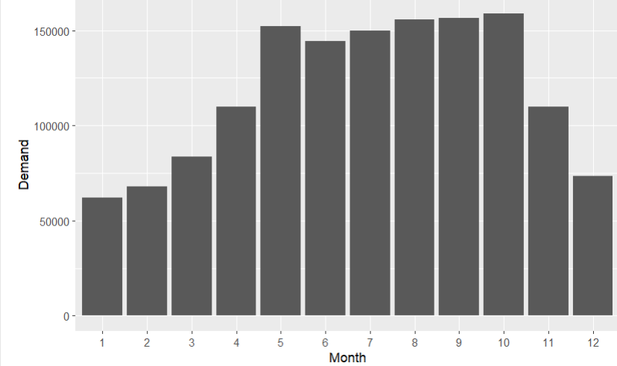
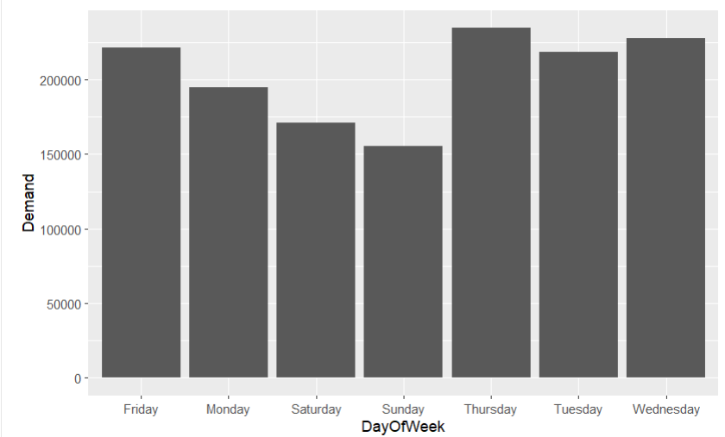
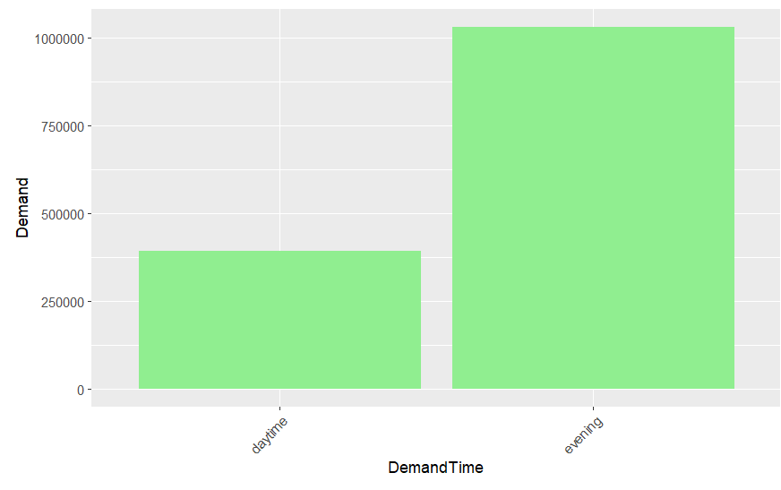
Visualizations to know Demand Over Time
Demand vs Month
Demand vs Day of Week
Demand vs Demand Time

Slide 7
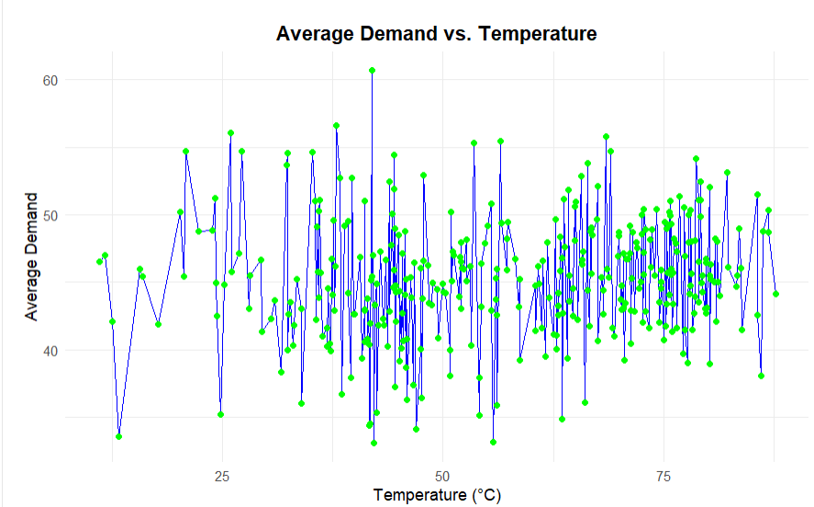
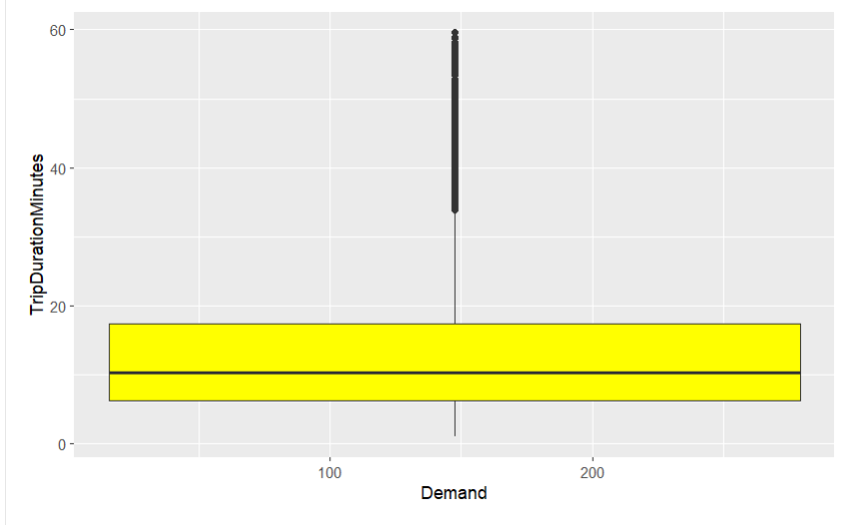
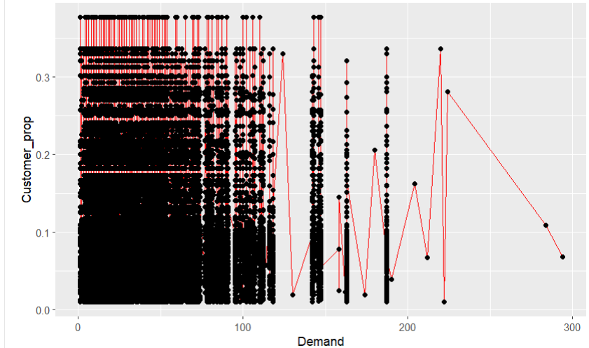

Slide 8
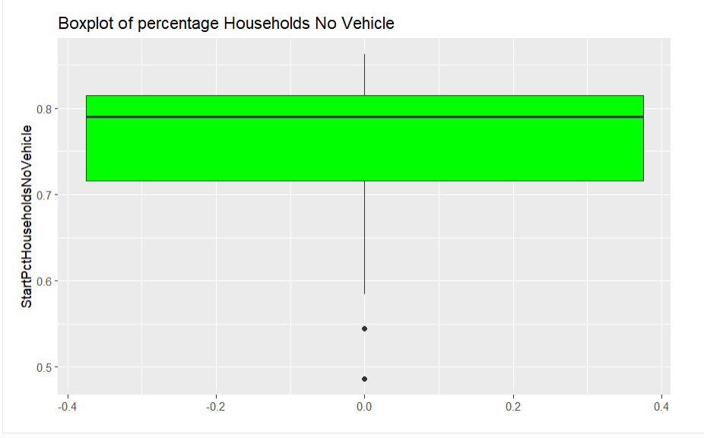
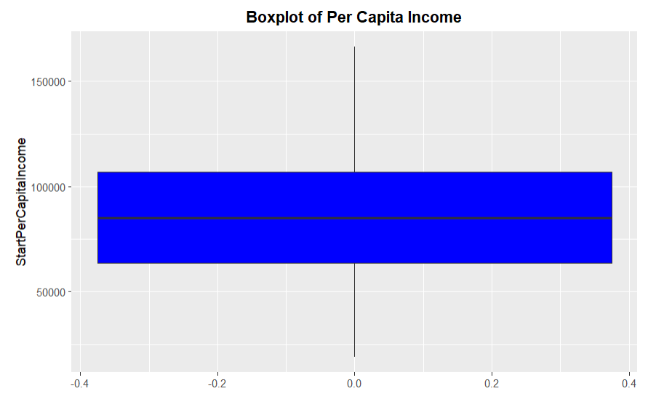
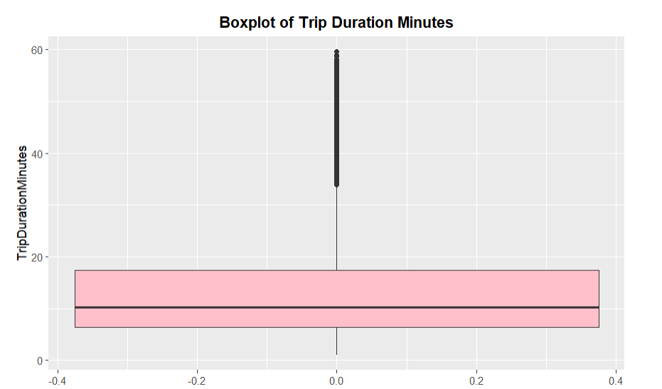
Boxplots

Slide 9
Predictive Analysis
Forecasting Demand Predictions: Guide the initial distribution of bikes to ensure efficient service and customer satisfaction.
Application of Optimization Models: Use Excel Solver to balance station capacity and demand targets.
Recommendations for Strategic Allocation: Suggest bike distributions to keep supply and demand in equilibrium.
Implementation of Dynamic Rebalancing: Focus on operational aspects and stress the importance of real-time adjustments for optimal service provision.

Slide 10
Predictive Analysis

Slide 11
Prescriptive Analysis
Prescriptive analytics enhances decision-making by offering targeted action recommendations drawn from predictive analysis outcomes.
In the context of Citi bikes, predictive analytics leverages past data to forecast future trends and bike demands.
Further, prescriptive analytics provides specific guidance on optimal bike allocation across different locations according to available inventory.
Ultimately, the goal is to optimize bike deployment at each station to meet the actual demand effectively.

Slide 12
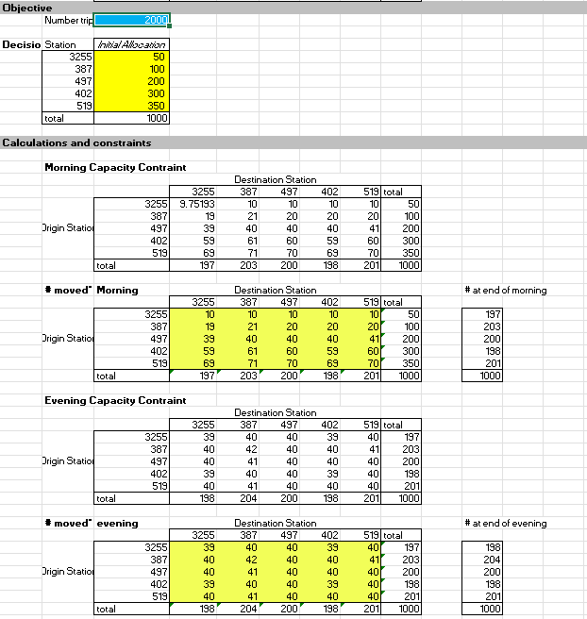
Enhanced Analysis

Slide 13
Conclusion
In conclusion, the demand for bikes exceeds the supply provided by City Bikes. To address this and prevent losing customers to competitors, the company should:
1. Increase Bike Supply:
Add more bikes to meet the higher demand.
Implement Dynamic Rebalancing:
Use a real-time system to adjust bike distribution based on demand patterns.
Utilize Optimization Tools:
Employ Excel Solver to efficiently distribute bikes across stations.
Monitor Demand Trends:
Track activities and events that might influence future demand.
Enhance User Experience:
Collect user feedback to improve services.
By taking these steps, City Bikes can better meet demand, improve user satisfaction, and stay ahead of competitors.

