Slide 1



Slide 2

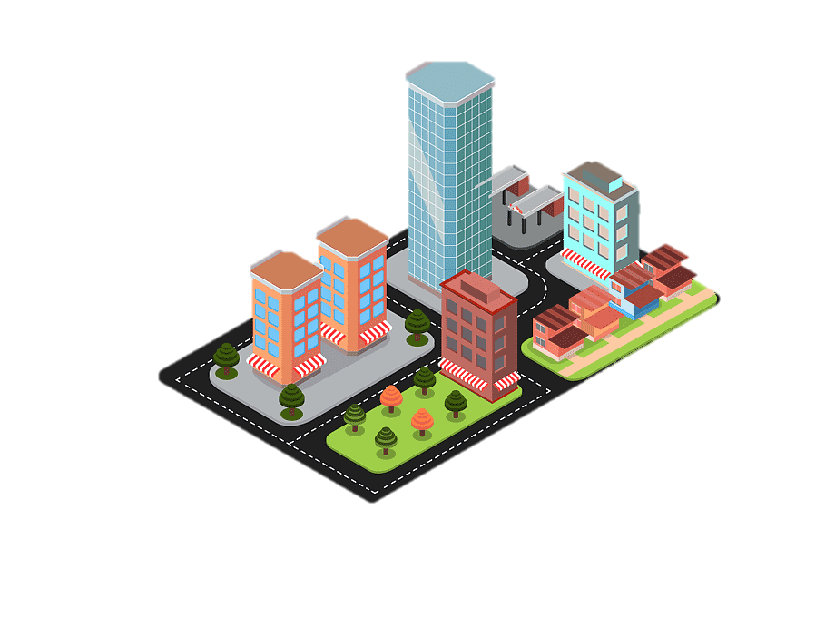
Mechanical Systems with Intelligence and Computer Vision Laboratory

