Slide 1



Slide 2
Mechanical Systems with Intelligence and Computer Vision Lab

Slide 3
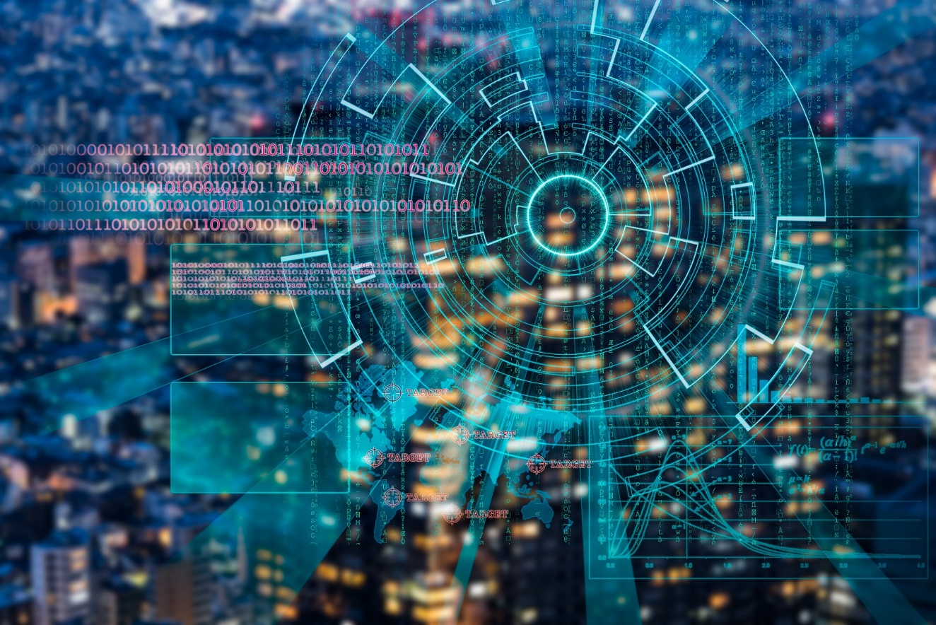



Slide 4


