Slide 1
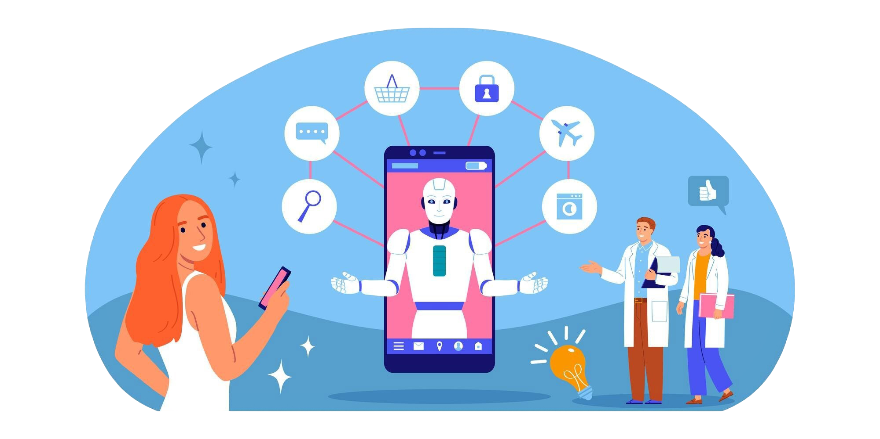
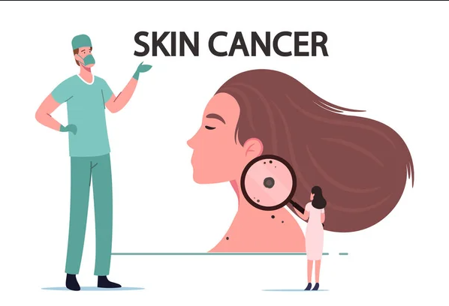
AI Based skin disease Detection Software
Phuoc van Tran(Man)

Slide 2
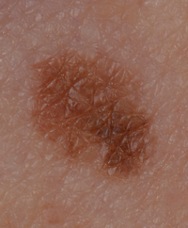
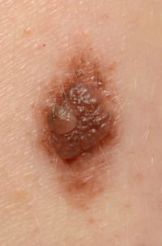
Skins diseases and skin cancer
Skin cancer is a significant health concern, yet many people remain unaware of its dangers. Among the most serious forms is Melanoma, a potentially fatal skin cancer with a high tendency to spread if not detected early.
Melanoma can develop in existing moles or appear suddenly as a dark spot that differs from the surrounding skin. Early detection is critical, as timely intervention can dramatically improve survival rates. However, traditional diagnostic methods relying on dermatologists’ expertise and biopsies—are often time-intensive, subjective, and inaccessible to many, especially in underserved regions.
Recent advancements in deep learning and machine learning have shown immense potential in automating the detection and analysis of skin diseases. These technologies promise improved diagnostic accuracy and accessibility. However, their clinical adoption remains a challenge due to the need for high precision, scalability, and robustness in real-world applications.
Melanoma
Not Melanoma
To address this pressing issue, our project aims to develop an automated system for detecting and analyzing skin lesions, particularly melanoma, using deep learning algorithms. By leveraging state of the art Convolutional Neural Networks (CNNs) such as ResNet and Inception.

Slide 3
literature review
Datasets play a critical role in developing robust and accurate models for skin cancer detection. Two prominent datasets frequently used in research are:
[1]ISIC Archive: The International Skin Imaging Collaboration (ISIC) Archive is one of the largest public databases of dermoscopic images. It provides a wide range of annotated images for training and testing machine learning models.
[2]HAM10000: This dataset comprises over 10,000 multi-source images of skin lesions, including both benign and malignant samples. Frequently used in Kaggle competitions, HAM10000 serves as a benchmark for evaluating the performance of skin cancer detection algorithms.
Preprocessing techniques, such as segmentation and contrast enhancement, play a crucial role in improving the quality of skin lesion images for analysis, enabling more accurate detection and classification. Studies, such as "Detection and Classification of Melanoma Skin Cancer Using Image Processing Techniques" [5], highlight the effectiveness of these methods in enhancing image clarity and contributing to higher diagnostic accuracy.
Deep learning, particularly convolutional neural networks (CNNs- רשת קונבולוציה), has emerged as the leading approach for skin cancer detection. For instance, [6]“Dermatologist-Level Classification of Skin Cancer with Deep Neural Networks” demonstrated the efficacy of CNNs in achieving dermatologist-level accuracy.
A systematic review by [4]"Skin Cancer Detection: A Review Using Deep Learning Techniques" consolidates findings from key research papers, emphasizing lesion parameters such as symmetry, color, and shape in distinguishing benign(גידול שפיר) and malignant skin(גידול ממאיר) cancers.

Slide 4
Dildar, M., Akram, S., Irfan, M., Khan, H. Ullah, Ramzan, M., Mahmood, A. Rehman, Alsaiari, S. Ayed, Saeed, A. Hakeem M., Alraddadi, M. Olaythah, Mahnashi, M. Hussen (2021). Skin cancer detection: A review using deep learning techniques. International Journal of Environmental Research and Public Health, 18(10), 5479. https://doi.org/10.3390/ijerph18105479
Kaushik Vikensh C., Nirmal Kummar P., Seetharaman R., Anitha D.(2023). Detection and Classification of Melanoma Skin Cancer Using Image Processing Technique. Diagnostics , 13(21), 3313. https://doi.org/10.3390/diagnostics13213313
Esteva, A., Kuprel, B., Novoa, R. A., Ko, J., Swetter, S. M., Blau, H. M., & Thrun, S. (2017). Dermatologist-level classification of skin cancer with deep neural networks. Nature, 542(7639), 115–118. https://doi.org/10.1038/nature21056

Slide 5
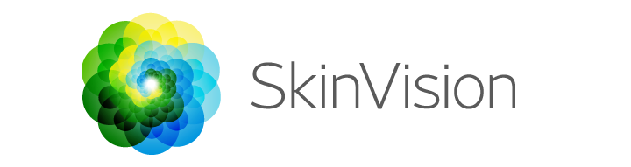

Competitors
SkinVision
SkinVision allows users to take photos of moles and other skin lesions and assesses their risk of skin cancer using AI and machine learning algorithms. The app provides users with risk assessments to guide whether they should seek medical advice.
MoleMapper
MoleMapper is a tool that utilizes photography to monitor changes in moles over time. It helps track variations in size, shape, and color, which may indicate a mole’s progression toward malignancy. it facilitates early detection of melanoma and other skin cancers, allowing for timely treatment and improved patient outcomes.
Competitor | Key Features | Strengths | Weaknesses
SkinVision | AI-based app for skin cancer detection | User-friendly, widely available | Requires subscription, accuracy depends on image quality
MoleMapper | Tracks mole changes over time | Free, good for long-term monitoring | available only on ios, no AI-based detection

Slide 6
Functional Requirements
Data Management
Image Preprocessing
User Requirements
Secure Data Storage: Safely store patient data, including images, analysis results, and reports.
History Management: Allow users to view and manage previous reports.
Report Export: Provide an option to export reports in formats like PDF.
Contrast Enhancement: Adjust brightness and contrast to improve image quality.
Resizing: Adapt images to the required input dimensions for the deep learning model.
Notifications for image quality issues (resolution or format).
Segmentation: Isolate skin lesions from the background using advanced techniques.
Support for high-resolution skin lesion images (minimum 1024x1024 pixels, JPEG/PNG formats).
Option for users to review uploaded images before analysis.
Notifications for image quality issues (resolution or format).
Result Display
Disease Detection
Detected Disease Name: Display the identified condition (if any).
Confidence Score: Show detection confidence (“80% confidence this is melanoma").
Visualized Results: Highlight lesions using bounding boxes or heatmaps.
Doctor Consultation: Recommend a meeting with a doctor based on results.
Summary Report: Provide findings in a clear, user-friendly format such as PDF.
Integrates traditional machine learning and deep learning for disease detection.
Uses Convolutional Neural Networks (ResNet50, InceptionV3) for skin lesion classification.
Differentiates between multiple skin diseases, including Benign, Melanoma, and Malignant.

Slide 7
Non-Functional
Performance
Scalability
The model should analyse and return results within few seconds for each uploaded image.
The system should handle up to 1,000 concurrent users during peak hours without degradation in performance.
Accuracy
• The detection model should achieve at least 80% accuracy, and 75% sensitivity based on test dataset evaluation.
Reliability
Security
The system should have an uptime of 99.9% and handle unexpected errors with user-friendly messages.
User data, including uploaded images and diagnosis results, must be securely stored using encryption.

Slide 8
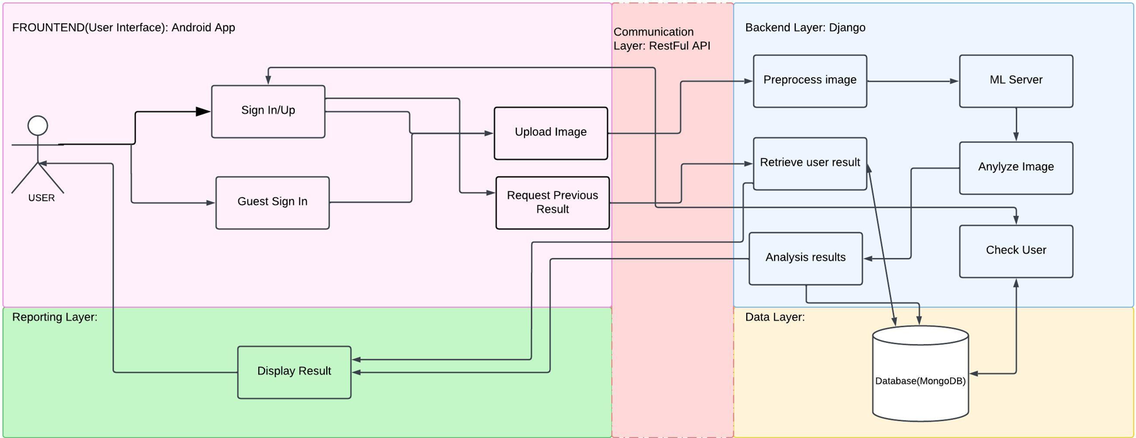
Architecture
Technical Requirements
Client Server
The project will utilize a Client-Server Architecture to efficiently handle user interactions, image analysis, and result management.
User Interface Layer:
Purpose: Handles user interactions, such as image uploads, result viewing, and report exporting.
Components:
Android App: Developed with Dart in Flutter.
app Interface: Supports image uploads directly via the app.
Communication Layer:
RESTful APIs ensure consistent communication between the app and backend, centralizing processing and detection logic.
Backend Layer:
Core Functionality:
Image Preprocessing: OpenCV for resizing, normalization, and segmentation.
Model Inference: Combines predictions from CNNs (PyTorch) using models such as Resnet50 or InceptionV3 or custom-designed CNN.
Result Generation: Produces disease names, confidence scores, and visualizations (heatmaps).
Retrieves stored results for signed-in users.
Data Layer:
MongoDB stores:
Uploaded and preprocessed images.
Model analysis results.
Patient records and reports.
Reporting Layer:
Mobile App: Displays results (disease type, confidence score) and enables report downloads.

Slide 9



Technical Requirements:
1. Programming Languages
Python: For deep learning model development, data preprocessing, and backend integration.
Dart: For Android/IOS app development, providing a seamless user experience.
2. Frameworks and Libraries
Deep Learning: PyTorch for model development and training.
Backend: Django for building RESTful APIs.
Android App: Developed using Flutter with dart.
Data Visualization: Matplotlib, Seaborn, or Plotly for presenting model results and metrics graphically.
3. Database
MongoDB for storing unstructured or semi-structured data, such as image data, patient records, and logs.
4. Development Tools
Image Processing: OpenCV for preprocessing tasks like resizing, normalization, and segmentation.
Integrated Development Environment (IDE): VS Code, PyCharm, or Jupyter Notebooks for coding and testing.
Version Control: GitHub for collaborative development and versioning.

Slide 10
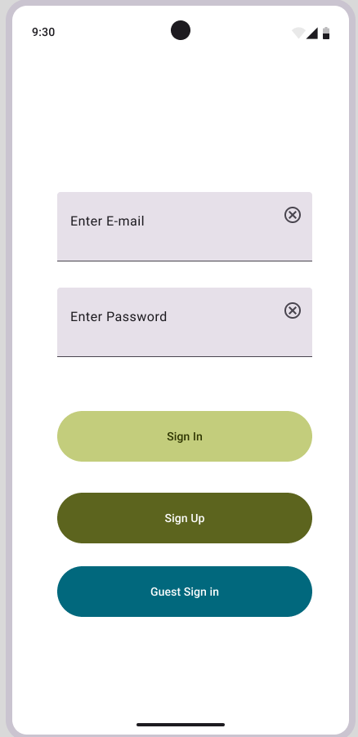
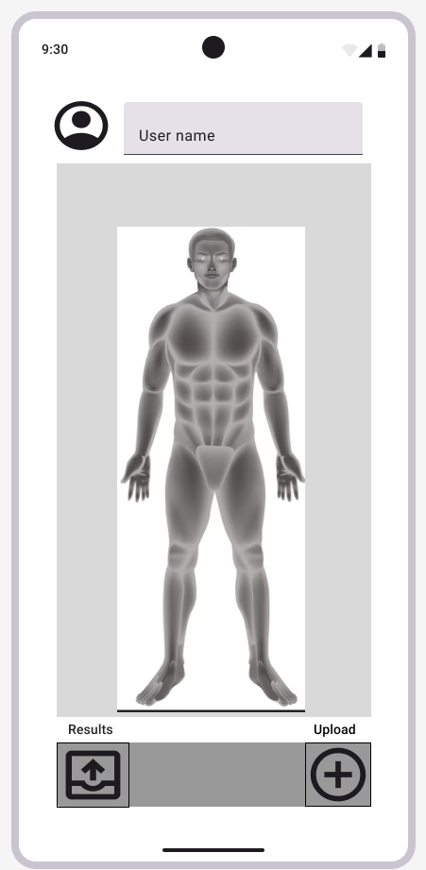
Interfaces
1) Purpose of the User Interface:
Allow users to upload skin lesion images, view analysis results, and download reports seamlessly.
2) Key Features:
Image Upload:
Users can upload high-resolution images (e.g., JPEG, PNG).Notify users if the image quality is insufficient (resolution below 1024x1024 pixels).
Review & Confirm:
Preview uploaded images before analysis.
Results Display:
Show detected disease name, confidence score, and visualized results (bounding boxes or heatmaps).
Report Management:
Export analysis reports in PDF format.
Access previously saved reports.
3) Platform Details:
Android App:
Built using Dart in Flutter for mobile use.
4) Design Approach:
Clean, user-friendly interface for intuitive navigation.
Emphasis on accessibility and clear visual presentation of results.

Slide 11
Convolutional Neural Networks (CNNs)
CNNs form the backbone of modern image analysis tasks. They are particularly well-suited for handling unstructured data, like images, and excel at automatically learning hierarchical features from raw data. Key advantages include:
•Feature Extraction: CNNs learn low-level features (edges, textures) in early layers and complex patterns (shapes, objects) in deeper layers.
•Spatial Hierarchies: By using convolutional layers and pooling layers, CNNs capture spatial dependencies, making them ideal for analyzing images.
Algorithmic Steps
Upload Image
The user uploads an image of a skin lesion through the Android app.
Preprocess the Image
Resize the image to the input dimensions required by the CNN model.
Normalize pixel values for consistent input data.
(to ensure compatibility with the model's input size and to stabilize the training process)
Feed Image into CNN for Feature Extraction and Prediction
The preprocessed image is fed into a pretrained Convolutional Neural Network (e.g., ResNet50, InceptionV3).
a pretrained CNN extracts features.
Convolutional layers extract hierarchical features such as edges, textures, and shapes.
Classification and Generate Predictions
Classify the image into categories (melanoma, benign/malignant skin lesion, or none).
Provide a confidence score for each category.
Visualize Model Focus with Heatmaps
Generate heatmaps to highlight regions of the image where the model focused during analysis.
Save and Display Results
Show the classification results, confidence scores, and heatmaps in the app.
allow users to export a summary report.
Algorithms

Slide 12
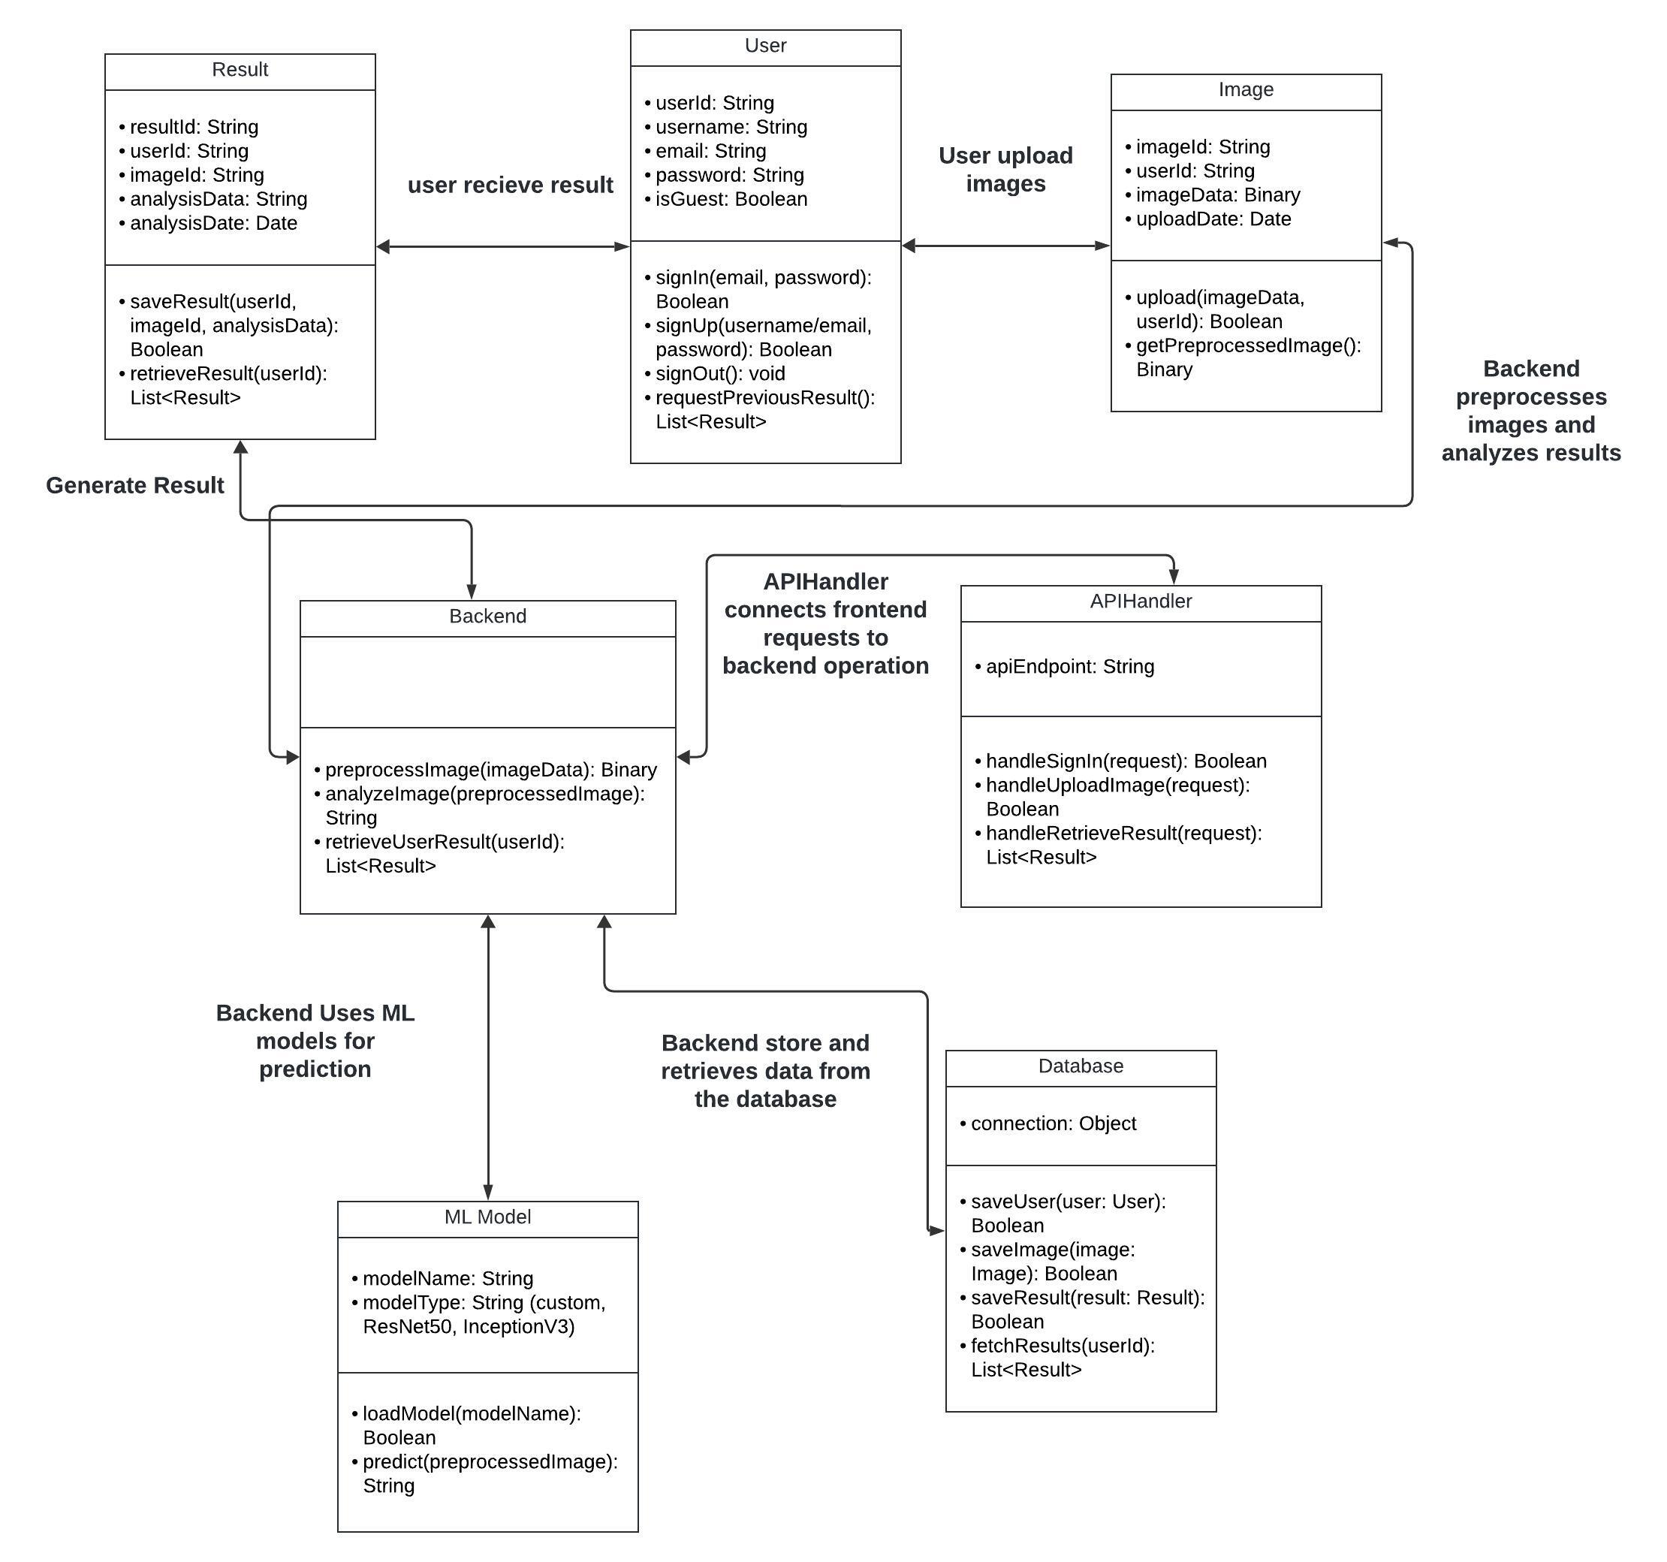
Database
Class Diagram
Users
user_id (Primary Key)
name (String)
email (String, unique)
password (String)
isGuest(Boolean)
profile_image
Images
image_id (Primary Key)
user_id (Foreign Key → Users.user_id)
upload_date (Date)
metadata (JSON, resolution, file type)
Results
result_id (Primary Key)
image_id (Foreign Key → Images.image_id)
analysis_date (Date)
disease_name (String)
confidence_score (Float)

