Slide 1
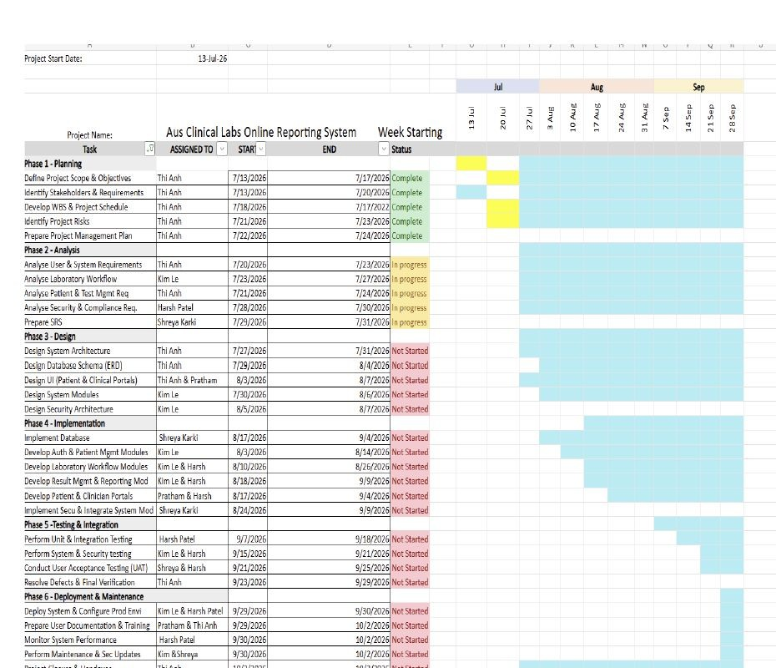
Gantt Chart — Project Timeline
DELIVERABLES, BUDGET & SCHEDULE
12-week schedule from Assessment 2
DELIVERABLES, BUDGET & SCHEDULE

Slide 2
Functional Requirements — System Coverage
REQUIREMENTS ANALYSIS
Access & Users
FR1–FR6
Patient & Requests
FR7–FR16
Registration, login, MFA, RBAC, user accounts
Patient records, duplicate detection, referrals, request validation
Specimen
FR17–FR24
Lab Operations
FR25–FR35
Registration, barcode, collection, tracking, acceptance/rejection
Worklists, assignments, result entry, import, validation, authorisation
Reports & Portals
FR36–FR47
Enhanced Services
FR48–FR67
Clinical comments, reports, distribution, patient/clinician portals, audit
Bookings, payments, reminders, inventory, roster, feedback and recovery
Traceability is maintained from FR → UI → DFD/Sequence → ERD/Data Dictionary → Test Cases.
REQUIREMENTS ANALYSIS

Slide 3
Database Design — Core Entity Groups
SYSTEM & DATABASE DESIGN
Identity & Access
Requests & Tests
Specimens
USER, ROLE, USER_ROLE, STAFF, CLINICIAN, PATIENT
LAB_TEST, TEST_REQUEST, TEST_REQUEST_ITEM
SPECIMEN, SPECIMEN_TRACKING, WORKLIST, TEST_ASSIGNMENT
Results & Alerts
TEST_RESULT, CRITICAL_ALERT_NOTIFICATION, ACKNOWLEDGEMENT
Reports & Audit
Configuration
LAB_REPORT, TEST_REPORT_RESULT, NOTIFICATION, AUDIT_LOG
SYSTEM_CONFIGURATION, reference ranges and test settings
Patient
Test Request
Specimen
Test Result
Lab Report
Audit Trail
Core relationship: Patient → Test Request → Specimen → Test Result → Clinical Report.

Slide 4
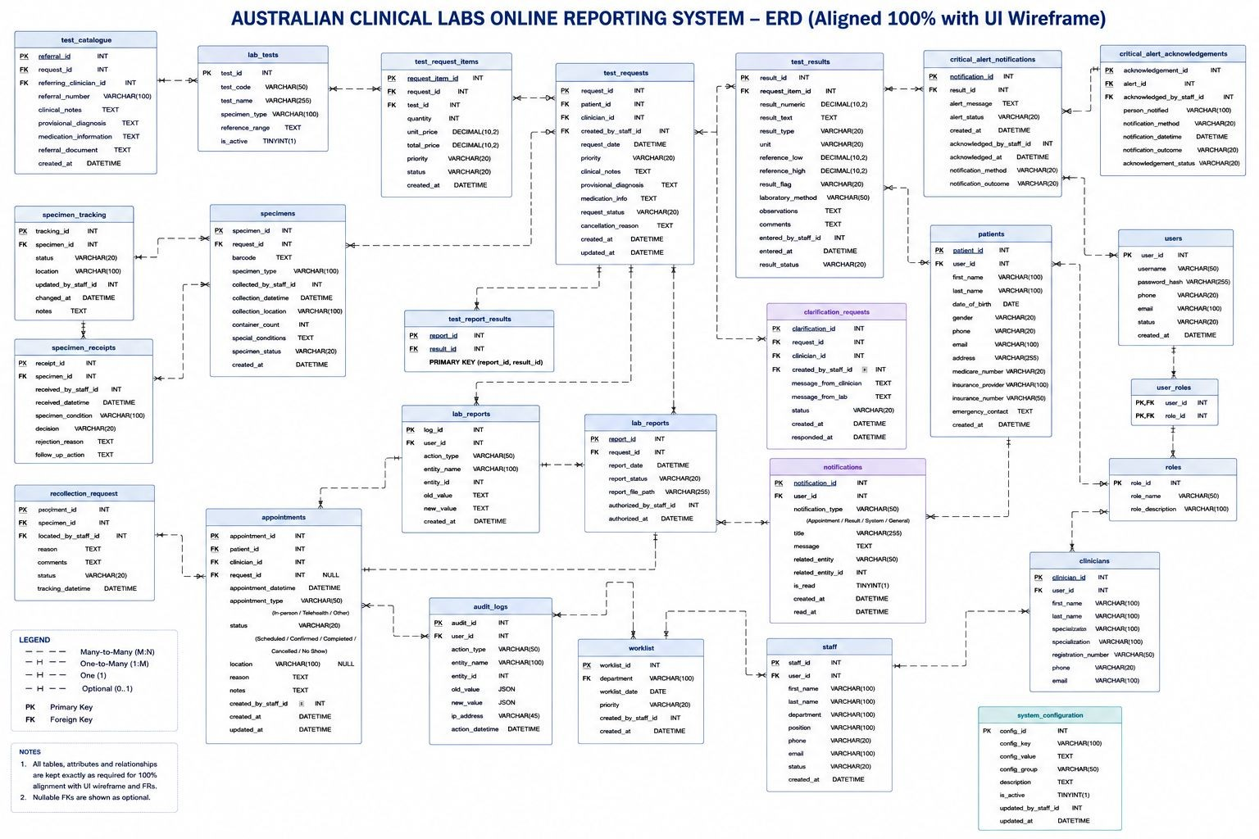
ERD Overview — Common Group Database Model
SYSTEM & DATABASE DESIGN

Slide 5
ERD — Core Relationship Walkthrough
SYSTEM & DATABASE DESIGN
Identity & roles
USERS → USER_ROLES → ROLES
Profiles link patient, clinician and staff records to user accounts.
Request lifecycle
PATIENTS / CLINICIANS → TEST_REQUESTS → TEST_REQUEST_ITEMS
→ LAB_TESTS
Specimen lifecycle
TEST_REQUESTS → SPECIMENS → SPECIMEN_TRACKING / RECEIPTS
→ TEST_ASSIGNMENT
Results & reporting
TEST_RESULTS → RESULT_REVISION / CRITICAL ALERTS → LAB_REPORTS → REPORT_DISTRIBUTION

Slide 6
Risk Management & Ethical Safeguards
RISK, COMMUNICATION & CLOSE
Incorrect patient information
Identity verification + duplicate detection
Wrong specimen / barcode
Barcode scanning + specimen tracking
Incorrect results
Validation + pathologist authorisation
Delayed critical reports
Critical alerts + acknowledgement
Unauthorised access
RBAC + MFA + encryption + audit trail
Database failure / ransomware
Daily backup + recovery plan
Ethical focus: protect sensitive health information and reduce patient-safety risks through traceable controls.
RISK, COMMUNICATION & CLOSE

