Slide 1
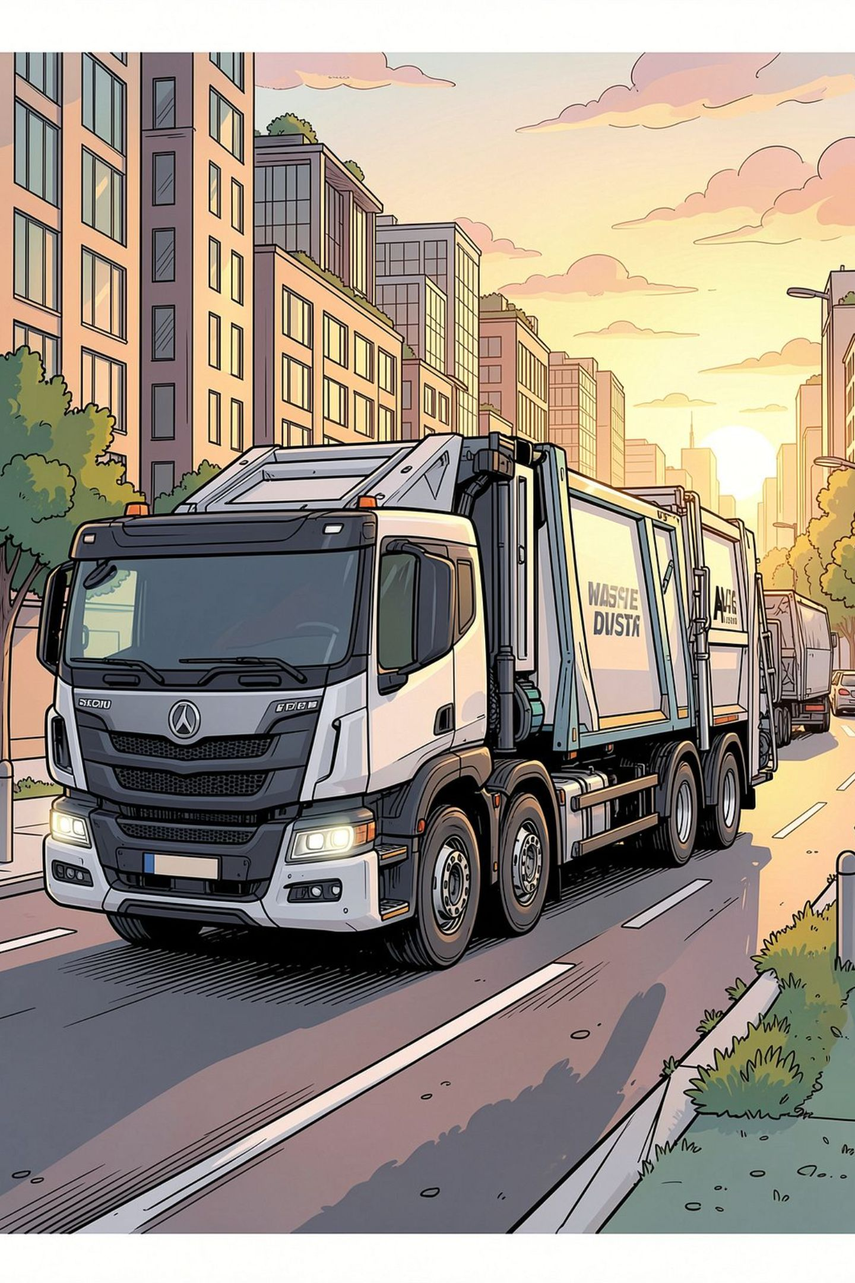
BINCOL Online Commercial Waste Collection System
Project Overview & Requirements — SRS Report Presentation
PROJECT BRIEF
STAKEHOLDER OVERVIEW
Team Members
Md Imran Hossain, Fahad Al Jobayer, Debisha Thapa, Sharmen Akter Urme, Fiza Taskeya

Slide 2
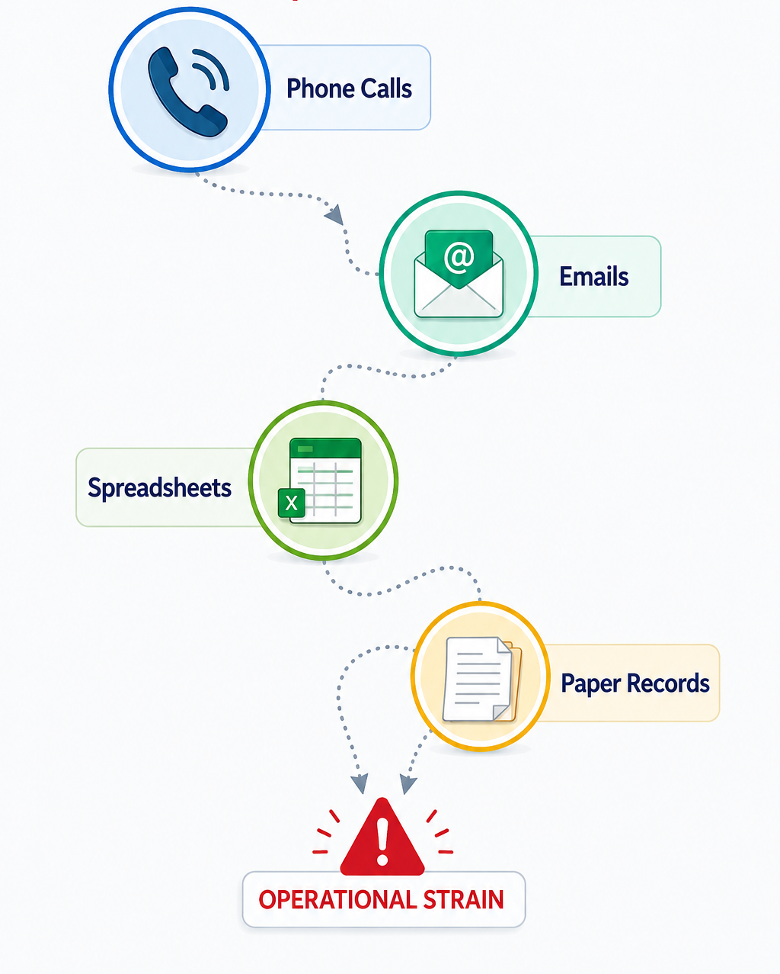
The Problem: A Manual System at Breaking Point
As BINCOL's customer base has grown, reliance on phone calls, emails, spreadsheets, and paper records has created serious operational strain.
Booking Errors
Missed and double-booked pickups caused by manual scheduling
Inefficient Routes
No systematic route planning — drivers lose time and fuel
Billing Disputes
Inconsistent invoicing and poor record management create friction
Slow Response
Delays in processing requests and resolving customer issues

Slide 3
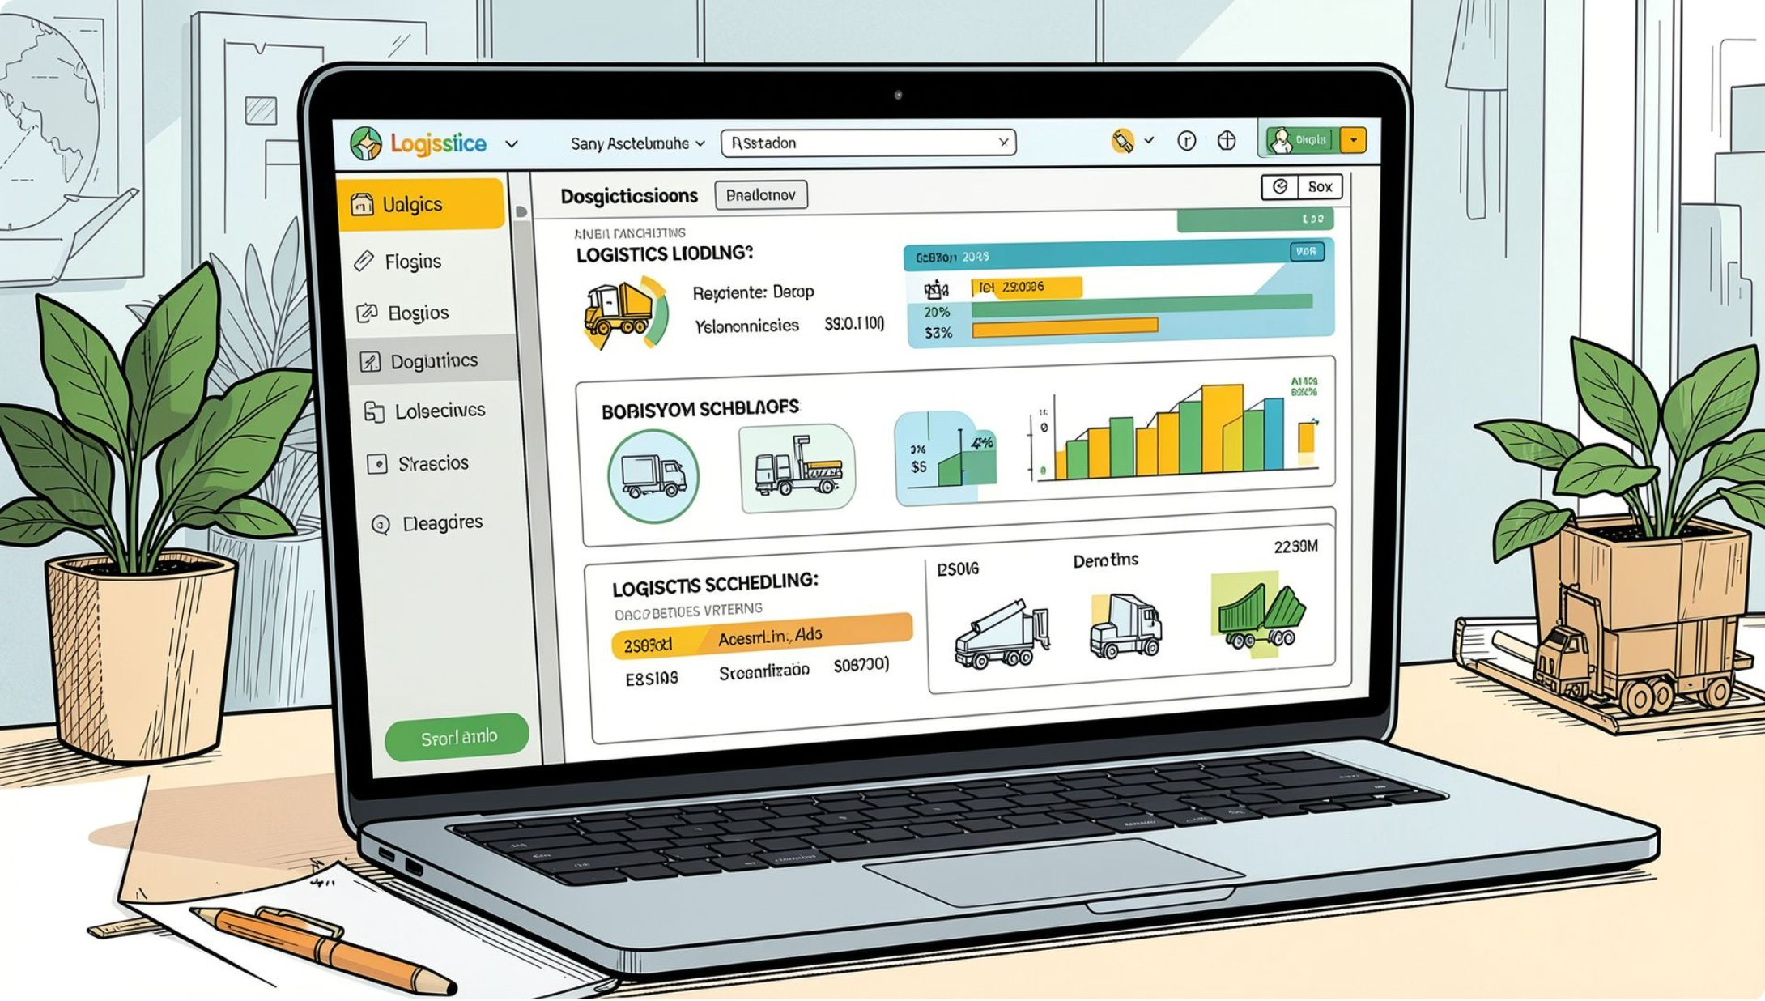
Purpose & Objectives
Core Purpose
Develop a single online platform connecting business customers, drivers, and office administrators — replacing all manual processes with a unified digital system.
Key Objectives
Customer self-service for bookings and account management
Automated scheduling and driver route information
Online payments and automated invoicing
Auditable records and improved data security
Management reporting and performance visibility

Slide 4
Project Scope
The system covers six core functional areas
Account Management
Pickup Booking
Customer registration, profiles, and service subscriptions
Online scheduling with automated confirmation and reminders
Online Payments
Driver & Route Management
Secure gateway integration for invoices and transactions
Real-time route assignments and truck allocation
Complaints & Feedback
Notifications & Reporting
Structured channels for customer issues and resolution tracking
Automated alerts and management performance dashboards

Slide 5
Project Deliverables
The project is structured across seven phases, each with defined outputs and approval gates.
01
02
03
Planning
Risk Management
Design
Project charter, scope definition, and stakeholder alignment
Risk register, mitigation strategies, and contingency planning
System architecture, UI/UX wireframes, and database design
04
05
06
Development
Testing
Deployment & Training
Iterative build sprints with regular stakeholder reviews
Functional, performance, and user acceptance testing
Go-live support, documentation, and staff training
07
Project Closure
Final review, handover, and lessons-learned report

Slide 6

Requirements at a Glance
49
15
Functional Requirements
Non-Functional Requirements
Across 9 operational categories
Covering quality, security, and resilience
7
3
Project Phases
Service Areas
From planning through to closure
Richmond, Fitzroy & Collingwood
All 64 requirements will be tracked, tested, and signed off before system deployment.

Slide 7
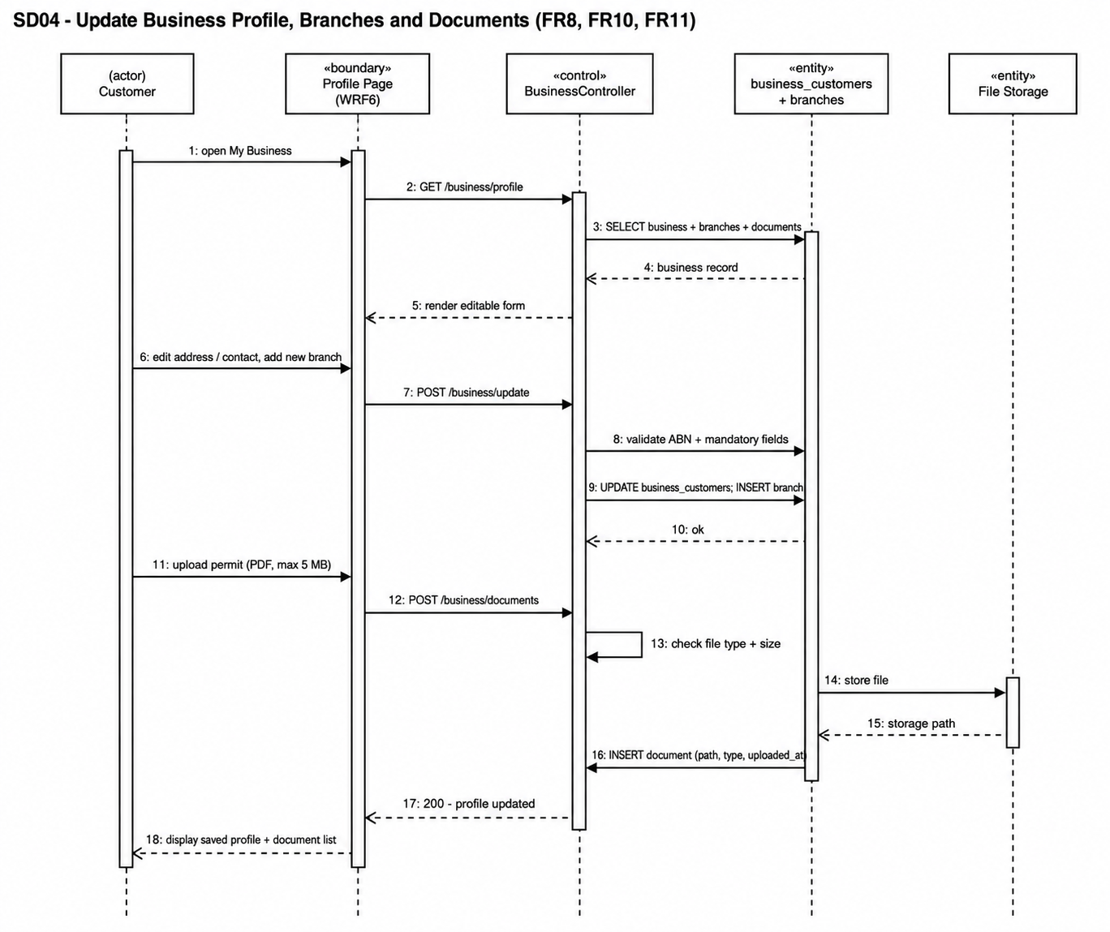
Imran
Sequence Diagram
SRS SECTION 9.0
Notes:
SECTION 6.0 — USE CASE DIAGRAM (about 40 seconds)
"A use case diagram answers one question: who is allowed to do what.
The table lists our actors. Four types of people — Customer, Waste Company Staff, Driver
and Administrator. Those are the four roles named in FR4, so the requirement and the
diagram agree. Then three outside systems: payment gateway, email, and the map and routing
API. They're listed as external actors because the system depends on them but does not
control them. If Stripe goes down, that isn't a bug in our code — it's a dependency, and
naming it as an external actor makes that visible.
The diagram on the left is Figure 6.3, the pickup and scheduling module — my module. The
customer can select waste category and bin size, request a one-time pickup, schedule a
recurring one, cancel or modify, and track status. Staff review and approve, or reschedule.
The two dashed arrows are the interesting part. They're marked include, which means the
step always runs. Every booking — one-time or recurring — runs View Estimated Cost, so a
customer never confirms blind. That's FR21. And every staff approval runs Check Truck and
Driver Availability, which is how FR26 and FR30 stop a truck being double-booked.
Include means always. Extend, which we use elsewhere, means optional — exporting a report
to PDF is an extend, because the report is already complete without it."
IF ASKED — 'why is Track Request Status not an include?'
It's a separate thing the customer chooses to do afterwards, not a step inside booking.
IF ASKED — 'why five diagrams instead of one?'
Eleven modules on one page is unreadable, and an unreadable diagram is a useless diagram.
Section 6.2 gives the overall picture; 6.3 to 6.6 break it down by the kind of work.

Slide 8
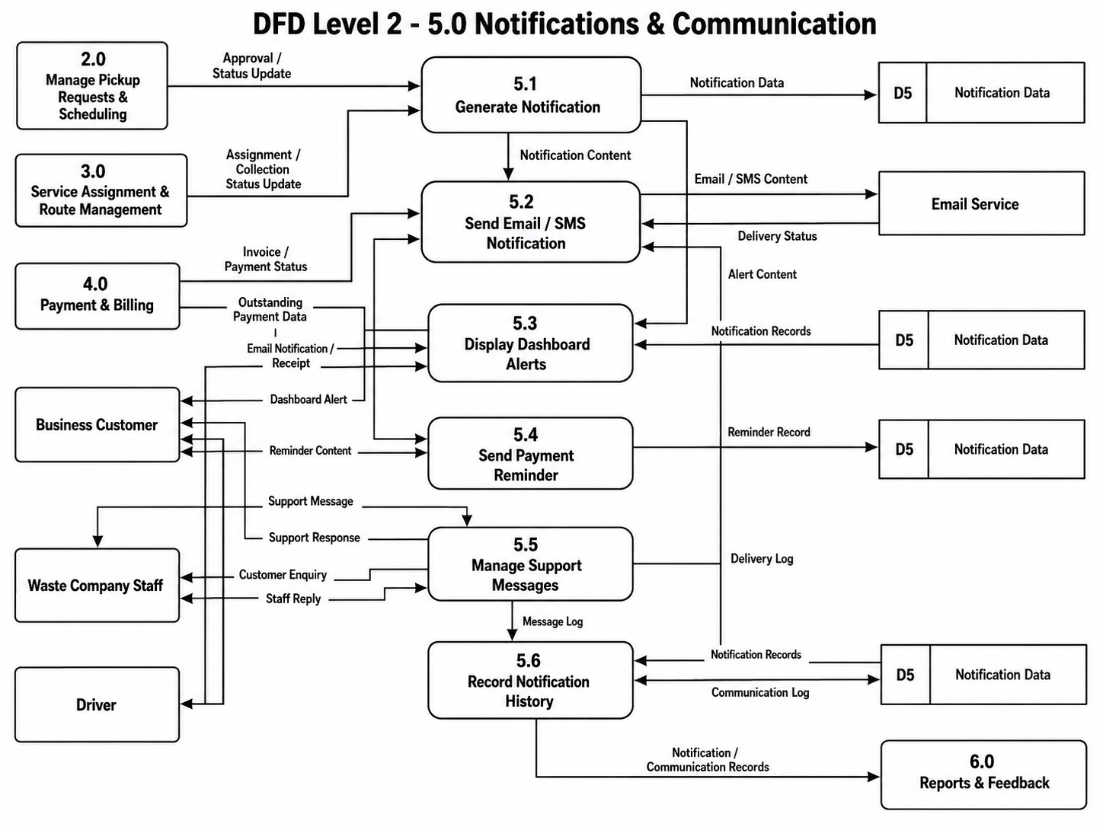
Imran
SRS SECTION 8.2
DFD Level 2 — Manage Notifications and Communications
Notes:
SECTION 8.2 — DFD LEVEL 2 (about 40 seconds)
"A data flow diagram answers a different question from the use case diagram — not who does
what, but where the data actually goes.
On our Level 1 diagram, all of pickup requests and scheduling is a single box numbered 2.0.
That's too coarse to build from, so Level 2 opens that one box into six steps.
2.1 creates the pickup request. 2.2 handles recurring schedules. 2.3 calculates the
estimated cost and sends it straight back to the customer — that's the Estimated Cost
arrow returning on the left. 2.4 is where staff review and approve. 2.5 is modify or
cancel. 2.6 tracks status.
Everything reads from and writes to D2, Pickup Request Data. It appears several times on
the diagram, but it's one store — repeating it just keeps the arrows from crossing.
Two things leave this process. Approved requests go to 3.0, Service Assignment and Route
Management. Status and approval updates go to 5.0, Notifications and Communication.
The discipline that matters here is balancing. Every arrow crossing into or out of box 2.0
on the Level 1 diagram has to appear on this diagram too. If Level 1 shows a flow that
Level 2 doesn't, the diagram leaks — data goes in and vanishes. Ours agrees in both
directions."
IF ASKED — 'why does D2 appear five times?'
It is one data store. Repeating the symbol is standard practice to avoid a tangle of long
crossing arrows — the D2 label is what tells you it's the same store.
IF ASKED — 'why is cost calculated in 2.3 and not inside 2.1?'
So capture and pricing stay separate. 2.1 records what the customer wants; 2.3 prices it
and returns the estimate before anything is confirmed. That's FR21.
IF ASKED — 'where does 1.0 come in?'
Customer and business information flows in from 1.0, Manage User & Business Information —
a request has to belong to a verified business account.

Slide 9
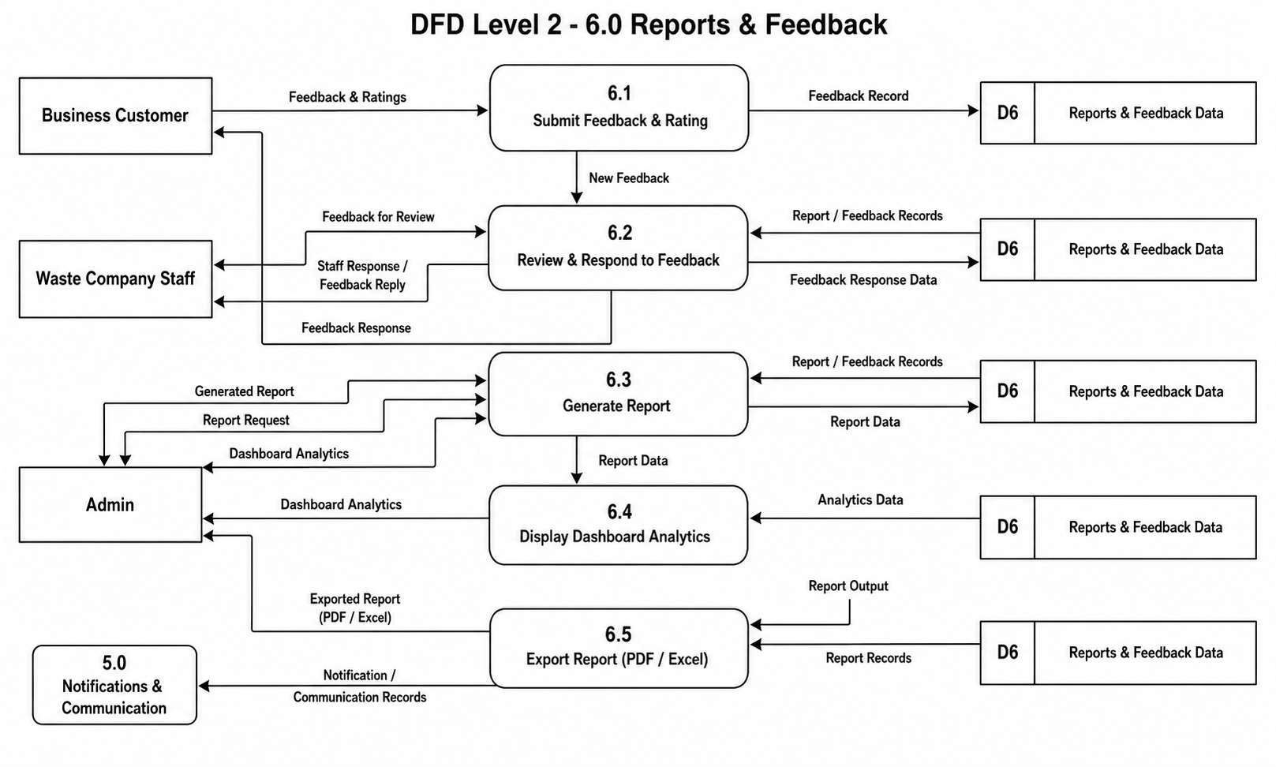
Imran
SRS SECTION 8.2
DFD Level 2 — Manage Reports and Feedback
Notes:
SECTION 8.2 — DFD LEVEL 2 (about 40 seconds)
"A data flow diagram answers a different question from the use case diagram — not who does
what, but where the data actually goes.
On our Level 1 diagram, all of pickup requests and scheduling is a single box numbered 2.0.
That's too coarse to build from, so Level 2 opens that one box into six steps.
2.1 creates the pickup request. 2.2 handles recurring schedules. 2.3 calculates the
estimated cost and sends it straight back to the customer — that's the Estimated Cost
arrow returning on the left. 2.4 is where staff review and approve. 2.5 is modify or
cancel. 2.6 tracks status.
Everything reads from and writes to D2, Pickup Request Data. It appears several times on
the diagram, but it's one store — repeating it just keeps the arrows from crossing.
Two things leave this process. Approved requests go to 3.0, Service Assignment and Route
Management. Status and approval updates go to 5.0, Notifications and Communication.
The discipline that matters here is balancing. Every arrow crossing into or out of box 2.0
on the Level 1 diagram has to appear on this diagram too. If Level 1 shows a flow that
Level 2 doesn't, the diagram leaks — data goes in and vanishes. Ours agrees in both
directions."
IF ASKED — 'why does D2 appear five times?'
It is one data store. Repeating the symbol is standard practice to avoid a tangle of long
crossing arrows — the D2 label is what tells you it's the same store.
IF ASKED — 'why is cost calculated in 2.3 and not inside 2.1?'
So capture and pricing stay separate. 2.1 records what the customer wants; 2.3 prices it
and returns the estimate before anything is confirmed. That's FR21.
IF ASKED — 'where does 1.0 come in?'
Customer and business information flows in from 1.0, Manage User & Business Information —
a request has to belong to a verified business account.

Slide 10
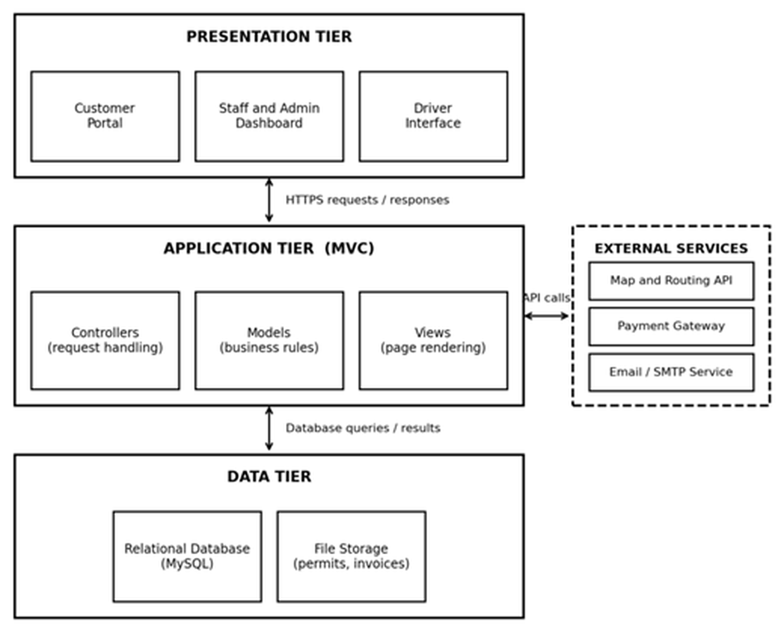
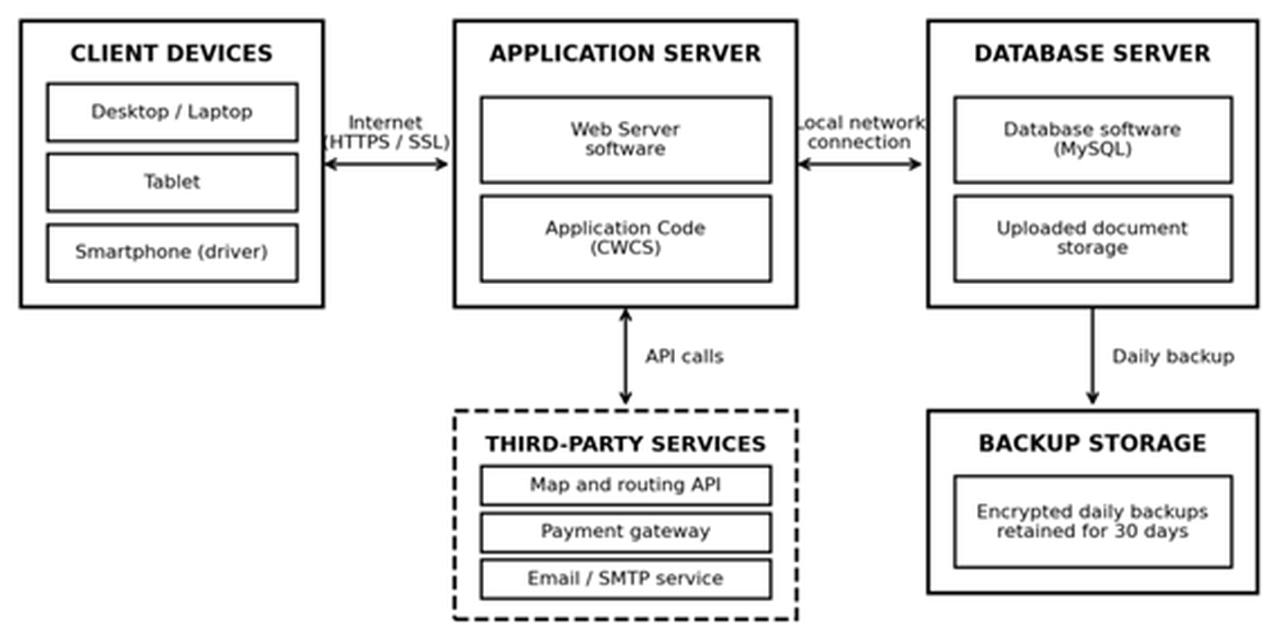
FAHAD
SRS SECTION 4.1
Software & Hardware Architecture
Figure 4.1 — Software architecture
Figure 4.2 — Hardware architecture
Presentation tier
Application tier
Data tier
What the user sees. Bootstrap 5, so the same site works on a driver's phone and an office desktop. NFR9, NFR10
Where every rule lives, once — cost estimate, hazardous-waste block, double-booking check. Laravel MVC. NFR11
MySQL for records, permits and invoices as files, encrypted daily backups kept 30 days. NFR5, NFR13
Hardware: application server 4 vCPU / 8 GB and database server 2 vCPU / 8 GB, both in an Australian region so customer data stays in Australia (NFR15). Maps, card payments and email are used, not built — three services we depend on but do not control.
Notes:
SECTION 4.1 — ARCHITECTURE (about 35 seconds)
"These two diagrams show how the system is put together.
On the left is the software. Three layers, and each one has a single job. The top layer
is what you see in the browser — customer portal, staff dashboard, driver interface.
Built with Bootstrap 5, so the same site works on a driver's phone and an office desktop.
That's NFR9 and NFR10.
The middle layer is where the thinking happens, and it's built as Model-View-Controller
because NFR11 asks for it. Every business rule lives here once: work out the cost before
the customer confirms, block hazardous waste from a standard bin, stop a truck being
booked twice in the same slot. If BINCOL changes a rule later, we change it in one place
instead of hunting through every screen.
The bottom layer just stores and returns — MySQL for records, file storage for permits
and invoices.
Notice the dashed box on the right: external services. Maps, payment gateway, email. We
use them, we don't build them, and drawing them dashed and outside says exactly that.
On the right is the hardware. Nobody installs anything — a browser is enough. Application
server and database server are separate, connected over a local network, with encrypted
daily backups kept for thirty days. Both sit in an Australian region, because NFR15
requires customer data to stay in Australia."
IF ASKED — 'why separate the database server?'
Each can be sized and backed up independently. They stay in the same region though; a
cross-region hop would put the 3-second page load in NFR1 at risk.
IF ASKED — 'why file storage separate from the database?'
Permits and invoices are documents, not rows. Keeping them as files keeps the database
small and backups fast.

Slide 11
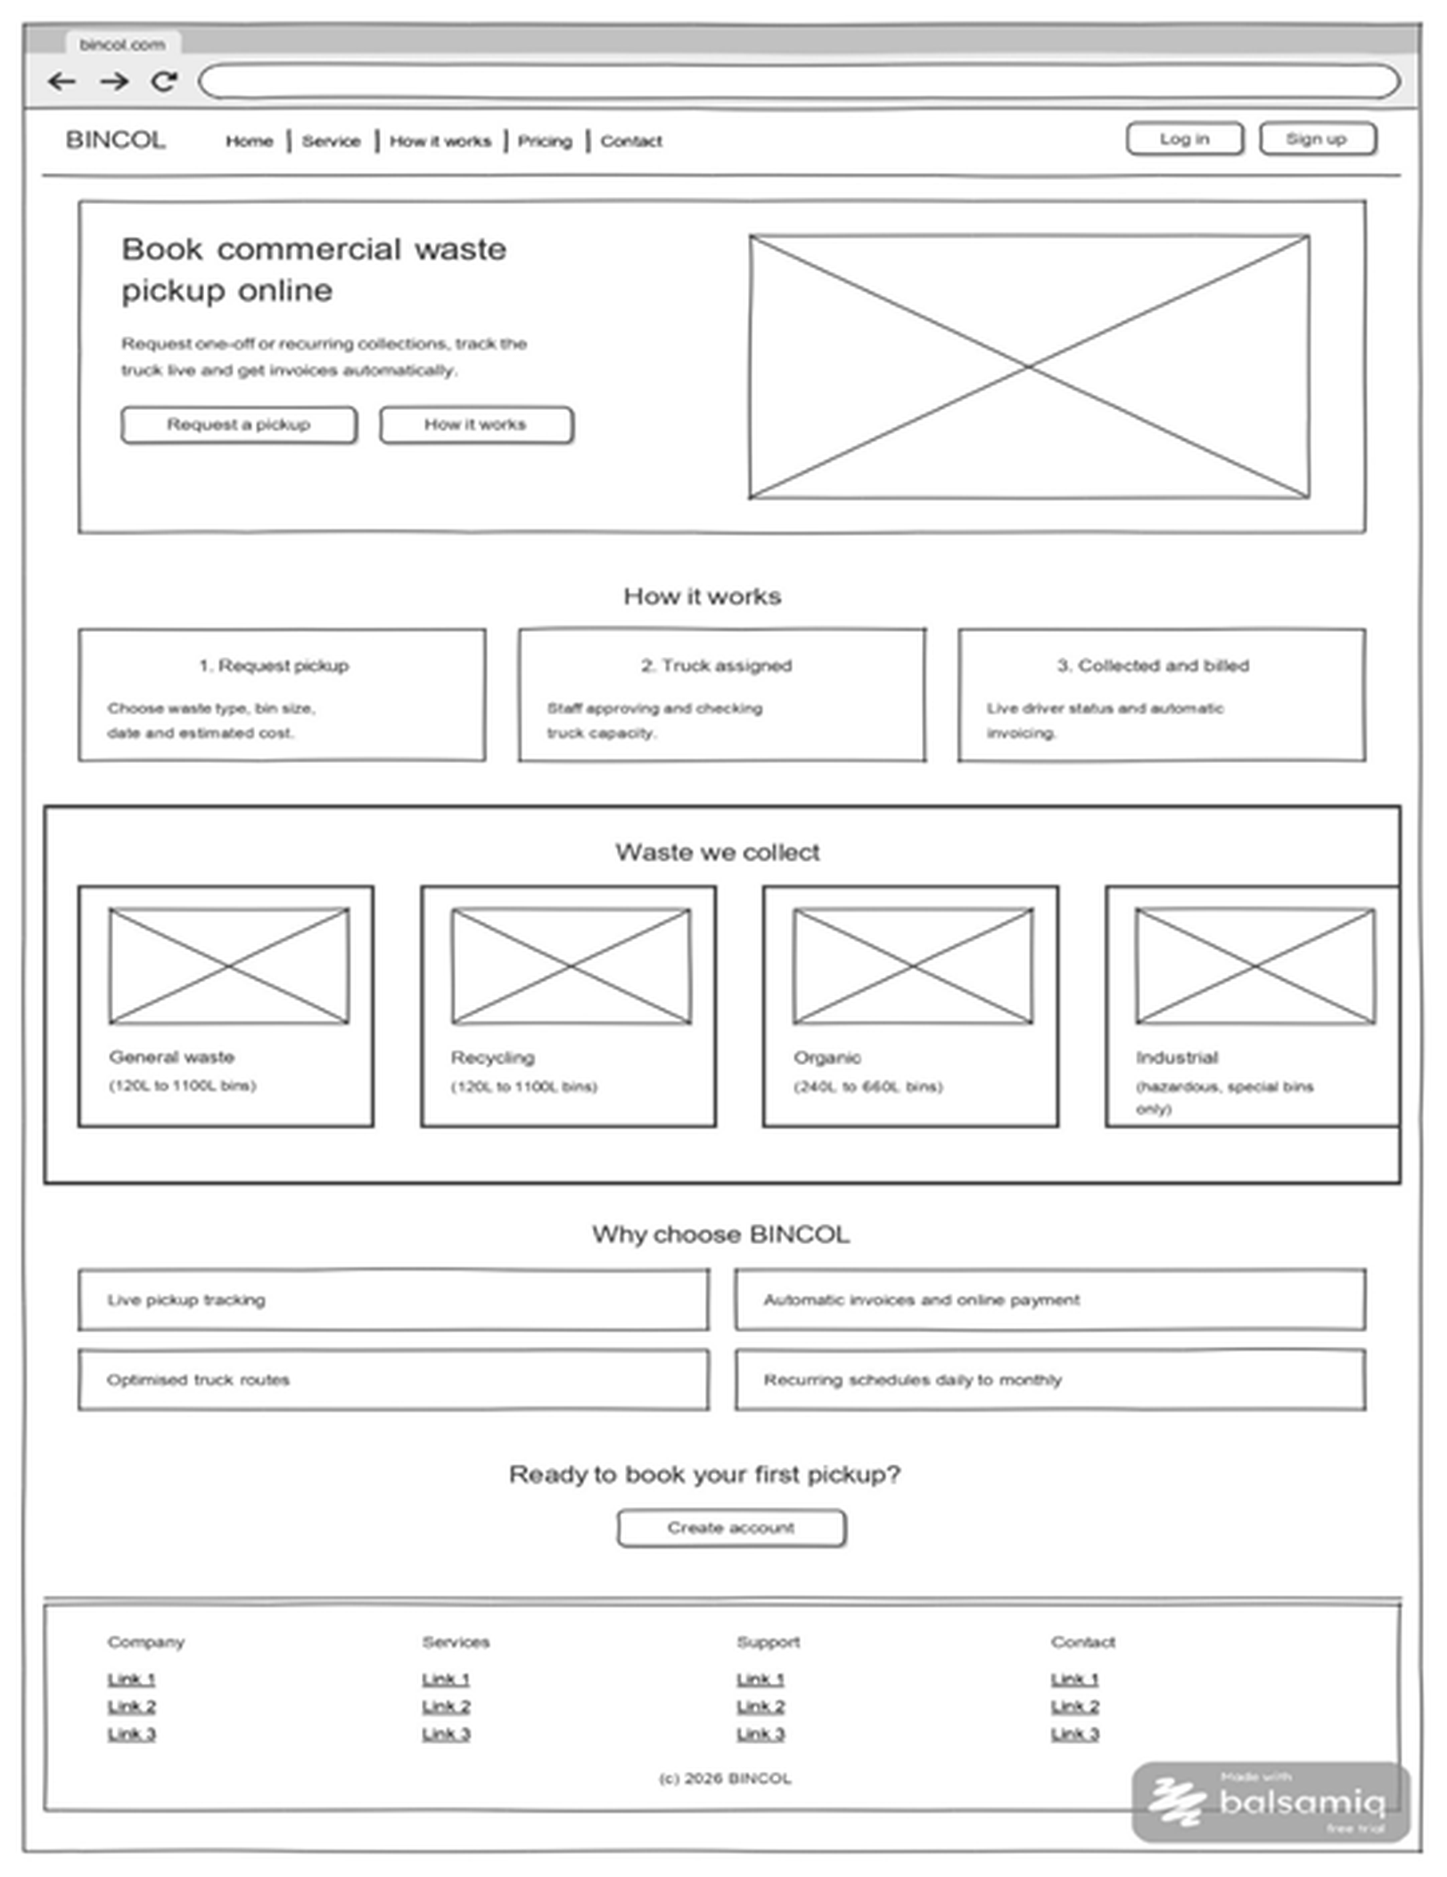
FAHAD
SRS SECTION 5.1
User Interface Design — Landing Page
Why the screen is laid out this way
One primary action
"Request a pickup" is the only emphasised button above the fold, so a visitor is never unsure what to do next. UI Requirement 1
Fixed information zones
Navigation, hero, content blocks and footer sit in the same place on every screen in the set, so messages and errors always appear where the user expects them. UI Requirement 2
Public before private
Only Log in and Sign up appear here. Which dashboard you land on afterwards is decided by your role — Customer, Staff, Driver or Admin. FR3, FR4
It answers the question before it is asked
"How it works" in three steps, the four waste categories with their bin sizes, and the reasons to choose BINCOL — all before any sign-up.
Built to flex
Twelve-column grid reflows to tablet and phone; contrast and focus order meet WCAG 2.1 AA. NFR9, NFR10
Wireframed in Balsamiq Cloud — one of ten screens in my set, WF01–WF10.
Notes:
SECTION 5.1 — UI DESIGN (about 40 seconds)
"This is the landing page — the first thing a business customer sees, before any login.
Three deliberate decisions.
First, there is one primary action. 'Request a pickup' is the emphasised button; 'How it
works' sits beside it as the quieter option. That's not decoration. UI Requirement 1 says
the user should always know what to do next, and the fastest way to say that is to make
one thing obviously the thing.
Second, the regions are fixed. Navigation across the top, hero, content blocks, footer.
Those same regions appear in the same place across all ten of my wireframes, which is UI
Requirement 2 — information and error messages always surface in one predictable spot.
Third, nothing role-specific appears here at all. Only Log in and Sign up. What you see
afterwards depends on whether you're a Customer, Staff, Driver or Admin — that's FR3 and
FR4 doing their job.
Down the page I answer the obvious questions before the customer has to ask: how it works
in three steps, the four waste categories with their bin sizes, and why BINCOL rather than
a competitor. Then one last call to action at the bottom for anyone who scrolled.
It's wireframed in Balsamiq Cloud, so it's deliberately grey — a wireframe fixes layout
and flow, not colour."
IF ASKED — 'why no residential sign-up?'
Scope is commercial customers only. FR1 requires an ABN at registration, so there is no
ABN-less path by design.
IF ASKED — 'is this the final look?'
No. Grey on purpose, so reviewers comment on the structure rather than the colours.
IF ASKED — 'why show hazardous waste on a public page?'
Industrial is listed as special-bins-only, which sets expectations before booking and
supports the compatibility rule in FR16.

Slide 12
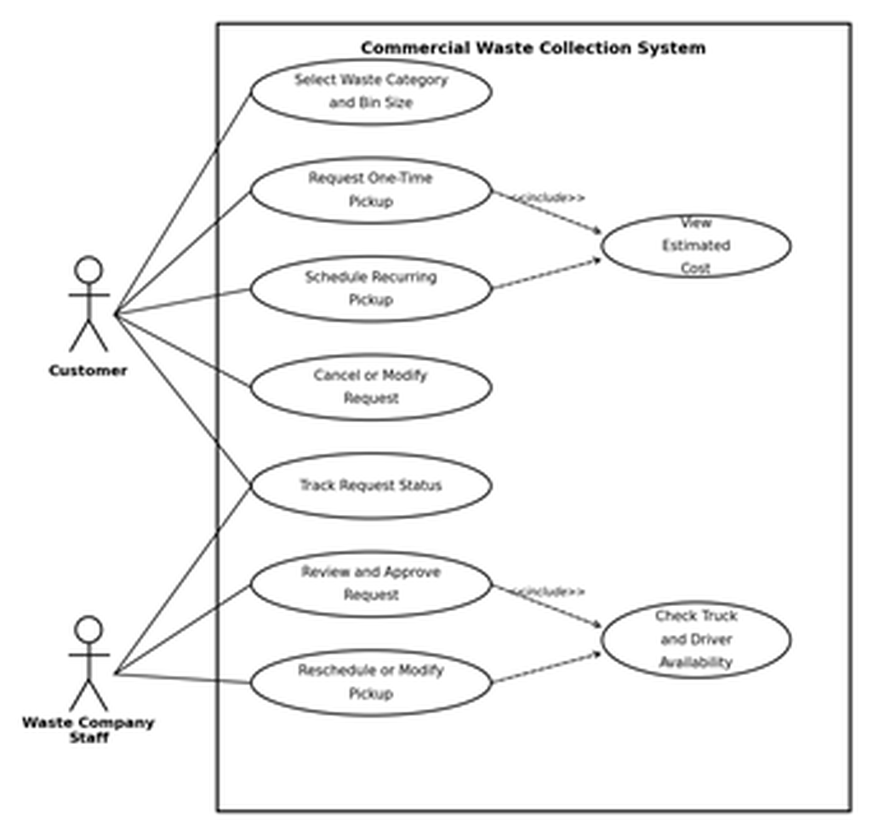
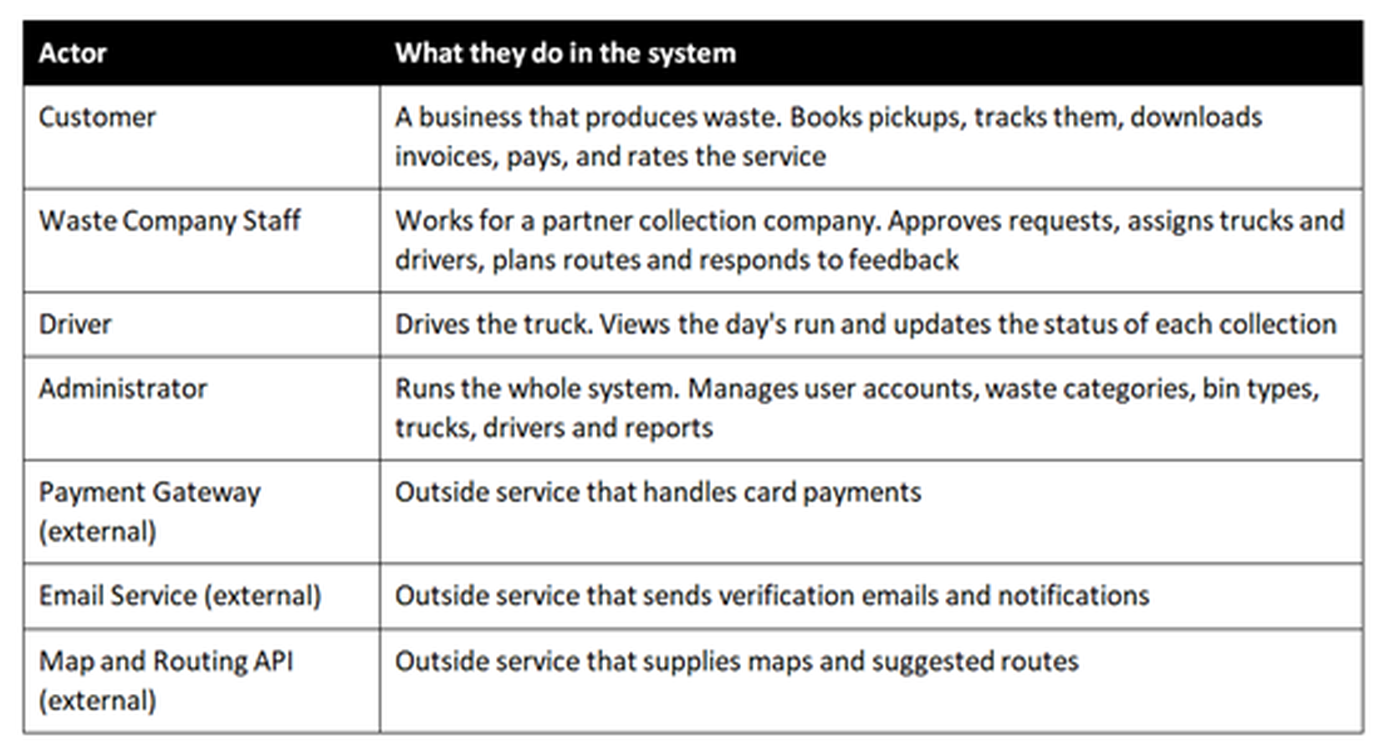
FAHAD
SRS SECTION 6.0
Requirement Analysis — Use Case Diagram
Table 6.1 — Actors in the BCWCS
Who is allowed to do what
Four human actors, three external systems
The external ones sit outside the boundary: we depend on them, we do not control them. Eleven modules on one page would be unreadable, so Section 6.0 gives an overview plus four diagrams by module.
«include» means it always runs
Figure 6.3 — Pickup request and scheduling
Every one-time and recurring booking runs View Estimated Cost — the customer never confirms blind (FR21). Every staff approval runs Check Truck and Driver Availability, which is how FR26 and FR30 stop a double-booking.
Notes:
SECTION 6.0 — USE CASE DIAGRAM (about 40 seconds)
"A use case diagram answers one question: who is allowed to do what.
The table lists our actors. Four types of people — Customer, Waste Company Staff, Driver
and Administrator. Those are the four roles named in FR4, so the requirement and the
diagram agree. Then three outside systems: payment gateway, email, and the map and routing
API. They're listed as external actors because the system depends on them but does not
control them. If Stripe goes down, that isn't a bug in our code — it's a dependency, and
naming it as an external actor makes that visible.
The diagram on the left is Figure 6.3, the pickup and scheduling module — my module. The
customer can select waste category and bin size, request a one-time pickup, schedule a
recurring one, cancel or modify, and track status. Staff review and approve, or reschedule.
The two dashed arrows are the interesting part. They're marked include, which means the
step always runs. Every booking — one-time or recurring — runs View Estimated Cost, so a
customer never confirms blind. That's FR21. And every staff approval runs Check Truck and
Driver Availability, which is how FR26 and FR30 stop a truck being double-booked.
Include means always. Extend, which we use elsewhere, means optional — exporting a report
to PDF is an extend, because the report is already complete without it."
IF ASKED — 'why is Track Request Status not an include?'
It's a separate thing the customer chooses to do afterwards, not a step inside booking.
IF ASKED — 'why five diagrams instead of one?'
Eleven modules on one page is unreadable, and an unreadable diagram is a useless diagram.
Section 6.2 gives the overall picture; 6.3 to 6.6 break it down by the kind of work.

Slide 13
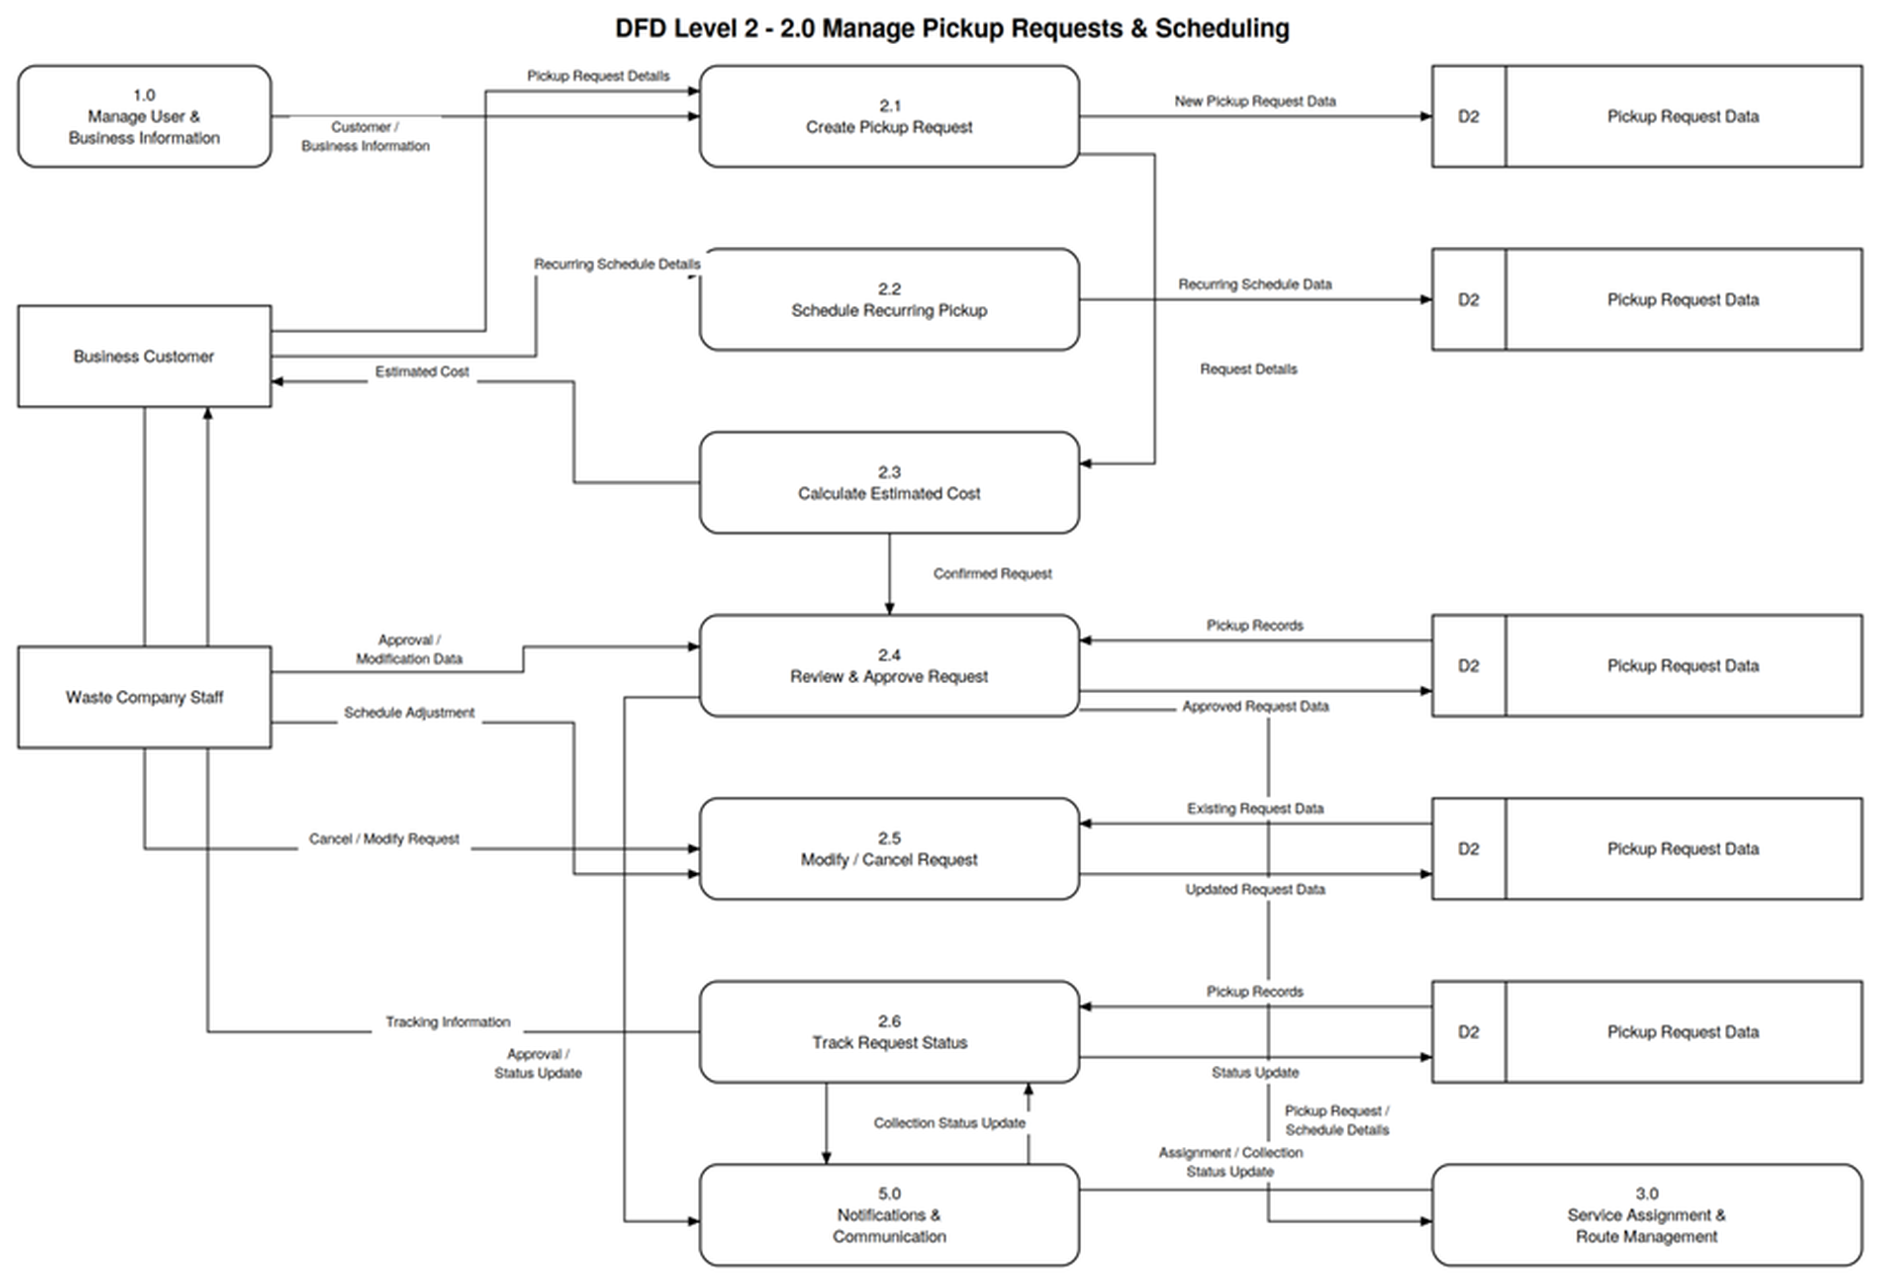
FAHAD
SRS SECTION 8.2
DFD Level 2 — Manage Pickup Requests & Scheduling
Where the data goes
2.0 opened up
One box on the Level 1 diagram, exploded into six sub-processes, 2.1 to 2.6
The flow
Create the request, schedule recurring, price it, staff approve, modify or cancel, then track status
One data store
D2 Pickup Request Data — written to and read back at every stage
It balances
Every arrow crossing into or out of 2.0 on Level 1 appears here too — nothing enters and disappears
Feeds 3.0 Service Assignment & Route Management with approved requests, and 5.0 Notifications & Communication with approval and status updates.
Notes:
SECTION 8.2 — DFD LEVEL 2 (about 40 seconds)
"A data flow diagram answers a different question from the use case diagram — not who does
what, but where the data actually goes.
On our Level 1 diagram, all of pickup requests and scheduling is a single box numbered 2.0.
That's too coarse to build from, so Level 2 opens that one box into six steps.
2.1 creates the pickup request. 2.2 handles recurring schedules. 2.3 calculates the
estimated cost and sends it straight back to the customer — that's the Estimated Cost
arrow returning on the left. 2.4 is where staff review and approve. 2.5 is modify or
cancel. 2.6 tracks status.
Everything reads from and writes to D2, Pickup Request Data. It appears several times on
the diagram, but it's one store — repeating it just keeps the arrows from crossing.
Two things leave this process. Approved requests go to 3.0, Service Assignment and Route
Management. Status and approval updates go to 5.0, Notifications and Communication.
The discipline that matters here is balancing. Every arrow crossing into or out of box 2.0
on the Level 1 diagram has to appear on this diagram too. If Level 1 shows a flow that
Level 2 doesn't, the diagram leaks — data goes in and vanishes. Ours agrees in both
directions."
IF ASKED — 'why does D2 appear five times?'
It is one data store. Repeating the symbol is standard practice to avoid a tangle of long
crossing arrows — the D2 label is what tells you it's the same store.
IF ASKED — 'why is cost calculated in 2.3 and not inside 2.1?'
So capture and pricing stay separate. 2.1 records what the customer wants; 2.3 prices it
and returns the estimate before anything is confirmed. That's FR21.
IF ASKED — 'where does 1.0 come in?'
Customer and business information flows in from 1.0, Manage User & Business Information —
a request has to belong to a verified business account.

Slide 14
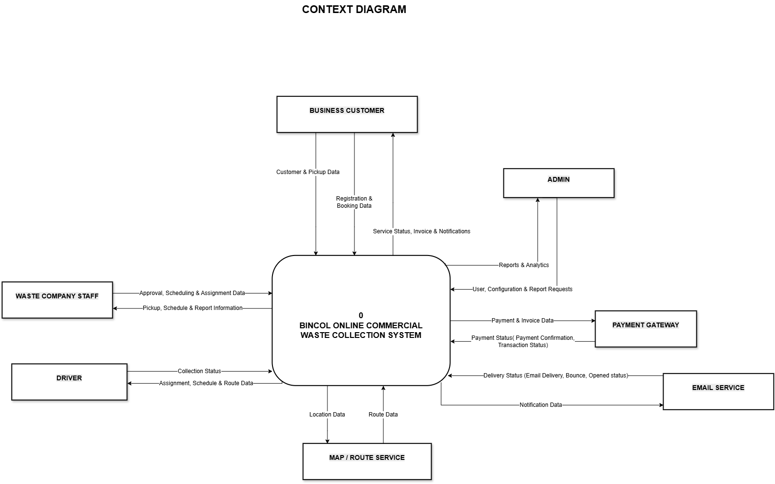
DFD Level 0
SRS SECTION 7
Debisha

Slide 15
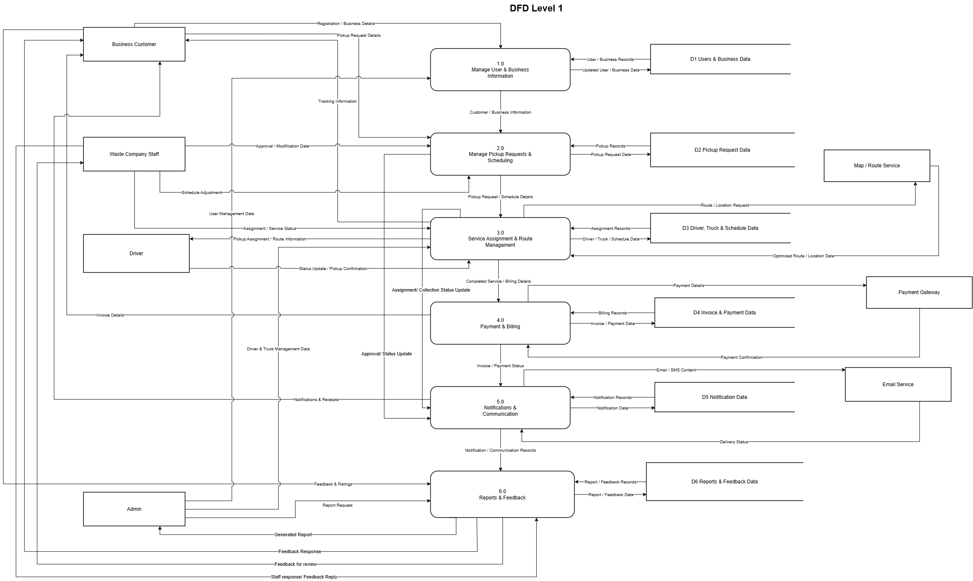
DFD Level 1
SRS SECTION 8.1

Slide 16
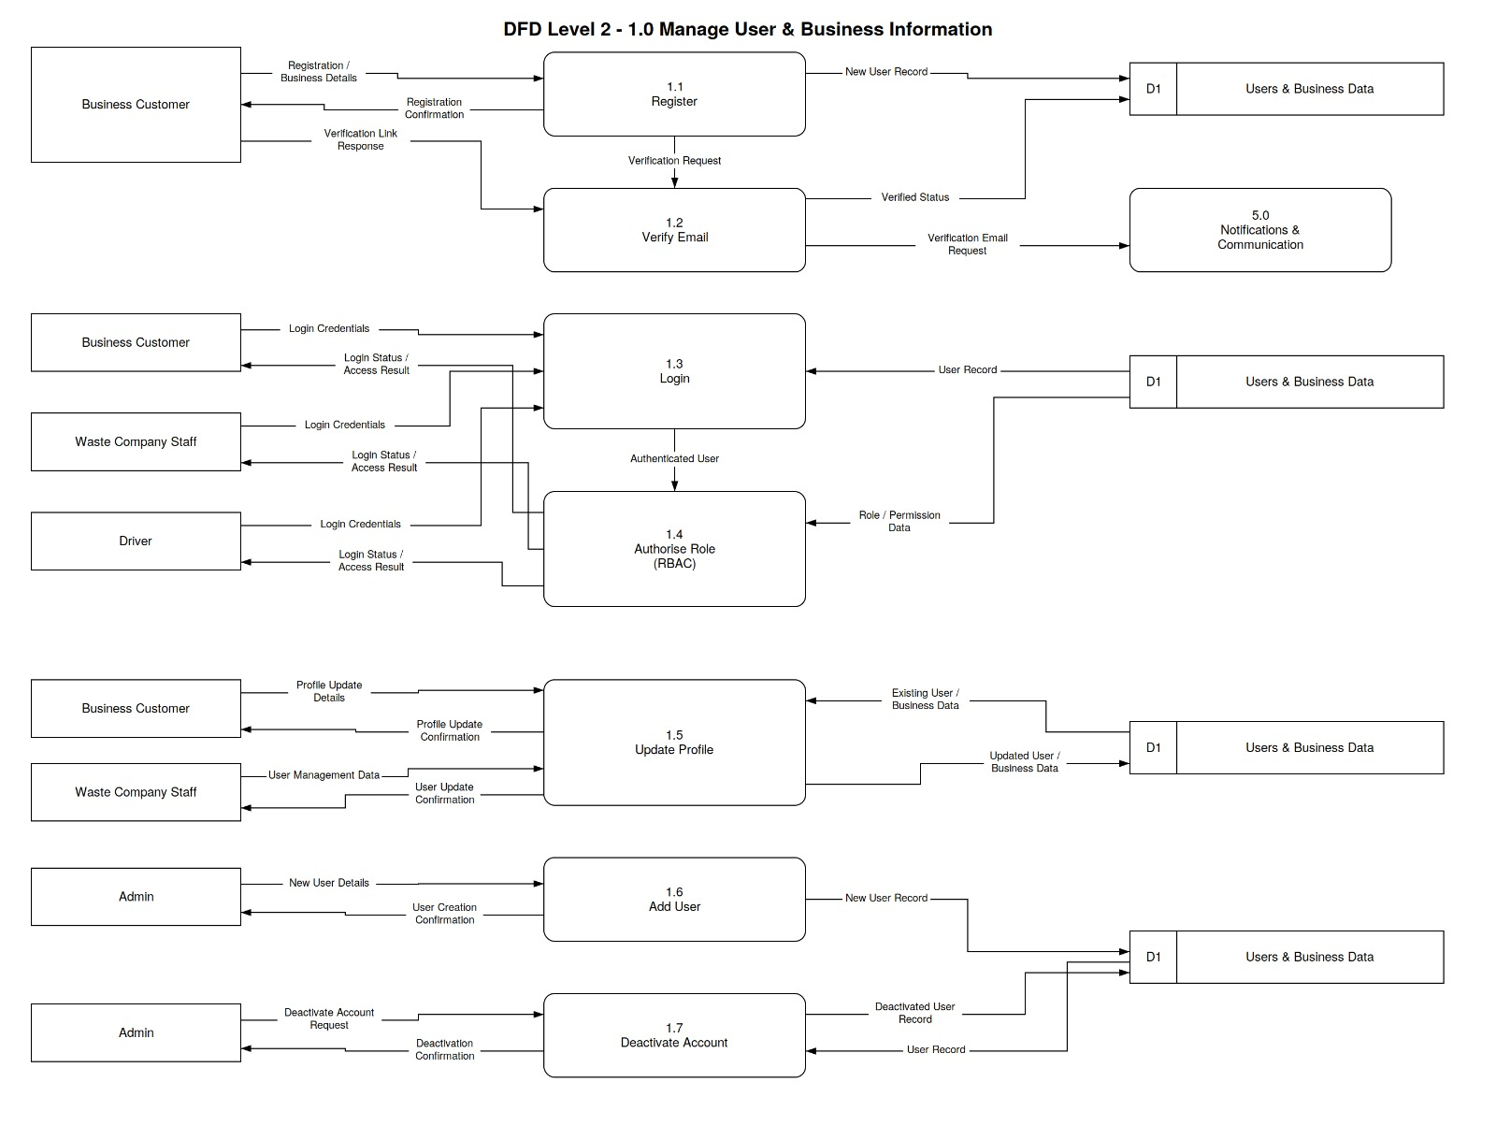
SRS SECTION 8.2
DFD Level 2 — User Management

Slide 17
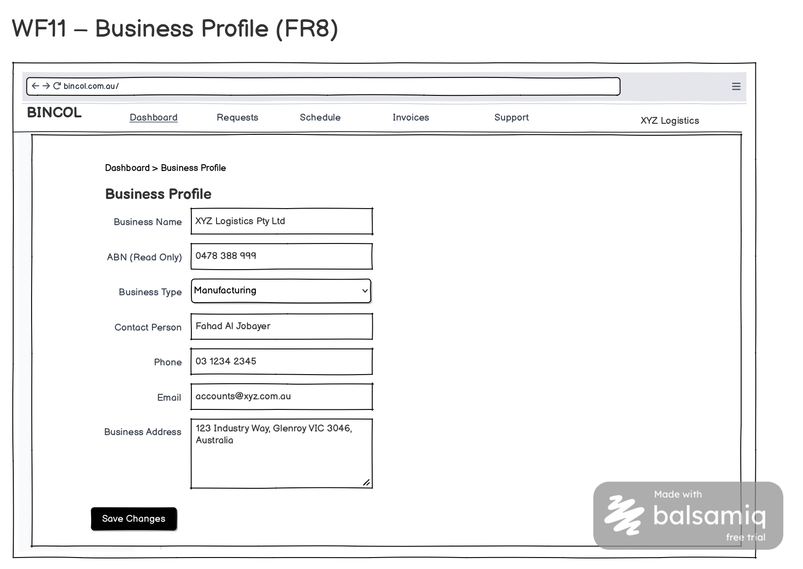
User Interface Design

Slide 18
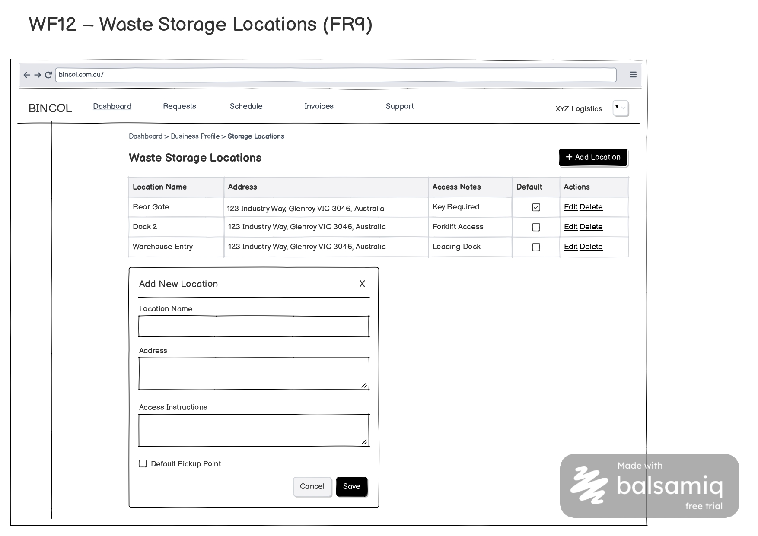

Slide 19
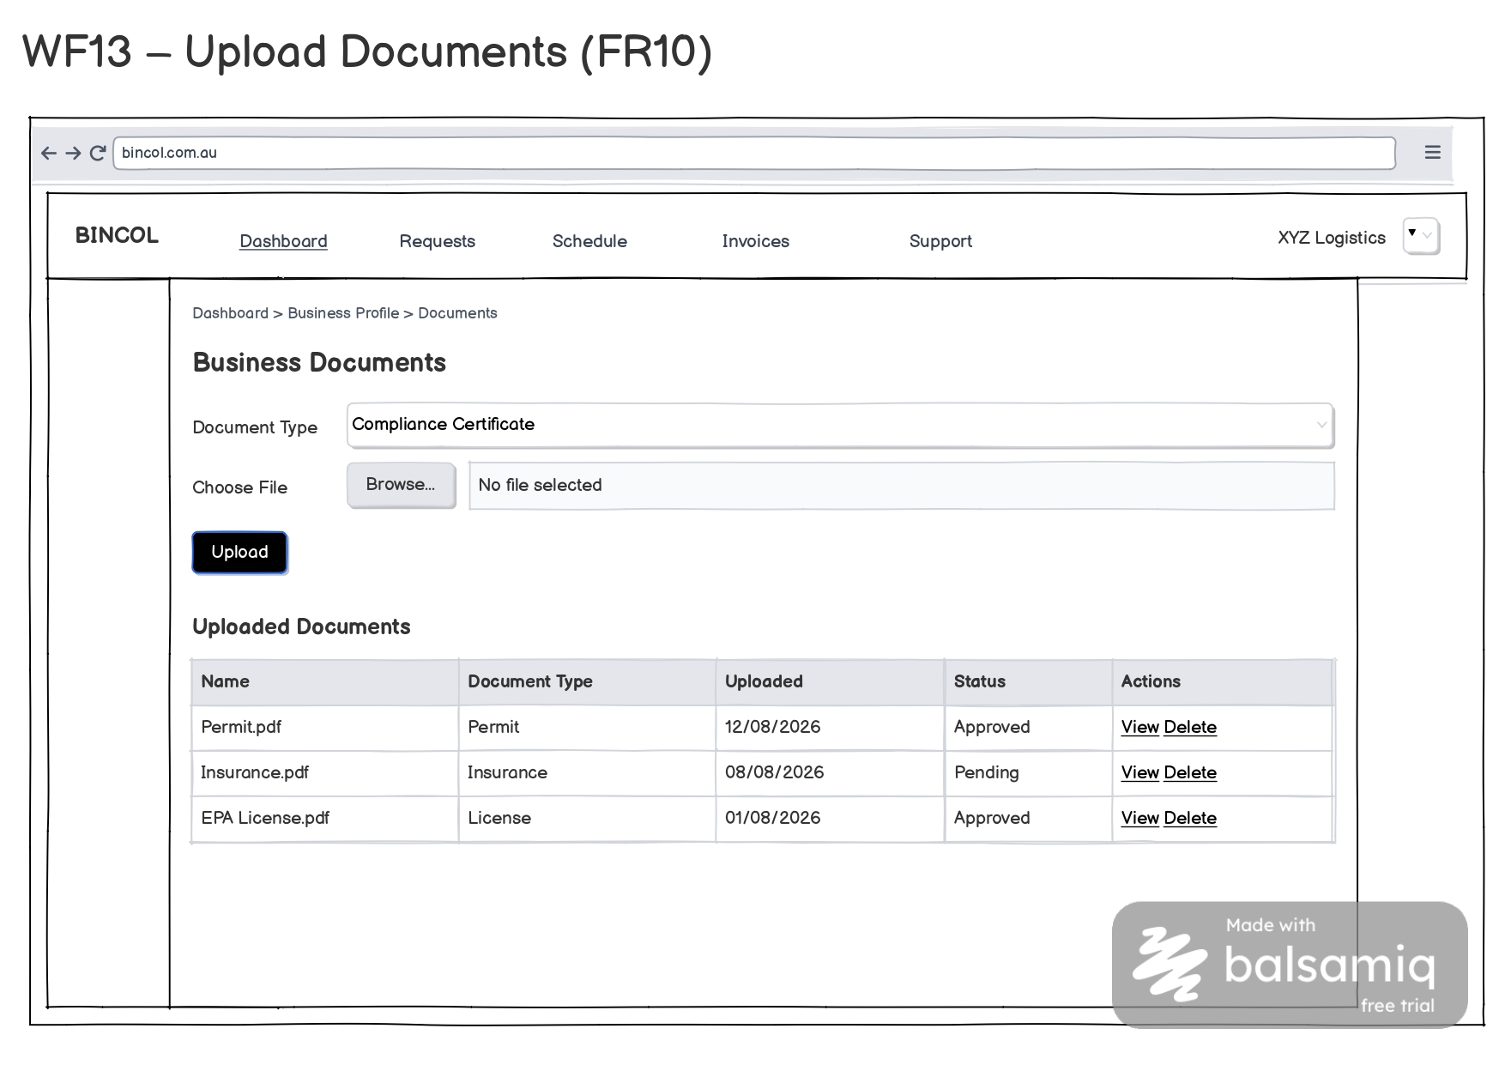

Slide 20
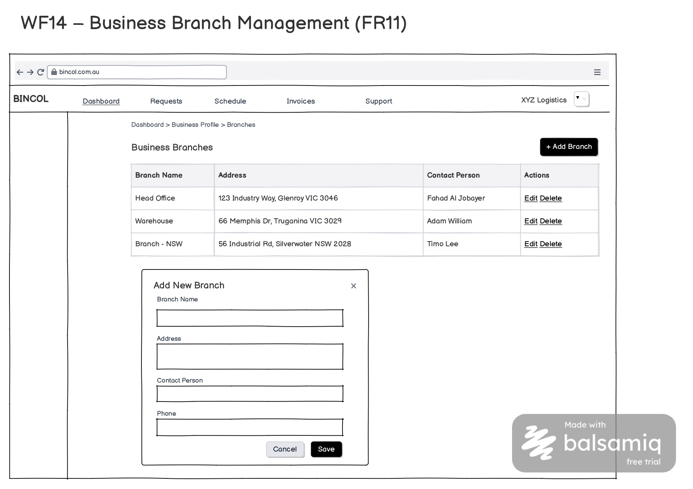

Slide 21
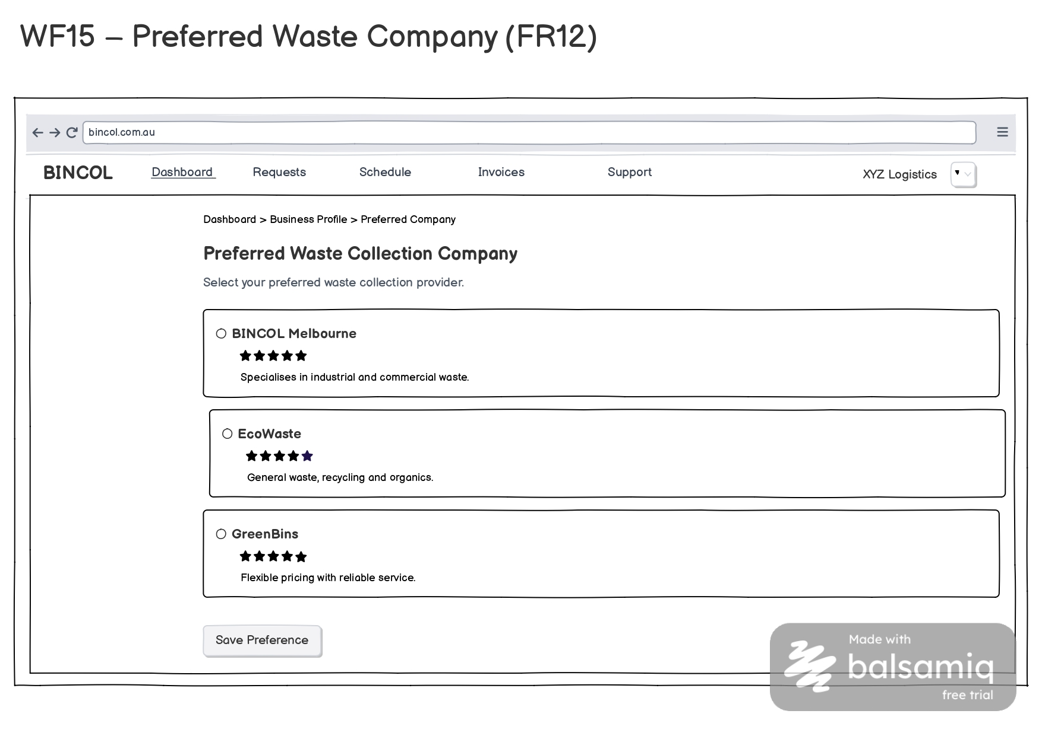

Slide 22
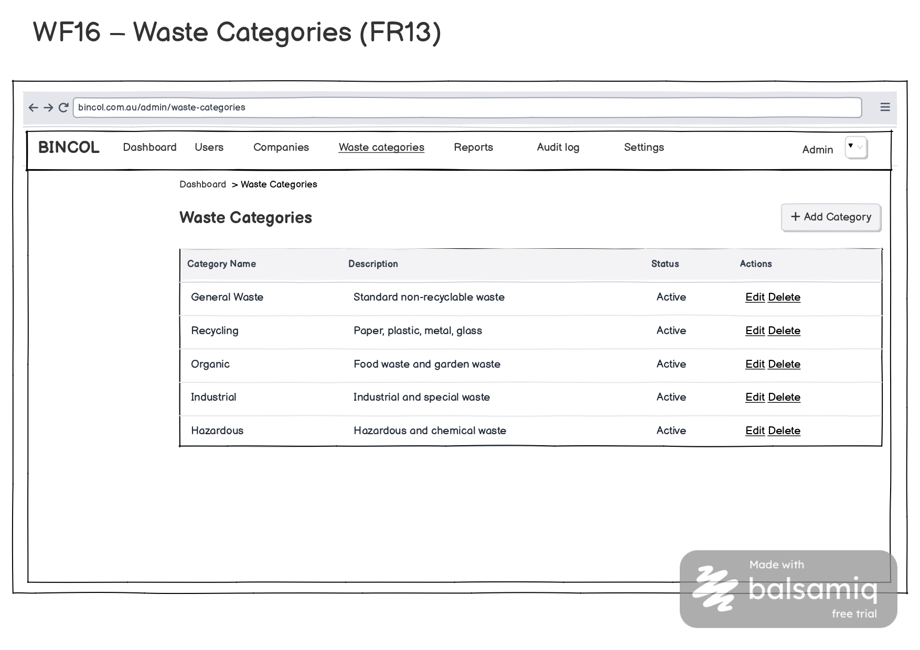

Slide 23
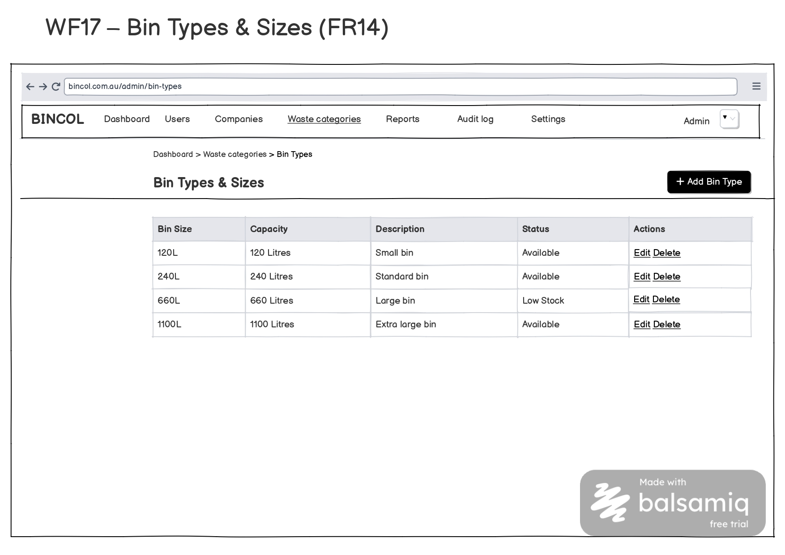

Slide 24
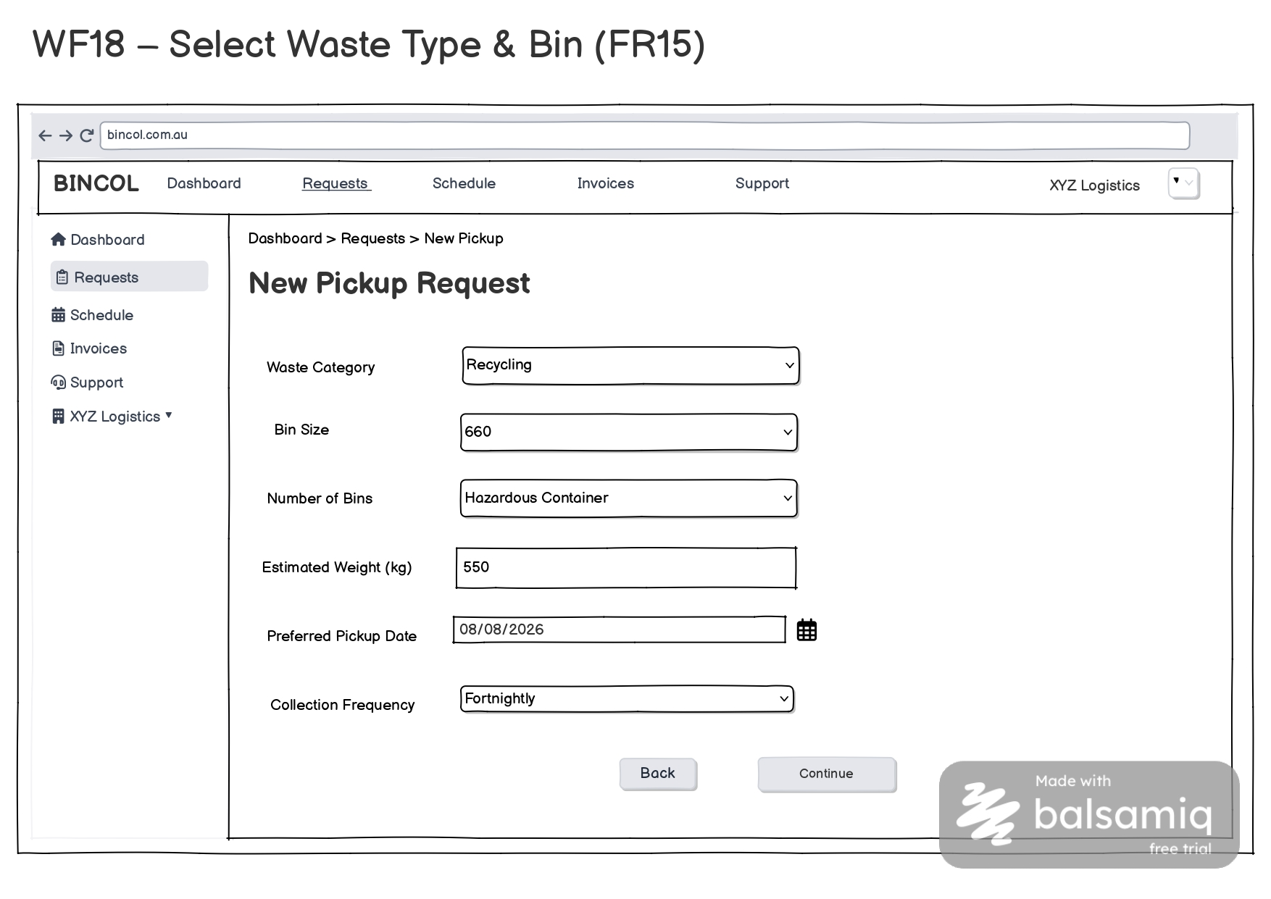

Slide 25
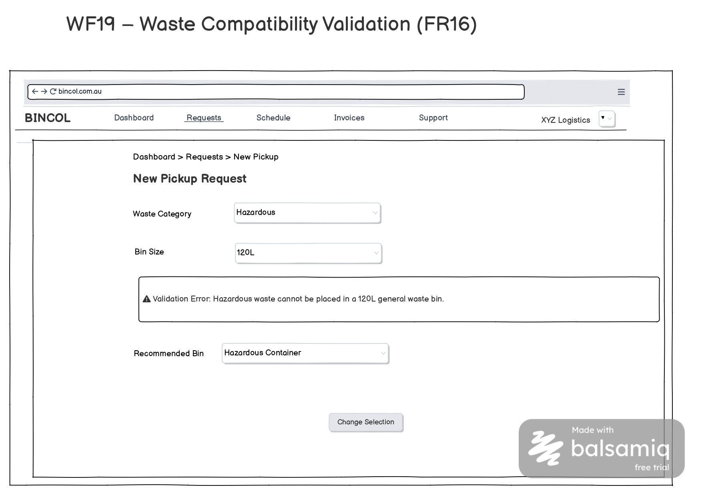

Slide 26
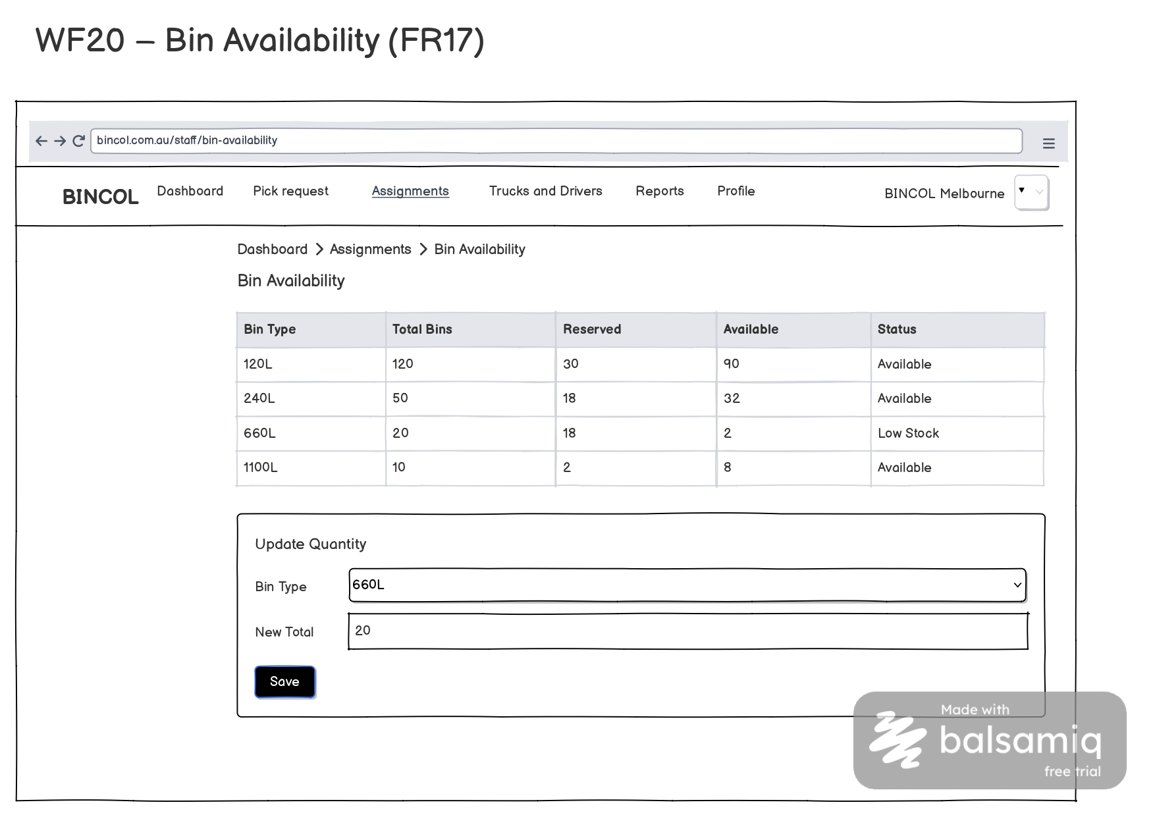

Slide 27
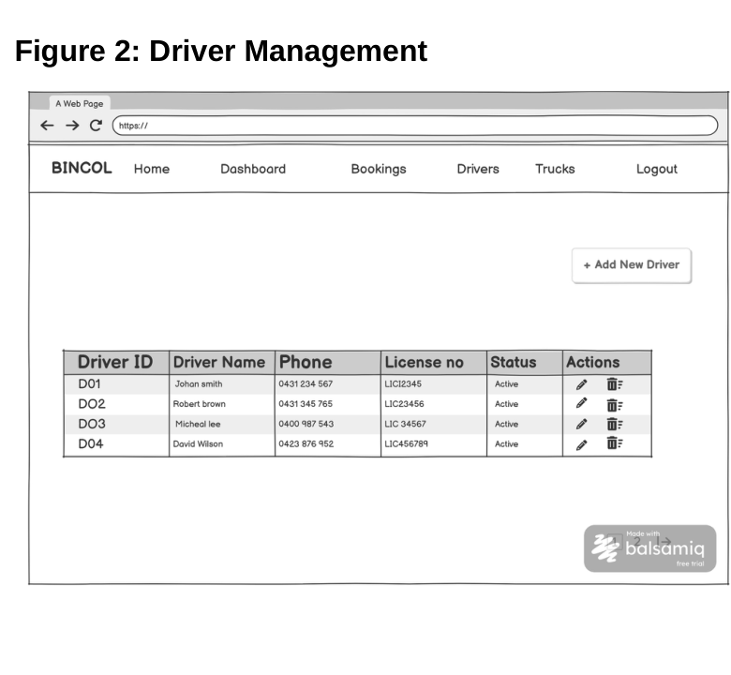
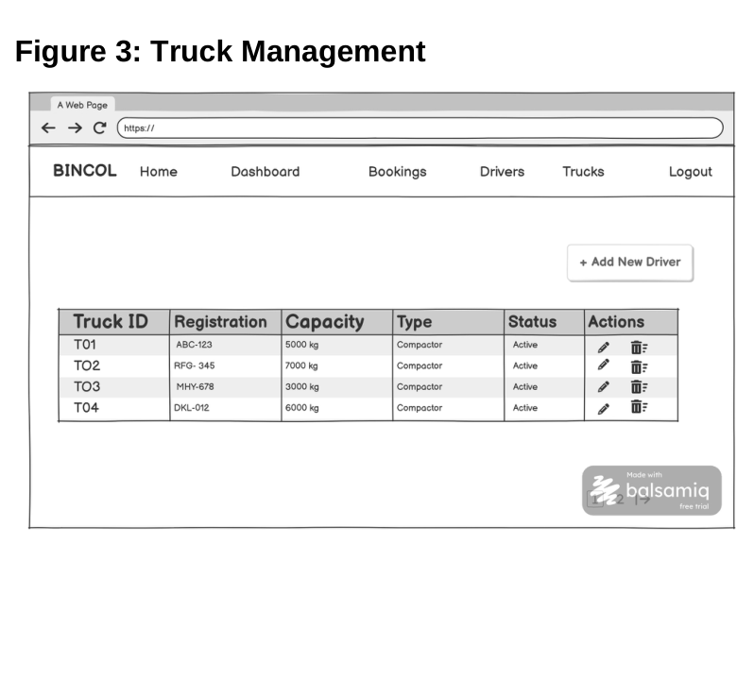
FIZA
SRS SECTION 5.1
UI Design — Driver & Truck Management
Figure 5.1 — Driver management
Figure 5.2 — Truck management
Driver records
Truck records
Capacity control
Licence, contact and availability details are maintained before assignment. FR27–FR28
Registration, vehicle type and capacity support dispatch decisions. FR29
Expected waste load is checked against the selected truck. FR30
Together, these screens provide verified resource data for daily assignment and route planning.
Notes:
These interfaces allow staff to manage driver and truck records. The system validates driver availability, truck registration and capacity before an assignment is completed.
[Sources]
- User-provided BINCOL UI Design, DFD Level 2, Development Methodology and System Testing documents.
[/Sources]

Slide 28
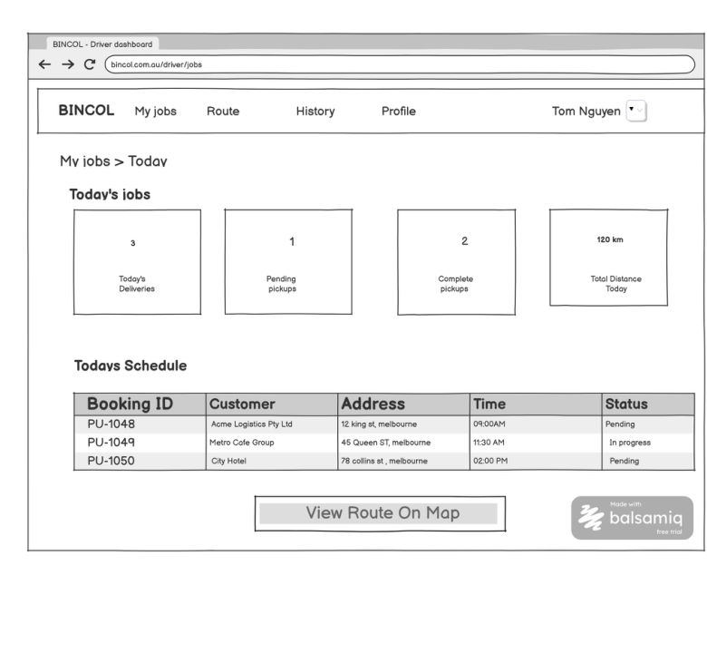
FIZA
SRS SECTION 5.1
UI Design — Driver Dashboard & Assignment
Why the dashboard is organised this way
Daily work at a glance
Today's jobs, completed pickups, pending work and issues appear in one view. FR31
One clear schedule
Customer, address, time and status stay together for quick scanning.
Assignment notification
Pickup, selected truck and schedule details reach the driver directly. FR33
Direct status updates
En-route, Arrived, Collected, Missed and Issue are available in the workflow. FR32
Driver Dashboard, Update Pickup Status and Driver Assignment Notification were wireframed in Balsamiq Cloud.
Notes:
The driver dashboard presents the daily schedule and progress clearly. Drivers receive assignment notifications and can update pickup status without leaving the workflow.
[Sources]
- User-provided BINCOL UI Design, DFD Level 2, Development Methodology and System Testing documents.
[/Sources]

Slide 29
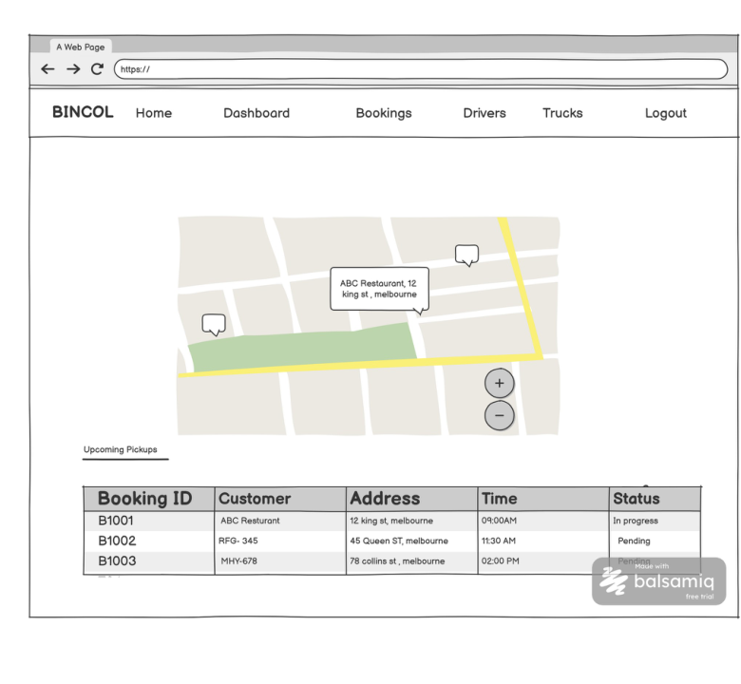
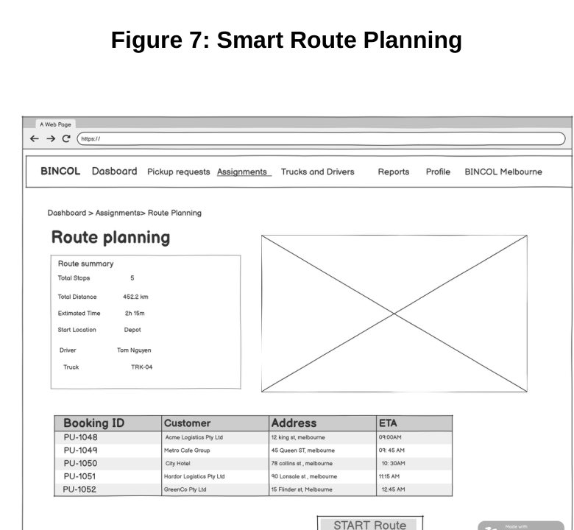
FIZA
SRS SECTION 5.1
UI Design — Map View & Smart Route Planning
Figure 5.3 — Customer map view
Figure 5.4 — Smart route planning
Map keeps location and schedule together
Optimised route supports the daily run
Customer locations, upcoming pickups and current status appear on one screen. FR34
Confirmed pickups form a practical sequence, with address-list fallback. FR35
The route screens connect confirmed bookings to field navigation and live pickup progress.
Notes:
The map view combines customer locations with the pickup list. Smart route planning organises confirmed jobs into an efficient sequence and keeps the address list available as a fallback.
[Sources]
- User-provided BINCOL UI Design, DFD Level 2, Development Methodology and System Testing documents.
[/Sources]

Slide 30
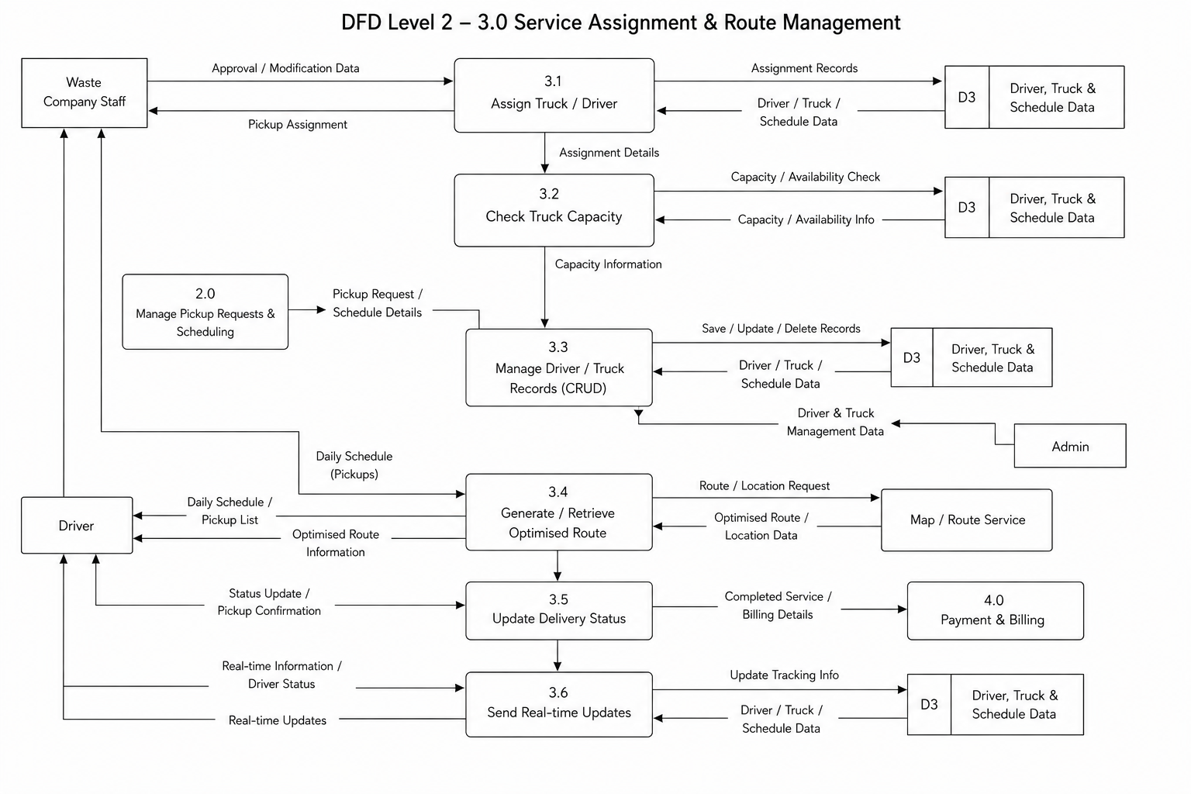
FIZA
SRS SECTION 8.2
DFD Level 2 — Service Assignment & Route Management
How data moves through the module
3.0 opened up
Six sub-processes cover assignment through real-time updates.
Assignment & capacity
D3 data supports driver, truck and capacity checks.
Route & status
Approved pickups become schedules, routes and status updates.
Balanced flow
Staff, Driver, Admin, Map, Booking and Billing remain connected.
D3 stores driver, truck and schedule data; completed services feed Payment & Billing.
Notes:
This Level 2 DFD expands process 3.0 into assignment, capacity checking, record management, route generation, delivery-status update and real-time communication.
[Sources]
- User-provided BINCOL UI Design, DFD Level 2, Development Methodology and System Testing documents.
[/Sources]

Slide 31
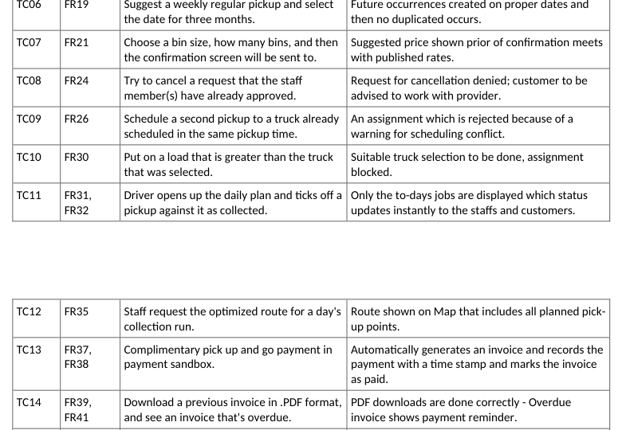
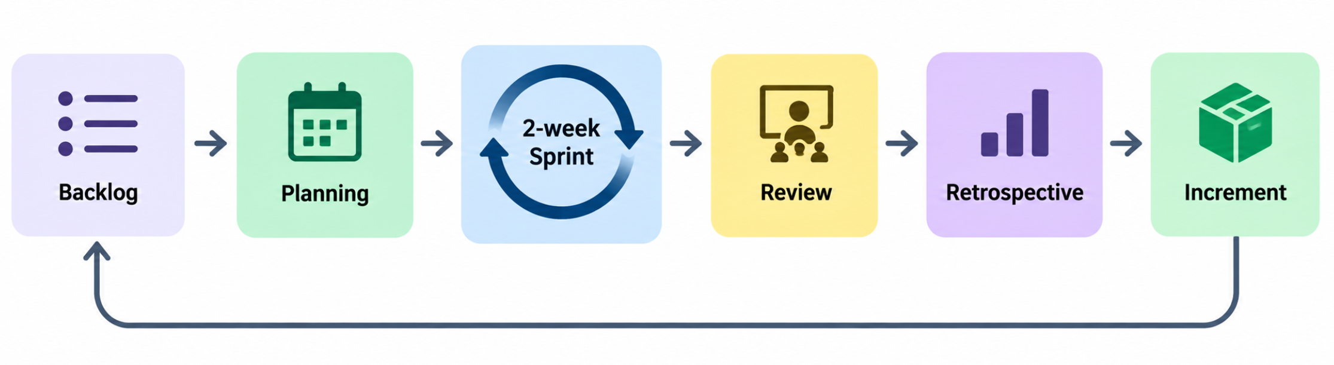
FIZA
SRS SECTIONS 13–14
Agile Development & System Testing
Agile Scrum delivery cycle
TC10–TC12 — module test coverage
Six two-week sprints
Continuous verification
Acceptance criteria
The five-member team delivers Driver & Route Management in Sprint 4.
Unit, integration and system testing are performed throughout development.
Capacity, schedule/status and optimised-route tests must pass before release.
Final release requires traceable tests, no open Severity 1–2 defects and formal BINCOL approval.
Notes:
Agile Scrum supports controlled delivery across six two-week sprints. Driver and Route Management is delivered in Sprint 4. TC10, TC11 and TC12 verify truck capacity, schedules and status updates, and route optimisation before user acceptance.
[Sources]
- User-provided BINCOL UI Design, DFD Level 2, Development Methodology and System Testing documents.
[/Sources]

Slide 32
User Interface Design & User Journey
CUSTOMER JOURNEY
1
→
2
→
3
→
4
→
5
New Request
Review & Confirm
My Pickups
Pickup Detail
Reschedule / Cancel
Category, bin size, date & time, estimated cost
Summary shown before final confirmation
Track Pending / Assigned / Completed
Full booking details + status stepper
New slot, or cancel with confirmation step
STAFF JOURNEY
1
→
2
Also designed:
Approval Queue
Modify Request
My Pickups — Empty State
New Request — Validation Errors
Staff review incoming pickup requests
Assign truck & driver, add a customer note, save

Slide 33
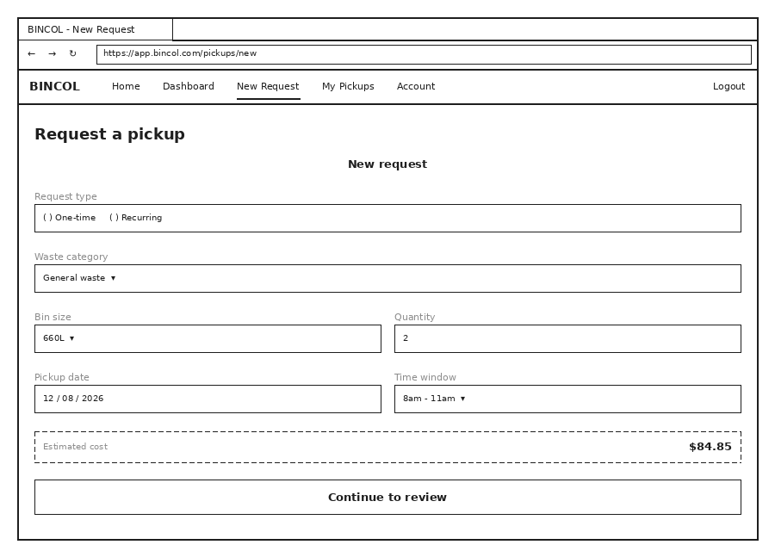
New Request Page
Customer selects one-time or recurring, sets waste category, bin size, quantity, date and time, and sees the estimated cost before continuing.

Slide 34
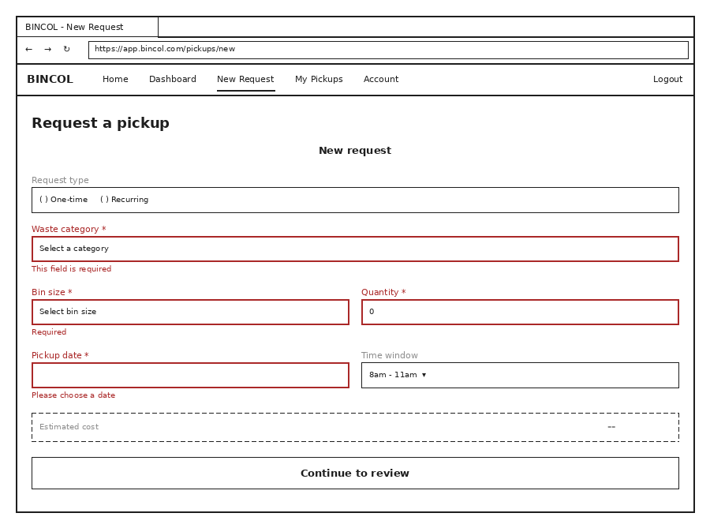
New Request — Validation Errors
Required fields are validated inline — the customer cannot continue to Review & Confirm until every error is resolved.

Slide 35
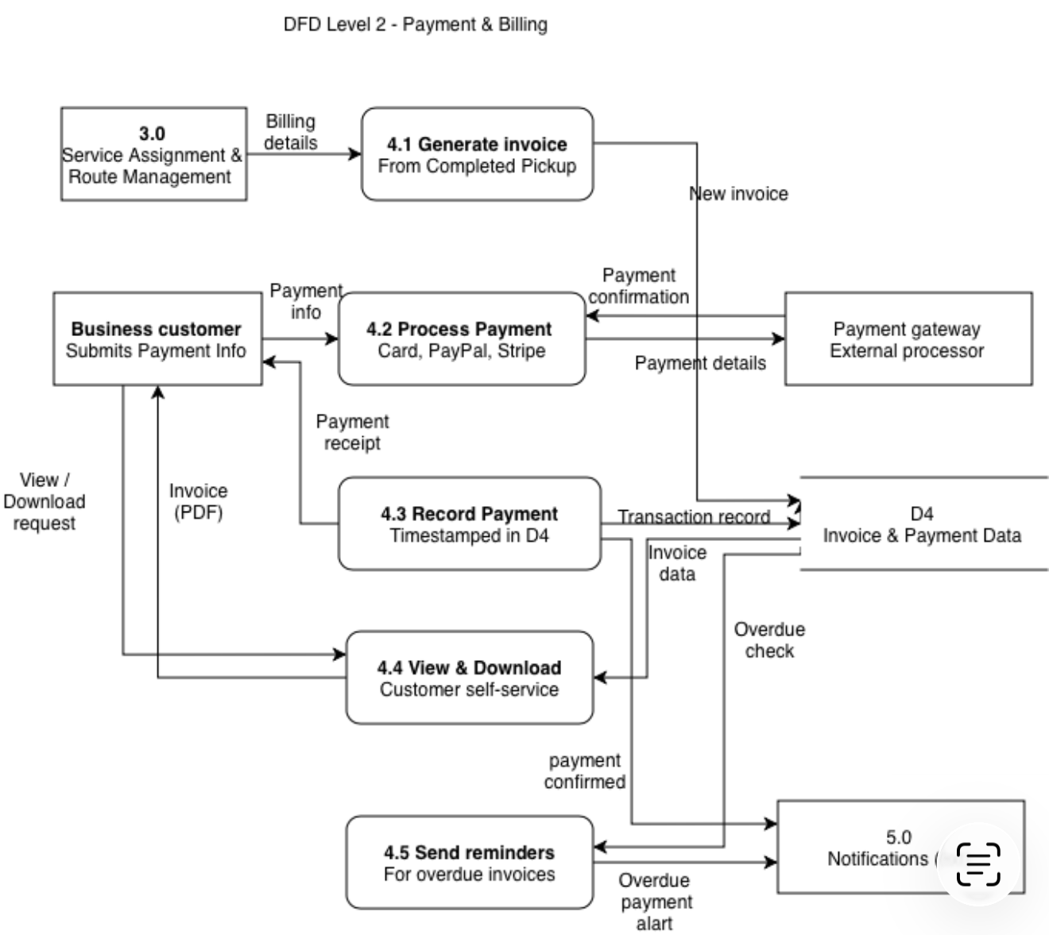
Data Flow Diagram — Payment & Billing
How the payment flow works
4.0 opened up
The billing process breaks into five sub-processes, from invoice generation through to overdue reminders.
Invoice and payment
A completed pickup generates an invoice, and the business customer pays by card, PayPal or Stripe through the payment gateway.
Record and remind
Confirmed payments are timestamped in D4, invoices become downloadable, and overdue invoices trigger reminders.
Balanced external flow
Business Customer, Payment Gateway and Notifications stay consistent with the parent Level 1 process.
Traceable payment chain: Payment → Invoice → Pickup Request → Business Customer → User — assessed in the DPIA (Section 12.0)

Slide 36
Data Dictionary
What This Section Documents
The data dictionary is the technical reference for every table in the BINCOL database — the single source of truth that developers, testers and future maintainers use to understand exactly what each field stores and how tables relate to one another.
29
Entities Documented
Field Exact column name as defined in the schema
Data Type INT, VARCHAR, DATE, DECIMAL, BOOLEAN, ENUM, TEXT
150+ fields across all tables
Description Plain-English meaning of the field
5 functional entity groups
Constraints Primary Key, Foreign Key, Not Null, Unique, Default
1 central transactional table — pickup_requests

Slide 37
Data Dictionary
Entities by Functional Group
29 tables organised into 5 functional areas
6
5
6
4
8
Customer
Waste Company / System
Waste Catalogue & Pickup Request
Operations
Billing & Feedback
users, business_customers, branches, storage_locations, customer_documents, customer_preferences
waste_companies, company_staff, drivers, trucks, bin_inventory
waste_categories, bin_types, bin_compatibility, pricing_rates, pickup_requests, recurring_schedules
service_assignments, status_updates, routes, route_stops
invoices, payments, notifications, messages, feedback, feedback_responses, report_exports, audit_logs

Slide 38
Data Dictionary
What Is 3NF?
Third Normal Form — the design rule behind our table structure
A table is in 3NF when every field describes only that row's own ID — nothing else. In practice, this means:
1
No repeating groups
Don't cram bin_type_1, bin_type_2, bin_type_3 into one row — give it its own table.
2
No duplicate data
Customer name and email don't belong inside pickup_requests — they live once, in business_customers.
Why it matters: if data is only stored once, updating it in one place keeps the whole system correct — no risk of two records disagreeing.

Slide 39
Why We Conducted a DPIA
What is a DPIA?
Why we added it
Benefits
A structured process required under the Australian Privacy Principles to identify and reduce privacy risks in a system before it goes live — not a one-off form, but part of the design process itself.
The Payment & Billing module links payment data back to an identifiable person through a traceable chain: Payments → Invoices → Pickup Requests → Business Customers → Users. That kind of processing is exactly what triggers the requirement under APP 11.
Catches privacy risks at design time, when they're cheap to fix
Demonstrates compliance with the Privacy Act 1988
Builds customer trust through responsible data handling
Leaves a clear risk record for future maintainers
Embeds privacy by design into the architecture

Slide 40
Data Protection Impact Assessment
Payments → Invoices → Pickup Requests → Business Customers → Users
Because payment data traces back to an identifiable individual through this chain, the module required a DPIA under APP 11.
Unauthorised access to the payments table
High
Mitigation: every query scoped to the authenticated customer_id / company_id
SQL injection / query-scoping error on request_id, customer_id, invoice_id
High
Mitigation: all inputs parameterised, validated and sanitised (NFR7)
A driver or staff role retrieving more data than their task needs
Medium
Mitigation: RBAC enforced at the join level, not just the table level
Compliance documents accessed outside the owning customer record
Medium
Mitigation: ownership checked on every document request
Notes:
This slide covers the DPIA risk table for Payment & Billing.
Opening line: "Because payment data traces back to an identifiable person through this chain — Payments to Invoices to Pickup Requests to Business Customers to Users — this module triggered a DPIA under APP 11."
Walk through each risk top to bottom, same pattern each time: name the risk, say the severity, then the one-line mitigation.
1. Unauthorised access to the payments table (High) — every query is scoped to the authenticated customer or company ID, so one account can never pull another's payment records.
2. SQL injection / query-scoping errors (High) — all inputs are parameterised, validated and sanitised, per NFR7.
3. Over-fetching by a driver or staff role (Medium) — RBAC is enforced at the join level, not just the table level, so a role can't accidentally join into data outside its task.
4. Compliance documents accessed outside the owning record (Medium) — ownership is checked on every document request.
Closing line: "Each of these was identified and mitigated at design time — that's the point of doing the DPIA before launch, not after."

Slide 41
Data Protection Impact Assessment
Payments → Invoices → Pickup Requests → Business Customers → Users
Because payment data traces back to an identifiable individual through this chain, the module required a DPIA under APP 11.
Unauthorised access to the payments table
High
Mitigation: every query scoped to the authenticated customer_id / company_id
SQL injection / query-scoping error on request_id, customer_id, invoice_id
High
Mitigation: all inputs parameterised, validated and sanitised (NFR7)
A driver or staff role retrieving more data than their task needs
Medium
Mitigation: RBAC enforced at the join level, not just the table level
Compliance documents accessed outside the owning customer record
Medium
Mitigation: ownership checked on every document request
Notes:
This slide covers the DPIA risk table for Payment & Billing.
Opening line: "Because payment data traces back to an identifiable person through this chain — Payments to Invoices to Pickup Requests to Business Customers to Users — this module triggered a DPIA under APP 11."
Walk through each risk top to bottom, same pattern each time: name the risk, say the severity, then the one-line mitigation.
1. Unauthorised access to the payments table (High) — every query is scoped to the authenticated customer or company ID, so one account can never pull another's payment records.
2. SQL injection / query-scoping errors (High) — all inputs are parameterised, validated and sanitised, per NFR7.
3. Over-fetching by a driver or staff role (Medium) — RBAC is enforced at the join level, not just the table level, so a role can't accidentally join into data outside its task.
4. Compliance documents accessed outside the owning record (Medium) — ownership is checked on every document request.
Closing line: "Each of these was identified and mitigated at design time — that's the point of doing the DPIA before launch, not after."

Slide 42
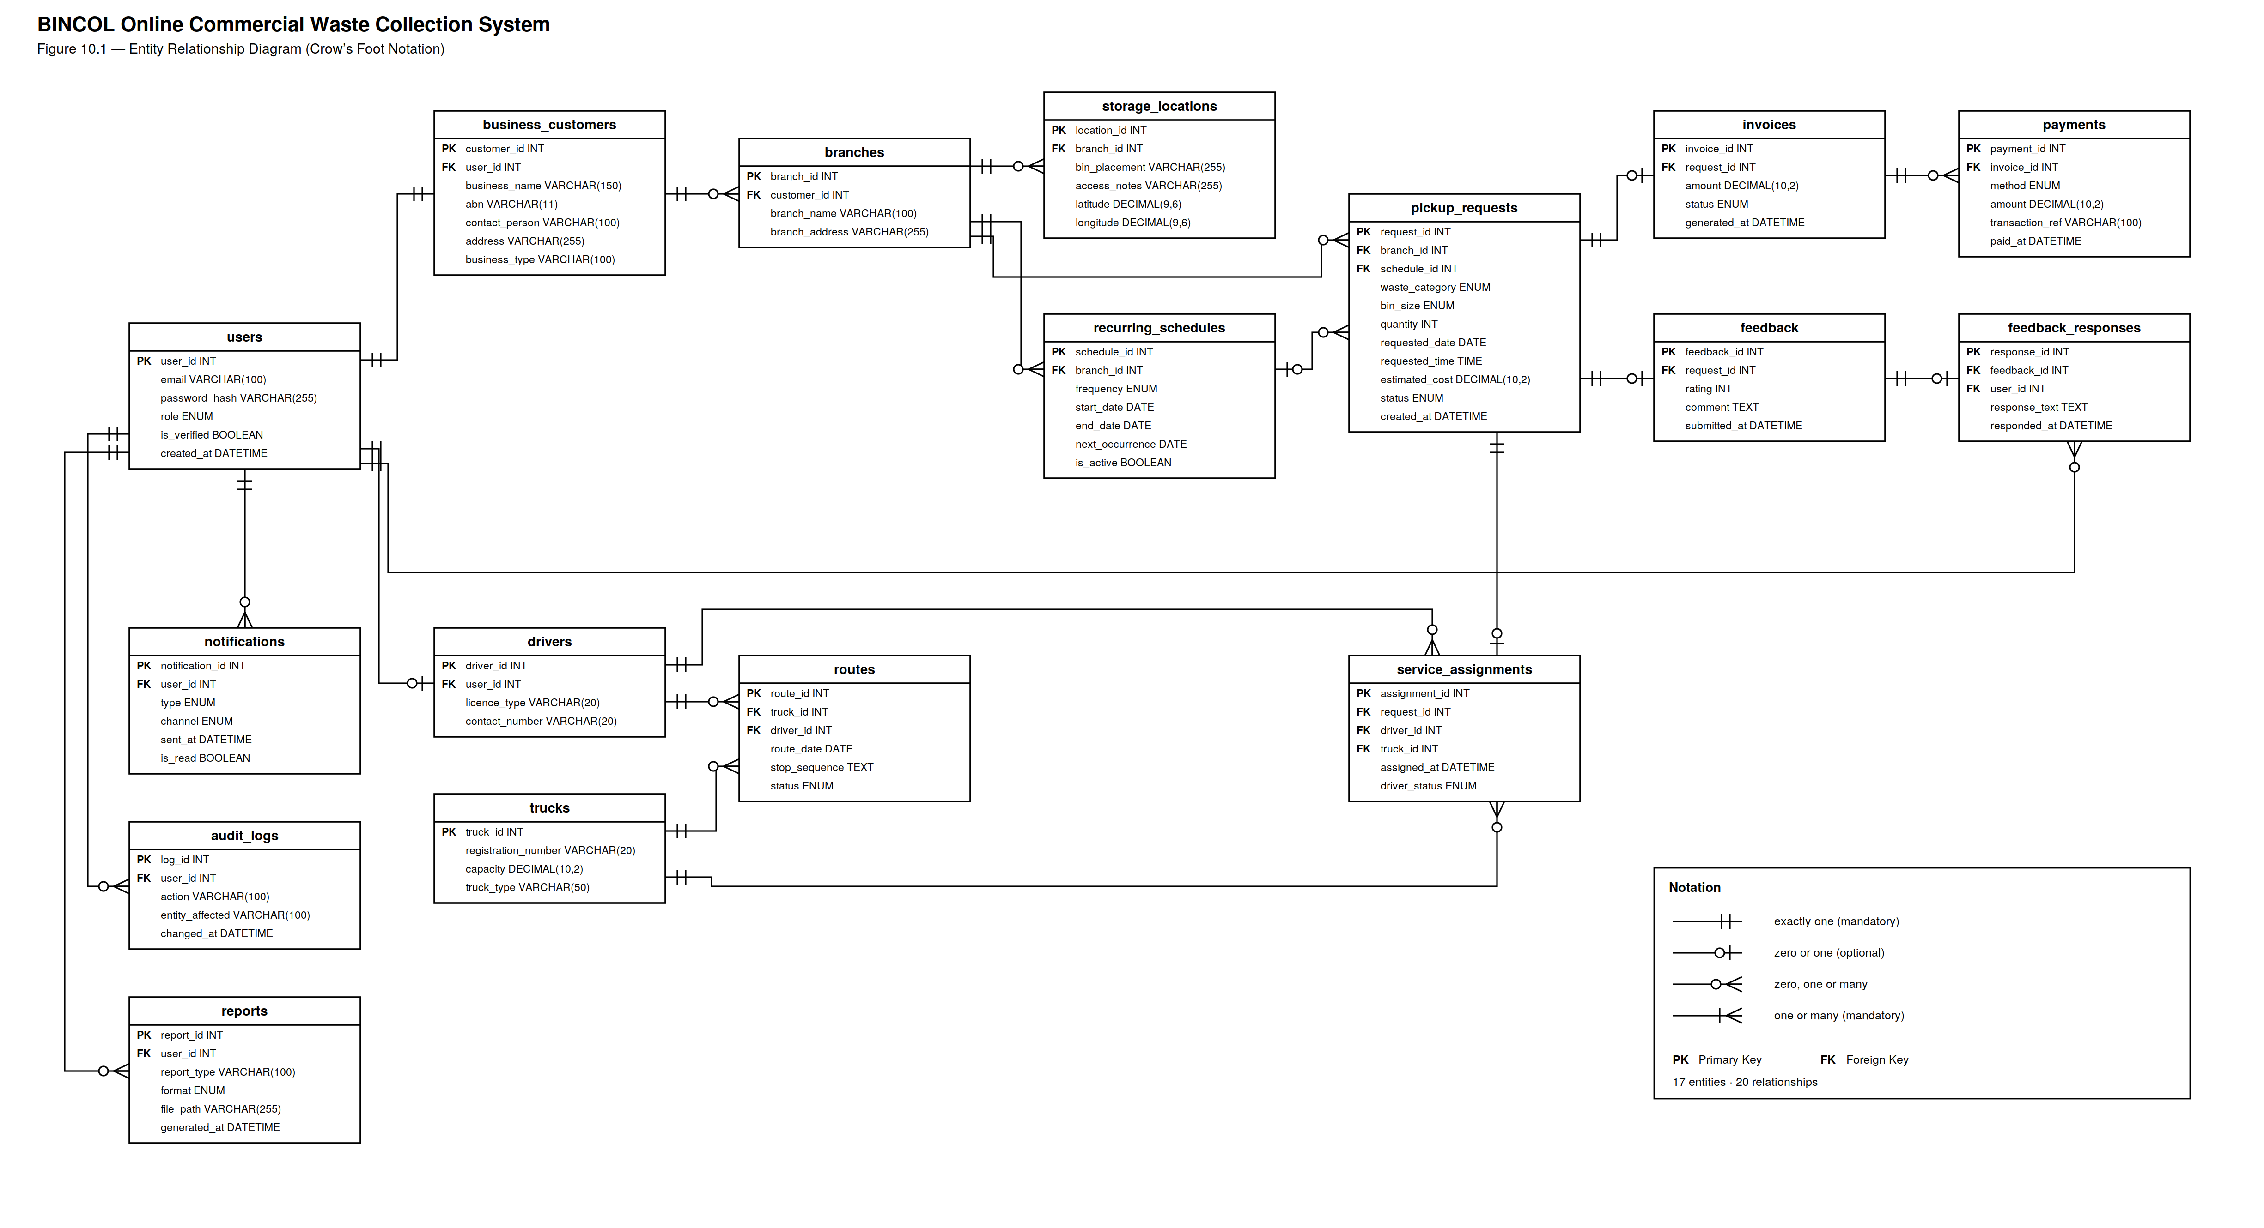
Entity Relationship Diagram (ERD)

Slide 43
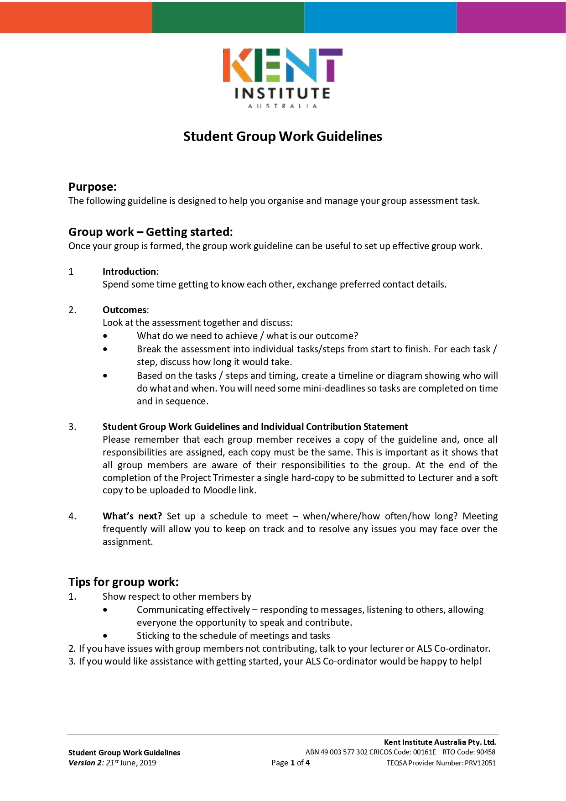

Slide 44
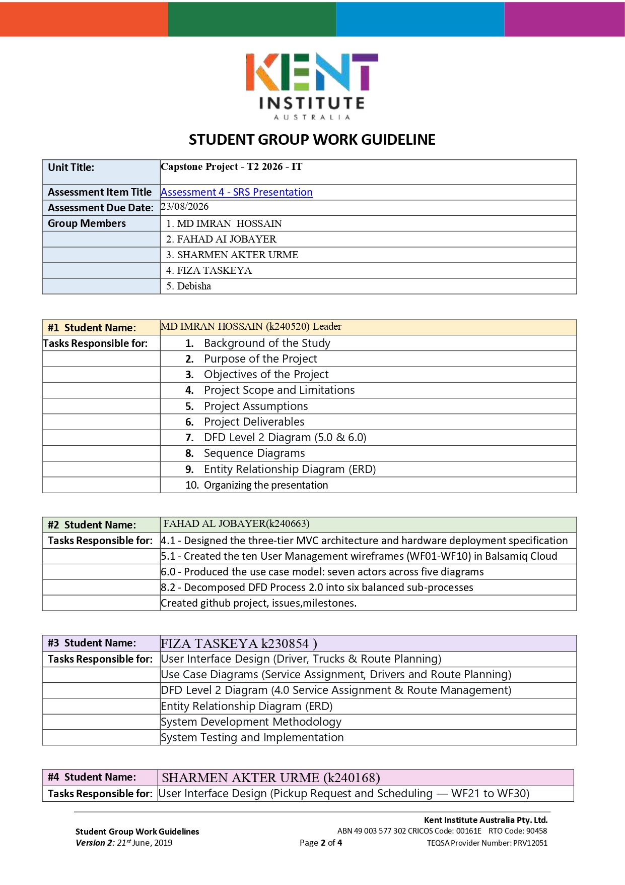

Slide 45
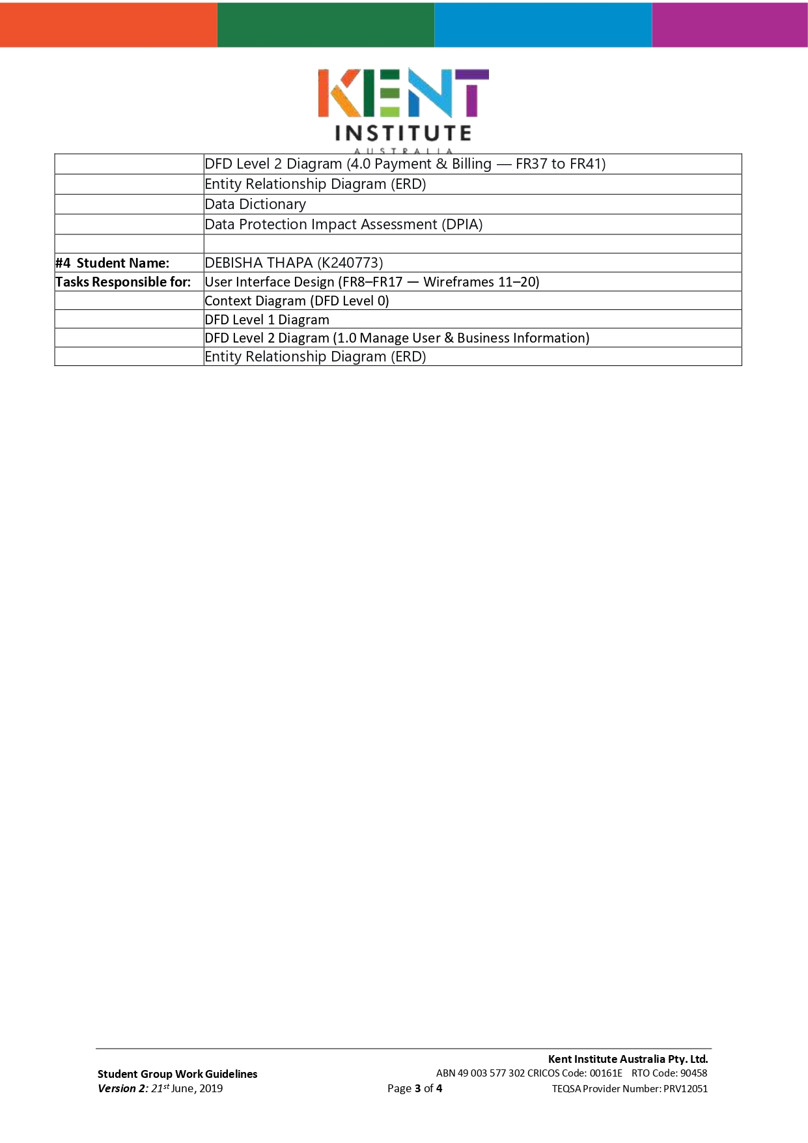

Slide 46
