Slide 1
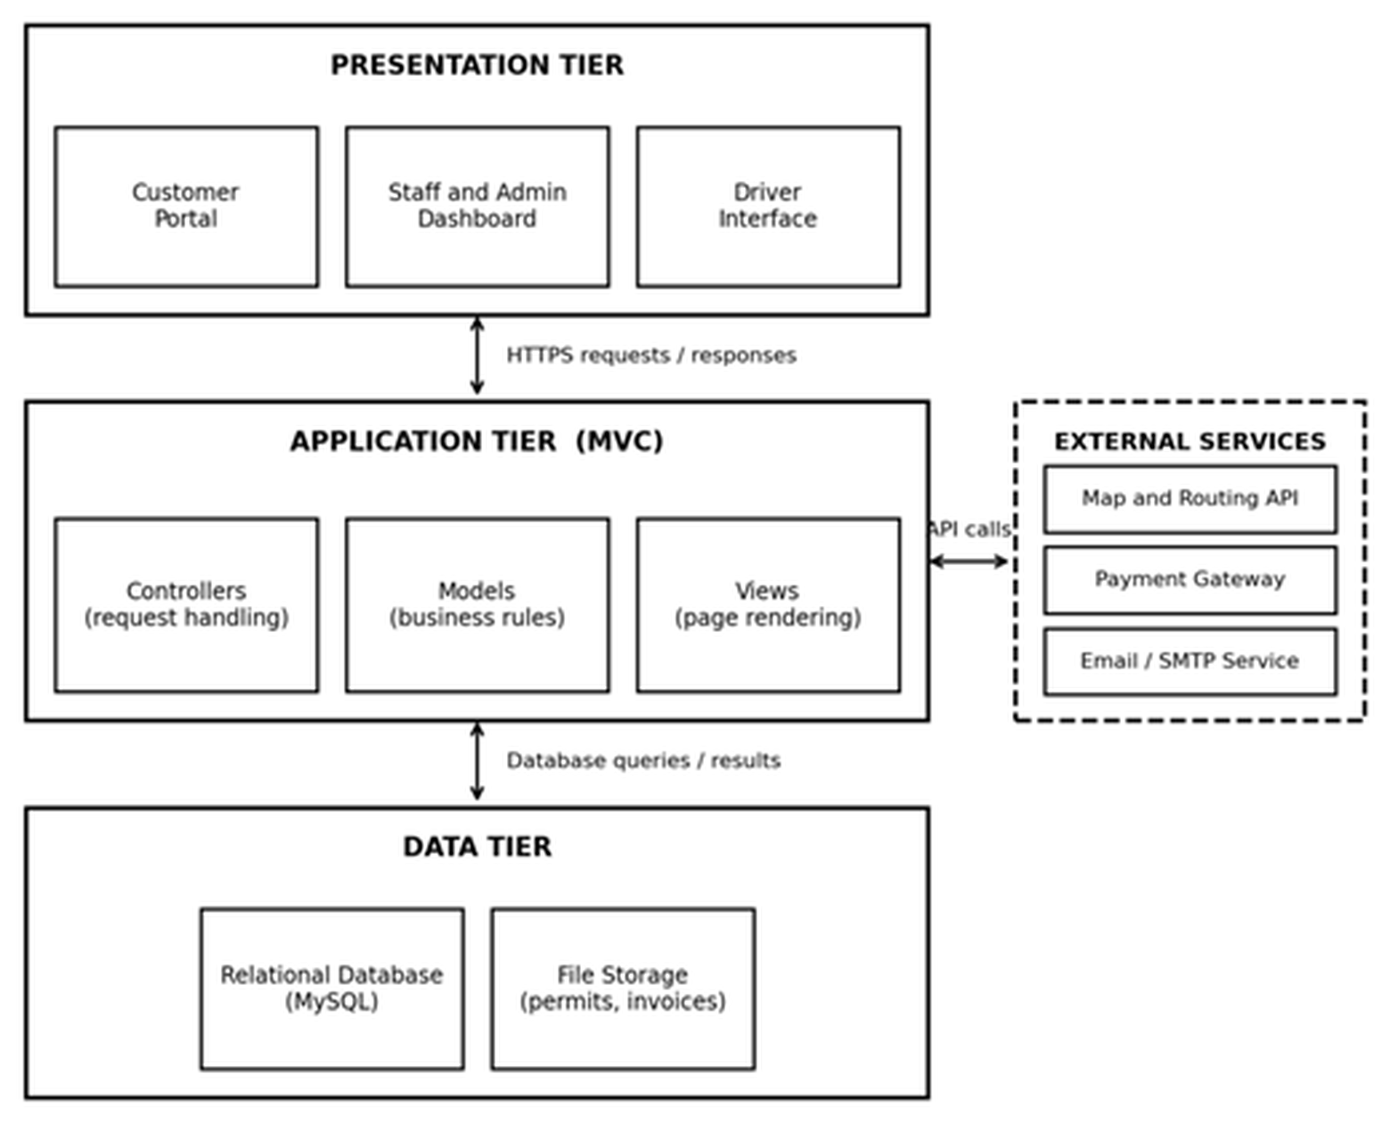
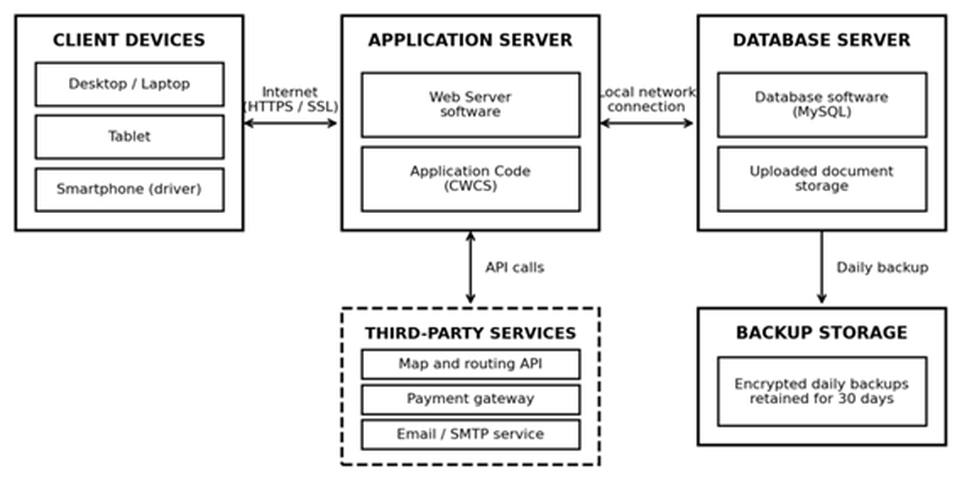
FAHAD
SRS SECTION 4.1
Software & Hardware Architecture
Figure 4.1 — Software architecture
Figure 4.2 — Hardware architecture
Presentation tier
Application tier
Data tier
What the user sees. Bootstrap 5, so the same site works on a driver's phone and an office desktop. NFR9, NFR10
Where every rule lives, once — cost estimate, hazardous-waste block, double-booking check. Laravel MVC. NFR11
MySQL for records, permits and invoices as files, encrypted daily backups kept 30 days. NFR5, NFR13
Hardware: application server 4 vCPU / 8 GB and database server 2 vCPU / 8 GB, both in an Australian region so customer data stays in Australia (NFR15). Maps, card payments and email are used, not built — three services we depend on but do not control.
Notes:
SECTION 4.1 — ARCHITECTURE (about 35 seconds)
"These two diagrams show how the system is put together.
On the left is the software. Three layers, and each one has a single job. The top layer
is what you see in the browser — customer portal, staff dashboard, driver interface.
Built with Bootstrap 5, so the same site works on a driver's phone and an office desktop.
That's NFR9 and NFR10.
The middle layer is where the thinking happens, and it's built as Model-View-Controller
because NFR11 asks for it. Every business rule lives here once: work out the cost before
the customer confirms, block hazardous waste from a standard bin, stop a truck being
booked twice in the same slot. If BINCOL changes a rule later, we change it in one place
instead of hunting through every screen.
The bottom layer just stores and returns — MySQL for records, file storage for permits
and invoices.
Notice the dashed box on the right: external services. Maps, payment gateway, email. We
use them, we don't build them, and drawing them dashed and outside says exactly that.
On the right is the hardware. Nobody installs anything — a browser is enough. Application
server and database server are separate, connected over a local network, with encrypted
daily backups kept for thirty days. Both sit in an Australian region, because NFR15
requires customer data to stay in Australia."
IF ASKED — 'why separate the database server?'
Each can be sized and backed up independently. They stay in the same region though; a
cross-region hop would put the 3-second page load in NFR1 at risk.
IF ASKED — 'why file storage separate from the database?'
Permits and invoices are documents, not rows. Keeping them as files keeps the database
small and backups fast.

Slide 2
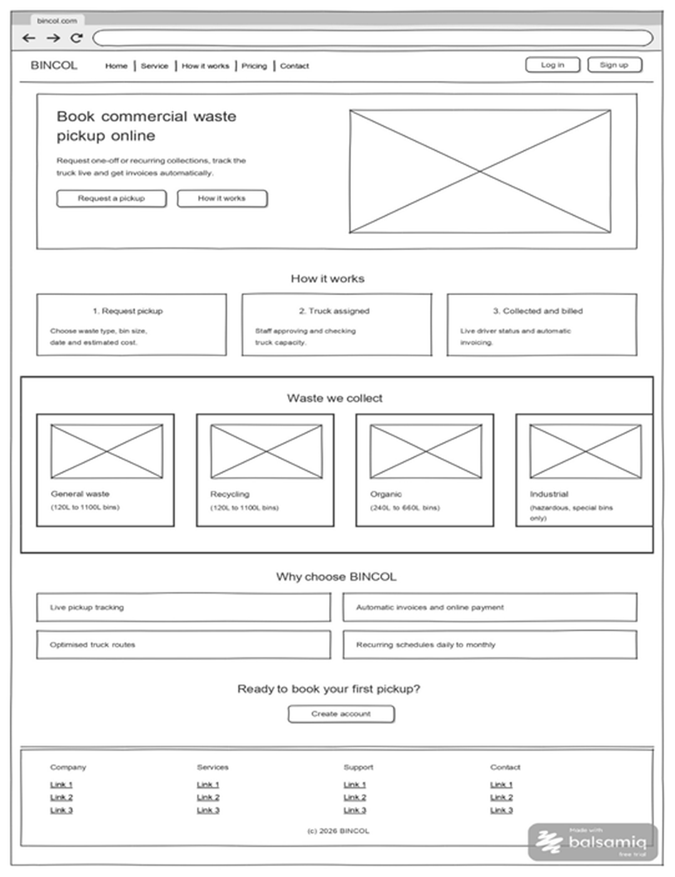
FAHAD
SRS SECTION 5.1
User Interface Design — Landing Page
Why the screen is laid out this way
One primary action
"Request a pickup" is the only emphasised button above the fold, so a visitor is never unsure what to do next. UI Requirement 1
Fixed information zones
Navigation, hero, content blocks and footer sit in the same place on every screen in the set, so messages and errors always appear where the user expects them. UI Requirement 2
Public before private
Only Log in and Sign up appear here. Which dashboard you land on afterwards is decided by your role — Customer, Staff, Driver or Admin. FR3, FR4
It answers the question before it is asked
"How it works" in three steps, the four waste categories with their bin sizes, and the reasons to choose BINCOL — all before any sign-up.
Built to flex
Twelve-column grid reflows to tablet and phone; contrast and focus order meet WCAG 2.1 AA. NFR9, NFR10
Wireframed in Balsamiq Cloud — one of ten screens in my set, WF01–WF10.
Notes:
SECTION 5.1 — UI DESIGN (about 40 seconds)
"This is the landing page — the first thing a business customer sees, before any login.
Three deliberate decisions.
First, there is one primary action. 'Request a pickup' is the emphasised button; 'How it
works' sits beside it as the quieter option. That's not decoration. UI Requirement 1 says
the user should always know what to do next, and the fastest way to say that is to make
one thing obviously the thing.
Second, the regions are fixed. Navigation across the top, hero, content blocks, footer.
Those same regions appear in the same place across all ten of my wireframes, which is UI
Requirement 2 — information and error messages always surface in one predictable spot.
Third, nothing role-specific appears here at all. Only Log in and Sign up. What you see
afterwards depends on whether you're a Customer, Staff, Driver or Admin — that's FR3 and
FR4 doing their job.
Down the page I answer the obvious questions before the customer has to ask: how it works
in three steps, the four waste categories with their bin sizes, and why BINCOL rather than
a competitor. Then one last call to action at the bottom for anyone who scrolled.
It's wireframed in Balsamiq Cloud, so it's deliberately grey — a wireframe fixes layout
and flow, not colour."
IF ASKED — 'why no residential sign-up?'
Scope is commercial customers only. FR1 requires an ABN at registration, so there is no
ABN-less path by design.
IF ASKED — 'is this the final look?'
No. Grey on purpose, so reviewers comment on the structure rather than the colours.
IF ASKED — 'why show hazardous waste on a public page?'
Industrial is listed as special-bins-only, which sets expectations before booking and
supports the compatibility rule in FR16.

Slide 3
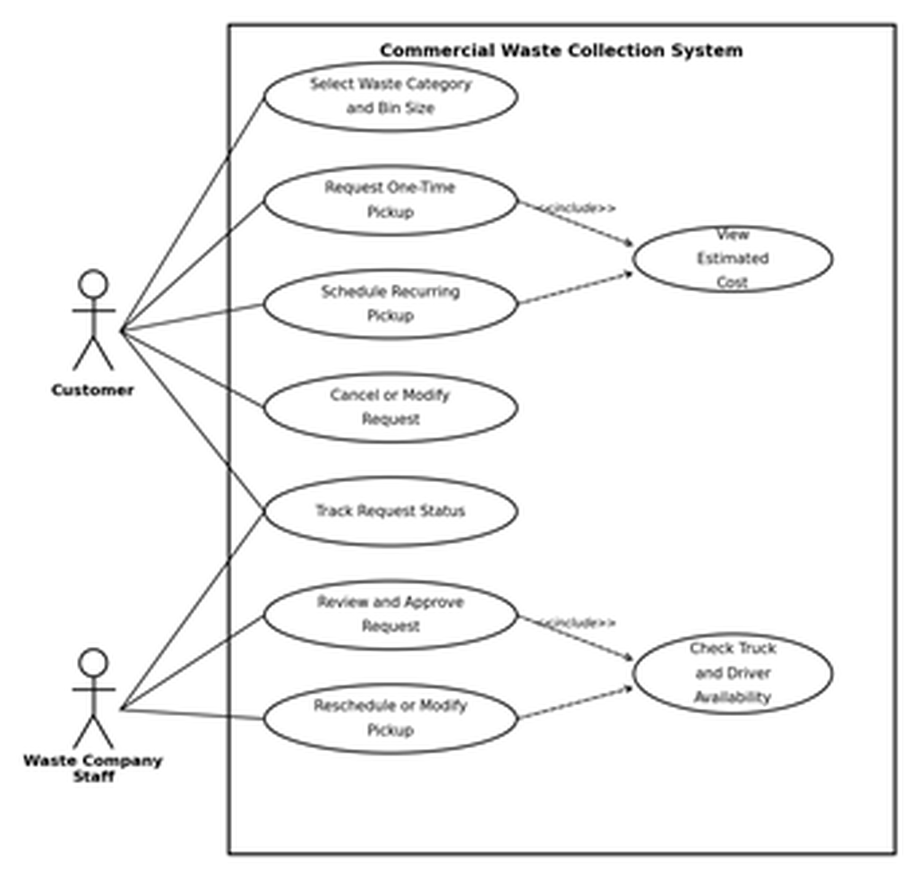
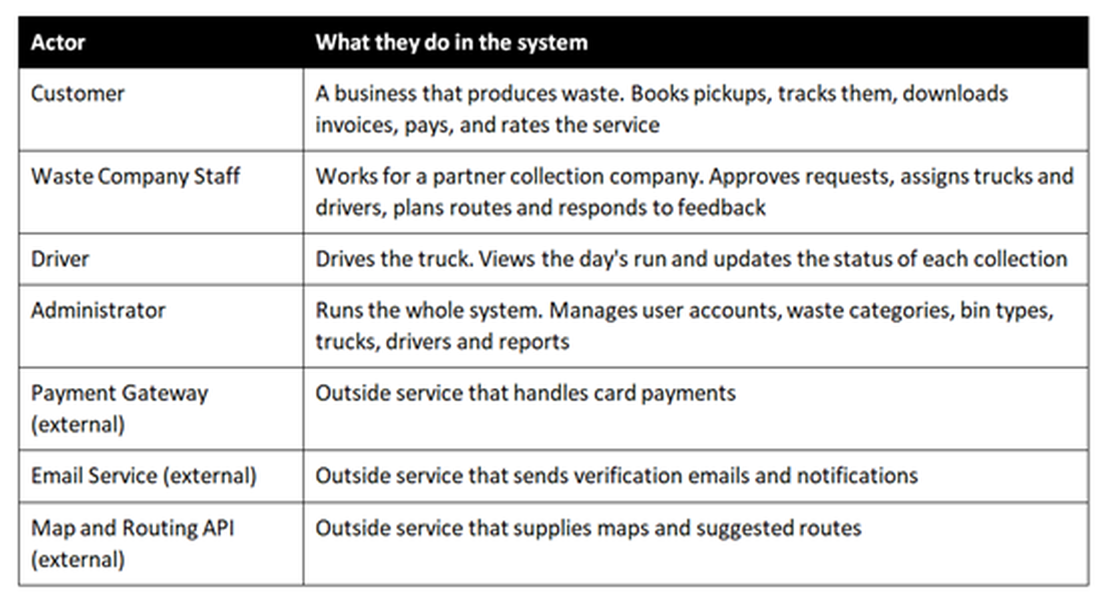
FAHAD
SRS SECTION 6.0
Requirement Analysis — Use Case Diagram
Table 6.1 — Actors in the BCWCS
Who is allowed to do what
Four human actors, three external systems
The external ones sit outside the boundary: we depend on them, we do not control them. Eleven modules on one page would be unreadable, so Section 6.0 gives an overview plus four diagrams by module.
«include» means it always runs
Figure 6.3 — Pickup request and scheduling
Every one-time and recurring booking runs View Estimated Cost — the customer never confirms blind (FR21). Every staff approval runs Check Truck and Driver Availability, which is how FR26 and FR30 stop a double-booking.
Notes:
SECTION 6.0 — USE CASE DIAGRAM (about 40 seconds)
"A use case diagram answers one question: who is allowed to do what.
The table lists our actors. Four types of people — Customer, Waste Company Staff, Driver
and Administrator. Those are the four roles named in FR4, so the requirement and the
diagram agree. Then three outside systems: payment gateway, email, and the map and routing
API. They're listed as external actors because the system depends on them but does not
control them. If Stripe goes down, that isn't a bug in our code — it's a dependency, and
naming it as an external actor makes that visible.
The diagram on the left is Figure 6.3, the pickup and scheduling module — my module. The
customer can select waste category and bin size, request a one-time pickup, schedule a
recurring one, cancel or modify, and track status. Staff review and approve, or reschedule.
The two dashed arrows are the interesting part. They're marked include, which means the
step always runs. Every booking — one-time or recurring — runs View Estimated Cost, so a
customer never confirms blind. That's FR21. And every staff approval runs Check Truck and
Driver Availability, which is how FR26 and FR30 stop a truck being double-booked.
Include means always. Extend, which we use elsewhere, means optional — exporting a report
to PDF is an extend, because the report is already complete without it."
IF ASKED — 'why is Track Request Status not an include?'
It's a separate thing the customer chooses to do afterwards, not a step inside booking.
IF ASKED — 'why five diagrams instead of one?'
Eleven modules on one page is unreadable, and an unreadable diagram is a useless diagram.
Section 6.2 gives the overall picture; 6.3 to 6.6 break it down by the kind of work.

Slide 4
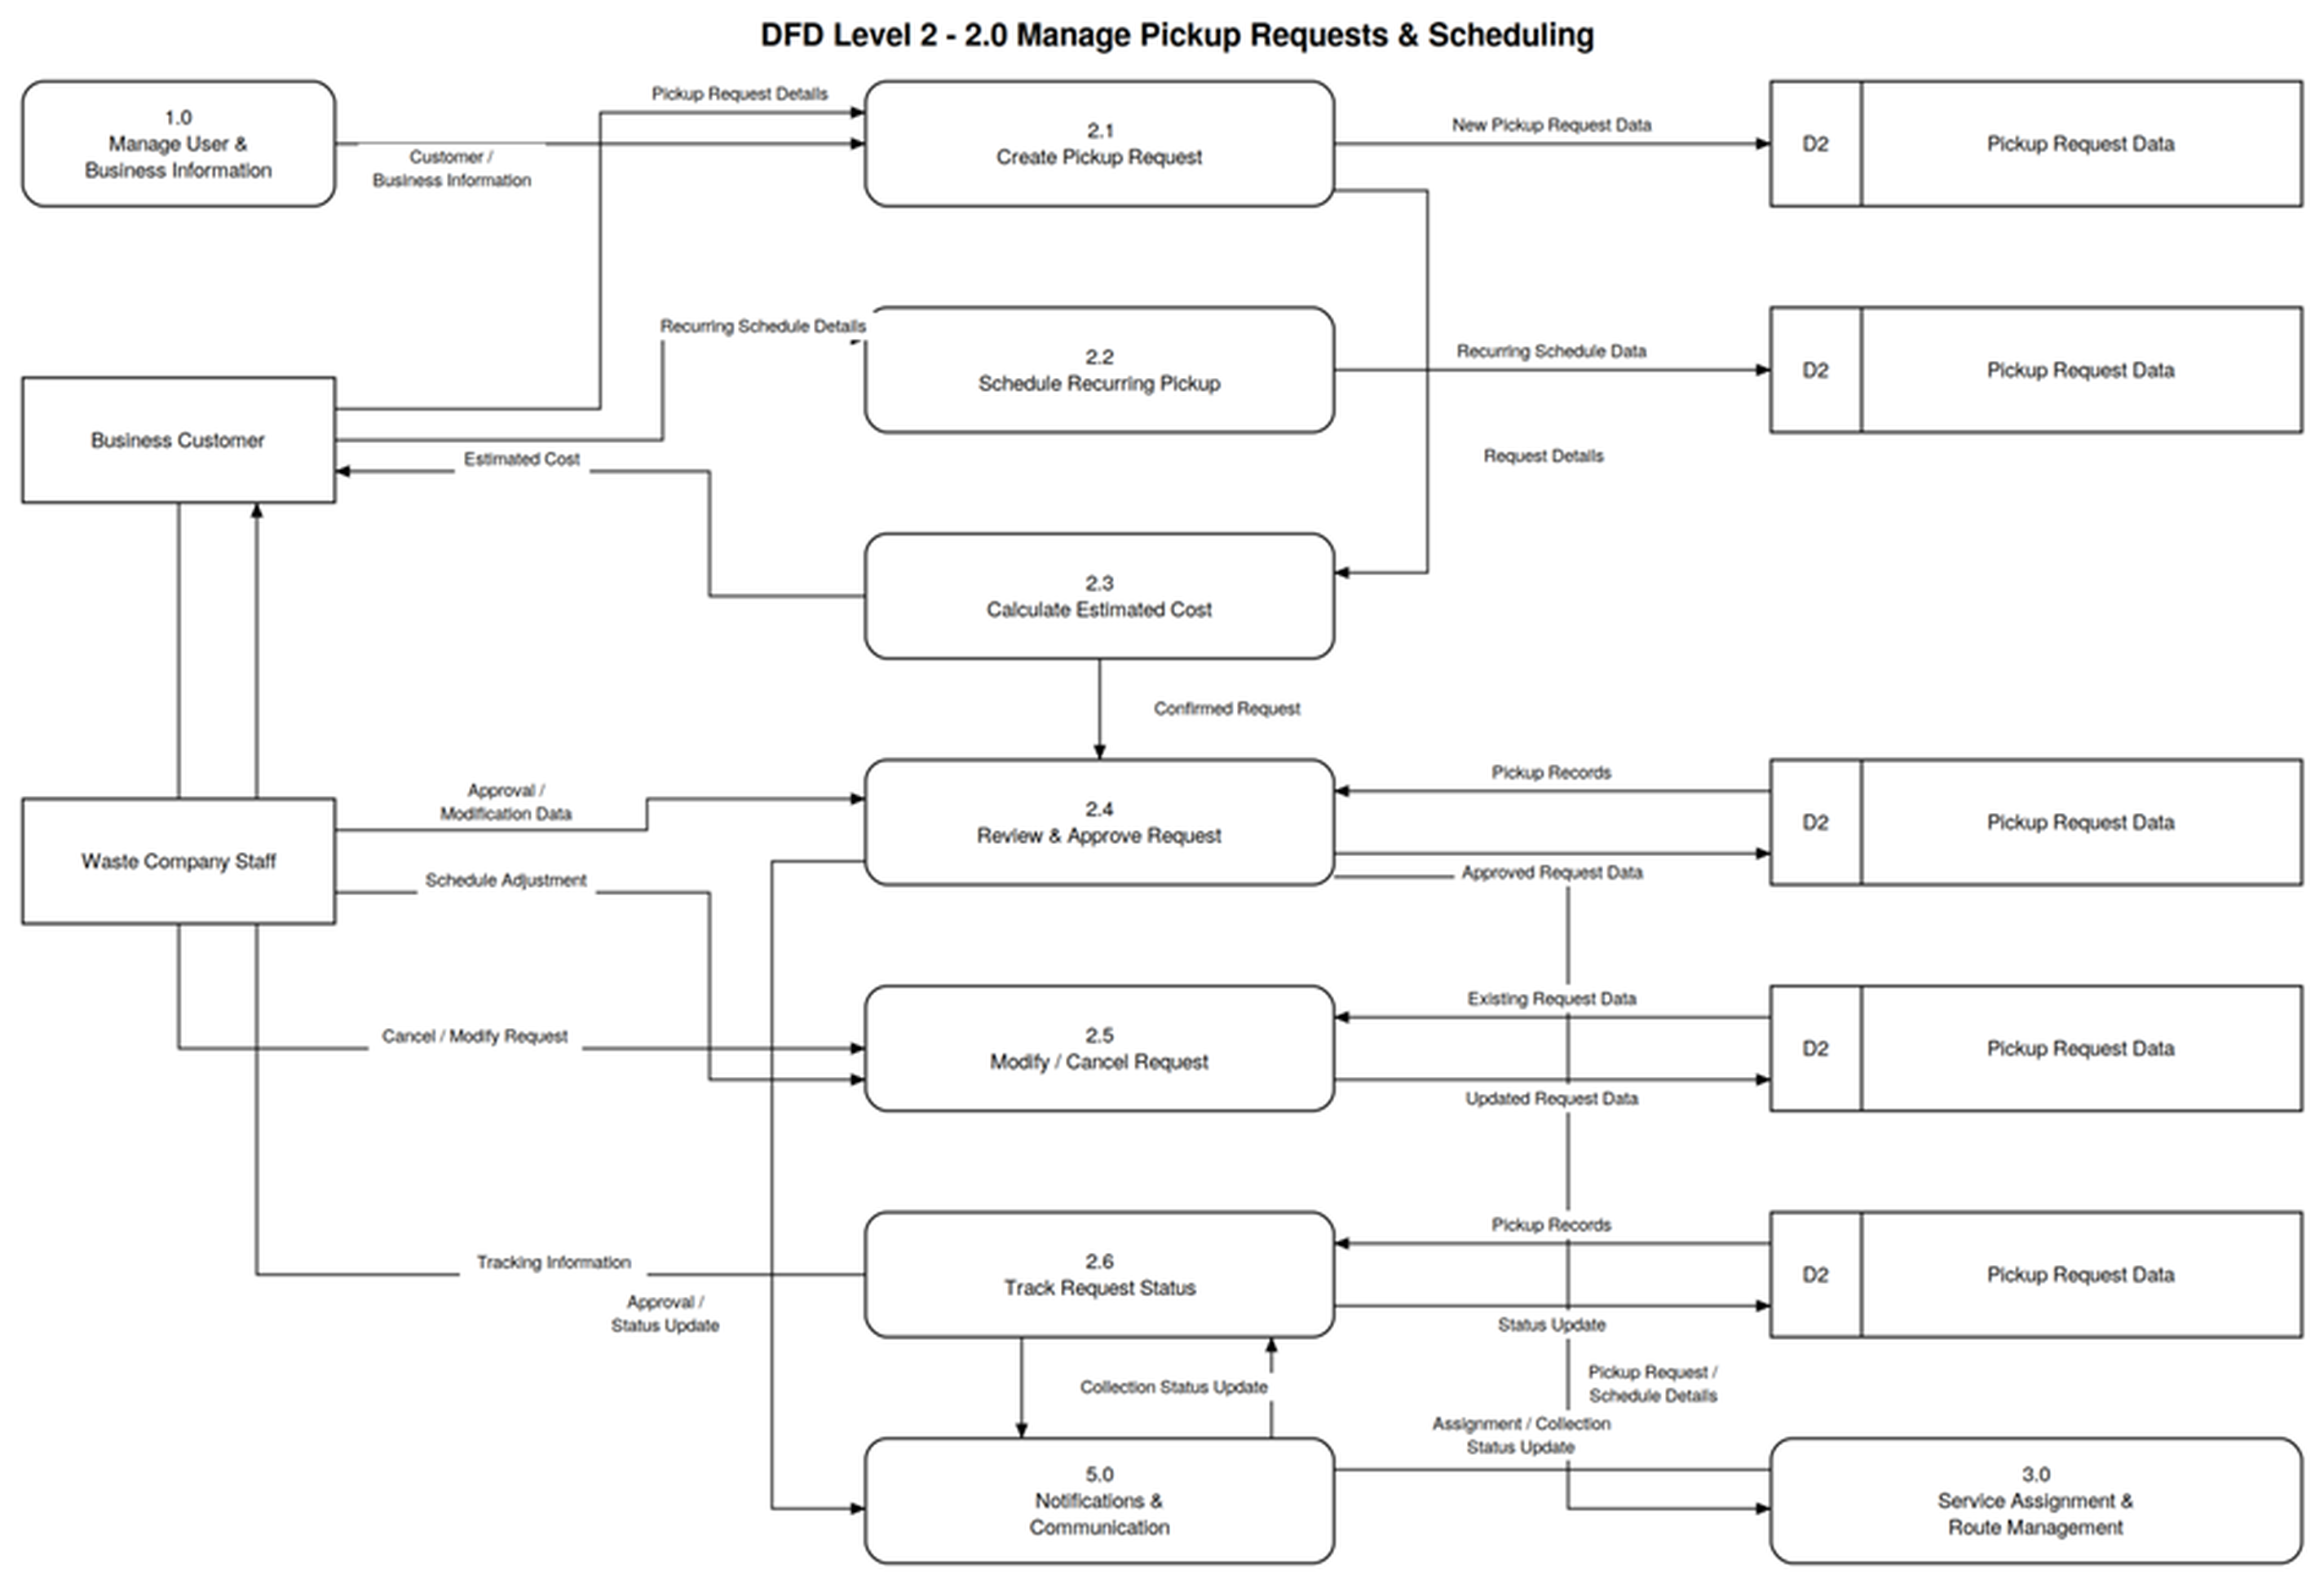
FAHAD
SRS SECTION 8.2
DFD Level 2 — Manage Pickup Requests & Scheduling
Where the data goes
2.0 opened up
One box on the Level 1 diagram, exploded into six sub-processes, 2.1 to 2.6
The flow
Create the request, schedule recurring, price it, staff approve, modify or cancel, then track status
One data store
D2 Pickup Request Data — written to and read back at every stage
It balances
Every arrow crossing into or out of 2.0 on Level 1 appears here too — nothing enters and disappears
Feeds 3.0 Service Assignment & Route Management with approved requests, and 5.0 Notifications & Communication with approval and status updates.
Notes:
SECTION 8.2 — DFD LEVEL 2 (about 40 seconds)
"A data flow diagram answers a different question from the use case diagram — not who does
what, but where the data actually goes.
On our Level 1 diagram, all of pickup requests and scheduling is a single box numbered 2.0.
That's too coarse to build from, so Level 2 opens that one box into six steps.
2.1 creates the pickup request. 2.2 handles recurring schedules. 2.3 calculates the
estimated cost and sends it straight back to the customer — that's the Estimated Cost
arrow returning on the left. 2.4 is where staff review and approve. 2.5 is modify or
cancel. 2.6 tracks status.
Everything reads from and writes to D2, Pickup Request Data. It appears several times on
the diagram, but it's one store — repeating it just keeps the arrows from crossing.
Two things leave this process. Approved requests go to 3.0, Service Assignment and Route
Management. Status and approval updates go to 5.0, Notifications and Communication.
The discipline that matters here is balancing. Every arrow crossing into or out of box 2.0
on the Level 1 diagram has to appear on this diagram too. If Level 1 shows a flow that
Level 2 doesn't, the diagram leaks — data goes in and vanishes. Ours agrees in both
directions."
IF ASKED — 'why does D2 appear five times?'
It is one data store. Repeating the symbol is standard practice to avoid a tangle of long
crossing arrows — the D2 label is what tells you it's the same store.
IF ASKED — 'why is cost calculated in 2.3 and not inside 2.1?'
So capture and pricing stay separate. 2.1 records what the customer wants; 2.3 prices it
and returns the estimate before anything is confirmed. That's FR21.
IF ASKED — 'where does 1.0 come in?'
Customer and business information flows in from 1.0, Manage User & Business Information —
a request has to belong to a verified business account.

