Slide 1
SOFTWARE PROJECT MANAGEMENT
Smart Appointment
Booking System
Presented by
Ahed Akrout
Backend Developer
Project Managing Presentation

Slide 2
OVERVIEW
The Problem & Our Solution
The Problem
Our Solution
• Manual booking processes (phone calls, paper records) are slow and error-prone.
• Customers cannot see real-time availability before contacting a business.
• Double bookings and scheduling conflicts happen often in busy practices.
• Business owners have no central view of appointments, services, or feedback.
• No reliable way to track customer history or no-show rates.
• A web-based platform where customers can book, modify, or cancel appointments online.
• Real-time slot availability — no double bookings, ever.
• Each business gets its own page, services menu, and weekly hours.
• Owners see today's appointments, weekly trends, and customer reviews on one dashboard.
• Admins approve new businesses and oversee the platform from a single panel.
Smart Appointment Booking System — Project Managing Presentation
2 / 16

Slide 3
TARGET USERS
Who Uses the System
Customer
Business Owner
Administrator
• Browses businesses by category
• Books appointments online
• Cancels or reschedules at any time
• Leaves reviews after a visit
• Receives email confirmations
• Manages a public business page
• Sets services, prices, durations
• Defines weekly hours and availability
• Views and updates appointments
• Replies to customer reviews
• Approves new business applications
• Oversees all users and businesses
• Moderates reviews if needed
• Audits all admin actions
• Suspends or reactivates accounts
Smart Appointment Booking System — Project Managing Presentation
3 / 16

Slide 4
WHO WE ARE
The Team
MM
BO
AA
ON
Melad Mustafabadran
Beste Ozkan
Ahed Akrout
Osamah Naji
Team Leader
Designer
Backend
Tester
Frontend
Frontend
Database
QA
Project planning · Frontend pages · Coordination
UI/UX design · Visual identity · Component styling
Flask routes · MySQL schema · API logic
Test plan · Test cases · System validation
Smart Appointment Booking System — Project Managing Presentation
4 / 16

Slide 5
8 WEEKS · 8 MILESTONES
Project Roadmap
#
Mission
Responsible
Deadline
Status
1
Project Requirements Analysis
Melad · Ahed
25 Feb
Done
2
UI/UX Design
Beste
01 Mar
Done
3
Website Pages Development
Melad
20 Mar
Done
4
Backend API Development
Ahed
10 Apr
Done
5
Database Implementation
Ahed
20 Apr
Done
6
System Testing
Osamah
25 Apr
Done
7
Bug Fixing
Melad · Ahed
01 May
In Progress
8
Documentation
All Members
05 May
In Progress
6 of 8 milestones completed · 2 in progress · Status updated 30 April 2026
Smart Appointment Booking System — Project Managing Presentation
5 / 16

Slide 6
WHAT WE BUILT
By the Numbers
25
4,000
48
33
Python source files
Lines of Python code
HTTP routes registered
Jinja2 templates
11
0
4
26
Automated tests passing
Failing tests
User access levels
UI screenshots captured
Numbers measured directly from the project repository on 5 May 2026.
Smart Appointment Booking System — Project Managing Presentation
6 / 16

Slide 7
HOW IT IS BUILT
Tech Stack
Frontend
HTML · CSS · Bootstrap 5 · Jinja2 templates · Vanilla JavaScript
Lightweight pages that render fast and work on any device.
Backend
Python 3.11 · Flask · Werkzeug · Role-based decorators
Clean route handlers, password hashing, and login throttling.
Database
MySQL 8 · mysql-connector-python · Connection pooling
Real relational storage for users, businesses, services, appointments and reviews.
Tooling & Process
GitHub for version control · GitHub Actions for continuous integration · Python unittest for automated tests
Smart Appointment Booking System — Project Managing Presentation
7 / 16

Slide 8
THE CORE FLOW
Booking in 3 Clicks
1
2
3
Pick a service
Choose date & time
Confirm
Customer opens a business page and selects from the services menu. Duration and price are shown right away — no surprises later.
Only slots that are actually free appear. Weekly hours, existing bookings and service duration are all checked in real time so the customer never sees a slot they cannot book.
One click confirms. Both the customer and the business owner receive an email and an in-app notification. The appointment shows up instantly on each dashboard.
No double bookings. No back-and-forth phone calls. Confirmed in seconds.
Smart Appointment Booking System — Project Managing Presentation
8 / 16

Slide 9
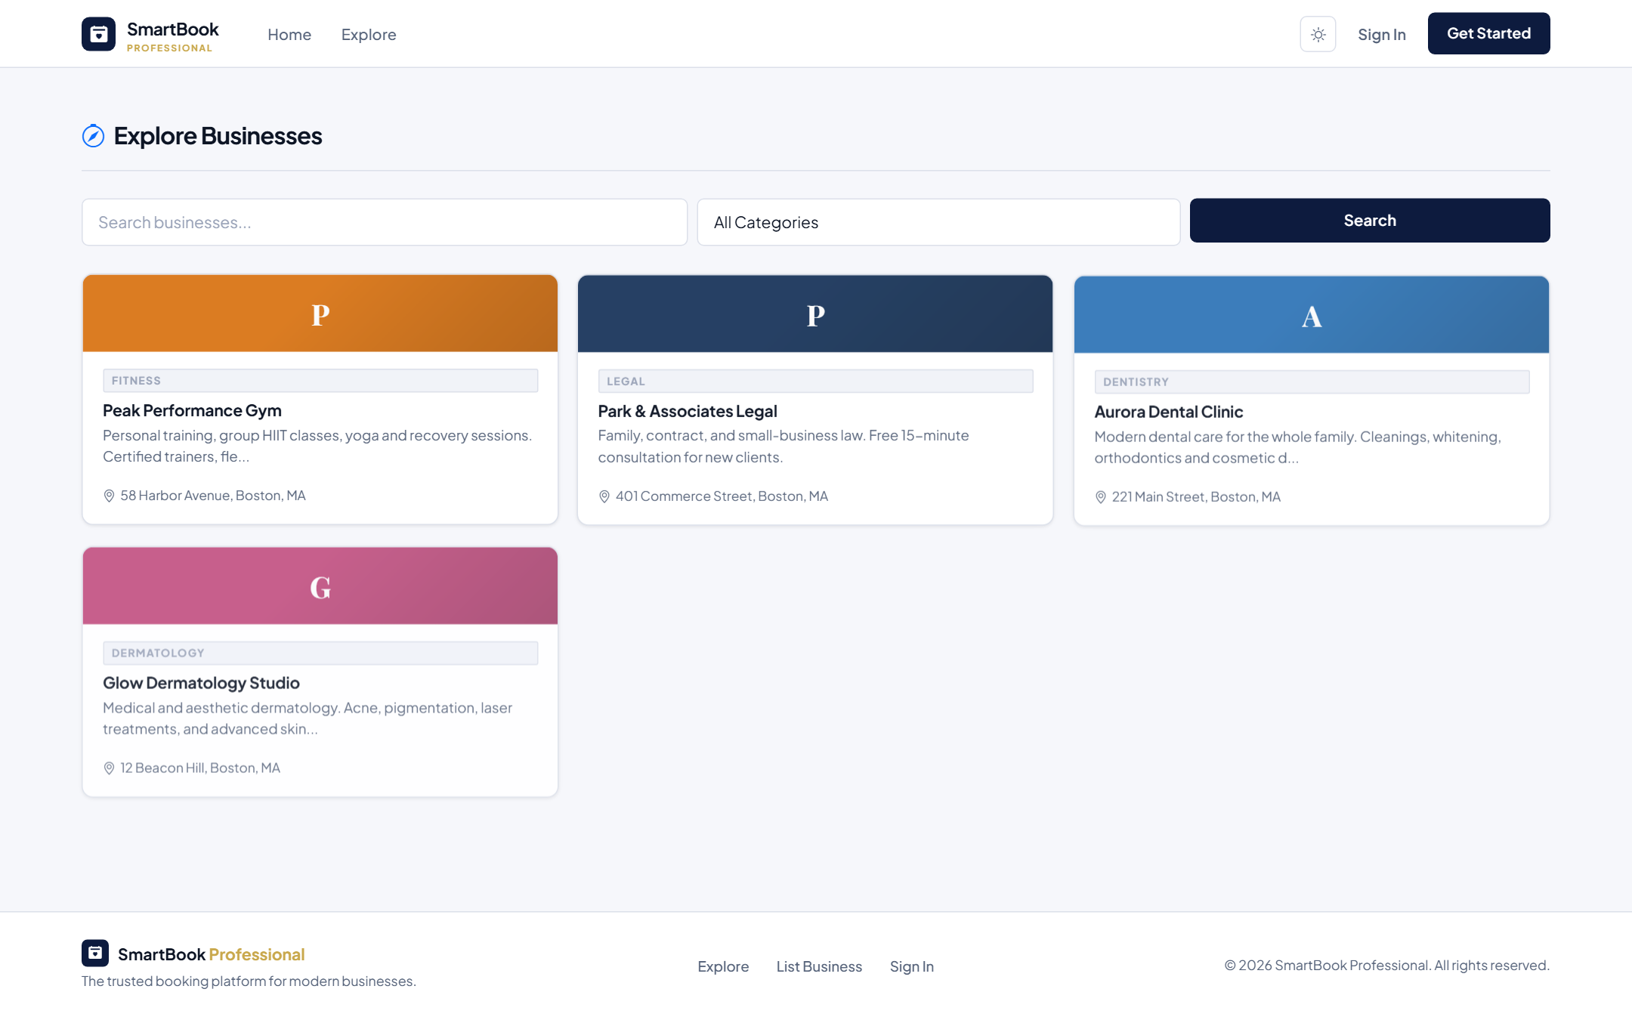
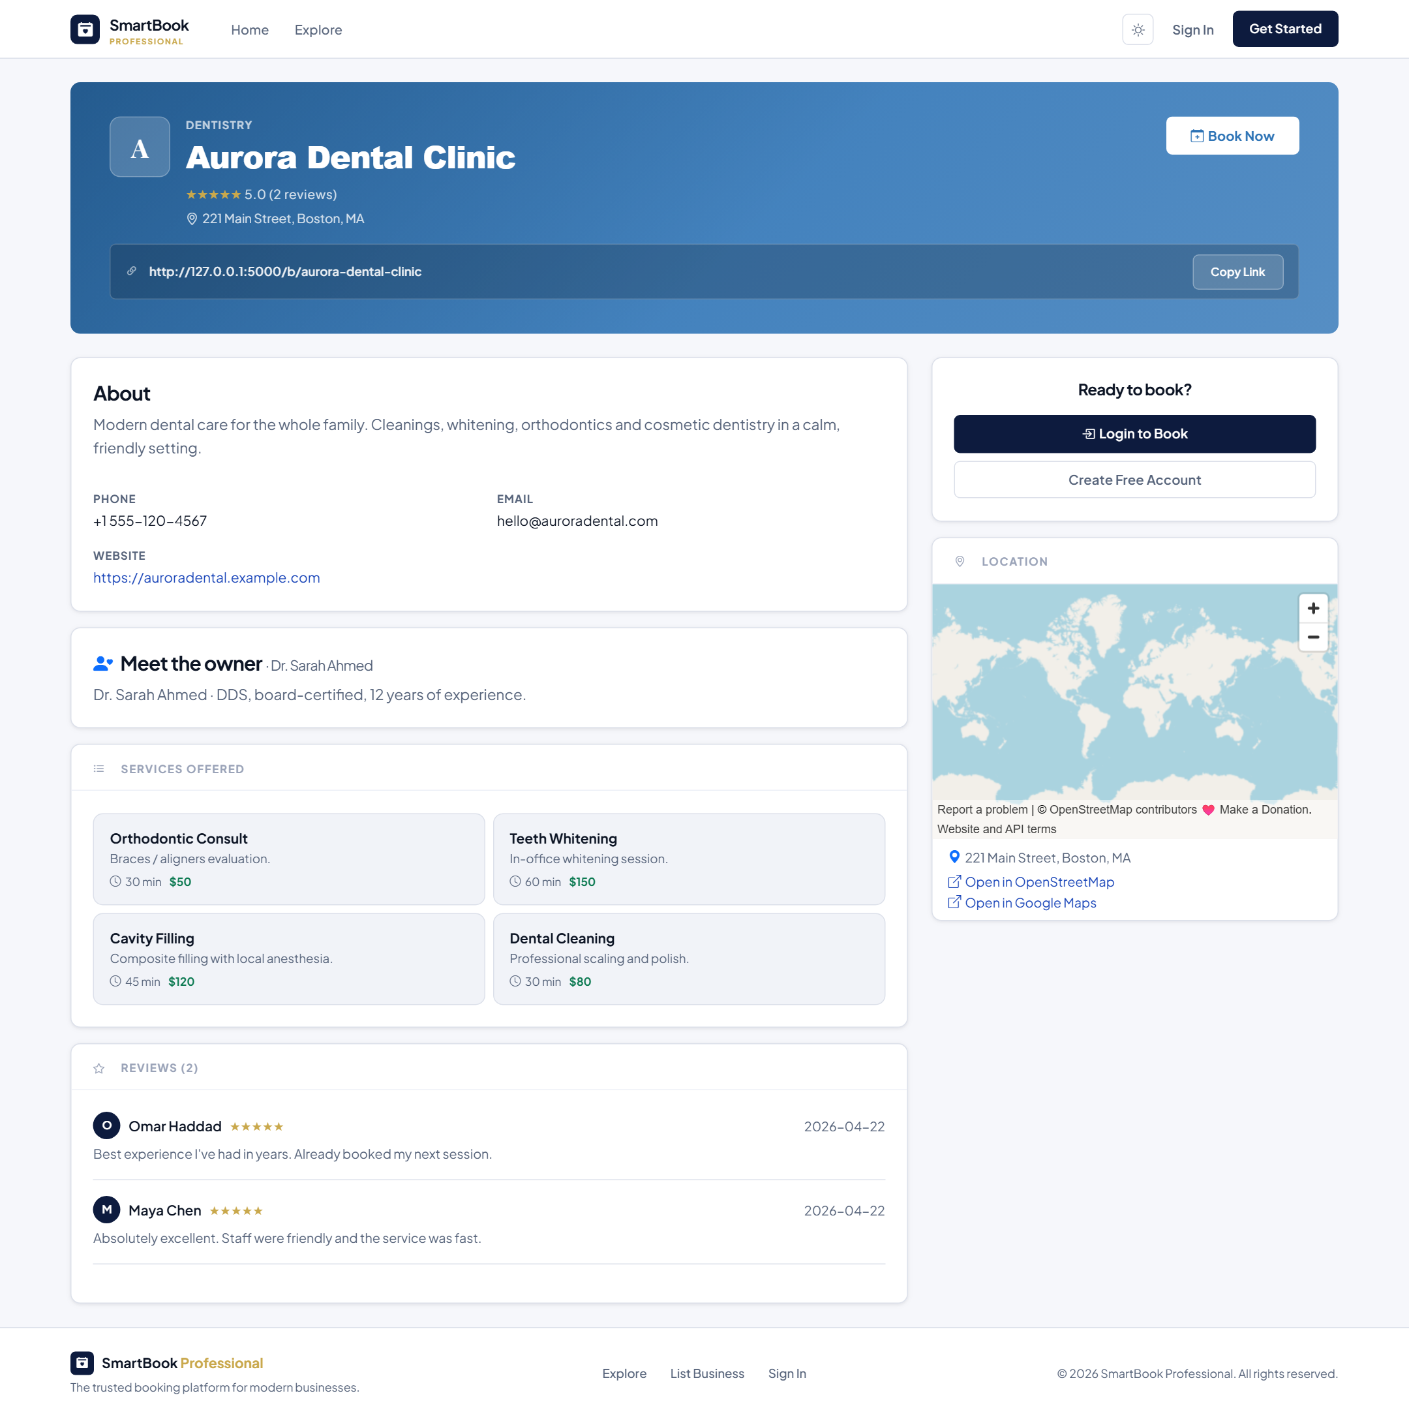
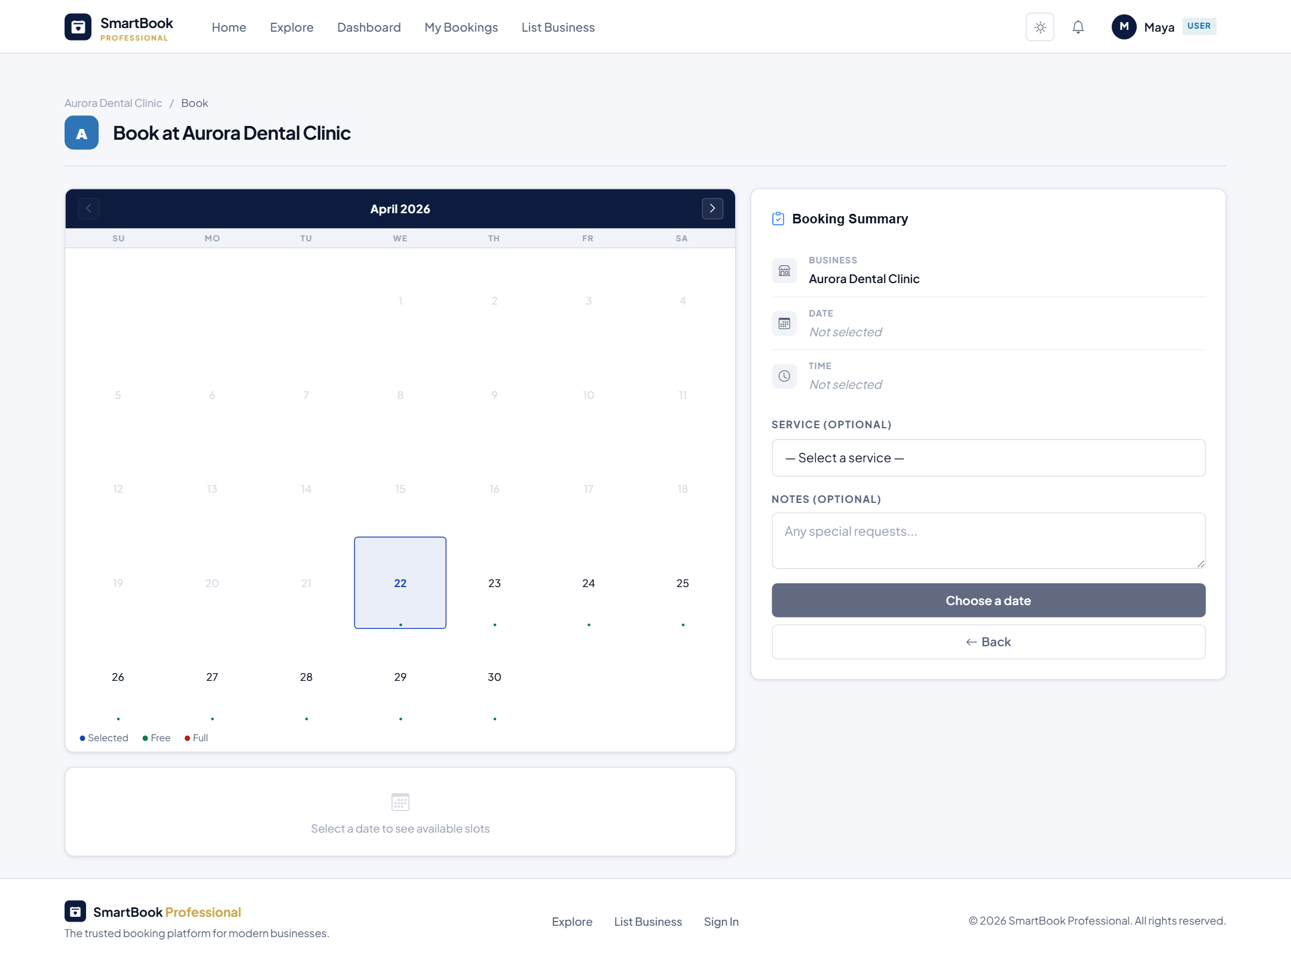
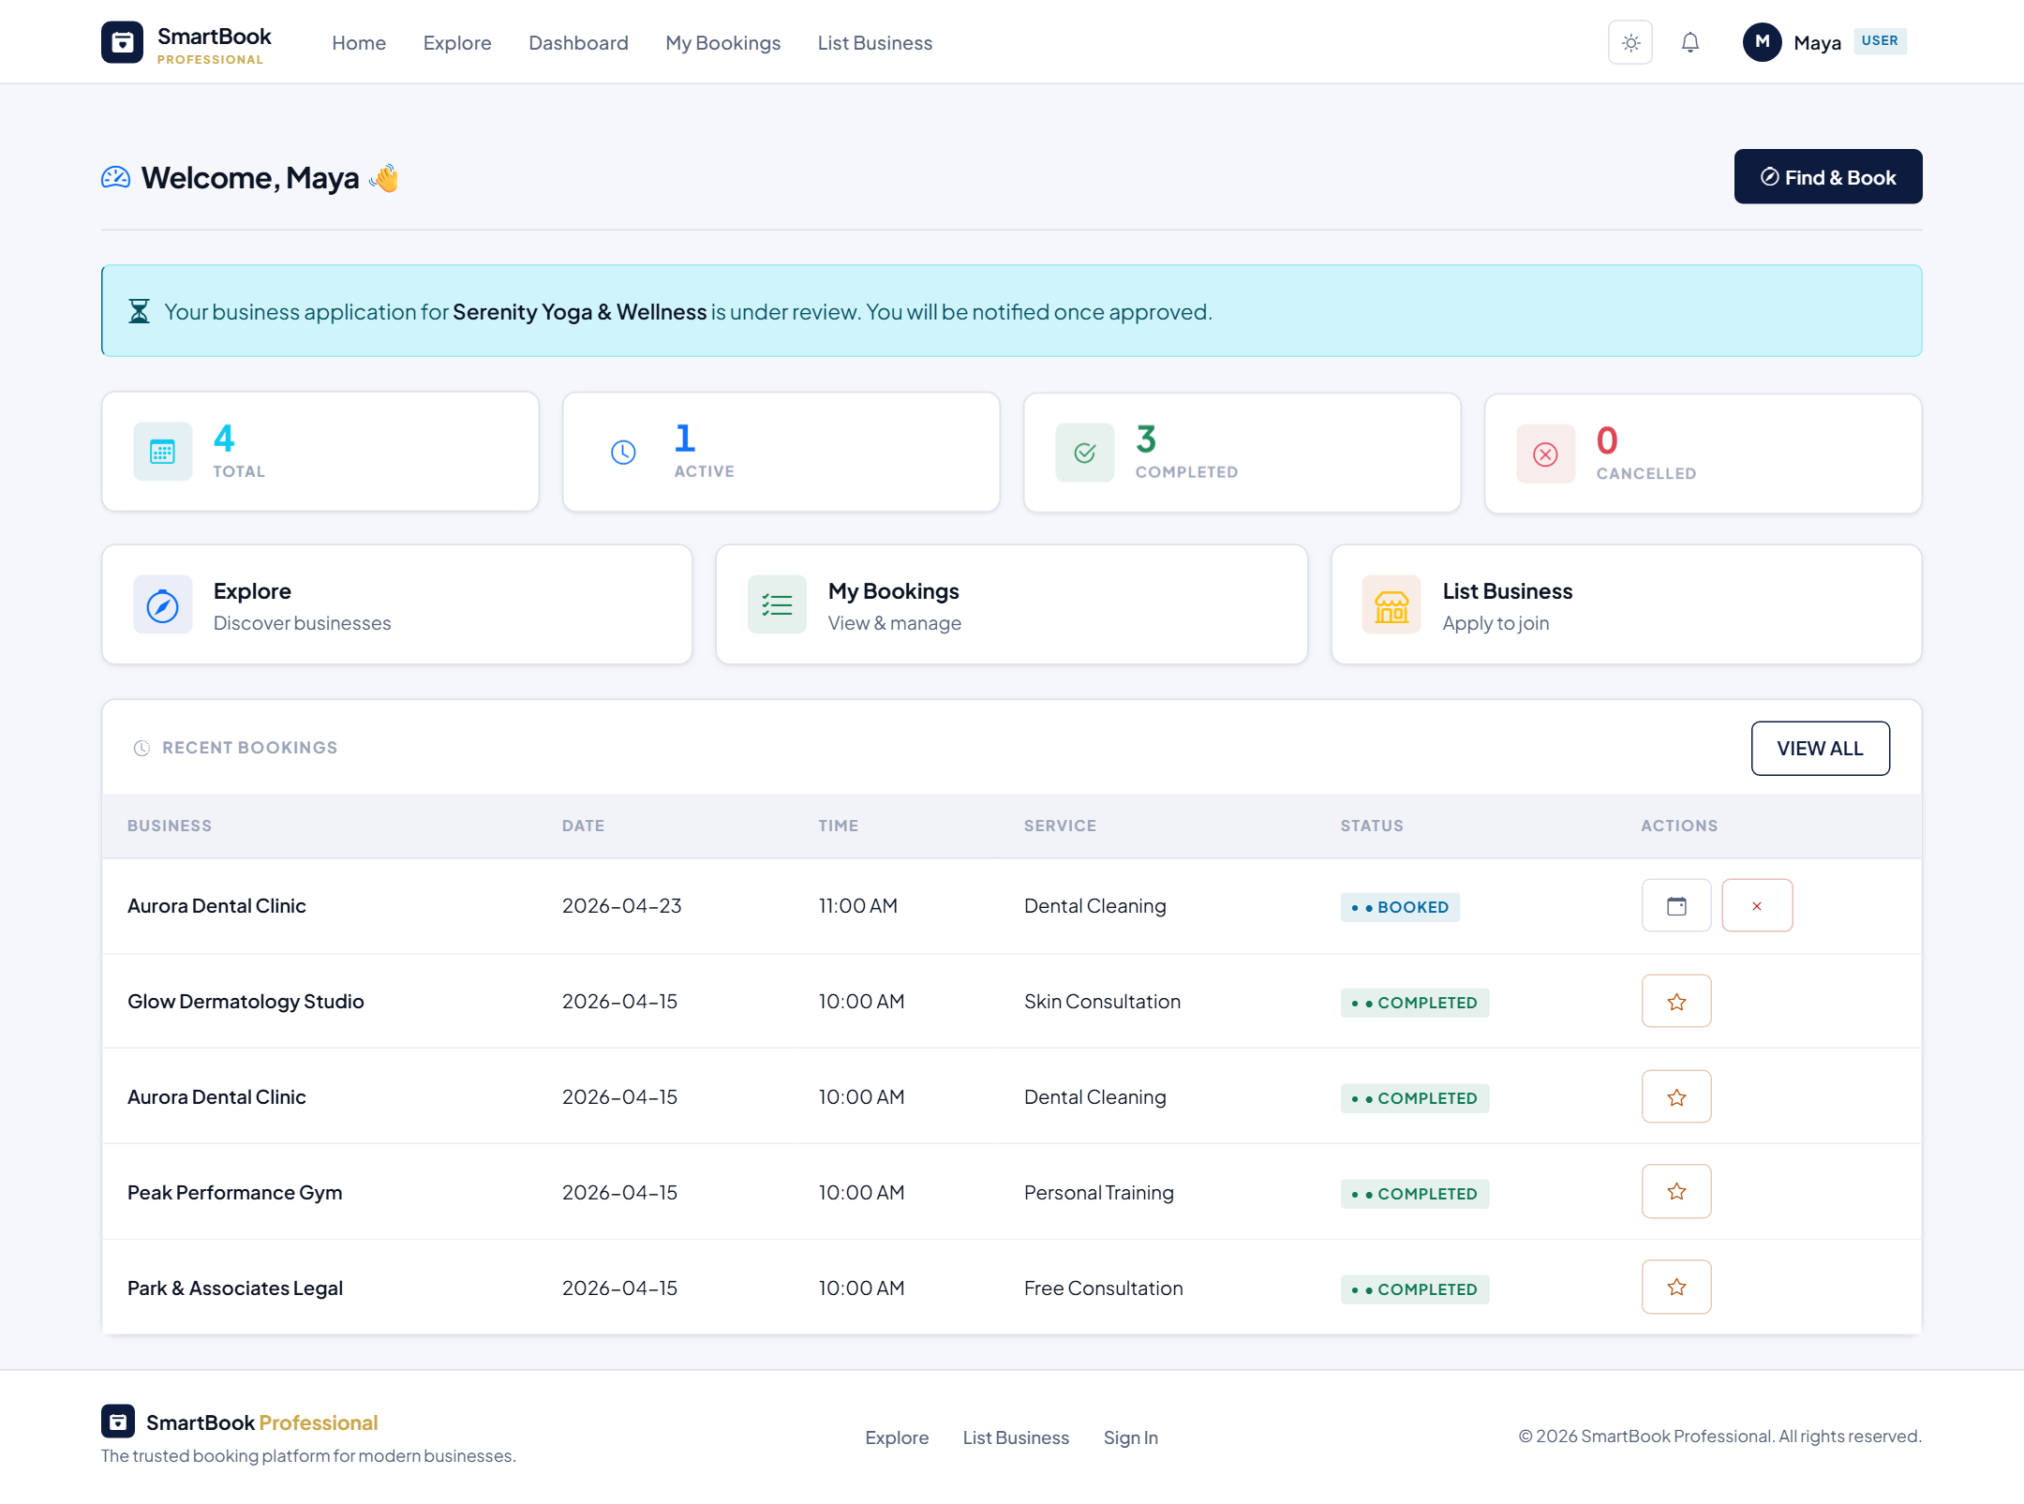
LIVE SCREENS
Customer Experience
Explore — browse businesses by category
Business detail — services, gallery, reviews
Booking calendar — pick a free slot
My dashboard — appointments at a glance
Smart Appointment Booking System — Project Managing Presentation
9 / 16

Slide 10
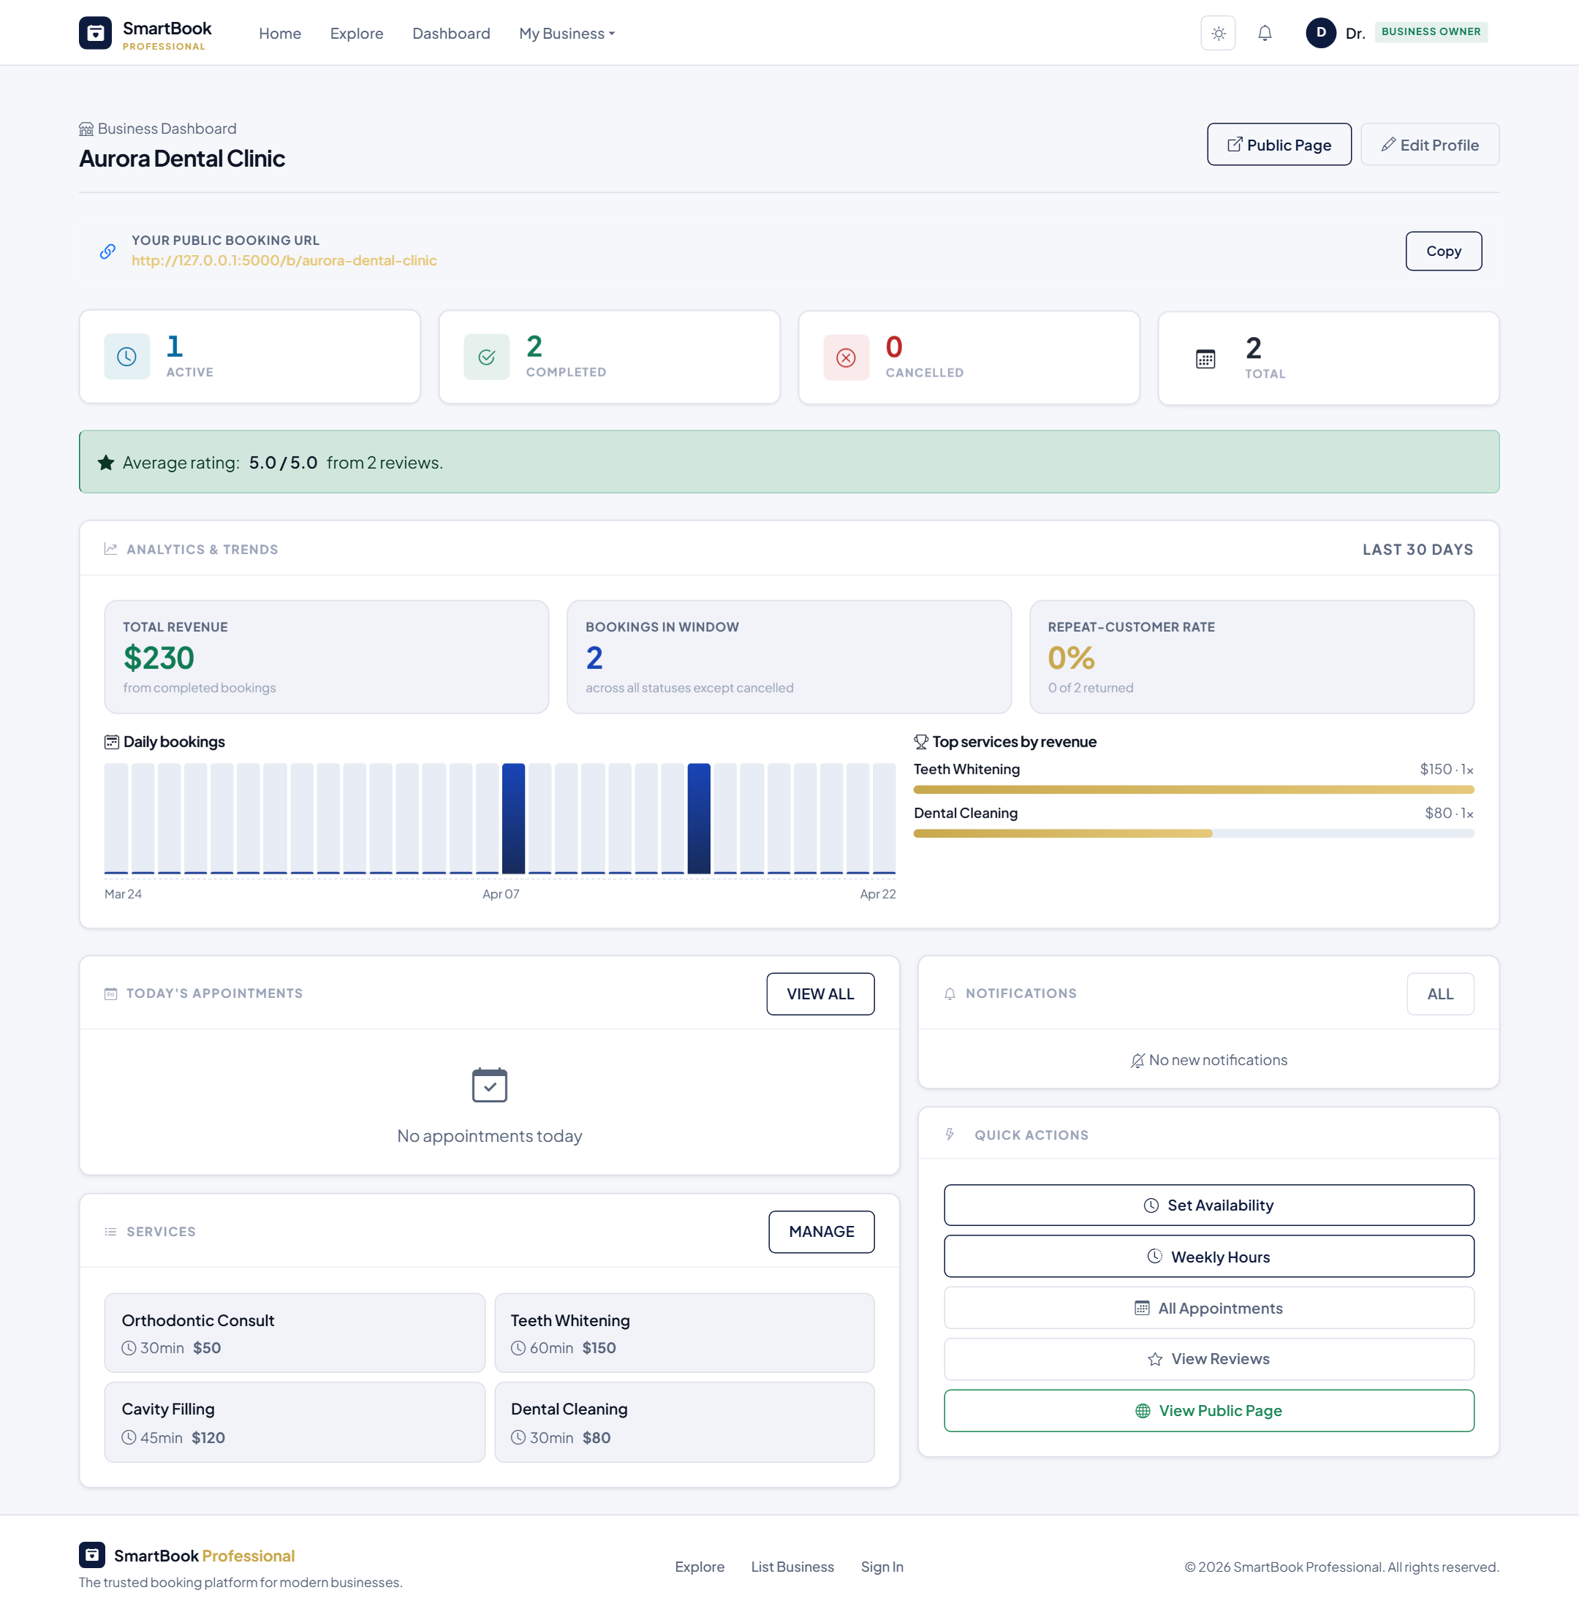
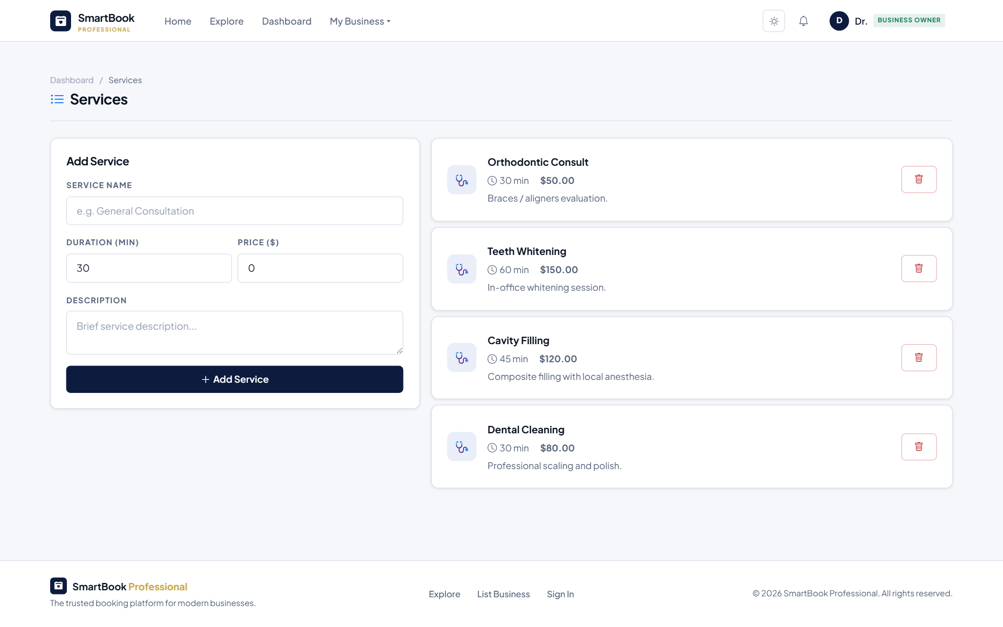
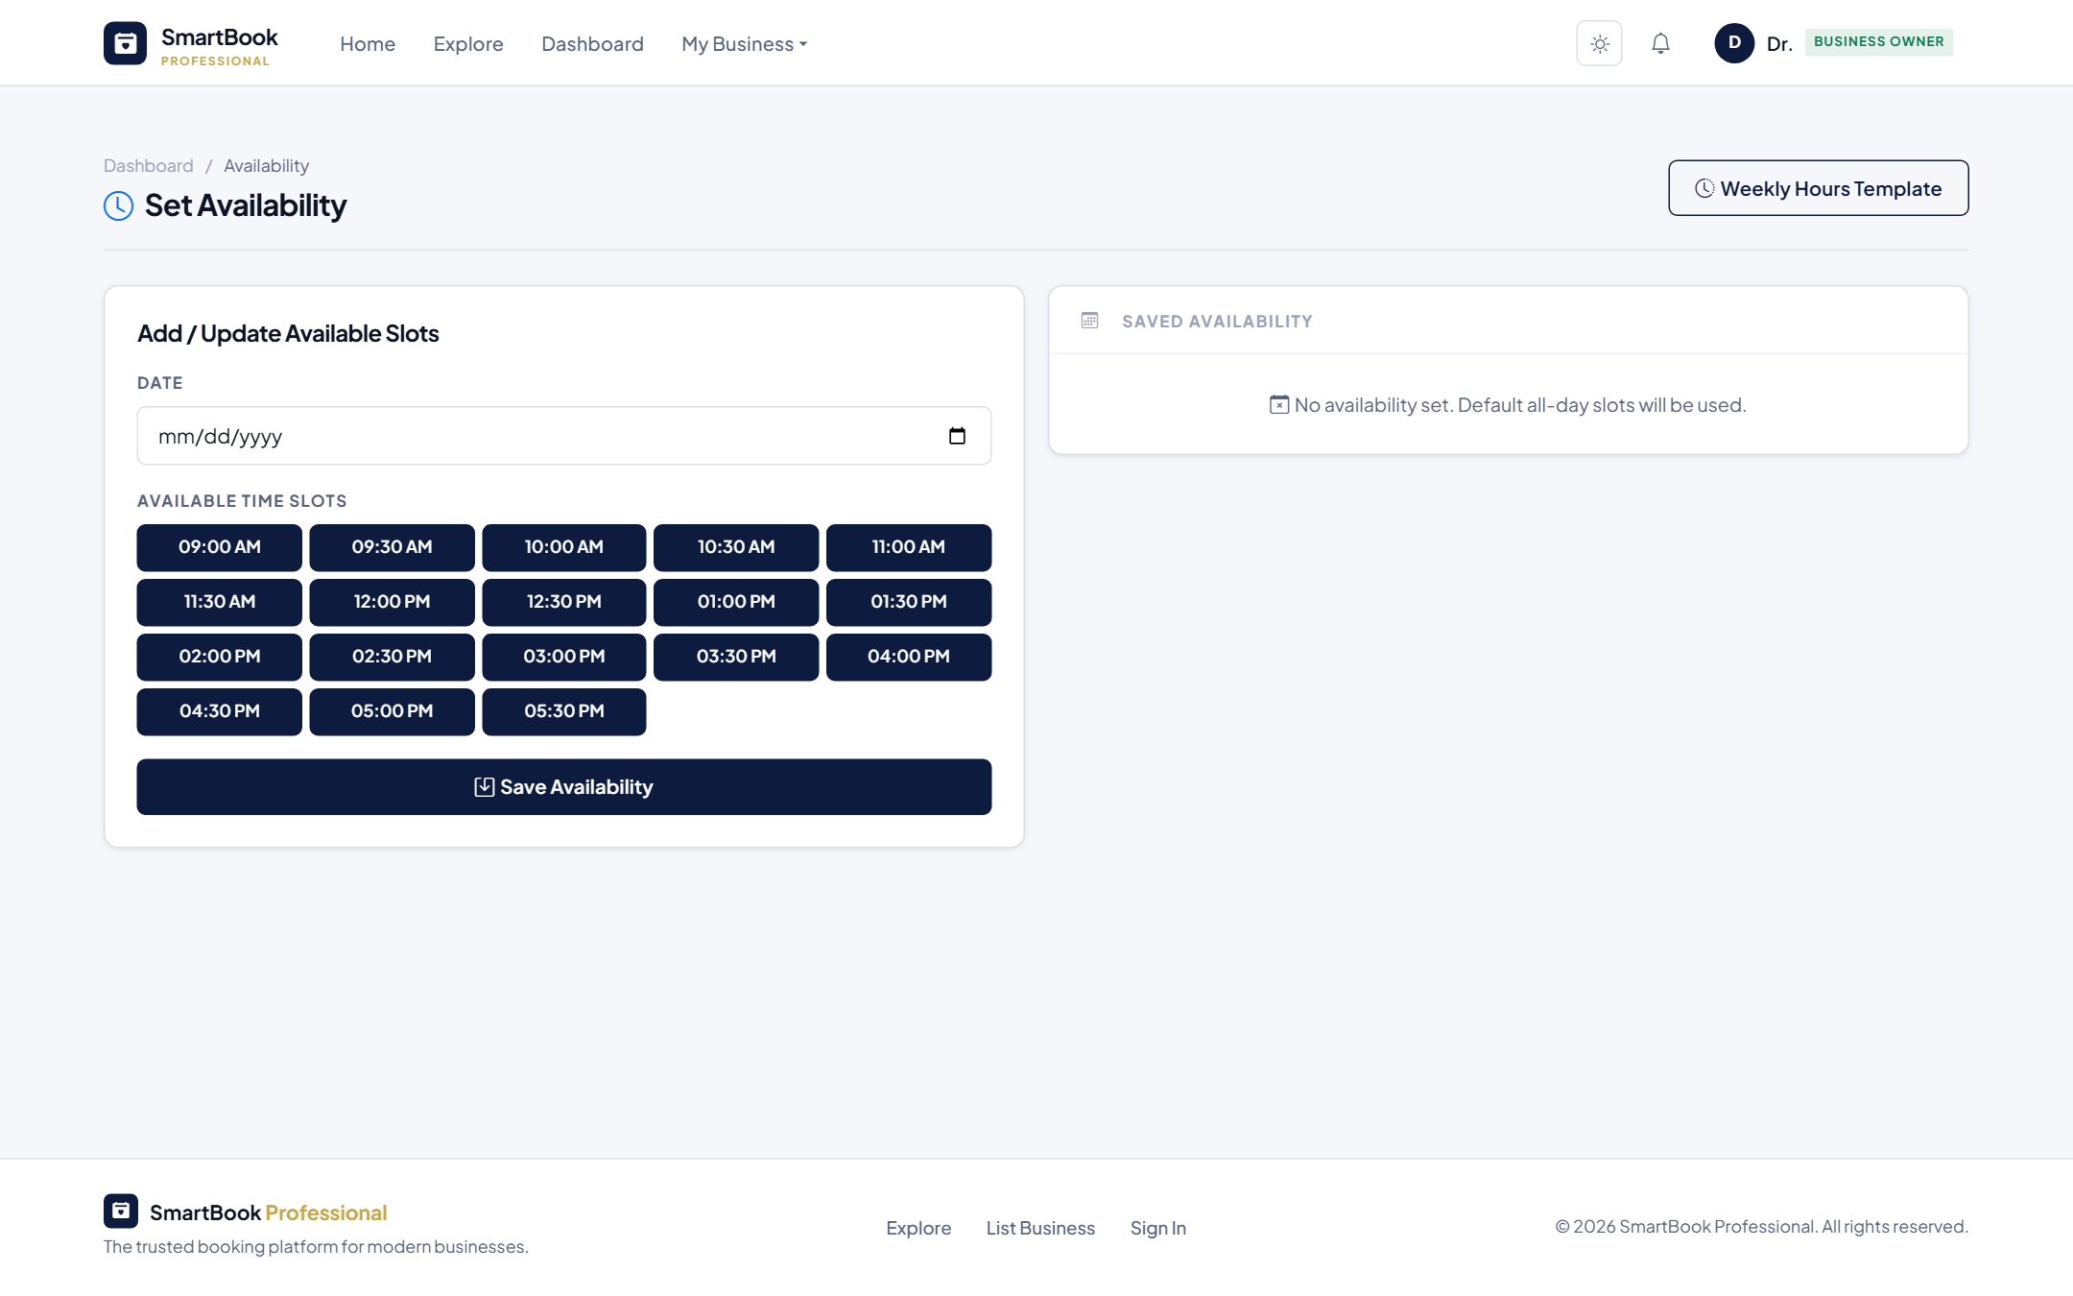
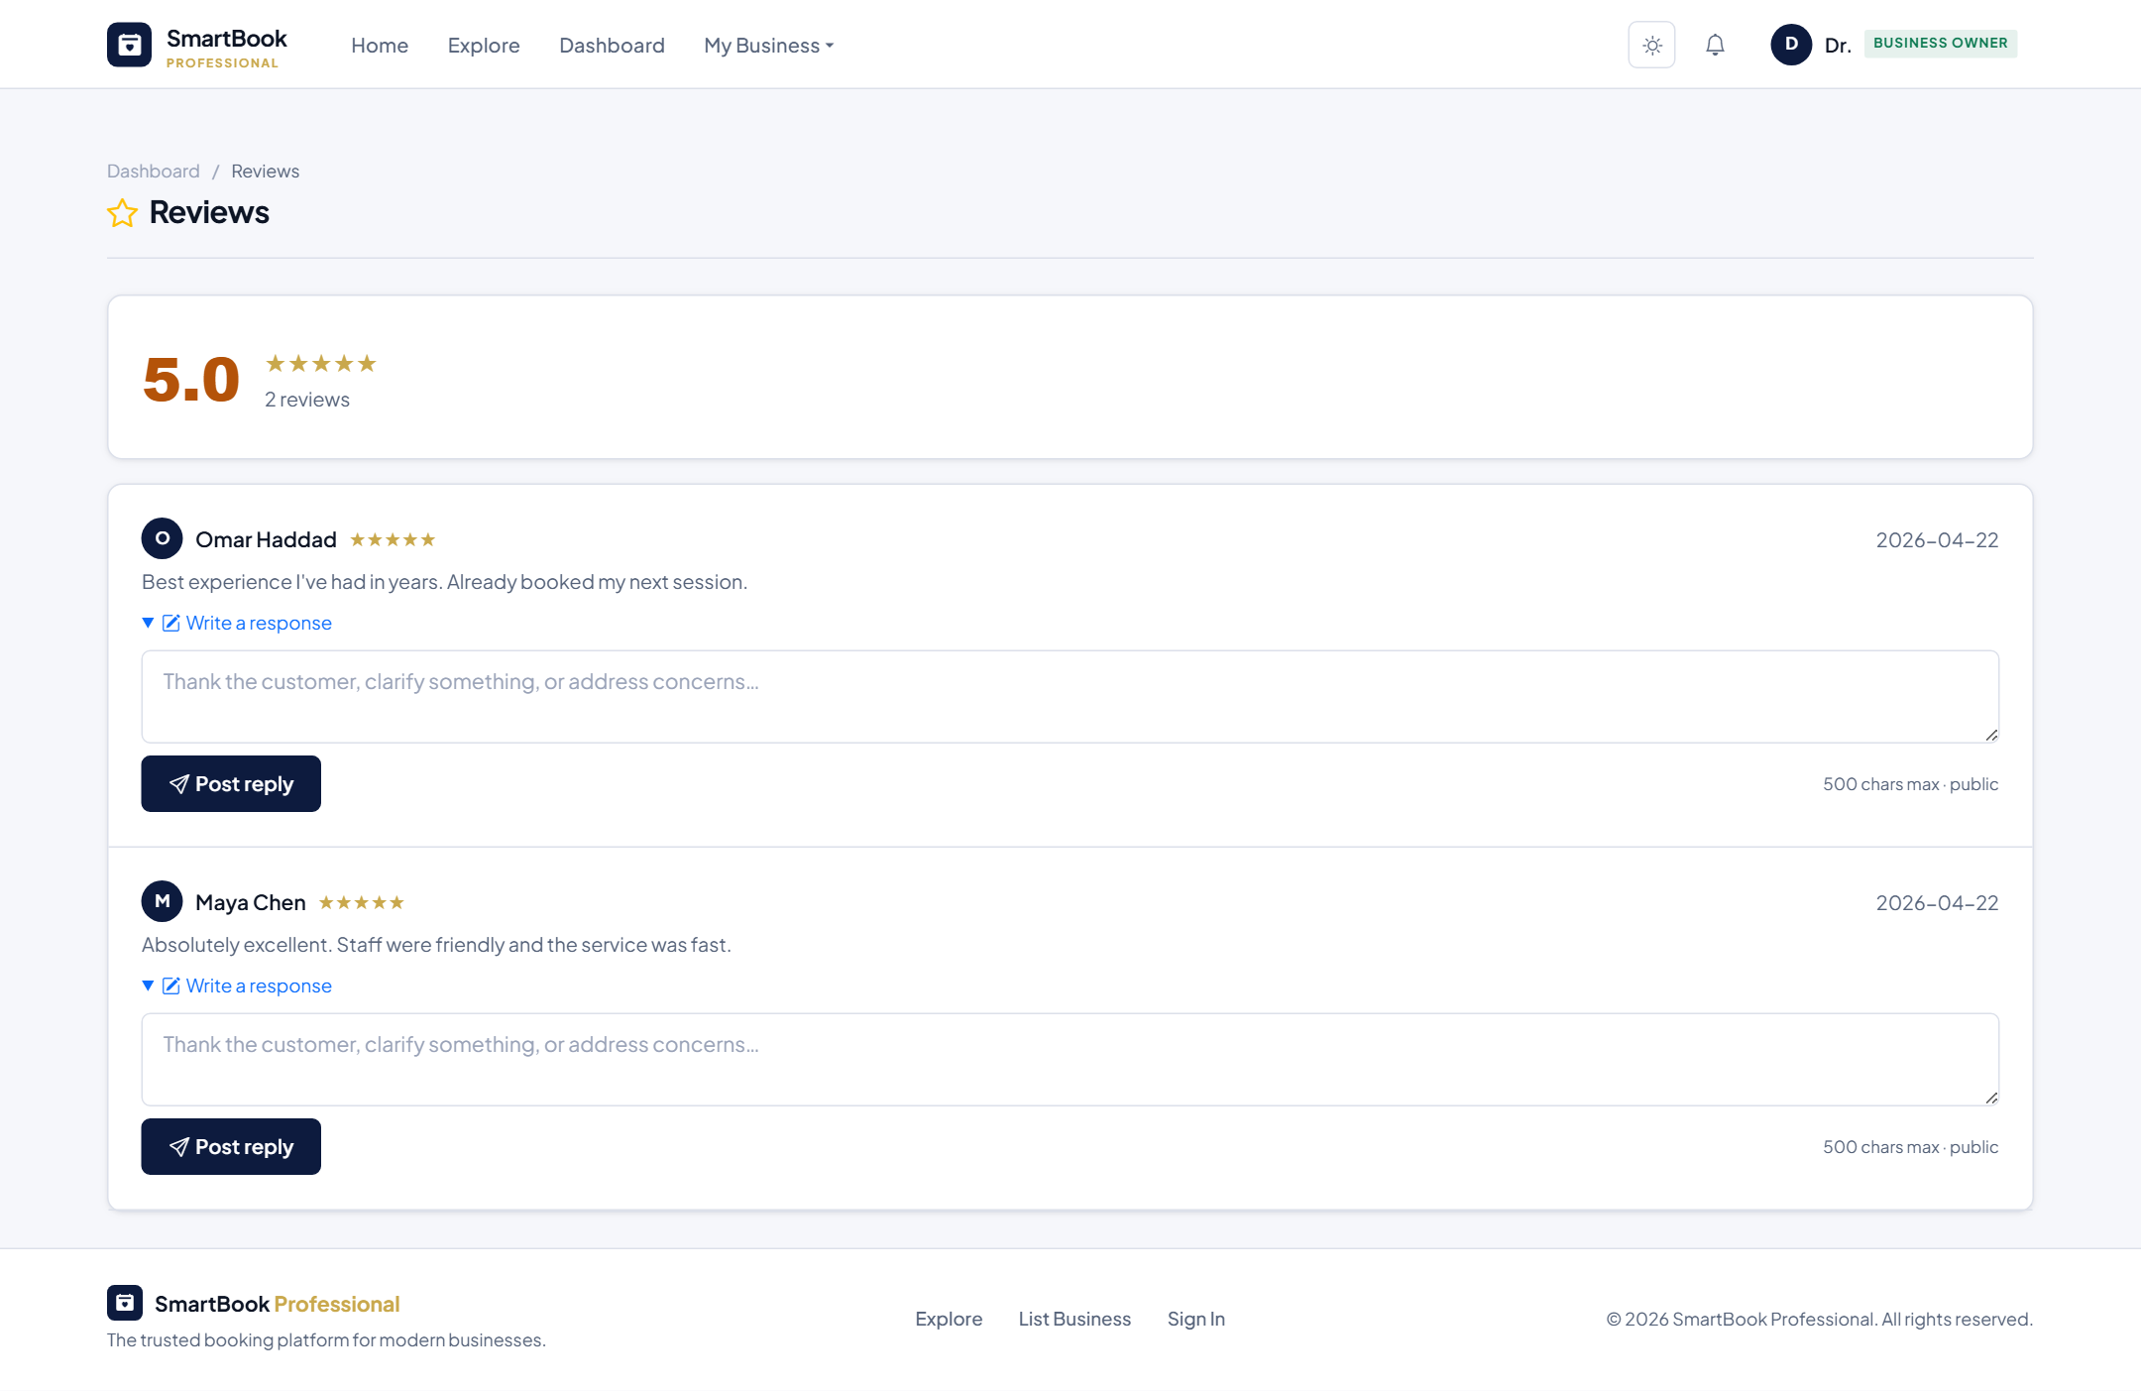
LIVE SCREENS
Business Owner Experience
Owner dashboard — today's schedule and analytics
Services menu — set name, duration, price
Availability — pick which slots are open per date
Reviews — read feedback and reply to customers
Smart Appointment Booking System — Project Managing Presentation
10 / 16

Slide 11
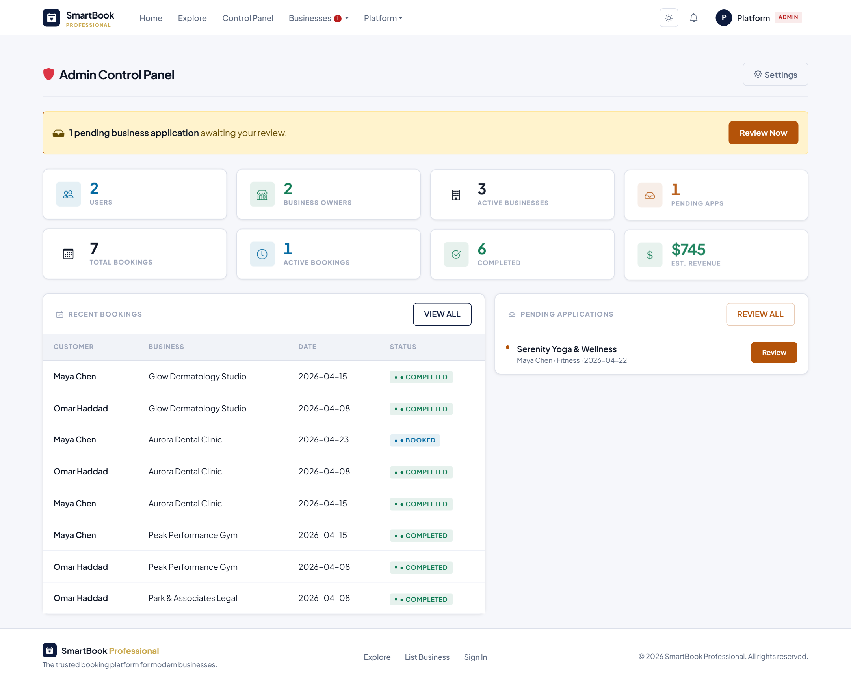
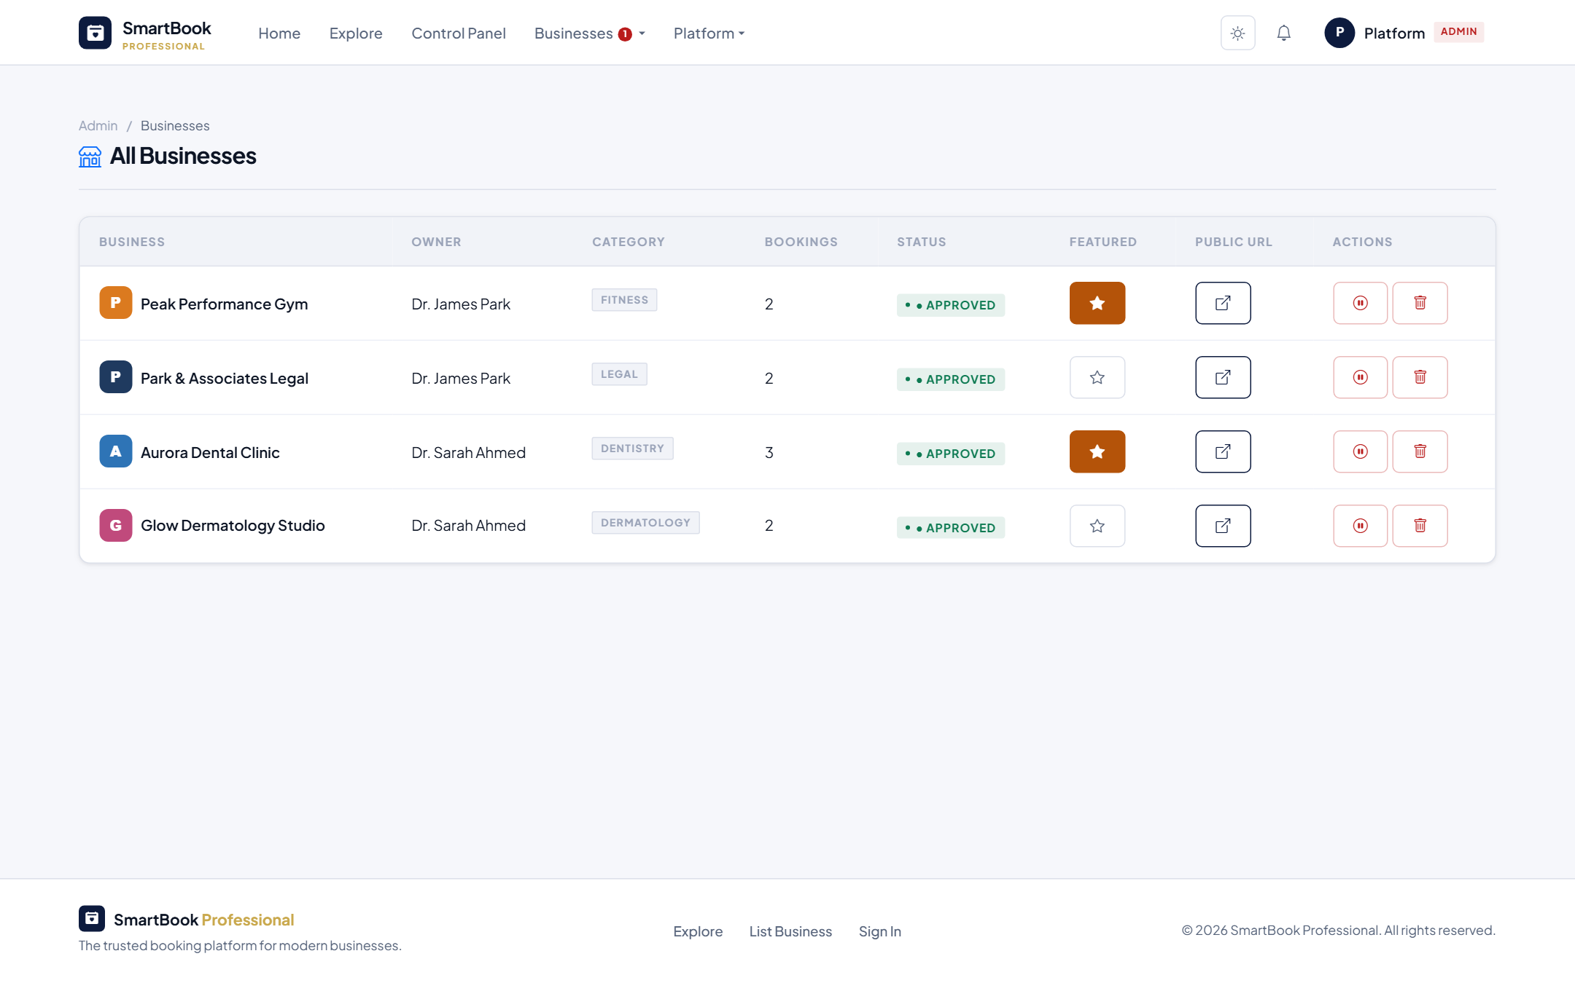
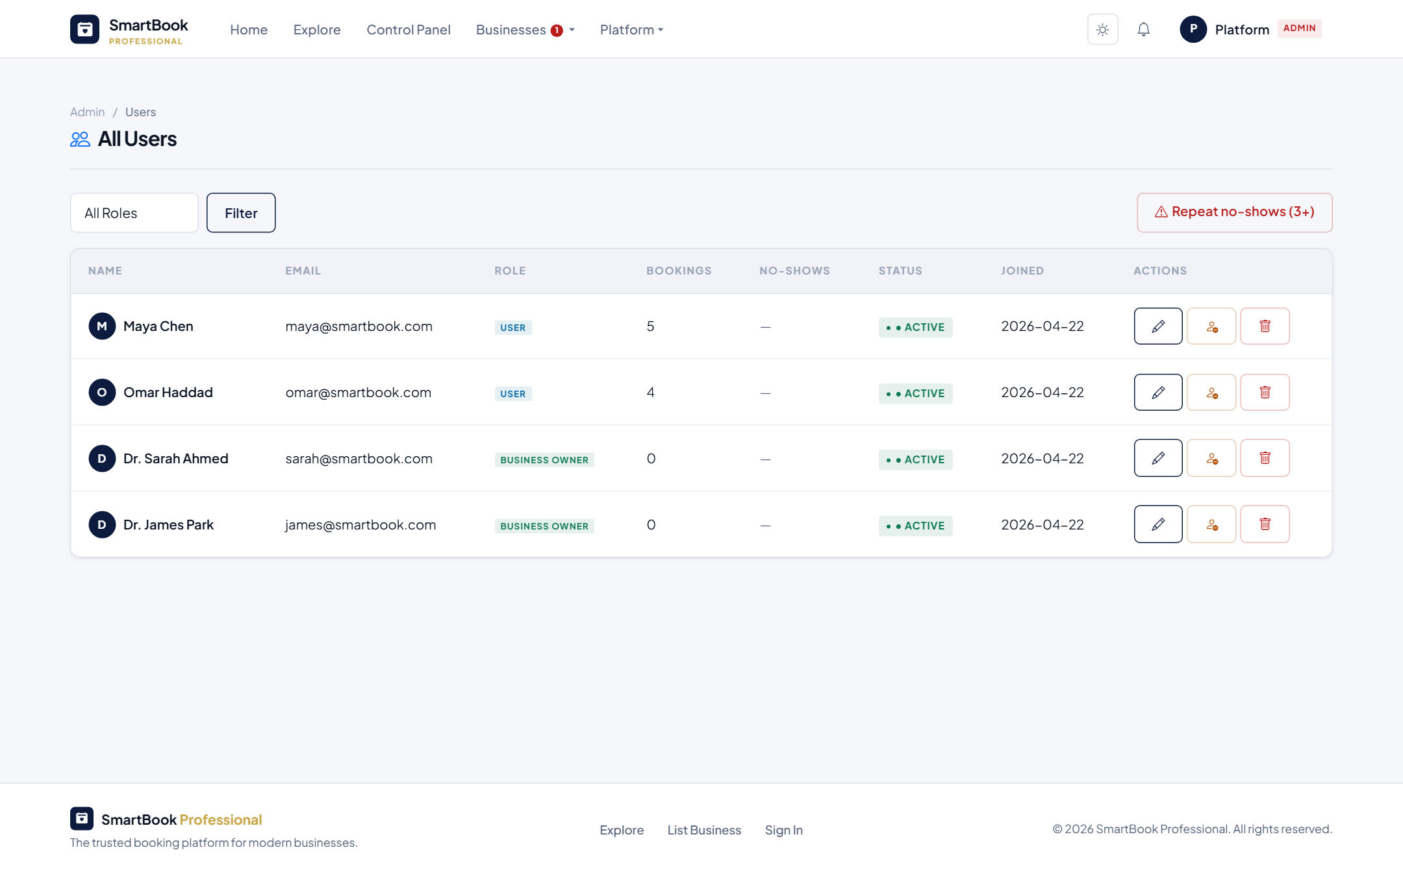
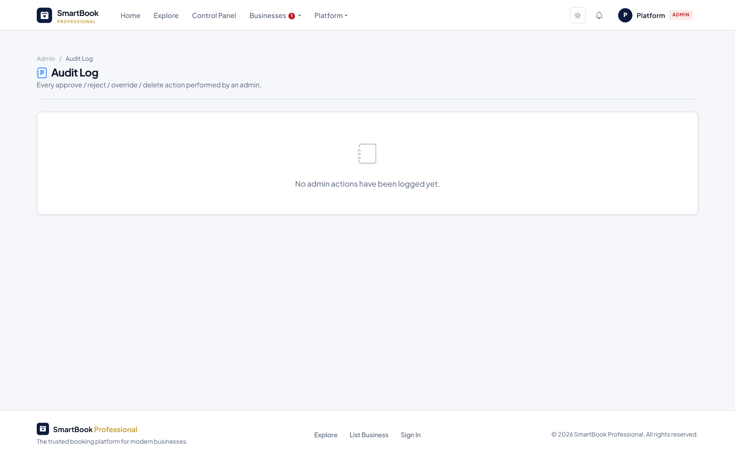
LIVE SCREENS
Administrator Experience
Admin dashboard — platform-wide stats
Businesses — toggle featured, suspend, delete
Users — flag no-show offenders, edit roles
Audit log — every admin action is recorded
Smart Appointment Booking System — Project Managing Presentation
11 / 16

Slide 12
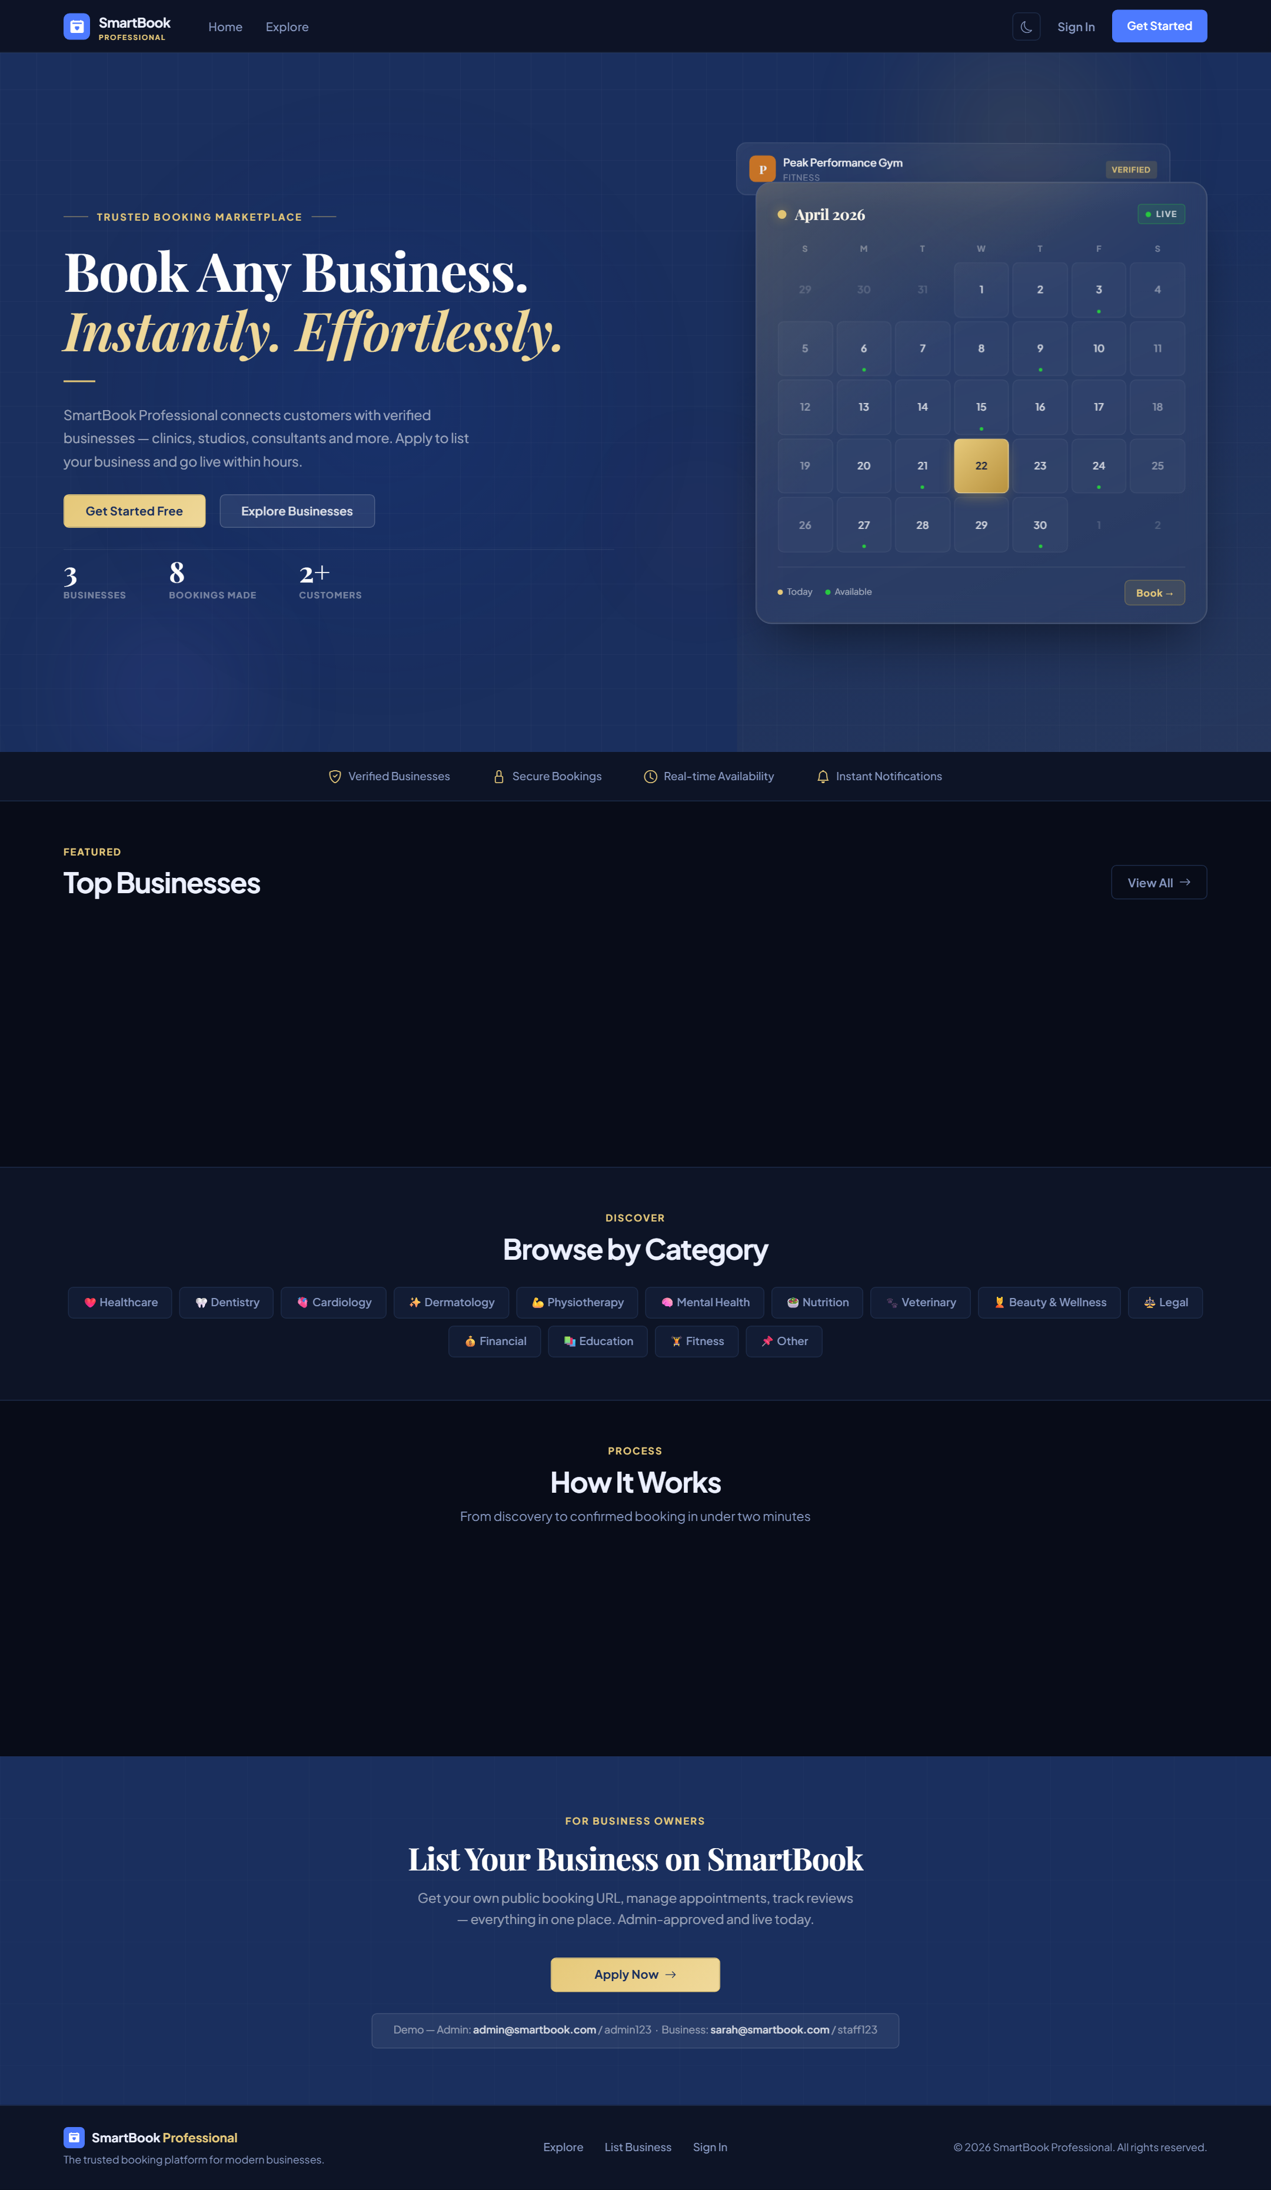
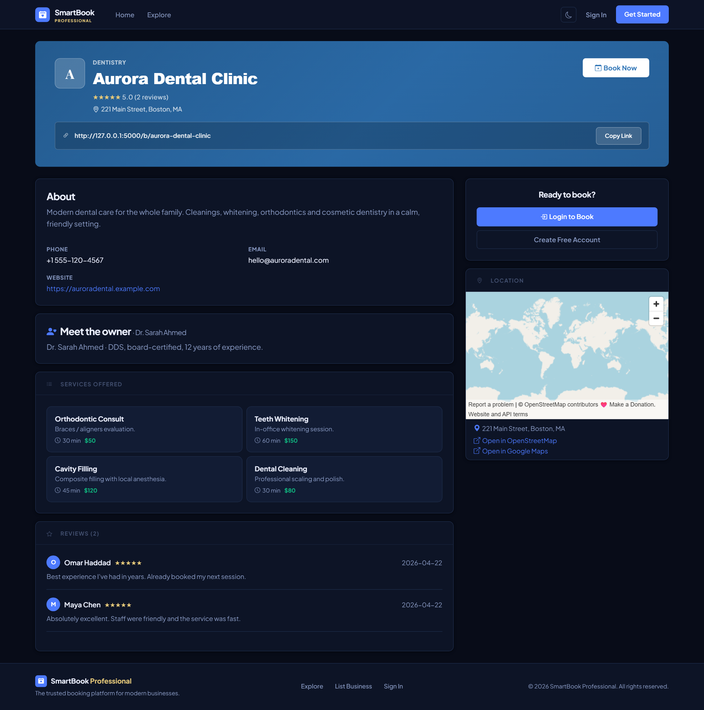
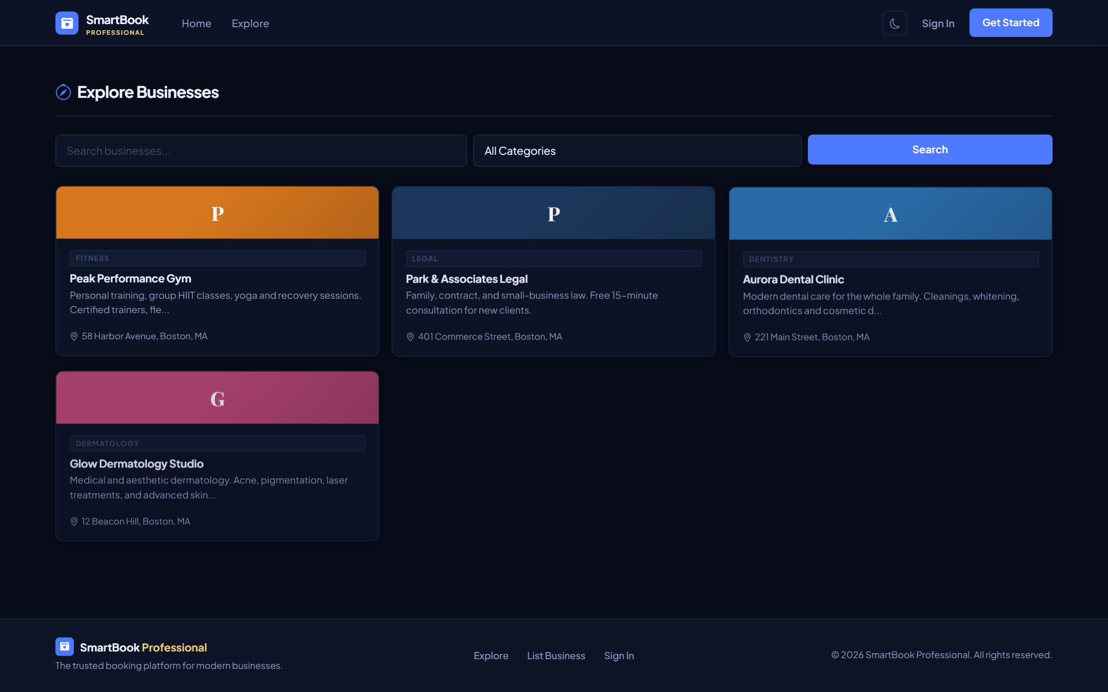
ONE TOGGLE · IDENTICAL FEATURES
Dark Theme
Home
Explore
Business page
A single toggle switches the whole site to dark mode — easier on the eyes in low light, and a modern feel on every page.
Smart Appointment Booking System — Project Managing Presentation
12 / 16

Slide 13
SIX CONTROLS IN PLACE
Security in Depth
1
Password hashing
2
Signed sessions
Werkzeug PBKDF2-HMAC-SHA256 with a per-password salt. Plain text passwords are never stored.
Flask session cookies are HMAC-signed with the server secret key — clients cannot forge a session.
3
Role-based access
4
Owner scoping
Every protected route uses @login_required or @role_required. Three distinct roles: user, business owner, admin.
Owner queries always filter by owner_id, so business owners can never see another business's data.
5
Login rate limiting
6
Audit log
Five failed logins from the same IP within 10 minutes triggers a temporary block. Generic error message — no user enumeration.
Every admin action (approve, reject, override, delete) is recorded with actor, target and timestamp.
Smart Appointment Booking System — Project Managing Presentation
13 / 16

Slide 14
IDENTIFIED & MITIGATED
Risk Management
Double Booking
System checks the slot in real time before confirming the booking. Slot logic accounts for service duration so longer appointments cannot overlap.
Risk level: High
Unauthorized Access
Role-based decorators on every protected route. Three distinct roles (user, business_owner, admin) — each has its own access boundary.
Risk level: High
Authentication Security
Passwords hashed with Werkzeug. Login throttling blocks an IP after 5 failed attempts within 10 minutes.
Risk level: High
User Input Errors
Server-side validation on every form (email, phone, hex color, time, date). Bad input is rejected with clear messages.
Risk level: High
Database Data Loss
Database access is centralised in db.py. Schema migrations are tracked in version control so the structure can be rebuilt at any time.
Risk level: Medium
Smart Appointment Booking System — Project Managing Presentation
14 / 16

Slide 15
OUR PROMISES
Success Criteria — Achieved
✓
Registration and login operate without errors and store user information correctly.
✓
Role permissions are enforced consistently across every protected route.
✓
Booking information is stored correctly with a clear confirmation message.
✓
User authentication is secure (hashed passwords, IP throttling, session-based).
✓
Already-reserved slots are rejected — users see a helpful suggestion for the next free slot.
✓
The platform performs reliably under multiple simultaneous user requests.
✓
Users can cancel or modify appointments; staff can view and manage all scheduled appointments.
✓
The project was delivered within the 8-week development timeline.
Smart Appointment Booking System — Project Managing Presentation
15 / 16

Slide 16
WHAT IS NEXT
Future Plans
• AI-based booking recommendations — suggest times and services based on the customer's history.
• Mobile applications — native iOS and Android clients on top of the same backend.
• SMS notifications — appointment reminders the day before, plus 1-hour-out alerts.
• Online payments — accept card payments at the time of booking.
• Analytics for business owners — deeper revenue, retention and demand-forecasting reports.
Thank you — we welcome your questions.
Ahed Akrout · Backend Developer · Smart Appointment Booking System
Smart Appointment Booking System — Project Managing Presentation
16 / 16

