Slide 1
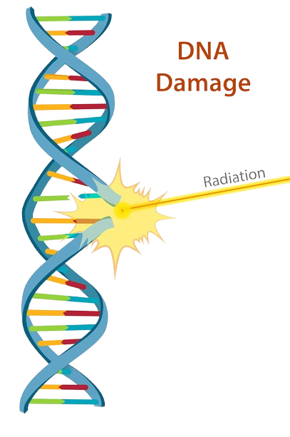
The dangers to health
of ionising radiation
IGCSE Edexcel Physics • Radioactivity
Specification 7.15–7.16
Contamination, irradiation, cell damage, mutations and radioactive waste
Made by Malak SII
IGCSE Edexcel Physics • 7.15–7.16 • Made by Malak SII
1 / 20

Slide 2
What you need to know
Pearson Edexcel International GCSE Physics (4PH1) — Radioactivity
7.4 / 7.5
Know that α, β and γ are ionising radiations from unstable nuclei, and compare ionising power and penetrating power.
7.15
Describe the difference between contamination and irradiation.
7.16
Describe the dangers of ionising radiation: mutations, cell and tissue damage, and problems of radioactive waste — plus how risks are reduced.
Exam skill
Use the correct terms, link ionisation to DNA damage, and explain why α is most dangerous inside the body.
IGCSE Edexcel Physics • 7.15–7.16 • Made by Malak SII
2 / 20

Slide 3
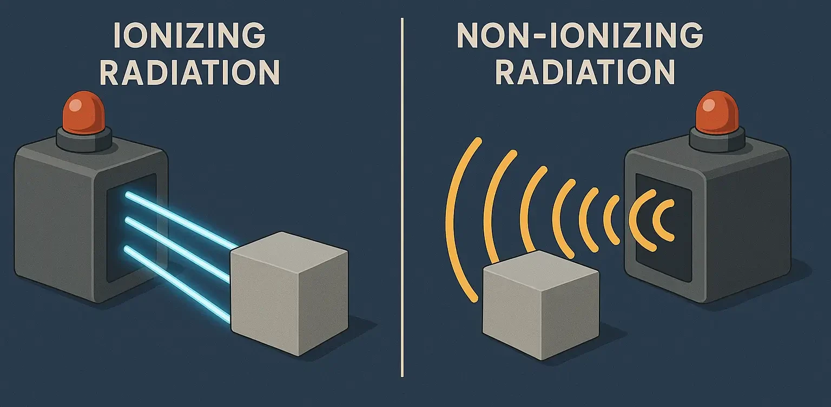
What is ionising radiation?
Ionising radiation is radiation with enough energy to remove electrons from atoms, forming ions.
That is why it can damage living cells: it changes atoms and molecules inside the body.
Examples you must know:
• Alpha particles (α) — helium nuclei (2 protons + 2 neutrons)
• Beta particles (β) — fast electrons from the nucleus
• Gamma rays (γ) — high-energy electromagnetic waves
• X-rays — also EM waves; produced in X-ray tubes, not by nuclei
Neutron radiation is also on the specification for nuclear equations, but α, β and γ are the main ionising types discussed for health hazards.
Key idea
Non-ionising radiation (radio, microwaves, visible light) does not have enough energy to knock electrons off atoms.
Only ionising radiation can directly damage DNA this way.
IGCSE Edexcel Physics • 7.15–7.16 • Made by Malak SII
3 / 20

Slide 4
Comparing α, β and γ
You distinguish them by nature, charge, ionising power and penetrating power.
Property | Alpha (α) | Beta (β) | Gamma (γ)
Nature | Helium nucleus (2p + 2n) | Fast electron | EM wave (photon)
Charge / mass | +2 • heavy | −1 • light | 0 • no mass
Ionising power | Very high | Medium | Low
Penetrating power | Very low | Medium | Very high
Stopped by | Paper / skin / few cm of air | A few mm of aluminium | Reduced by thick lead or concrete
Range in air | A few centimetres | Up to ~1 metre | Unlimited (intensity falls)
IGCSE Edexcel Physics • 7.15–7.16 • Made by Malak SII
4 / 20

Slide 5
Why this matters inside the body
Alpha — most ionising
Beta — medium
Gamma — most penetrating
α particles dump a lot of energy in a very small volume of tissue. They cannot reach organs from outside (skin stops them), but if a source is swallowed, inhaled or in a wound they are the most damaging.
β particles travel further than α, so they can damage cells a short distance into the body. Thin metal or plastic shielding is used to reduce the risk.
γ rays pass through the body easily. They are weakly ionising per millimetre, but they can irradiate deep organs from outside. Thick lead or concrete is needed to absorb them.
Exam line: The more strongly ionising the radiation, the more damage it does per millimetre of tissue — but the less far it travels.
IGCSE Edexcel Physics • 7.15–7.16 • Made by Malak SII
5 / 20

Slide 6
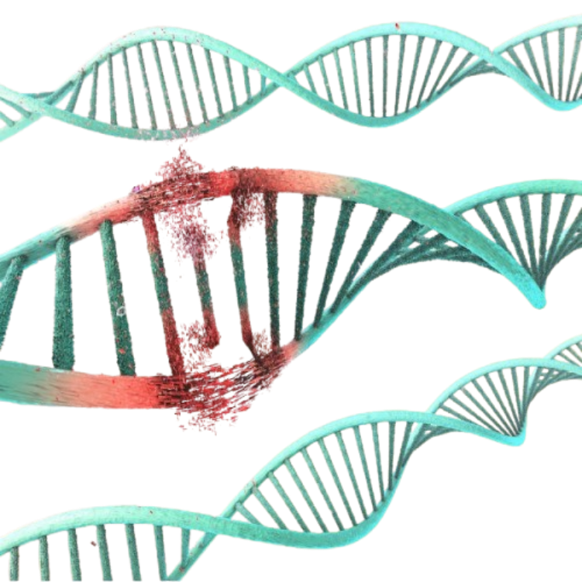
How does ionising radiation damage cells?
When ionising radiation enters the body, it interacts with atoms and molecules in cells.
This can:
• Remove electrons (ionisation)
• Break chemical bonds
• Damage DNA in the nucleus
• Create highly reactive molecules (free radicals) from water in the cell
• Damage or kill cells
If the damage is severe, the cell may die. If damaged DNA is not correctly repaired, the cell may become abnormal and divide out of control.
IGCSE Edexcel Physics • 7.15–7.16 • Made by Malak SII
6 / 20

Slide 7
Mutations and cancer
A mutation is a change in the DNA of a cell. This is a core 7.16 point.
1. DNA hit
2. Faulty repair
3. Mutation
4. Possible cancer
Ionising radiation breaks strands or changes bases in DNA.
The cell may repair the DNA wrongly, or fail to repair it.
The genetic code is permanently changed.
If genes that control cell division are mutated, cells can divide uncontrollably — a tumour / cancer.
Two places mutations matter
• Body (somatic) cells → may cause cancer in that person later.
• Reproductive cells (sperm / egg) → a mutation can be passed to offspring.
Higher dose, longer exposure, and more strongly ionising radiation all increase the chance of harmful mutations.
IGCSE Edexcel Physics • 7.15–7.16 • Made by Malak SII
7 / 20

Slide 8
Damage to cells and tissue
Effects depend on dose, time of exposure, type of radiation, and which organ is hit.
Type of effect | What happens | Typical result
Cell death | So many cells are killed that the tissue cannot work | Burns, hair loss, organ failure at very high dose
Tissue damage | Organs that divide quickly are most sensitive | Skin, bone marrow, gut lining
Mutation | DNA changed; cell still lives | Increased cancer risk
Sterility / unborn baby | Reproductive tissue or a foetus is exposed | Infertility or harm to a developing baby
IGCSE focus: you do not need named diseases in detail. You do need: radiation can kill cells / damage tissue, and it can cause mutations that may lead to cancer.
IGCSE Edexcel Physics • 7.15–7.16 • Made by Malak SII
8 / 20

Slide 9
Contamination vs irradiation (7.15)
IRRADIATION
CONTAMINATION
• The object / person is exposed to radiation from an outside source.
• No radioactive material is transferred.
• The person does not become radioactive.
• Exposure stops when the source is removed or shielded.
• Example: a hospital X-ray; standing near a sealed gamma source.
• Radioactive material gets onto or into the object / person (dust, liquid, gas).
• The person now carries a source and keeps being irradiated.
• Especially dangerous if swallowed or inhaled (α inside the body).
• Radiation continues until the material is removed or decays.
• Example: radioactive powder on skin; radon gas in lungs.
Food and surgical instruments can be irradiated on purpose to kill bacteria — they are not left radioactive.
IGCSE Edexcel Physics • 7.15–7.16 • Made by Malak SII
9 / 20

Slide 10
Side-by-side comparison
Feature | Irradiation | Contamination
Radioactive material present? | No | Yes
Object becomes a source? | No | Yes
Stops when you walk away? | Yes (source stays behind) | No — source is on/in you
Can make you radioactive? | No | Yes (you emit radiation)
Typical prevention | Time, distance, shielding | Sealed sources, gloves, suits, no eating/drinking in labs
Example | X-ray of a broken bone | Spill of radioactive liquid on a bench
IGCSE Edexcel Physics • 7.15–7.16 • Made by Malak SII
10 / 20

Slide 11
Reducing the hazard — time, distance, shielding
TIME
DISTANCE
SHIELDING
Keep exposure as short as possible. Plan the task. Do not linger near a source.
Stay as far away as you can. Use tongs or remote handling. Intensity falls quickly with distance.
Put a suitable absorber between you and the source: paper/plastic for β, thick lead or concrete for γ.
Other IGCSE precautions
• Store sources in lead-lined boxes • never point a source at anyone • wear gloves / lab coats to avoid contamination
• Monitor with a Geiger–Müller detector or photographic film badge • radioactive symbol on stores and rooms
• Limit who is allowed near sources • do not eat, drink or apply makeup in a radioactivity lab
IGCSE Edexcel Physics • 7.15–7.16 • Made by Malak SII
11 / 20

Slide 12
Which radiation is most dangerous?
Outside the body: γ (and X-rays) are the main hazard because they penetrate skin and organs.
Inside the body: α is the worst because it is the most strongly ionising — all its energy is absorbed by nearby cells.
Situation | Biggest risk | Why
Sealed source across the room | Gamma | α and β may not even reach you; γ can
Source on the skin | Beta (and γ) | α stopped by outer dead skin; β can burn living skin
Dust inhaled / food swallowed | Alpha | No skin barrier; dense ionisation in lungs or gut
IGCSE Edexcel Physics • 7.15–7.16 • Made by Malak SII
12 / 20

Slide 13
Radioactive waste (7.16)
Waste keeps emitting ionising radiation. Some isotopes have half-lives of thousands of years.
Spent fuel rods are very hot and highly radioactive. They must be stored, not dumped.
Nuclear power
Used in diagnosis and cancer treatment. Sources and contaminated items become waste.
Hospitals
Tracers, thickness gauges, labs. Must be collected and stored safely.
Industry & research
IGCSE Edexcel Physics • 7.15–7.16 • Made by Malak SII
13 / 20

Slide 14
How the risks from waste are reduced
Shielded containers
Remote handling
Lead, steel or concrete absorbs radiation so workers and the public are not irradiated.
Robots or long tongs keep people away from high-activity waste.
Cooling / ponds
Secure storage
Spent fuel is stored under water at first. Water cools it and acts as a shield.
Sealed stores stop leaks into soil, air or drinking water (prevents contamination).
Deep geological disposal
Monitor and restrict access
Long-lived waste can be buried deep underground, isolated for a very long time.
Warning signs, GM monitors, and limited access reduce accidental exposure.
IGCSE Edexcel Physics • 7.15–7.16 • Made by Malak SII
14 / 20

Slide 15
Background radiation (linked idea 7.10)
We are always exposed to a low level of ionising radiation. It is not usually a large extra risk, but you must know the sources.
Radon gas
Rocks & building materials
Cosmic rays
From rocks and soil; can collect in buildings. An α emitter if inhaled.
Natural radioactive isotopes in granite and bricks.
High-energy radiation from space. Greater in aircraft and at high altitude.
Food and drink
Medical uses
Nuclear industry / fallout
Tiny amounts of natural isotopes (e.g. carbon-14, potassium-40).
X-rays, CT scans, nuclear medicine — useful, but they add a dose.
A small fraction of average background in most places.
IGCSE Edexcel Physics • 7.15–7.16 • Made by Malak SII
15 / 20

Slide 16
Uses still involve a hazard
7.14 uses of radioactivity — always balanced against 7.16 dangers.
Cancer radiotherapy
High dose of γ (or other beams) is aimed at a tumour to kill cancer cells. Nearby healthy tissue must be shielded or the beam shaped.
Tracers in medicine
A small amount of a short-half-life gamma emitter is swallowed or injected. The patient is briefly irradiated from inside; contamination of other people is controlled.
Sterilising equipment / food
Gamma irradiation kills bacteria. The objects do not become radioactive.
Smoke alarms
Americium-241 (α) ionises air in the detector. The source is sealed so you are not contaminated.
Thickness gauges / industry
β or γ through paper, foil or metal. Workers stay behind shielding.
Nuclear power
Fission produces heat and a large amount of radioactive waste that must be stored for a long time.
IGCSE Edexcel Physics • 7.15–7.16 • Made by Malak SII
16 / 20

Slide 17
Phrases that gain marks
01
Ionising radiation can remove electrons from atoms in cells.
02
This can damage or kill cells / damage tissue.
03
It can cause mutations in DNA, which may lead to cancer.
04
Mutations in reproductive cells can be inherited.
05
Irradiation is exposure to radiation; the object does not become radioactive.
06
Contamination is unwanted radioactive material on or in a person / object.
07
Alpha is the most ionising, so most dangerous if the source is inside the body.
08
Gamma is the most penetrating, so most dangerous from outside the body.
09
Reduce risk by reducing time, increasing distance, and using shielding.
10
Radioactive waste remains hazardous for a long time because of long half-lives; store it shielded and isolated.
IGCSE Edexcel Physics • 7.15–7.16 • Made by Malak SII
17 / 20

Slide 18
Practice questions
1. Define ionising radiation. Name the three types emitted by unstable nuclei.
2. Explain why alpha radiation is more dangerous than gamma radiation if a source is swallowed, but less dangerous if the source is outside the body.
3. A technician stands near a sealed cobalt-60 source. Is this contamination or irradiation? Explain.
4. Radioactive powder is spilled on a glove. Identify the hazard and say how the risk should be reduced.
5. Describe how ionising radiation can cause cancer.
6. State two problems of disposing of radioactive waste and two ways of reducing the risk.
7. Give three precautions taken in a school lab when using sealed radioactive sources.
8. Food can be irradiated to kill bacteria. Explain why the food is not radioactive afterwards.
IGCSE Edexcel Physics • 7.15–7.16 • Made by Malak SII
18 / 20

Slide 19
Outline answers
1. Radiation with enough energy to remove electrons / form ions. α, β, γ.
2. Inside: α is highly ionising so it damages nearby cells a lot; γ is weakly ionising. Outside: skin / air stop α, so it does not reach organs; γ penetrates the body.
3. Irradiation — sealed source, no material transferred, technician does not become radioactive.
4. Contamination. Do not touch with bare skin; remove glove as hazardous waste; wash; monitor with a GM detector; prevent powder spreading.
5. Radiation damages DNA → mutation → cell may divide uncontrollably → cancer.
6. Problems: remains radioactive for a long time; can contaminate land/water and harm people. Reduce: shielded containers, remote handling, secure / deep underground storage, restricted access.
7. Any three: tongs; store in lead box; short time; keep distance; never point at people; film badge / GM check; no eating in lab.
8. Irradiation does not transfer radioactive nuclei to the food; only energy is delivered, so the food does not become a source.
IGCSE Edexcel Physics • 7.15–7.16 • Made by Malak SII
19 / 20

Slide 20
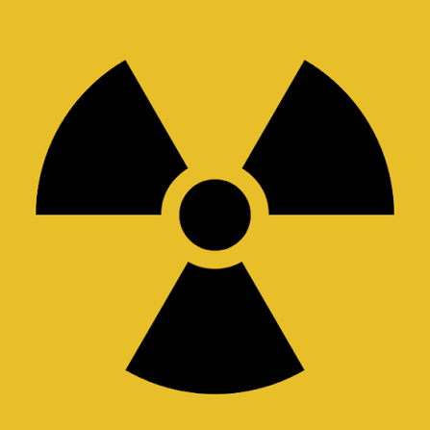
Remember this
Ionise → damage cells / DNA → death or mutation (cancer).
Irradiation ≠ contamination.
Time • distance • shielding.
Waste: long-lived, must be stored and isolated.
Made by Malak SII • IGCSE Edexcel Physics
IGCSE Edexcel Physics • 7.15–7.16 • Made by Malak SII
20 / 20

