Slide 1
Intel Unnati
Power-Manager-Telemetry
MELVIN RICHARDSON P
(URK21AI1037)

Slide 2
Problem Statement:
In the era of 5G and edge computing, the deployment of devices across different locations has increased, leading to a higher power consumption. To address this issue, the government is pushing enterprises and industries to reduce power usage. The goal is to achieve net-zero power consumption. Additionally, the price of electricity is increasing, making it crucial to understand the total power drawn by system.
Researching and identifying open-source tools for power measurement.
Identifying and documenting the available knobs in a system to measure power.
Collect power telemetry data from CPU, memory, NIC, and TDP etc.
Measure and record system power utilization for CPU, NIC, and TDP based on the input parameter of system utilization percentage.
Create a report on the power problem, technical approach, and results.

Slide 3
Idea:
The project aimed to tackle high CPU usage by applications and analyze the impact of imposing CPU limits.
1. Data Collection: Initially, CPU usage data was collected under normal conditions and then under CPU limits of 80%, 50%, and 30%.
2. Tools: Utilizing `psutil`, we monitored and compared the data to understand the patterns and impacts on system performance.
3. Visualizations: Visualizations were created to show overall CPU usage and application-specific impacts, highlighting the top 50 applications.
4. Analysis: The analysis provided insights into significant contributors to high CPU usage and recommendations for optimizing system performance.
5. Approach: The project followed a structured approach of identifying the problem, collecting data, evaluating impacts, and acting on the findings.

Slide 4
Features Offered
1. Data Collection:
- Initial Data: Gather CPU usage data under normal conditions.
- Limited Data: Collect data under CPU limits (80%, 50%, 30%).
2. Tool Utilization:
- psutil: Monitor and collect system and process information.
3. Data Analysis:
- Average Calculation: Compute average CPU usage for each application.
- Comparative Analysis: Compare CPU usage data before and after limits.
4. Visualization:
- Bar Plot: Compare CPU usage of each application under different limits.
- Overall Comparison: Visualize total system performance impact.

Slide 5
Features Offered
5. Structured Approach:
- Identification: Define high CPU usage problem and objectives.
- Evaluation: Analyze data for impact and insights.
- Recommendations: Suggest CPU usage optimizations.
These features provide a thorough analysis of CPU usage, the effects of CPU limitations, and actionable optimization insights.

Slide 6
Process flow
1.Start
2.Define Problem Statement
Identify the issue of high CPU usage by applications.
3.Set Objectives
Outline goals: Monitor CPU usage, apply CPU limits, analyze impact.
4.Data Collection
Collect Initial Data: Gather CPU usage data for all running applications without any limitations.
Collect Limited Data:
Apply 80% CPU limit and collect usage data.
Apply 50% CPU limit and collect usage data.
Apply 30% CPU limit and collect usage data.

Slide 7
Process flow
5. Data Processing
Calculate Average CPU Usage: Compute the average CPU usage for each application under all scenarios.
Group Data by Application: Organize the collected data by application name.
6. Comparative Analysis
Compare Average CPU Usage: Analyze and compare the average CPU usage data for each application under different CPU limits.
Calculate Changes: Determine the changes in CPU usage for each application before and after imposing limits.
7. Visualization
Bar Plot: Create bar plots to compare the top 50 applications' CPU usage under different scenarios.
Overall System Performance: Create visualizations to show the overall system performance impact of the CPU limits.

Slide 8
Process flow
8. Insights and Recommendations
Identify High Usage Applications: Pinpoint applications that significantly consume CPU resources.
Provide Optimization Suggestions: Offer recommendations for optimizing CPU usage based on the analysis.
9. End
By following this process flow, the project systematically addresses the problem of high CPU usage, applies necessary limits, and provides a thorough analysis of the impacts, leading to actionable insights and recommendations.

Slide 9
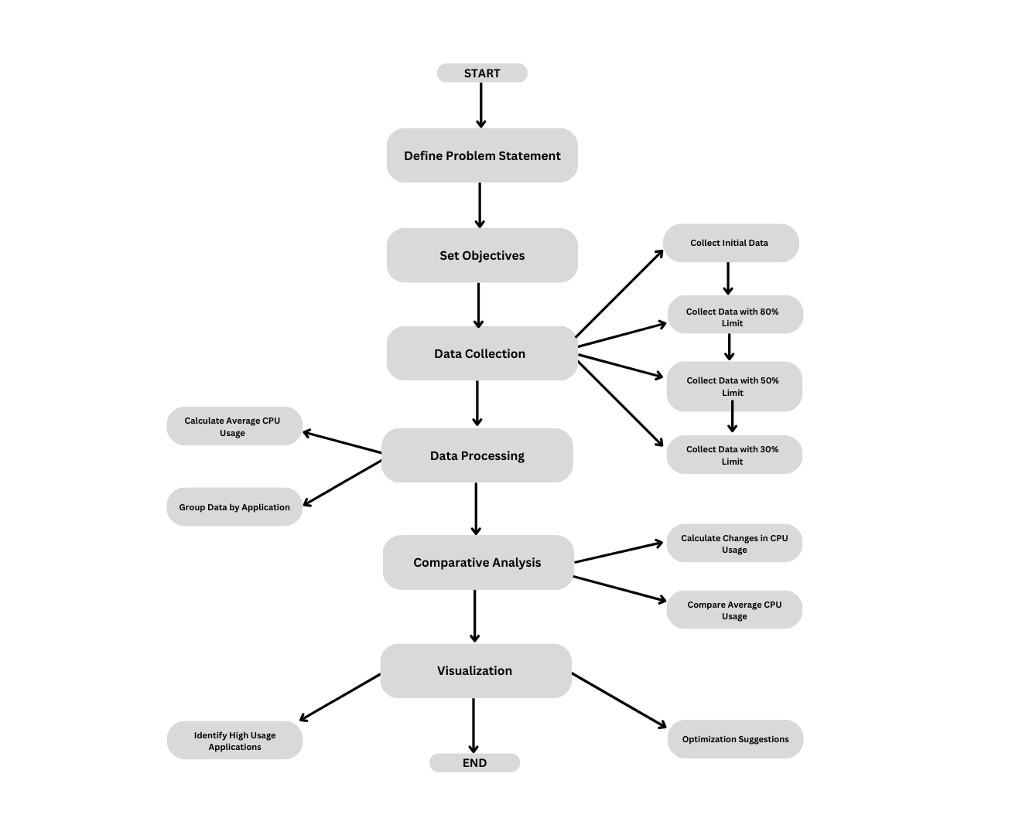
Architecture Diagram

Slide 10
Technologies used
1. Python
Primary language for scripting and execution.
2. Python Libraries:
psutil: Collects real-time CPU and memory usage data.
pandas: Reads, processes, and analyzes data.
matplotlib: Creates visualizations like bar plots and line charts.
seaborn: Enhances visualizations with attractive and informative statistical graphics.

Slide 11
Technologies used
3. Activity Monitor:
Built-in macOS tool for collecting initial CPU and memory usage data.
4. Shell Scripts:
Automates the process of applying CPU limits on macOS.
Summary
These technologies facilitate efficient data collection, processing, and visualization, enabling a comprehensive analysis of CPU usage and the impact of imposed limits.

Slide 12
Team members and contribution:
This project was entirely executed by myself.

Slide 13
Conclusion
This project effectively tackled the challenge of high CPU usage by applications through comprehensive data collection, analysis, and visualization. Utilizing Python and its powerful libraries, we gathered real-time data on CPU and memory usage, applied various CPU limits, and compared the results to observe the impact of these limits. Our approach provided clear insights into which applications were consuming the most resources and how different CPU limits affected overall system performance.
The visualizations created with matplotlib and seaborn highlighted the differences in CPU usage across various scenarios, offering valuable insights into the benefits of imposing CPU limits. This project demonstrated a robust methodology for optimizing system performance, providing actionable recommendations for managing CPU usage in real-world environments.

