Slide 1


Gestational Diabetes Risk: A Proactive Forecasting Framework
Empowering Maternal Care with Precision Predictions
- TEAM MEMBERS -
DHANUSH P
RAMAKRISHNAN V
C KAVYASHREE
MELVIN
Notes:
1

Slide 2
The Challenge: Anticipating Gestational Diabetes Risk
Gestational Diabetes Mellitus (GDM) poses significant risks for both mother and child. Accurate and timely forecasting of glucose levels and related vitals is crucial for proactive management, yet traditional methods often lack the precision and interpretability required for effective clinical intervention.
Variability in Vitals
Limitations of Current Models
Glucose, blood pressure, and other clinical parameters can fluctuate, making consistent risk assessment difficult.
Many existing models are either univariate, missing holistic patient context, or black-box, lacking clinical interpretability.
Notes:
2

Slide 3

Our Solution: A Multivariate Forecasting Framework
We propose an innovative multivariate forecasting framework designed to provide accurate and interpretable predictions for gestational diabetes risk. This approach moves beyond single-variable predictions by integrating a rich set of clinical and temporal features.
Holistic Patient View: Combines a wide array of clinical parameters for a comprehensive understanding of maternal health.
Temporal Intelligence: Incorporates time-based insights to capture dynamic physiological changes.
Notes:
3

Slide 4



Methodology: Comprehensive Dataset & Feature Integration
Our framework is built upon a robust dataset, comprising 180 days of hourly patient data. This granular approach allows us to capture subtle physiological changes and develop highly responsive predictive models for targeted interventions.
Clinical Parameters
Temporal Context
Lifestyle Vitals
Blood Pressure, Insulin, BMI, HbA1c, Cholesterol, Triglycerides, Stress Index.
Time-based context derived from hourly readings provides critical dynamic insights into patient health trends.
Incorporates lifestyle-related data to offer a more complete and actionable picture of patient health.
Notes:
4

Slide 5




Preprocessing & Advanced Feature Engineering
To maximize the predictive power of our models, we employed sophisticated preprocessing and feature engineering techniques. These steps convert raw data into highly informative variables, essential for capturing complex patterns in patient health.
Cyclical Time Encodings
Standardization
Representing hours and days as cyclical features to capture recurring physiological rhythms effectively.
Ensuring continuous features are scaled appropriately to prevent bias and improve model training stability.
Lag Features
Rolling Statistics
Incorporating past glucose values (1h, 24h, 168h) to reflect immediate and historical physiological trends.
Calculating dynamic averages and variations (6h, 24h, 168h) for robust and real-time trend detection.
Notes:
5

Slide 6
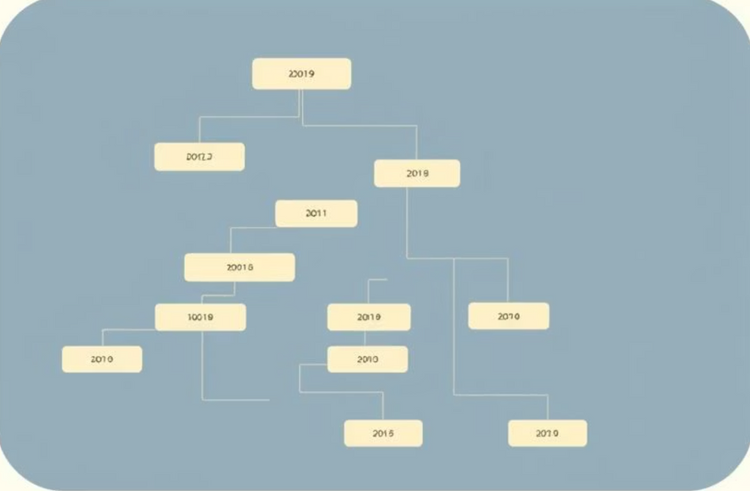
Robust Model Development & Selection
Our development process involved benchmarking a wide array of forecasting models to identify the most effective solution for gestational diabetes prediction. We rigorously evaluated each model's performance and interpretability.
Models Benchmarked:
Naive & SARIMA
Support Vector Regression (SVR)
K-Nearest Neighbors (KNN)
Gradient Boosting Algorithms
Deep Learning Models (LSTM, GRU, CNN)
Ultimately, the Random Forest forecaster, when combined with our engineered features, consistently outperformed all other models in accuracy and reliability.
Notes:
6

Slide 7
Exceptional Results: Unprecedented Accuracy
Our framework achieved remarkable accuracy, providing clinicians with highly reliable predictions to support crucial patient care decisions.
0.28
0.997
Root Mean Square Error (RMSE)
Coefficient of Determination (R²)
A low RMSE indicates minimal prediction error, signifying high precision in glucose forecasting.
An R² value close to 1 demonstrates that our model explains nearly all the variance in glucose levels.
This level of accuracy ensures clinicians can have confidence in the predictive insights generated by our system, leading to better patient outcomes.
Notes:
7

Slide 8

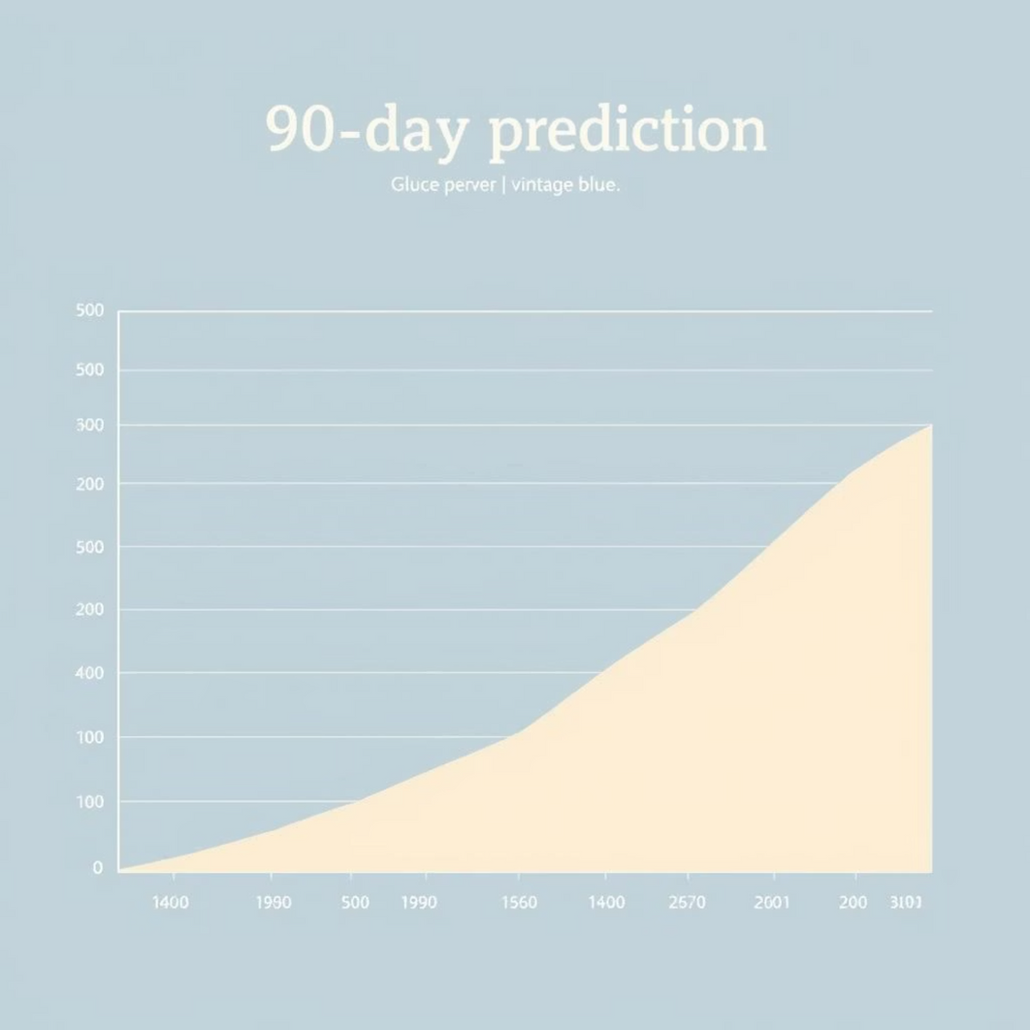
Actionable Insights: 90-Day Forward Forecasts
Our system doesn't just predict; it empowers. It generates robust 90-day forward forecasts for glucose and related vitals, offering a critical window for proactive maternal care planning and intervention.
Early Risk Identification
1
Identify potential GDM risks weeks in advance, allowing for timely and preventative interventions.
2
Personalized Treatment
Tailor management plans based on individual patient trajectories and precise predictive trends.
3
Clinician Empowerment
Provides interpretable results, enabling clinicians to confidently explain and act on predictions.
Notes:
8

Slide 9





Our Workflow: From Data to Clinical Insights
Our streamlined process ensures efficient data utilization and timely generation of valuable clinical insights, bridging the gap between raw data and actionable healthcare decisions.
Data Collection
180 days of granular hourly patient vitals.
Preprocessing & Feature Engineering
Transforming raw data into highly predictive features.
Model Selection
Random Forest chosen for its superior performance.
90-Day Forecast
Generating reliable future predictions for patient care.
Clinical Insights
Interpretable, actionable information for enhanced care.
This systematic approach ensures the highest quality in predictive analytics for maternal health, leading to better patient management.
Notes:
9

Slide 10

Conclusion: Advancing Proactive Maternal Healthcare
Our multivariate forecasting framework offers a robust, accurate, and interpretable solution for predicting gestational diabetes risk, marking a significant step forward in proactive maternal care.
Key Takeaways:
High accuracy with interpretable Random Forest model.
Integration of diverse clinical and temporal data.
90-day forecasts empower proactive clinical decisions.
Explore more about our project: well-doc-kes3.vercel.app/
Thank You
Notes:
10

