Slide 1
Python for data science
Nicolas Vannson, PhD
TBS - 2026

Slide 2
A bit of presentation?
Nicolas Vannson, PhD
Audiologist @ Brussels in 2010
Master in healthcare @ Montpellier in 2012
PhD in auditory neuroscience @ Toulouse in 2016
Yesterday :
Audiologist / CNRS associate researcher/ lecturer
Today :
Hearing Data Scientist – founder of Hearing Data Science

Slide 3
Courses menu and evaluation?
Courses :
Python for data science
Advanced python for data science (December)
Evaluations :
Python for data science - personal project
Advanced python for data science – group project
Overall :
Questions (MCQ) for your final year project

Slide 4
Objectives?
Master the basics of data analysis
Create data visualisation & manipulating DataFrame
Write your own function

Slide 5

WHY PYTHON?

Slide 6
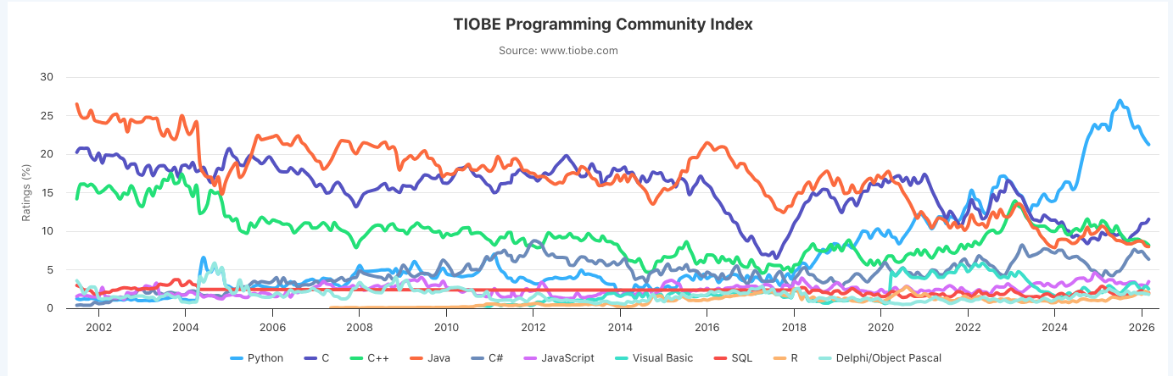
Why Python?

Slide 7
Python vs R?
 | Python | R
Origin and purpose | General-purpose programming language | Language and environment for statistical computing
Data Analysis | Powerful with Pandas & NumPy. | Data frames built into the language, tidyverse
Data Visualization | Matplotlib, Seaborn, Plotly | ggplot2 (grammar of graphics)
Modelling and deployment | Widely used for machine learning and deep learning (Scikit-Learn, PyTorch, TensorFlow). | Strong in classical statistical modelling. Shiny and plumber for apps and APIs.

Slide 8
WHY DATA SCIENCE?
“90 %”
Guillaume Saint-Cirgue, Machine Learnia founder

Slide 9
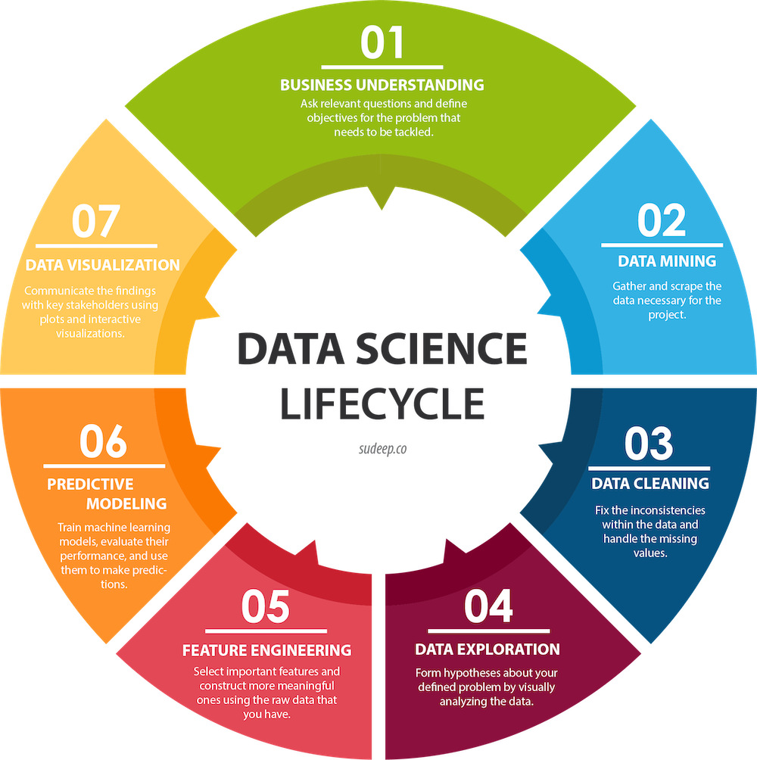
Data science a whole process?
Customer needs
Report /dashboard
Pipeline to collect
data
ML/DL
https://www.clicdata.com

Slide 10
BASIC PROGRAMMING

Slide 11
Let’s practice
This course is a hands-on course
3 exercises and correction
15-20 minutes for all exercises
Go as your own pace !
Notes:
Ask a student to answer each exercise.

Slide 12
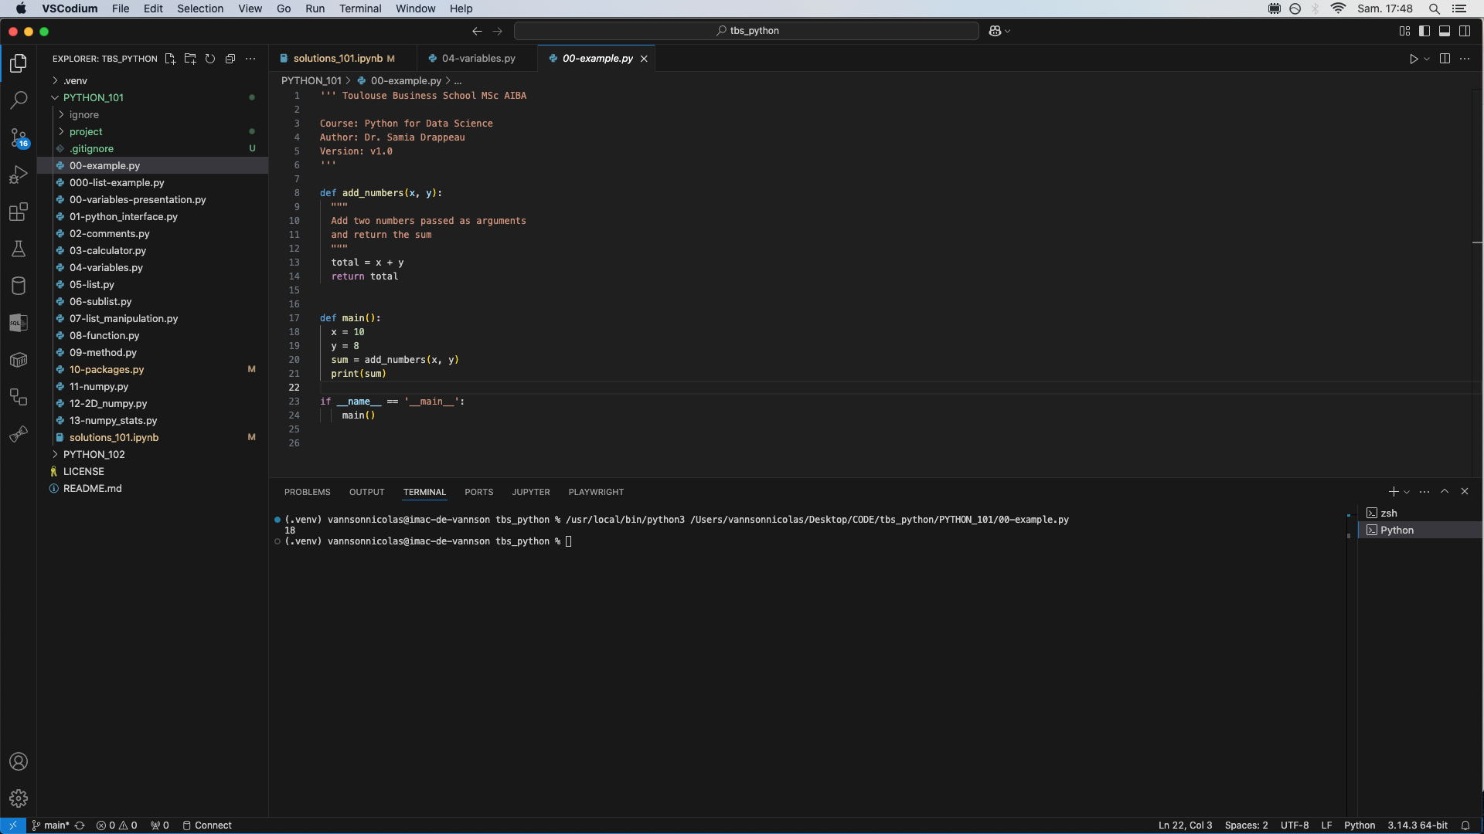
VS Code the IDE
PLAY BUTTON TO RUN YOUR SCRIPT
CODING ZONE
FOLDER
TERMINAL : OUTPUT

Slide 13
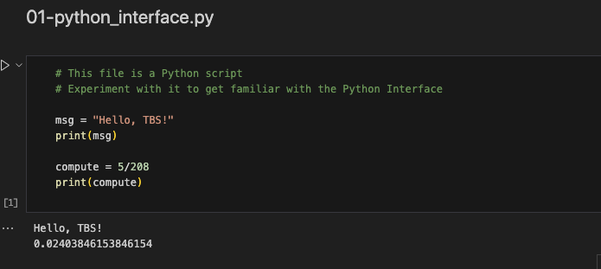
A python script!
A python script ends with .py (extension) => terminal is another window
A python notebook ends with .ipynb (advanced python course)
terminal below code block

Slide 14
Clone the GitHub repo?
Cloning a Git repository:
Copy the repository URL: https://github.com/MEMAUDATA/tbs_python.git
In VS Code Welcome window, click on “Clone Git Repository”.
Paste the URL into the input field at the top and select Desktop as the destination folder.
Click on Open (or Open Repository) when prompted.
In the File Explorer, navigate to the PYTHON_101 folder to access the exercises.

Slide 15
Let’s practice
01-python_interface.py
02-comments.py
03-calculator.py

Slide 16
Variables and types?
A variable is a named storage for a value that can change throughout the code
  a = 2
  print(a**2)
  >>> 4
Type
  Numbers : float (3.14) or int (3)
  Text : str (“2” or ‘2’)
  Boolean : bool (True or False)
Different types cause different behaviour
  2 + 2 >>> 4 (=> int)
  "2" + "2" >>> "22" (=> str)
Always check the variable’s type to avoid simple mistakes !
  price = 100
  type(price)
  >>> int

Slide 17
List?
A list is a named collection of values or variables
Can contain any type (even a list)
Example :
savings = [100,200,300,400,500]
type(savings)
>>> list
client_savings = ["c1", 100, "c2", 200]
type(client_savings)
>>> list

Slide 18
Get access to an item of the list?
Use index to get access to an element of the list. First element starts at 0 ( not 1) and to get access to the last element : -1
  savings = [100, 200, 300, 400, 500]
  print(savings[0])
  >>> 100
  print(savings[-1])
  >>> 500
List slicing : [start: end] => include start and exclude end
  print(savings[1:3])
  >>> [200, 300]
  print(savings[:3])
  >>> [100, 200, 300]
  print(savings[1:])
  >>> [200,300,400,500]

Slide 19
List manipulation?
Manipulate one or more values within the list (change, add, remove)
  savings = [100,200,300,400,500]
  savings[0] = 800
  print(savings)
  >>> [800,200,300,400,500]
  savings[1:3] = [8000,1000]
  print(savings)
  >>> [800,8000,1000,400,500]
  bigger_savings = savings + [100]
  print(bigger_savings)
  >>> [800,8000,1000,400,500,100]
  del bigger_savings[0]
  print(bigger_savings)
  >>> [8000,1000,400,500,100]

Slide 20
Let’s practice
04-variables.py
05-list.py
06-sublist.py
07-list_manipulation.py

Slide 21
Function?
A function is a reusable block of code
# Custom function
def add_numbers(a,b):
print(a+b)
add_numbers(1,3)
# built-in function
min(savings)
max(savings)
# need help on the function
help(min)

Slide 22
Method?
A method ( method() ) is a function linked (by a .) to an object
savings = [100, 200, 300, 400, 500]
# Add 100 to the list of savings
savings.append(100) # .append() is a method
print(savings)
>>> [100, 200, 300, 400, 500, 100]
# Count the number of times 100 appears
savings.count(100) #.count is also a method
>>> 2
name = "liz"
name.capitalize()
>>> 'Liz'
name.replace("z","sa")
>>> 'lisa' # name itself is unchanged (immutable)

Slide 23
Let’s practice
08-function.py
09-method.py

Slide 24
What’s a python package?
Package is a directory of Python scripts
Each script of a package is called a module
Modules specify functions, methods and new Python types aimed at solving particular problems
Packages for data science:
NumPy to efficiently work with arrays
Pandas for data analysis
Matplotlib for data visualization
scikit-learn for machine learning
Not all these packages are available in Python by default

Slide 25
Install and use a python package?
Install a package
Using a command in the terminal : pip (sometimes uv)
  pip install numpy
Use a package
In a script, at the top of it, you have to import the package in order to use it
import numpy
  import numpy as np # better way to import package
  # Compute mean
  students_mean = np.mean(students)
  # Compute mean without as np
  students_mean = numpy.mean(students)
Use a module from a package
  from numpy import random
  random.randint(1,10)

Slide 26
NumPy?
Really important for data science ( such as pandas as well)
Numpy : Numerical Python
List of numbers called numpy arrays ( better for data manipulation than basic python list)
import numpy as np
height = [1.85, 1.79, 1.67]
np_height = np.array(height)
weight = [65.4, 59.2, 63.6]
np_weight = np.array(weight)
bmi = np_weight/np_height**2
print(bmi)
>>> [19.10883857 18.47632721 22.80469002]
weight/height**2 # using basic python list
>>> TypeError: unsupported operand type(s) for ** or pow(): 'list' and 'int'

Slide 27
NumPy?
Filter an array ?
print(bmi)
>>> [19.10883857 18.47632721 22.80469002]
print(bmi>20)# Which BMI values are above 20?
>>> [False False True]
upper_20 = bmi>20 # Give me all the BMI values above 20
print(bmi[upper_20])
>>> [22.80469002]
print(bmi[bmi>20])
>>> [22.80469002]

Slide 28
Let’s practice
10-packages.py
11-numpy.py

Slide 29
2D-NumPy?
A 2D NumPy array means that an array can have multiple rows and columns
np_height = np.array([1.85, 1.79, 1.67])
np_weight = np.array([65.4, 59.2, 63.6])
type(np_height)
>>> numpy.ndarray # same type for np_weight
np_2d = np.array([[1.85, 1.79, 1.67],[65.4, 59.2, 63.6]])
np_2d.shape
>>>(2,3) # 2 rows, 3 columns

Slide 30
2D-NumPy?
Selecting elements within np_2d
np_2d = np.array([[1.85, 1.79, 1.67],
          [65.4, 59.2, 63.6]])
np_2d[0]
>>> array([1.85, 1.79, 1.67])
np_2d[:, 1:3] # select all rows and columns 1 and 2
>>> array([[ 1.79, 1.67], [59.2 , 63.6 ]])

Slide 31
Basic NumPy stats?
import numpy as np
np_2d = np.array([[1.85, 1.79, 1.67],
          [65.4, 59.2, 63.6]])
np.mean(np_2d[:, 0]) # mean of the first column
>>> 33.625
np.std(np_2d[:, 0]) # std of the first column
>>> 31.775
# there's a ton of stats you can do with NumPy … Let's practice!

Slide 32
Let’s practice
12-2D_numpy.py
13-numpy_stats.py

Slide 33
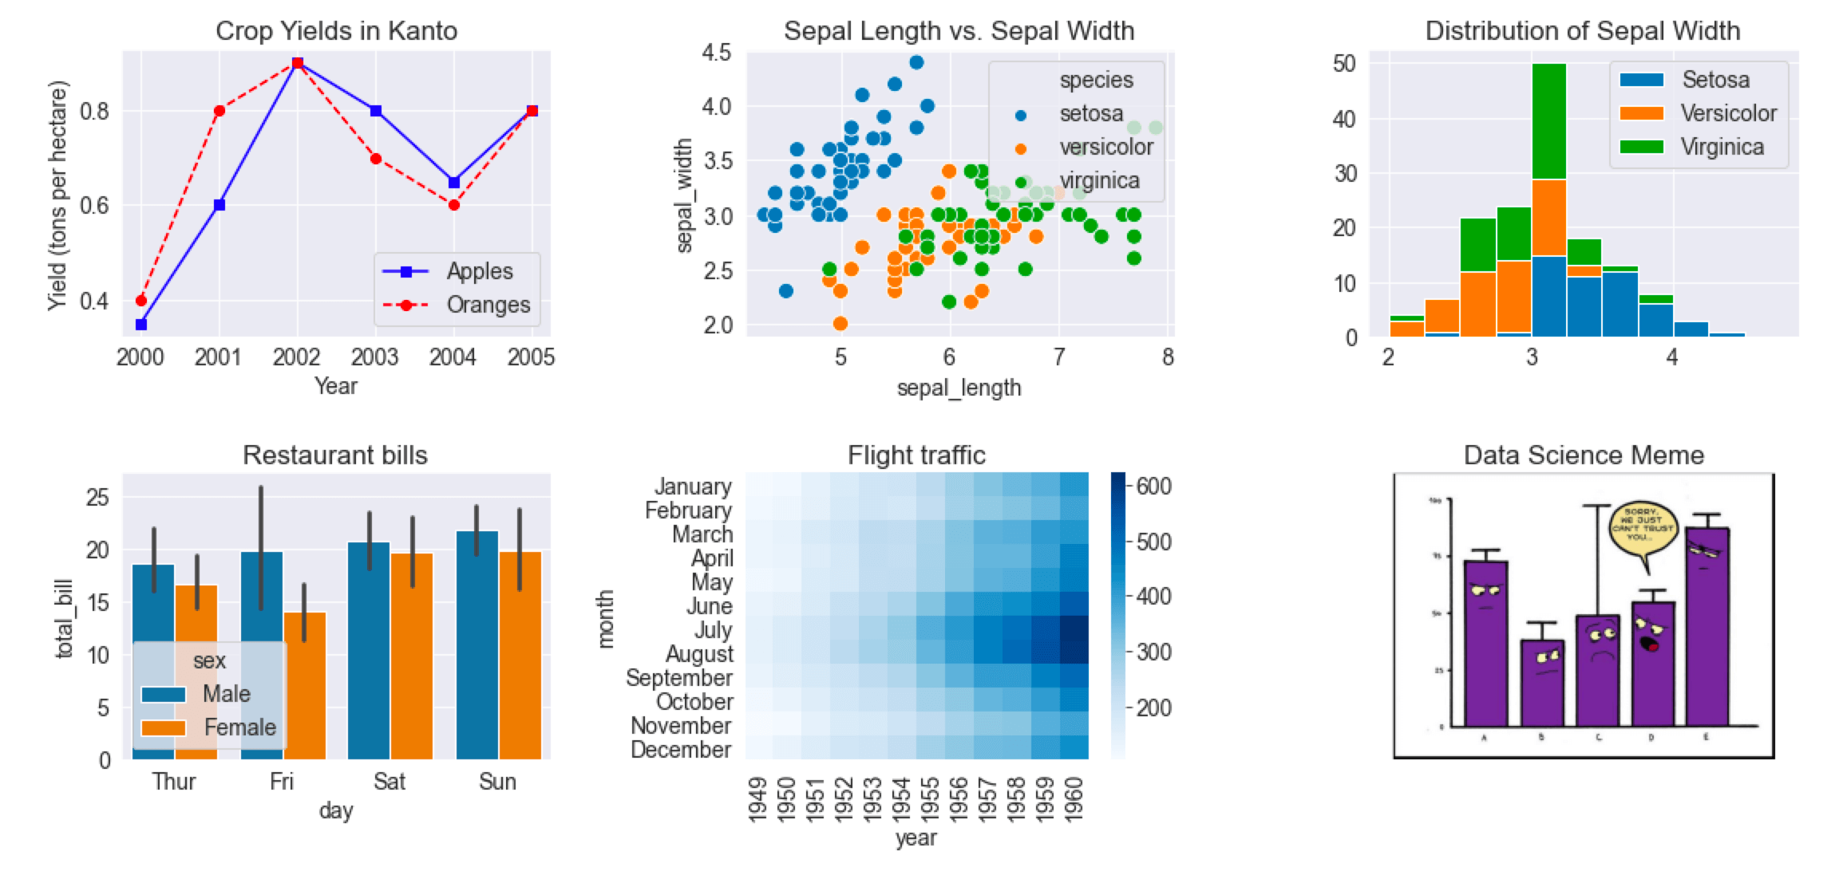
DATA VISUALIZATION
Source: Northwestern (https://nustat.github.io/DataScience_Intro_python/Data%20visualization.html)

Slide 34
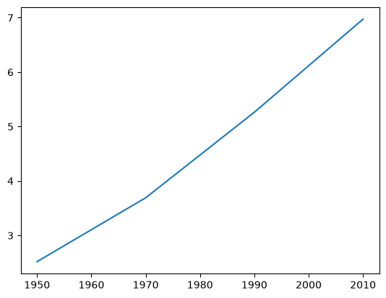
Figures – Matplotlib package!
pip install matplotlib (in the terminal)
import matplotlib.pyplot as plt
year = [1950, 1970, 1990, 2010]
pop = [2.519, 3.692, 5.263, 6.972] plt.plot(year, pop)
plt.show()

Slide 35
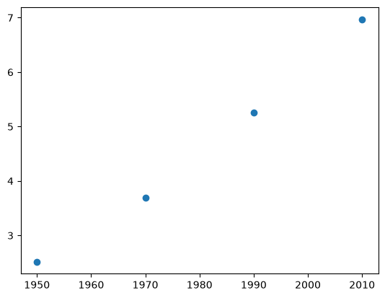
Figures
import matplotlib.pyplot as plt
year = [1950, 1970, 1990, 2010]
pop = [2.519, 3.692, 5.263, 6.972] plt.scatter(year,pop)
plt.show()

Slide 36
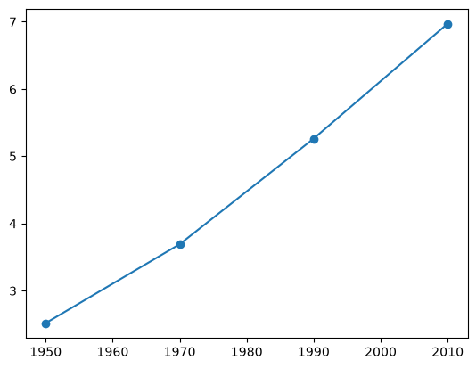
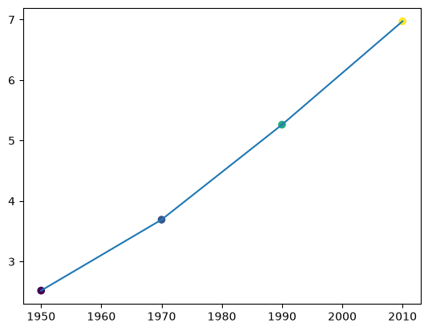
Figures
import matplotlib.pyplot as plt
year = [1950, 1970, 1990, 2010]
pop = [2.519, 3.692, 5.263, 6.972] plt.plot(year, pop)
plt.scatter(year,pop)
plt.show()
import matplotlib.pyplot as plt
year = [1950, 1970, 1990, 2010]
pop = [2.519, 3.692, 5.263, 6.972] plt.plot(year, pop)
plt.scatter(year,pop,c=pop)
plt.show()

Slide 37
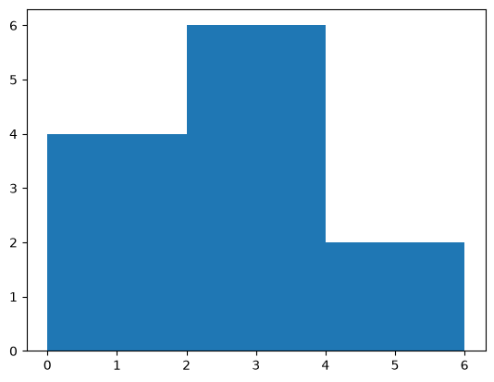
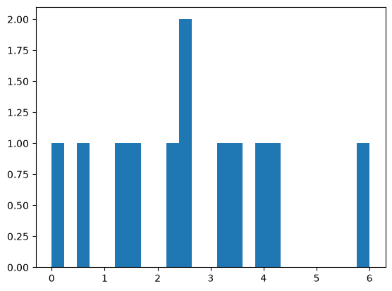
Figures - Histograms
import matplotlib.pyplot as plt
values = [0,0.6,1.4,1.6,2.2,2.5,2.6,3.2,3.5,3.9,4.2,6]
plt.hist(values, bins=3)
plt.show()
import matplotlib.pyplot as plt
values = [0,0.6,1.4,1.6,2.2,2.5,2.6,3.2,3.5,3.9,4.2,6]
plt.hist(values, bins=25)
plt.show()
# Make really sense?

Slide 38
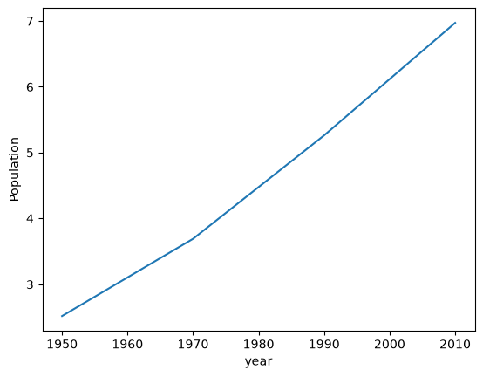
Figures – Customisation
import matplotlib.pyplot as plt
year = [1950, 1970, 1990, 2010]
pop = [2.519, 3.692, 5.263, 6.972]
plt.plot(year, pop)
plt.xlabel("year")
plt.ylabel("Population")
plt.show()

Slide 39
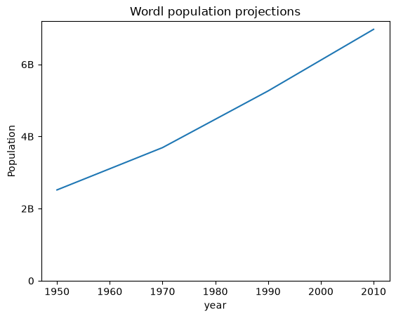
Figures – Customisation
import matplotlib.pyplot as plt
year = [1950, 1970, 1990, 2010]
pop = [2.519, 3.692, 5.263, 6.972]
plt.plot(year, pop)
plt.xlabel("year")
plt.ylabel("Population")
plt.title("World population projections")
plt.yticks([0,2,4,6],["0","2B","4B","6B"])
plt.show()
There are tons of customization options ! Your job is to find the proper visualization to answer the question/problem

Slide 40
Let’s practice
14-basic_plots.py
15-histogram.py
16-customization.py

Slide 41
Data manipulation using dictionary!
# list of numbers
pop = [30.55, 2.77, 39.21]
countries = ["afghanistan", "albania", "algeria"]
# list of countries
ind_alb = countries.index("albania")
print(ind_alb)
print(pop[ind_alb])
>>> 1
>>> 2.77 # Not really handy

Slide 42
Data manipulation using dictionary!
# lists
pop = [30.55, 2.77, 39.21]
countries = ["afghanistan", "albania", "algeria"]
world = {"afghanistan" : 30.55,
"albania" :2.77 ,
"algeria":39.21} # key and a value => dictionary
world["albania"]
>>> 2.77

Slide 43
Data manipulation using dictionary!
# add value
world = {"afghanistan" : 30.55,
"albania" :2.77 ,
"algeria":39.21}
world['sealand'] = 0.000027
print(world)
>>> {'afghanistan': 30.55, 'albania': 2.77, 'algeria': 39.21, 'sealand': 2.7e-05}
# Check a key within the dict
"sealand" in world
>>> True

Slide 44
Data manipulation using dictionary!
# change a value
world['sealand'] = 0.000028
print(world)
>>> {'afghanistan': 30.55, 'albania': 2.77, 'algeria': 39.21, 'sealand': 2.8e-05}
# delete an entry
del world['sealand']
print(world)
>>> {'afghanistan': 30.55, 'albania': 2.77, 'algeria': 39.21}

Slide 45
Pandas DataFrame?
Country | Capital | Area | Population
Brazil | Brasilia | 8.516 | 200.4
Russia | Moscow | 17.10 | 143.5
India | New Delhi | 3.286 | 1252
China | Beijing | 9.597 | 1357
South Africa | Pretoria | 1.221 | 52.98
Tabular DataFrame => Rows are observations, columns are variables
Mix different variable types (str, float etc)
Built on Numpy (remember 2D-Numpy)
Great for data manipulation
Can be created from CSV, dictionary, etc.

Slide 46
Pandas DataFrame?
# DataFrame from csv
import pandas as pd
brics = pd.read_csv("/path/brics.csv")
# DataFrame from dict
data = {
"country": ["Brazil", "Russia", "India",
"China", "South Africa"],
"capital": ["Brasilia", "Moscow", "New Delhi",
"Beijing", "Pretoria"],
"area": [8.516, 17.10, 3.286, 9.597, 1.221],
"population": [200.4, 143.5, 1252, 1357, 52.98]
}
brics = pd.DataFrame(data)

Slide 47
Access data with Pandas
2 methods:
Square brackets
Advanced methods: loc & iloc
brics["country"]
>>> 0 Brazil 1 Russia 2 India 3 China 4 South Africa
type(brics["country"])
>>> pandas.Series
type(brics)
>>> pandas.DataFrame

Slide 48
Access data with Pandas
country capital area population
0 Brazil Brasilia 8.516 200.40
1 Russia Moscow 17.100 143.50
2 India New Delhi 3.286 1252.00
3 China Beijing 9.597 1357.00
4 South Africa Pretoria 1.221 52.98
brics[["country","capital"]]
>>>
  country capital
  0 Brazil Brasilia
  1 Russia Moscow
  2 India New Delhi
  3 China Beijing
  4 South Africa Pretoria

Slide 49
Access data with Pandas
country capital area population
0 Brazil Brasilia 8.516 200.40
1 Russia Moscow 17.100 143.50
2 India New Delhi 3.286 1252.00
3 China Beijing 9.597 1357.00
4 South Africa Pretoria 1.221 52.98
brics[1:4]
>>>
  country capital area population
  1 Russia Moscow 17.100 143.5
  2 India New Delhi 3.286 1252.0
  3 China Beijing 9.597 1357.0

Slide 50
Access data with Pandas
country capital area population
0 Brazil Brasilia 8.516 200.40
1 Russia Moscow 17.100 143.50
2 India New Delhi 3.286 1252.00
3 China Beijing 9.597 1357.00
4 South Africa Pretoria 1.221 52.98
  brics.index = ["BR", "RU", "IN", "CH", "SA"]
  brics
  >>>
country capital area population
BR Brazil Brasilia 8.516 200.40
RU Russia Moscow 17.100 143.50
IN India New Delhi 3.286 1252.00
CH China Beijing 9.597 1357.00
SA South Africa Pretoria 1.221 52.98

Slide 51
Access data with Pandas
country capital area population
BR Brazil Brasilia 8.516 200.40
RU Russia Moscow 17.100 143.50
IN India New Delhi 3.286 1252.00
CH China Beijing 9.597 1357.00
SA South Africa Pretoria 1.221 52.98
brics.loc["RU"]
>>> country Russia
  capital Moscow
  area 17.1
  population 143.5
  Name: RU,
  dtype: object # pandas.Series
  brics.loc[["RU"]] #pandas.DataFrame
  >>> country capital area population
  RU Russia Moscow 17.1 143.5

Slide 52
Access data with Pandas
country capital area population
BR Brazil Brasilia 8.516 200.40
RU Russia Moscow 17.100 143.50
IN India New Delhi 3.286 1252.00
CH China Beijing 9.597 1357.00
SA South Africa Pretoria 1.221 52.98
brics.loc[["RU", "BR","SA"]]
>>>
  country capital area population
  RU Russia Moscow 17.100 143.50
  BR Brazil Brasilia 8.516 200.40
  SA South Africa Pretoria 1.221 52.98
brics.loc[["BR", "RU"],["country","capital"]]
>>> country capital
BR Brazil Brasilia
RU Russia Moscow

Slide 53
Access data with Pandas
country capital area population
BR Brazil Brasilia 8.516 200.40
RU Russia Moscow 17.100 143.50
IN India New Delhi 3.286 1252.00
CH China Beijing 9.597 1357.00
SA South Africa Pretoria 1.221 52.98
brics.iloc[0,0]
>>> Brazil
brics.iloc[:,0]
>>>
  BR Brazil
  RU Russia
  IN India
  CH China
  SA South Africa
  Name: country, dtype: str

Slide 54
Let’s practice
17-dictionary.py
18-pandas.py

Slide 55
Comparison operators
# Boolean response
2<3
>>> True
2 == 3
>>> False
2 <= 3
>>> True
x = 2
y = 3
y > x
>>> True
# Boolean response
"carl" < "chris"
>>> True
3 < "chris"
>>> TypeError!
3 < 4.1
>>> True
bmi = np.array([21,20,35,19.5])
bmi > 23
>>> array([False, False, True, False])

Slide 56
Comparison operators
Comparator | Meaning
< | Strictly less than
<= | Less than or equal
> | Strictly greater than
>= | Greater than or equal
== | Equal
!= | Not equal

Slide 57
Boolean operators
# AND
True and True
>>> True
False and True
>>> False
# Find a value between two limits ? (example)
x = 12
x > 5 and x < 15
>>> True

Slide 58
Boolean operators
# OR
True or True
>>> True
False or True
>>> True
# Find a value outside two limits ? (example)
x = 20
x < 5 or x > 15
>>> True

Slide 59
Boolean operators
# not
not True
>>> False
not False
>>> True

Slide 60
Boolean operators
# filtering data
bmi = np.array([21,20,35,19.5])
bmi > 23
>>> array([False False True False])
bmi <30
>>> array([True True False True])
bmi > 20 and bmi < 30 # Warning when combining operators
>>> ValueError: The truth value of an array with more than one element is ambiguous. Use a.any() or a.all()
# => LIMITS OF CLASSIC PYTHON
(bmi > 20) & (bmi < 30) # NumPy
>>> array([True False False False])

Slide 61
Boolean operators
# NumPy
(bmi > 20) & (bmi < 30)
>>> array([True False False False])
# NumPy
np.logical_and(bmi>20 , bmi<30)
>>> array([True False False False])
# & works on bits, logical_and works on truth values.
On comparisons (already boolean), both give the same result, so use &.

Slide 62
Boolean operators
Python | Pandas / NumPy
and | & or np.logical_and
or | | or np.logical_or
not | ~ or np.logical_not

Slide 63
If, elif, else operators
if condition :
expression
# example
if z == 3:
print("victory")
# when z = 3
>>> victory
# when z = 4
>>> …
# add a condition : else
if z == 3:
print("victory")
# all other cases
else:
print("defeat")
# when z = 3
>>> victory
# when z = 4
>>> defeat
# when z = 5
>>> defeat

Slide 64
If, elif, else operators
# add a specific condition : elif
if z == 3:
print("victory")
# evaluated only if the previous condition is False
elif z == 4:
print("draw")
# all other cases
else:
print("defeat")
# when z = 3
>>> victory
# when z = 4
>>> draw
# when z = 5
>>> defeat

Slide 65
Let’s practice
19-comparison_operators.py
20-boolean_operators.py
21-condition_operators.py

Slide 66
Filtering a dataframe
# DataFrame from csv
import pandas as pd
brics = pd.read_csv("/path/brics.csv")
country capital area population
0 Brazil Brasilia 8.516 200.40
1 Russia Moscow 17.100 143.50
2 India New Delhi 3.286 1252.00
3 China Beijing 9.597 1357.00
4 South Africa Pretoria 1.221 52.98
# Select countries with area over 8 millions km2 ?
# Step 1 : get the column
# Step 2 : do comparison on the column
# Step 3 : use result to select the countries

Slide 67
Filtering a dataframe
country capital area population
0 Brazil Brasilia 8.516 200.40
1 Russia Moscow 17.100 143.50
2 India New Delhi 3.286 1252.00
3 China Beijing 9.597 1357.00
4 South Africa Pretoria 1.221 52.98
import pandas as pd
brics = pd.read_csv("/path/brics.csv")
# Step 1: get the column
brics["area"] # a pandas Series
# Step 2: do comparison on the column
is_huge = brics["area"] > 8 # boolean Series
# Step 3: use the result to select the countries
brics[is_huge]
>>>
country capital area population
0 Brazil Brasilia 8.516 200.40
1 Russia Moscow 17.100 143.50
3 China Beijing 9.597 1357.00

Slide 68
Filtering a DataFrame
country capital area population
0 Brazil Brasilia 8.516 200.40
1 Russia Moscow 17.100 143.50
2 India New Delhi 3.286 1252.00
3 China Beijing 9.597 1357.00
4 South Africa Pretoria 1.221 52.98
# faster way
brics[brics["area"] > 8]
>>>
country capital area population
0 Brazil Brasilia 8.516 200.40
1 Russia Moscow 17.100 143.50
3 China Beijing 9.597 1357.00

Slide 69
Filtering a DataFrame
# other ways
import numpy as np
brics[np.logical_and(brics["area"] > 8, brics["area"] < 15)]
>>>
country capital area population
0 Brazil Brasilia 8.516 200.40
3 China Beijing 9.597 1357.00
brics[(brics["area"] > 8) & (brics["area"] < 15)] # operator &
>>>
country capital area population
0 Brazil Brasilia 8.516 200.40
3 China Beijing 9.597 1357.00

Slide 70
Let’s practice
22-filtering_dataframe.py

Slide 71
While loop
while condition: # as long as the condition is True
expression
error = 50.0
while error > 1:
error = error /4
print(error)
>>> 12.5
>>> 3.125
>>> 0.78125 # the loop stops: error < 1

Slide 72
While loop
# warning infinite loop : AVOID !!!!
error = 50.0
while error > 1: # always true
print(error)
>>> 50.0
>>> 50.0
>>> …

Slide 73
For loop
for var in sequence:
expression
bmi = [19.7,40,28,23]
# print each value instead of the whole list
for value in bmi:
print(value)
>>>
19.7
40
28
23

Slide 74
For loop
bmi = [19.7,40,28,23]
for index,value in enumerate(bmi):
print("index " + str(index) + " : " + str(value))
>>>
index 0 : 19.7
index 1 : 40
index 2 : 28
index 3 : 23
for index,value in bmi: # WARNING
print("index " + str(index) + " : " + str(value))
>>> TypeError: cannot unpack non-iterable float object

Slide 75
For loop
for c in "family":
print(c.capitalize())
F
A
M
I
L
Y

Slide 76
Let’s practice
23-while_loop.py
24-for_loop.py

Slide 77
For loop on a data structure
# dict
world = {"afghanistan" : 30.55,
"albania" :2.77 ,
"algeria":39.21}
# select each key + value of the dict
for key, value in world.items():
print(key + " : " + str(value))
>>>
  afghanistan : 30.55
  albania : 2.77
  algeria : 39.21

Slide 78
For loop on a data structure
# dict
world = {"afghanistan": 30.55,
"albania": 2.77,
"algeria": 39.21}
bmi = [21, 20, 35]
# items() on a dict: gives (key, value)
list(world.items())
[('afghanistan', 30.55), ('albania', 2.77), ('algeria', 39.21)]
# enumerate on a list: gives (index, value)
list(enumerate(bmi))
[(0, 21), (1, 20), (2, 35)]
# enumerate on a dict: gives (index, KEY), not the value
list(enumerate(world))
[(0, 'afghanistan'), (1, 'albania'), (2, 'algeria')]

Slide 79
For loop on a data structure
import numpy as np
np_height = np.array([1.73, 1.68, 1.71, 1.89, 1.79])
np_weight = np.array([65.4, 59.2, 63.6, 88.4, 68.7])
bmi = np_weight / np_height ** 2
for val in bmi:
print(f"{val:.3f}")
>>>
21.852
20.975
21.750
24.747
21.441

Slide 80
For loop on a data structure
import numpy as np
np_height = np.array([1.73, 1.68, 1.71, 1.89, 1.79])
np_weight = np.array([65.4, 59.2, 63.6, 88.4, 68.7])
meas = np.array([np_weight,np_height])
for val in meas:
print(val)
>>>
[65.4 59.2 63.6 88.4 68.7]
[1.73 1.68 1.71 1.89 1.79]

Slide 81
For loop on a data structure
import numpy as np
np_height = np.array([1.73, 1.68, 1.71, 1.89, 1.79])
np_weight = np.array([65.4, 59.2, 63.6, 88.4, 68.7])
meas = np.array([np_weight,np_height])
# iterate over each element
for val in np.nditer(meas):
print(val)
>>>
65.4
59.2
…

Slide 82
Loop on a dataframe
country capital area population
BR Brazil Brasilia 8.516 200.40
RU Russia Moscow 17.100 143.50
IN India New Delhi 3.286 1252.00
CH China Beijing 9.597 1357.00
SA South Africa Pretoria 1.221 52.98
import pandas as pd
# import csv and use column 0 as index
brics = pd.read_csv("/path/brics.csv", index_col=0)
for val in brics: # equivalent as brics.columns (works as a dict)
print(val)
>>>
country
capital
area
population

Slide 83
For loop on a dataframe
import pandas as pd
# import csv and use column 0 as index
brics = pd.read_csv("/path/brics.csv", index_col=0)
for lab, row in brics.iterrows():
print(lab) # label
print(row) # row (Series)
>>>
BR
country Brazil
capital Brasilia
area 8.516
population 200.4
Name: BR, dtype: object
# dtype: object because the row mixes str and float
RU …

Slide 84
For loop on a dataframe
for lab, row in brics.iterrows():
print(lab + ":" + row["capital"])
>>>
BR:Brasilia
RU:Moscow
IN:New Delhi
CH:Beijing
SA:Pretoria

Slide 85
Let’s practice
25-loop_datastructure.py
26-loop_dataframe.py

Slide 86
WRITE YOUR OWN FUNCTION

Slide 87
Write your own function
A function has a name, parameters and a body. return sends a value back to the caller
def add_numbers(a, b): # a, b are parameters
return a + b # send the result back
result = add_numbers(1, 3) # 1, 3 are arguments
print(result)
>>> 4
# print() only displays a value, return gives it back
def add_print(a, b):
print(a + b)
x = add_print(1, 3) # displays 4
print(x)
>>> None

Slide 88
Parameters and return values
A function can take several parameters and return several values (as a tuple)
def bmi(weight, height):
"""Return the body mass index""" # docstring: help text
return weight / height ** 2
round(bmi(65.4, 1.85), 2)
>>> 19.11
def min_max(values):
return min(values), max(values) # returns a tuple
low, high = min_max([19.7, 40, 28, 23]) # tuple unpacking
print(low, high)
>>> 19.7 40

Slide 89
Counting with a dictionary
Pattern: loop over the values and update a dictionary (key = value, count = occurrences)
languages = ["en", "fr", "en", "es", "en"]
counts = {}
for lang in languages:
if lang in counts.keys():
counts[lang] = counts[lang] + 1 # key exists: add 1
else:
counts[lang] = 1 # new key: start at 1
print(counts)
>>> {'en': 3, 'fr': 1, 'es': 1}

Slide 90
Function on a DataFrame
Pass the DataFrame and a column name as parameters, loop over the column, return the result
def column_mean(df, col_name):
"""Return the mean of a numeric column"""
total = 0
for value in df[col_name]:
total = total + value
return total / len(df)
round(column_mean(brics, "area"), 3)
>>> 7.944
import matplotlib.pyplot as plt
plt.bar(brics["country"], brics["area"]) # bar plot
plt.show()

Slide 91
Let’s practice
27-user_defined_function.py
28-multi_params.py
29-final_script.py

Slide 92
END COURSE EVALUATION

Slide 93
End course evaluation
In PYTHON_101 folder lies the project folder containing the script template with all the instructions
Rename the template with your name and PYTHON_101,
ex: VANNSON_PYTHON_101.py
When done, upload it on campus
You’ll have a week, deadline : 23/10/2026 @23h59

Slide 94

vannson.nicolas@gmail.com
Notes:
Ik zal met plezier al uw vragen, in het Engels beantwoorden.

