Slide 1

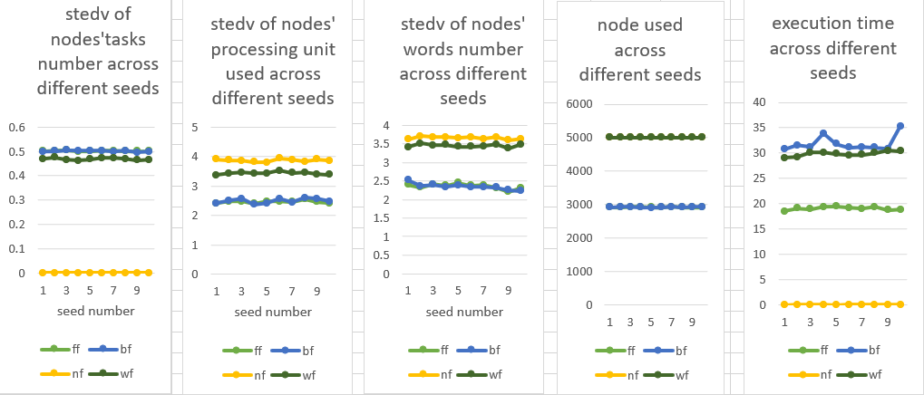
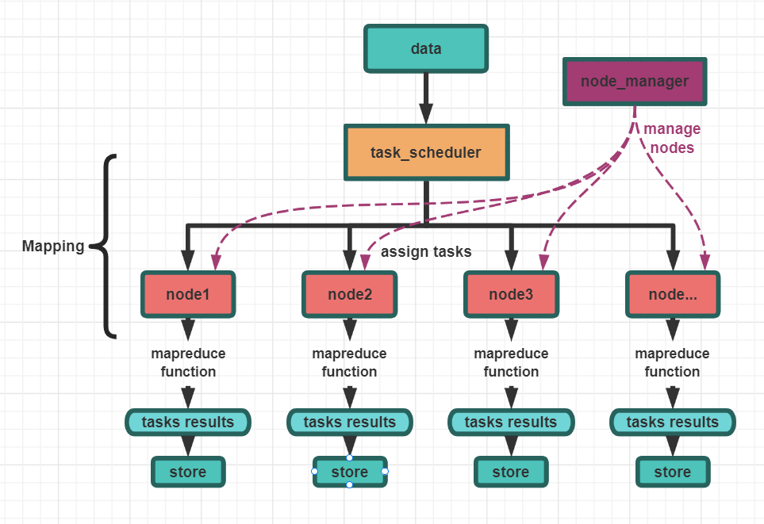
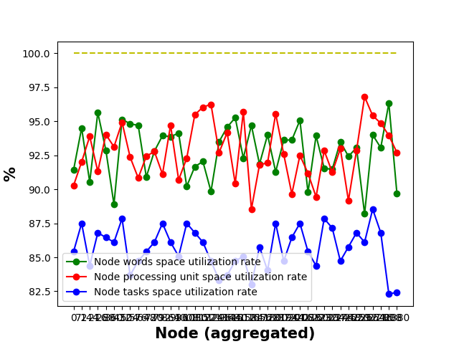
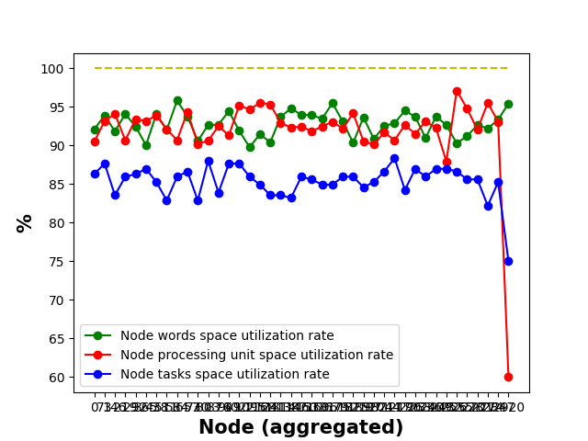
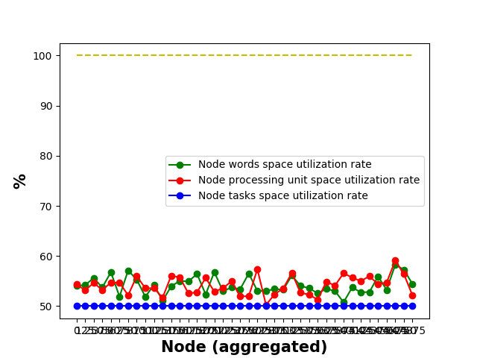
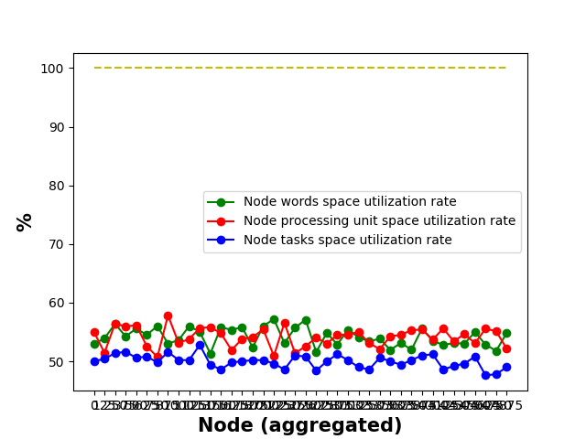
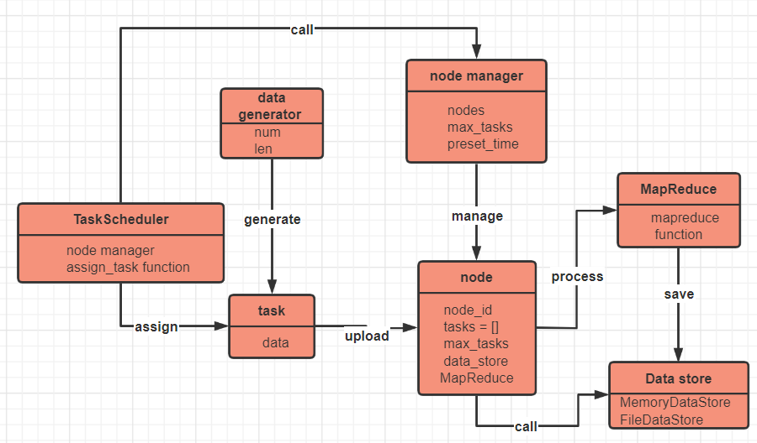
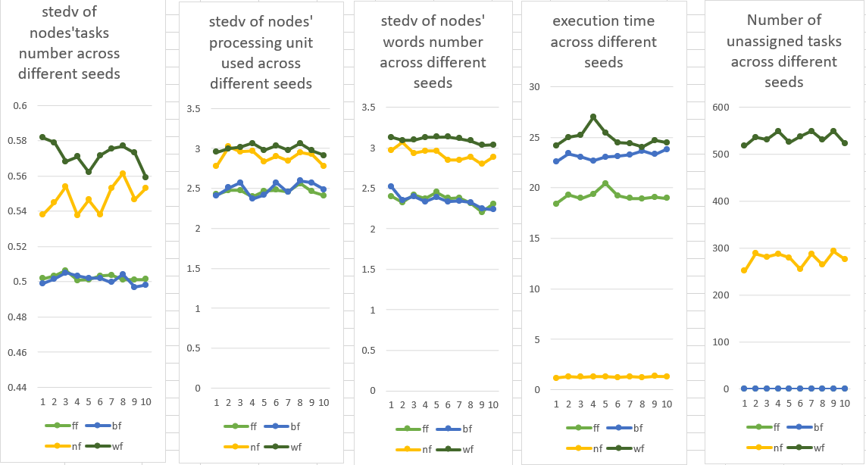
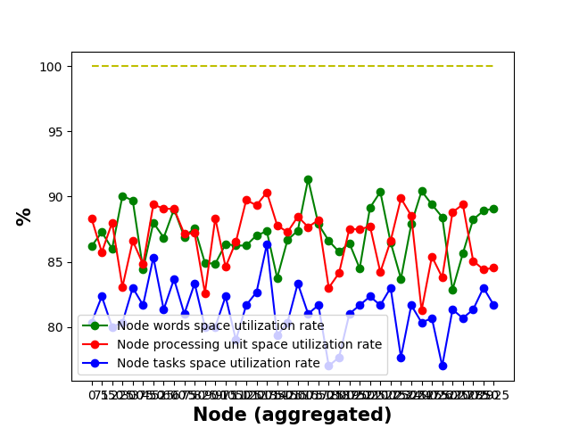
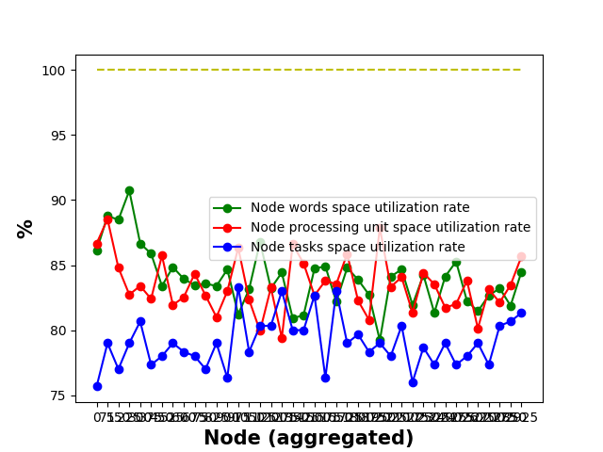
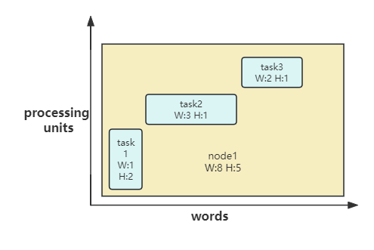
Exploring Modularity in MapReduce Distributed computing Framework
Name: Wenbo Yang
GUID: 2727018y
1.Introduction
4.Result and Discussion
5.Conclusion
With the continuous development of technology, software engineers are facing increasingly complex problems. An efficient and scalable automation solution is particularly important. Modularization, as applied in the field of computer science, has the capacity to enhance adaptability and diminish intricacy within software applications.
In this paper, we delve into the potential of adaptive modularization within the distributed computing framework.
Node
Max tasks | Max words | Through put | Number of nodes
4 | 22 | 20 | 5000
Task
words range | processing unit range | Number of tasks
1-9(average 5) | 1-10(average 5.5) | 10000
The experiment tested with the input parameters on the left under ten random seeds.
Based on Figure 4, the task allocated uniformity, NF＞WF＞ FF＞BF≈FF . The uniformity of node’s total processing unit consumption and total words storage consume follows a similar ranking. FF ≈ BF ＞ WF ＞ NF. For node usage, both FF and BF used less than 3000 units, while NF and WF use all the nodes. Execution time, BF＞WF＞FF＞NF.
According to Figure 5, utilization rate in all dimensions, FF≈BF＞NF≈WF.
First Fit and Best Fit Algorithms:
High node utilization rates and uniform distribution across tasks, processing units, and words.
These algorithms take longer to run and are unable to distribute tasks across a specific number of nodes.
Best Fit algorithm takes longer than the First Fit algorithm.
The uniformity of the Best Fit algorithm is worse than that of the First Fit algorithm when nodes are insufficient.
Next Fit and Worst Fit Algorithms:
These algorithms distribute tasks across a specific number of nodes.
Next Fit algorithm has an advantage in speed and can quickly allocate all tasks.
The Worst Fit algorithm doesn't have the speed of the Next Fit algorithm, but its resource distribution is more uniform.
If the number of nodes is not sufficient, both algorithms will have tasks that can't be allocated and the uniformity of task distribution decreases.
Table 1. Node and task parameters
2.Environment Setup
A simulated distributed framework based on the MapReduce has been built. Figure 1, data is assigned by the task scheduler to different nodes to run MapReduce function, a process also known as mapping. The Node Manager is used to manage the nodes. Additionally, four allocation algorithm modules have been introduced in the task scheduler to assign tasks.
Figure 2 shows the class structure diagram of the MapReduce simulation framework at the code level.
Figure 4. result parameters diagram
First Fit Best Fit Next Fit Worst Fit
Figure 5. Node Utilization Chart
6.Reflection
Figure 1. MapReduce framework flowchart
Node
Max tasks | Max words | Through put | Number of nodes
4 | 22 | 20 | 3000
Task
words range | processing unit range | Number of tasks
1-9(average 5) | 1-10(average 5.5) | 10000
According to Figure 6, after reducing the number of nodes, each values of FF and BF do not change. Notably, the uniformity of task allocation in NF and WF significantly declines. The rankings for other parameters remain unchanged. However, when the number of nodes is significantly reduced, NF and WF both face insufficient space. As Figure 7, the node usage of FF and BF remains unchanged, whereas the utilization of NF and WF slightly increases compared to when there are 5000 nodes, but it's still very low. NF has a higher utilization than WF, which also explains why WF has more unallocated tasks.
The entire experiment was conducted in a simulated environment with artificial data, which may not represent real-world conditions accurately.
In more complex real-world scenarios, additional parameters may need to be considered for a comprehensive evaluation of the module's operation.
Due to equipment limitations, the volume of experimental data is not large enough.
None of the four designed allocation algorithms favored any particular dimension significantly, resulting in similar experimental outcomes across different dimensions.
The Best Fir algorithm, which had a more complex design and took more time to develop, underperformed compared to the simpler First Fit algorithm.
The experiment only conducted modular testing on a part of the MapReduce framework without demonstrating this module's performance in the entire system.
Table 2. Node and task parameters
Figure 2. MapReduce framework UML
3.Experiment Design
The experiment investigate the performance of each allocation algorithm module under different conditions by using control variable method. These four allocation algorithm modules are used to solve the problem of assigning tasks to nodes, which is the mapping part in the Figure 1.
Task parameters and Node parameters are the input variable for the experiment. Result parameters are the output of the experiment.
Figure 6. result parameters diagram
First Fit Best Fit Next Fit Worst Fit
Module 1
First fit algorithm
Module 2
Best fit algorithm
Module 3
Next fit algorithm
Module 4
Worst fit algorithm
Task parameters
Node parameters
Figure 5. Node Utilization Chart
1. Max processing unit
2. Max words
3. Tasks number
1. Max tasks
2. Through put
3. Max words
4. Nodes number
7.Future
Result parameters
Node
Max tasks | Max words | Through put | Number of nodes
4 | 22 | 20 | 5000
Task
words range | processing unit range | Number of tasks
1-9(average 5) | 1-10(average 5.5) | 10000
Control groups were set up here for testing, with the aim of studying the impact on various algorithms when the constraint of a certain dimension increases.
The same experimental results are observed and compared using the same method as above. The results showed that as the maximum capacity of the processing unit dimension decreases, the space utilization of each algorithm in this dimension increases, and the space utilization in other dimensions decreases. It still maintains that the utilization rate of the FF and BF algorithms are similar and greater than NF, which is greater than WF. The ranking of result parameters among each algorithm remains essentially unchanged
1.Add more types of allocation algorithm modules in the subsequent work.
2.Introduce a more diverse range of data types.
3.Continue to improve the MapReduce simulation framework and add modules for other parts, enabling the assembly of modules.
4.Try to solve practical problems.
5.Introduce more parameter indices to measure data.
6.Incorporate AI to automate the assembly and invocation of modules.
1.Standard deviation of nodes’ tasks number
2.Standard deviation of nodes’ processing unit used
3.Standard deviation of nodes’ words number
4. Node used number
5. Fit execution time
Node
Max tasks | Max words | Through put | Number of nodes
4 | 22 | 18 | 5000
Task
words range | processing unit range | Number of tasks
1-9(average 5) | 1-10(average 5.5) | 10000
The problem solved by the allocation algorithm is similar to the two-dimensional bin packing problem, with the number of words and the number of processing units as two different dimensions. Different shaped tasks are packed into nodes of specific shapes.
Node
Max tasks | Max words | Through put | Number of nodes
4 | 22 | 16 | 5000
Task
words range | processing unit range | Number of tasks
1-9(average 5) | 1-10(average 5.5) | 10000
Figure 3. bin packing problem example chart
Node
Max tasks | Max words | Through put | Number of nodes
4 | 22 | 14 | 5000
Task
words range | processing unit range | Number of tasks
1-9(average 5) | 1-10(average 5.5) | 10000
Table 3. Node and task parameters

