Slide 1
MULTI TASKING
Multitasking is a logical extension of multiprogramming system that supports multiple programs to run concurrently.
In multitasking ,more than one task are executed at the same time.
The operating system is able to keep track of where you are in these tasks and go from one to the other without losing information.

Slide 2
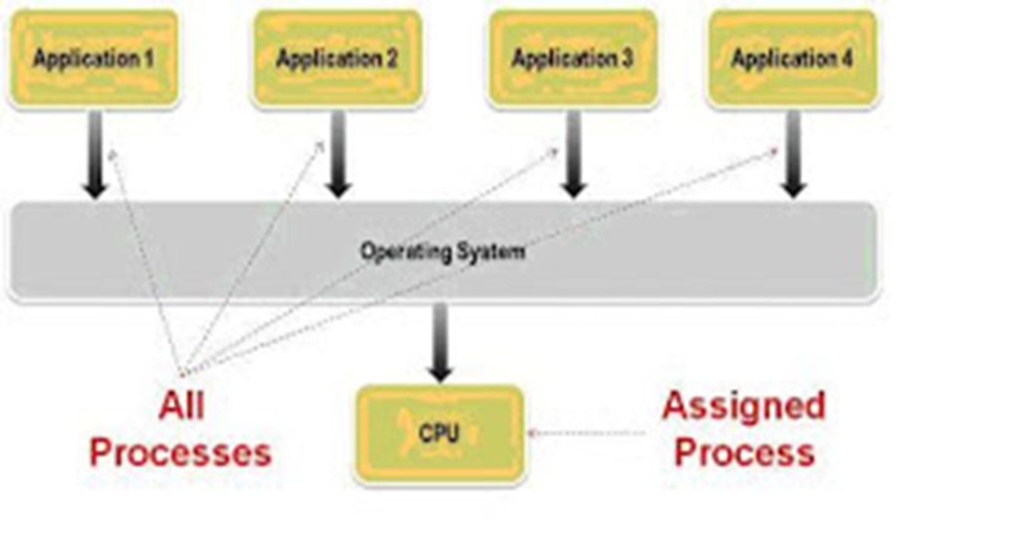
Multitasking solves the problem by scheduling and deciding which task should be the running task and when a waiting task should get turn
.

Slide 3
MULTI THREADING
Multithreading is the ability of an operating system process to manage its use by more than one user at a time and to even manage multiple requests by the same user without having to have multiple copies of the programming running in the computer.
A thread maintains a list of information relevant to its execution including the priority schedule, exception handlers, a set of CPU registers, and stack state in the address space of its hosting process.

Slide 4
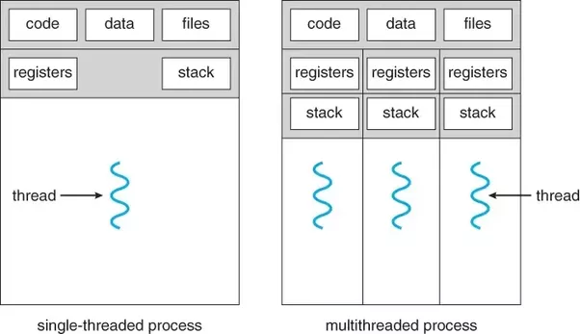
It is a type of execution model that allows multiple threads to exist within the context of a process such that they execute independently but share their process resources

Slide 5
TIME SHARING
A time sharing system allows many users to share the computer resources simultaneously.
In other words, time sharing refers to the allocation of computer resources in time slots to several programs simultaneously.
The time sharing systems were developed to provide an interactive use of the computer system.

Slide 6
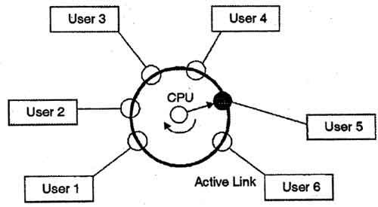
A time shared system uses CPU scheduling and multiprogramming to provide each user with a small portion of a time-shared computer.

