Slide 1

ENVIRONMENT

Slide 2
TEAM MEMBERS
PAVITHRA
SHUBHAM
SANDEEP
GAURAV MAYEKER

Slide 3
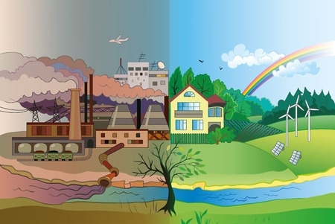
NEED AND IMPORTANCE OF ENVIRONMENT

Slide 4
Only planet to live

Slide 5
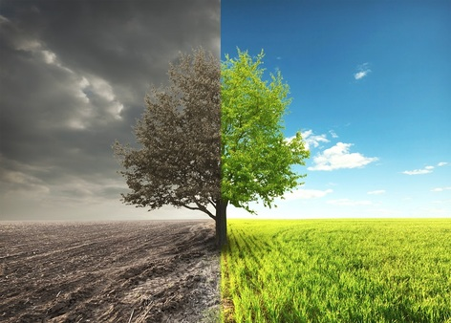
Climate change

Slide 6
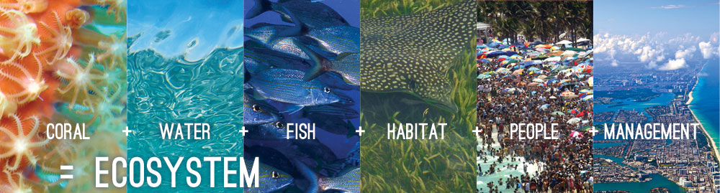
ecosystem

Slide 7
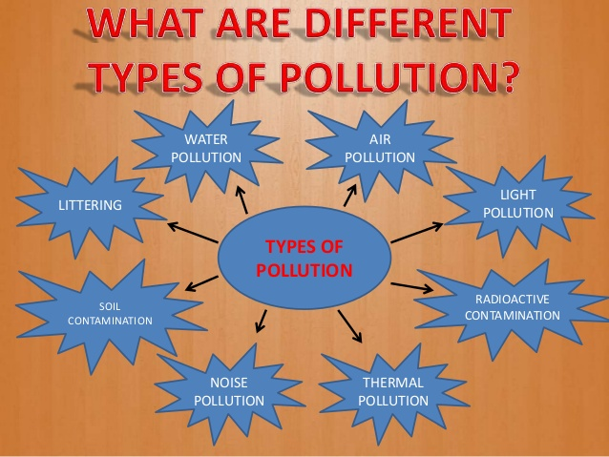
Types of pollution

Slide 8
Some ways to prevent pollution
PLANT FOR THE PLANET
GO GREEN WITH BICYCLES
USE COMPRESSED NATURAL GAS
SEGREGATE WASTE
STOP BURNING & CHARRING
SEWAGE TREATMENT INITIATIVE
CHECK THOSE DECIBELS
STOP LITTERING
RECYCLE & REUSE
CAR POOLING & PUBLIC TRANSPORT

Slide 9
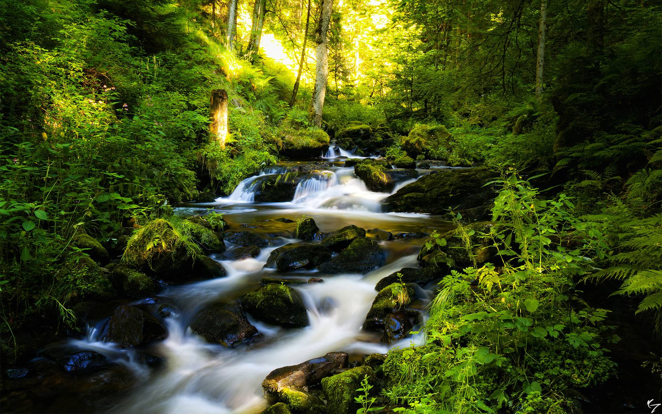
forests

Slide 10
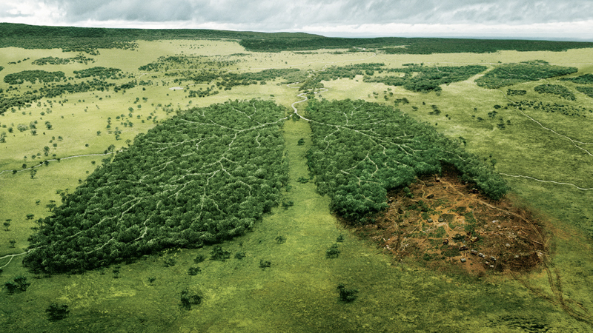
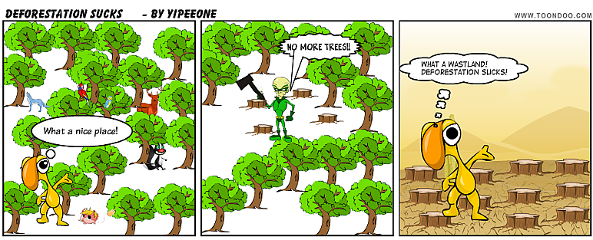
Before - after
BEFORE - AFTER

Slide 11
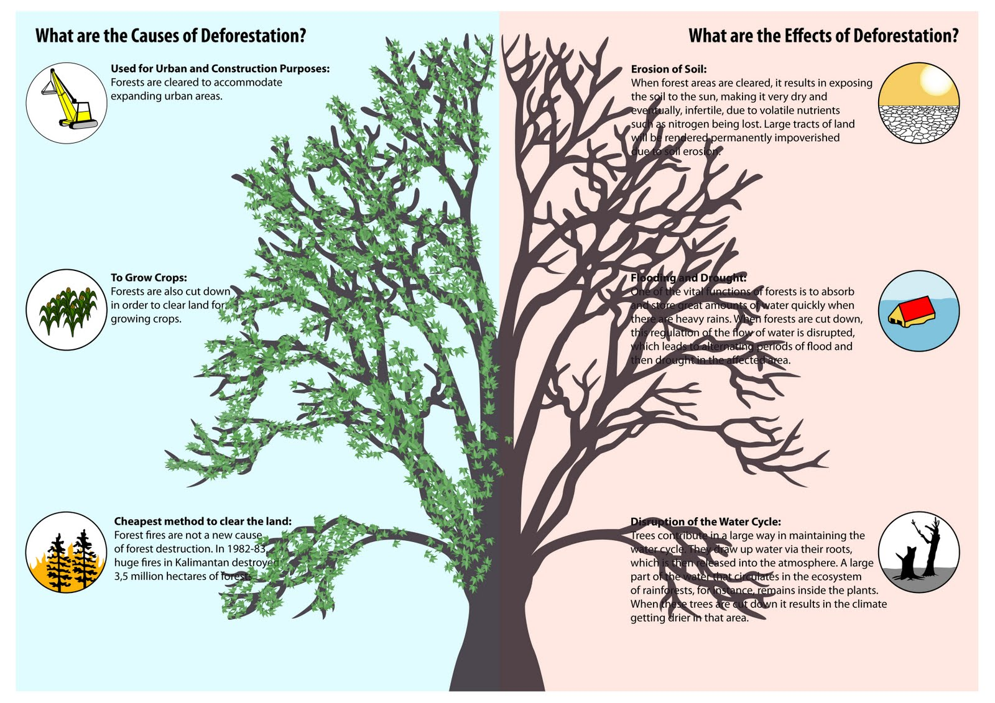

Slide 12
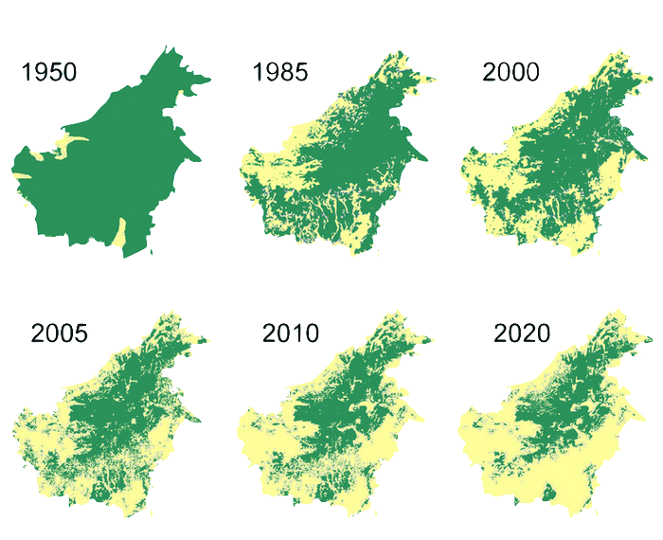
DEFORESTATION STATISTICS

Slide 13

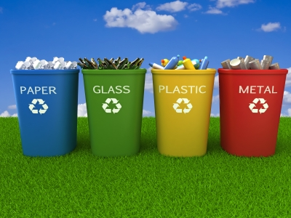
RECYCLING

Slide 14
WAYS TO RECYCLE
Buy Rechargeable Batteries
Reuse Plastic Bags
Recycle your outdated technology
Buy recycled paper and print on both sides
Make recycling bins readily available
Purchase rewritable CDs and DVDs

Slide 15
ENERGY CONSERVATION

Slide 16
CARBON FOOTPRINT

Slide 17
ORGANIZATIONS WORKING TOWARDS PRESERVING/SAVING THE ENVIRONMENT

Slide 18
ROLE OF GOVERNMENT

Slide 19


