Slide 1
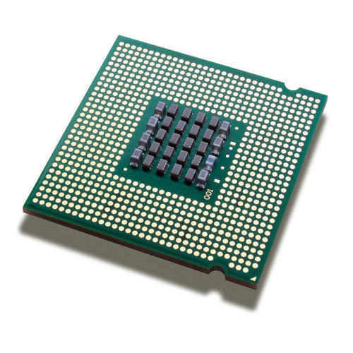
Microprocessor
An integrated circuit that contains all the functions of a central processing unit of a computer.
The microprocessor is a multipurpose, clock driven, register based, digital-integrated circuit which accepts binary data as input, processes it according to instructions stored in its memory, and provides results as output.
Microprocessors contain both combinational logic and sequential digital logic.
Microprocessors operate on numbers and symbols represented in the binary numeral system.

Slide 2
Types of Microprocessor
Intel 4004
Intel 8008
Intel 8080
Intel 8085
Intel 8086
Intel 8088
Intel 80186
Intel 80286
Intel 80386
Intel 80486
Pentium
Pentium II
Pentium III
Pentium IV

Slide 3
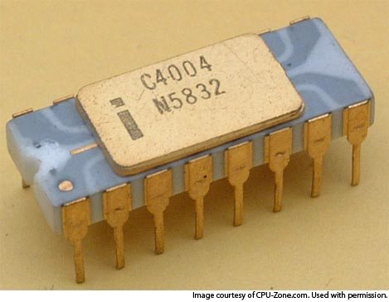
Intel 4004(1971)
Maximum clock speed of 740 kHz.
Up to 92600 instructions per second.
Separate program and data storage.
12-bit addresses.
8-bit instructions.
4-bit microprocessor.
4 KB program memory.
640 bytes data memory.
3-level deep stack.
No interrupts.
16-pin DIP(Dual Inline Package).
PMOS(P-type metal-oxide-semiconductor ) Technology.
2,300 transistors

Slide 4
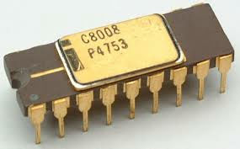
Intel 8008(1972)
8-bit microprocessor.
Up to 800 KHz.
16 KB memory.
7-level deep stack.
8 In / 24 Out ports.
18-pin DIP(Dual Inline Package)
45,000 to 100,000 instructions per second .
3,500 transistors.

Slide 5
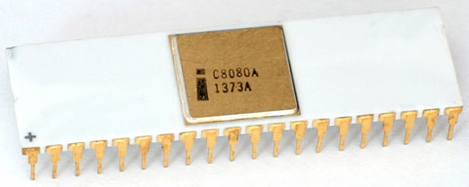
Intel 8080(1973)
8-bit microprocessor.
64 KB RAM.
Stack in RAM.
256 I/O ports.
40-pin DIP(Dual Inline Package).
2 MHz clock speed.
More than 4,500 transistors.
N-MOS(N-type metal-oxide-semiconductor) Technology.

Slide 6
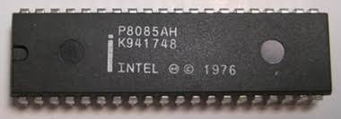
Intel 8085(1975)
8 bit microprocessor.
Single +5V DC power supply.
Maximum clock frequency 3MHz .
Minimum clock frequency 500KHz.
64 KB RAM.
40-pin DIP(Dual Inline Package).
44-pin PLCC(Power line carrier communication).
6200 transistors.
N-MOS (n-type Metal Oxide Semiconductor) Technology.

Slide 7
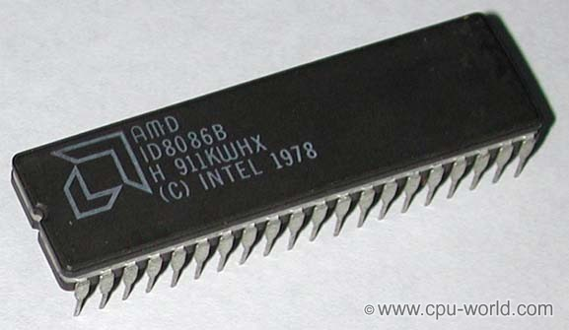
Intel 8086(1978)

Slide 8
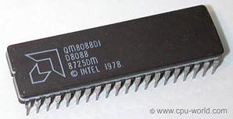
Intel 8088(1979)

Slide 9
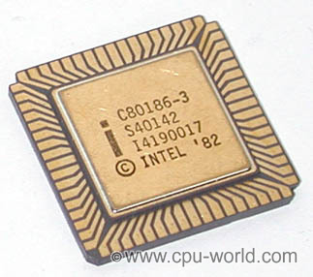
Intel 80186(1982)

Slide 10
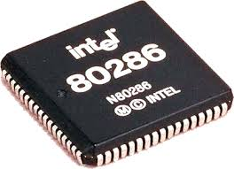
Intel 80286(1983)

Slide 11
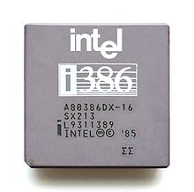
Intel 80386(1986)

Slide 12
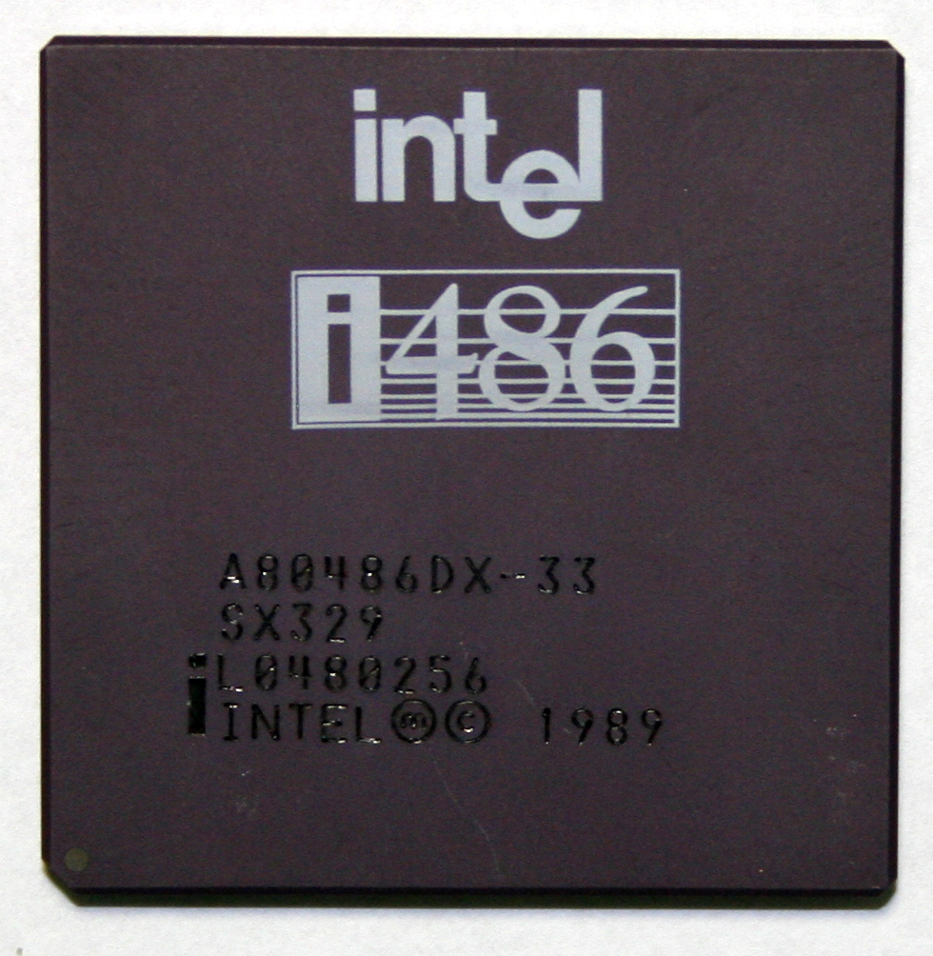
Intel 80486(1989)

