Slide 1

Database (DB)
A database is a collection of information that is organized so that it can be easily accessed, managed and updated.
Need of Database
Data independence and efficient access.
Reduced application development time.
Data integrity and security.
Uniform data administration.
Concurrent access, recovery from crashes.
User-friendly declarative query language.

Slide 2
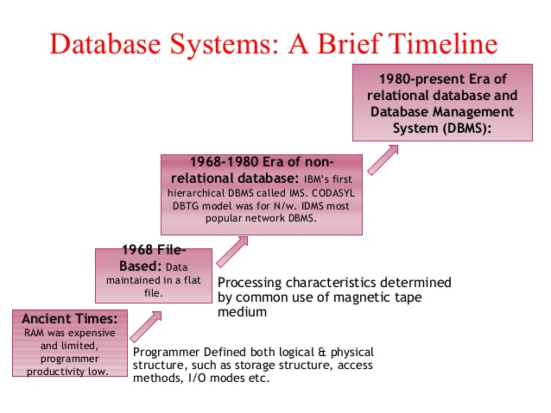
History of Database
The sizes, capabilities, and performance of databases and their respective DBMSs have grown in orders of magnitude.

Slide 3
Data Modeling
A Data Model is a logical structure of Database. It describes the design of database to reflect entities, attributes, relationship among data, constrains etc.

