Slide 1
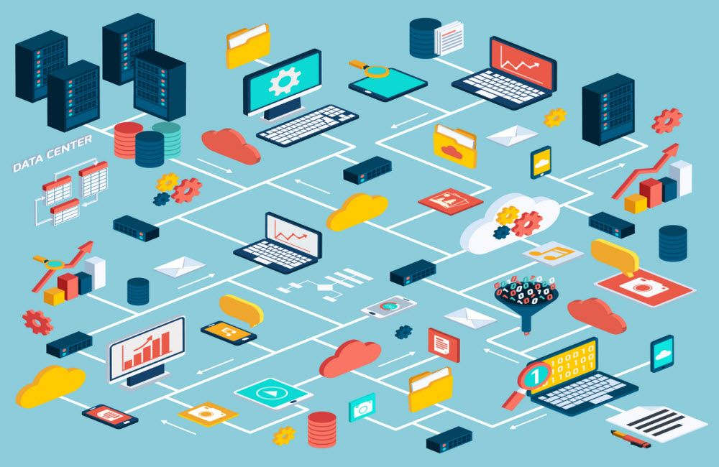
Database (DB)
A database is a collection of information that is organized so that it can be easily accessed, managed and updated.
Need of Database
Data independence and efficient access.
Reduced application development time.
Data integrity and security.
Uniform data administration.
Concurrent access, recovery from crashes.
User-friendly declarative query language.

Slide 2
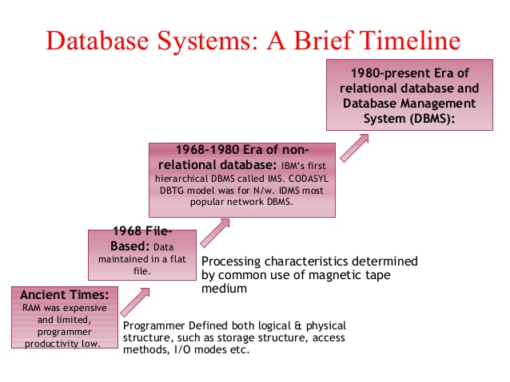
History of Database
The sizes, capabilities, and performance of databases and their respective DBMSs have grown in orders of magnitude.

Slide 3
Hierarchical Databases - The hierarchical database model mandates that each child record has only one parent
Network Databases - The network model is a database model conceived as a flexible way of representing objects and their relationships. Its distinguishing feature is that the schema
Relational Databases - Relational data model is the primary data model and
the properties and capabilities required to process data with storage efficiency
Object Databases -A database object is any defined object in a database that is used to store or reference data
Object Relational Databases - objects, classes and inheritance are directly supported in database schemas and in the query language

Slide 4
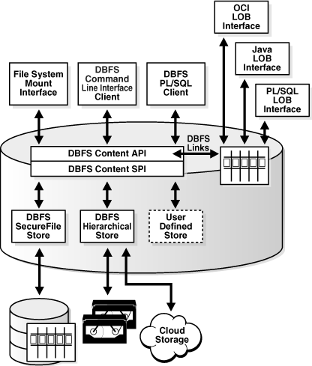
Data Modeling
A Data Model is a logical structure of Database. It describes the design of database to reflect entities, attributes, relationship among data, constrains etc.
File Systems
A File Management system is a DBMS that allows access to single files or tables at a time.
In a File System, data is directly stored in set of files. It contains flat files that have no relation to other files (when only one table is stored in single file, then this file is known as flat file).

Slide 5
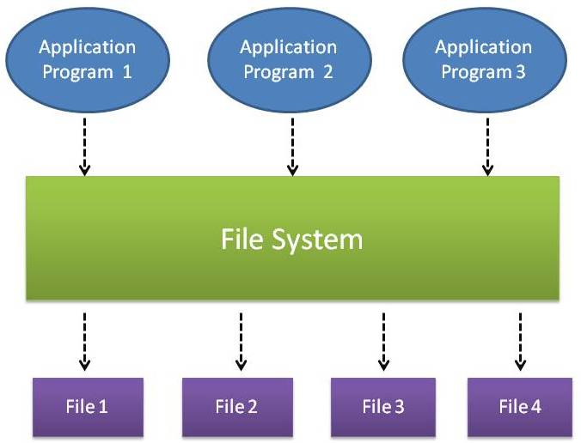
File Based Approach
In traditional approach, information is stored in flat files which are maintained by the file system under the operating system’s control
Application programs go through the file system in order to access these flat files
Data is stored in flat files as records and it consist of various fields which are delimited by a space, comma, pipe, any special character etc. End of records and end of files will be marked using any predetermined character set or special characters in order to identify them.

Slide 6
Disadvantages of file based approach
File-processing system coordinates only the physical access
File-processing system is designed to allow predetermined access to data (i.e. compiled programs)
Is usually designed to allow one or more programs to access different data files at the same time. In a file-processing system, a file can be accessed by two programs concurrently only if both programs have read-only access to the file
Redundancy is not in file system
Unauthorized access is not restricted in the file system

Slide 7
Database Approach
Increase speed of implementing applications
Ease data access by programmers and users
Increase data independence
Reduce program maintenance
Improve standards
Provide a management view
Order Dept.
Accounting
Dept.
Payroll
Dept.
Program
A
Program
B
Program
C
Ordering
filing
System
Invoicing
System
Payroll
System
Back
Orders
file
Inventory
Master
file
Customer
Master
file
Inventory
Pricing
file
Employee
Master
file

