Slide 1
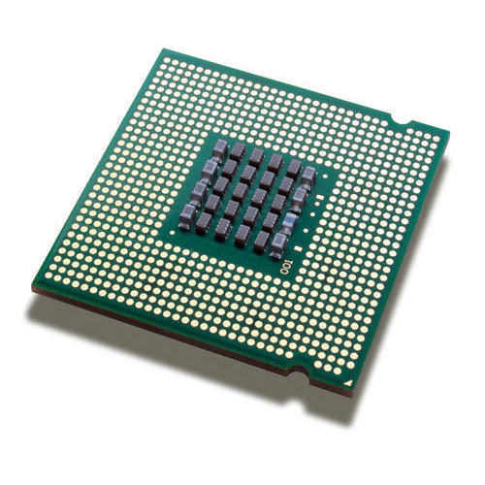
Microprocessor
An integrated circuit that contains all the functions of a central processing unit of a computer.
The microprocessor is a multipurpose, clock driven, register based, digital-integrated circuit which accepts binary data as input, processes it according to instructions stored in its memory, and provides results as output.
Microprocessors contain both combinational logic and sequential digital logic.
Microprocessors operate on numbers and symbols represented in the binary numeral system.

Slide 2
Types of Microprocessor
Intel 4004
Intel 8008
Intel 8080
Intel 8085
Intel 8086
Intel 8088
Intel 80186
Intel 80286
Intel 80386
Intel 80486
Pentium
Pentium Pro
Pentium II
Pentium III
Pentium IV

Slide 3
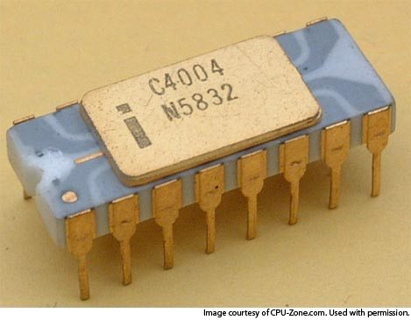
Intel 4004(1971)
Maximum clock speed of 740 kHz.
Up to 92600 instructions per second.
Separate program and data storage.
12-bit addresses.
8-bit instructions.
4-bit microprocessor.
4 KB program memory.
640 bytes data memory.
3-level deep stack.
No interrupts.
16-pin DIP(Dual Inline Package).
PMOS(P-type metal-oxide-semiconductor ) Technology.
2,300 transistors

Slide 4
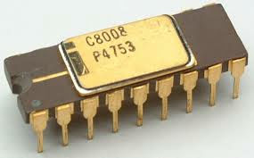
Intel 8008(1972)
8-bit microprocessor.
Up to 800 KHz.
16 KB memory.
7-level deep stack.
8 In / 24 Out ports.
18-pin DIP(Dual Inline Package)
45,000 to 100,000 instructions per second .
3,500 transistors.

Slide 5
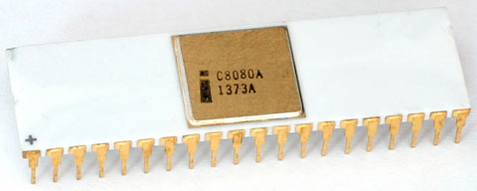
Intel 8080(1973)
8-bit microprocessor.
64 KB RAM.
Stack in RAM.
256 I/O ports.
40-pin DIP(Dual Inline Package).
2 MHz clock speed.
More than 4,500 transistors.
N-MOS(N-type metal-oxide-semiconductor) Technology.

Slide 6
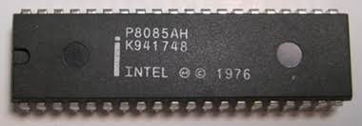
Intel 8085(1975)
8 bit microprocessor.
Single +5V DC power supply.
Maximum clock frequency 3MHz .
Minimum clock frequency 500KHz.
64 KB RAM.
40-pin DIP(Dual Inline Package).
44-pin PLCC(Power line carrier communication).
6200 transistors.
N-MOS (n-type Metal Oxide Semiconductor) Technology.

Slide 7
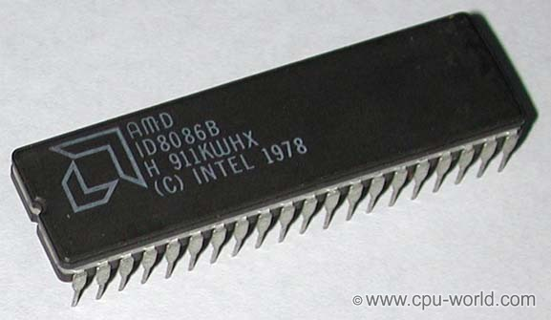
Intel 8086(1978)
16-bit microprocessor.
20-bit address bus.
8086 has an instruction queue.
8086 supports a pipelined architecture.
29,000 transistors.
256 vectored interrupts.
1 MB RAM.
64K I/O ports.
40-pin DIP(Dual Inline Package).
56-pin QFP(Quad Flat Package).
44-pin PLCC (Power line carrier communication).

Slide 8
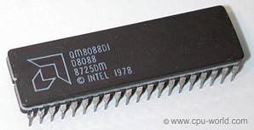
Intel 8088(1979)
8-Bit Data Bus.
16-Bit Internal Architecture.
Direct Addressing Capability to 1 MB of Memory .
Direct Software Compatibility with 8086 CPU .
24 Operand Addressing Modes.
Slower clock.

Slide 9
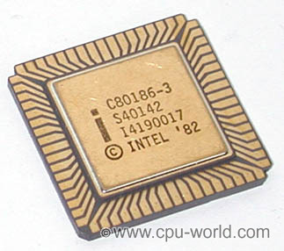
Intel 80186(1982)
16 – bit data bus.
20-bit address bus.
Initial clock rate was 6 MHz.
256 instructions.
6502 registers.
Available in 10 MHz and 8 MHz Versions.
1 MB main memory.

Slide 10
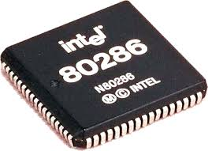
Intel 80286(1983)
It is 16 bit processor.
It has 24 bit address lines.
It can access 16 MB of physical memory.
It is available in various versions that run on 12.5 MHz, 10 MHz and 8 MHz clock frequencies.
80286 is upwardly compatible with 8086 in terms of instruction set.
Memory management and concepts of virtual memory is introduced in 80286.
Intel’s 80286 is the first CPU to incorporate the integrated memory management unit.

Slide 11
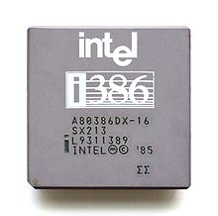
Intel 80386(1986)
8, 16, 32-Bit Data Types.
8 General Purpose 32-Bit Registers.
Very Large Address Space(4 Gigabyte Physical,64 Terabyte Virtual,4 Gigabyte Maximum Segment Size).
20, 25 and 33 MHz Clock.
40, 50 and 66 Megabytes/Sec Bus Bandwidth.

Slide 12
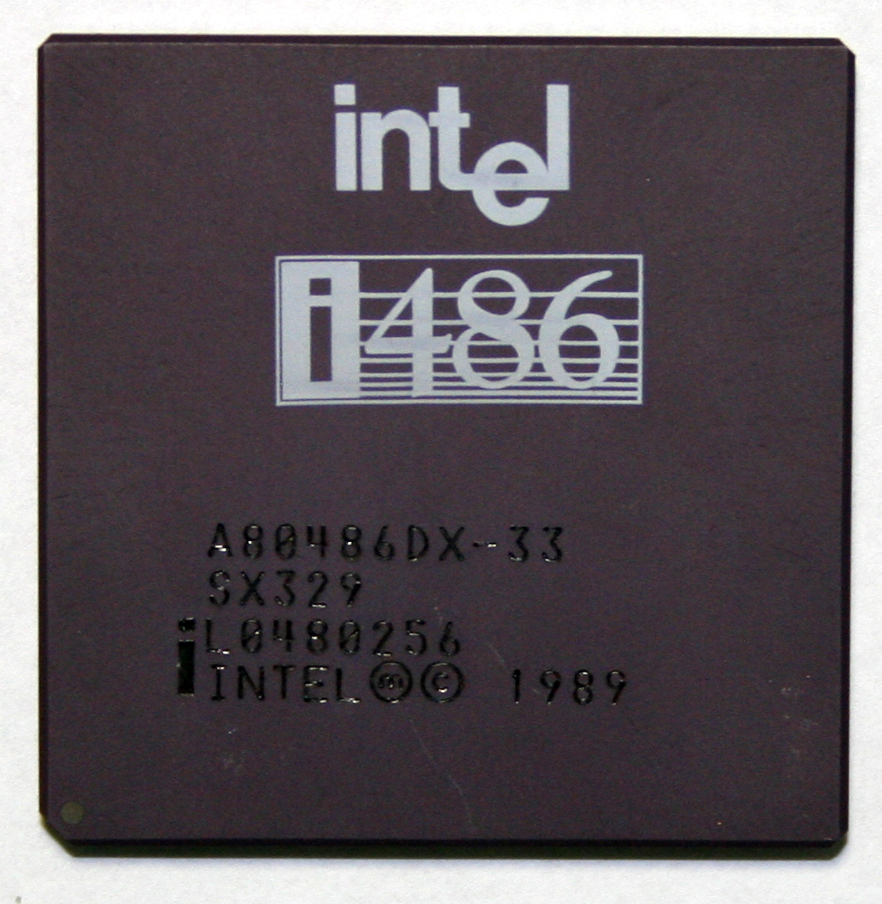
Intel 80486(1989)
32-bit high performance microprocessor.
40 million instructions per second.
50 MIPS(Million Instructions Per Second) peak performance.
4 GB main memory.
8 K byte cache on one package.

Slide 13
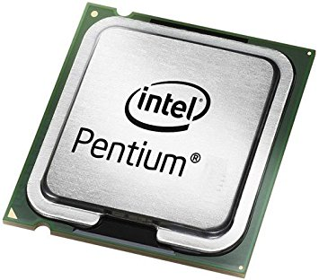
Pentium(1993)
32-bit microprocessor
Clock frequency of either 60 or 66 MHz
3.1 million transistors
64-Bit Bus & 32-bit address bus
4 GB main memory

Slide 14
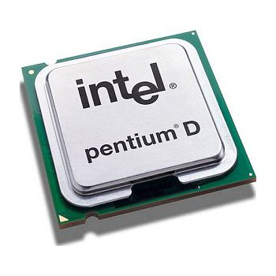
Pentium Pro (1995)
32-bit microprocessor, formerly code-named P6
64 GB main memory, 64-bit data bus and 36-bit address bus
16 KB L1 cache (split instruction/data: 8 KB each), 256 KB L2 cache

Slide 15
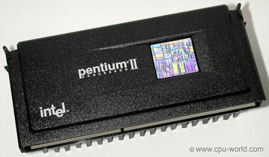
Pentium II (1995)
L1 cache: 16 + 16 KB (Data + Instructions)
L2 cache: 512 KB external chip on CPU module running at 100% of CPU speed.
Front-side bus: 60 or 66 MHz, GTL+
Fabrication: 0.25 µm.
MMX(Multimedia Extensions) support.

Slide 16
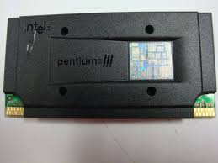
Pentium III (1999)
Clock speeds up to 800 MHz.
included 70 new computer instructions .
Pentium III were Celeron (for low-end versions) and Xeon (for high-end versions).
256 and 512 KB L2 cache memory.
133 MHz address bus.
370-pin FC-PGA2 package.

Slide 17
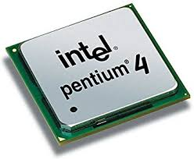
Pentium IV (2002)
Clock speed that now exceeds 2 GHz.
42 million transistors, 0.18-micron process, 217 sq. mm die (Willamette).
55 million transistors, 0.13-micron process, 131 sq. mm die (Northwood).
125 million transistors, 0.09-micron process, 112 sq. mm die (Prescott).
Processor (front-side) bus runs at 400MHz, 533MHz, 800MHz, or 1066MHz.

