Slide 1
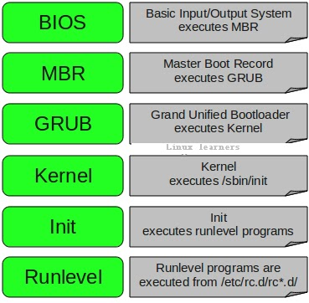
Linux Booting Process
A Linux boot process is the initialization of the Linux open source operating system on a computer. Also known as the Linux startup process, a Linux boot process covers a number of steps from the initial bootstrap to the launch of the initial user-space application.
BIOS
Boot loader
Kernel
Scheduler
Init

Slide 2
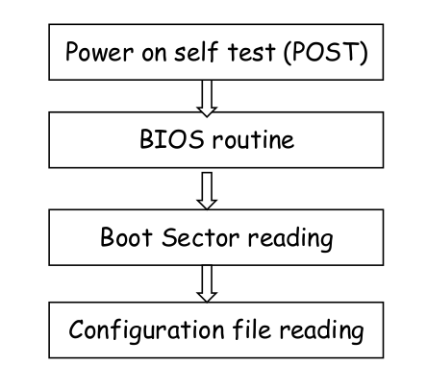
BIOS (Basic Input / Output System)
The computer begins the boot sequence by resetting the CPU. This sets several registers to fixed values and then executes the code found at a specific address. This address is mapped in hardware to a ROM chip that contains the BIOS. This ROM chip is usually an EEPROM, which allows it to be electrically erased and reprogrammed, like when you upgrade or "flash", your BIOS.
The Power On Self Test, or POST routine runs to find certain hardware and to test that the hardware is working at a basic level. - Hardware devices are initialized. PCI devices need to be given IRQs, input/output addresses and a table of these devices is then displayed on-screen. - The BIOS must search for an operating system on the various media that is supported. This usually occurs by searching for a boot sector on the devices that are specified in the CMOS.

Slide 3
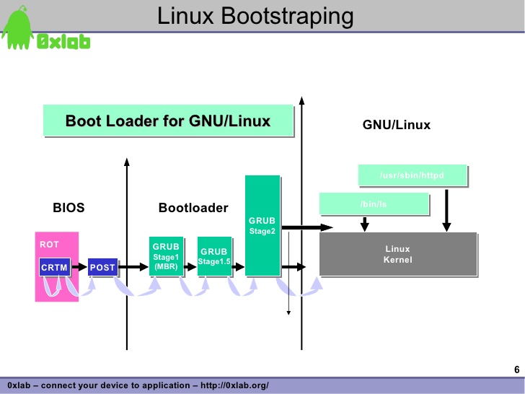
Bootstrap Loader
A bootstrap is the program that initializes the operating system (OS) during startup.
Bootstrapping a computer is said to start with a blank main memory.
Bootstrap loaders perform checksum verification of the kernel image, and most perform decompression and relocation of the kernel image.
Bootloader is a piece of code that runs before any operating system is running.
Bootloader are used to boot other operating systems, usually each operating system has a set of bootloaders specific for it.

Slide 4
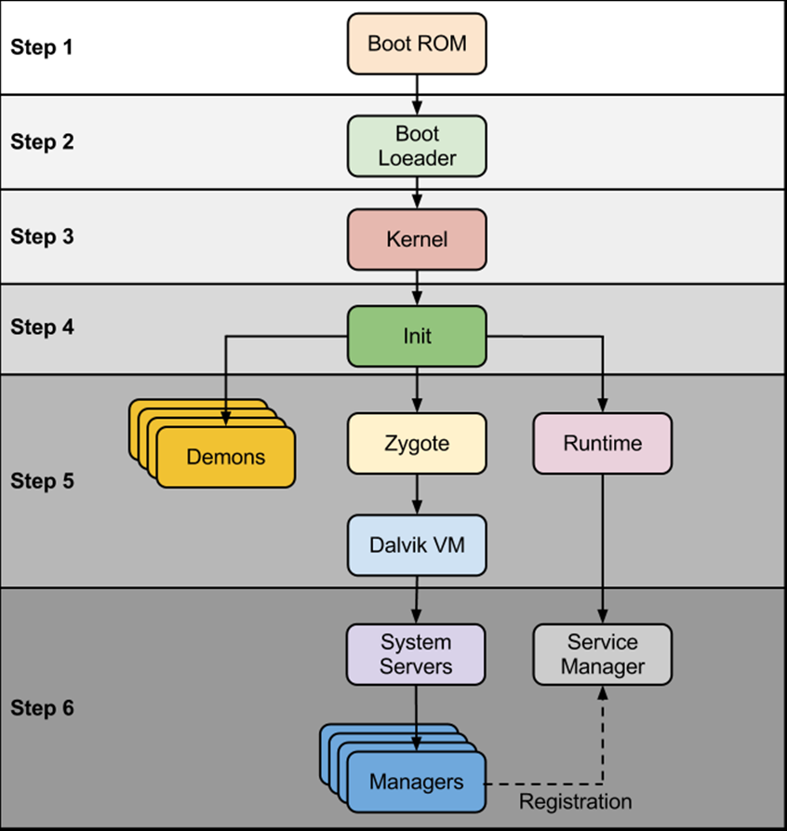
Boot Loader (Boot Manager)
A boot loader, also called a boot manager, is a small program that places the operating system (OS) of a computer into memory. When a computer is powered-up or restarted, the basic input/output system (BIOS) performs some initial tests, and then transfers control to the master boot record (MBR) where the boot loader resides.
GNU GRUB
LILO (Linux Loader)
BURG – New Boot Loader
Syslinux
NeoGRUB
Clover
rEFInd
EFISTUB

Slide 5
Linux Boot Loader
LILO(Linux Loader) | GRUB (GRand Unified Bootloader)
LILO does not depend on a specific file system. LILO can boot an operating system (e.g., Linux kernel images) from floppy disks and hard disks. LILO is the only boot loader that supports booting from a RAID system. LILO has no interactive command interface. LILO is simpler and easier to use. | GRUB loads a large number of Operating System. GRUB can boot operating systems from external devices such as floppy disks and hard drives. GRUB support booting from a network. GRUB has interactive command interface. GRUB is more complicated to use.

Slide 6
Linux Kernel
Mounts the root file system as specified in the “root=” in grub.conf
Kernel executes the /sbin/init program
Since init was the 1st program to be executed by Linux Kernel, it has the process id (PID) of 1. Do a ‘ps -ef | grep init’ and check the pid.
initrd stands for Initial RAM Disk.
initrd is used by kernel as temporary root file system until kernel is booted and the real root file system is mounted. It also contains necessary drivers compiled inside, which helps it to access the hard drive partitions, and other hardware.

Slide 7
Init
After the kernel is booted and initialized, the kernel starts the first user-space application.
This is the first program invoked that is compiled with the standard C library.
Prior to this point in the process, no standard C applications have been executed.
In a desktop Linux system, the first application started is commonly /sbin/init. But it need not be.
Rarely do embedded systems require the extensive initialization provided by init (as configured through /etc/inittab).
In many cases, you can invoke a simple shell script that starts the necessary embedded applications.

Slide 8
Runlevels
Runlevel defines the state of the machine after boot. It has a certain number of services stopped or started, giving the user control over the behavior of the machine. Only one runlevel is executed on start up. It is numbered from zero to six.
0 - Halt the system.
1 - Single-user mode (for special administration).
2 - Local Multiuser without network service (like NFS)
3 - Full Multiuser with Networking
4 - Not Used
5 - Full Multiuser with Networking and X Windows (GUI) or X11 mode
6 - Reboot.

