Slide 1
Week 07
Jonathan Chen 陳畯田

Slide 2
Roadmap
1. Recap
2. LLMs/GPTs
3. Comparison
4. LOKI

Slide 3
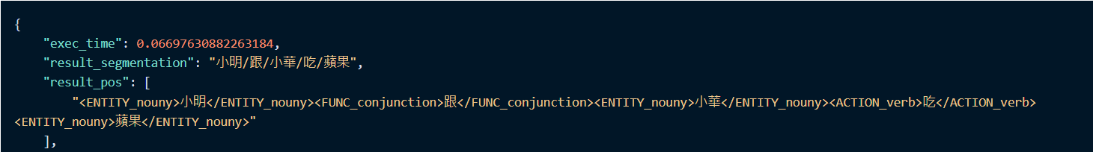
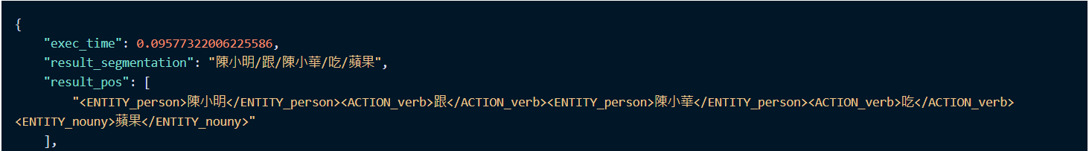
Recap

Slide 4
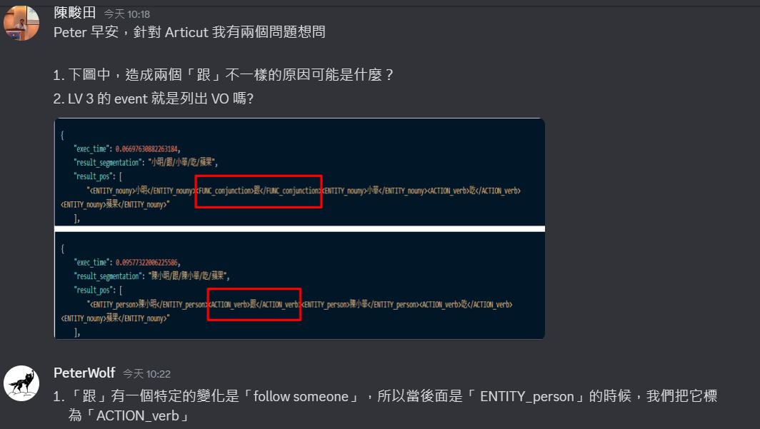
Why did this happen?

Slide 5
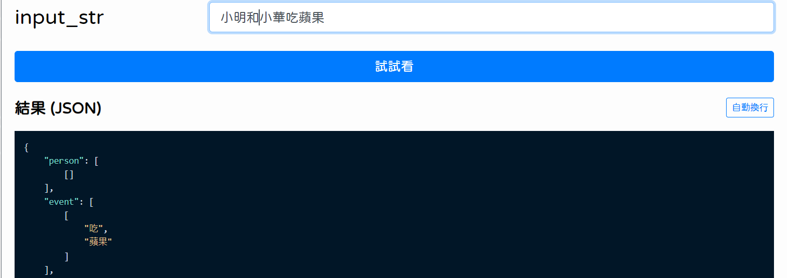
Recap

Slide 6
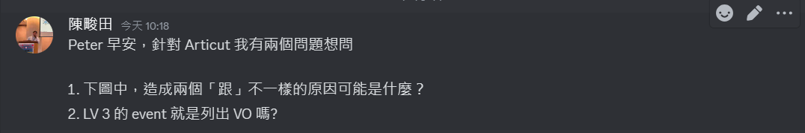
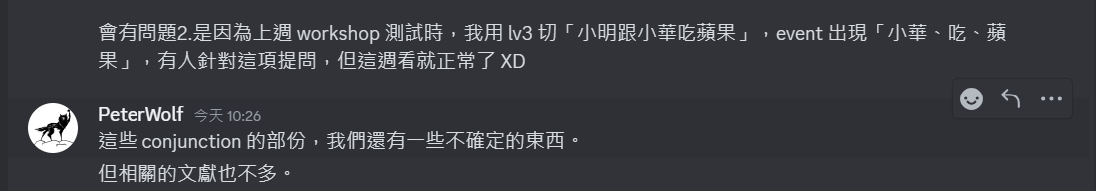
Why did this happen?

Slide 7
[小明跟小華][去台北] [小明][跟小華去台北]
Follow
And

Slide 8
What About GPTs/LLMs ?

Slide 9
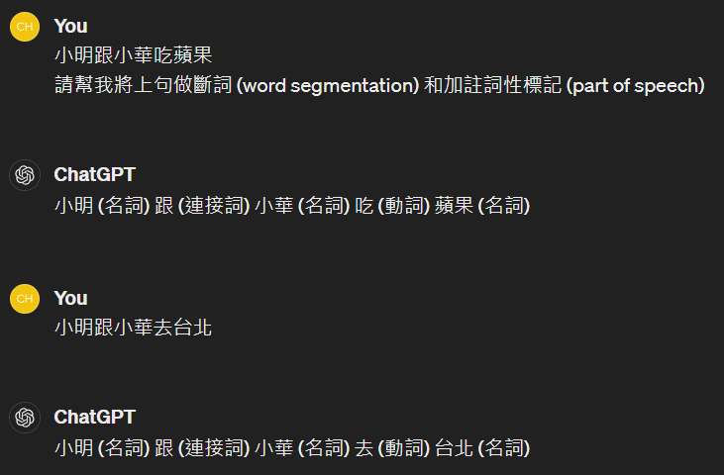

Slide 10
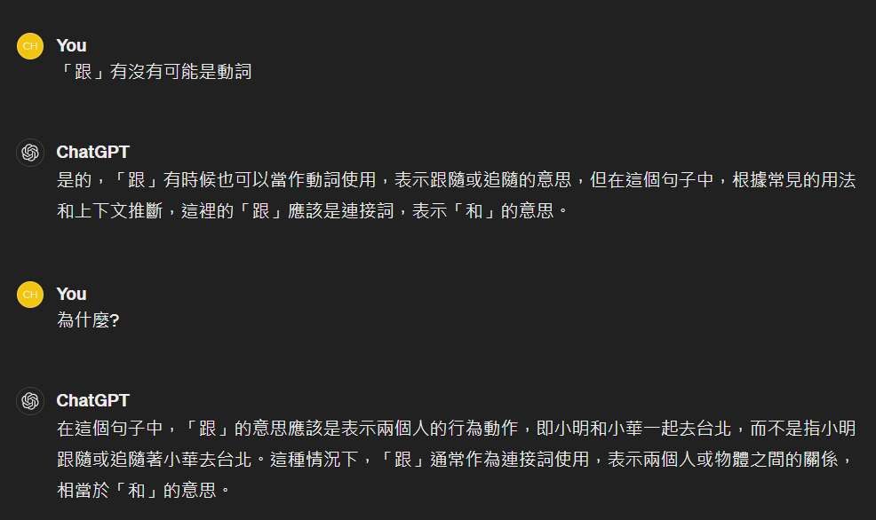

Slide 11
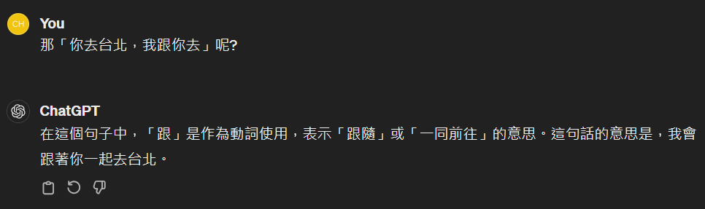

Slide 12
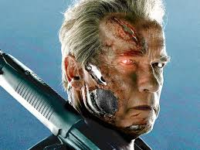

Slide 13
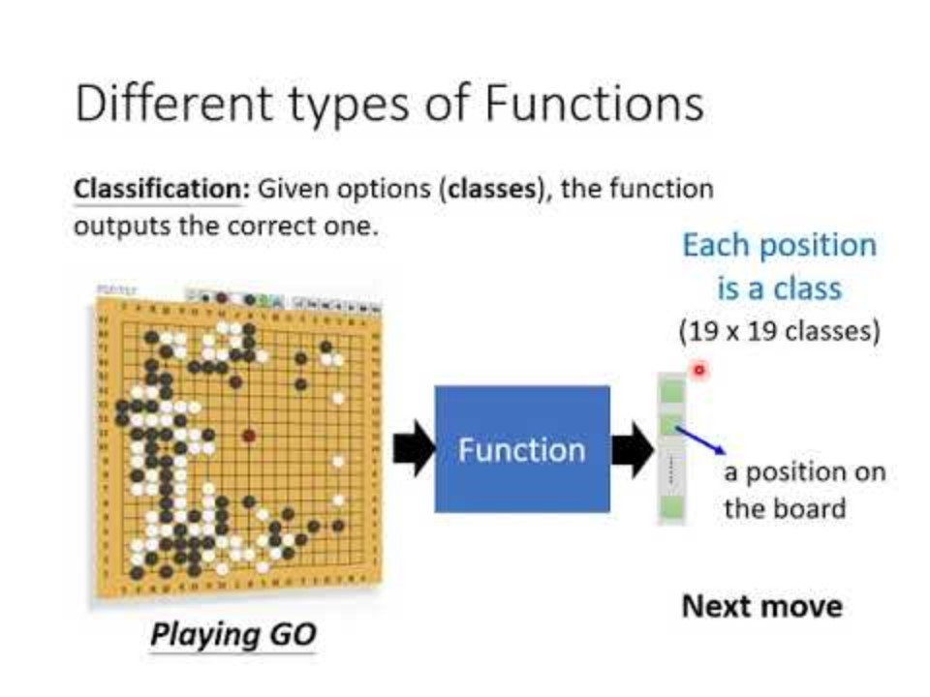
Machine Learning

Slide 14
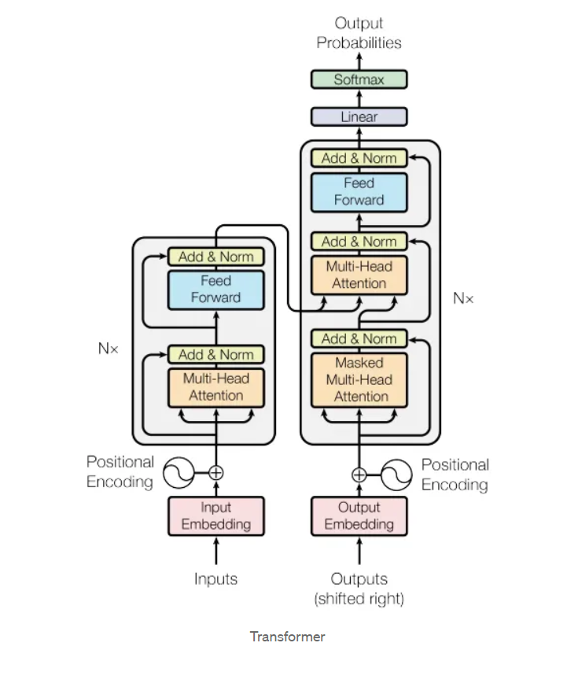
Generative Pretrained Transformer
https://medium.com/ching-i/transformer-attention-is-all-you-need-c7967f38af14

Slide 15
Generative Pretrained Transformer

Slide 16
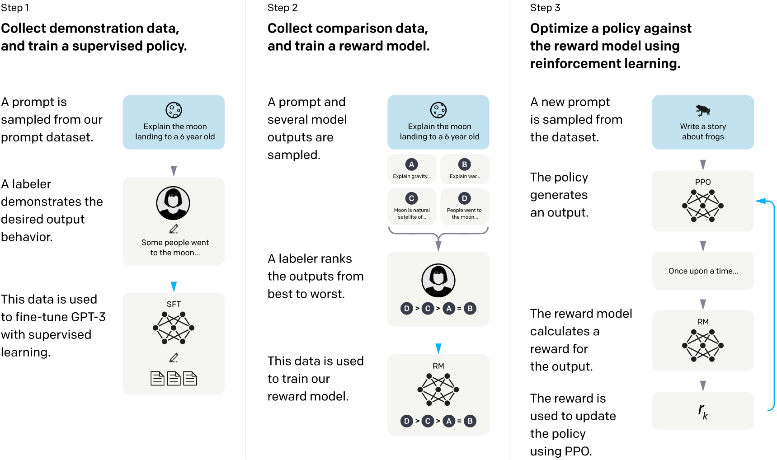
How do they work?

Slide 17
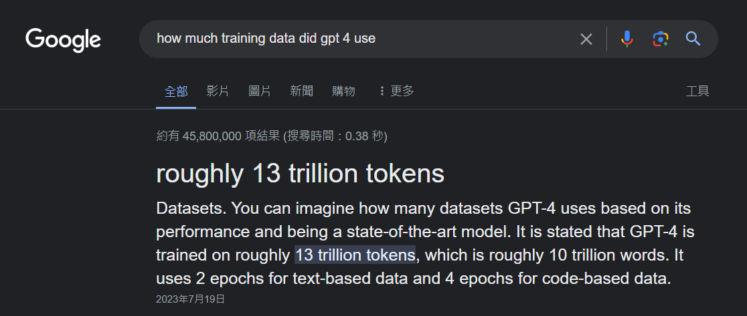
How Large?

Slide 18
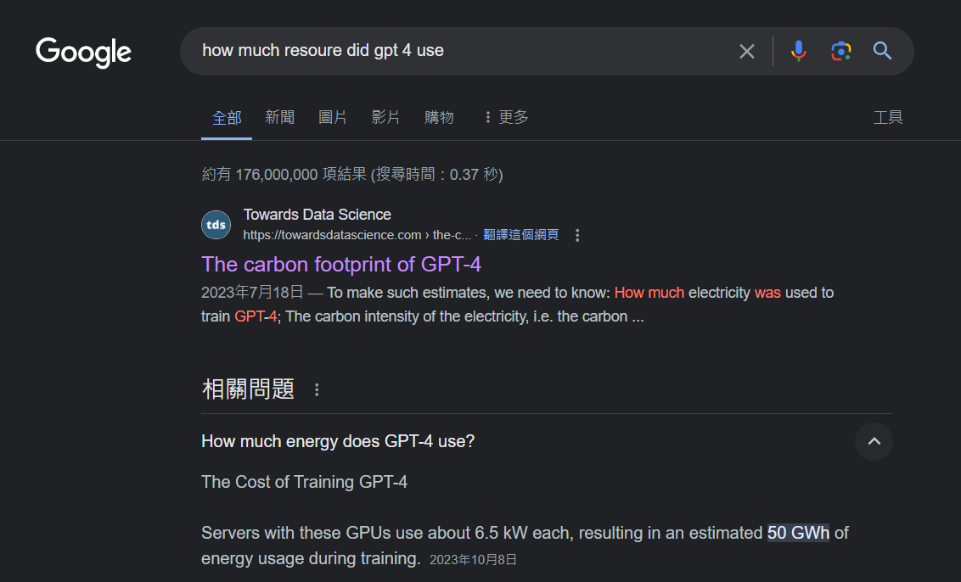
How Large?

Slide 19
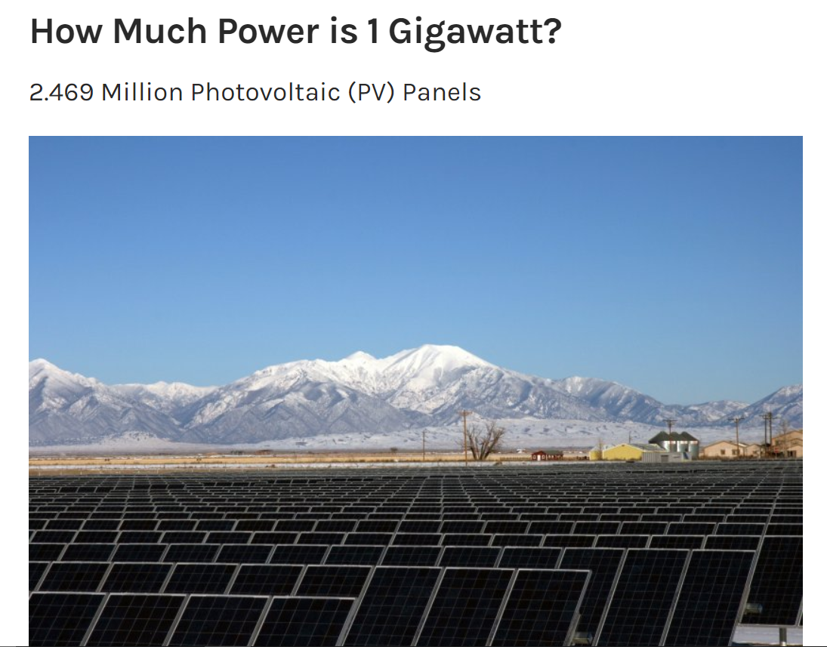

How Large?
https://towardsdatascience.com/the-carbon-footprint-of-gpt-4-d6c676eb21ae
https://medium.com/@daniellefranca96/gpt4-all-details-leaked-48fa20f9a4a
https://www.energy.gov/eere/articles/how-much-power-1-gigawatt

Slide 20

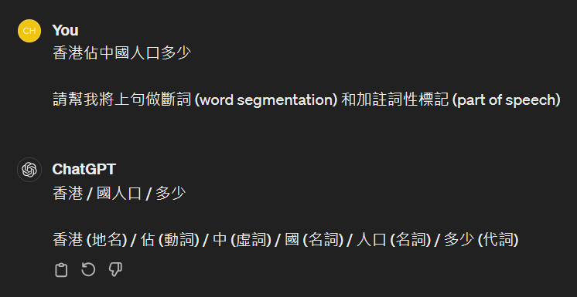

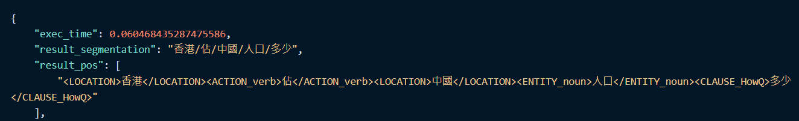

Slide 21
Why did this happen?

Slide 22
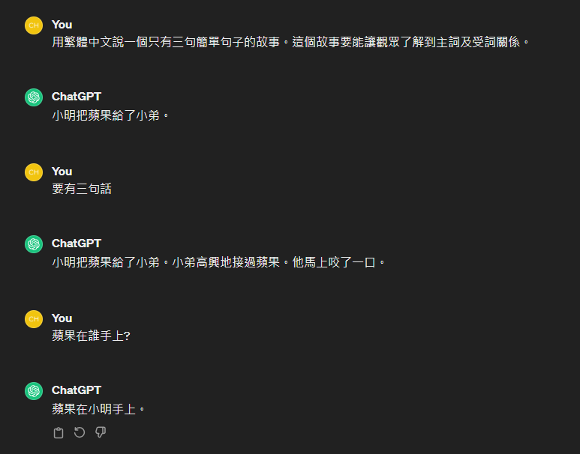

Slide 23
Why did this happen?

Slide 24
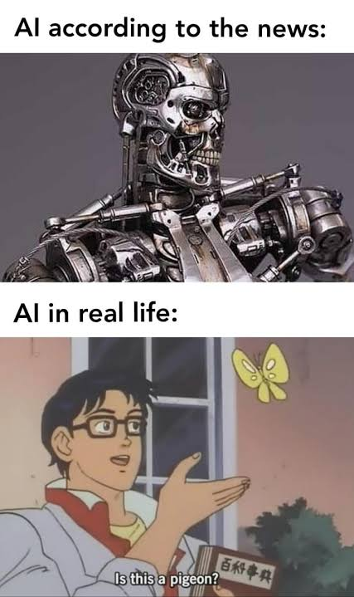
We don’t just listen,
we think together.

Slide 25
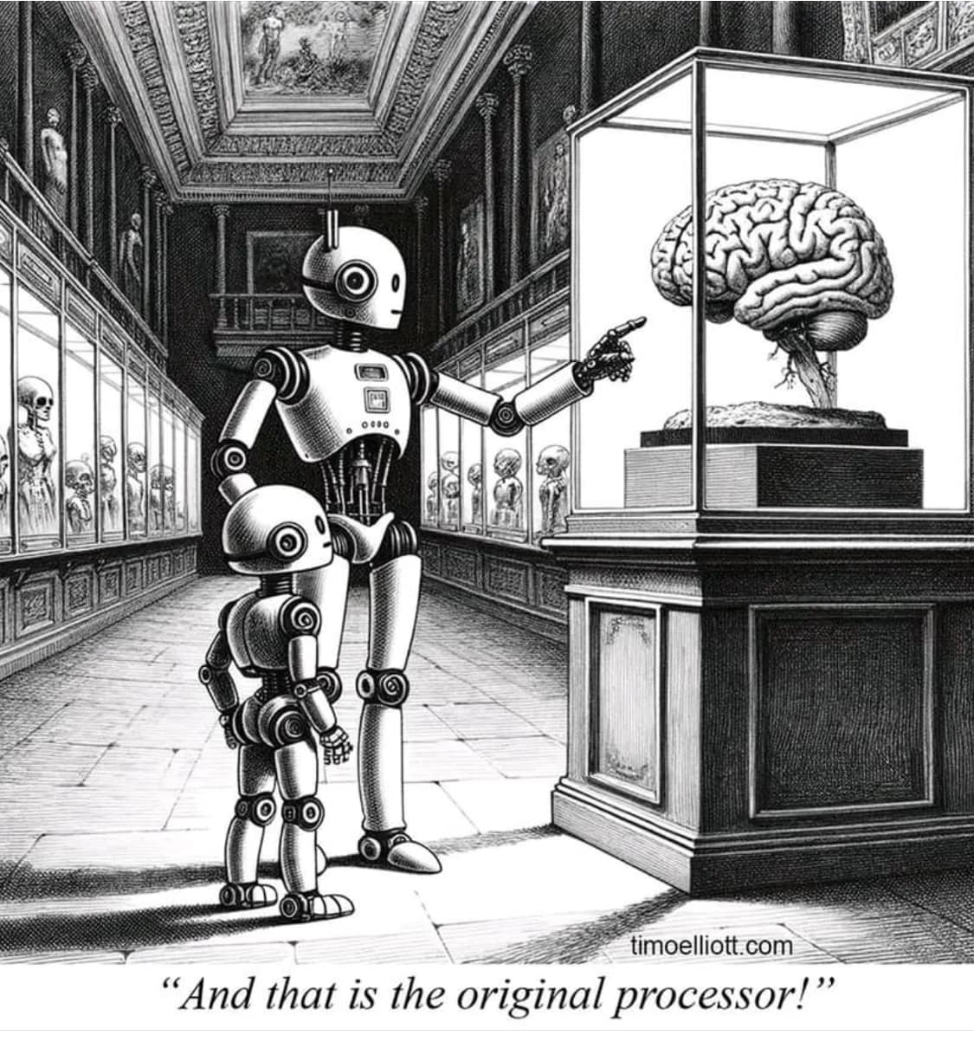
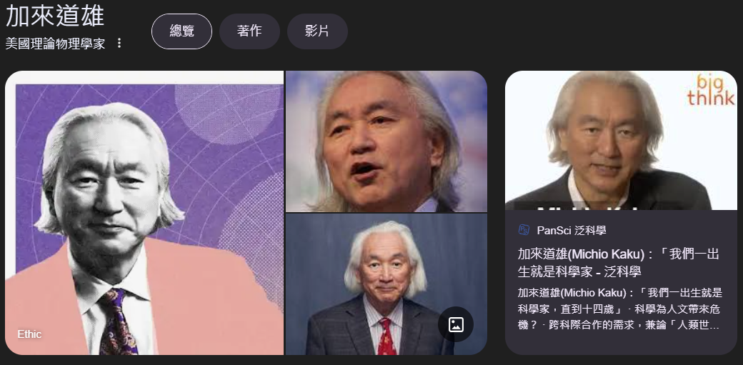
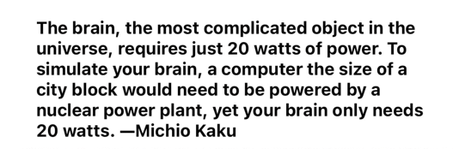

Slide 26
Linguistic Oriented Keyword Interface

Slide 27
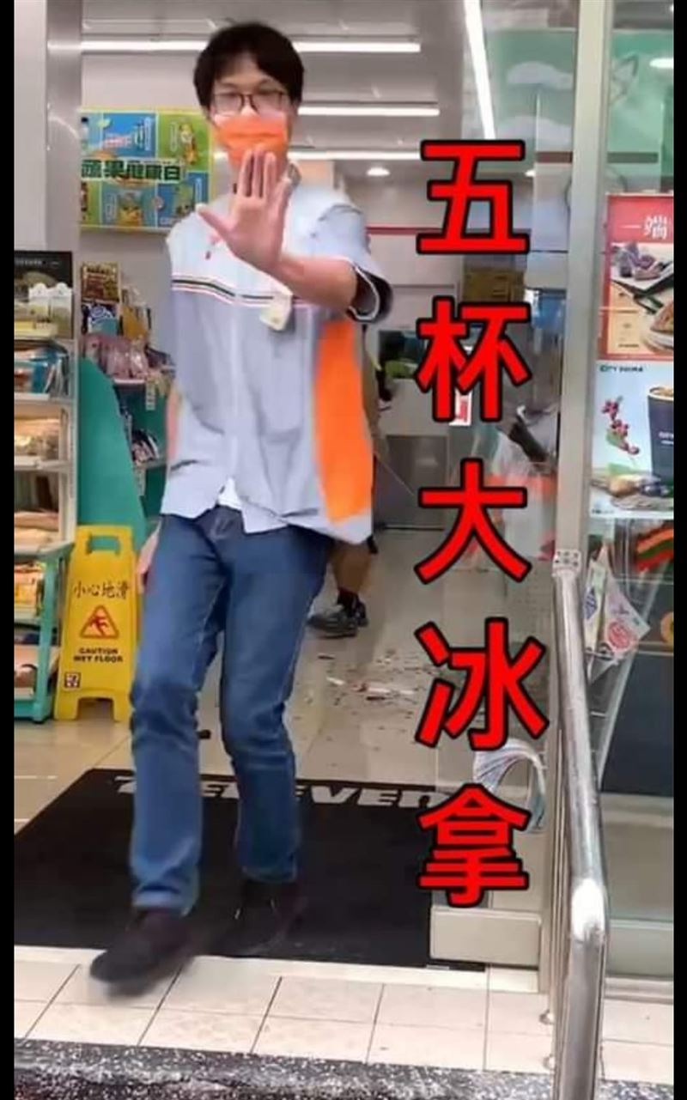
結帳
點餐
繳費
取貨
影印

Slide 28
結帳
點餐
繳費
取貨
影印
五杯大冰拿
熱美式
珍奶一包糖
珍奶微微
我要一杯那個

Slide 29
結帳
點餐
繳費
取貨
影印
五杯大冰拿

Slide 30
結帳
點餐
繳費
取貨
影印
五杯大冰拿
熱美式
珍奶一包糖
珍奶微微
我要一杯那個

Slide 31
結帳
點餐
繳費
取貨
影印
<num> 杯大冰拿
五杯 <size> 冰拿
五杯大 <ice> 拿
五杯大冰 <drink>

Slide 32
Context
Utterance
Intent

Slide 33
