Slide 1
WEEK 05
Jonathan Chen 陳畯田

Slide 2
Roadmap
1. Recap & Thoughts On Task 01
2. Hands-On Task 02
3. Simon Show

Slide 3
Roadmap
1. Recap & Thoughts On Task 01
2. Hands-On Task 02
3. Simon Show

Slide 4

def extractSubject(inputLIST)

Slide 5
Start From The Flow Chart
重要的不是要打那些 code，而是要完成什麼/哪些任務

Slide 6
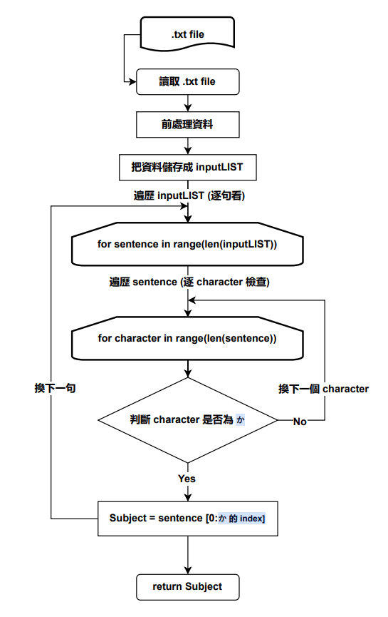
Start From The Flow Chart
重要的不是要打那些 code，而是要完成什麼/哪些任務
Divide & Conquer

Slide 7
https://asana.com/zh-tw/resources/process-mapping

Slide 8
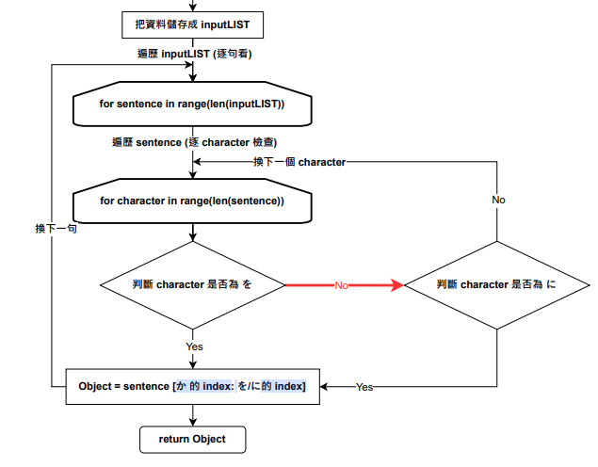
Object?

Slide 9
任務是什麼 (input/ouput)
觀察語/資料 (有無需要處理的地方/是否有問題)
一步一步想 (總有些東西能做吧)
步驟具體化 (如果跟AI )
上網查資料 (有邏輯之後，程式怎麼寫都查得到)
多嘗試測試 (多COMMIT)
You Are Solving A Problem, Not Doing Homework.

Slide 10
Roadmap
1. Recap & Thoughts On Task 01
2. New NLP Mission - Grammar Checking
3. Hands-On Task 02
4. Simon Show

Slide 11
Grammar Checking
Any Thoughts?

Slide 12

ChatGPT Huh?

Slide 13
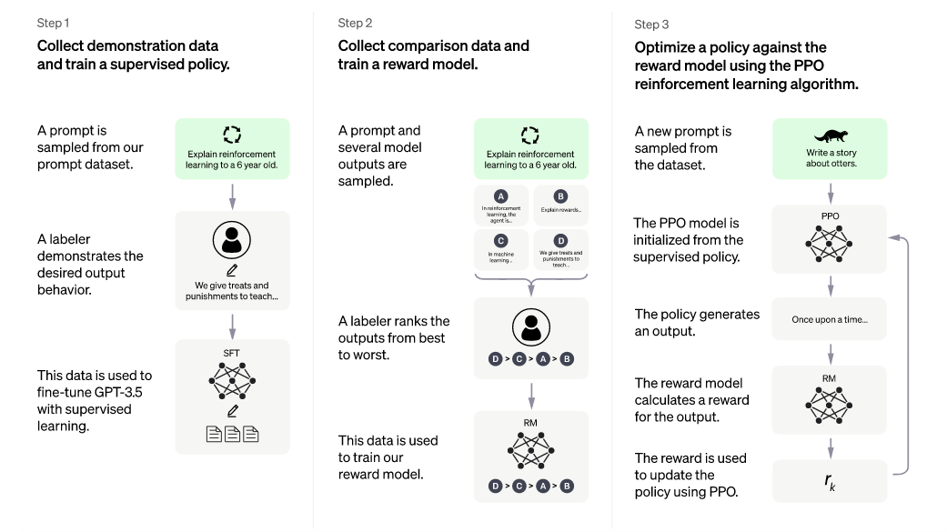
Grammar Checking

Slide 14
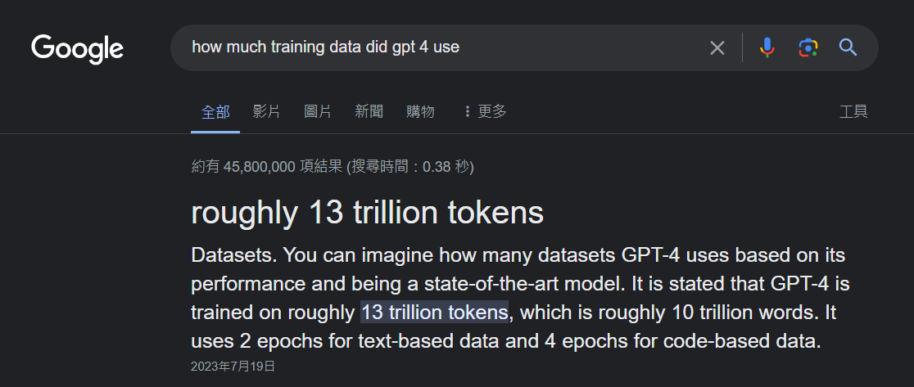
Grammar Checking

Slide 15
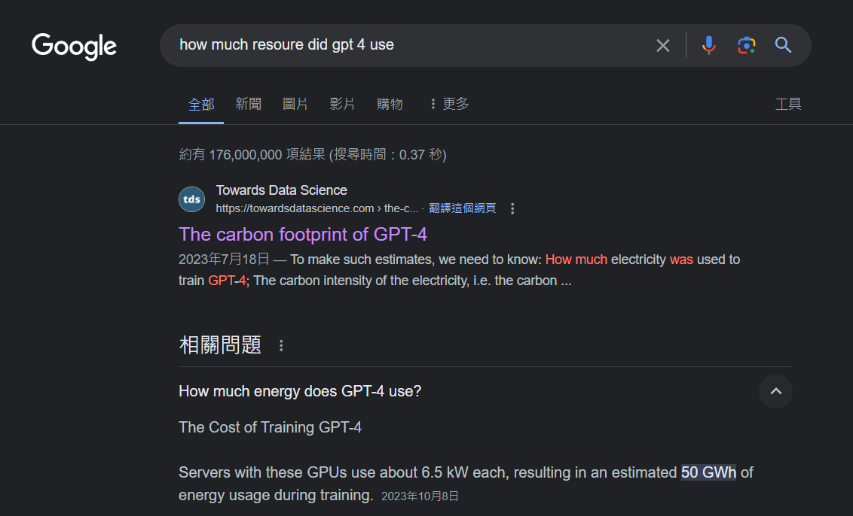
Grammar Checking

Slide 16
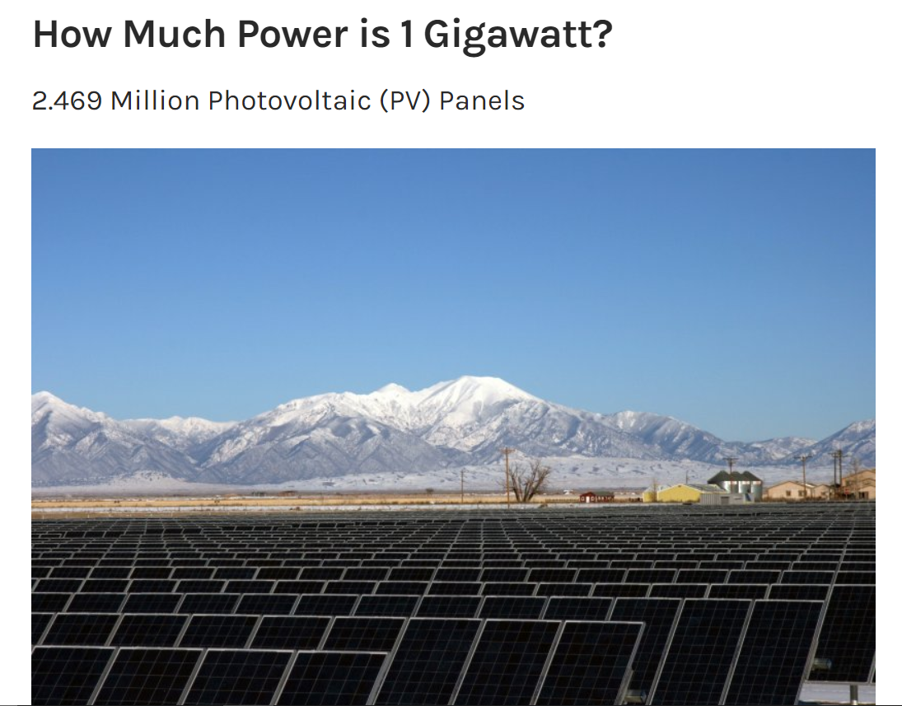

Grammar Checking
https://towardsdatascience.com/the-carbon-footprint-of-gpt-4-d6c676eb21ae
https://medium.com/@daniellefranca96/gpt4-all-details-leaked-48fa20f9a4a
https://www.energy.gov/eere/articles/how-much-power-1-gigawatt

Slide 17
Roadmap
1. Recap & Thoughts On Task 01
2. Hands-On Task 02
3. Simon Show

Slide 18
Task 02
Deal With A Real Corpus

Slide 19
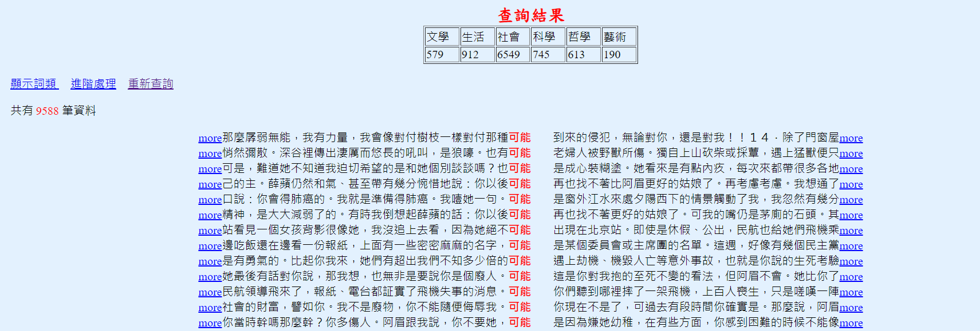
Let’s Break It Down Divide and Conquer, Remember?
Start from the data.

Slide 20
Let’s Break It Down Divide and Conquer, Remember?
Start from the data.

Slide 21
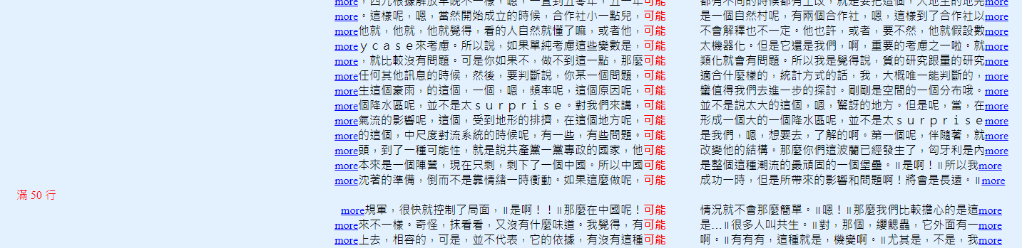
Let’s Break It Down Divide and Conquer, Remember?
Start from the data.

Slide 22
Let’s Break It Down Divide and Conquer, Remember?
Start from the data.
dataLIST = [
“…可能…”,
“…可能…”,
“…可能…”,
“…可能…”,
“…可能…”,
]
processed.txt

Slide 23
Task 02 Spec
Deal With A Real Corpus
可能
應該
必須
可以
希望
覺得
Get the sentences from SINICA Corpus https://asbc.iis.sinica.edu.tw/
BLABLABLA
Clean and Processed data
in a .txt file named {ke_neng}_processed.txt

Slide 24
Start From The Flow Chart, Remember?

