Slide 1
Week 06
Jonathan Chen 陳畯田

Slide 2
Roadmap
Task 02 Hands-on
Articut

Slide 3
Roadmap
Task 02 Hands-on
Articut

Slide 4
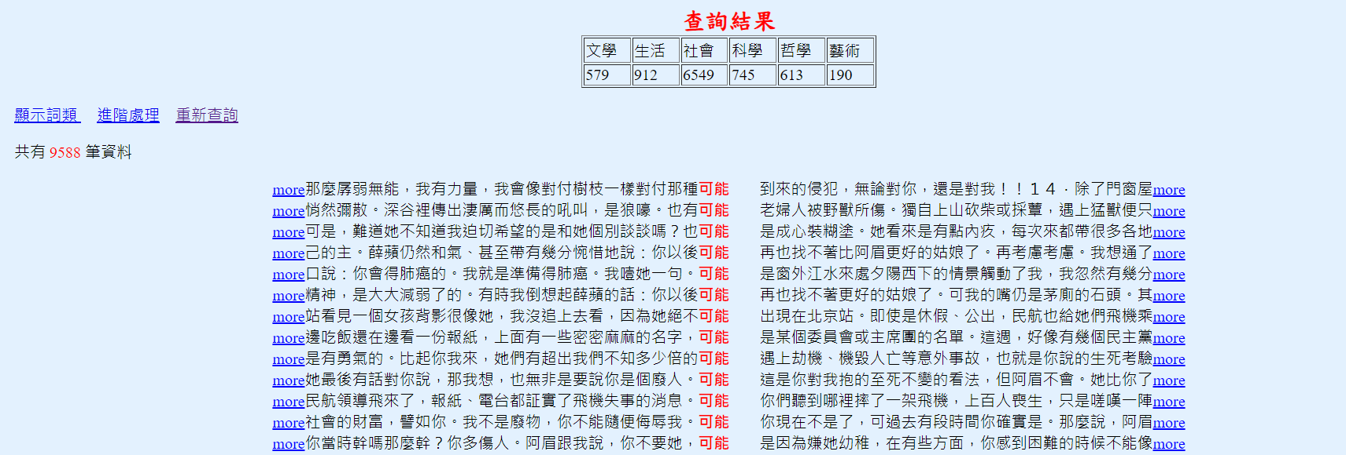
Let’s Break It Down Divide and Conquer, Remember?
Start from the data.

Slide 5
Let’s Break It Down Divide and Conquer, Remember?
Start from the data.
dataLIST = [
“…可能…”,
“…可能…”,
“…可能…”,
“…可能…”,
“…可能…”,
]

Slide 6
Flow Chart, Remember?

Slide 8
Roadmap
Task 02 Hands-on
Articut

Slide 10
Flow Chart, Remember?

