Slide 1
AI BOOTCAMP — MAY 2026
Universal Review
Analyzer
Customer Review Sentiment Dashboard
Prepared by: Mbuyelo Nyathi
End-To-End Technology Programme · CAPACITI

Slide 2
01 INTRODUCTION
What is the Universal Review Analyzer?
🍔 McDonald's
Reviews Dataset
A Streamlit-based dashboard that classifies customer reviews as Positive, Negative, or Neutral — generating word clouds, sentiment trends, and top review summaries from any uploaded dataset.
Hotels
Restaurants
Products
Services
Sentiment
Classification
Word Cloud
Visualizer
Trend
Analysis
Places
Universal · Flexible · Scalable

Slide 3
02 SYSTEM OVERVIEW
Tech Stack & Architecture
Python
Streamlit
NLTK VADER
Matplotlib
WordCloud
Core language
Dashboard UI
Sentiment engine
Charts & graphs
Text visualization
Dashboard Tabs
Dataset Overview
Sentiment Analysis
Word Cloud
Sample reviews, count & avg rating
Positive / Negative / Neutral distribution
Most frequent review terms
Trend Analysis
Top Reviews
Sentiment changes over time
Best & worst customer examples

Slide 4
03 DEMONSTRATION OF OUTPUTS
Key Dashboard Features
CSV Upload & Text Input
Dataset Overview
01
02
Sidebar supports drag-and-drop CSV upload or direct text entry for on-the-fly analysis.
Displays sample reviews, total review count, and the average rating at a glance.
Sentiment Distribution
Word Cloud
03
04
Bar chart visualizing the proportion of Positive, Negative, and Neutral reviews.
Visual representation of the most frequently used words across all reviews.
Trend Analysis Graph
Top Reviews Tab
05
06
Time-series chart of sentiment shifts when timestamp data is available.
Highlights the most positive and most negative reviews for quick human review.

Slide 5
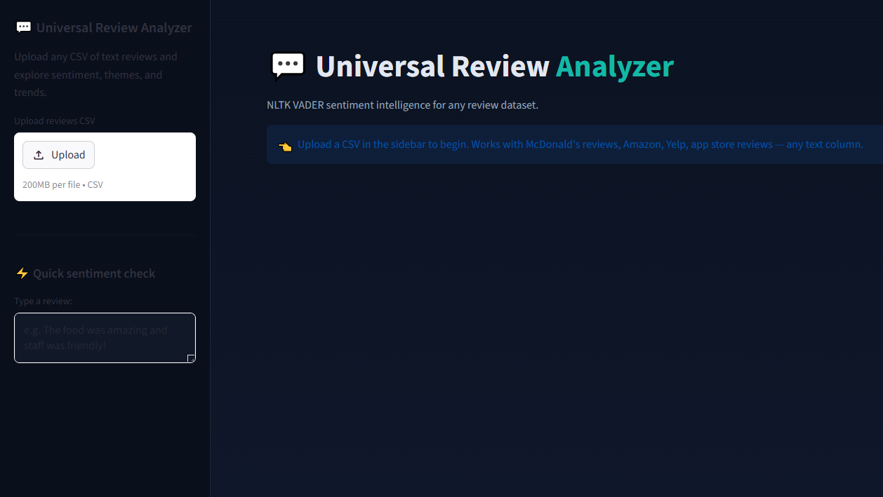
How The App Looks Like

Slide 6
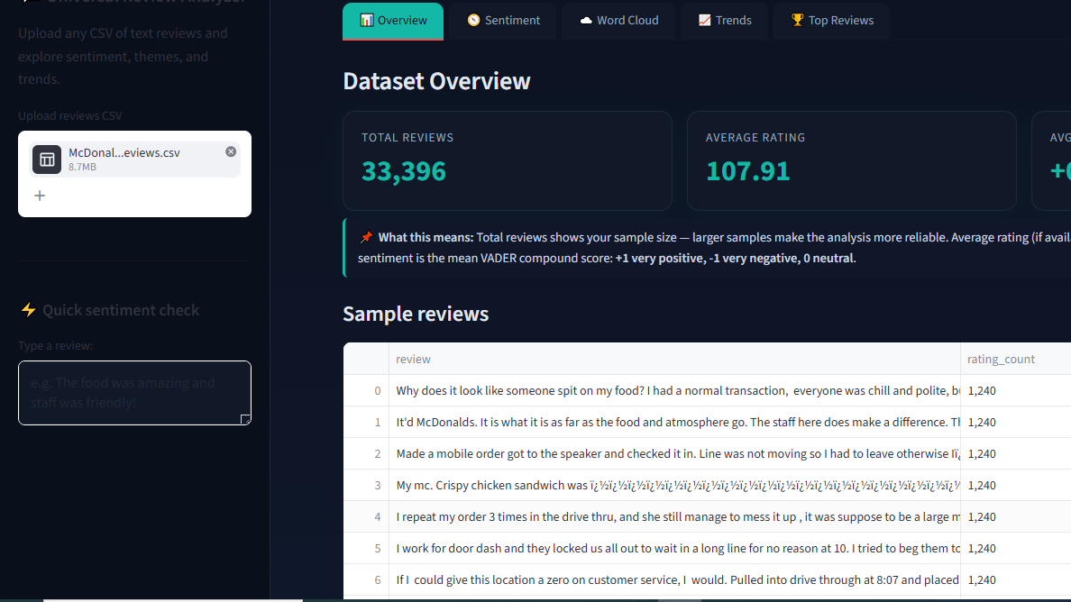

Slide 7
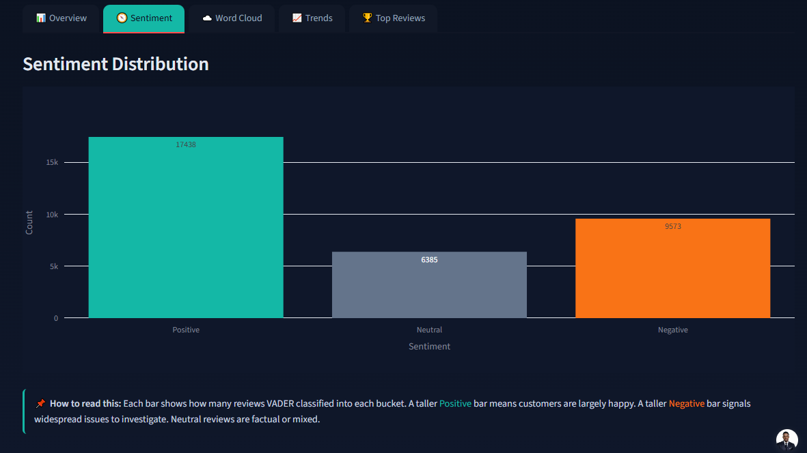

Slide 8
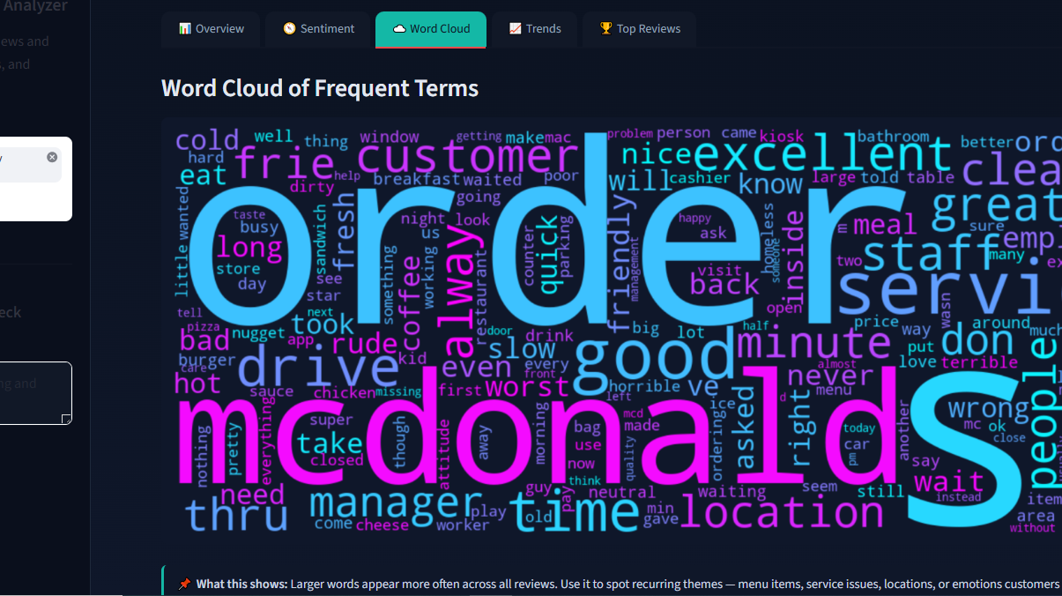

Slide 9
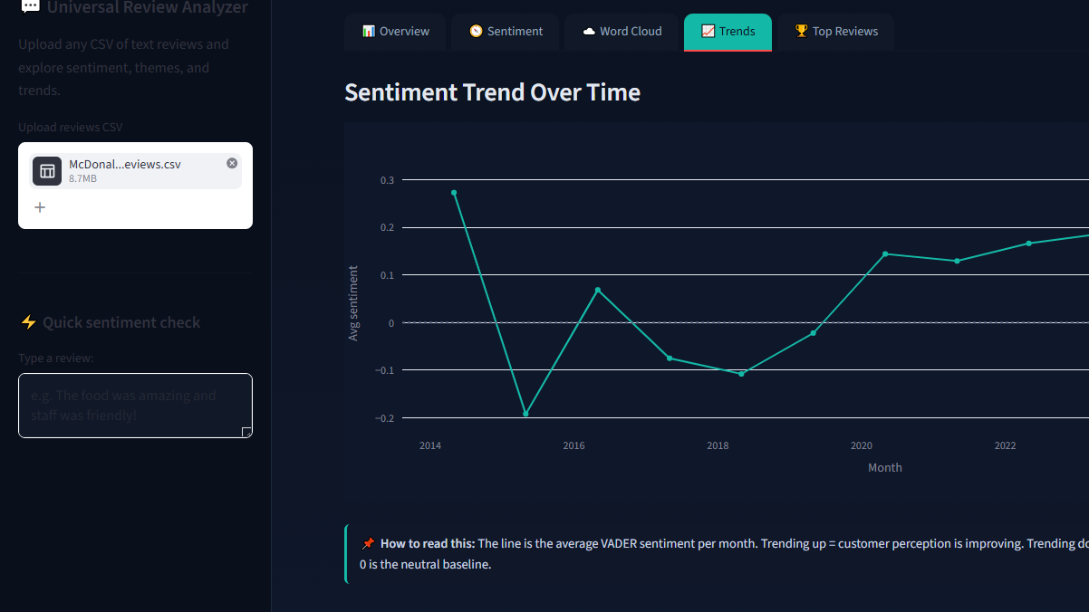

Slide 10
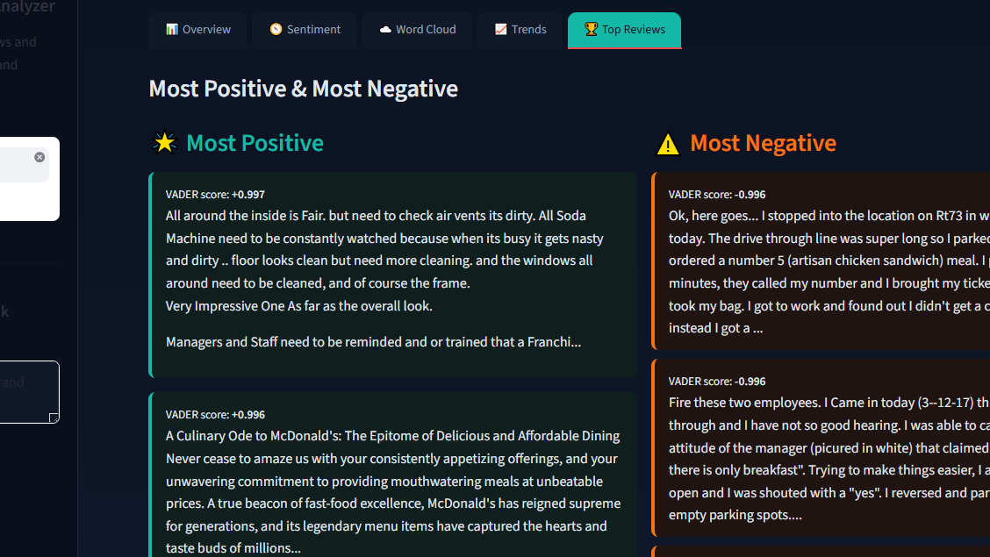

Slide 11
04 CHALLENGES & RISKS
⚡ CHALLENGES
⚠️ RISKS
Handling CSV encoding issues gracefully
Misclassification due to sarcasm or ambiguity
Generalizing beyond McDonald's dataset
Over-reliance on VADER without domain tuning
Designing a modern multi-tab UI
Data privacy when uploading customer datasets
Managing time constraints during bootcamp sprint

Slide 12
05 LESSONS LEARNED & IMPACT
Lessons Learned
Impact
📊
Visualization dramatically improves interpretability of sentiment data
⏱️
Time Saved
Automates sentiment classification that would take hours manually
⚡
Streamlit enables rapid prototyping but demands careful UI planning
💡
Actionable Insights
Trends and top reviews surface real business intelligence fast
🎯
Technical accuracy must be balanced with user experience
🏆
Portfolio Showcase
Demonstrates applied AI skills suitable for industry use
🤝
AI tools are powerful but require human oversight to guide decisions
🌍
Cross-Industry Use
Applicable to hotels, restaurants, products, and beyond

Slide 13
CONCLUSION
Transforming Raw Text
Into Meaningful Insights
The Universal Review Analyzer combines sentiment analysis, visualization, and user-friendly design to deliver a professional tool applicable across industries — from restaurants to hotels to products.
Sentiment AI
Rapid Prototyping
Industry-Ready
Mbuyelo Nyathi · CAPACITI · AI Bootcamp 2026

