Slide 1


PRESENTED BY
Salwa Ahmed
An Engineer & Entrepreneur
Founder, Marka Di Fantasya General Trading
Presenting at:
Atheer Al-Watar
Businesswomen Forum
22 May 2026
The taste of home, wherever you are طعم البيت، وين ما مشيت
01 / 11

Slide 2
ABOUT ME
My Story
A Biomedical Engineer who built a business — and is now building a marketplace for 5 million people.
Engineering Career
An Engineer, specialized in healthcare infrastructure projects across the UAE
Learning Phase
2 years studying e-commerce, dropshipping, digital marketing & online retail
MDF Founded
2024, Registered Marka Di Fantasya General Trading (L.L.C & S.P.C)
First Venture
Launched an e-commerce brand — ran META ads, gained real hands-on experience
Next Chapter
Building 249Souq.com, the first global marketplace for the Sudanese diaspora
2+
1
2
Years in E-commerce
Venture Launched
Industries Mastered
249Souq.com The taste of home, wherever you are طعم البيت، وين ما مشيت
249Souq.com The taste of home, wherever you are طعم البيت، وين ما مشيت
02 / 11

Slide 3
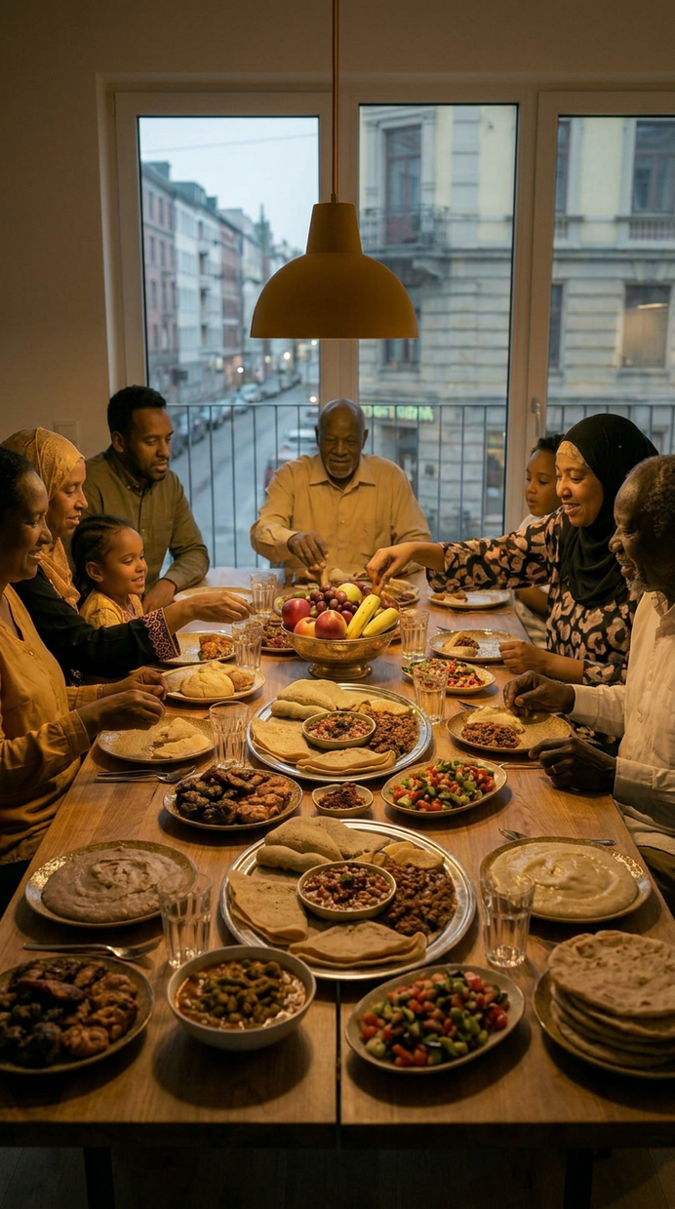
THE PROBLEM
BY THE NUMBERS
A Community Without
A Home Online
4.5M+
Over 4.5 million Sudanese people live outside Sudan — carrying their culture, their tastes and their memories. Yet no trusted digital marketplace exists to serve them.
Sudanese people living outside Sudan
Traditional Garments Unavailable
$3B
01
Toub, jalabiya and handcrafted Sudanese garments have no dedicated global platform.
Perfumes & Oud Unreachable
Sent annually in remittances to Sudan
02
Karkar, bukhoor, oud, iconic Sudanese scents, classified as dangerous goods, cross-border shipping complex
Strong
Purchasing Power
No Access to Authentic Food
03
Ful, kisra, dukua, Sudanese spices & staples nearly impossible to source abroad through a reliable channel
A community that spends — with no dedicated platform to spend on
No Trusted Marketplace Exists
04
Diaspora members face unreliable informal sellers, zero buyer protection and fragmented costly shipping
Diaspora spending power is real.
No platform is serving them yet.
249Souq.com The taste of home, wherever you are طعم البيت، وين ما مشيت
249Souq.com The taste of home, wherever you are طعم البيت، وين ما مشيت
03 / 11

Slide 4
THE OPPORTUNITY
The White Space
No One Has Filled
FIRST MOVER
ADVANTAGE
Over 5 million Sudanese people spread worldwide with strong purchasing power, and no dedicated marketplace to serve them. 249Souq.com is the first-mover opportunity.
5M+ Sudanese worldwide.
Zero dedicated marketplace.
One opportunity.
Diaspora Spending Power — $3B Annually
01
The Sudanese diaspora sends over $3 billion in remittances to Sudan every year
No Dominant Competitor
KEY MARKETS
02
There is currently NO established global marketplace for Sudanese products, 249Souq.com enters a true white space
GCC Countries
~1.1M Sudanese
Mobile-First, Social-Ready Community
Egypt
~1M+ Sudanese
03
The Sudanese diaspora is highly active on TikTok, Instagram & WhatsApp, perfectly positioned for social commerce
Europe
~500K+ Sudanese
Built-in Founder Trust
04
A platform built by a Sudanese founder FOR Sudanese people creates instant community trust no outsider can replicate
North America
~100K+ Sudanese
Australia
~17K Sudanese
249Souq.com The taste of home, wherever you are طعم البيت، وين ما مشيت
249Souq.com The taste of home, wherever you are طعم البيت، وين ما مشيت
04 / 11

Slide 5
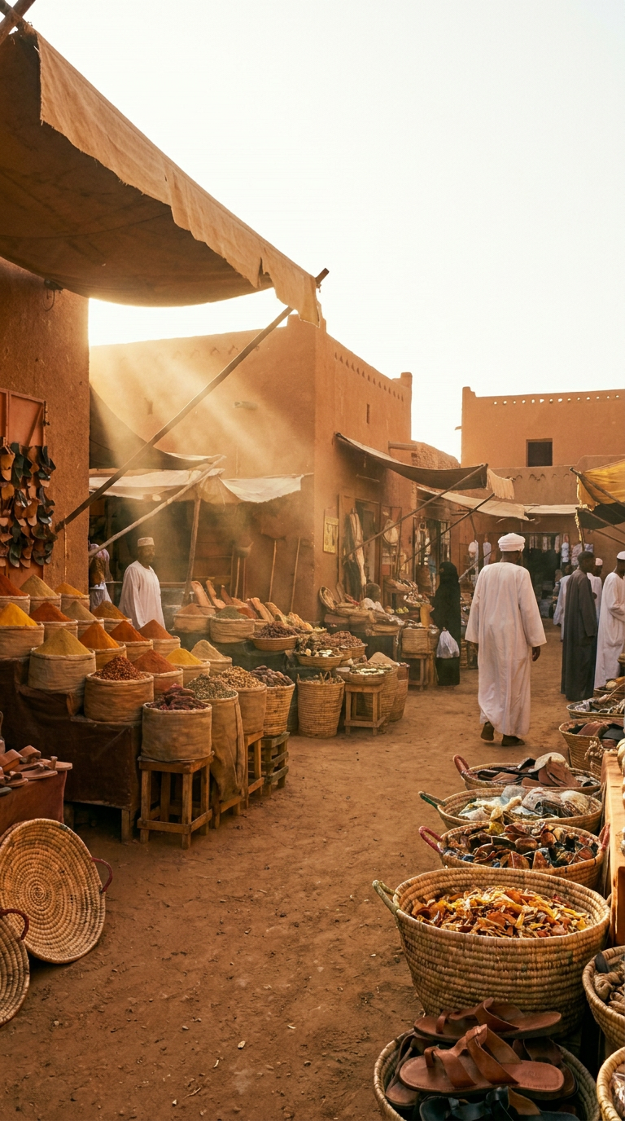
THE SOLUTION
Introducing
249Souq
249souq.com
The first dedicated global marketplace for the Sudanese diaspora, connecting 5M+ Sudanese people worldwide to authentic products, tastes and traditions from home.
249
Souq
The country code of Sudan, our identity, our pride, our community
Arabic for marketplace warm, familiar and universally trusted
Global
Authentic
Serving Sudanese diaspora in GCC, Europe, Americas & beyond
Products sourced directly from Sudanese sellers & makers
249Souq.com The taste of home, wherever you are طعم البيت، وين ما مشيت
05 / 10

Slide 6
BUSINESS MODEL
249souq.com — The Plan.
One project. Three parallel workstreams. All moving together from Day 1.
01
Organic Community
02
Platform Setup
03
Scale & Funding
STARTS DAY 1 — NEVER STOPS
RUNS ALONGSIDE FROM DAY 1
BUILDS AS TRACTION IS PROVEN
— TikTok — discovery & virality
— 249Souq.com live on Shopify
— Mobile app development
— Instagram — brand identity
— Seller onboarding begins
— Investor & grant outreach
— Facebook Groups — diaspora reach
— Product catalogue built
— Expand seller base globally
— WhatsApp — close sales & loyalty
— Secure payments integrated
— Premium seller subscriptions
— Zero ad spend to start
— DG-certified logistics partner
— Brand partnerships & media
— Community owns the brand
— Buyer protection policy live
— 249Souq global expansion
Community First
Platform Grows With It
Scale When Ready
249Souq.com The taste of home, wherever you are طعم البيت، وين ما مشيت
249Souq.com The taste of home, wherever you are طعم البيت، وين ما مشيت
06 / 11

Slide 7
CHALLENGES & APPROACH
I See the Road Blockers.
I CAN MOVE IT
I NEED HELP WITH THIS
Some I Can Move. Others I Need Help With.
01
Community Trust
I am Sudanese. I know the food, the scents, the culture, the language. No outsider can replicate this; it is my most powerful unfair advantage.
I CAN MOVE IT
02
Seller & Supplier Network
I have personal connections within the Sudanese diaspora. The founding seller network starts with people I already know and trust.
I CAN MOVE IT
03
Logistics & Shipping Costs
Starting GCC-first minimises shipping distance. Aramex SME program offers negotiated rates for small businesses.
I CAN MOVE IT
04
Dangerous Goods — Perfumes & Oud
DG-certified freight forwarders handle this category. Seller compliance training and DG-ready packaging are part of onboarding.
I CAN MOVE IT
05
Financial Support & Funding
Seeking strategic partners are the path forward. I am here today because this room is exactly where that conversation starts.
I NEED HELP WITH THIS
249Souq.com The taste of home, wherever you are طعم البيت، وين ما مشيت
249Souq.com The taste of home, wherever you are طعم البيت، وين ما مشيت
07 / 11

Slide 8
WHAT I AM LOOKING FOR
I Am Not Here Just to Present.
I Am Here to Find the Right People to Build With.
01
02
03
04
Funding & Investment
Business Partners
Visibility & Media
Mentorship & Guidance
— Seed funding for 249Souq platform
— Logistics, GCC to Africa
— Press & media for 249Souq
— Experienced entrepreneurs to advise
— Open to equity partnerships
— Tech partners for marketplace
— Speaking opportunities
— Feedback on the business model
— Investment to move Phase 2 forward
— Sudanese seller & supplier networks
— Introductions to diaspora communities
— Introductions to the right networks
— DG-certified freight forwarders
— Social media collaborations
— Women in business who've been here
— Brand ambassador connections
— Anyone who believes in this vision
249Souq.com The taste of home, wherever you are طعم البيت، وين ما مشيت
249Souq.com The taste of home, wherever you are طعم البيت، وين ما مشيت
08 / 11

Slide 9
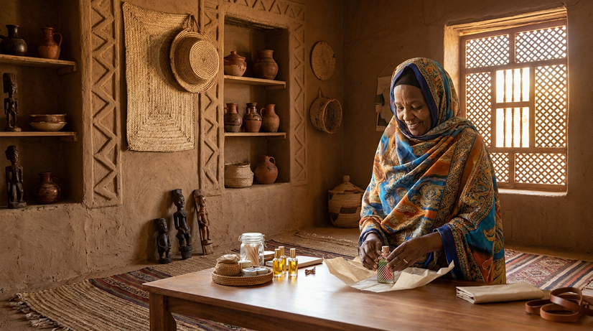
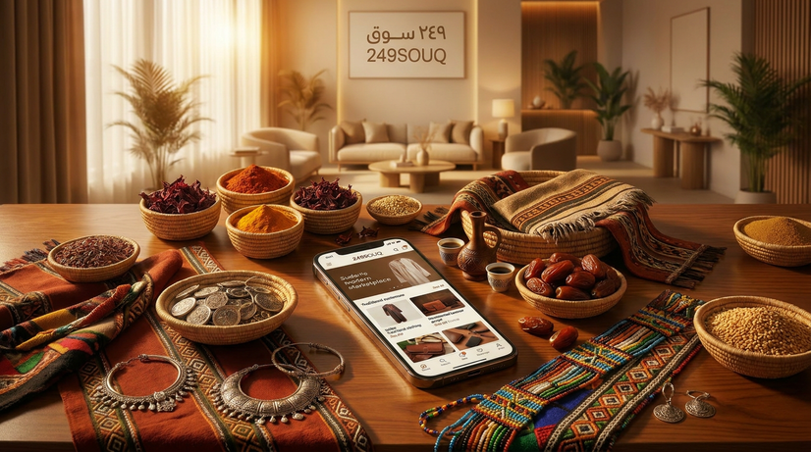
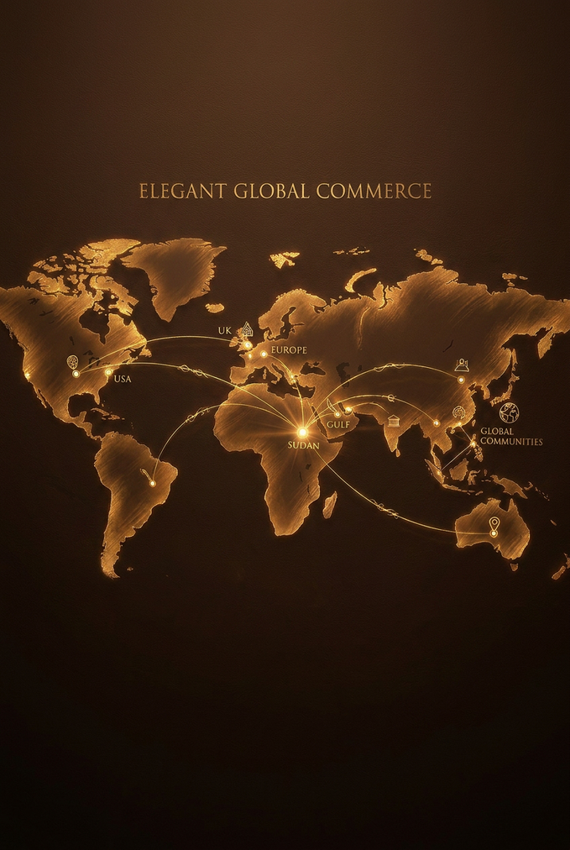
THE BUSINESS MODEL
How 249Souq Makes Money.
Zero inventory. Zero warehouse. 100% community.
THE MAKER
The Platform
THE BUYER
Sandaliya maker.
Bakhoor lady.
Traditional garment seller.
249souq.com
Sudanese diaspora.
Anywhere in the world.
They give 249Souq special bulk pricing & sign an agreement to sell through our platform.
Lists the product. Handles the order. Connects maker to buyer. Takes 10–15% commission on every completed sale.
Finds authentic Sudanese products. Orders online. Receives at home. No compromise on culture.
The Maker Wins
The Buyer Wins
249Souq.com Wins
More customers, organized sales. Reaches diaspora she could never reach alone. We handle payments — she focuses on making.
Authentic Sudanese products delivered to their door. Trusted platform. No more unreliable WhatsApp sellers.
10–15% commission on every sale. Zero inventory. Zero warehouse. Grows with every new maker and buyer added.
249Souq.com The taste of home, wherever you are طعم البيت، وين ما مشيت
249Souq.com The taste of home, wherever you are طعم البيت، وين ما مشيت
09 / 11

Slide 10
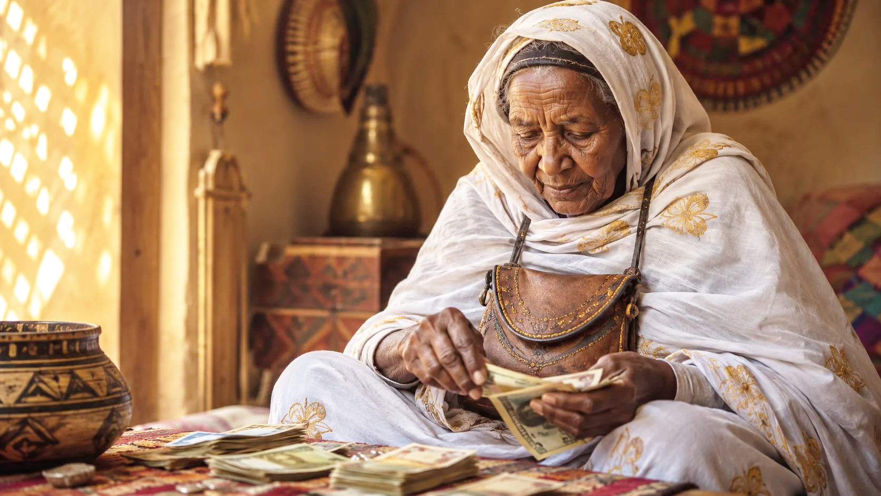
I
V
E
S
T
M
E
N
T

Slide 11
THE INVESTMENT
AED 150,000.
What we require, and what you get back.
ALREADY IN PLACE — AED 0
AED 150,000 GOES INTO
YOUR RETURN
✓ UAE Trade License — active
Platform Build
AED 25,000
15% Equity
Shopify marketplace + multi-vendor setup
✓ Multi-currency bank account
for AED 150,000
Content & Branding
AED 30,000
✓ Shopify store — ready to build
TikTok, Instagram, brand identity
PROJECTED RETURNS
✓ Domain: 249souq.com — secured
Paid Marketing
AED 15,000
Year 1
AED 500K GMV
~AED 60K to you
Targeted ads to Sudanese diaspora
✓ Sudanese community network
Maker Onboarding
AED 20,000
Year 2
AED 2M GMV
~AED 240K to you
Agreements, logistics, seller support
You are not funding a dream.
You are accelerating what already exists.
Legal & Ops
AED 15,000
Year 3
AED 5M GMV
~AED 600K to you
Contracts, payments, customer service
Reserve Buffer
AED 45,000
Year 1: recover costs
Year 2: double your money
Year 3: 4x your investment
6-month operations + founder costs
"5 million Sudanese. Zero competitors. A founder who is one of them. AED 150,000 today, for a platform no one else is building."
249Souq.com The taste of home, wherever you are طعم البيت، وين ما مشيت
249Souq.com The taste of home, wherever you are طعم البيت، وين ما مشيت
10 / 11

Slide 12
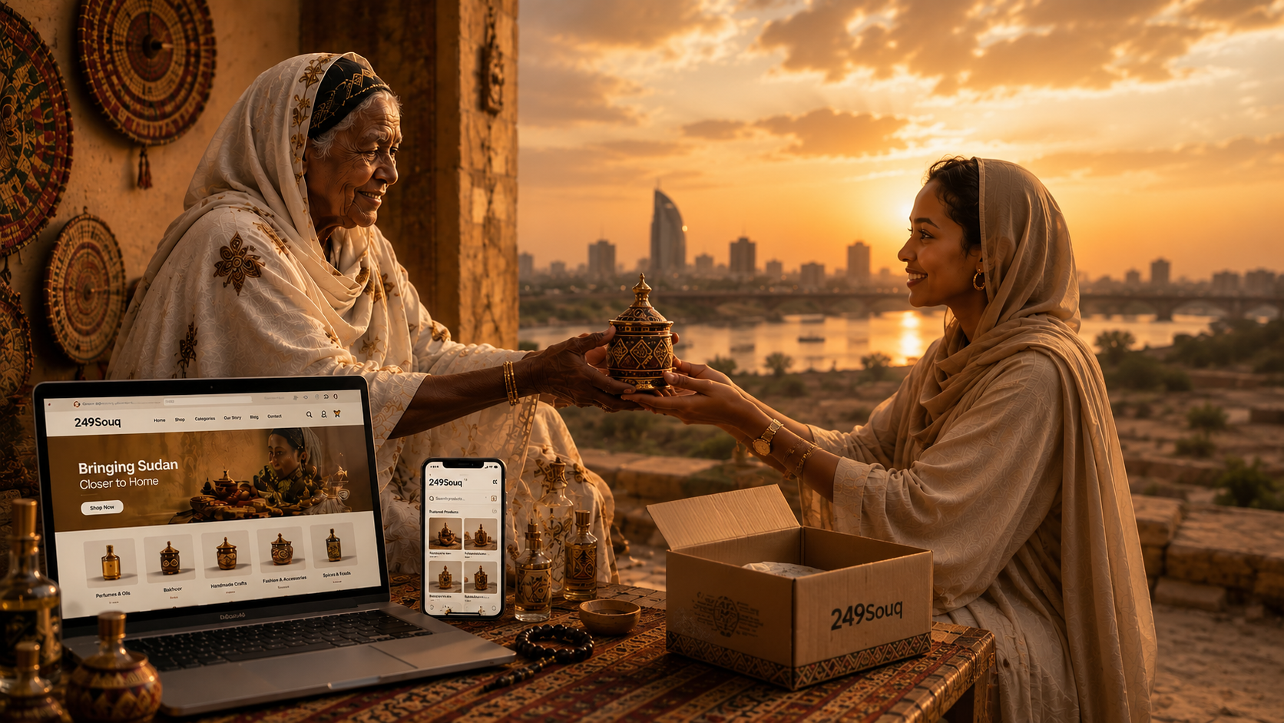
Let's Connect & Build Together
THANK YOU
"The Taste of Home, Wherever You Are" طعم البيت، وين ما مشيت
11 / 11

