Slide 1

Modern Level Crossing
Introduction
TVAG
The Basingstoke Club was invited to build a diorama that could be used by Network Rail's Community Safety Manager for Wessex Route, to take to schools and promote railway safety.
A number of scenarios of particular safety situations were to be included, one of which would be a modern, full barrier level crossing with adjacent footbridge.
I found I had been volunteered to build the level crossing.
Notes:
A number of safety scenarios were required to be included:
Level crossing and footbridge
Footpath level crossing
Tunnel
Bridge
Cycling on platform
Sitting on platform edge
Sitting on bridge parapet
Going off the platform end

Slide 2
Modern Level Crossing
Prototyping
TVAG
For low cost and fast development, I hoped an Arduino Nano would suffice.
I put together a rough prototype with a Nano, one servo, two red and one yellow LED, a piezo sounder and a push button to start the sequence.
The 'servo' and 'tone' Arduino libraries were loaded and a simple finite state machine was created as a sketch.
Notes:
The prototype was created from items I had in my 'gloat' boxes. It was meant to prove the feasibility of using a Nano, and to demonstrate the function to other club members.

Slide 3
Modern Level Crossing
The Sequence
TVAG
The current regulations can be found online. Also, lots of Youtube videos. This is the basic sequence:
Sounder alarm starts
Yellow light on for approximately 5 seconds
Both red Wig-Wag lights on and yellow off
Red Wig-Wag lights alternate approximately every second
At least 5 seconds before barriers start to close
Closing barriers takes approximately 5 seconds
Sounder alarm may stop now, or when barriers have reopened
At least 5 seconds before train arrives
After train passes, barriers rise taking approximately 5 seconds
Wig-Wag lights stop, and sounder alarms stops, if still on.
Notes:
Obviously there are variants, as viewing Youtube videos will demonstrate. Also, there are no running trains on the diorama, so some imagination is required.
At the end of the sequence, there is a 10 second pause before the push button is illuminated again, and the sequence can be restarted.

Slide 4
Modern Level Crossing
The Sounder Alarm
TVAG
The 'Tone' library can only produce one frequency at a time.
To emulate the multi frequency warble of the real thing, I slightly change the frequency rapidly.
Although not correct, it seems to produce an acceptable representation.
Notes:
The piezo sounder is firmly glued to a container to amplify its sound. It is still rather quiet. It could become annoying if it is too loud, but it may not be loud enough for a school classroom.
The 'tone' library can only produce a single frequency at a time, and can only support one sounder.

Slide 5
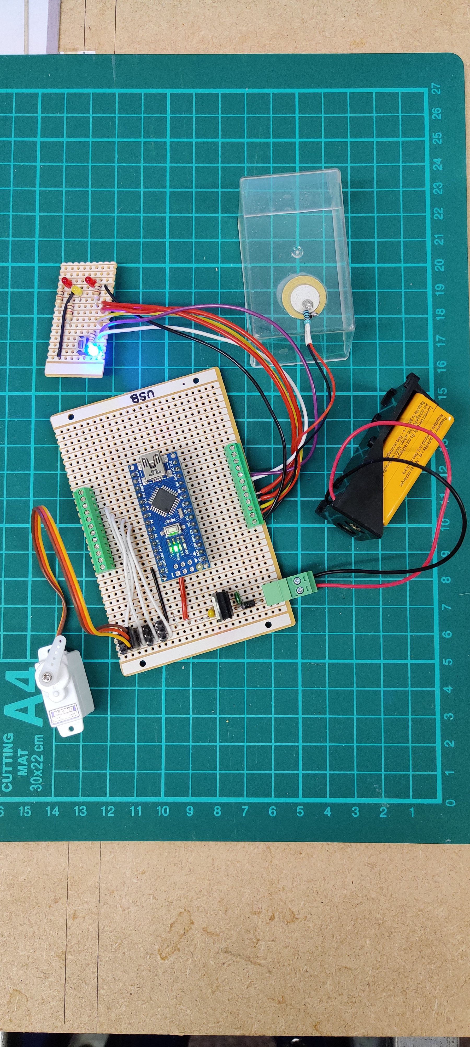
Modern Level Crossing
Demonstration of Prototype
TVAG
Notes:
For the demo/feasibility prototype I mounted an Arduino Nano on socket strips on veroboard, added a 5V regulator and breakout terminals, plus servo connectors. The piezo sounder is glued to a plastic box and LEDs and a pushbutton fitted to another veroboard scrap. All powered from a 9V PP3 battery.

Slide 6
Modern Level Crossing
The Final Build
TVAG
To reduce the use of solder (unleaded) I used modules from eBay that used screw terminals or connectors.
A suitable container to fit underneath shallow baseboards, but would fit all the modules had to be found.
9-pin D Type connectors were used to connect the four 'sets' of LEDs and a servo.
A illuminated push button starts the sequence, when illuminated.
A 12V DC power supply feeds a buck converter for 5V DC used by the Arduino and servos.
Notes:
The diorama is built on Model Railway Scenery 'Layout in a box' baseboards which fit in three 'Really Useful' crates for ease of transport.
The baseboards are quite narrow, and very shallow underneath for fitting servos and electronics.

Slide 7
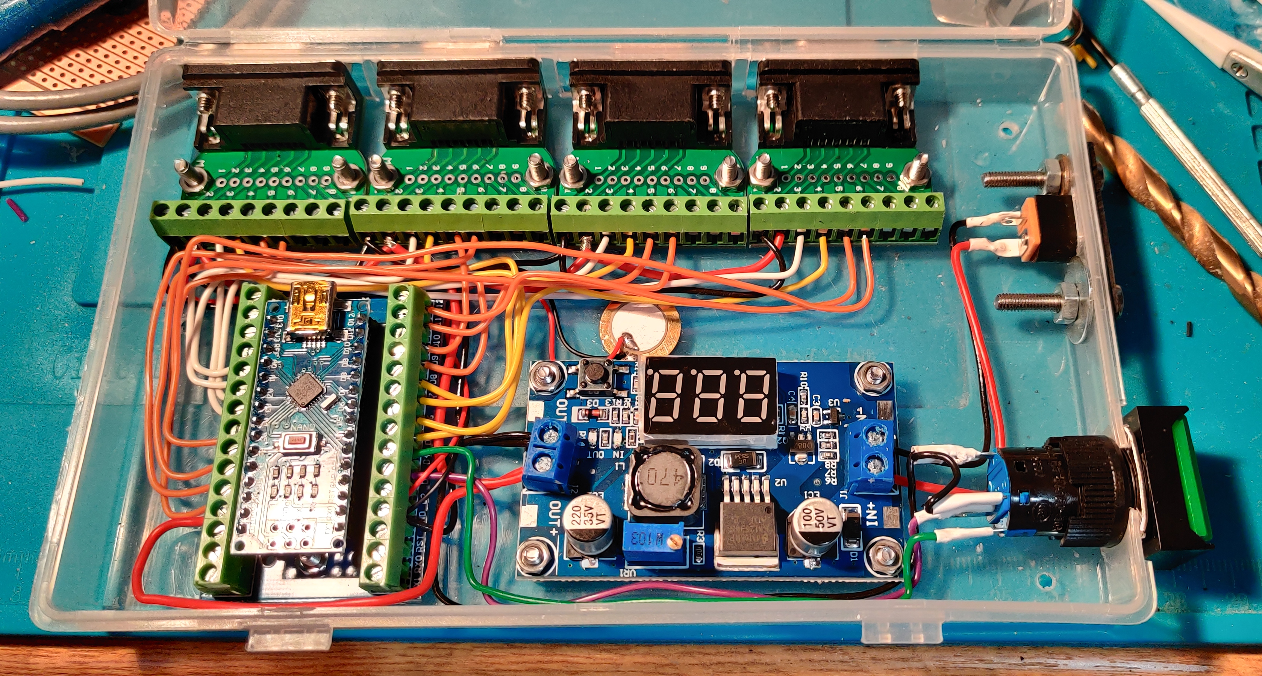
Modern Level Crossing
The Final Build
TVAG
Notes:
The D type connectors with terminals and a Nano breakout module were found on eBay.
The buck converter with voltmeter shows the input voltage when switched on. A button has to be pressed to show the output voltage, so it is not ideal.
The push button has a built-in LED and fits in a hole at the rear of the baseboard, as does the power socket.

Slide 8
Modern Level Crossing
The Model
TVAG
In the UK, 4 barrier crossings all have a folding 'skirt' that drops down below the booms.
Not feasible to model this within time and budget.
Veissmann make them, but at eye-watering cost.
Two Peco Half-Barrier Crossing kits would form the basis of the visible model.
Notes:
Peco LK-51 Level Crossing Barriers.

Slide 9
Modern Level Crossing
Wig-Wag Lights
TVAG
The Peco kits have the Wig-Wag lights mounted on top of the barrier mechanisms. While there are such units on the real railways, the build is simplified by having them on separate posts, which is also prototypical.
The Peco kits do not include Wig-Wag lights for the right hand side of the road, which should be there. Using two kits to provide 4 barriers also provided the correct number of Wig-Wag lights.
The position and size of the moulded lamps is correct, and the hoods over the lamps are nice, but the back boards are too small, being the size of the black part, without the surrounding red and white markings.

Slide 10
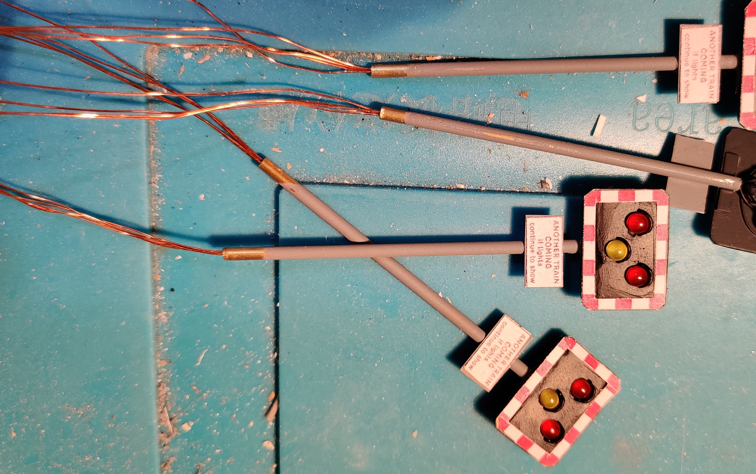
Modern Level Crossing
Wig-Wag Lights
TVAG
Notes:
A surround was cut from plastic sheet the size of the red and white markings. A full size backboard of plastic sheet was glued to the rear for strength. The lamp lenses were then drilled for 3mm diameter LEDs to be a tight fit.
Brass tube posts with phosphor bronze sheet soldered on provided a way to glue the post to the light panel, and to fit warning message to. LED 'legs' were soldered for a common supply, and 4 enamelled copper wire leads run down the inside of the posts.

Slide 11
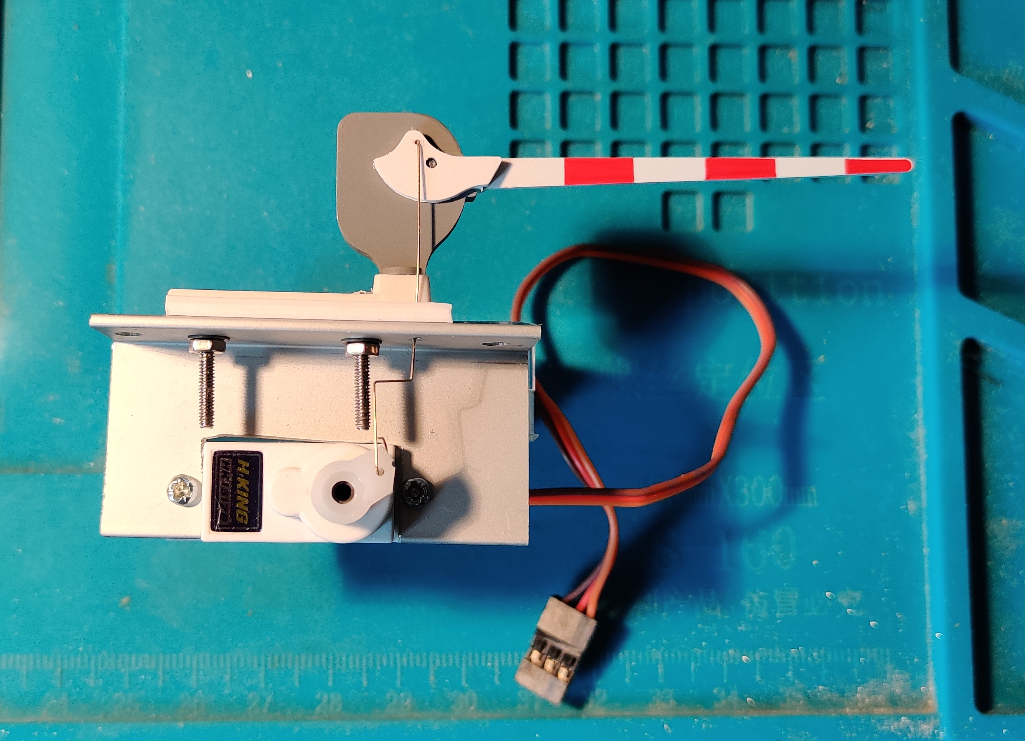
Modern Level Crossing
Barriers
TVAG
Notes:
L section aluminium was cut and drilled to mount the servos. The Peco base was bolted to the top and a fine Z-shaped wire fitted to operate the boom.
The boom was a tight fit and required a lot of filing before it raised and lowered freely under its own weight.
The hollowed out rear of the boom mechanism was filled with plastic sheet and Milliput.

Slide 12
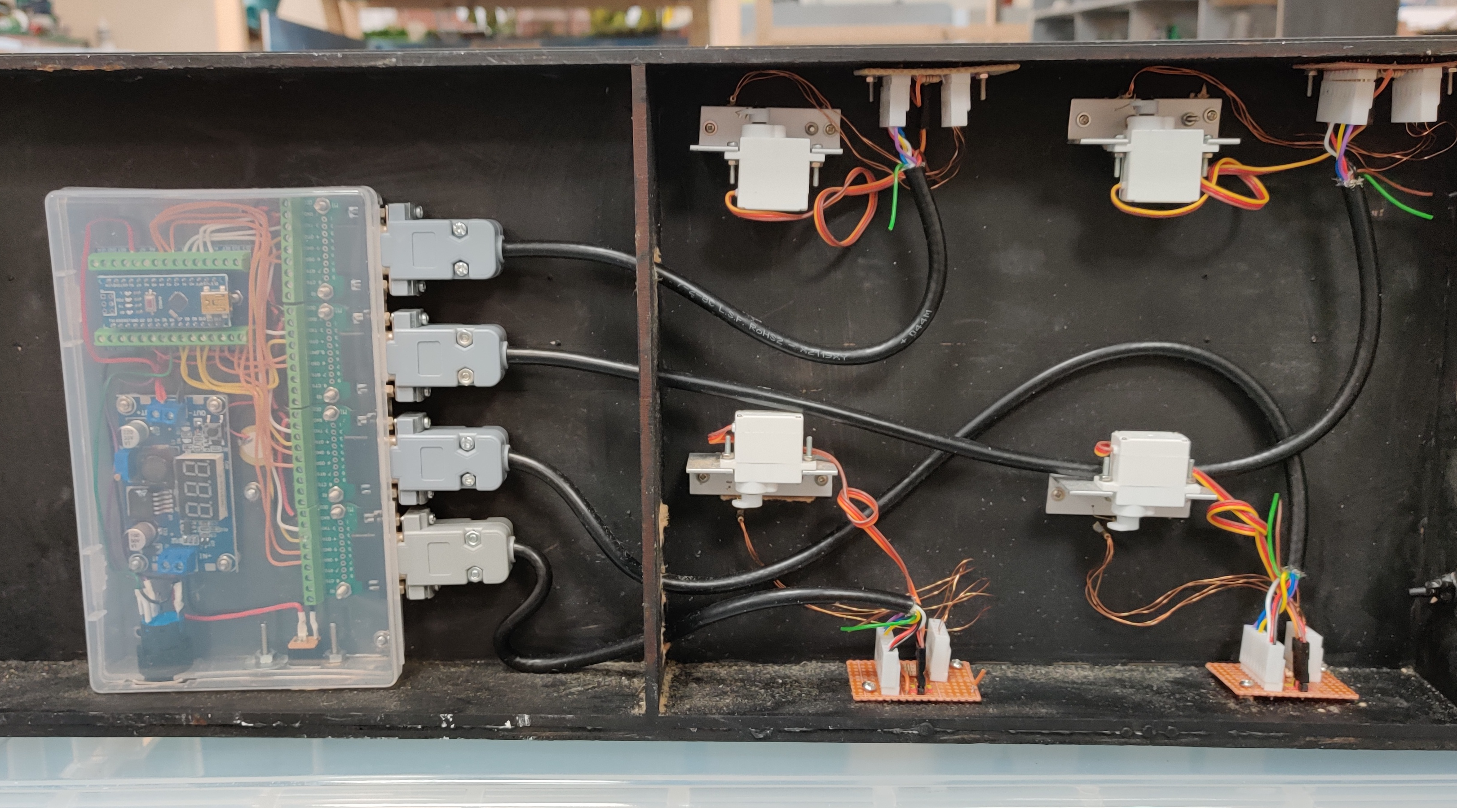
Modern Level Crossing
Installation
TVAG
Notes:
Small veroboard modules were fitted with connectors for the servo and LEDs and the lead from the electronic box. Current limit resistors for the LEDs are also fitted to the veroboard.

Slide 13
Modern Level Crossing
Operation
TVAG
Notes:
The completed crossing, before completion of the surrounding scenery.

Slide 14
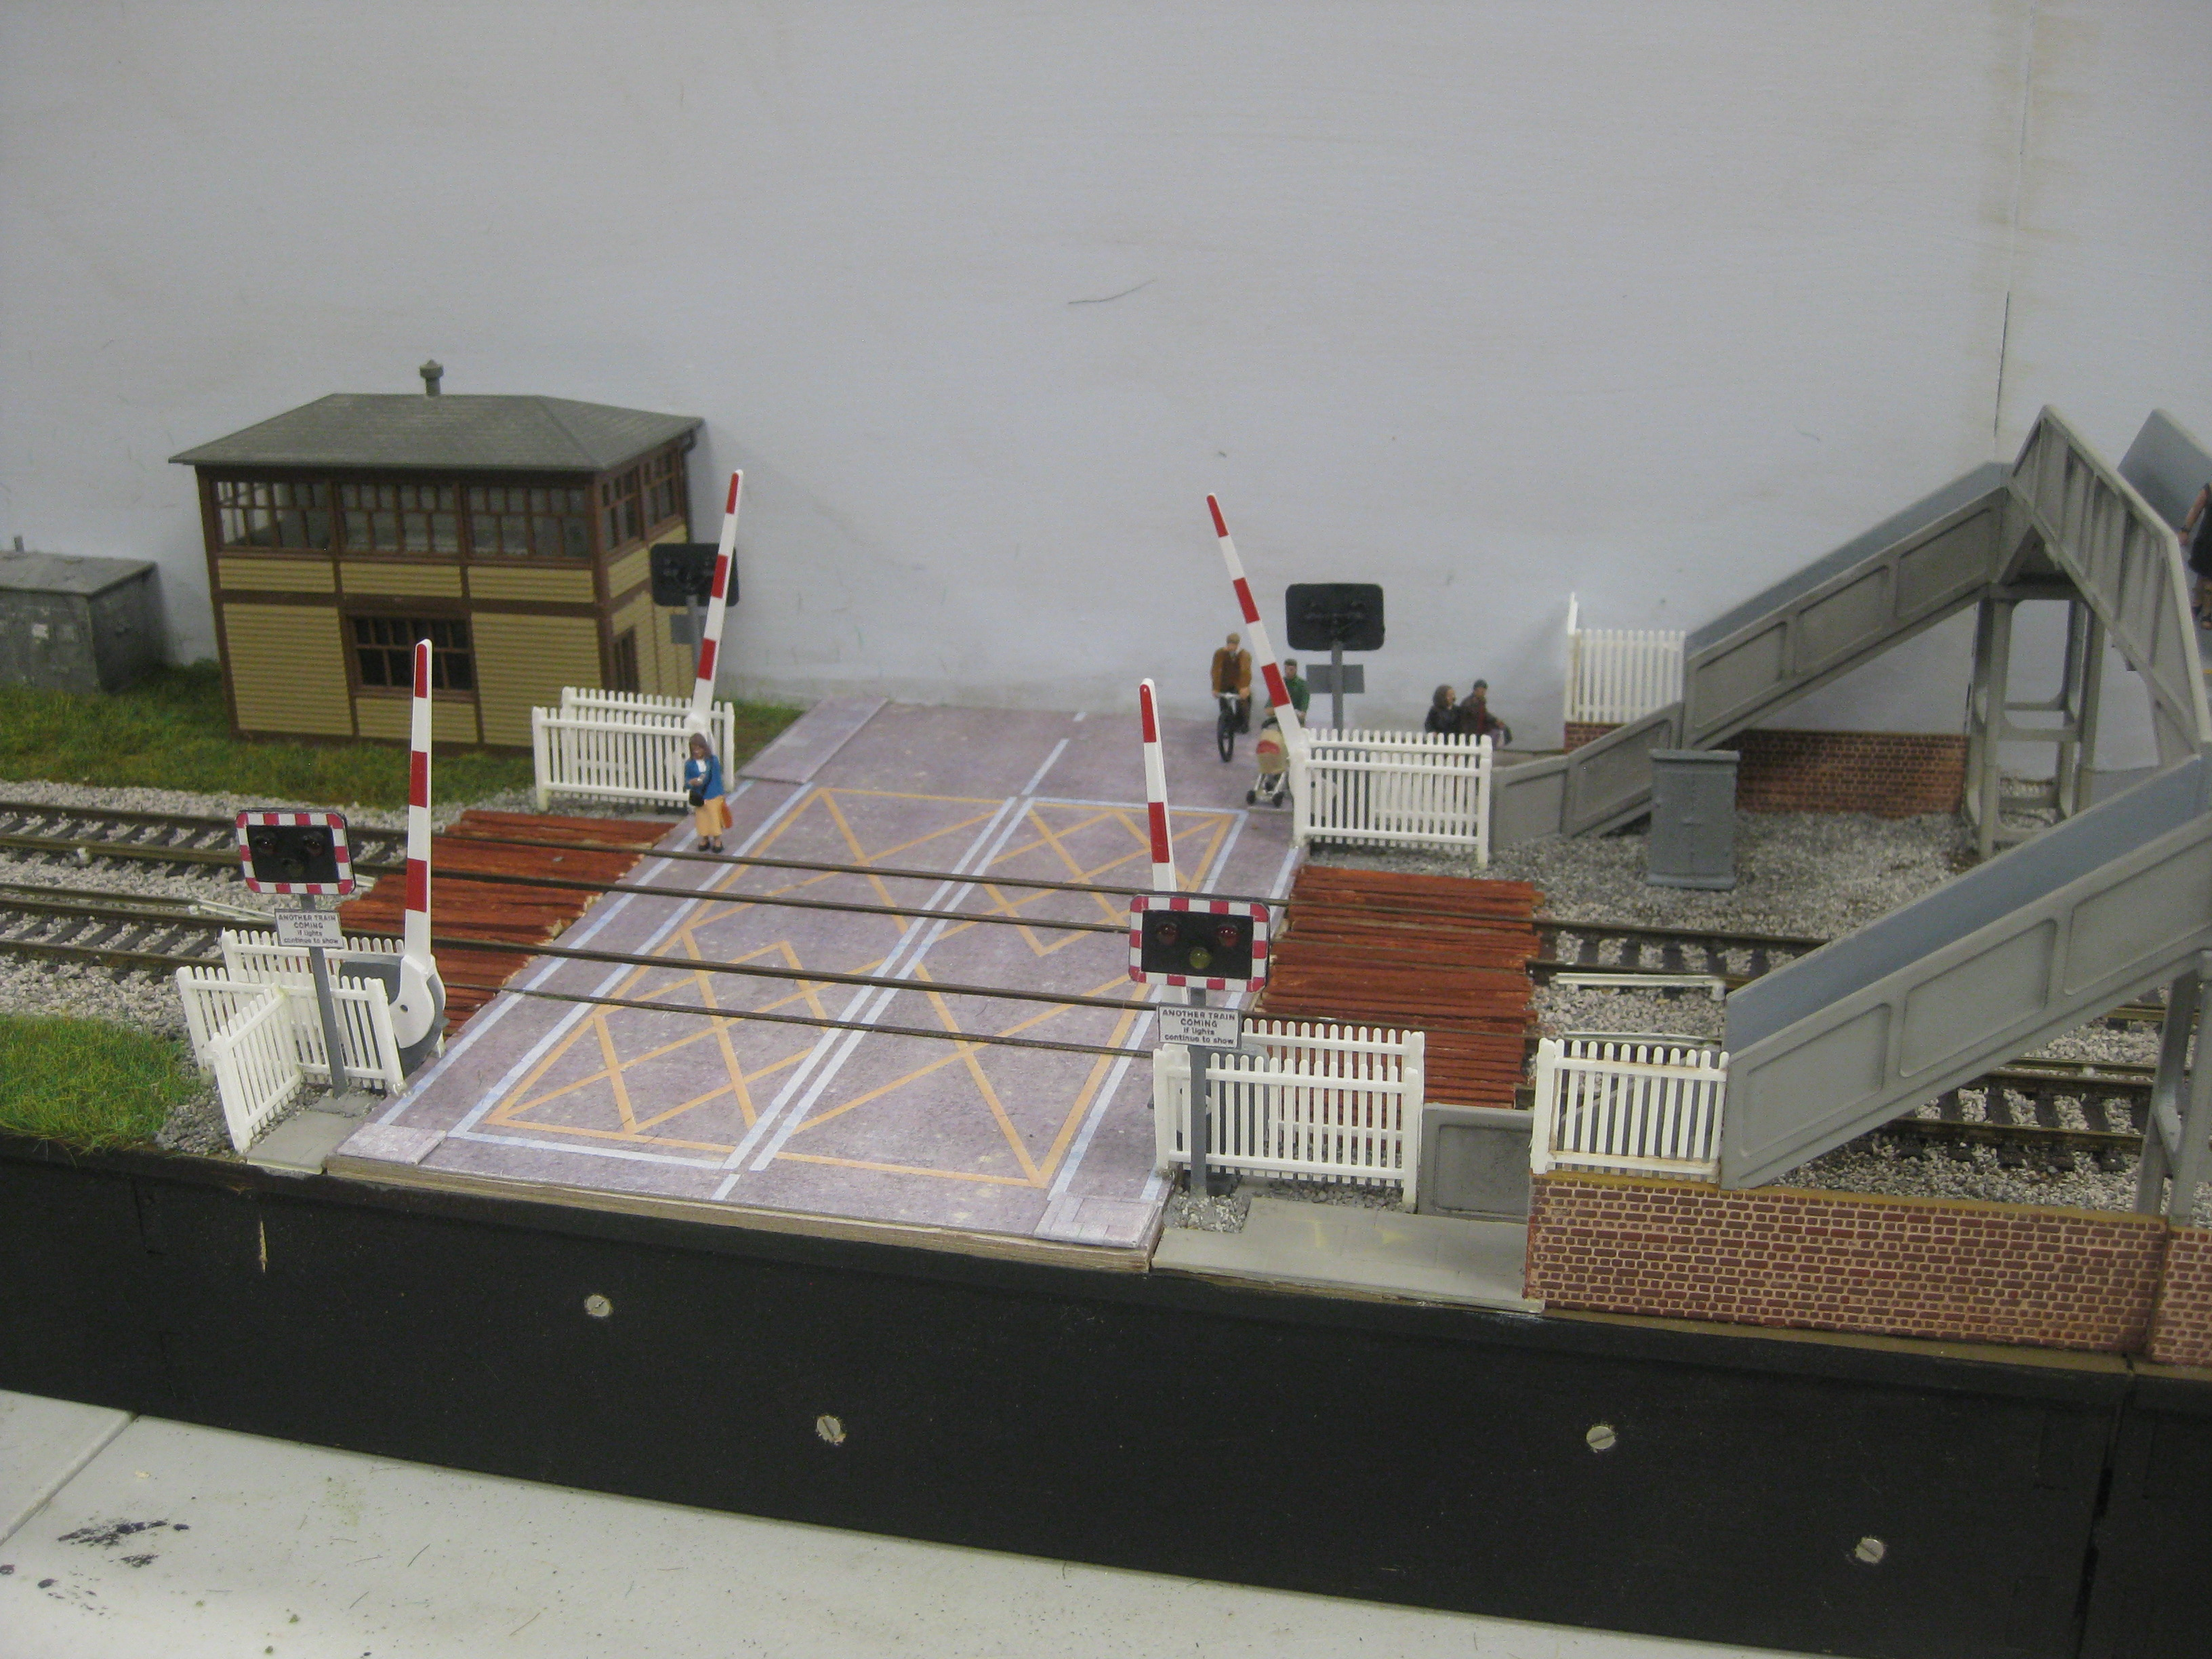
Modern Level Crossing
Operation
TVAG
Notes:
The completed scene.

Slide 15
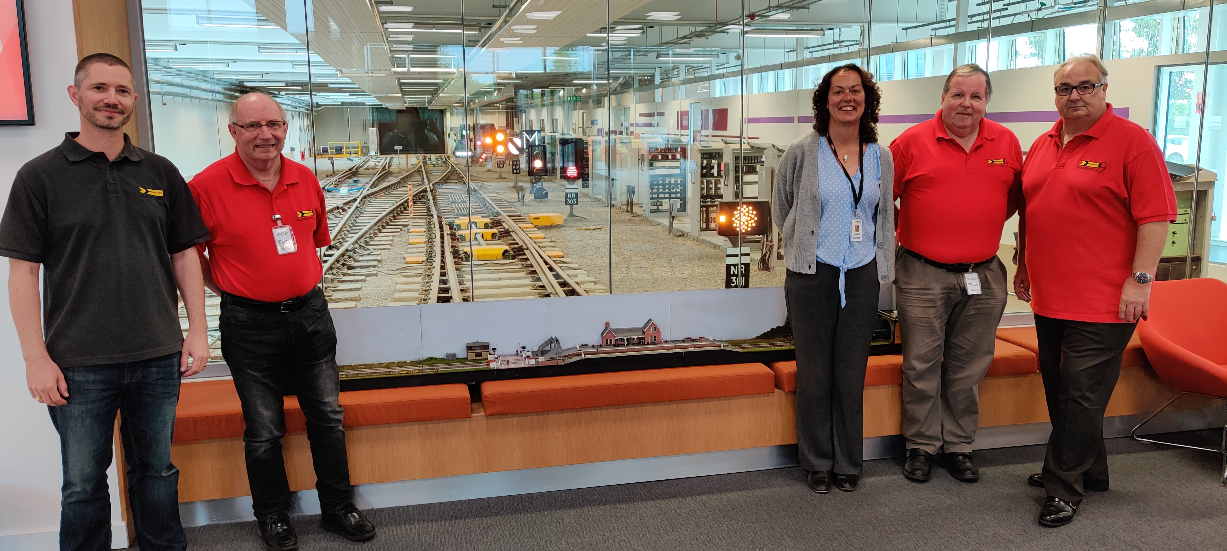
Modern Level Crossing
Handover
TVAG
Notes:
Handing over the diorama to Network Rail Community Safety Manager for Wessex Route at Basingstoke Railway Operation Centre (ROC).

