Slide 1
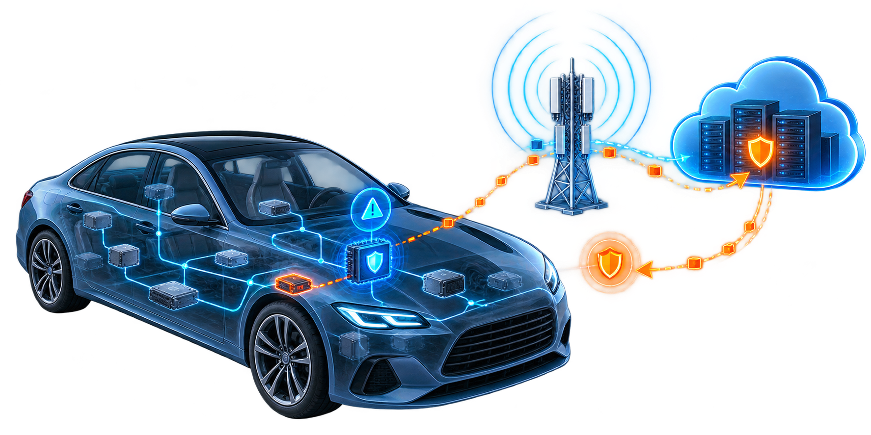
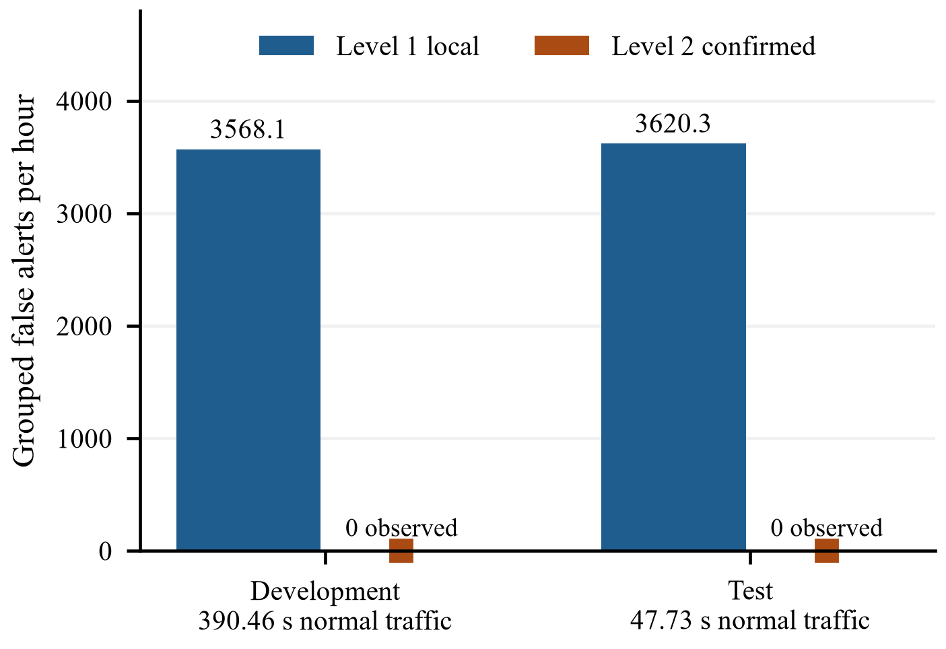
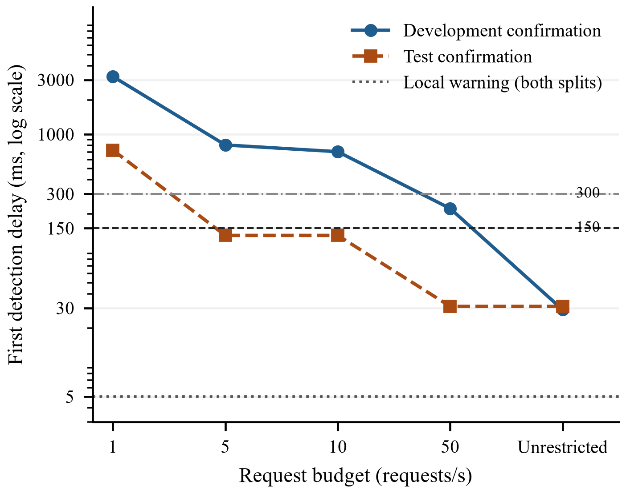
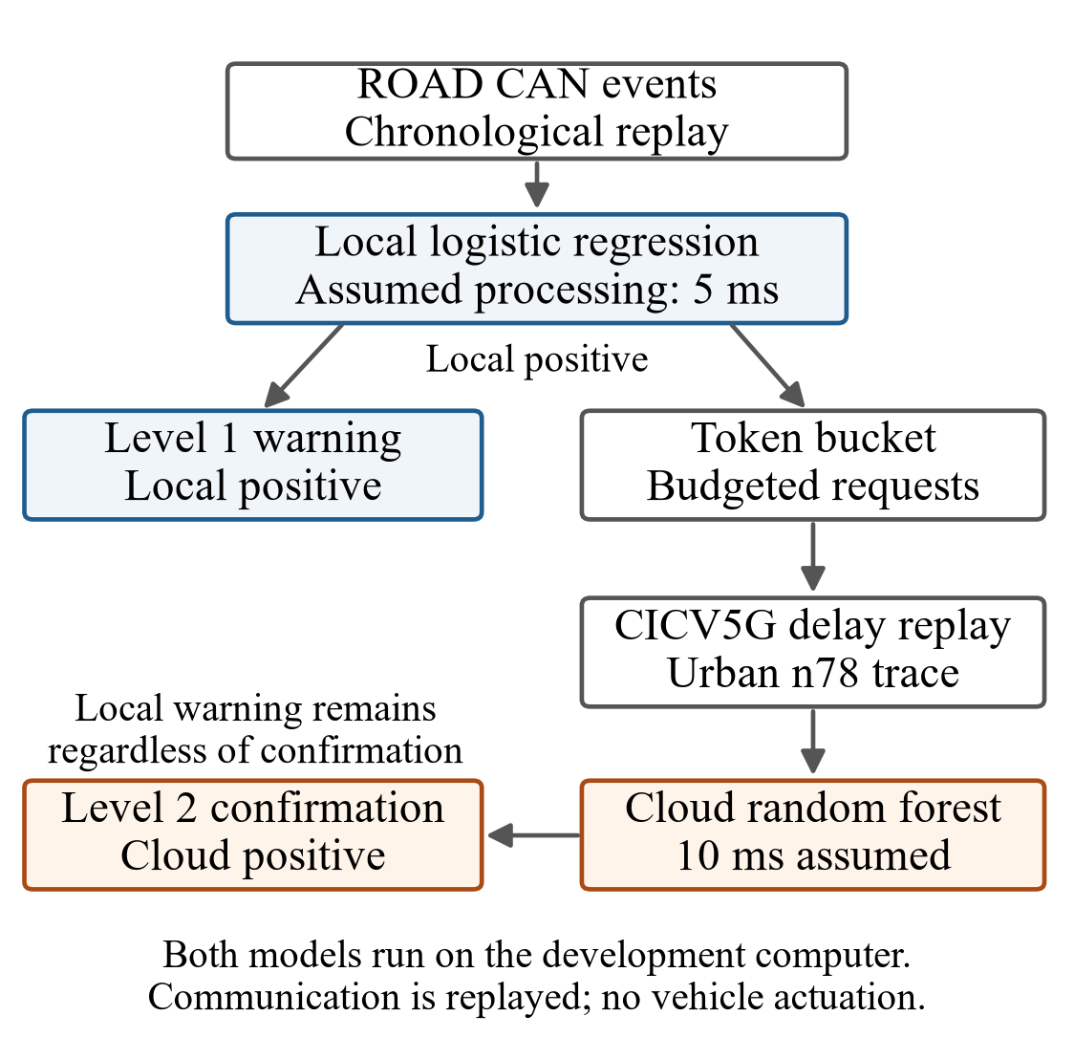
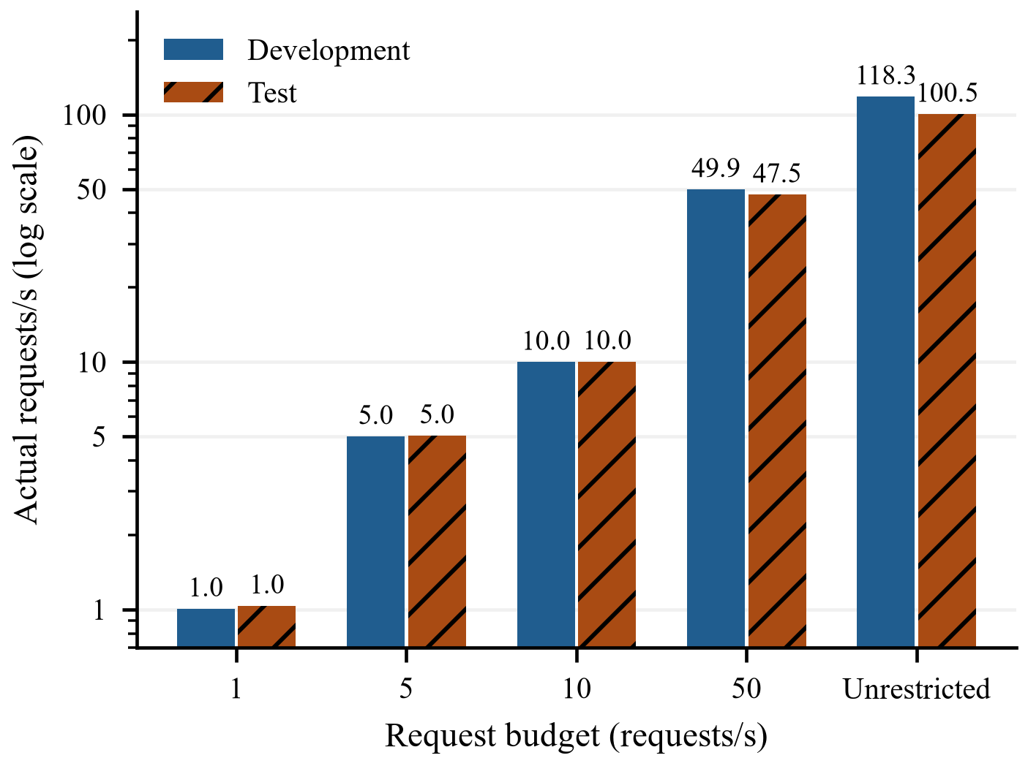
V2C-Sentinel
IEEE-STYLE A0 POSTER
A Deadline-Aware Two-Level Architecture for CAN Masquerade Detection
Meryem EL OSMANI¹ · Nissrine BESTOUT¹ · Asmaa Berdigh²* · Khalid EL YASSINI³*
¹ Master IASDO, Faculty of Sciences Meknes, Moulay Ismail University | ² IA Laboratory, International University of Rabat | ³ Computer Science Department, Faculty of Sciences Meknes, Moulay Ismail University | * Supervisors
Local warning first. Cloud confirmation only when requested.
V2C-Sentinel separates two operational decisions: an immediate level-1 warning from a local detector, and a level-2 confirmation returned through a replayed cellular-delay channel. A token bucket limits cloud requests and exposes the trade-off between confirmation speed and communication demand.
5 ms local warning
29–31 ms best confirmation
150 / 300 ms deadlines
PROBLEM AND CONTRIBUTION
EXPERIMENTAL DESIGN
FALSE-ALERT BURDEN
CAN intrusion detection must distinguish malicious activity from legitimate vehicle traffic while producing a warning early enough to support action. A remote model can add evidence, but request admission and cellular delay determine when that evidence becomes available.
Chronological replay with request budgets of 1, 5, 10, 50 requests/s and an unrestricted condition. Each configuration is evaluated at 150 ms and 300 ms reporting deadlines. Local warnings remain visible regardless of cloud outcome.
CONTRIBUTION
CONFIRMATION LATENCY
• Preserves every local positive as a level-1 warning
• Sends eligible positives to a separate cloud detector
• Replays measured 5G delay under finite request budgets
• Reports warning and confirmation timing separately
SYSTEM ARCHITECTURE
Level 1 produced approximately 3,568 and 3,620 grouped false alerts per hour on the development and test normal recordings. Level 2 produced no observed false alerts on those two short recordings. This does not establish a zero population false-alert rate.
COMMUNICATION DEMAND
Development confirmation improves from 3.208 s at 1 request/s to 223.6 ms at 50 requests/s and 29.0 ms without admission limits. Test confirmation reaches 129.8 ms at 5–10 requests/s and 31.0 ms at 50 requests/s or unrestricted.
DATA AND MODELS
DEADLINE OUTCOMES
ROAD CAN recordings
• Development: 63,260 attack messages; 874,018 normal messages
• Test: 38,003 attack messages; 106,939 normal messages
• One evaluated attack episode and one normal recording per split
Budget | Dev 150 | Dev 300 | Test 150 | Test 300
1 req/s | 0/1 | 0/1 | 0/1 | 0/1
5 req/s | 0/1 | 0/1 | 1/1 | 1/1
10 req/s | 0/1 | 0/1 | 1/1 | 1/1
50 req/s | 0/1 | 1/1 | 1/1 | 1/1
Unrestricted | 1/1 | 1/1 | 1/1 | 1/1
Unrestricted replay admitted 49,539 development requests and 6,503 test requests. Finite budgets reduce network load but can delay the first useful confirmation beyond the application deadline.
WHAT THE EVIDENCE SUPPORTS
LOCAL
Logistic regression; 95th-percentile attack-class threshold; assumed 5 ms processing.
SUPPORTED
• Immediate local warnings in both evaluated attack episodes
• Cloud confirmation reduced observed false alerts on two normal recordings
• Confirmation latency depends on request budget and recording
CLOUD
Random forest; requests admitted by token bucket; assumed 10 ms processing plus replayed cellular delay.
Cell values are timely confirmations / evaluated attack episodes. With one episode per split, these are observed case outcomes rather than population detection rates.
LIMITATIONS
One attack episode per split; short normal exposure; assumed processing times; both models executed on the development computer; no target-vehicle or production-cloud validation.
Conclusion
Cloud assistance can strengthen alert confidence, but it cannot replace the immediate local warning. Confirmation must be reported with its admission policy, communication delay, and deadline.
Sources: ROAD dataset [Verma et al., 2024] · CICV5G delay data [Zhang et al., 2026] · Saved V2C-Sentinel replay outputs
Notes:
Poster evidence sources:
1. M. E. Verma et al., A comprehensive guide to CAN IDS data and introduction of the ROAD dataset, PLOS ONE, 2024. DOI: 10.1371/journal.pone.0296879.
2. X. Zhang et al., 5G communication delay dataset for cloud-based vehicle planning and control, Scientific Data, 2026. DOI: 10.1038/s41597-026-07239-7.
3. Local project outputs: results/final_two_level/summary.csv, paper_table.csv, all_runs.csv.
4. Hero visual generated with OpenAI ImageGen for this poster; no text embedded in the generated image.

